Slide 1
CMPT 409/815
Advanced Algorithms
September 9, 2020

Slide 2
General information
Instructor: Igor Shinkar
My email: ishinkar@sfu.ca
Course webpage: cs.sfu.ca/~ishinkar/teaching.html
→ Teaching/Seminars → CMPT 409/815
Office hours: Email me to schedule a meeting
Discussion forum: piazza.com – you should have received an invitation

Slide 3
General information
TA:
Vahid Asadi <vasadi@sfu.ca>
Email: cmpt-409-help@sfu.ca
Office hours/format: Schedule by email

Slide 4
General information
Homeworks:
5 assignments, every ~2 weeks
All assignment are theoretical (writing algorithms)
Midterm: End of October, TBA
Final: TBA
The exams will be take home exams, to be submitted within 3 hours.

Slide 5
General information
https://www.cs.sfu.ca/~ishinkar/teaching/fall20/cmpt815/info.html
General info
Lecture notes
Homework assignments
Quizzes
Lecture notes/exams from last year can be found at
https://www.cs.sfu.ca/~ishinkar/teaching/
No need to go to oneclass / coursehero / …

Slide 6
Grading
Final – 35%
Midterm - 25%
Homeworks – 35%
Participation - 5%

Slide 7
Prerequisites
You are expected to be familiar with
  Algorithms
  Probability Theory
  Linear algebra

Slide 8
Questions so far?

Slide 9
Plan for today
An example of an approximation algorithm
An example of a randomized algorithm

Slide 10
2-approximation
algorithm
for Minimum
Vertex Cover

Slide 11
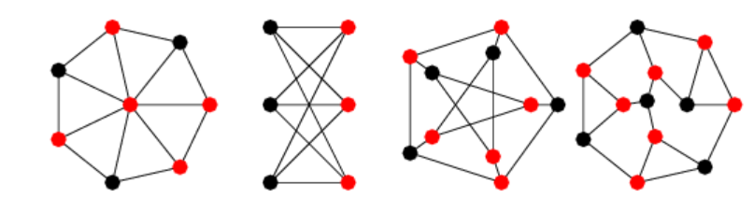
The Min Vertex Cover Problem
Input: A graph G = (V,E).
Output: A minimal collection of vertices touching all edges of G.

Slide 12
The Min Vertex Cover Problem
Input: A graph G = (V,E).
Output: A minimal VC – minimal subset of V touching all edges.
Fact: The problem of finding a smallest collection is NP-complete
In particular, we don’t know a polynomial time algorithm for this problem.
…and we don’t believe there exists a polynomial time algorithm for this problem.
Theorem: The Minimum Vertex Cover Problem has a polynomial time 2-approximation algorithm.
That is, if the algorithm gets a graph with a vertex cover of size k, then the output of the algorithm is a vertex cover of size at most 2k.

Slide 13
The Min Vertex Cover Problem
Theorem: The Minimum Vertex Cover Problem has a polynomial time
2-approximation algorithm.
That is, if the algorithm gets a graph with a vertex cover of size k, then the output of the algorithm is a vertex cover of size at most 2k.
Algorithm:
Set C = empty set
While G contains edges do
  Pick any edge (u,v) in G
  Add u and v to C
  Remove the u and v from G, and remove all edges touching them
Return C
What is the runtime of the algorithm?

Slide 14
The Min Vertex Cover Problem
Theorem: If G has a vertex cover of size k, then the algorithm returns a vertex cover of size at most 2k.
That is, the algorithm gives a 2-approximation for min vertex cover problem.
Proof: It is clear that C is a vertex cover.
Fix any vertex cover C* in G of size k. We show that |C| <= 2k.
Observe that for any edge the algorithm chooses, at least one of its end points must be in C*. (why?)
Therefore, since all edges chosen by the algorithm are disjoint, it follows that the number of edge we choose is at most |C*| = k.
For each such edge, we add 2 vertices to our solution.
Therefore, the output contains at most 2k vertices.

Slide 15
More on approximation algorithms

Slide 16
More on approximation algorithms
Definition: Let L be a minimization problem.
(E.g., min vertex cover, min set cover, traveling salesman problem)
An algorithm ALG is said to be an α-approximation for L (for α >1)
if for any input it returns a solution that it at most α*OPT
Same for maximization:
Definition: Let L be a maximization problem (max-sat, max clique, max-cut)
An algorithm ALG is said to be an α-approximation for L (for 0<α<1)
if for any input it returns a solution that it at least α*OPT

Slide 17
More on approximation algorithms
We focus on poly-time approximation algorithms for NP complete problems.
Examples:
Min Vertex Cover has a poly-time 2-approximation algorithm
Traveling salesman problem (TSP) in general graphs cannot be approximated within any factor in poly time
TSP on metric graphs has 1.5-approximation algorithm
Max-cut has a 0.878-approximation algorithm.
A better 0.95-approximation is NP complete
Max-clique on n vertices has a log²(n)/n approximation algorithm
A better 1/n^{0.99}-approximation is NP complete
More on this in the future lectures…

Slide 18
Questions so far?

Slide 19
A randomized algorithm for computing π

Slide 20
A randomized algorithm for computing π
Goal: Write an algorithm that prints π up to 10 decimal digits
Equivalently: Compute the area of a unit disk up to 10 decimal digits.
Fact: the area of a unit disc = π
Idea: Estimate p₀ = Pr_{x,y in [-1,1]}[(x,y) is in the disc]
Since the area of the square is 4
it follows that area of the disc is 4*p₀
Q: How can we compute p₀?
A: Sample many random points in [-1,1], and check how many are in the disc.

Slide 21
A randomized algorithm for computing π
Goal: Write an algorithm that prints π up to 10 decimal digits
Equivalently: Compute the area of a unit disk up to 10 decimal digits.
Fact: the are of a unit disc = π
Algorithm:
Sample n random points (x_{i},y_{i}) ∈[-1,1] x [-1,1]
Let t be the number of point such that
x_{i}²+ y_{i}² ≤1
Let p_{est} = t/n, and output 4*p_{est}.

Slide 22
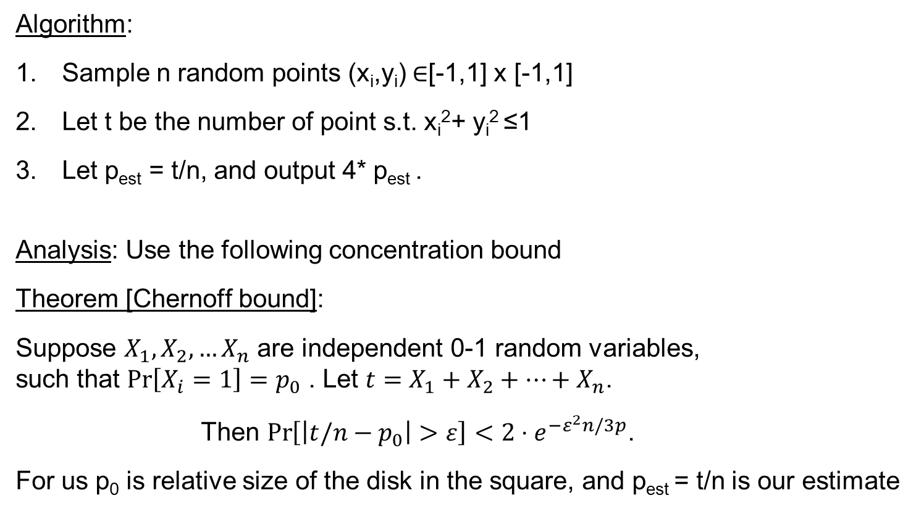
A randomized algorithm for computing π
Algorithm:
Sample n random points (x_{i},y_{i}) ∈[-1,1] x [-1,1]
Let t be the number of point s.t. x_{i}²+ y_{i}² ≤1
Let p_{est} = t/n, and output 4* p_{est} .
Analysis: Use the following concentration bound
Theorem [Chernoff bound]:
Suppose $X_{1},X_{2},…X_{n}$ are independent 0-1 random variables,
such that $\operatorname{Pr}\left[X_{i}=1\right]=p_{0}$ . Let $t=X_{1}+X_{2}+…+X_{n}$.
Then $\operatorname{Pr}\left[\left|t/n−p_{0}\right|>ε\right]<2⋅e^{{−ε}^{2}n/3p}$.
For us p₀ is relative size of the disk in the square, and p_{est} = t/n is our estimate
Intuitively, p_{est} should roughly be equal to the relative size of the disc in the square.

Slide 23
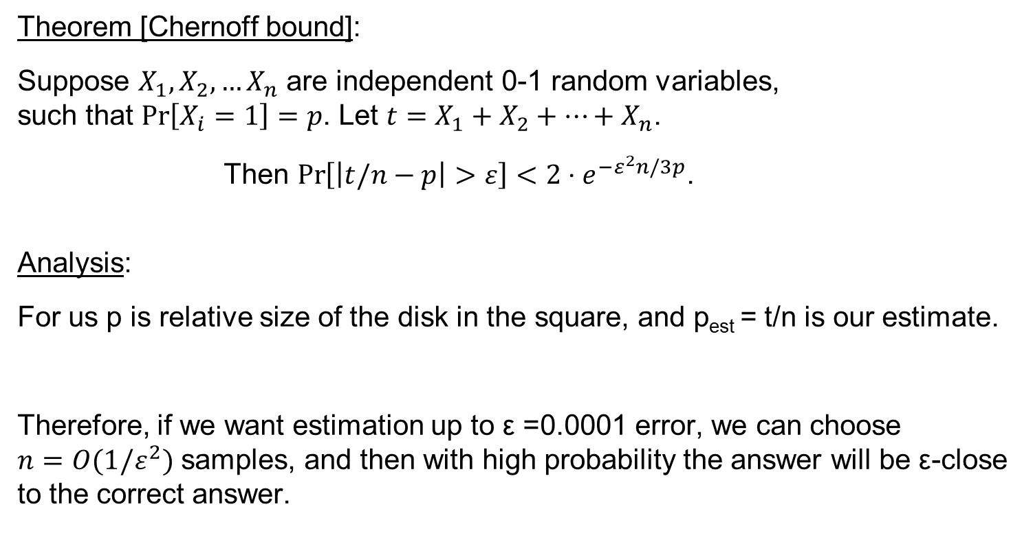
A randomized algorithm for computing π
Theorem [Chernoff bound]:
Suppose $X_{1},X_{2},…X_{n}$ are independent 0-1 random variables,
such that $\operatorname{Pr}\left[X_{i}=1\right]=p$. Let $t=X_{1}+X_{2}+…+X_{n}$.
Then $\operatorname{Pr}\left[\left|t/n−p\right|>ε\right]<2⋅e^{{−ε}^{2}n/3p}$.
Analysis:
For us p is relative size of the disk in the square, and p_{est} = t/n is our estimate.
Therefore, if we want estimation up to ε =0.0001 error, we can choose
$n=O(1/ε^{2})$ samples, and then with high probability the answer will be ε-close to the correct answer.

Slide 24
Questions?
Comments?

