Slide 1
CMPT 409/815
Advanced Algorithms
September 16, 2020

Slide 2
Plan for today
Some basic probability theory
Linearity of expectation
Markov‘s inequality
Chebyshev‘s inequality
Chernoff inequality
An application
7/8 approximation for Max-3-SAT

Slide 3
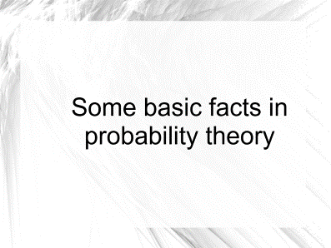
Some basic facts in probability theory

Slide 4
Expectation of a random variable
Expectation: Let X>=0 be a random variable taking integer values.
The expectation of X, is defined as E[X] = ∑_{i>=0} i * Pr[X = i].
*Do not confuse with the median Med[X], this is a number M
such that Pr[X<= M] >= ½ and Pr[X>= M] >= ½.
Example: X is the random variable with
Pr[X=1] = 1/4, Pr[X=2] = 1/3 , Pr[X=3] = 5/12
Then
E[X] = 1*(1/4) + 2*(1/3) + 3*(5/12) = 13/6
M[X] = 2

Slide 5
Linearity of expectation
Linearity of expectation: Let X₁, X₂…X_{n} random variables taking integer values.
Then E[X₁ + X₂ + … + X_{n}] = E[X₁] + E[X₂] + … + E[X_{n}]
In particular, E[k*X₁] = k*E[X₁]
This is true even if the variables are dependent.

Slide 6
Markov’s inequality
Markov’s inequality: Let X be a random variables taking non-negative values.
Then, for all t>0 Pr[X >= t] <= E[X]/t.
In particular, for all 𝛼>1 Pr[X >= 𝛼*E[X]] <= 1/𝛼.
Proof (for integer values X):
Write E[X] = ∑_{i>=0} i * Pr[X = i] = ∑_{0<=i<t} i * Pr[X = i] + ∑_{i>=t} i * Pr[X = i]
>= ∑_{i>=t} i * Pr[X = i]
>= ∑_{i>=t} t * Pr[X = i]
= t * ∑_{i>=t} Pr[X = i] = t*Pr[X>=t]

Slide 7
Variance of a random variable
Variance: Let X be a random variable taking integer/real values.
The variance of X, is defined as Var[X] = E[(X-E[X])²]
Note that Var[X]>=0 with equality if and only if X is constant
Claim: Var[X] = E[X²] - E[X]²
Proof: By definition we have
Var[X] = E[(X-E[X])²] = E[X² -2X*E[X] + E[X]²]
= E[X²] – 2E[X*E[X]] + E[X]² = E[X²] - E[X]²
Fact: Let X₁, X₂…X_{n} be independent random variables.
Then Var[X] = Var[X₁] + Var[X₂] + … + Var[X_{n}]

Slide 8
Chebyshev’s inequality
Chebyshev inequality: Let X be a random variables taking real values.
Then, for all t>0 Pr[| X - E[X] | > t] < Var[X]/t² = (𝜎/t)²
Here 𝜎 =(Var[X])^{1/2} is the standard deviation of X.
Proof:
Pr[| X - E[X] | > t] = Pr[(X - E[X])² > t²]
[By Markov] <= E[(X - E[X])²] / t²
= Var[X] / t²

Slide 9
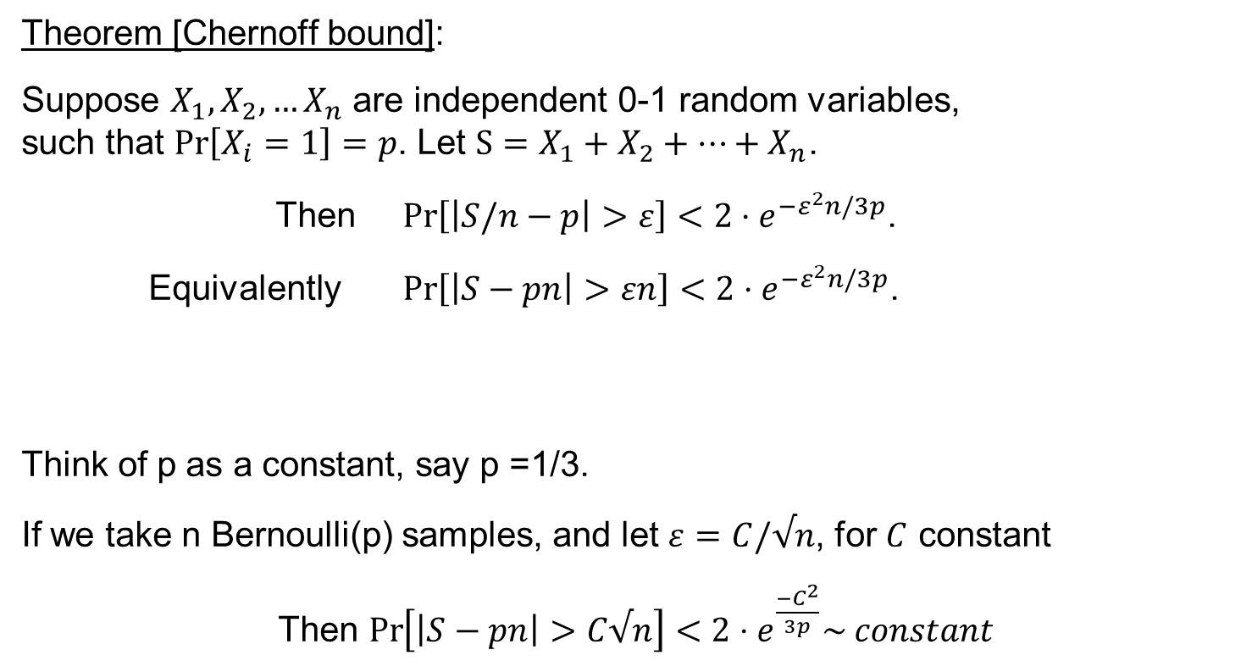
Chernoff bound
Theorem [Chernoff bound]:
Suppose $X_{1},X_{2},…X_{n}$ are independent 0-1 random variables,
such that $\operatorname{Pr}\left[X_{i}=1\right]=p$. Let $S=X_{1}+X_{2}+…+X_{n}$.
Then $\operatorname{Pr}\left[\left|S/n−p\right|>ε\right]<2⋅e^{{−ε}^{2}n/3p}$.
Equivalently $\operatorname{Pr}\left[\left|S−pn\right|>εn\right]<2⋅e^{{−ε}^{2}n/3p}$.
Think of p as a constant, say p =1/3.
If we take n Bernoulli(p) samples, and let $ε=C/√n$, for $C$ constant
Then $\operatorname{Pr}\left[\left|S−pn\right|>C√n\right]<2⋅e^{\frac{{−C}^{2}}{3p}}\sim constant$

Slide 10
Questions?
Comments?

Slide 11
7/8 Approximation for MAX-3-CNF

Slide 12
7/8 approximation for Max-3-CNF
Let 𝛷 be a 3-CNF formula, i.e. formula of the form
(x₁ v x₂ v ~x₃) ⋀ (~x₂ v x₃ v ~x₄) ⋀ … ⋀ (~x₁ v x₂ v ~x₅)
Claim: If 𝛷 is a 3-CNF formula with m clauses, then there exists an assignment to x that satisfies at least 7m/8 clauses.
Proof: Choose each x_{i} to be 0 or 1 independently w.p. ½ each.
Let Z_{i}∈{0,1} be the indicator that the i’th clause is satisfied.
Then E[Z_{i}] = Pr[Z_{i} = 1] = 7/8 (because 7 out of 8 assignments are satisfying)
The expected number of satisfied clauses is E[Z₁+Z₂+…+Z_{m}] = 7m/8.
This implies that there is some assignment that satisfies at least 7m/8 clauses

Slide 13
7/8 approximation for Max-3-CNF
Write a poly time algorithm for the following problem
Input: A 3-CNF formula 𝛷 with n variables and m clauses.
Goal : Find and assignment that satisfies at least 7m/8 clauses.
Algorithm (randomized):
Repeat m log(m) times
Choose each x_{i} to be 0 or 1 independently w.p. ½ each.
If the number of satisfied clauses is >=7m/8, return this assignment
If reached here, return FAIL

Slide 14
7/8 approximation for Max-3-CNF
Algorithm (randomized):
Repeat m log(m) times:
Choose each x_{i} to be 0 or 1 independently w.p. ½ each.
Count the number of satisfied clauses by this x
If the number of satisfied clauses is >=7m/8, return this assignment
If reached here, return FAIL
Claim: Suppose m is divisible by 8. Then in each iteration
Pr[number of satisfied clauses >= 7m/8] >= 8/(m+8).
Hence, if we repeat m log(m) times, then
Pr[all iterations fail] <= (1-8/(m+8))^{m log(m)} < e^{-8m log(m)/(m+8)} < 1/m

Slide 15
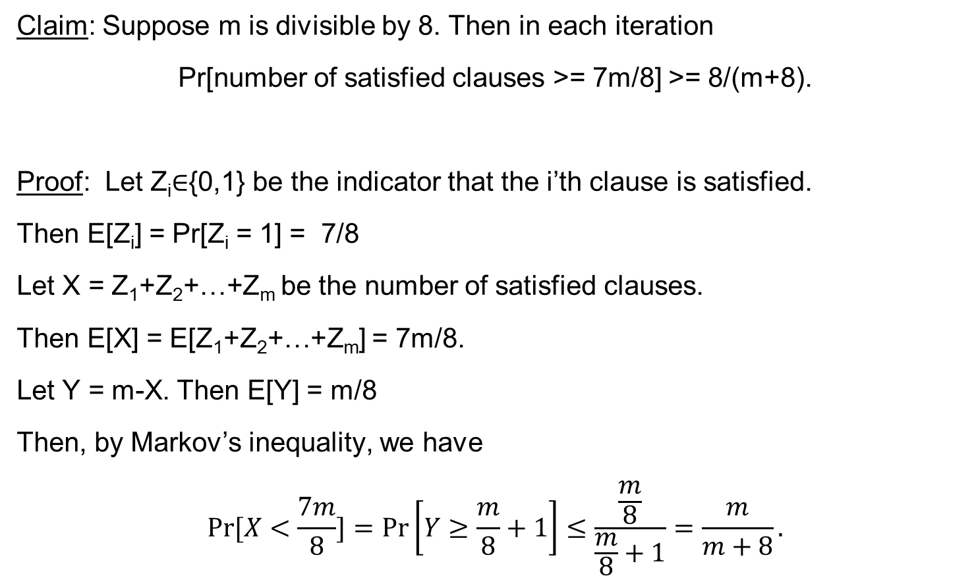
7/8 approximation for Max-3-CNF
Claim: Suppose m is divisible by 8. Then in each iteration
Pr[number of satisfied clauses >= 7m/8] >= 8/(m+8).
Proof: Let Z_{i}∈{0,1} be the indicator that the i’th clause is satisfied.
Then E[Z_{i}] = Pr[Z_{i} = 1] = 7/8
Let X = Z₁+Z₂+…+Z_{m} be the number of satisfied clauses.
Then E[X] = E[Z₁+Z₂+…+Z_{m}] = 7m/8.
Let Y = m-X. Then E[Y] = m/8
Then, by Markov’s inequality, we have
$$\operatorname{Pr}{[X<\frac{7m}{8}]}=\operatorname{Pr}\left[Y≥\frac{m}{8}+1\right]≤\frac{\frac{m}{8}}{\frac{m}{8}+1}=\frac{m}{m+8}.$$

Slide 16
7/8 approximation for Max-3-CNF
What about a deterministic algorithm?
Algorithm (randomized):
Repeat m log(m) times:
Choose each x_{i} to be 0 or 1 independently w.p. ½ each.
Count the number of satisfied clauses by this x
If the number of satisfied clauses is >=7m/8, return this assignment
If reached here, return FAIL
Claim: Suppose m is divisible by 8. Then in each iteration
Pr[number of satisfied clauses >= 7m/8] >= 8/(m+8).
Hence, if we repeat m log(m) times, then
Pr[all iterations fail] <= (1-8/(m+8))^{m log(m)} < e^{-8m log(m)/(m+8)} < 1/m

Slide 17
Questions?
Comments?

