Slide 1
CMPT 409/815
Advanced Algorithms
September 21, 2020

Slide 2
Plan for today
7/8 approximation for Max-3-SAT – a deterministic algorithm
Discrepancy using Chernoff bound
Approximate DNF counting

Slide 3
7/8 Approximation for MAX-3-CNF

Slide 4
7/8 approximation for Max-3-CNF
Let 𝛷 be a 3-CNF formula, i.e. formula of the form
(x₁ v x₂ v ~x₃) ⋀ (~x₂ v x₃ v ~x₄) ⋀ … ⋀ (~x₁ v x₂ v ~x₅)
Claim: If 𝛷 is a 3-CNF formula with m clauses, then there exists an assignment to x that satisfies at least 7m/8 clauses.
Proof: Choose each x_{i} to be 0 or 1 independently w.p. ½ each.
Let Z_{i}∈{0,1} be the indicator that the i’th clause is satisfied.
Then E[Z_{i}] = Pr[Z_{i} = 1] = 7/8 (because 7 out of 8 assignments are satisfying)
The expected number of satisfied clauses is E[Z₁+Z₂+…+Z_{m}] = 7m/8.
This implies that there is some assignment that satisfies at least 7m/8 clauses

Slide 5
7/8 approximation for Max-3-CNF
Write a poly time algorithm for the following problem
Input: A 3-CNF formula 𝛷 with n variables and m clauses.
Goal : Find and assignment that satisfies at least 7m/8 clauses.
Algorithm (randomized):
Repeat m log(m) times
Choose each x_{i} to be 0 or 1 independently w.p. ½ each.
If the number of satisfied clauses is >=7m/8, return this assignment
If reached here, return FAIL
Theorem: With probability > 1- 1/m the algorithm returns an assignment that satisfied at least 7m/8 clauses.
What about a deterministic algorithm?

Slide 6
7/8 approximation for Max-3-CNF
How do we compute the expected number of satisfied clauses?
Algorithm (deterministic):
For each x_{i} do
Fix x_{i}=0 and compute the expected number of satisfied clauses where the non-fixed-variables x_{i} are chosen to be 0 or 1 independently w.p. ½ each.
Fix x_{i}=1 and compute the expected number of satisfied clauses where the non-fixed-variables x_{i} are chosen to be 0 or 1 independently w.p. ½ each.
Set x_{i} to the one that maximizes the expectation
Return the assignment
Claim: In every iteration at least on of the expectations (in line 1 or 2)
is at least 7m/8.
Proof: Obvious

Slide 7
7/8 approximation for Max-3-CNF
Q: How to compute the expected number of satisfied clauses?
After some variables are fixed: let’s focus on a specific clause, compute the probability that it is satisfied, and then use linearity of expectation.
A clauses has one literal already satisfied, e.g., (x₁ v ~x₆ v x₈) and x₈=true
then Pr[clause will be satisfied] = 1
A clauses has all three variables left: (x₁ v ~x₆ v x₈),
then Pr[clause will be satisfied] = 7/8
If a clauses has two literals left: (x₁ v ~x₆ v x₈) and x₁=false
then Pr[clause will be satisfied] = 3/4
If a clauses has one literal left: (x₁ v ~x₆ v x₈) and x₁=false, x₆=true
then Pr[clause will be satisfied] = 1/2
A clauses has no literals left: (x₁ v ~x₆ v x₈) and x₁=false , x₆=true , x₈=false
then Pr[clause will be satisfied] = 0

Slide 8
7/8 approximation for Max-3-CNF
Q: How to compute the expected number of satisfied clauses?
After some variables are fixed: let’s focus on a specific clause, compute the probability that it is satisfied, and then use linearity of expectation.
Denote by p_{i}=Pr[i’th clause will be satisfied by random assignment, conditioned on the fixed values].
Then E[number of satisfied clauses | fixed values] = p₁ + p₂ + … + p_{m}

Slide 9
7/8 approximation for Max-3-CNF
Example: 𝛷 = (x₁ v x₂ v ~x₃) ⋀ (~x₁ v x₃ v ~x₄) ⋀ (~x₁ v x₂ v x₅) ⋀ (~x₂ v x₃ v x₄)
Iteration 1:
x₁ = true: E[# sat clauses | x₁=1] = 1 + 3/4 + 3/4 +7/8
x₁ = false: E[# sat clauses | x₁=0] = 3/4 + 1 + 1 +7/8
Iteration 2:
x₂ = true: E[# sat clauses | x₁=0, x₂=1] = 1 + 1 + 1 + 3/4
x₂ = false: E[# sat clauses | x₁=0, x₂=0] = 1/2 + 1 + 1 + 1
Iteration 3:
x₃ = true: E[# sat clauses | x₁=0, x₂=1, x₃=1] = 1 + 1 + 1 + 1
x₃ = false: E[# sat clauses | x₁=0, x₂=1, x₃=0] = 1/2 + 1 + 1 + 1/2
x₁ = false
x₂ = true
x₃ = true

Slide 10
7/8 approximation for Max-3-CNF
Algorithm (deterministic):
For each x_{i} do
Fix x_{i}=0 and compute the expected number of satisfied clauses where the non-fixed-variables x_{i} are chosen to be 0 or 1 independently w.p. ½ each.
Fix x_{i}=1 and compute the expected number of satisfied clauses where the non-fixed-variables x_{i} are chosen to be 0 or 1 independently w.p. ½ each.
Set x_{i} to the one that maximizes the expectation
Return the assignment
What is the runtime of the algorithm?

Slide 11
7/8 approximation for Max-3-CNF
Remarks:
Inapproximability Theorem [Håstad ‘97] For all ε>0, given a satisfiable 3CNF formula, it is NP-hard to find an assignment that satisfies more than (7/8+ε)m clauses.
Conclusion: The trivial algorithm that chooses a random assignment is essentially optimal.
A stronger claim: If 𝛷 is a 3-CNF formula with m clauses, then
Pr[a random assignment satisfies at least 7m/8 clauses] > Ω(1)
In particular, it suffices to repeat the randomized algorithm only O(1) times for constant success probability

Slide 12
Questions?
Comments?

Slide 13
Discrepancy

Slide 14
Discrepancy
Input: A hypergraph H = (V, E)
Goal: color the vertices of the hypergraph using two colors so that the edges of H are as “balanced” as possible.

Slide 15
Discrepancy
Fix a coloring X:V → {-1,1}
Define the discrepancy of the edge e∈E using X as disc_{X}(e) =| ∑_{v∈e}X(v) |
Discrepancy of H with X is disc_{X}(H) = max_{e∈E} disc_{X}(e)
Discrepancy of H is defined
Disc(H) = min_{X:V→{-1,1}}disc_{X}(H)
Disc(H)=d means that for some coloring all edges have discrepancy <= d.

Slide 16
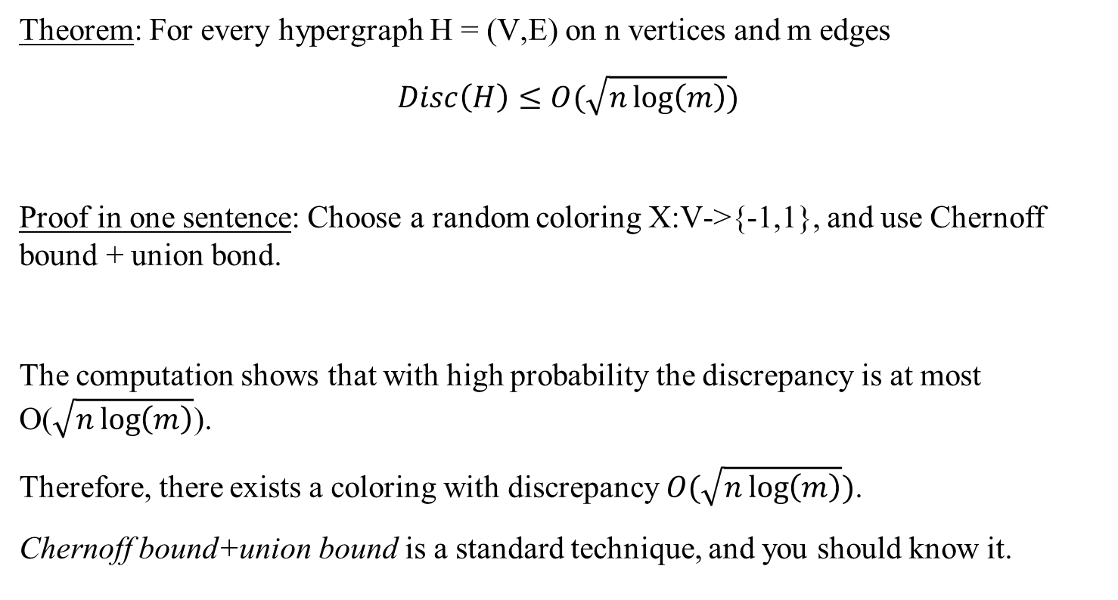
Discrepancy
Theorem: For every hypergraph H = (V,E) on n vertices and m edges
$$Disc\left(H\right)≤O(\sqrt{n\log\left(m\right)})$$
Proof in one sentence: Choose a random coloring X:V->{-1,1}, and use Chernoff bound + union bond.
The computation shows that with high probability the discrepancy is at most O($\sqrt{n\log\left(m\right)}$).
Therefore, there exists a coloring with discrepancy $O(\sqrt{n\log\left(m\right)})$.
Chernoff bound+union bound is a standard technique, and you should know it.

Slide 17
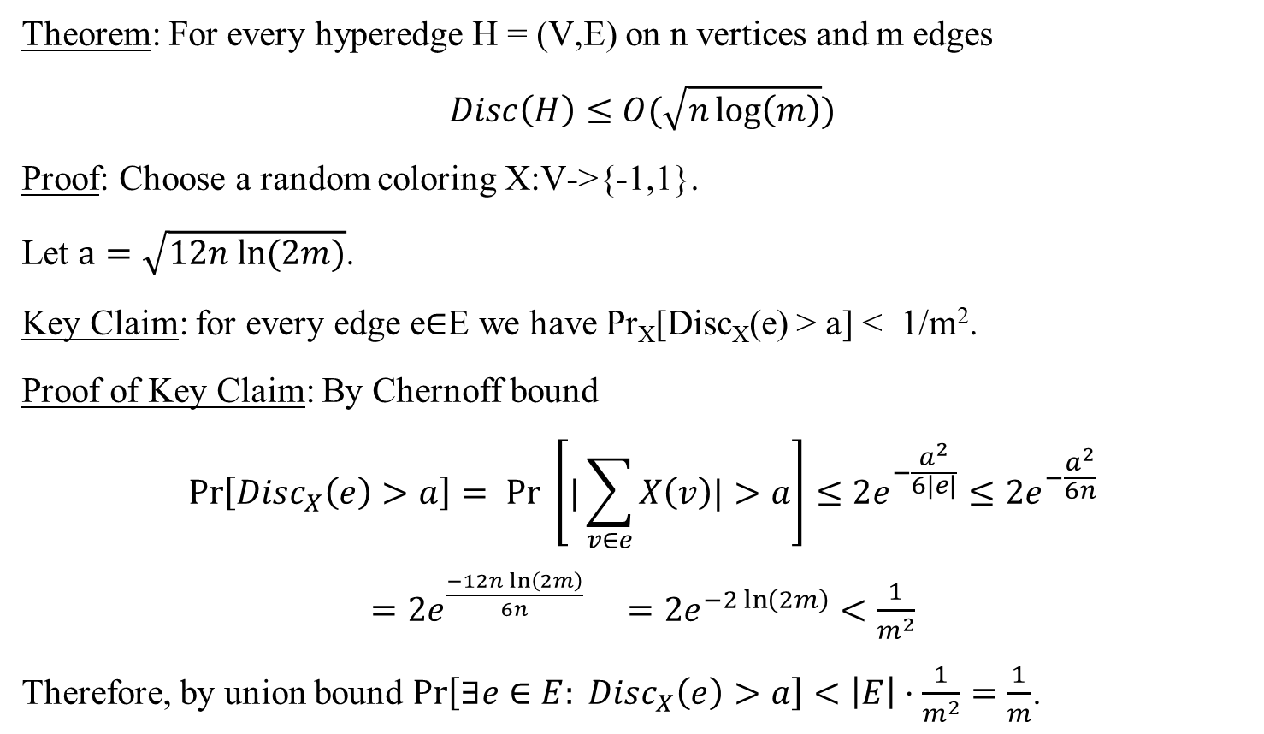
Discrepancy
Theorem: For every hyperedge H = (V,E) on n vertices and m edges
$$Disc\left(H\right)≤O(\sqrt{n\log\left(m\right)})$$
Proof: Choose a random coloring X:V->{-1,1}.
Let $a=\sqrt{12n ln⁡(2m)}$.
Key Claim: for every edge e∈E we have Pr_{X}[Disc_{X}(e) > a] < 1/m².
Proof of Key Claim: By Chernoff bound
$$\operatorname{Pr}\left[Disc_{X}\left(e\right)>a\right]= Pr \left[|\sum_{v∈e}{X\left(v\right)|>a}\right]≤2e^{−\frac{a^{2}}{6|e|}}≤2e^{−\frac{a^{2}}{6n}}$$
$=2e^{\frac{−12n\ln\left(2m\right)}{6n}}$ $=2e^{−2\ln\left(2m\right)}<\frac{1}{m^{2}}$
Therefore, by union bound $\operatorname{Pr}\left[∃e∈E: Disc_{X}\left(e\right)>a\right]<\left|E\right|⋅\frac{1}{m^{2}}=\frac{1}{m}$.

Slide 18

Discrepancy – bounded degree case
Beck-Fiala Theorem: Let H = (V,E), s.t. every vertex has degree at most t,
i.e. every vertex belongs to at most t sets. Then $Disc\left(H\right)<2t$.
Beck-Fiala Conjecture: Let H = (V,E), s.t. every vertex has degree at most t,
i.e. every vertex belongs to at most t sets. Then $Disc\left(H\right)<O(\sqrt{t}$).
Banaszczyk ‘98: Let H = (V,E), s.t. every vertex has degree at most t,
i.e. every vertex belongs to at most t sets. Then $Disc\left(H\right)<O(\sqrt{t log⁡(|E|)}$.

Slide 19
Approximate
DNF Counting

Slide 20
Approximate DNF Counting
Let 𝛷 be a DNF formula, i.e. formula of the form
(x₁ ⋀ x₂ ⋀ ~x₃ ⋀ x₄) v (~x₂ ⋀ x₃ ⋀ ~x₅ ⋀ x₆ ) v … v (~x₁ ⋀ x₂ ⋀ x₄ ⋀ ~x₆ ⋀ ~x₈)
Note that finding a satisfying solution is easy.
Input: A DNF formula 𝛷 with n variables and m clauses.
Goal: Find the #SAT(𝛷) = number of satisfying assignments.
Observation: The problem is hard NP-hard. [If we could tell if the number of solutions is 2^{n}, then we could solve the 3-SAT problem]
Goal 2: Approximate the number of satisfying assignments.

Slide 21
Approximate DNF Counting
Input: A DNF formula 𝛷 with n variables and m clauses.
Goal: Approximate the number of satisfying assignments.
Question: What do we mean by approximate?
A1: Up to an additive error up to ε2^{n}
A2: Up to a small multiplicative error
Algorithm for A1 is rather easy:
Sample x₁, x₂, … , x_{t} ∈ {0,1}^{n} for t = O(1/ε²)
Let s = be the number of x_{i}’s that satisfy 𝛷.
Output (s/t)*2^{n}
Analysis: By Chernoff bound Pr[ | #SAT(𝛷) - (s/t)*2^{n} | < ε2^{n}] > 0.99.

Slide 22

Approximate DNF Counting
So far:
Input: A DNF formula 𝛷 with n variables and m clauses.
Goal: Approximate #SAT(𝛷) up to an additive error up to ε2^{n}.
Goal*: Approximate #SAT(𝛷) up to a multiplicative error of (1+ε).
That is, output A such that
$\left(1−ε\right)⋅\#SAT\left(Φ\right)≤A≤\left(1+ε\right)⋅\#SAT(Φ)$.
Suppose that #SAT(𝛷) << 2^{n/2}
E.g. if each clause has 0.6n literals, and there are poly(n) clauses,
Then #SAT(𝛷)<poly(n)*2^{0.4n}
For such 𝛷 the algorithm will output 0 with high probability

Slide 23
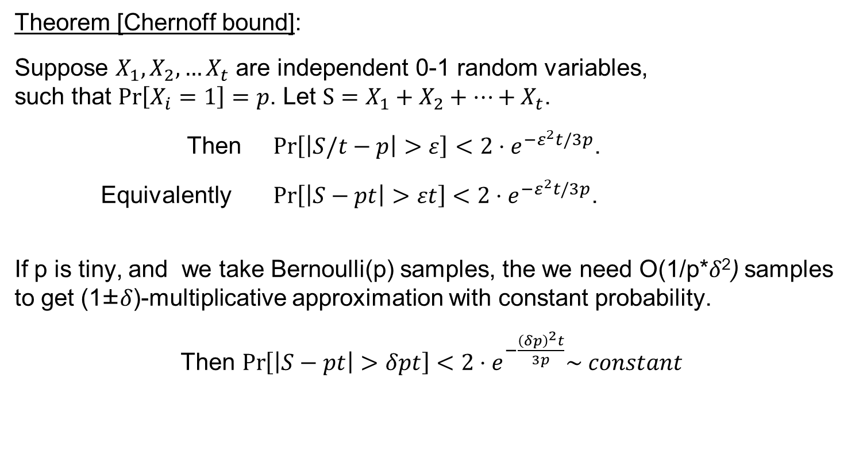
Chernoff bound
Theorem [Chernoff bound]:
Suppose $X_{1},X_{2},…X_{t}$ are independent 0-1 random variables,
such that $\operatorname{Pr}\left[X_{i}=1\right]=p$. Let $S=X_{1}+X_{2}+…+X_{t}$.
Then $\operatorname{Pr}\left[\left|S/t−p\right|>ε\right]<2⋅e^{{−ε}^{2}t/3p}$.
Equivalently $\operatorname{Pr}\left[\left|S−pt\right|>εt\right]<2⋅e^{{−ε}^{2}t/3p}$.
If p is tiny, and we take Bernoulli(p) samples, the we need O(1/p*𝛿²) samples to get (1±𝛿)-multiplicative approximation with constant probability.
Then $\operatorname{Pr}\left[\left|S−pt\right|>δpt\right]<2⋅e^{−\frac{{\left(δp\right)}^{2}t}{3p}}\sim constant$

Slide 24
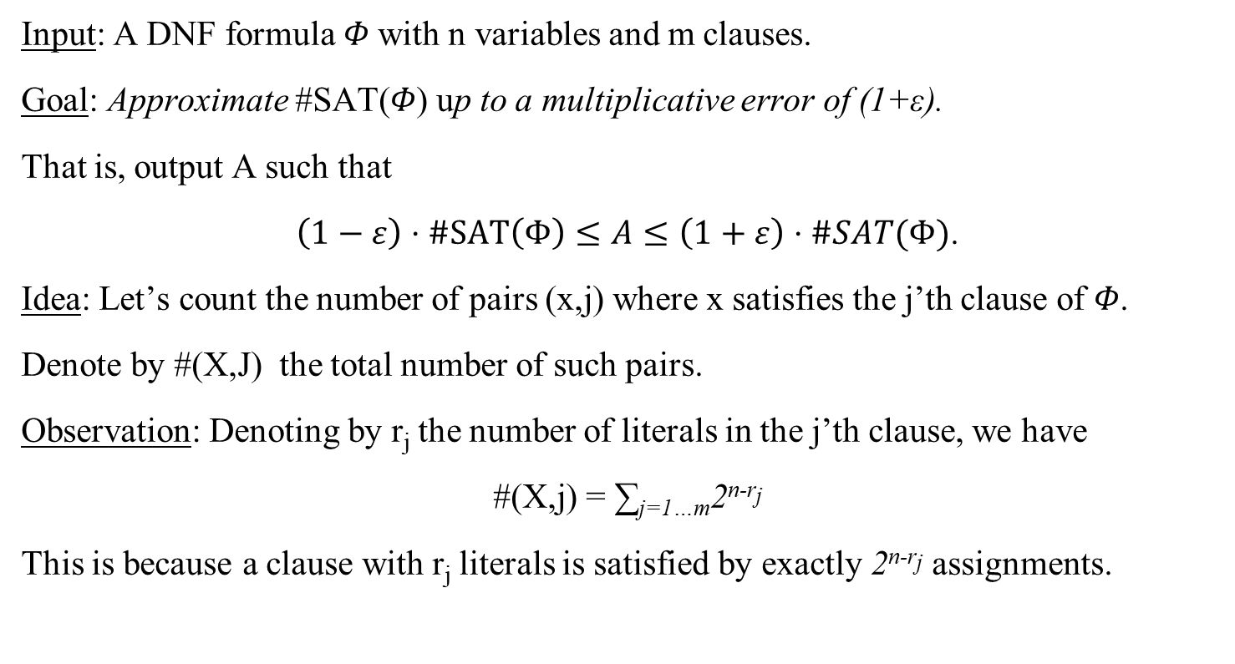
Approximate DNF Counting
Input: A DNF formula 𝛷 with n variables and m clauses.
Goal: Approximate #SAT(𝛷) up to a multiplicative error of (1+ε).
That is, output A such that
$\left(1−ε\right)⋅\#SAT\left(Φ\right)≤A≤\left(1+ε\right)⋅\#SAT(Φ)$.
Idea: Let’s count the number of pairs (x,j) where x satisfies the j’th clause of 𝛷.
Denote by #(X,J) the total number of such pairs.
Observation: Denoting by r_{j} the number of literals in the j’th clause, we have
#(X,j) = ∑_{j=1…m}2^{n-rj}
This is because a clause with r_{j} literals is satisfied by exactly 2^{n-rj} assignments.

Slide 25
Approximate DNF Counting
Denote by #(X,J) the total number of such pairs. Then #(X,J) = ∑_{j=1…m}2^{n-rj}
Definition: (x,j) is canonical is j is the first clause satisfied by x
Key Observation 1: #SAT(𝛷) = the number of canonical pairs
Therefore, we need to approximate the number of canonical pairs.
Key Observation 2: the number of canonical pairs > #(X,J)/m
Therefore, if we can take O(m) uniform samples (x,j), then by Chernoff bound we will get a (1±0.01) approximation with high probability

Slide 26
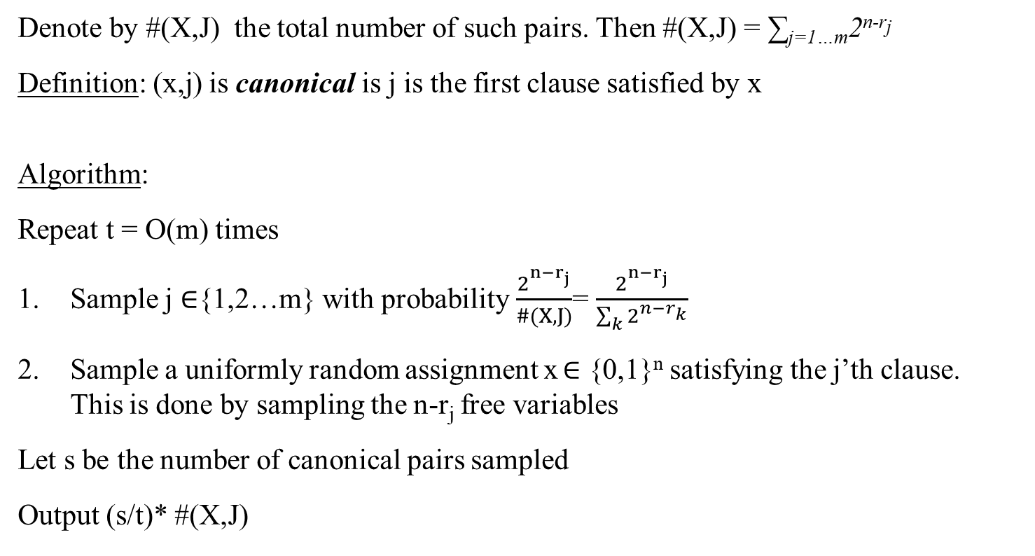
Approximate DNF Counting
Denote by #(X,J) the total number of such pairs. Then #(X,J) = ∑_{j=1…m}2^{n-rj}
Definition: (x,j) is canonical is j is the first clause satisfied by x
Algorithm:
Repeat t = O(m) times
Sample j ∈{1,2…m} with probability $\frac{2^{n−r_{j}}}{\#(X, J)}$= $\frac{2^{n−r_{j}}}{\sum_{k}{2^{n−r_{k}}}}$
Sample a uniformly random assignment x ∈ {0,1}^{n} satisfying the j’th clause.
This is done by sampling the n-r_{j} free variables
Let s be the number of canonical pairs sampled
Output (s/t)* #(X,J)

Slide 27
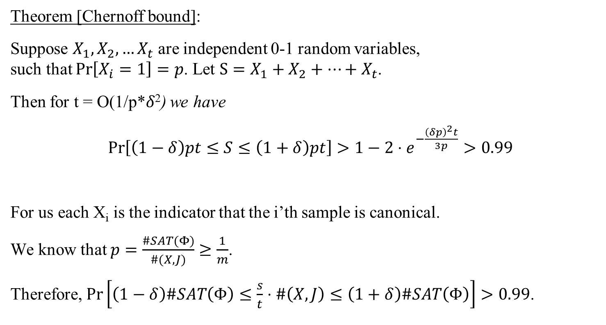
Approximate DNF Counting
Theorem [Chernoff bound]:
Suppose $X_{1},X_{2},…X_{t}$ are independent 0-1 random variables,
such that $\operatorname{Pr}\left[X_{i}=1\right]=p$. Let $S=X_{1}+X_{2}+…+X_{t}$.
Then for t = O(1/p*𝛿²) we have
$\operatorname{Pr}\left[\left(1−δ\right)pt≤S≤\left(1+δ\right)pt\right]>1−2⋅e^{−\frac{{\left(δp\right)}^{2}t}{3p}}>0.99$
For us each X_{i} is the indicator that the i’th sample is canonical.
We know that $p=\frac{\#SAT(Φ)}{\#(X,J)}≥\frac{1}{m}$.
Therefore, $Pr\left[\left(1−δ\right)\#SAT\left(Φ\right)≤\frac{s}{t}⋅\#\left(X,J\right)≤\left(1+δ\right)\#SAT\left(Φ\right)\right]>0.99$.

Slide 28
Approximate DNF Counting
Open problem: What about deterministic algorithms for approximate DNF counting?
For additive approximation up to ε2^{n} the best algorithm runs in time O(n^{loglog(n)}).
It is a very nice open problem to design a poly-time algorithm for ε2^{n} additive approximation (with constant ε, say ε=0.1)

Slide 29
Questions?
Comments?

