Slide 1
CMPT 409/815
Advanced Algorithms
November 23, 2020

Slide 2
Announcements
Take-home final exam: The exam will be posted on Dec 16 at 10am.
Submit it to Coursys before Dec 17, 10pm (the scheduled deadline)
The test is open books/internet. Shouldn‘t take you more than 3 hours.
Homeworks:
Assignmnet 4 is out – submit by Dec 2
Assignmnet 5 is out – submit by Dec 9
The HW grade will be best 4 out of 5

Slide 3
Linearity Testing

Slide 4
Linearity testing
Goal for today: Given a Boolean function f:{0,1}^{n}->{0,1} we want to check if f is linear by making only a small number of queries to f.
That is, we “pay” for every query we make to f, and we want to be confident with high probability that f is linear (or at least, f is close to linear)

Slide 5
Linearity testing
Definition: A Boolean function f:{0,1}^{n}->{0,1} is said to be linear if there are some a₁…a_{n}∈{0,1} such that
f(x)=f(x₁…x_{n}) = a₁x₁+a₂x₂+…a_{n}x_{n} (mod 2) for all x∊{0,1}^{n}
Equivalently, there is a subset of coordinates S⊆[n] such that
f(x) = f(x₁…x_{n}) = Σ_{i∊S}x_{i}
For example, f(x) = x₁+x₃+x₇ (mod 2) is a linear function.
Q: Given a function f, how can we check if f is linear?
Let’s say f is given as an evaluation table. For each x∊{0,1}^{n} we can read f(x).

Slide 6
Linearity testing
Q: Given a function f, how can we check if f is linear?
Let’s say f is given as an evaluation table. For each x∊{0,1}^{n} we can read f(x).
One solution:
Observation: if f is linear, i.e., of the form f(x) = a₁x₁+a₂x₂+…a_{n}x_{n} (mod 2), then
f(e₁) = a₁, f(e₂) = a₂…f(e_{n})=a_{n}
So we can read all the f(e_{i})
And then for every x check that f(x) is consistent with these values
What about sublinear time algorithms?

Slide 7
Linearity testing
Q: Given a function f, how can we check if f is linear by reading a few bits?
Clearly impossible if we want an exact solution
Relaxation: Design an algorithm that gets f, reads only a few bits from f and distinguishes between
YES: f is linear
NO: f is ε-far from linear, i.e., f differs from any linear function in >ε2^{n} outputs.
ε-far

Slide 8
Linearity testing
Exercise1: Consider the following two functions.
f(x₁…x_{n}) = x₁ for all x∊{0,1}^{n}
z(x₁…x_{n}) = 0 for all x∊{0,1}^{n}
Compute dist(f,z) = {x: f(x) ≠z(x) }/2^{n} = Pr_{x}[f(x) ≠z(x)]
This is exactly dist₁(f,z)= sum_{x} |f(x)-z(x)| /2^{n}
Answer: Pr_{x}[f(x) ≠z(x)] = Pr_{x}[f(x) ≠0] = Pr_{x}[f(x) =1] = 0.5.
Exercise2: Prove that this notion of distance satisfies the triangle inequality.
That is, prove that for all f,g,h it holds that
dist(f,g) ≤ dist(f,h) + dist(h,g)

Slide 9
Linearity testing
Goal: Design an algorithm that gets f, reads only a few bits from f and distinguishes between
YES: If f is linear, then Pr[ALG(f) = ACCEPT] = 1
NO: if f is ε-far from linear, then Pr[ALG(f) = ACCEPT] < ½.
A “local” definition: f is linear if and only if f(x) + f(y) = f(x+y) (mod 2) for all x,y.
This suggests the following test:
BLR linearity test: Given a f:{0,1}^{n}->{0,1} repeat the following basic test
Sample x,y∈{0,1}^{n} independently, uniformly at random
Check if f(x) + f(y) = f(x+y)
If all repetitions are ok, return ACCEPT, Otherwise return REJECT

Slide 10
Linearity testing
BLR linearity test: Given a f:{0,1}^{n}->{0,1} repeat the following basic test
Sample x,y∈{0,1}^{n} independently, uniformly at random
Check if f(x) + f(y) = f(x+y)
If all repetitions are ok, return ACCEPT, Otherwise return REJECT
YES case: Clearly, if f is linear, then Pr[ALG(f) = ACCEPT] = 1.
Q: What if f is ε-far from linear?
Theorem [BLR’90]: If f is ε-far from linear, then the basic test rejects with probability at least ε.
Hence, if we repeat the basic test O(1/ε) times, then the test rejects w.p. >½.

Slide 11
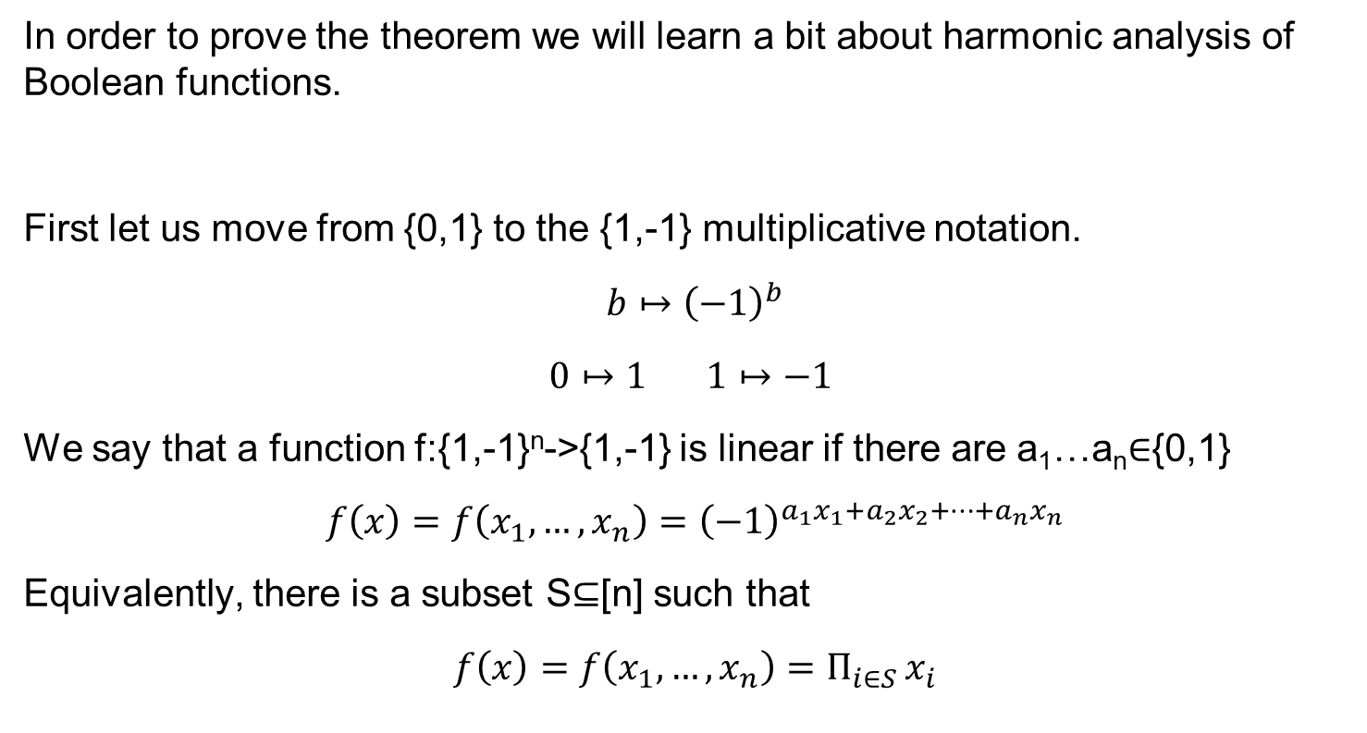
Linearity testing
In order to prove the theorem we will learn a bit about harmonic analysis of Boolean functions.
First let us move from {0,1} to the {1,-1} multiplicative notation.
$$b↦{\left(−1\right)}^{b}$$
$$0↦1 1↦−1$$
We say that a function f:{1,-1}^{n}->{1,-1} is linear if there are a₁…a_{n}∈{0,1}
$$f\left(x\right)=f\left(x_{1}, …, x_{n}\right)={\left(−1\right)}^{a_{1}x_{1}+a_{2}x_{2}+…+a_{n}x_{n}}$$
Equivalently, there is a subset S⊆[n] such that
$$f\left(x\right)=f\left(x_{1}, …, x_{n}\right)=Π_{i∈S }x_{i}$$

Slide 12
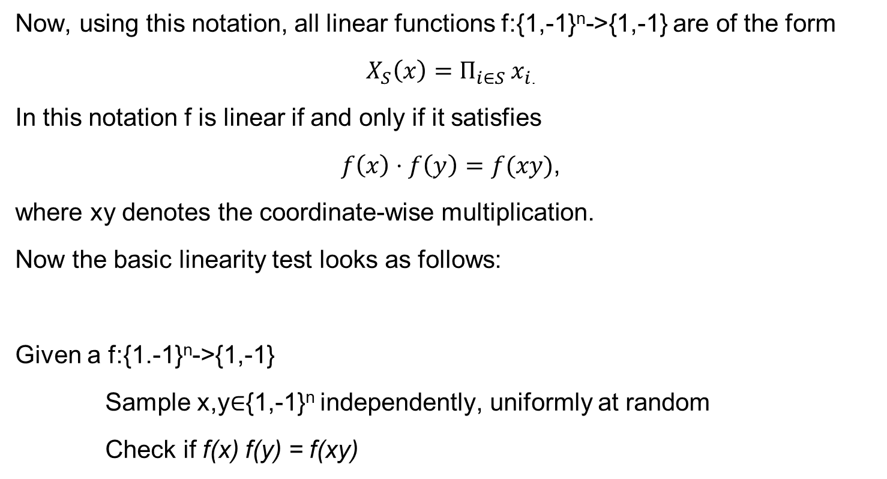
Linearity testing
Now, using this notation, all linear functions f:{1,-1}^{n}->{1,-1} are of the form
$X_{S}\left(x\right)=Π_{i∈S }x_{i}$.
In this notation f is linear if and only if it satisfies
$f\left(x\right)⋅f\left(y\right)=f(xy)$,
where xy denotes the coordinate-wise multiplication.
Now the basic linearity test looks as follows:
Given a f:{1.-1}^{n}->{1,-1}
Sample x,y∈{1,-1}^{n} independently, uniformly at random
Check if f(x) f(y) = f(xy)

Slide 13
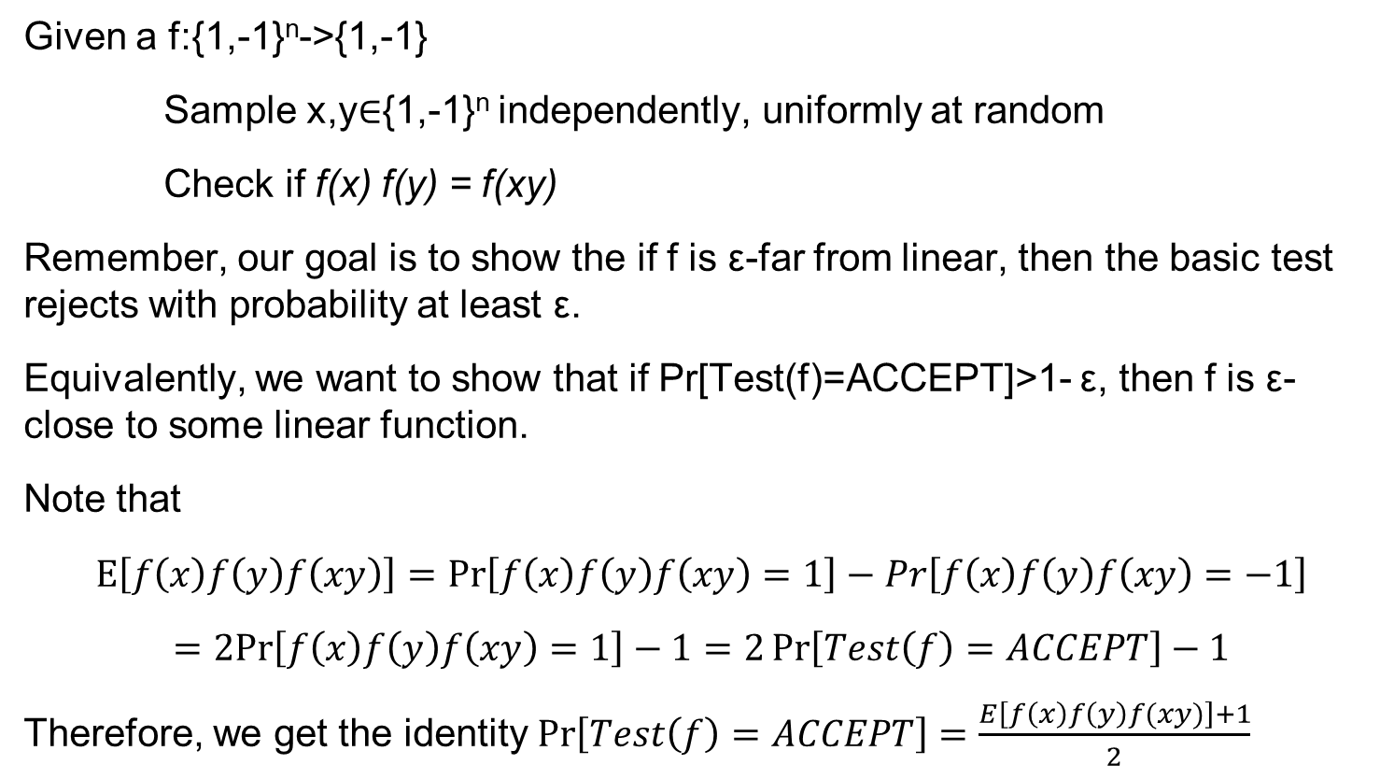
Linearity testing
Given a f:{1,-1}^{n}->{1,-1}
Sample x,y∈{1,-1}^{n} independently, uniformly at random
Check if f(x) f(y) = f(xy)
Remember, our goal is to show the if f is ε-far from linear, then the basic test rejects with probability at least ε.
Equivalently, we want to show that if Pr[Test(f)=ACCEPT]>1- ε, then f is ε-close to some linear function.
Note that
$$E\left[f\left(x\right)f\left(y\right)f\left(xy\right)\right]=\operatorname{Pr}\left[f\left(x\right)f\left(y\right)f\left(xy\right)=1\right]−Pr\left[f\left(x\right)f\left(y\right)f\left(xy\right)=−1\right]$$
$$=2Pr\left[f\left(x\right)f\left(y\right)f\left(xy\right)=1\right]−1=2\operatorname{Pr}\left[Test\left(f\right)=ACCEPT\right]−1$$
Therefore, we get the identity $\operatorname{Pr}\left[Test\left(f\right)=ACCEPT\right]=\frac{E\left[f\left(x\right)f\left(y\right)f(xy)\right]+1}{2}$

Slide 14

Linearity testing
We have the identity
$$E\left[f\left(x\right)f\left(y\right)f\left(xy\right)\right]=2\operatorname{Pr}\left[Test\left(f\right)=ACCEPT\right]−1$$
We want to show that if $\operatorname{Pr}\left[Test\left(f\right)=ACCEPT\right]>1−ε$, then f is $ε$-close to some linear function.

Slide 15
Harmonic Analysis of Boolean Functions
Consider the space of all real value functions g:{1,-1}^{n}->R.
Equivalently, we may this of each such g as a vector in R^{N}, where N=2^{n}
This is a linear space of dimension 2^{n}.
This space has a natural basis: {e_{a}∊R^{N} : a∊{0,1}^{n}}, where e_{a}(x)=1_{x=a}.
In the vector notation each e_{a} is a unit vector with 1 in the a’th coordinate,
and 0’s everywhere else.
Next we will find a different basis that will be more convenient for us.

Slide 16
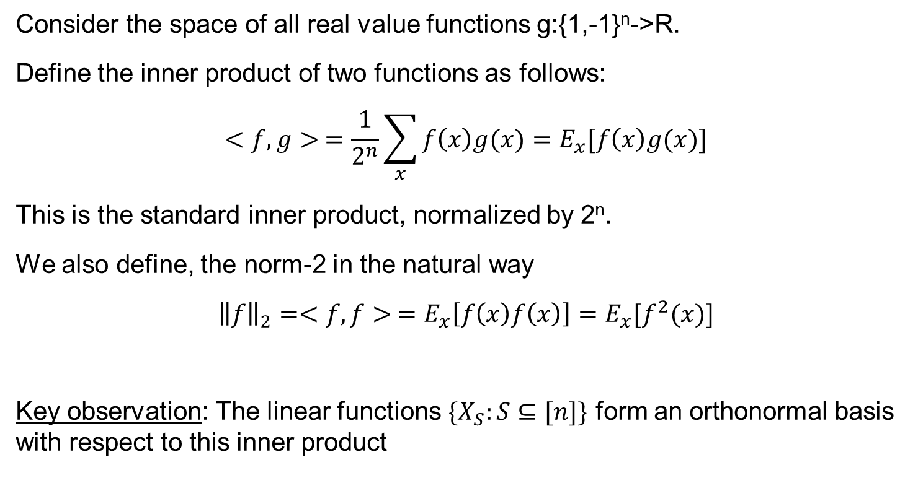
Harmonic Analysis of Boolean Functions
Consider the space of all real value functions g:{1,-1}^{n}->R.
Define the inner product of two functions as follows:
$$<f,g> =\frac{1}{2^{n}}\sum_{x}{f\left(x\right)g(x)}=E_{x}[f\left(x\right)g(x)]$$
This is the standard inner product, normalized by 2^{n}.
We also define, the norm-2 in the natural way
$${\left\|f\right\|}_{2}=<f,f> =E_{x}\left[f\left(x\right)f\left(x\right)\right]=E_{x}[f^{2}(x)]$$
Key observation: The linear functions ${\{X}_{S}:S⊆[n]\}$ form an orthonormal basis with respect to this inner product

Slide 17
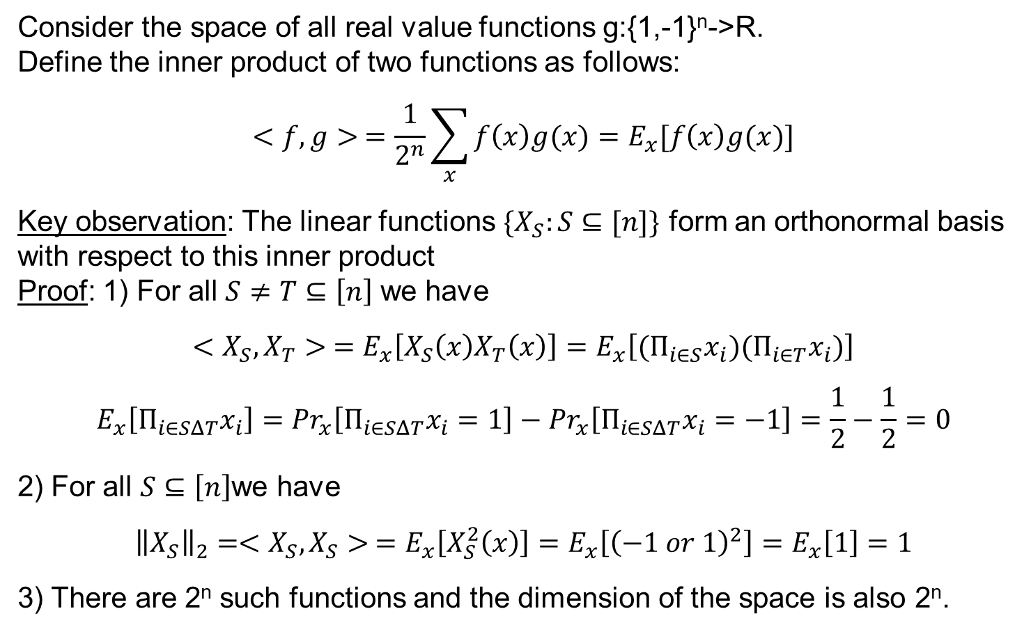
Harmonic Analysis of Boolean Functions
Consider the space of all real value functions g:{1,-1}^{n}->R.
Define the inner product of two functions as follows:
$$<f,g> =\frac{1}{2^{n}}\sum_{x}{f\left(x\right)g(x)}=E_{x}[f\left(x\right)g(x)]$$
Key observation: The linear functions ${\{X}_{S}:S⊆[n]\}$ form an orthonormal basis with respect to this inner product
Proof: 1) For all $S≠T⊆\left[n\right]$ we have
$$<X_{S},X_{T}> =E_{x}\left[X_{S}\left(x\right)X_{T}\left(x\right)\right]=E_{x}\left[(Π_{i∈S}x_{i}{)(Π}_{i∈T}x_{i})\right]$$
$$E_{x}\left[Π_{i∈SΔT}x_{i}\right]={Pr}_{x}\left[Π_{i∈SΔT}x_{i}=1\right]−{Pr}_{x}\left[Π_{i∈SΔT}x_{i}=−1\right]=\frac{1}{2}−\frac{1}{2}=0$$
2) For all $S⊆\left[n\right]$we have
$${\left\|X_{S}\right\|}_{2}=<X_{S},X_{S}> =E_{x}\left[X_{S}^{2}\left(x\right)\right]=E_{x}\left[{\left(−1 or 1\right)}^{2}\right]=E_{x}\left[1\right]=1$$
3) There are 2^{n} such functions and the dimension of the space is also 2^{n}.

Slide 18
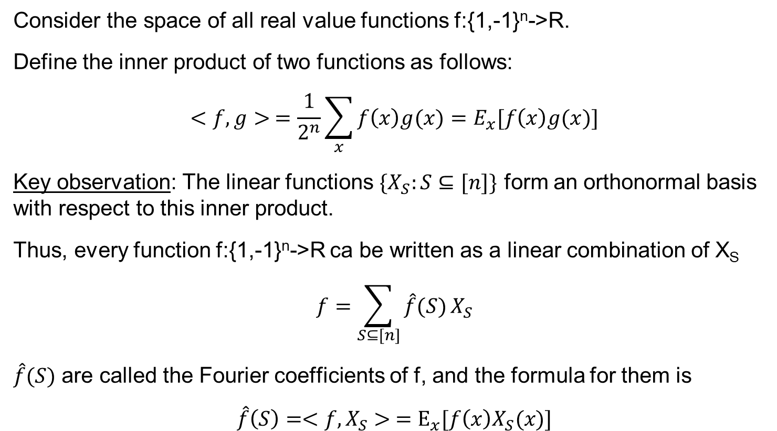
Harmonic Analysis of Boolean Functions
Consider the space of all real value functions f:{1,-1}^{n}->R.
Define the inner product of two functions as follows:
$$<f,g> =\frac{1}{2^{n}}\sum_{x}{f\left(x\right)g(x)}=E_{x}[f\left(x\right)g(x)]$$
Key observation: The linear functions ${\{X}_{S}:S⊆[n]\}$ form an orthonormal basis with respect to this inner product.
Thus, every function f:{1,-1}^{n}->R ca be written as a linear combination of X_{S}
$$f=\sum_{S⊆[n]}{\hat{f}(S)}X_{S}$$
$\hat{f}(S)$ are called the Fourier coefficients of f, and the formula for them is
$$\hat{f}\left(S\right)=<f,X_{S}> =E_{x}[f\left(x\right)X_{S}(x)]$$

Slide 19
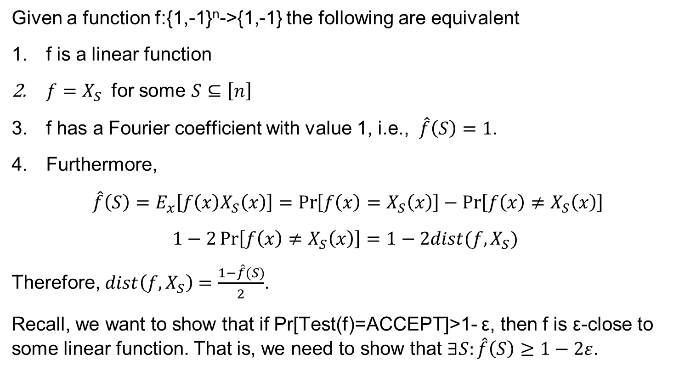
Harmonic Analysis of Boolean Functions
Given a function f:{1,-1}^{n}->{1,-1} the following are equivalent
f is a linear function
$f=X_{S}$ for some $S⊆\left[n\right]$
f has a Fourier coefficient with value 1, i.e., $\hat{f}\left(S\right)=1$.
Furthermore,
$\hat{f}\left(S\right)=E_{x}\left[f\left(x\right)X_{S}\left(x\right)\right]=\operatorname{Pr}\left[f\left(x\right)=X_{S}\left(x\right)\right]−\operatorname{Pr}\left[f\left(x\right)≠X_{S}\left(x\right)\right]$
$$1−2\operatorname{Pr}\left[f\left(x\right)≠X_{S}\left(x\right)\right]=1−2dist(f,X_{S})$$
Therefore, $dist\left(f,X_{S}\right)=\frac{1−\hat{f}(S)}{2}$.
Recall, we want to show that if Pr[Test(f)=ACCEPT]>1- ε, then f is ε-close to some linear function. That is, we need to show that $∃S:\hat{f}\left(S\right)≥1−2ε$.

Slide 20
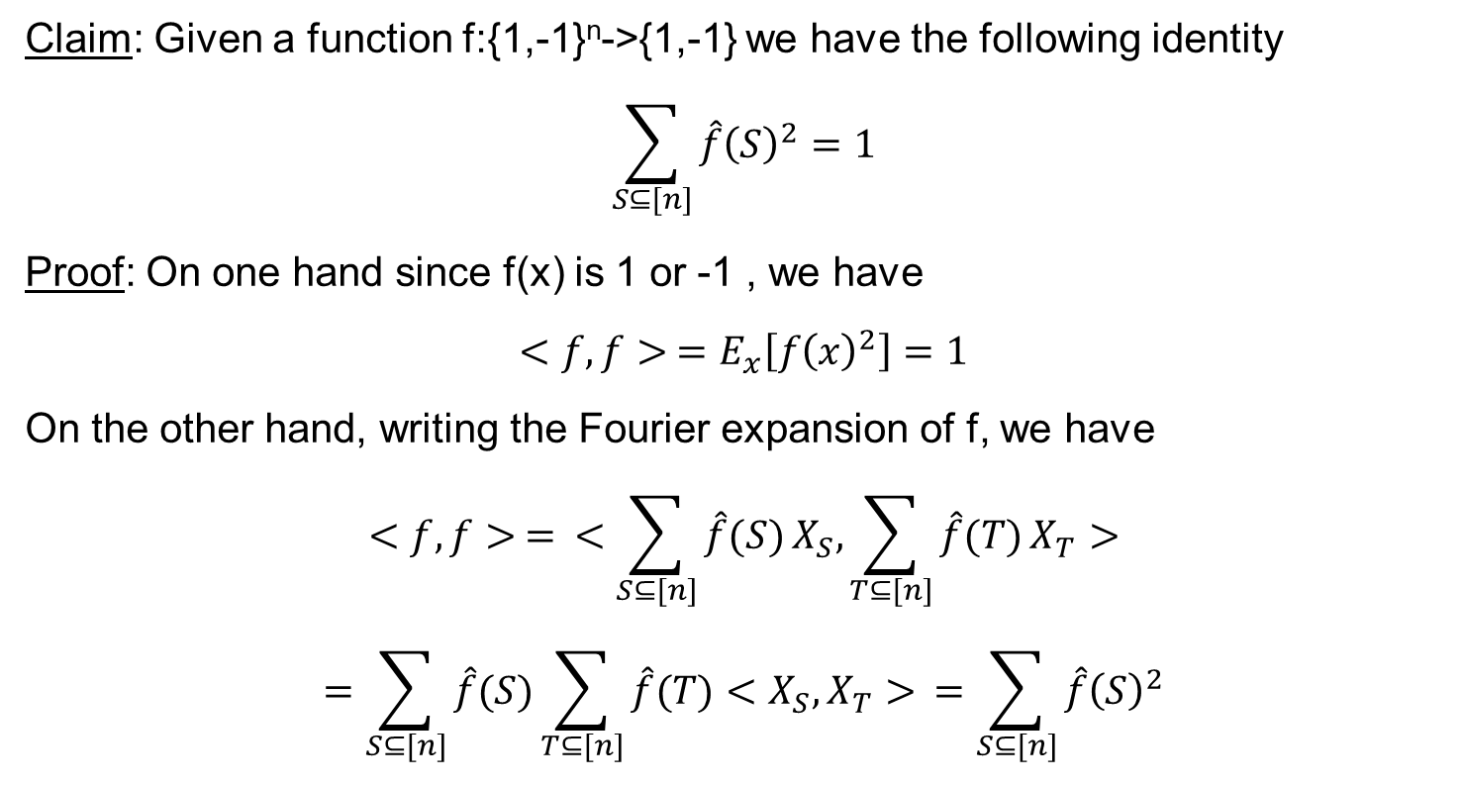
Parceval’s identity
Claim: Given a function f:{1,-1}^{n}->{1,-1} we have the following identity
$$\sum_{S⊆[n]}{\hat{f}{\left(S\right)}^{2}}=1$$
Proof: On one hand since f(x) is 1 or -1 , we have
$$<f,f> =E_{x}\left[f{\left(x\right)}^{2}\right]=1$$
On the other hand, writing the Fourier expansion of f, we have
$$<f,f> = <\sum_{S⊆[n]}{\hat{f}(S)}X_{S},\sum_{T⊆[n]}{\hat{f}(T)}X_{T}>$$
$$=\sum_{S⊆[n]}{\hat{f}(S)}\sum_{T⊆[n]}{\hat{f}(T)}<X_{S}, X_{T}> =\sum_{S⊆[n]}{\hat{f}{\left(S\right)}^{2}}$$

Slide 21
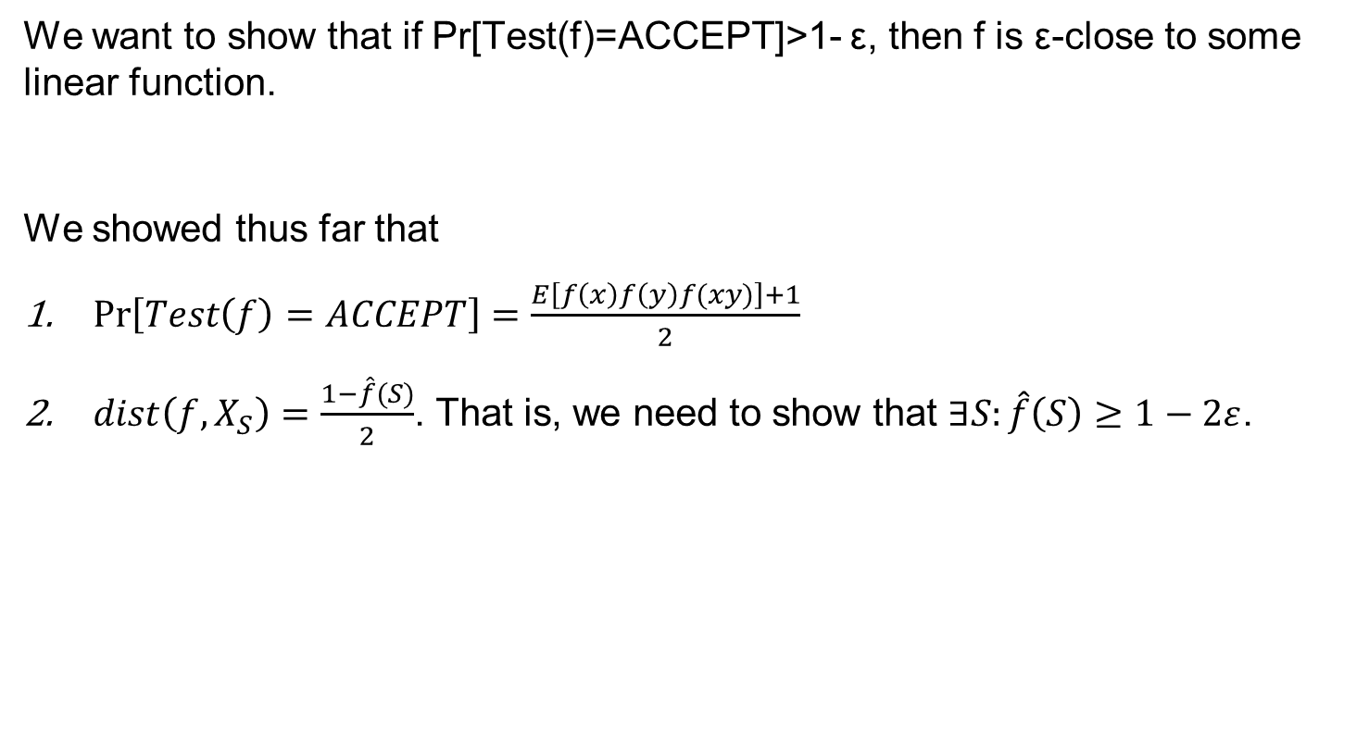
Harmonic Analysis of Boolean Functions
We want to show that if Pr[Test(f)=ACCEPT]>1- ε, then f is ε-close to some linear function.
We showed thus far that
$\operatorname{Pr}\left[Test\left(f\right)=ACCEPT\right]=\frac{E\left[f\left(x\right)f\left(y\right)f(xy)\right]+1}{2}$
$dist\left(f,X_{S}\right)=\frac{1−\hat{f}(S)}{2}$. That is, we need to show that $∃S:\hat{f}\left(S\right)≥1−2ε$.

Slide 22
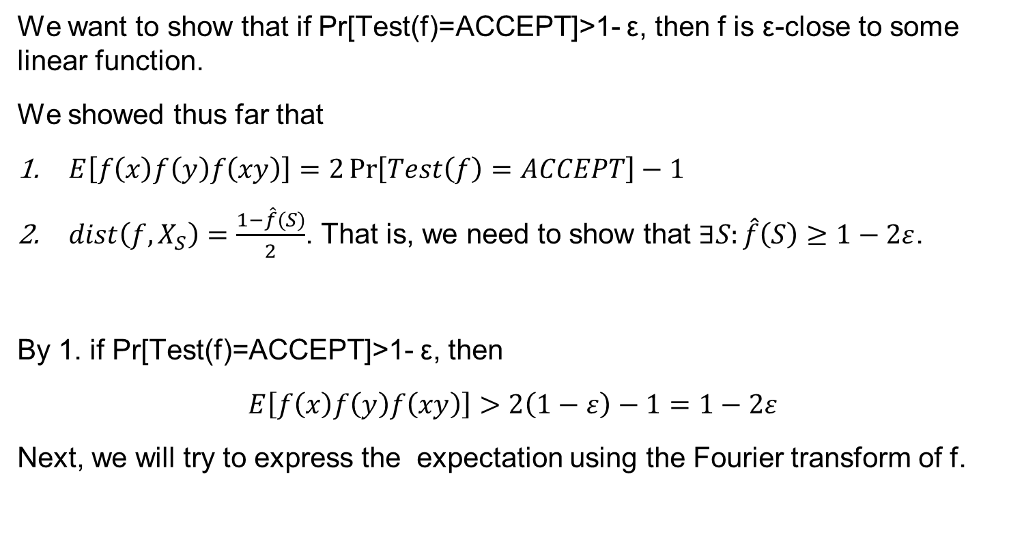
Back to Linearity testing
We want to show that if Pr[Test(f)=ACCEPT]>1- ε, then f is ε-close to some linear function.
We showed thus far that
$E\left[f\left(x\right)f\left(y\right)f\left(xy\right)\right]=2\operatorname{Pr}\left[Test\left(f\right)=ACCEPT\right]−1$
$dist\left(f,X_{S}\right)=\frac{1−\hat{f}(S)}{2}$. That is, we need to show that $∃S:\hat{f}\left(S\right)≥1−2ε$.
By 1. if Pr[Test(f)=ACCEPT]>1- ε, then
$$E\left[f\left(x\right)f\left(y\right)f\left(xy\right)\right]>2\left(1−ε\right)−1=1−2ε$$
Next, we will try to express the expectation using the Fourier transform of f.

Slide 23
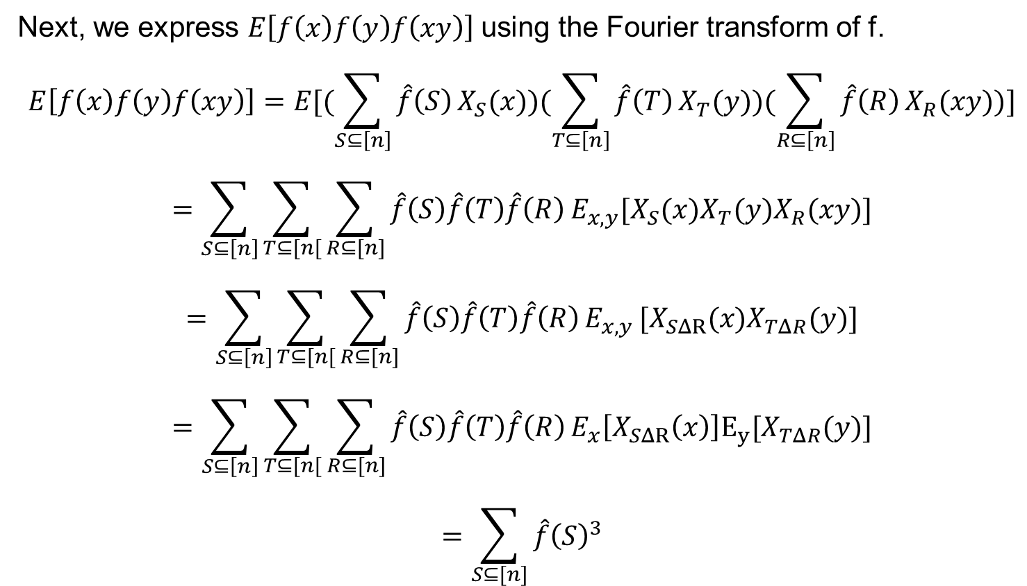
Back to Linearity testing
Next, we express $E\left[f\left(x\right)f\left(y\right)f\left(xy\right)\right]$using the Fourier transform of f.
$$E\left[f\left(x\right)f\left(y\right)f\left(xy\right)\right]=E[(\sum_{S⊆\left[n\right]}{\hat{f}\left(S\right)}X_{S}(x))(\sum_{T⊆\left[n\right]}{\hat{f}\left(T\right)}X_{T}(y))(\sum_{R⊆\left[n\right]}{\hat{f}\left(R\right)}X_{R}(xy))]$$
$$=\sum_{S⊆\left[n\right]}{\sum_{T⊆[n[}{\sum_{R⊆[n]}{\hat{f}\left(S\right)\hat{f}\left(T\right)\hat{f}\left(R\right)}}}E_{x,y}[X_{S}(x)X_{T}(y)X_{R}(xy)]$$
$$=\sum_{S⊆\left[n\right]}{\sum_{T⊆[n[}{\sum_{R⊆[n]}{\hat{f}\left(S\right)\hat{f}\left(T\right)\hat{f}\left(R\right)}}}E_{x,y }[X_{SΔR}(x)X_{TΔR}(y)]$$
$$=\sum_{S⊆\left[n\right]}{\sum_{T⊆[n[}{\sum_{R⊆[n]}{\hat{f}\left(S\right)\hat{f}\left(T\right)\hat{f}\left(R\right)}}}E_{x}\left[X_{SΔR}\left(x\right)\right]E_{y}[X_{TΔR}(y)]$$
$$=\sum_{S⊆[n]}{\hat{f}{\left(S\right)}^{3}}$$
E[X_{SΔR}(x)]=1 if S = R
E[X_{SΔR}(x)]=0 if S ≠ R
Same for the T and R

Slide 24
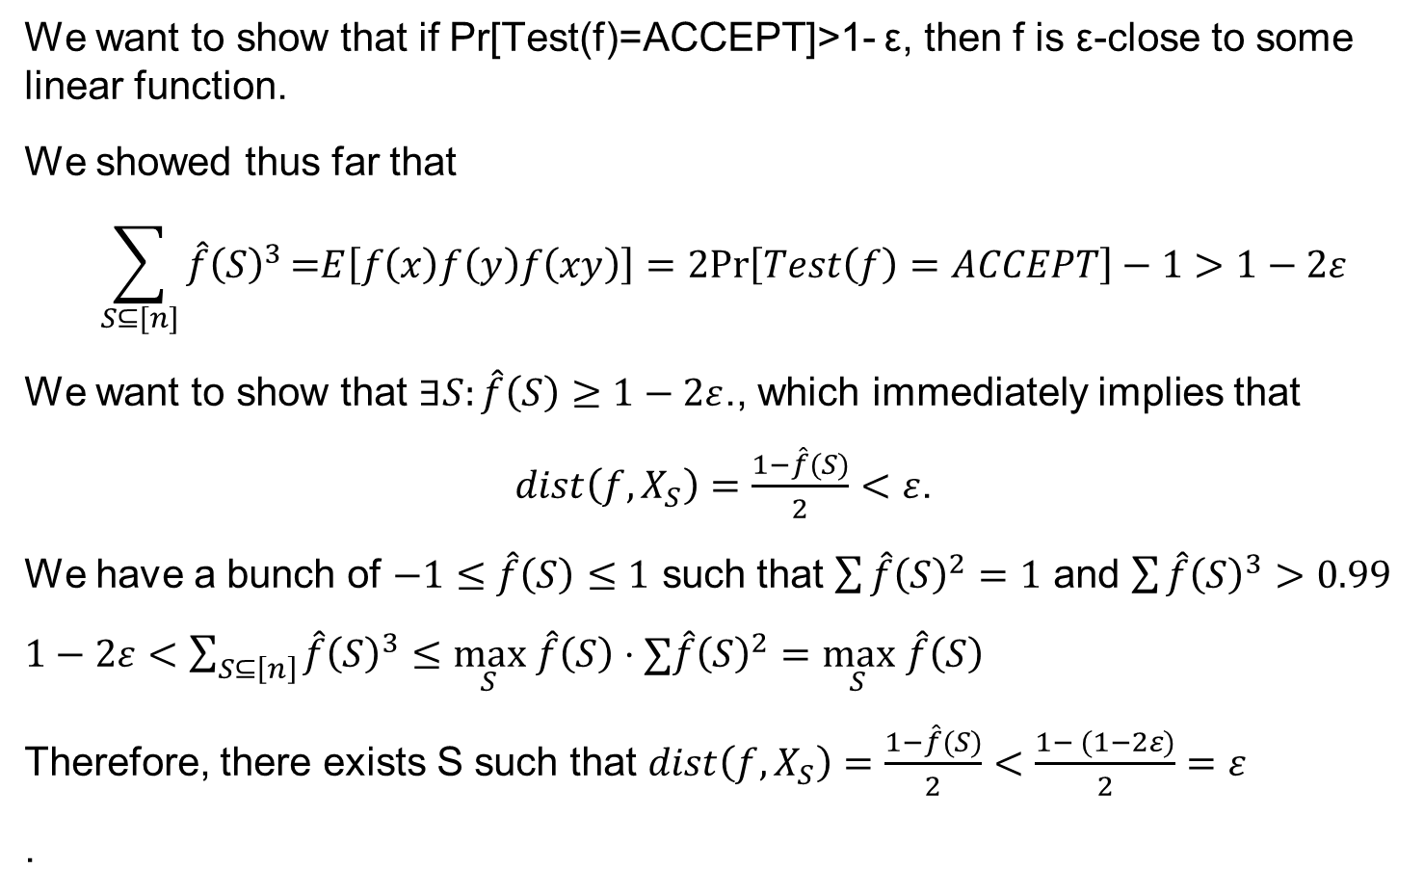
Back to Linearity testing
We want to show that if Pr[Test(f)=ACCEPT]>1- ε, then f is ε-close to some linear function.
We showed thus far that
$$\sum_{S⊆[n]}{\hat{f}{\left(S\right)}^{3}}\text{=}E\left[f\left(x\right)f\left(y\right)f\left(xy\right)\right]=2Pr\left[Test\left(f\right)=ACCEPT\right]−1>1−2ε$$
We want to show that $∃S:\hat{f}\left(S\right)≥1−2ε$., which immediately implies that
$dist\left(f,X_{S}\right)=\frac{1−\hat{f}(S)}{2}<ε$.
We have a bunch of $−1≤\hat{f}\left(S\right)≤1$ such that $\sum{\hat{f}{\left(S\right)}^{2}}=1$ and $\sum{\hat{f}{\left(S\right)}^{3}}>0.99$
$1−2ε<\sum_{S⊆\left[n\right]}{\hat{f}{\left(S\right)}^{3}}≤\max_{S}$ $\hat{f}\left(S\right)⋅∑\hat{f}{\left(S\right)}^{2}=\max_{S} \hat{f}\left(S\right)$
Therefore, there exists S such that $dist\left(f,X_{S}\right)=\frac{1−\hat{f}(S)}{2}<\frac{1− (1−2ε)}{2}=ε$
.

Slide 25
Linearity testing
BLR linearity test: Given a f:{0,1}^{n}->{0,1} repeat the following basic test
Sample x,y∈{0,1}^{n} independently, uniformly at random
Check if f(x) + f(y) = f(x+y)
If all repetitions are ok, return ACCEPT, Otherwise return REJECT
Theorem [BRL’90]:
YES case: Clearly, if f is linear, then Pr[ALG(f) = ACCEPT] = 1.
NO case: If f is ε-far from linear, then the basic test rejects with probability at least ε.
Hence, if we repeat the basic test O(1/ε) times, then the test rejects w.p. >½.

Slide 26
Questions?
Comments?

