Slide 1
CMPT 706 - Algorithms for Big Data
Big-O notation and Arithmetic
January 16, 2020

Slide 2
Big-O notation and its friends

Slide 3
Big-O notation
Formally: Let f(n) and g(n) be two functions on positive integers.
We say that f = O(g) if there exists a large enough constant C (e.g. C = 100) such that f(n) <= C*g(n) for all sufficiently large n.
Example: Let f(n) = 1.5n² + 4n+ 3
Claim: f(n) = O(n²)
Proof: Let C=8.5. Then f(n) = 1.5n² + 4n+ 3 <= 1.5n² + 4n² + 3n² <= 8.5n².
Therefore f = O(n²)
There exists a constant C (e.g. C = 100) such that f(n)/g(n) <= C for all n sufficiently large.
It’s ok to ignore n’s up to 10 or 20

Slide 4
Big-O notation
Formally: Let f(n) and g(n) be two functions on positive integers.
We say that f = O(g) if there exists a large enough constant C (e.g. C = 100) such that f(n) <= C*g(n) for all sufficiently large n.
Example: Let f(n) = 1.5n² + 4n+ 3
Claim: f(n) = O(n³) // not tight, but still correct
Proof: Let C=8.5. Then f(n) = 1.5n² + 4n+ 3 <= 8.5n² <=8.5n³.
Therefore f = O(n³)
There exists a constant C (e.g. C = 100) such that f(n)/g(n) <= C for all n sufficiently large.

Slide 5
Big-O notation
Formally: Let f(n) and g(n) be two functions on positive integers.
We say that f = Θ(g) if there are two constants C, D (e.g. C = 10, D = 0.5) such that D*g(n) <= f(n) <= C*g(n) for all sufficiently large n.
Example: Let f(n) = 1.5n² + 4n+ 3
Claim: f(n) = Θ(n²)
Proof: Let D = 1.5, C=8.5. Then D n²<= f(n) <= Cn². Therefore f = Θ(n²)
There exist constant C, D such that D <= f(n)/g(n) <= C for all n sufficiently large.

Slide 6
Big-O notation
Formally: Let f(n) and g(n) be two functions on positive integers.
We say that f = Θ(g) if there are two constants C, D (e.g. C = 10, D = 0.5) such that D*g(n) <= f(n) <= C*g(n) for all sufficiently large n.
Ex1: Prove that if f = Θ(g), then g = Θ(f)
Ex2: Show an example where f = O(g), but it is not true that g=O(f)
3*g(n)
f(n)
g(n)
0.5*g(n)

Slide 7
Common orders of magnitude
O(1) – bounded by some absolute constant (e.g., <= 100)
O(log n) – logarithmic complexity – very fast
O(n) – linear: That is constant times the size of the input. We consider it very efficient
O(n log n) – Almost as good as linear.
O(n²) – quadratic time
O(n³), O(n⁴), ...O(n⁷)... O(n^{const}) – polynomial
O(2^{n}) – exponential: considered as very inefficient
O(4^{n}) – exponential: even worse than 2^{n}

Slide 8
Big-O notation – simple rules
Fix 0 <a < b (e.g., a=2, b=4) Then nª =O(n^{b}) , for example n² = O(n⁴) But n^{b} =O(nª) does not holds
log(n) is smaller than any power of n: log(n) = O(n^{0.1})
log₂(n) = log₁₀(n) * log₂(10). Hence, in O(log(n)) the base doesn’t matter.
log(a*b) = log(a) + log(b). In particular log(n²) = log(n)+log(n) = 2log(n)
If f = O(g) and g = O(h), then f = O(h)
If f₁ = O(g) and f₂ = O(g), then f₁+f₂ = O(g)
f+g <= 2max(f,g) = Θ(max(f,g))

Slide 9
Big-O notation
Sort the functions in the increasing order:
f₁(n) = n² + 100n
f₂(n) = 2n + n⁶ + 100n
f₃(n) = n³ log(n) + 400n²
f₄(n) = 2n³ + 100n + 10⁸
f₅(n) = (log(n))¹⁰
f₆(n) = 99n + log(n) + 4^{n}
f₇(n) = n log(n) + 100n
f₈(n) = log(n/2)

Slide 10
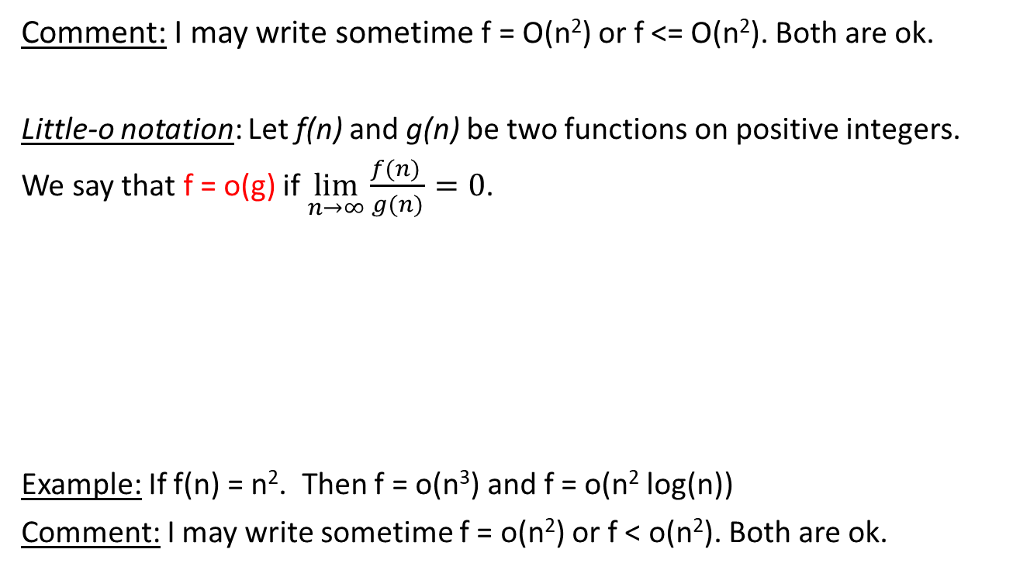
Big-O notation – related definitions
Comment: I may write sometime f = O(n²) or f <= O(n²). Both are ok.
Little-o notation: Let f(n) and g(n) be two functions on positive integers.
We say that f = o(g) if $\lim_{n→∞}\frac{f(n) }{g(n)}=0$.
Example: If f(n) = n². Then f = o(n³) and f = o(n² log(n))
Comment: I may write sometime f = o(n²) or f < o(n²). Both are ok.
In simple words that f = o(g) if
f(n) < g(n) for all large enough n
f(n) < g(n)/10 for all large enough n
f(n) < g(n)/1000 for all large enough n

Slide 11

Big-O notation – related definitions
Big-Omega notation: Let f(n) and g(n) be functions on positive integers.
We say that f = Ω(g) if g = O(f)
Little-Omega notation: Let f(n) and g(n) be functions on positive integers.
We say that f = ω(g) if g = o(f), i.e. $\lim_{n→∞}\frac{g(n) }{f(n)}=0$.
Comment: I may write sometime f = Ω(n²) or f >= Ω(n²). Both are ok.
Similarly, both f = ω(n²) or f > ω(n²) are ok.
In simple words that there is a constant c (small enough, e.g. c = 0.01 such that f(n) >= c*g(n) for large enough n.
In simple words that for any constant C (e.g. C = 100, 1000) it holds that f(n) >= C*g(n) for large enough n.

Slide 12
Big-O notation – practice problems
Ex 1: Suppose that f = O(n) and f = Ω(n). Prove that f = Θ(n)
Ex 2: Let f(n) = n²+10n. Prove that f = ω(n). Prove that f = ω(n^{1.5}).
Ex 3: Let f(n) = n log(n)/10 + 100 n + log (n). Prove that f = Θ(n log(n)).
Ex 4: Let f(n) = 2^{n}+n. Prove that f = Θ(2^{n}). Prove that f = o(4^{n}).

Slide 13
Arithmetic and Algorithms

Slide 14
Complexity of Arithmetic: Exponentiation
We saw last week:
Addition of two numbers n-bits long can be done is O(n) time
Multiplication of two numbers n-bits long can be done is O(n²) time
Next week we’ll see how to do it in o(n²) time
What about exponentiation?
Input: two positive integers a, b
Output: a^{b}= a*a*…*a (b times)
Observation: The length of a^{b} is Θ(log(a) * b).
Therefore, the algorithm cannot run in time o(log(a) * b)
Practicing the o / Θ notations

Slide 15
Complexity of Arithmetic: Exponentiation
Input: two positive integers a, b
Output: a^{b}= a*a*…*a (b times)
Naïve algorithm
result = 1
for i=1…b
result = result * a
return result
Runtime: we perform b multiplications.
In the i'th iteration we are multiplying a^{i-1} by a.
The runtime of the i’th iteration is log(a^{i-1}) * log(a) = (i-1)*log²(a)
Therefore, the total running time is
O(log²(a) + 2log ²(a) + 3log²(a) + … + (b-1)*log²(a) = O(b²*log²(a))
Can we do better?
Can we do O(b log(a))?

Slide 16
Modular Arithmetic: Congruences
In some situations we care only about the remainder of an integer when it is divided by some specified positive number. For instance, when we ask what time it will be 50 hours from now, we care only about the remainder of 50 plus the current hour divided by 24.
Definition: If a and b are integers and m is a positive integer, then a is congruent to b modulo m if m divides a – b.
Notation: Write a ≡ b (mod m) to say a is congruent to b modulo m.
If a and b are not congruent modulo m, we write a ≠ b (mod m).
Proposition: Integers a and b are congruent modulo m if and only if they have the same remainder when divided by m.
Proof: if a – b = km and b = qm + r, then a = km + b = (k + q)m + r

Slide 17
Modular Arithmetic: Congruences
Examples:
12 ≡ 5 (mod 7)
12 ≡ 6 ≡ 0 (mod 3)
12 ≡ -3 (mod 15)
12 ≡ 0 (mod 12)
12 ≡ -5 (mod 17)
For integers a, b, m we have
a ≡ b (mod m) if and only if a = b + km for some integer k.

Slide 18
Congruences and Arithmetic Operations
Addition, subtraction, multiplication behave really well with respect to modulo
Theorem:(Substitution Rule)
Let m be positive integer. If a ≡ b (mod m) and c ≡ d (mod m),
then a + c ≡ b + d (mod m), a – c ≡ b – d (mod m), and ac ≡ bd (mod m)
Proof: (For multiplication)
We have a = b + km and c = d + lm for some k and l.
Then ac = (b + km)(d + lm) = bd + blm + dkm + kmlm
= bd + (bl + dk +klm)*m
Example: 7 ≡ 2 (mod 5) and 11 ≡ 1 (mod 5)
18 = 7 + 11 ≡ 2 + 1 = 3 (mod 5)
77 = 7*11 ≡ 2*1 = 2 (mod 5)

Slide 19
Congruences and Arithmetic Operations
Division is not so great.
Example:
We have 8 ≡24 (mod 4) and 4 ≡8 (mod 4)
But 8/4 ≡ 2 (mod 4)
24/8 ≡ 3 (mod 4)
2 ≠ 3. So division does not work well with congruences.

Slide 20
Residues
All integers are divided into m classes, where every class contains all integers congruent modulo m to each
We choose a representative from each such class to be Z_{m} = {0…m-1}
The residue of an integer a modulo m is such a number b such that b ∈Z_{m} and a ≡ b (mod m)
We denote it by 𝑎 mod 𝑚
In other words, the residue of a (mod m) is the remainder of a when divided by m.

Slide 21
Modular Arithmetic
We define addition, subtraction, and multiplication of residues:
Let a,b ∈Z_{m}. Then
a + b (mod m) is the element c ∈ Z_{m} such that c ≡ a + b (mod m) a – b (mod m) is the element c ∈ Z_{m} such that c ≡ a – b (mod m) a ⋅ b (mod m) is the element c ∈ Z_{m} such that c ≡ a ⋅ b (mod m)
Example. Construct operation tables for Z₅
+ | 0 | 1 | 2 | 3 | 4
0
1
2
3
4
⋅ | 0 | 1 | 2 | 3 | 4
0
1
2
3
4
0
1
2
3
4
0
0
0
0
0
1
2
3
4
0
0
1
2
3
4
2
3
4
0
1
0
2
4
1
3
3
4
0
1
2
0
3
1
4
2
4
0
1
2
3
0
4
3
2
1

Slide 22
Complexity of Arithmetic: Exponentiation
Input: positive integers a, b, m
Output: a^{b} (mod m)
Naïve algorithm
result = 1
for i=1…b
result = result * a (mod m)
return result (mod m)
Runtime: we perform b multiplications (mod m).
In the i'th iteration we are multiplying a^{i} by a (mod m).
The runtime of the i’th iteration is log(a^{i-1}) * log(a) = (i-1)*log²(a)
Therefore, the total running time is
log²(a)² + 2log²(a) + 3log²(a) + … + (b-1)*log²(a) = O(b²*log²(a))
Can we do better?
Can we do O(b log(a))?

Slide 23
Complexity of Arithmetic: Exponentiation
Input: positive integers a, b, m
Output: a^{b} (mod m)
Idea:
Compute a, a², a⁴, a⁸,… up to a^{b} (or the largest power of 2 <= b)
Write b in binary b
Compute a^{b} by multiplying all relevant powers of a
The number of multiplications is O(log(b))
We need to consider the runtime of each multiplication
We’ll see it next time.

Slide 24
Homework and Reading for next time
Exercises from the Book:
0.1, 0.2
1.2, 1.6, 1.9, 1.10
Reading
Chapters 1.2.3, 1.2.4, 1.2.5, 1.3

