Slide 1
CMPT 706 - Algorithms for Big Data
Arithmetic and Algorithms
January 21, 2020

Slide 2
Complexity of Arithmetic

Slide 3
Complexity of Arithmetic: Exponentiation
Can we do better?
Input: two positive integers a, b, m
Output: a^{b} (mod m)
Naïve algorithm
result = 1
for i=1…b
result = result * a
return result (mod m)
Runtime: we perform b multiplications.
In the i'th iteration we are multiplying a^{i-1} by a.
The runtime of the i’th iteration is O(log(a^{i-1}) * log(a)) = O((i-1)* log²(a))
Therefore, the total running time is
O(log²(a) + 2 log²(a) + 3 log²(a) + … + (b-1)*log²(a)) = O(b²* log²(a))
Actually, we can do all multiplications modulo m.

Slide 4
Complexity of Arithmetic: Exponentiation
Input: two positive integers a, b, m
Output: a^{b} (mod m)
Naïve algorithm
result = 1
for i=1…b
result = result * a (mod m)
return result
Runtime: we perform b multiplications.
In the i'th iteration we are multiplying a^{i} by a (mod m).
The runtime of the i’th iteration is O(log²(m))
Therefore, the total running time is
O(b log²(m))
Can we do better?

Slide 5
Example
a=8435406 b=10, m=100
Compute a mod 100 = 6
Result = 1
Result = 1*6=6
Result = 6*6 =36
Result = 36*6 = 216 (mod 100) = 16
Result = 16*6 = 96
Result = 96*6 = 76

Slide 6
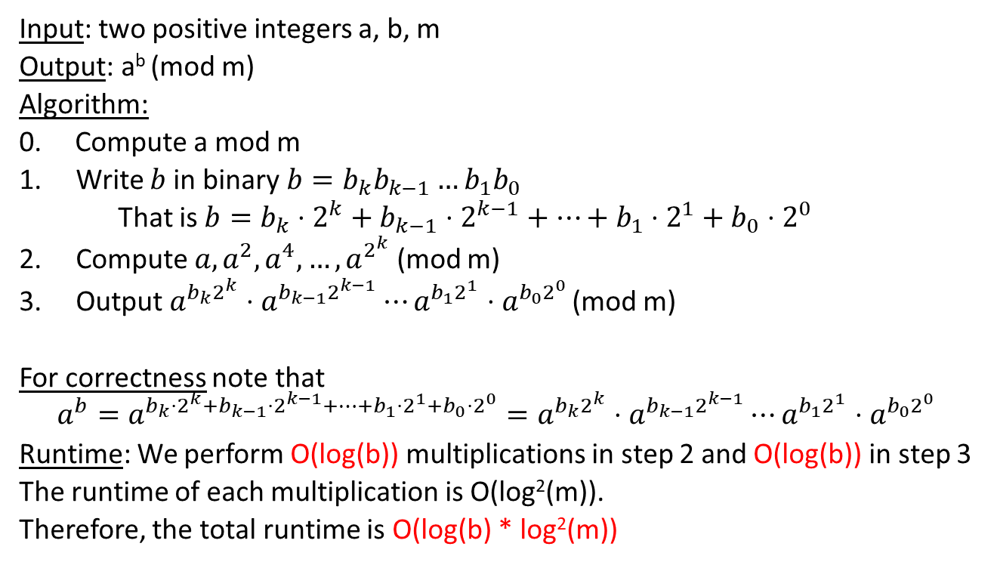
Complexity of Arithmetic: Exponentiation
Input: two positive integers a, b, m
Output: a^{b} (mod m)
Algorithm:
0. Compute a mod m
Write $b$ in binary $b=b_{k}b_{k−1}…b_{1}b_{0}$
That is $b=b_{k}⋅2^{k}+b_{k−1}⋅2^{k−1}+…+b_{1}⋅2^{1}+b_{0}⋅2^{0}$
Compute ${a, a^{2},a^{4},…,a}^{2^{k}}$ (mod m)
Output $a^{b_{k}2^{k}}⋅a^{b_{k−1}2^{k−1}}⋯a^{b_{1}2^{1}}⋅a^{b_{0}2^{0}}$ (mod m)
For correctness note that
$$a^{b}=a^{b_{k}⋅2^{k}+b_{k−1}⋅2^{k−1}+…+b_{1}⋅2^{1}+b_{0}⋅2^{0}}=a^{b_{k}2^{k}}⋅a^{b_{k−1}2^{k−1}}⋯a^{b_{1}2^{1}}⋅a^{b_{0}2^{0}}$$
Runtime: We perform O(log(b)) multiplications in step 2 and O(log(b)) in step 3
The runtime of each multiplication is O(log²(m)).
Therefore, the total runtime is O(log(b) * log²(m))
Example: b = 49
Then k = 4 and b = 11001
If we want to be super precise, computing a mod m takes another O(log(a)*log(m)) time
That’s better than O(b log²(m))

Slide 7
Exponentiation over integers (without mod)
Input: two positive integers a, b
Output: a^{b} (over integers)
Naïve algorithm
result = 1
for i=1…b
result = result * a
return result
Runtime: we perform b multiplications.
In the i'th iteration we are multiplying a^{i-1} by a.
The runtime of the i’th iteration is log(a^{i-1}) * log(a) = (i-1)*(log(a))²
Therefore, the total running time is
(log(a))² + 2(log(a))² + 3(log(a))² + … + (b-1)*(log(a))² = O(b²*log(a)²)
Last time we saw the following:
Can we improve the runtime?

Slide 8
Exponentiation over integers (without mod)
Input: two positive integers a, b
Output: a^{b} (over integers)
Exercise: Suppose that there is an algorithm that given two n-bit numbers computes their product in time O(n^{1.5}).
Design an algorithm that computes a^{b} in time O(b^{1.5} log^{1.5}(a)).
Prove the correctness and the runtime guarantee of the algorithm
Nothing special about 1.5.
Works for any constant < 2

Slide 9
Integer Multiplication in o(n²) time

Slide 10
Integer multiplication in o(n²) time
Input: two positive integers a, b
Output: their product, a*b
Example:
2 | 6
4 | 3
x
+
7
8
1
0
4
1
1
1
8

Slide 11

Integer multiplication in o(n²) time
Input: two positive integers a, b
Output: their product, a*b
Example of an explicit computation:
26*43 = (20+6) * (40+3)
= (2*4) * 100 + (2*3 + 6*4) *10 + (6*3) *1
= 8*100 + 30*10 + 18*1 = 800 + 300 + 18 = 1118
Crazy method:
26*43 = ?
Units = 3*6 = 18
Hundreds = 2*4 = 8
Tens = (2+6)*(4+3) – Unit – Hundreds = 8*7 –18 – 8 = 30
Answer = 8*100 + 30*10 + 18*1 = 1118

Slide 12
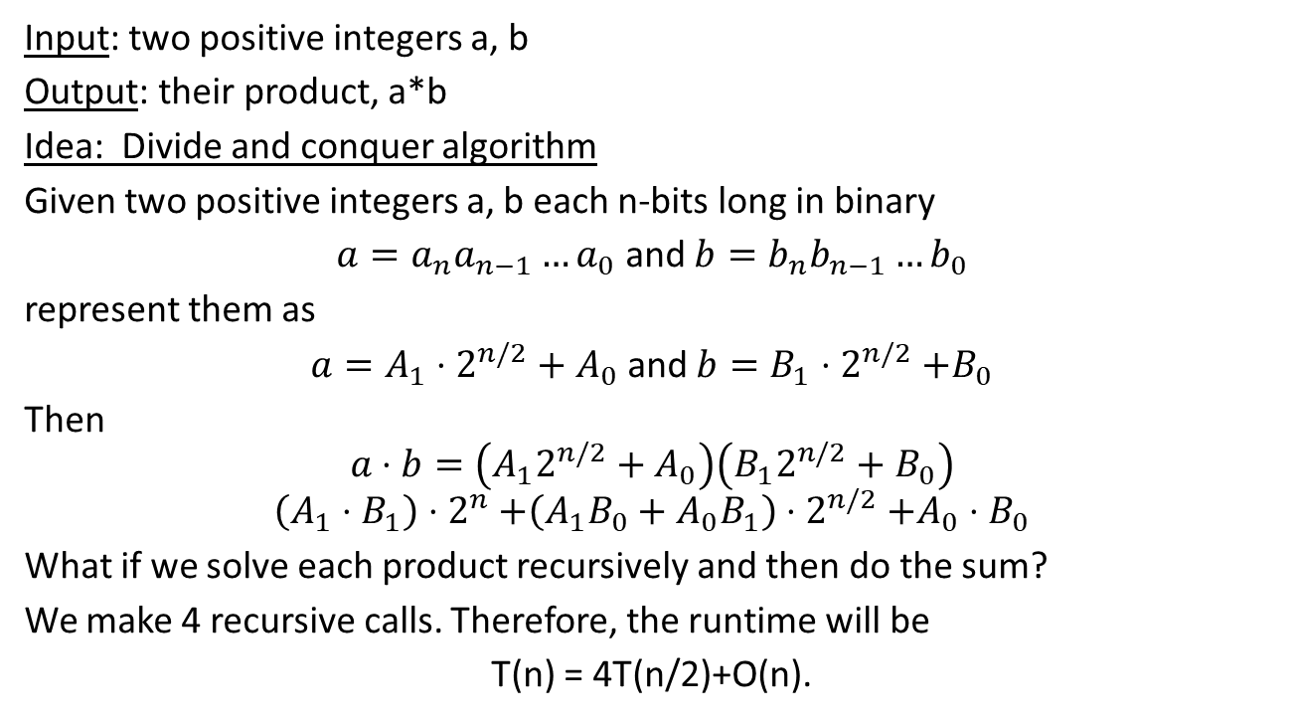
Integer multiplication in o(n²) time
Input: two positive integers a, b
Output: their product, a*b
Idea: Divide and conquer algorithm
Given two positive integers a, b each n-bits long in binary
$a=a_{n}{a_{n−1}…a}_{0}$ and $b=b_{n}{b_{n−1}…b}_{0}$
represent them as
$a=A_{1}⋅2^{n/2}+A_{0}$ and $b=B_{1}{⋅2}^{n/2}+B_{0}$
Then
$$a⋅b=\left(A_{1}2^{n/2}+A_{0}\right)\left(B_{1}2^{n/2}+B_{0}\right)$$
$$\left(A_{1}⋅B_{1}\right){⋅2}^{n}+\left(A_{1}B_{0}+{A_{0}B}_{1}\right){⋅2}^{n/2}+A_{0}{⋅B}_{0}$$
What if we solve each product recursively and then do the sum?
We make 4 recursive calls. Therefore, the runtime will be
T(n) = 4T(n/2)+O(n).
Q: Can we make less than 4 recursive calls?
This gives T(n) = O(n²)

Slide 13
Integer multiplication in o(n²) time
Runtime: Let T(n) be the runtime of the algorithm on inputs of length n.
Then T(n) = 4T(n/2) + O(n).
Claim: T(n) = O(n²)
Proof: by induction on n.

Slide 14
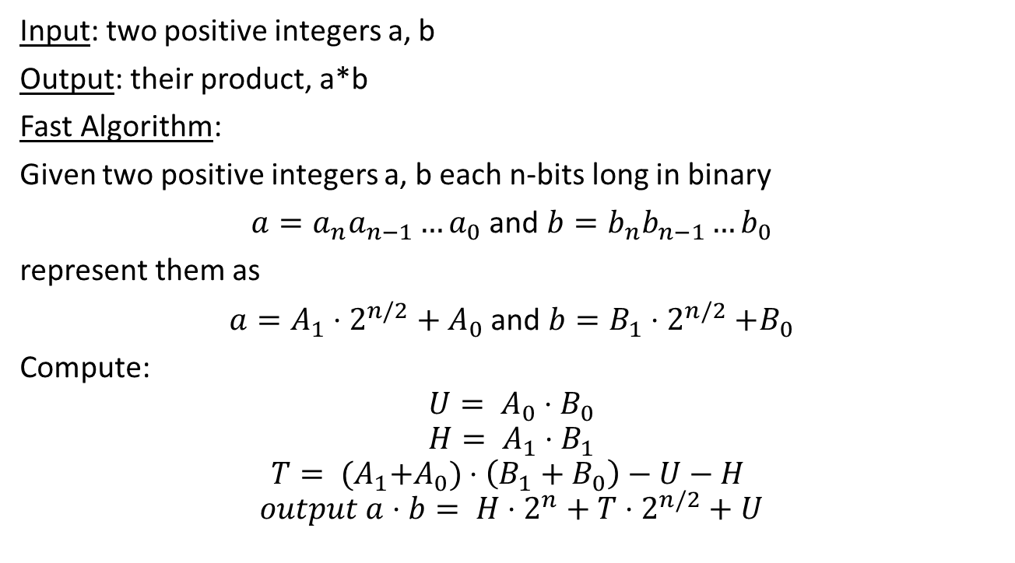
Integer multiplication in o(n²) time
Input: two positive integers a, b
Output: their product, a*b
Fast Algorithm:
Given two positive integers a, b each n-bits long in binary
$a=a_{n}{a_{n−1}…a}_{0}$ and $b=b_{n}{b_{n−1}…b}_{0}$
represent them as
$a=A_{1}⋅2^{n/2}+A_{0}$ and $b=B_{1}{⋅2}^{n/2}+B_{0}$
Compute:
$$U= A_{0}{⋅B}_{0}$$
$$H= A_{1}{⋅B}_{1}$$
$$T= {(A}_{1}+A_{0})⋅\left(B_{1}+B_{0}\right)−U−H$$
$$output a⋅b= {H⋅2}^{n}+T⋅2^{n/2}+U$$
Observe that tens =A₁*B₀+A₀*B₁

Slide 15
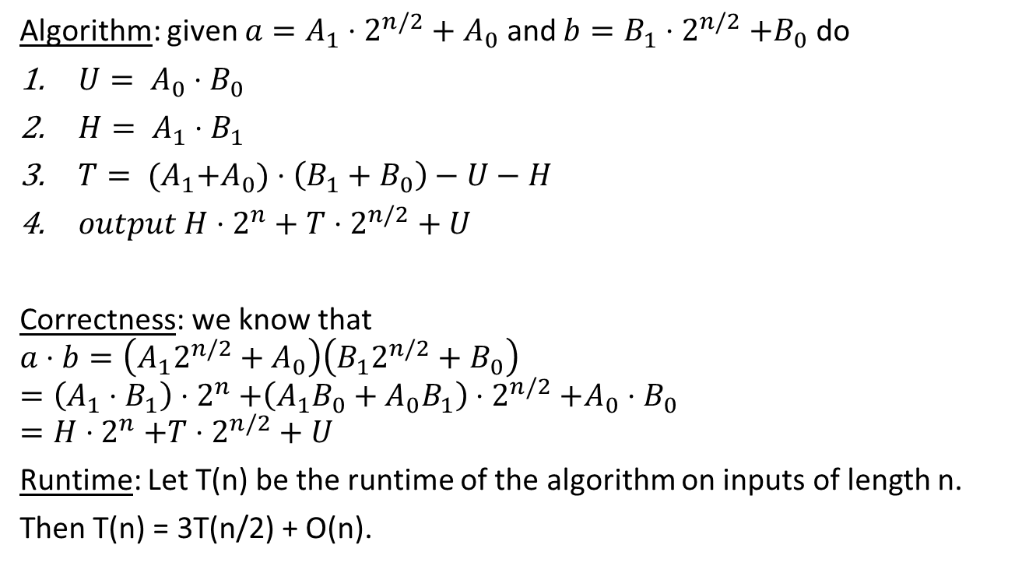
Integer multiplication in o(n²) time
Algorithm: given $a=A_{1}⋅2^{n/2}+A_{0}$ and $b=B_{1}{⋅2}^{n/2}+B_{0}$ do
$U= A_{0}{⋅B}_{0}$
$H= A_{1}{⋅B}_{1}$
$T= {(A}_{1}+A_{0})⋅\left(B_{1}+B_{0}\right)−U−H$
$output {H⋅2}^{n}+T⋅2^{n/2}+U$
Correctness: we know that
$$a⋅b=\left(A_{1}2^{n/2}+A_{0}\right)\left(B_{1}2^{n/2}+B_{0}\right)$$
$$=\left(A_{1}⋅B_{1}\right){⋅2}^{n}+\left(A_{1}B_{0}+{A_{0}B}_{1}\right){⋅2}^{n/2}+A_{0}{⋅B}_{0}$$
$$=H{⋅2}^{n}+T{⋅2}^{n/2}+ U$$
Runtime: Let T(n) be the runtime of the algorithm on inputs of length n.
Then T(n) = 3T(n/2) + O(n).
O(n) time for additions / shifts
+ 3 recursive calls

Slide 16
Integer multiplication in o(n²) time
Runtime: Let T(n) be the runtime of the algorithm on inputs of length n.
Then T(n) = 3T(n/2) + O(n).
Claim: T(n) = O(n^{log2(3)}) = O(n^{1.585})
Proof: by induction on n.

Slide 17
Homework and Reading for next time
Exercises from the Book:
0.1, 0.2
1.2, 1.6, 1.9, 1.10
Reading
Chapters 1.2.3, 1.2.4, 1.2.5, 1.3

