Slide 1
CMPT 706 - Algorithms for Big Data
Solving recursive relations
Euclidean algorithm and RSA encryption
January 23, 2020

Slide 2
Discussion session:
  Tomorrow, Friday Jan 24, 12:00-14:00pm in TASC1 9204 West
Quiz 1- January 30 – first 20 minutes of the class
Assignment 1
  will be out tonight. Due to next week.
  To be submitted to the assignment box in CSIL (in class is also ok)

Slide 3
Missing claims from last time on runtime of recursive functions

Slide 4
On runtime of recursive functions
Let’s try to prove that after applying the recursion i times we get:
T(n) <= 4^{i}*T(n/2^{i})+(2i-1)Cn
Claim : Let T(n) be the runtime of the algorithm on inputs of length n such that T(n) = 4*T(n/2) + O(n) and T(1) = 1. Then T(n) = O(n²)
Proof: By definition, there is some constant C>0 such that for all n we have
T(n) <= 4*T(n/2) + Cn
Let’s try to open up the recursion:
T(n) <= 4*T(n/2) + Cn
[apply recursion on n/2]<= 4*(4*T(n/4) + Cn/2) + Cn
= 4²*T(n/4) + 3Cn
[apply recursion on n/4] <= 4²*(4*T(n/8) + Cn/4) + 3Cn
= 4³*T(n/8) + 7Cn
Do you see the pattern?

Slide 5
On runtime of recursive functions
Claim : Let T(n) be the runtime of the algorithm on inputs of length n such that T(n) = 4*T(n/2) + O(n) and T(1) = 1. Then T(n) = O(n²)
Proof: By definition, there is some constant C>0 such that T(n) <= 4*T(n/2) + Cn for all n.
We prove by induction on i=0,1,…,log₂(n) that T(n) <= 4^{i} T(n/2^{i}) + (2^{i}-1)*Cn.
Base case i=0: trivial – we have T(n) <= T(n)
For the induction step: Suppose that T(n) <= 4^{i} T(n/2^{i}) + (2^{i}-1)*Cn.
Prove it for i+1
T(n) <= 4^{i} *T(n/2^{i}) + (2^{i}-1)*Cn
<= 4^{i} *(4T(n/2^{i+1})+Cn/2^{i}) + (2^{i}-1)*Cn
= 4^{i+1} *T(n/2^{i+1})+4^{i}*Cn/2^{i} + (2^{i}-1)*Cn
=4^{i+1} *T(n/2^{i+1})+2^{i}*Cn + (2^{i}-1)*Cn
=4^{i+1} *T(n/2^{i+1})+(2^{i+1}-1)*Cn
as required.

Slide 6
On runtime of recursive functions
Claim : Let T(n) be the runtime of the algorithm on inputs of length n such that T(n) = 4*T(n/2) + O(n) and T(1) = 1. Then T(n) = O(n²)
Proof: By definition, there is some constant C>0 such that T(n) <= 4*T(n/2) + Cn for all n.
We proved that T(n) <= 4^{i} T(n/2^{i}) + (2^{i}-1)*Cn holds for all i=0,1,…,log₂(n).
Now by taking i=log₂(n) we get
T(n) <= 4^{i} T(n/2^{i}) + (2^{i}-1)*Cn
=4^{log2(n)} *T(1) + (2^{log2(n)}-1)*Cn
=n²*T(1) + (n-1) * Cn = O(n²)

Slide 7
On runtime of recursive functions
Let’s try to prove that after applying the recursion i times we get:
T(n) <= 3^{i}*T(n/2^{i})+(1+1.5+1.5²+..1.5^{i-1})Cn
Runtime: Let T(n) be the runtime of the algorithm on inputs of length n such that T(n) = 3T(n/2) + O(n).
Then T(n) = O(n^{log2(3)}) = O(n^{1.585})
Proof: By definition, there is some constant C>0 such that for all n we have
T(n) <= 3*T(n/2) + Cn
Let’s try to open up the recursion:
T(n) <= 3*T(n/2) + Cn
[apply recursion on n/2]<= 3*(3*T(n/4) + Cn/2) + Cn
= 3²*T(n/4) + (1+3/2)Cn
[apply recursion on n/4] <= 3²*(3*T(n/8) + Cn/4) + (1+3/2)Cn
= 3³*T(n/8) + (1+3/2+3²/2²)Cn
Do you see the pattern?

Slide 8
On runtime of recursive functions
Claim : Let T(n) be the runtime of the algorithm on inputs of length n such that T(n) = 3*T(n/2) + O(n) and T(1) = 1. Then T(n) = O(n^{1.585})
Proof: By definition, there is some constant C>0 such that T(n) <= 3*T(n/2) + Cn for all n.
By induction on i=0,1…,log₂(n) we show T(n) <= 3^{i} T(n/2^{i}) + (1+1.5+1.5²+…+1.5^{i-1})*Cn.
Base case i=0: trivial – we have T(n) <= T(n)
For the induction step: Suppose that T(n) <= 3^{i} T(n/2^{i}) + (1+1.5+1.5²+…+1.5^{i-1})*Cn.
Prove it for i+1
T(n) <= 3^{i} *T(n/2^{i}) + (1+1.5+1.5²+…+1.5^{i-1})*Cn
<= 3^{i} *(3T(n/2^{i+1})+Cn/2^{i}) + (1+1.5+1.5²+…+1.5^{i-1})*Cn
= 3^{i +1}*T(n/2^{i+1}) + (1+1.5+1.5²+…+1.5^{i-1}+1.5^{i})*Cn
as required.

Slide 9
On runtime of recursive functions
Claim : Let T(n) be the runtime of the algorithm on inputs of length n such that T(n) = 3*T(n/2) + O(n) and T(1) = 1. Then T(n) = O(n^{2.585})
Proof: We proved so far that T(n) <= 3^{i} T(n/2^{i}) + (1+1.5+1.5²+…+1.5^{i-1})*Cn.
Let’s plug in i = log₂(n).
We get
T(n) <= 3^{i} T(n/2^{i}) + (1+1.5+1.5²+…+1.5^{i-1})*Cn.
=3^{log2(n)} *T(1) + (1+1.5+1.5²+…+1.5^{i-1})*Cn.
=n^{log2(3)} + O(1.5^{log2(n)})*n
=n^{log2(3)} + O(1.5^{log2(n)})*2^{log2(n)}
=n^{log2(3)} + O(1.5^{log2(n)}*2^{log2(n)})
=O(n^{log2(3)})

Slide 10
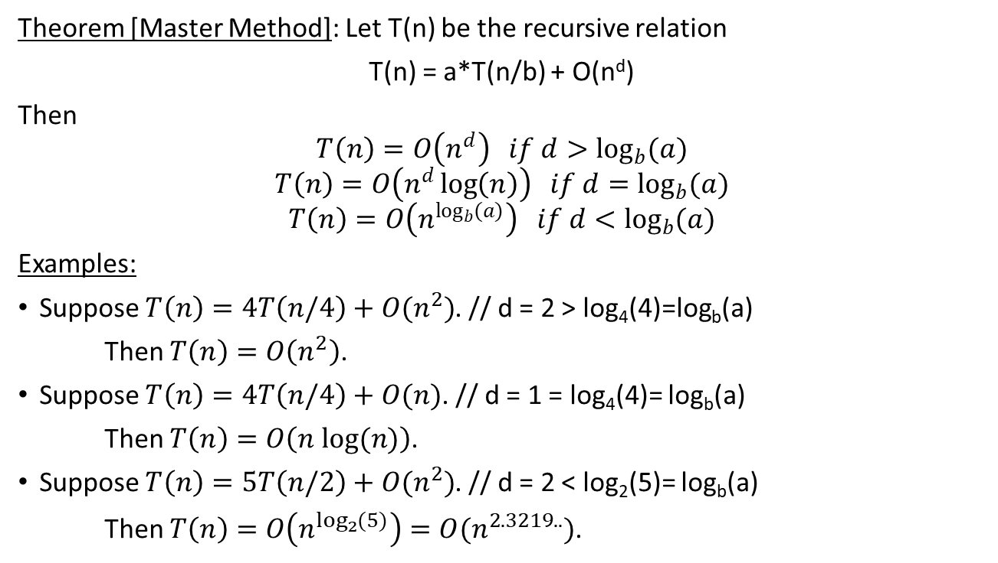
Master Method
Theorem [Master Method]: Let T(n) be the recursive relation
T(n) = a*T(n/b) + O(n^{d})
Then
$$T\left(n\right)=O\left(n^{d}\right) if d>\log_{b}{(a})$$
$$T\left(n\right)=O\left(n^{d}\log\left(n\right)\right) if d=\log_{b}{(a})$$
$$T\left(n\right)=O\left(n^{\log_{b}{(a)}}\right) if d<\log_{b}{(a})$$
Examples:
Suppose $T\left(n\right)=4T\left(n/4\right)+O(n^{2})$. // d = 2 > log₄(4)=log_{b}(a)
Then $T\left(n\right)=O\left(n^{2}\right)$.
Suppose $T\left(n\right)=4T\left(n/4\right)+O(n)$. // d = 1 = log₄(4)= log_{b}(a)
Then $T\left(n\right)=O\left(n log⁡(n)\right)$.
Suppose $T\left(n\right)=5T\left(n/2\right)+O(n^{2})$. // d = 2 < log₂(5)= log_{b}(a)
Then $T\left(n\right)=O\left(n^{\log_{2}{(5)}}\right)=O(n^{2.3219..})$.

Slide 11
Euclidean Algorithm

Slide 12
Greatest common divisor
c is divisible by
both a and b
Let a, b be positive integers.
A positive integer c is said to be a common divisor of a and b if c|a and c|b.
In other words a = 0 (mod c) and b = 0 (mod c)
Example: a = 60, b = 72. Then 1, 2, 3, 4, 6, 12 are common divisors of 60 and 72.
A greatest common divisor of a and b is the largest integer c that both a and b.
Denote the greatest common divisor of a and b by gcd(a,b)
Question: Compute gcd(70, 42).

Slide 13
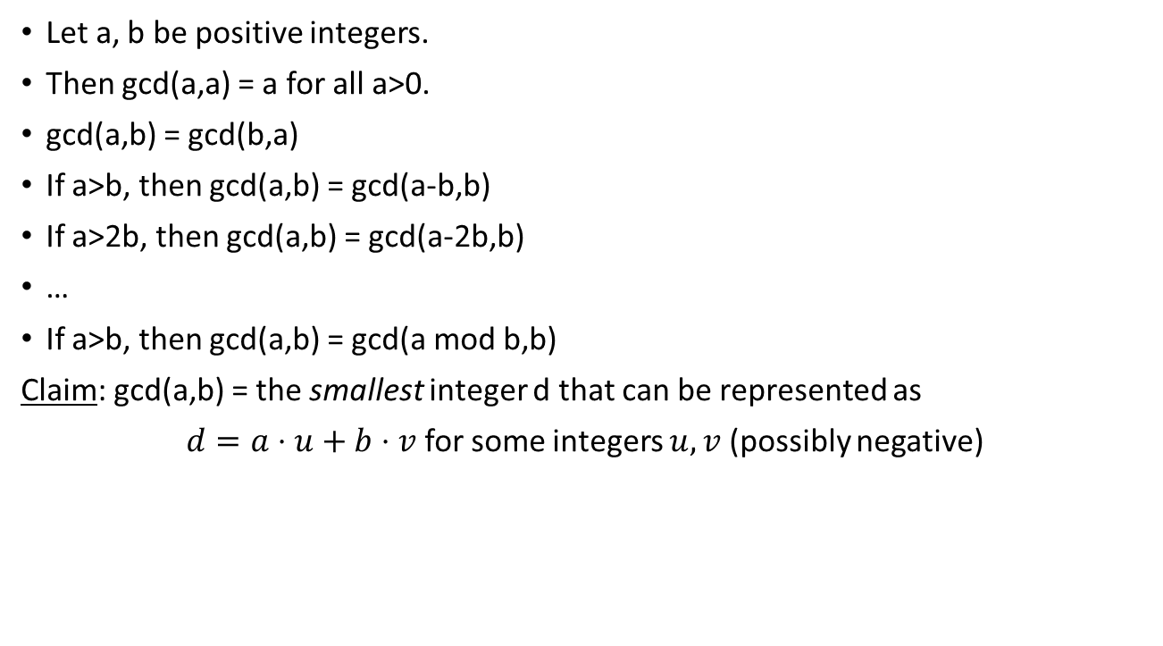
Properties of gcd
Let a, b be positive integers.
Then gcd(a,a) = a for all a>0.
gcd(a,b) = gcd(b,a)
If a>b, then gcd(a,b) = gcd(a-b,b)
If a>2b, then gcd(a,b) = gcd(a-2b,b)
…
If a>b, then gcd(a,b) = gcd(a mod b,b)
Claim: gcd(a,b) = the smallest integer d that can be represented as
$d=a⋅u+b⋅v$ for some integers $u,v$ (possibly negative)

Slide 14
Euclidean Algorithm
Input: two positive integers a >= b
Output: gcd(a,b)
Algorithm: Suppose a >= b (if not, swap them)
if b | a
  return b
else
  return gcd(b, a mod b)
Example:
gcd(42, 70) = gcd(70, 42)
gcd(70, 42) = gcd(42, 70 mod 42) = gcd(42, 28)
gcd(42, 28) = gcd(28, 42 mod 28) = gcd(28, 14)
14 | 28 => Return 14.

Slide 15
Euclidean Algorithm
Input: two positive integers a >= b
Output: gcd(a,b)
Algorithm: Suppose a >= b (if not, swap them)
if b | a
  return b
else
  return gcd(b, a mod b)
Correctness:
If a is divisible by b, then clearly gcd(a,b) = b.
Otherwise, use the property that gcd(a,b) = gcd(a mod b, b)

Slide 16
Euclidean Algorithm
Input: two positive integers a >= b
Output: gcd(a,b)
Algorithm: Suppose a >= b (if not, swap them)
If b | a Return b
Else Return gcd(b, a mod b)
Runtime: Suppose that a>b, and let a’ = a mod b.
If a > 2b, then a’ = a mod b < a/2
Otherwise b < a < 2b – In this case a’ = a-b < a/2 - because a < 2b
This means in both cases a reduces by at least a factor of 2.
Therefore, the total number of iterations is O(log(max(a,b)).
Each iteration takes O(log(a)log(b)).
Therefore the total runtime is O(log³(max(a,b))

Slide 17
Computing inverse mod m

Slide 18
Inverse modulo m
Fix m, and let a be a reside modulo m.
We say that b is the inverse of a modulo m if ab = 1 (mod m).
The inverse of a is denoted by a⁻¹.
Example1: 3 is the inverse of 2 modulo 5. (because 2*3 = 1 mod 5)
Example2: 2 does not have an inverse modulo 4.
Theorem: Fix m, and let a be a reside modulo m. The following are equivalent.
a has an inverse modulo m
a is relatively prime to m, i.e., gcd(a,m) = 1. CAN CHECK USING EUCLIDEAN ALGORITHM
For any b ≠ 0 mod m we have ab ≠ 0 mod m
Example1: 3 has inverse modulo 5 ⬄ gcd(3,5) = 1
Example2: 2 does not have an inverse mod 4 ⬄ gcd(2,4) ≠ 1 ⬄ 2*2 = 0 mod 4

Slide 19

Computing Inverse modulo m
Suppose gcd(a,m) = 1, i.e. a has an inverse. How can we find it?
Claim: gcd(a,m) = 1 if and only if $1=a⋅u+m⋅v$ for some integers $u,v$ (possibly negative)
Therefore, $u=a^{−1}$
How can we find u?

Slide 20
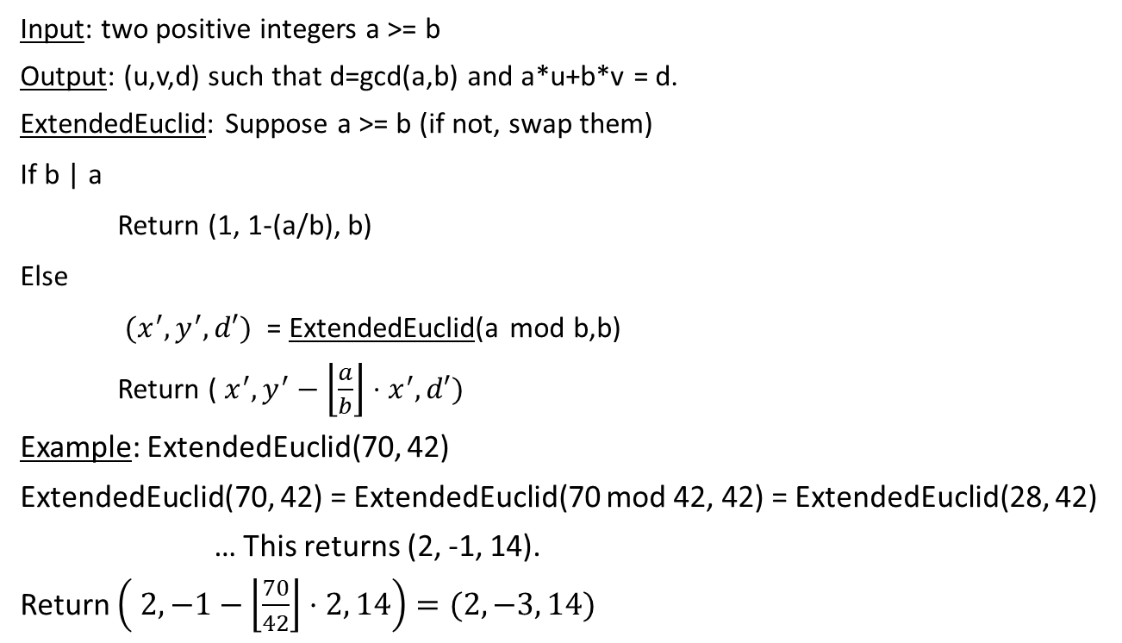
Extended Euclidean Algorithm
Input: two positive integers a >= b
Output: (u,v,d) such that d=gcd(a,b) and a*u+b*v = d.
ExtendedEuclid: Suppose a >= b (if not, swap them)
If b | a
Return (1, 1-(a/b), b)
Else
$(x^{′}, y^{′}, d′)$ = ExtendedEuclid(a mod b,b)
Return ($x^{′},y^{′}−\left\lfloor \frac{a}{b}\right\rfloor ⋅x^{′},d′)$
Example: ExtendedEuclid(70, 42)
ExtendedEuclid(70, 42) = ExtendedEuclid(70 mod 42, 42) = ExtendedEuclid(28, 42)
… This returns (2, -1, 14).
Return $\left( 2, −1−\left\lfloor \frac{70}{42}\right\rfloor ⋅2, 14\right)=(2,−3, 14)$
Indeed, 28*2 + 42*(-1) = 14
Indeed, 70*2 + 42*(-3) = 14

Slide 21
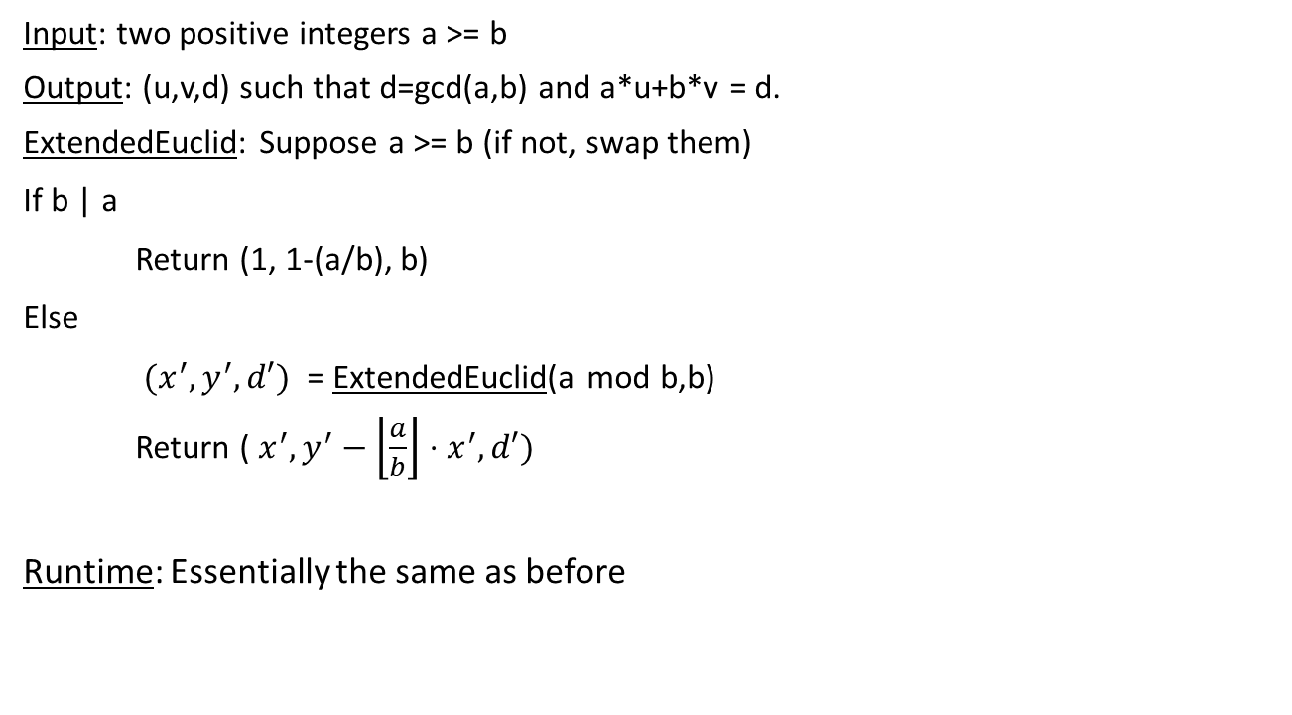
Extended Euclidean Algorithm
Input: two positive integers a >= b
Output: (u,v,d) such that d=gcd(a,b) and a*u+b*v = d.
ExtendedEuclid: Suppose a >= b (if not, swap them)
If b | a
Return (1, 1-(a/b), b)
Else
$(x^{′}, y^{′}, d′)$ = ExtendedEuclid(a mod b,b)
Return ($x^{′}, y^{′}−\left\lfloor \frac{a}{b}\right\rfloor ⋅x^{′},d′)$
Runtime: Essentially the same as before

Slide 22
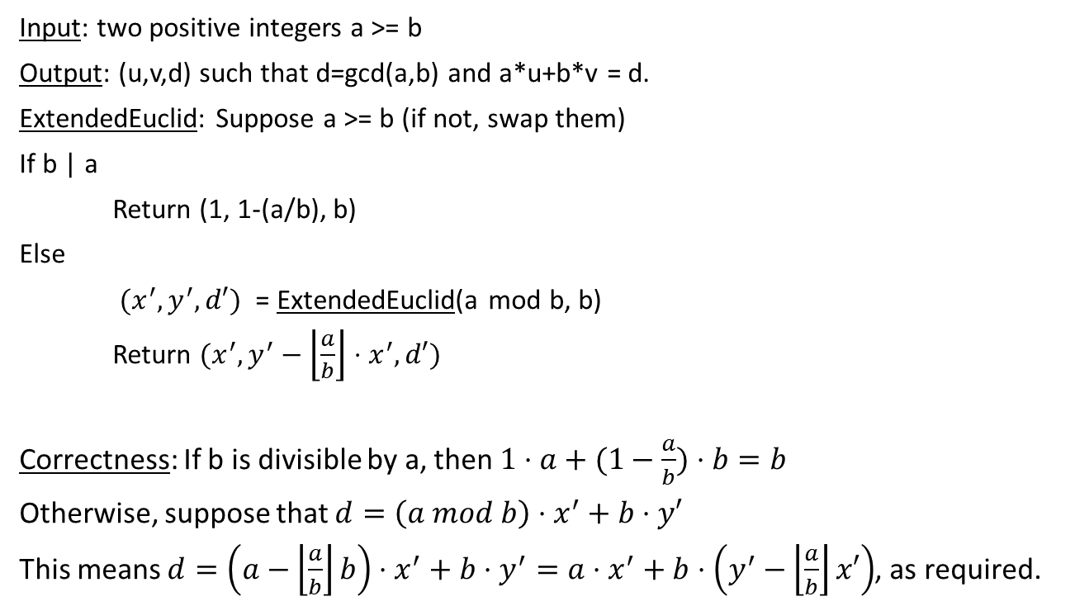
Extended Euclidean Algorithm
Input: two positive integers a >= b
Output: (u,v,d) such that d=gcd(a,b) and a*u+b*v = d.
ExtendedEuclid: Suppose a >= b (if not, swap them)
If b | a
Return (1, 1-(a/b), b)
Else
$(x^{′}, y^{′}, d′)$ = ExtendedEuclid(a mod b, b)
Return $(x^{′},y^{′}−\left\lfloor \frac{a}{b}\right\rfloor ⋅x^{′}, d′)$
Correctness: If b is divisible by a, then $1⋅a+(1−\frac{a}{b})⋅b=b$
Otherwise, suppose that $d=\left(a mod b\right)⋅x^{′}+b⋅y′$
This means $d=\left(a−\left\lfloor \frac{a}{b}\right\rfloor b\right)⋅x^{′}+b⋅y^{′}=a⋅x^{′}+b⋅\left(y^{′}−\left\lfloor \frac{a}{b}\right\rfloor x′\right)$, as required.

Slide 23
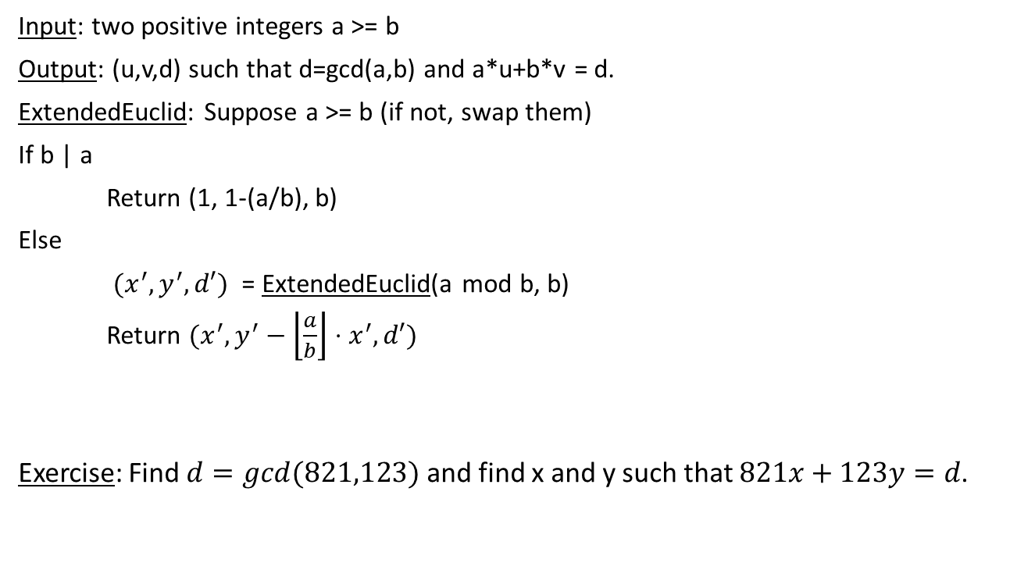
Extended Euclidean Algorithm
Input: two positive integers a >= b
Output: (u,v,d) such that d=gcd(a,b) and a*u+b*v = d.
ExtendedEuclid: Suppose a >= b (if not, swap them)
If b | a
Return (1, 1-(a/b), b)
Else
$(x^{′}, y^{′}, d′)$ = ExtendedEuclid(a mod b, b)
Return $(x^{′},y^{′}−\left\lfloor \frac{a}{b}\right\rfloor ⋅x^{′}, d′)$
Exercise: Find $d=gcd⁡(821,123)$ and find x and y such that $821x+123y=d$.

Slide 24
Public Key Cryptography
RSA Cryptosystem

Slide 25
Public Key Cryptography
Cryptosystems are used to encode messages so that only the intended recipients can understand them (even if the message read by the enemy)
Symmetric cryptosystems, such as Caesar cipher, use the same key for encryption and decryption; it is secret, and if one knows the key he knows everything.
Example of Caesar cipher:
Ciphertext: efgfoe uif fbtu xbmm pg uif dbtumf
Can you decrypt it?

Slide 26
Public Key Cryptography
Public key cryptosystems use a different approach
Such a system uses different keys for encryption and decryption:
Every person has a key for encryption, and can write an encrypted message
But this does not help to decrypt the message

Slide 27
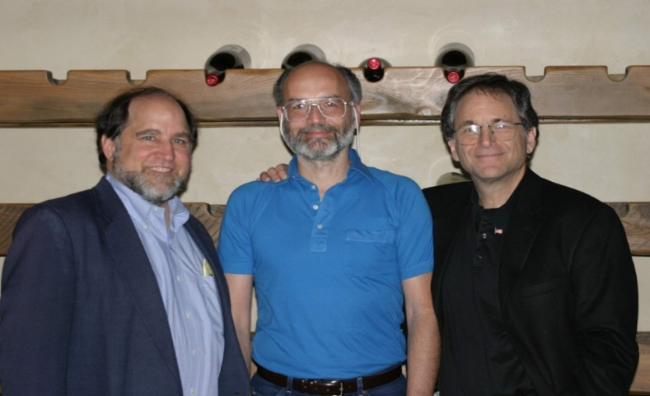
RSA
RSA stands for the names of the inventors: Rivest, Shamir, Adleman
RSA keys: a modulus n = p*q, where p and q are large prime numbers.
Current standards are 128, 256, or 512 digits
Public key is the pair (n,e) where
n (but p and q are secret)
an exponent e a residue mod (p – 1)(q – 1) such that gcd(e, (p – 1)(q – 1)) = 1
From left to right:
Ron Rivest
Adi Shamir
Len Adleman

Slide 28
RSA
Public key is the pair (n,e) where
n (but p and q are secret)
an exponent e a residue mod (p – 1)(q – 1) such that gcd(e, (p – 1)(q – 1)) = 1.
Secret key is: (p,q,d) where
(p, q) – the factoring of n
d – the inverse of e mod (p-1)(q-1)
Encryption scheme: Given a message M consider it as a number modulo n.
The cyphertext is Me (mod n)
Decryption scheme: Given a cyphertex C – as a number modulo n
Compute C^{d} (mod n)
Can be computed in time O(log³(n))
Can be computed in time O(log³(n)) if d is known
We don’t know how to to it only from public key

Slide 29
RSA
Example:
p = 43, q = 59 – HUGE SECRET!
n = 43*59 = 2537 – PUBLIC
e = 13 – PUBLIC
Encrypt the word “STOP”
Translate STOP to numbers: S = 18, T = 19, O = 14, P = 15
M = 1819 1415 (each of the two numbers is modulo 2537
Encryption:
C₁ = 1819¹³ = 2081 (mod n)
C₂ = 1415¹³ = 2182 (mod n)
The encrypted message is 2081 2182
Note: gcd(13, 42*58) = 1
(because 13 is prime
and 42, 58 are not divisible by 13)

Slide 30
RSA
Note: gcd(13, 42*58) = 1
(because 13 is prime
and 42, 58 are not divisible by 13)
Example:
p = 43, q = 59 – HUGE SECRET!
n = 43*59 = 2537 – PUBLIC
e = 13 – PUBLIC d = 937 – HUGE SECRET
Encrypt the word “STOP”
Translate STOP to numbers: S = 18, T = 19, O = 14, P = 15
M = 1819 1415 (each of the two numbers is modulo 2537
Encryption:
C₁ = 1819¹³ = 2081 (mod n), C₂ = 1415¹³ = 2182 (mod n)
The encrypted message is 2081 2182
To decrypt: compute 2081^{d} = 1819 (mod n) and 2182^{d} = 1415 (mod n)
You can check that d*e = 1 mod (p-1)(q-1)

Slide 31
RSA – Why does it work?
Fix n = pq
Let e be relatively prime to (p-1)(q-1), and let d = e⁻¹ mod (p-1)(q-1).
Let M be some message modulo n
We want to show that if we take C = Me, and then C^{d}, we get back our message.
Claim: C^{d} – M = (Me)^{d}-M=0 mod n
Proof: It suffices to prove that (1) M^{ed} – M = 0 (mod p) and (2) M^{ed} – M = 0 (mod q)
Let’s prove it only for p. For q it’s the same.
Since e*d = 1 mod (p-1)(q-1) we get that e*d = 1 + k*(p-1) for some integer k.
Therefore, M^{ed} –M = M^{1+k(p-1)} – M.
Therefore, M^{ed} - M = M^{1+k(p-1)} - M= M * (M^{(p-1)})^{k} – M = 0 mod n.
Fermat’s Little Theorem: If p is a prime and M≠0 mod p, then M^{p-1} = 1 mod p.
Q: What if M = 0 mod p?

Slide 32
RSA – Why is it secure?
The security comes from the fact that we don’t know how to find an inverse mod n without knowing p and q.
Exercise: Suppose we know p and q. Using the Extended Euclidean algorithm to find inverse of any exponent e.
In order to RSA to be secure, we need to guarantee that factoring n cannot be done efficiently. Thus n is a product of 2 large primes (each 256 or 512 bits long).

Slide 33
Homework and Reading for next time
Exercises from the Book:
1.11, 1.13, 1.18, 1.20, 1.21, 1.22, 1.24, 1.27
Reading
Chapters 1.3, 1.5, 2.3, 2.4

