Slide 1
CMPT 706 - Algorithms for Big Data
Graphs
February 11, 2020

Slide 2
Graphs

Slide 3
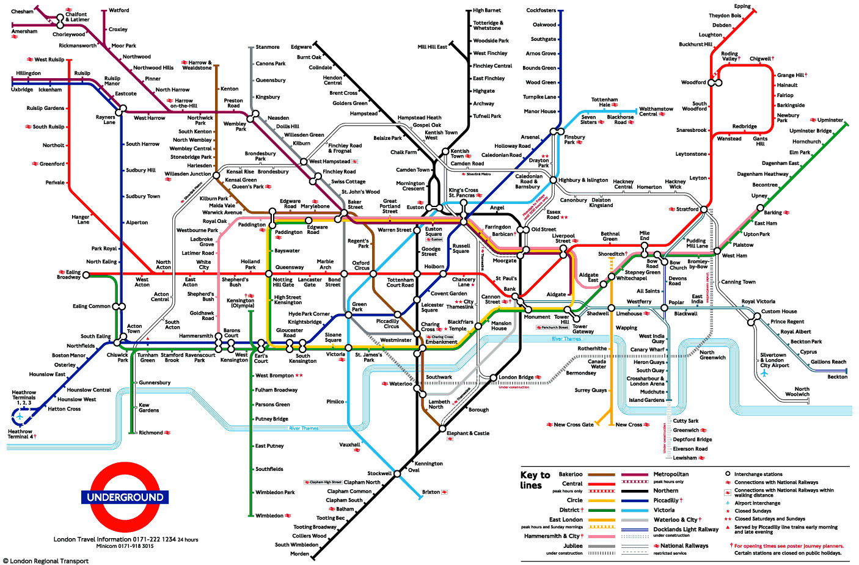
Graphs
Often we are interested in relations/connections between objects.

Slide 4
Graphs
A graph 𝐺=(𝑉,𝐸) consists of:
- a nonempty set of vertices (or nodes) denoted by V,
- and a set of edges (or arcs), denote by E.
Each edge is an unordered pair or vertices, called its endpoints. An edge is said to connect its endpoints.
Such a graph is also called undirected.

Slide 5
Graphs
A directed graph 𝐺=(𝑉,𝐸) consists of:
- a nonempty set of vertices (or nodes) denoted by V,
- and a set of directed edges (or arcs), denote by E.
Each edge is an ordered pair or vertices, called its endpoints. An edge is said to connect its endpoints.

Slide 6
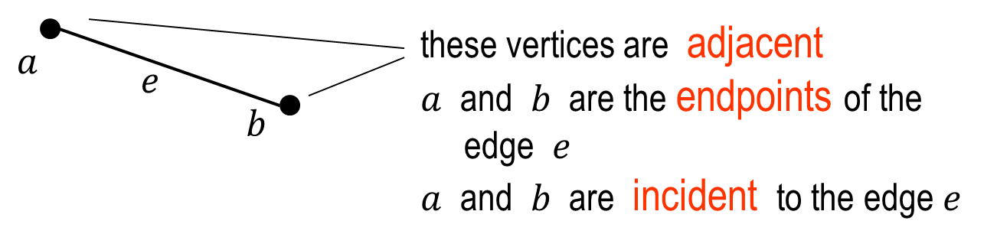
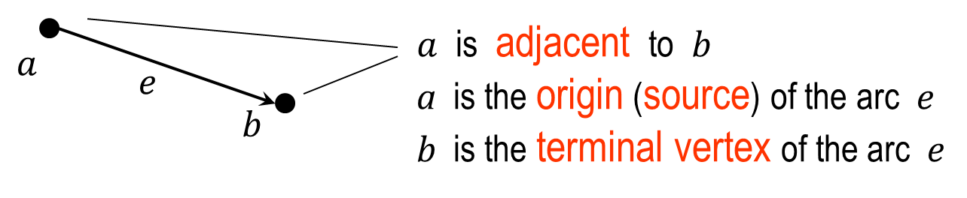
Graphs

Slide 7
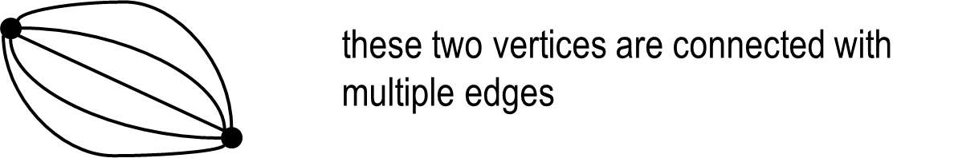
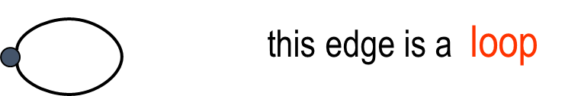
Graphs
A simple graph is a graph with no loops and parallel edges.

Slide 8
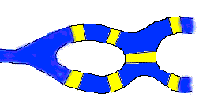
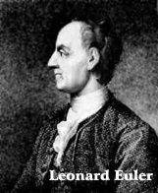
Graphs
In the downtown of Konigsberg (previously in Prussia) there are seven bridges across the river Pregel and islands
Question: Is there a walk that uses every bridge exactly once and returns to the origin?
Leonard Euler solved this problem in 1736; starting graph theory

Slide 9
Degree of a vertex
Degree of a vertex is in a simple undirected graph is the number of edges incident with it.
Example: deg(a) = 2, deg(b) = 4, deg(g) = 0…
A vertex of degree 0 is called isolated. g is isolated.
b
c
d
p
q
r
s
a
f
e
g
t

Slide 10
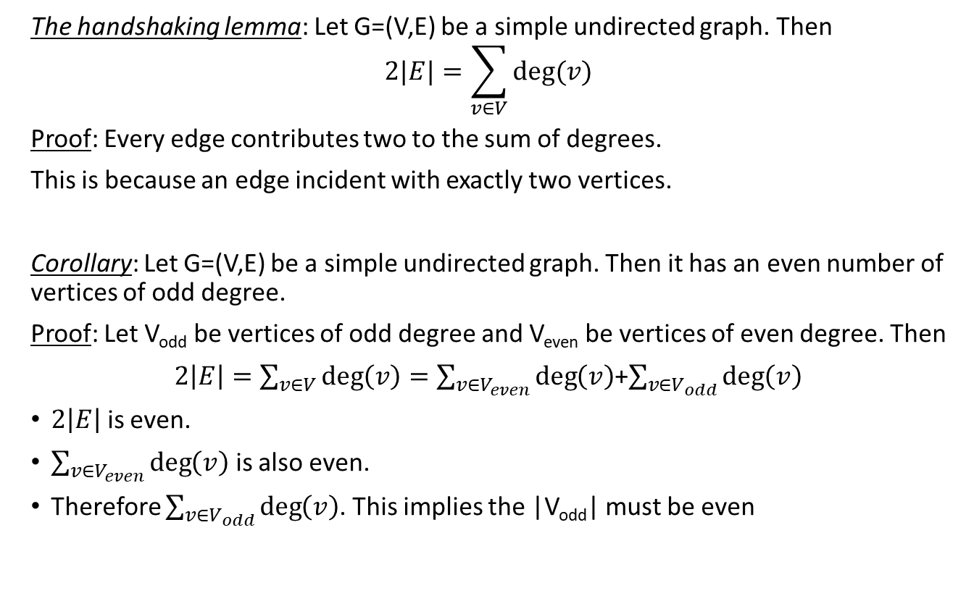
Degree of a vertex
The handshaking lemma: Let G=(V,E) be a simple undirected graph. Then
$$2|E|=\sum_{v∈V}{deg⁡(v)}$$
Proof: Every edge contributes two to the sum of degrees.
This is because an edge incident with exactly two vertices.
Corollary: Let G=(V,E) be a simple undirected graph. Then it has an even number of vertices of odd degree.
Proof: Let V_{odd} be vertices of odd degree and V_{even} be vertices of even degree. Then
$2\left|E\right|=\sum_{v∈V}{\deg\left(v\right)}=\sum_{v∈V_{even}}{\deg\left(v\right)}$+$\sum_{v∈V_{odd}}{\deg\left(v\right)}$
$2\left|E\right|$ is even.
$\sum_{v∈V_{even}}{\deg\left(v\right)}$ is also even.
Therefore $\sum_{v∈V_{odd}}{\deg\left(v\right)}$. This implies the |V_{odd}| must be even

Slide 11
A Walk in a graph
Fix a graph 𝐺=(𝑉,𝐸). Let u, v be two (not necessarily distinct) vertices in an undirected graph.
A 𝑢-𝑣 walk in 𝐺 is a finite sequence 𝑢=𝑢₀, 𝑒₁, 𝑢₁, 𝑒₂, 𝑢₂, 𝑒₃,…, 𝑒_{𝑛−1}, 𝑢_{𝑛−1}, 𝑒_{𝑛}, 𝑢_{𝑛}=𝑣
of vertices and edges from 𝐺, starting at vertex 𝑢 and ending at vertex 𝑣 and involving the 𝑛 edges 𝑒_{𝑖}=(𝑢_{𝑖−1}, 𝑢_{𝑖}).
The length of this walk is the number of edges in the walk.
A walk is said to be closed if it starts and ends with the same vertex.

Slide 12
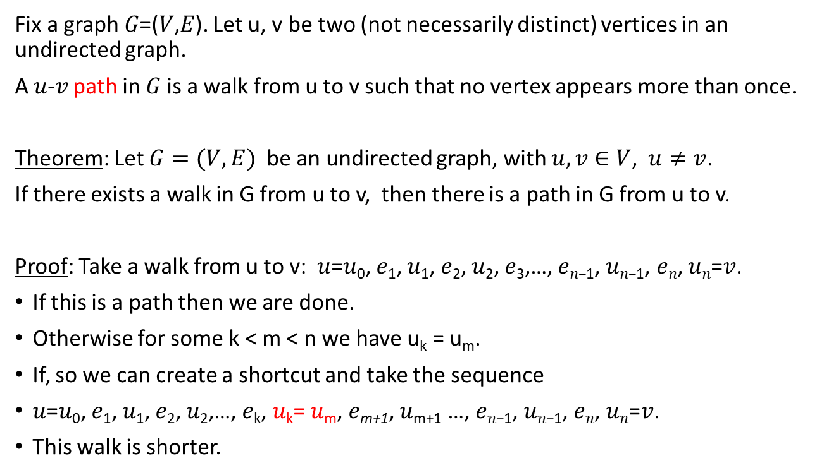
A path in a graph
We can repeat the argument:
Either (1) we already have a path or (2) we can make the walk shorted.
But we cannot continue this forever,
hence we will reach a path at some point.
Fix a graph 𝐺=(𝑉,𝐸). Let u, v be two (not necessarily distinct) vertices in an undirected graph.
A 𝑢-𝑣 path in 𝐺 is a walk from u to v such that no vertex appears more than once.
Theorem: Let $G=(V,E)$ be an undirected graph, with $u,v∈V$, $u≠v$.
If there exists a walk in G from u to v, then there is a path in G from u to v.
Proof: Take a walk from u to v: 𝑢=𝑢₀, 𝑒₁, 𝑢₁, 𝑒₂, 𝑢₂, 𝑒₃,…, 𝑒_{𝑛−1}, 𝑢_{𝑛−1}, 𝑒_{𝑛}, 𝑢_{𝑛}=𝑣.
If this is a path then we are done.
Otherwise for some k < m < n we have u_{k} = u_{m}.
If, so we can create a shortcut and take the sequence
𝑢=𝑢₀, 𝑒₁, 𝑢₁, 𝑒₂, 𝑢₂,…, 𝑒_{k}, 𝑢_{k}= 𝑢_{m}, 𝑒_{m+1}, 𝑢_{m+1} …, 𝑒_{𝑛−1}, 𝑢_{𝑛−1}, 𝑒_{𝑛}, 𝑢_{𝑛}=𝑣.
This walk is shorter.

Slide 13
Connected components
An undirected graph G=(V,E) is said to be connected if there is a path between any two vertices in G.
If a graph is not connected we may consider its connected components:
A connected component W is a subset of vertices such that there is a path between any two vertices in W
The graph has three connected components:
{a,b,c,d,e,f}
{g}
{p,q,r,s,t}
b
c
d
p
q
r
s
a
f
e
g
t

Slide 14
Some special graphs
Complete graphs: A complete graph on n vertices, denoted by K_{n}.
It is the graph that has an edge between every two vertices.
Q: How many edges are there in K^{n}?

Slide 15
Some special graphs
Cycles graphs: A cycle graph on n vertices, denoted by C_{n}.
Q: How many edges are there in K^{n}?

Slide 16
Representation of Graphs
Lists of Vertices and Edges:
b
c
d
V = {a, b, c, d, e, f, e, g}
E = { ab, bc, af, bf, fc, be, fe, ce, cd }
a
f
e
g
b
c
d
V = {a, b, c, d, e, f, g}
E = { (b,a), (c,b), (f,a), (b,f), (c,f), (e,b), (c,e), (d,c) }
a
f
e
g

Slide 17
Representation of Graphs
Adjacency List:
vert. | neighbours | vert. | neighbours
a | b, f | e | c, b, f
b | a, f, e, c | f | a, b, c, e
c | b, d, e, f | g
d | c
b
c
d
a
f
e
g
b
c
d
vert. | neighbours | vert. | neighbours
a |  | e | b, f
b | a, f | f | a
c | b, e, f | g
d | c
a
f
e
g

Slide 18
Representation of Graphs
Adjacency Matrix:
b
c
d
a
f
e
g
b
c
d
a
f
e
g

Slide 19
Representation of Graphs
Ex: Draw a graphs whose adjacency matrices are:
Ex: What is the adjacency matrix of K_{n}?
Ex: What is the adjacency matrix of C_{n}?

Slide 20
Subgraphs
Sometimes we need only a part of a big graph.
A subgraph of a graph G=(V,E) is a graph H=(W,F), where 𝑊⊆𝑉 and 𝐹⊆𝐸 such that for each edge in F it endpoints are in W.
G
H

Slide 21

Subgraphs
Let $G=(V,E)$ be a graph and $W⊆V$ a nonempty set of vertices.
The subgraph of G induced by W is the subgraph whose vertex set is W and which contains all edges (from G) with endpoints in W.
A subgraph H of a graph $G=(V,E)$ is called an induced subgraph if there is $W⊆V$ such that H is the subgraph induced by W.
b
c
W = {a,b,c,e}:
b
c
a
f
e
a
e

Slide 22

Bipartite Graphs
A simple graph G is bipartite if its vertex set V can be partitioned into two disjoint sets $V_{1}$ and $V_{2}$ such that every edge in the graph connects a vertex in $V_{1}$ and a vertex in $V_{2}$.
We call the pair $V_{1},V_{2}$ a bipartition of the vertex set V of G.

Slide 23
Complete Bipartite Graphs
The complete bipartite graph K_{m,n} is the graph that has its vertex set partitioned into two subsets of m and n vertices.
There is an edge between two vertices if and only if one vertex is in the first subset and the other vertex is in the second subset.

Slide 24
More on Bipartite Graphs
Theorem: For a graph G=(V,E) the following are equivalent:
G is bipartite
G does not contain an odd cycle
it is possible to color each vertex of G in one of two different colors so that no two adjacent vertices are colored the same color.

Slide 25
Homework and Reading for next time
Exercises from the Book:
---
Reading
3.1, 3.2, 3.3, 3.4

