Slide 1
CMPT 706 - Algorithms for Big Data
Graphs
March 5, 2020

Slide 2
Minimum Spanning Trees

Slide 3
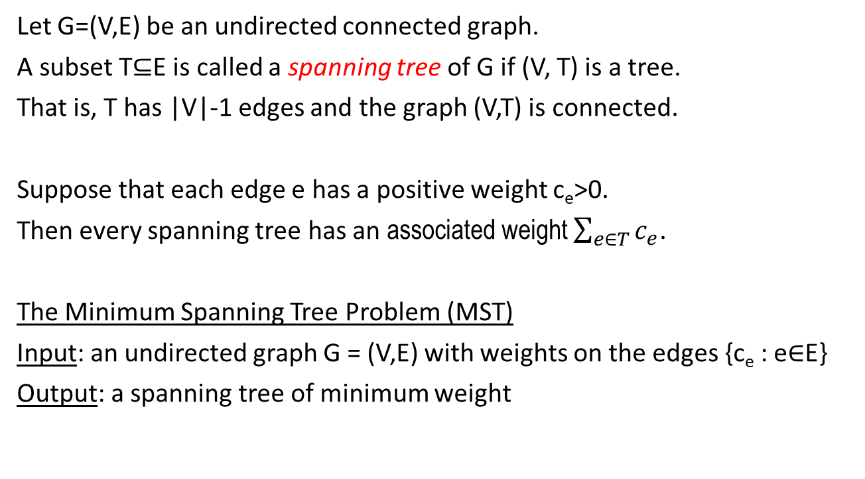
Minimum Spanning Tree (MST)
Let G=(V,E) be an undirected connected graph.
A subset T⊆E is called a spanning tree of G if (V, T) is a tree.
That is, T has |V|-1 edges and the graph (V,T) is connected.
Suppose that each edge e has a positive weight c_{e}>0.
Then every spanning tree has an associated weight $\sum_{e∈T}{c_{e}}$.
The Minimum Spanning Tree Problem (MST)
Input: an undirected graph G = (V,E) with weights on the edges {c_{e} : e∈E}
Output: a spanning tree of minimum weight

Slide 4
Minimum Spanning Tree (MST)
a
a
2
1
MST:
2
1
b
3
c
b
c
1
2
1
3
8
2
3
5
d
e
f
d
e
3
f
2
1
1
g
7
h
g
h

Slide 5
Kruskal’s Algorithm
Input: an undirected graph G = (V,E) with weights on the edges {c_{e} : e∈E}
Output: a spanning tree of minimum weight
Set T = empty set
While |T| < |V|-1 do
Pick an edge e∈E\T with minimum weight such that T∪{e} does not contain a cycle.
Add e to T

Slide 6
Kruskal’s Algorithm - example
a
a
2
1
MST:
2
1
b
3
c
b
c
1
2
1
3
8
2
3
5
d
e
f
d
e
3
f
2
1
1
g
7
h
g
h

Slide 7
Kruskal’s Algorithm: Runtime
Runtime: Suppose G has n vertices and m edges.
Straightforward analysis: We add n-1 edges, each time looking for the lightest edge that does not close a cycle.
Kruskal’s algorithm runs in time at most < n * m * O(m+n) = O(m²n)
An improvement: first sort the edges, and in each check the next edge.
Runtime: O(m log(m)) + n * O(m+n) = O(mn)
Using a good data structure that efficiently stores connected components we can construct a MST in time O(m log(n)).
Q: What do we need from our data structure?

Slide 8
Data structure for disjoint sets
To work efficiently Kruskal’s algorithm requires a data structure to store the collection of connected components of a graph and merge then when necessary.
More precisely, the data structure has to support the following operations:
makeset(x) - create a singleton set containing just x.
find(x) - returns a label of the set containing x.
union(x,y) - merge the sets containing x and y.
Find(x) – returns some element contained in the set/CC together with s.
If x and y are in the same set/CC, then find returns the same element.

Slide 9
Kruskal’s Algorithm
To avoid searching for an edge of minimum weight, sort the edges in the beginning of the algorithm.
If T is the current set of selected edges, the data structure contains the collection of connected components of (V, T).
To check whether edge (v,w) forms a cycle just check if find(v) = find(w)
Follow the sorted list of edges:
Every time if an edge (v,w) closes a cycle, remove it from the list.
If it does not,
Apply union(v,w) - merge the sets containing v and w
Remove the edge from the list.

Slide 10
Kruskal’s Algorithm
Input: an undirected graph G = (V,E) with weights on the edges {c_{e} : e ∈ E}
Output: a spanning tree of minimum weight
Sort edges according to c_{e} in a list
For each vertex v ∈ V
makeset(v)
Set T = empty set
While |T| < |V|-1 do
Pick the first edge e = (u,v) in the list
If find(u) ≠ find (v) Add e to T
union(u,v)
Remove (u,v) from the list // continue to the next edge

Slide 11
A Data Structure for Disjoint Sets

Slide 12
A Data Structure for Disjoint Sets
Represent every set as a tree:
Equip every element of the set with a pointer to the predecessor.
Label of the set will be its root.
Also we define the rank of vertices, which is (for now) the height of the subtree rooted at the vertex in the data structure.
makeset(𝑣):
set 𝜋(𝑣)=𝑣
set rank(𝑣)=0
find(𝑣):
while 𝜋(𝑣)≠𝑣 do
𝑣=𝜋(𝑣)
return 𝑣
The runtime of find is O(depth of tree)

Slide 13
A Data Structure for Disjoint Sets
a
b
d
c
e
f
g
h
i
j
a
d
b
e
f
g
c
h
i
j
d
a
b
e
f
g
c
h
i
j

Slide 14
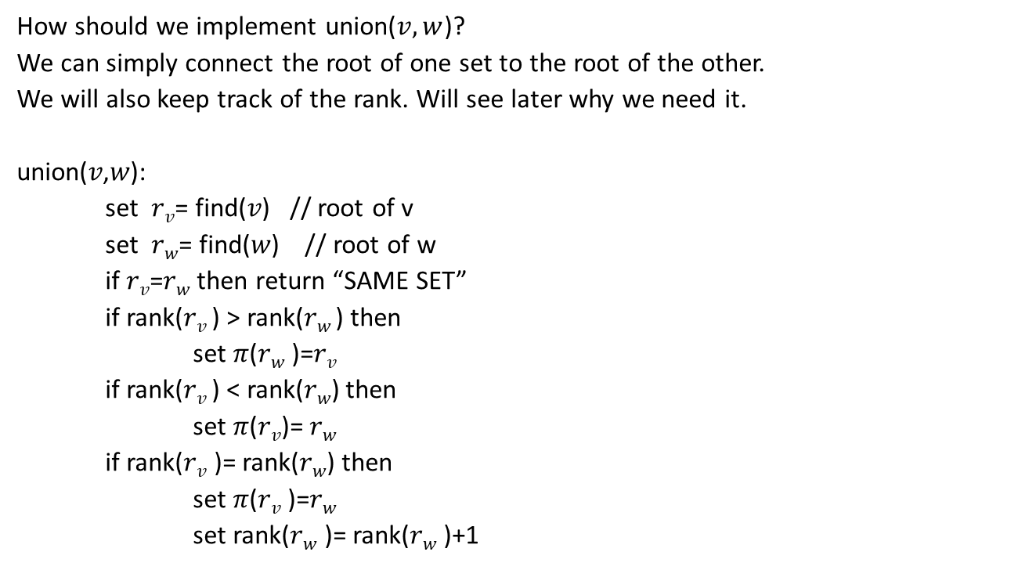
A Data Structure for Disjoint Sets
How should we implement union($v,w$)?
We can simply connect the root of one set to the root of the other.
We will also keep track of the rank. Will see later why we need it.
union(𝑣,𝑤):
set 𝑟_{𝑣}= find(𝑣) // root of v
set 𝑟_{𝑤}= find(𝑤) // root of w
if 𝑟_{𝑣}=𝑟_{𝑤} then return “SAME SET”
if rank(𝑟_{𝑣} ) > rank(𝑟_{𝑤} ) then
set 𝜋(𝑟_{𝑤} )=𝑟_{𝑣}
if rank(𝑟_{𝑣} ) < rank(𝑟_{𝑤}) then
set 𝜋(𝑟_{𝑣})= 𝑟_{𝑤}
if rank(𝑟_{𝑣} )= rank(𝑟_{𝑤}) then
set 𝜋(𝑟_{𝑣} )=𝑟_{𝑤}
set rank(𝑟_{𝑤} )= rank(𝑟_{𝑤} )+1

Slide 15
A Data Structure for Disjoint Sets
a
b
d
c
e
f
g
h
i
j
a
d
b
e
f
g
c
h
i
j
d
a
b
e
f
g
c
h
i
j

Slide 16
A Data Structure for Disjoint Sets
Property 1: For any 𝑣 (except a root) rank(𝑣) < rank(𝜋(𝑣))
Property 2: Any vertex of rank k has at least 2^{k} vertices in the subtree rooted at that vertex.
This is by induction:
If in the union(𝑣, 𝑤) we had rank(𝑣) > rank(𝑤), then the ranks don’t change, but the number of vertices under 𝑣 increases.
Same for rank(𝑣) < rank(𝑤)
If in the union(𝑣, 𝑤) we had rank(𝑣) = rank(𝑤), then both subtrees had at least 2^{k} vertices by induction. So merging will give at least 2^{k+1} vertices.
Property 2’: Therefore, if there are n vertices, then maximal rank=depth is at most log₂(n). Therefore, find and union run in O(log(n)) time.

Slide 17
Kruskal’s Algorithm
Input: an undirected graph G = (V,E) with weights on the edges {c_{e} : e ∈ E}
Output: a spanning tree of minimum weight
Sort edges according to c_{e} in a list
For each vertex v ∈ V
makeset(v)
Set T = empty set
While |T| < |V|-1 do
Pick the first edge e = (u,v) in the list
If find(u) ≠ find (v) union(u,v)
Add e to T
Remove (u,v) from the list // continue to the next edge

Slide 18
Kruskal’s Algorithm: Runtime
Runtime: Suppose G has n vertices and m edges.
Sorting the edges takes O(m log(m)) time.
Note that log(m) < 2 log(n). Therefore Sorting takes O(m log(n)) time.
Then we have m iterations and in each iteration the runtime is O(log(n))
Therefore, the total runtime is O(m log(n)).

Slide 19
A Better Data Structure for Disjoint Sets
It is possible to improve the data structure even more efficient:
Idea:
makeset(𝑣):
Set rank(𝑣)=0
Set root(𝑣)=𝑣
find(𝑣):
if root(𝑣)≠𝑣
Set root(𝑣) = find(root(𝑣)) // recursive call
return root(𝑣)
Fact: Using this implementation improves the run time of find() from log(n) to almost constant
For details read Section 5.1.4 “Path compression”

Slide 20
Homework and Reading for next time
Exercises from the Book:
5.1, 5.2, 5.3, 5.4, 5.8, 5.9, 5.11, 5.12
Reading
5.1.4, 5.2, 6.1, 6.2

