Slide 1
CMPT 706 - Algorithms for Big Data
Compression algorithms - Huffman Encoding
March 10, 2020

Slide 2
Compression algorithms - Huffman Encoding

Slide 3
Compression algorithms
Suppose we are given a long string in a certain alphabet. What is the most economical way to store it?
The textbooks give an example of an MP3 encoding.
More examples:
Compressing a DNA strand.
The string contains 130 million letters from the alphabet {A,C,G,T}
The straightforward way is to encode every letter with 2 bits, which results in 260 million bits of memory required.
However, if the relative frequency of each letter is known, we can do better than that.
Compressing text.
There are 26 letter in the alphabet + spaces, punctuation marks.
So we need ~5 bits/letter
Can we do better?

Slide 4
Compression algorithms
In the DNA example suppose that the frequencies of the 4 letters are:
A – 70 mil C – 3 mil G – 20 mil T – 37 mil
Another encoding:
A=0
C=110
G=111
T=10
Total length: 1*70+3*3+3*20+2*37 mil
=213 mil bits
A simple encoding:
A=00
C=01
G=10
T=11
Total length: 2*(70+3+20+37) mil
=260 mil bits
Saving of ~ 18%
But can we uniquely decode?

Slide 5
Compression algorithms
In the DNA example suppose that the frequencies of the 4 letters are:
A – 70 mil C – 3 mil G – 20 mil T – 37 mil
Encoding:
A=0 C=110 G=111 T=10
Can we uniquely decode the string from the encoding:
Example: Decode the following string 1100011110110010.
CAAGTCAT

Slide 6
Prefix-free codes
To avoid ambiguity any good code has to satisfy the prefix-free property:
No codeword is a prefix of another codeword
If this is the case a code can be represented by a full binary tree.
A=0 C=110 G=111 T=10
Binary === zeros/ones
Codewords are leaves === prefix free
If we have a vertex with 1 child, then the encoding is not optimal
Observation: If a code can be represented as such a tree, then any string can be uniquely decoded.
0
1
A
0
1
T
0
1
C
G

Slide 7

Optimal Encoding Problem
Input: An alphabet {a₁,a₂…a_{n}} and their frequencies f₁…f_{n}
Output: A prefix code c₁…c_{n} that minimizes
$\sum_{i=1}^{n}{f_{i}⋅|c_{i}|}$
Frequencies can be thought of as weights of the leaves
0
1
A [70/130]
0
1
T [37/130]
0
1
G [20/130]
C [3/130]

Slide 8
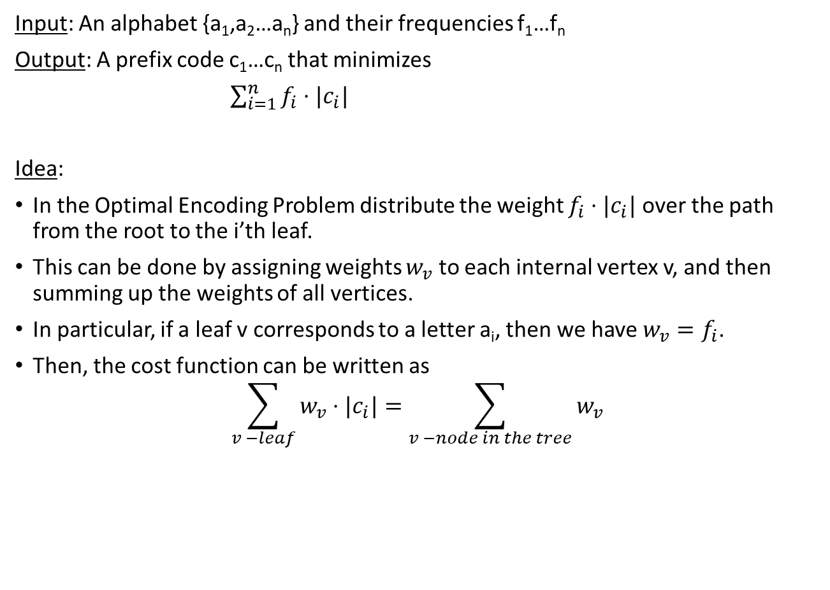
Optimal Encoding Problem
Input: An alphabet {a₁,a₂…a_{n}} and their frequencies f₁…f_{n}
Output: A prefix code c₁…c_{n} that minimizes
$\sum_{i=1}^{n}{f_{i}⋅|c_{i}|}$
Idea:
In the Optimal Encoding Problem distribute the weight $f_{i}⋅|c_{i}|$ over the path from the root to the i’th leaf.
This can be done by assigning weights $w_{v}$ to each internal vertex v, and then summing up the weights of all vertices.
In particular, if a leaf v corresponds to a letter a_{i}, then we have $w_{v}=f_{i}$.
Then, the cost function can be written as
$$\sum_{v −leaf}{w_{v}}⋅|c_{i}|=\sum_{v −node in the tree}{w_{v}}$$

Slide 9
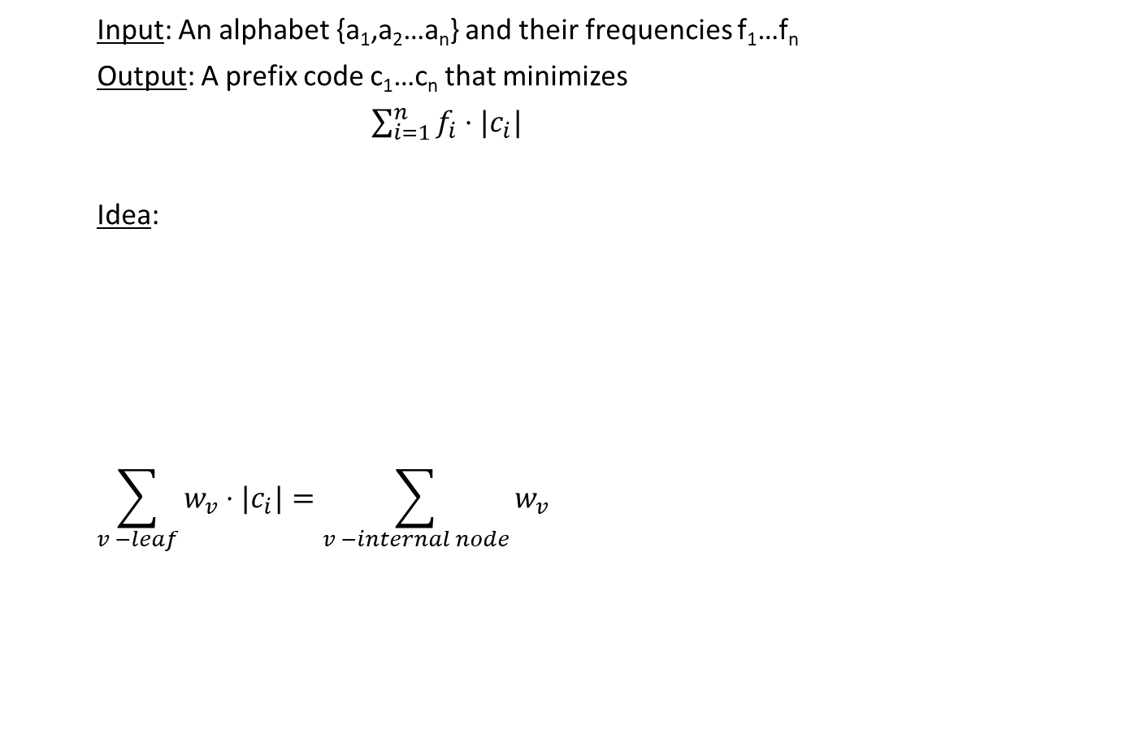
Optimal Encoding Problem
Input: An alphabet {a₁,a₂…a_{n}} and their frequencies f₁…f_{n}
Output: A prefix code c₁…c_{n} that minimizes
$\sum_{i=1}^{n}{f_{i}⋅|c_{i}|}$
Idea:
$$\sum_{v −leaf}{w_{v}}⋅|c_{i}|=\sum_{v −internal node}{w_{v}}$$
[130/130]
0
1
[60/130]
A [70/130]
0
1
[23/130]
T [37/130]
0
1
C [3/130]
G [20/130]

Slide 10
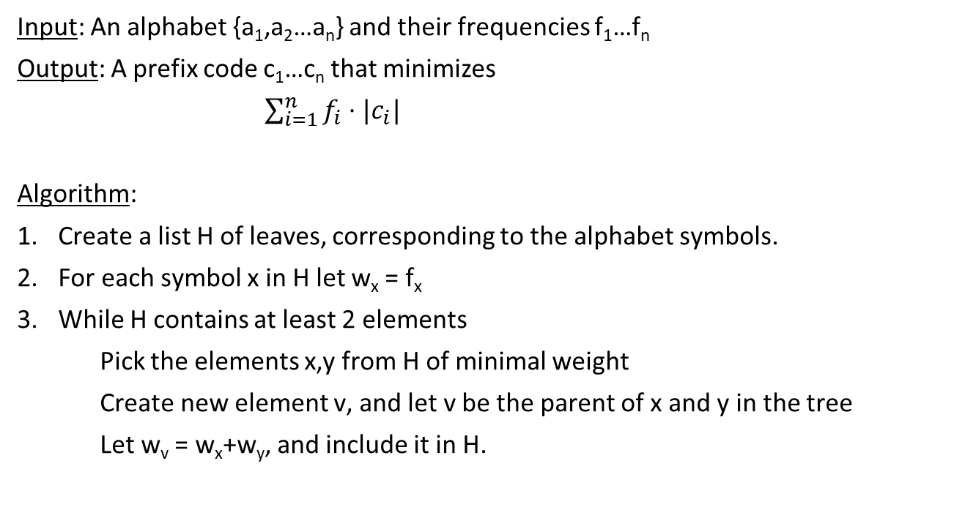
Optimal Encoding Problem
Input: An alphabet {a₁,a₂…a_{n}} and their frequencies f₁…f_{n}
Output: A prefix code c₁…c_{n} that minimizes
$\sum_{i=1}^{n}{f_{i}⋅|c_{i}|}$
Algorithm:
Create a list H of leaves, corresponding to the alphabet symbols.
For each symbol x in H let w_{x} = f_{x}
While H contains at least 2 elements
Pick the elements x,y from H of minimal weight
Create new element v, and let v be the parent of x and y in the tree
Let w_{v} = w_{x}+w_{y}, and include it in H.

Slide 11
Optimal Encoding Problem
[130/130]
Example:
1
0
[60/130]
0
1
[30/130]
1
0
[10/130]
0
1
A [70/130]
B [7/130]
C[3/130]
D [20/130]
E [30/130]

Slide 12
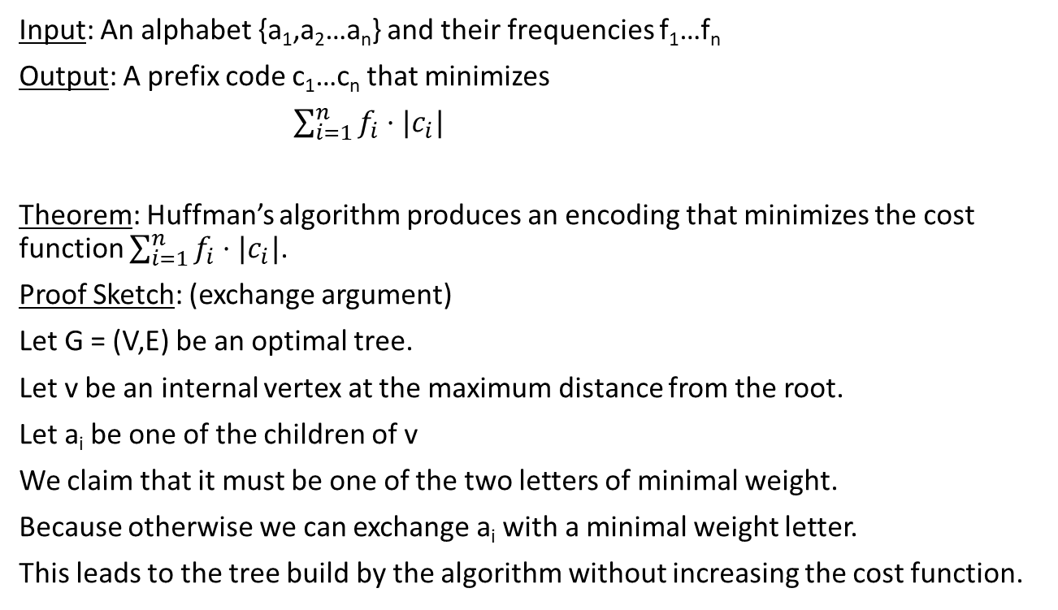
Optimal Encoding Problem
Input: An alphabet {a₁,a₂…a_{n}} and their frequencies f₁…f_{n}
Output: A prefix code c₁…c_{n} that minimizes
$\sum_{i=1}^{n}{f_{i}⋅|c_{i}|}$
Theorem: Huffman’s algorithm produces an encoding that minimizes the cost function $\sum_{i=1}^{n}{f_{i}⋅|c_{i}|}$.
Proof Sketch: (exchange argument)
Let G = (V,E) be an optimal tree.
Let v be an internal vertex at the maximum distance from the root.
Let a_{i} be one of the children of v
We claim that it must be one of the two letters of minimal weight.
Because otherwise we can exchange a_{i} with a minimal weight letter.
This leads to the tree build by the algorithm without increasing the cost function.

Slide 13
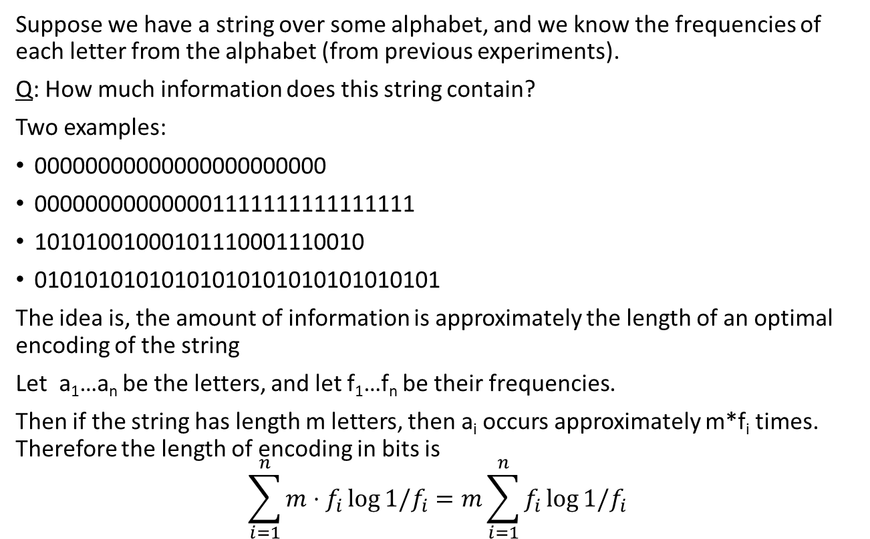
Entropy
Suppose we have a string over some alphabet, and we know the frequencies of each letter from the alphabet (from previous experiments).
Q: How much information does this string contain?
Two examples:
00000000000000000000000
000000000000001111111111111111
10101001000101110001110010
01010101010101010101010101010101
The idea is, the amount of information is approximately the length of an optimal encoding of the string
Let a₁…a_{n} be the letters, and let f₁…f_{n} be their frequencies.
Then if the string has length m letters, then a_{i} occurs approximately m*f_{i} times. Therefore the length of encoding in bits is
$$\sum_{i=1}^{n}{m⋅f_{i}\log{1/f_{i}}}=m\sum_{i=1}^{n}{f_{i}\log{1/f_{i}}}$$

Slide 14
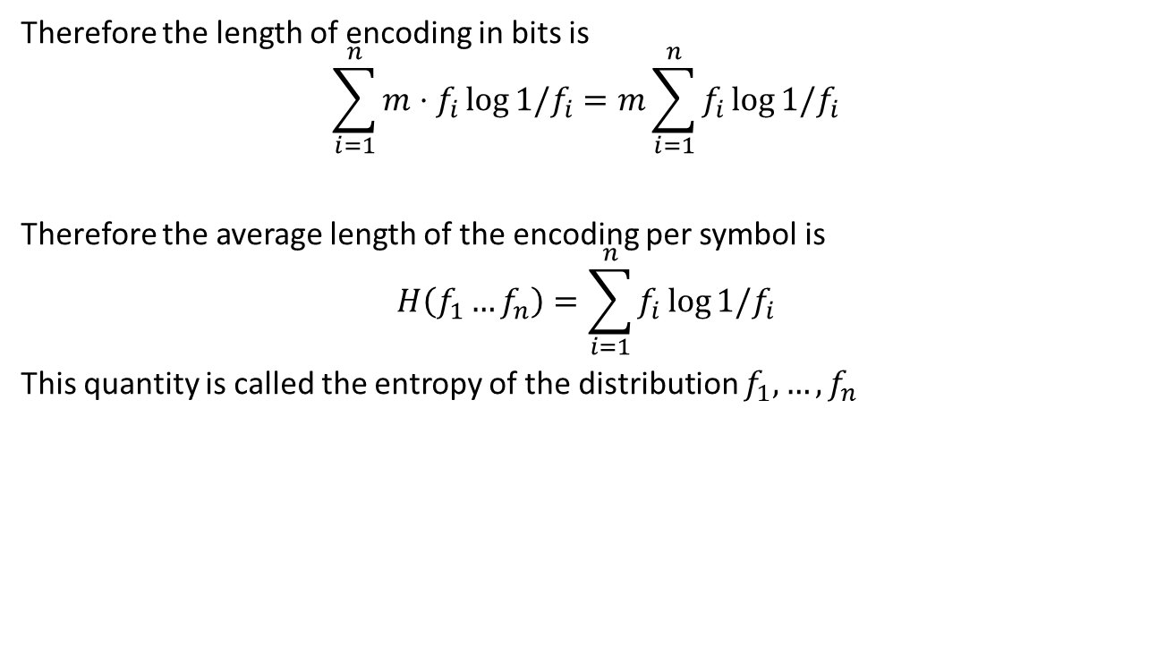
Entropy
Therefore the length of encoding in bits is
$$\sum_{i=1}^{n}{m⋅f_{i}\log{1/f_{i}}}=m\sum_{i=1}^{n}{f_{i}\log{1/f_{i}}}$$
Therefore the average length of the encoding per symbol is
$$H\left(f_{1}…f_{n}\right)=\sum_{i=1}^{n}{f_{i}\log{1/f_{i}}}$$
This quantity is called the entropy of the distribution $f_{1},…,f_{n}$

Slide 15
Homework and Reading for next time
Exercises from the Book:
5.14, 5.15, 5.16, 5.17, 5.18
Reading
5.4, 6.1, 6.2, 6.3

