Slide 1
CMPT 706 - Algorithms for Big Data
Parallel Algorithms
April 7, 2020

Slide 2
Multiprocessor Computation

Slide 3
Multiprocessor Computation
Obviously, several communicating processors often can solve problems faster than a single processor.
The processors can do computation and communication between them.
Today we’ll see examples where the speedup is significant.
Master
processor
Processor
1
Processor
2
Processor
k

Slide 4
Matrix Multiplication

Slide 5
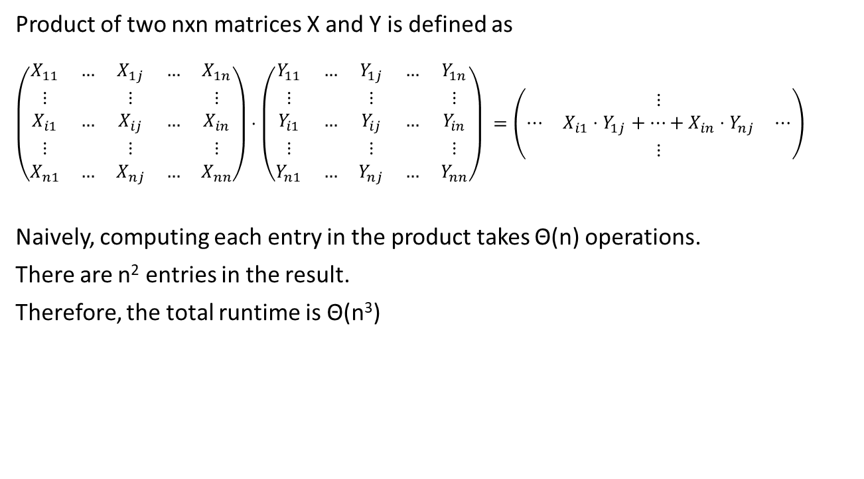
Matrix Multiplication
Product of two nxn matrices X and Y is defined as
$$\left(\begin{matrix}X_{11} & … & X_{1j} & … & X_{1n} \\ ⋮ & & ⋮ & & ⋮ \\ X_{i1} & … & X_{ij} & … & X_{in} \\ ⋮ & & ⋮ & & ⋮ \\ X_{n1} & … & X_{nj} & … & X_{nn}\end{matrix}\right)⋅\left(\begin{matrix}Y_{11} & … & Y_{1j} & … & Y_{1n} \\ ⋮ & & ⋮ & & ⋮ \\ Y_{i1} & … & Y_{ij} & … & Y_{in} \\ ⋮ & & ⋮ & & ⋮ \\ Y_{n1} & … & Y_{nj} & … & Y_{nn}\end{matrix}\right) =\left(\begin{matrix} & ⋮ & \\ ⋯ & X_{i1}⋅Y_{1j}+…+X_{in}⋅Y_{nj} & ⋯ \\ & ⋮ & \end{matrix}\right)$$
Naively, computing each entry in the product takes Θ(n) operations.
There are n² entries in the result.
Therefore, the total runtime is Θ(n³)
Can we using parallel computation to solve the problem faster?

Slide 6
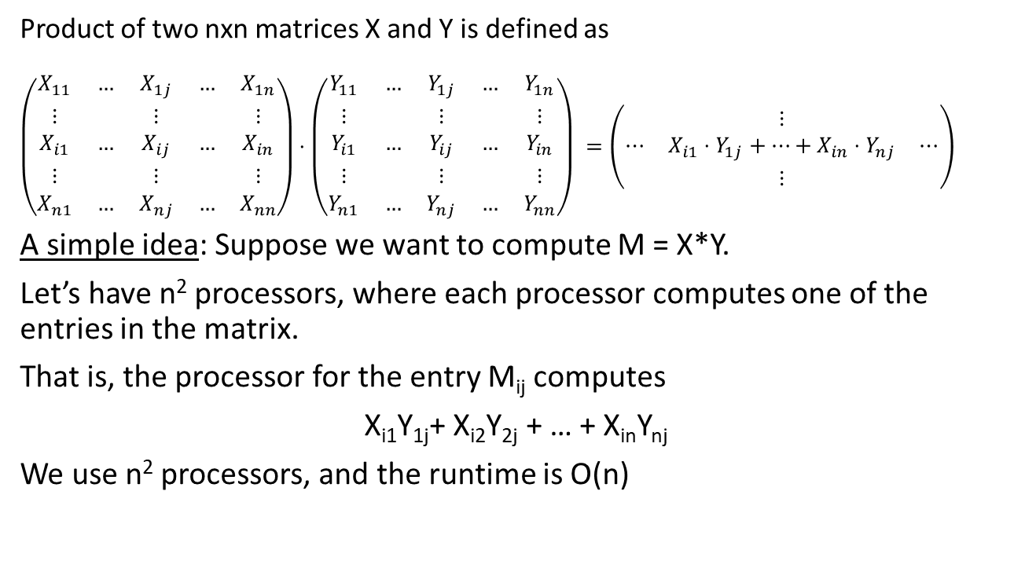
Matrix Multiplication
Product of two nxn matrices X and Y is defined as
$$\left(\begin{matrix}X_{11} & … & X_{1j} & … & X_{1n} \\ ⋮ & & ⋮ & & ⋮ \\ X_{i1} & … & X_{ij} & … & X_{in} \\ ⋮ & & ⋮ & & ⋮ \\ X_{n1} & … & X_{nj} & … & X_{nn}\end{matrix}\right)⋅\left(\begin{matrix}Y_{11} & … & Y_{1j} & … & Y_{1n} \\ ⋮ & & ⋮ & & ⋮ \\ Y_{i1} & … & Y_{ij} & … & Y_{in} \\ ⋮ & & ⋮ & & ⋮ \\ Y_{n1} & … & Y_{nj} & … & Y_{nn}\end{matrix}\right) =\left(\begin{matrix} & ⋮ & \\ ⋯ & X_{i1}⋅Y_{1j}+…+X_{in}⋅Y_{nj} & ⋯ \\ & ⋮ & \end{matrix}\right)$$
A simple idea: Suppose we want to compute M = X*Y.
Let’s have n² processors, where each processor computes one of the entries in the matrix.
That is, the processor for the entry M_{ij} computes
X_{i1}Y_{1j}+ X_{i2}Y_{2j} + … + X_{in}Y_{nj}
We use n² processors, and the runtime is O(n)
Can we get the runtime to O(log(n))?

Slide 7
Matrix Multiplication
Idea 2: Suppose we want to compute M = X*Y.
Before we had n² processors, where each processor computed
M_{ij} = X_{i1}Y_{1j}+ X_{i2}Y_{2j} + … + X_{in}Y_{nj}
Observation: M_{ij} can be computed with O(n) processors in O(log(n)) time.
First we have n processors, computing each product separately in parallel.
Then, we have n/2 processors computing the sums of pairs
X_{i1}Y_{1j}+ X_{i2}Y_{2j}, … X₃₁Y_{3j}+ X_{i4}Y_{4j}, … X_{i,n-1}Y_{n-1,j}+ X_{i,n}Y_{n,j}
Then use n/4 processors to compute sums of 4-tuples
…
Therefore using 2n³ processors we can compute X*Y in time O(log(n)).
The total number of processors is n²*(n+n/2+n/4+n/8…)<2n³

Slide 8















Matrix Multiplication
Z₁+Z₂+...+Z_{n} is computable with O(n) processors in O(log(n)) time.
Fact: It is possible to do it with O(n/log(n)) processors in O(log(n)) time.
$$+$$
$$+$$
$$+$$
$$+$$
$$+$$
$$+$$
$$+$$
$$z1$$
$$z2$$
$$z_{3}$$
$$z_{4}$$
$$z_{5}$$
$$z_{6}$$
$$z_{7}$$
$$z_{8}$$

Slide 9
Matrix Multiplication
Observation: Suppose we have a parallel algorithm that solves a problem in time T(n) using P(n) processors.
Then we can convert it into a sequential algorithm with runtime T(n)*P(n).
In the Matrix multiplication example we had an O(n³) algorithm.
We got a parallel algorithm with O(log(n)) runtime using O(n³) processors.
Q: Can we get O(log(n)) runtime using O(n³/ log(n)) processors?
By the observation above that this would be tight.
A: Yes, it is possible, but out of scope for today

Slide 10
Graph Reachability

Slide 11
Graph Reachability
Input: A directed graph G = (V,E) and two vertices s,t.
Output: Is there a path from s to t?
We know that BFS/DFS can solve this problem in time O(|V|+|E|)
Q: Can we do it faster using parallel algorithms?
The common belief is that we cannot implement BFS/DFS in parallel.
That is, the task of finding the shortest paths is inherently sequential.

Slide 12

Graph Reachability
Input: A directed graph G = (V,E) and two vertices s,t.
Output: Is there a path from s to t?
Theorem: The reachability problem, can be solved in O(log²(n)) time using parallel computation with O(n³*log(n)) processors.
Idea: Given G=(V,E) look at its adjacency matrix A=A(G).
Add 1’s on the diagonal corresponding to self loops.
Key Observation: (A²)_{ij} = 0 ⬄ there is no path of length <= 2 from i to j.
(A²)_{ij} is equal to the number of vertices v such that (i,v) and (v,j) are edges
$$A(G)=\left(\begin{matrix}1 & 1 & 1 & 0 \\ 1 & 1 & 1 & 0 \\ 1 & 1 & 1 & 1 \\ 0 & 0 & 1 & 1\end{matrix}\right)$$
1
3
4
2

Slide 13

Graph Reachability
Idea: Given G=(V,E) look at its adjacency matrix A=A(G).
Add 1’s on the diagonal corresponding to self loops.
Key Observation: (A²)_{st} > 0 ⬄ there is a path of length <= 2 from s to t.
Analogously, (A^{k})_{s,t}>0 ⬄ there is a path of length <= k from s to t.
Therefore, G has a path from s to t ⬄ (A^{n-1})_{s,t}>0.
We saw how to compute matrix multiplication in O(log(n)) parallel time.
We know how to compute A^{n-1} using O(log(n)) matrix multiplications.
Therefore, reachability can be solved in O(log²(n)) parallel time.
1
$$A(G)=\left(\begin{matrix}1 & 1 & 1 & 0 \\ 1 & 1 & 1 & 0 \\ 1 & 1 & 1 & 1 \\ 0 & 0 & 1 & 1\end{matrix}\right)$$
3
4
2

Slide 14
Graph Reachability
Idea: Given G=(V,E) look at its adjacency matrix A=A(G).
Add 1’s on the diagonal corresponding to self loops.
Prove: (A²)_{s,s}=degree(s) // including the self loop
(A^{k})_{s,t} equals to the number of paths from s to t in the graph of length at most k.
The common belief is that we cannot implement BFS in O(log(n)) time in parallel. Give some evidence supporting this belief.
1
$$A(G)=\left(\begin{matrix}1 & 1 & 1 & 0 \\ 1 & 1 & 1 & 0 \\ 1 & 1 & 1 & 1 \\ 0 & 0 & 1 & 1\end{matrix}\right)$$
3
4
2

Slide 15
Reading for next time
Nothing

