Slide 1
CMPT 706 - Algorithms for Big Data
Sublinear Time Algorithms
April 9, 2020

Slide 2
Sublinear Time Algorithms
There are many scenarios where we get a large input, and would like to get a meaningful information about it without reading the entire input.
In the beginning this may seem impossible. How can I say anything meaningful without reading the input.
However, statisticians do it all the time when running polls.
Sublinear time algorithms combine between statistics and (sometimes very sophisticated) algorithms.

Slide 3
First Example
Estimating the fraction of 1’s in a string

Slide 4
Estimating the number of 1’s in a string
Input: An n-bit string x
Goal: Compute the number of ones in x
We can read the entire input and count the number of 1’s
The runtime time is O(n).
Can we do it faster?
Well, if we allow small error, then we certainly can.

Slide 5
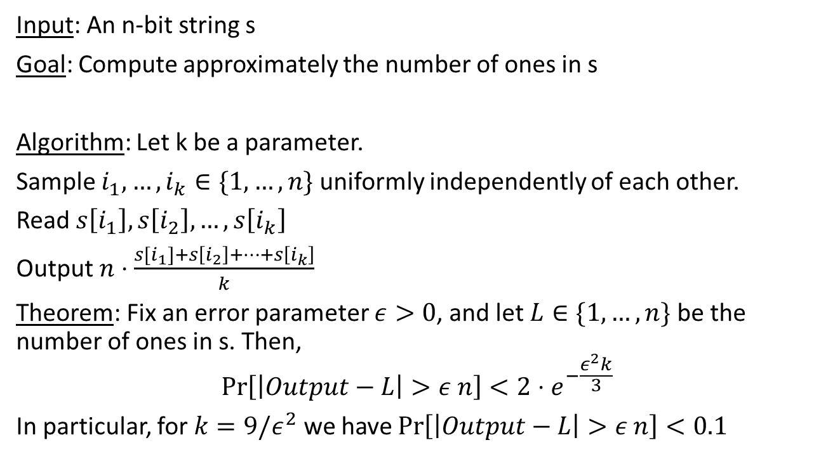
Estimating the number of 1’s in a string
Input: An n-bit string s
Goal: Compute approximately the number of ones in s
Algorithm: Let k be a parameter.
Sample $i_{1},…, i_{k}∈\{1,…, n\}$ uniformly independently of each other.
Read $s\left[i_{1}\right],s\left[i_{2}\right],…,s\left[i_{k}\right]$
Output $n⋅\frac{s[i_{1}]+s\left[i_{2}\right]+…+s\left[i_{k}\right]}{k}$
Theorem: Fix an error parameter $ε>0$, and let $L∈\{1,…,n\}$ be the number of ones in s. Then,
$$\operatorname{Pr}\left[\left|Output−L\right|>ε n\right]<2⋅e^{−\frac{ε^{2}k}{3}}$$
In particular, for $k=9/ε^{2}$ we have $\operatorname{Pr}\left[\left|Output−L\right|>ε n\right]<0.1$
The algorithm outputs
a close answer with high probability

Slide 6
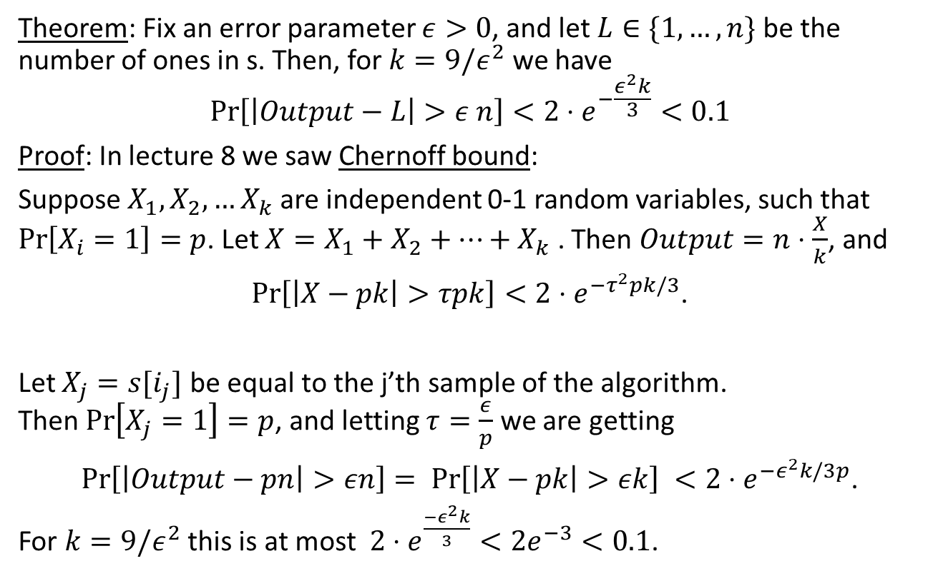
Estimating the number of 1’s in a string
Theorem: Fix an error parameter $ε>0$, and let $L∈\{1,…,n\}$ be the number of ones in s. Then, for $k=9/ε^{2}$ we have
$$\operatorname{Pr}\left[\left|Output−L\right|>ε n\right]<2⋅e^{−\frac{ε^{2}k}{3}}<0.1$$
Proof: In lecture 8 we saw Chernoff bound:
Suppose $X_{1},X_{2},…X_{k}$ are independent 0-1 random variables, such that $\operatorname{Pr}\left[X_{i}=1\right]=p$. Let $X=X_{1}+X_{2}+…+X_{k}$ . Then $Output=n⋅\frac{X}{k}$, and
$\operatorname{Pr}\left[\left|X−pk\right|>τpk\right]<2⋅e^{{−τ}^{2}pk/3}$.
Let $X_{j}=s[i_{j}]$ be equal to the j’th sample of the algorithm.
Then $\operatorname{Pr}\left[X_{j}=1\right]=p$, and letting $τ=\frac{ε}{p}$ we are getting
$\operatorname{Pr}\left[\left|Output−pn\right|>εn\right]= \operatorname{Pr}\left[\left|X−pk\right|>εk\right] <2⋅e^{{−ε}^{2}k/3p}$.
For $k=9/ε^{2}$ this is at most $2⋅e^{\frac{{−ε}^{2}k}{3}}<2e^{−3}<0.1$.

Slide 7
Estimating the number of 1’s in a string
Ex: An 2-query algorithm that gets an input s – n-bit string, and it’s goal is to check that the number of 1’s in s is exactly n/2.
The algorithm gets an n-bit string s
It makes 2 queries to s, i.e. reads 2 coordinates from s
and decides to say YES or NO (maybe using more randomness.
The algorithm has the following guarantee
If the number of 1’s in s is exactly n/2
then Pr[algorithm says YES] = 0.9
If the number of 1’s in s is either > 0.6n or less than 0.4n
then Pr[algorithm says YES] < 0.85

Slide 8
Testing if an array is sorted

Slide 9
Testing if an array is sorted
Input: An array of n distinct numbers
Goal: Check if the array is sorted
We can read the entire input and check that it is sorted
The runtime time is O(n).
Q: Can we do it faster?
A: Clearly the answer is no.
For example consider the array A = [1,2,3…n] and now change a random entry to be 0.
Then, it is unlikely that we will see that anything is wrong without reading the entire input (or at least a good fraction of the input).

Slide 10
Testing if an array is sorted
Input: An array A of n distinct numbers
Goal: Check if the array is sorted
Let’s still try to do something here….
Algorithm:
Choose a random coordinate i∈{1…n}, and read A[i].
Let z = A[i]
Run binary search searching for z (without knowing i)
If found, output SORTED
Otherwise, output NOT-SORTED

Slide 11
Testing if an array is sorted
Choose a random coordinate i∈{1…n}, and read A[i].
Let z = A[i]
Run binary search searching for z (without knowing i)
If found, output SORTED
Otherwise, output NOT-SORTED
Searching for 4
 |  | 4
 |  |  |  |  |  |  |  | 9
 |  |  | 5 |  |  |  |  | 9
 | 2 |  | 5 |  |  |  |  | 9
 | 2 | 4 | 5 |  |  |  |  | 9

Slide 12
Testing if an array is sorted
Theorem:
1) If the algorithm is sorted, then the algorithm always outputs SORTED.
2) If the algorithm outputs SORTED with probability 1-ε, then the array is sorted in (1-ε)n coordinates.
2’) If the array is ε-far from sorted, then the algorithm outputs NOT-SORTED with probability >ε.
Note that we can repeat the algorithm 100 times.
If the algorithm outputs SORTED with high probability, then we should be pretty confident that it is mostly sorted.
Conclusion: Using only O(log(n)) queries we can check with high probability that the array is mostly sorted.

Slide 13
Testing if an array is sorted
Theorem:
1) If the array is sorted, then the algorithm always outputs SORTED.
2) If the algorithm outputs SORTED with probability 1-ε, then the array is sorted in (1-ε)n coordinates.
Proof:
1) Obvious. If the array is sorted the binary search algorithm succeeds.
2) Suppose that the algorithm outputs SORTED with probability 1-ε.
We want to show that there are some (1-ε)n coordinates in which the array is sorted.

Slide 14
Testing if an array is sorted
Proof:
Suppose that the algorithm outputs SORTED with probability 1-ε.
We want to show that there are some (1-ε)n coordinates in which the array is sorted.
The randomness of the algorithm is only in choosing a random coordinate.
Once the coordinate is chosen, the algorithm run Binary Search (which is a deterministic algorithm).
Let’s G = {i∈{1…n}: coordinates on which the algorithm outputs SORTED}
Note that |G| = (1-ε)n.
Claim: A is sorted on the coordinates of G.

Slide 15
Testing if an array is sorted
Let’s G = {i∈{1…n}: coordinates on which the algorithm outputs SORTED}
Note that |G| = (1-ε)n.
Claim: A is sorted on the coordinates of G.
Proof of Claim:
Fix i<j two coordinates in G. We want to show that A[i]<A[j].
Consider the “splits” leading to i and splits leading to j.
For example: suppose i = n/8 and j =3n/8
Then the “splits” for i are: n/2, n/4, n/8
And the “splits” for j are: n/2, n/4, 3n/8
Since the binary search finds both i and j it follows that A[i] < A[n/4] < A[j].

Slide 16
Testing if an array is sorted
Example: suppose i = n/8 and j =3n/8
Then the “splits” for i are: n/2, n/4, n/8
And the “splits” for j are: n/2, n/4, 3n/8
Binary search for A[i]:
Look at A[n/2], we know that BinSearch reached i=n/8.
It mean that A[i] < A[n/2]
Next we go to n/4: Look at A[n/4]. We know that BinSearch reached i=n/8.
It means that A[i] < A[n/4].
Binary search for A[j]:
Look at A[n/2], we know that BinSearch reached j=3n/8.
It mean that A[j] < A[n/2]
Look at A[n/4], and we know that BinSearch reached j=3n/8.
It means that A[n/4] < A[j]

Slide 17
Testing if an array is sorted
Let’s G = {i∈{1…n}: coordinates on which the algorithm outputs SORTED}
Note that |G| = (1-ε)n.
Claim: A is sorted on the coordinates of G.
Proof of Claim: Fix i<j two coordinates in G. We show that A[i]<A[j].
Consider the “splits” leading to i and splits leading to j.
For example, the first “splits” is n/2 for both.
Let k be their last common split.
Since the binary search finds both i and j it follows that A[i] < A[k] < A[j].
Therefore, A is sorted on G.
Since |G| = (1-ε)n, it follows that A is “(1-ε)-sorted”.

Slide 18
Sublinear time algorithms
A fascinating research area that studies algorithms that
read only tiny portion of the input
learn meaningful information about it.
Applied to every area studied by general algorithms:
Graphs
Arrays
Functions
Distributions
If you are interested, I’ll be happy to tell you more about it.

