Slide 1
CMPT 405/705
Design & Analysis of Algorithms
January 12, 2022

Slide 2
General information
Instructor: Igor Shinkar
My email: ishinkar@sfu.ca
Course webpage: cs.sfu.ca/~ishinkar/teaching.html
→ Teaching/Seminars → CMPT 405
Office hours:
→ when: Wednesdays 1:30PM-2:30PM (after the Wednesday class)
→ same zoom link as the lectures
→ if we go back to in-person mode: TASC1 9017
Discussion forum: piazza.com – you should have received an invitation

Slide 3
General information
TAs:
Akbar Rafiey: <arafiey@sfu.ca>
Zheng Wu: <zwa190@sfu.ca>
Email: cmpt-405-help@sfu.ca
Email: cmpt-705-help@sfu.ca
Office hours/format: TBA look at the course homepage

Slide 4
Grading – option 1
Homeworks:
4 assignments, every ~3 weeks
The assignments are not for grading, and you don‘t need to submit them.
I will post the solutions.
Quizzes: 4 x 15%
4 quizzes after the solutions are posted
The quizzes will be loosely based on the homework problems
You will benefit by solving the homework problems by yourself!
Final exam: 40%
Date TBA
All info is on the course homepage

Slide 5
Grading – option 2
Homeworks: 4 x 10% = 40%
4 assignments, every ~3 weeks
The assignments are for grading.
I will post the solutions (after the submission).
Midterm : 20%
Around week 7
The midterm is in person, no exceptions.
Final exam: 40%
Date TBA
All info is on the course homepage

Slide 6
General information
https://www.cs.sfu.ca/~ishinkar/teaching/spring22/cmpt405/info.html
General info
Lecture notes
Homework assignments

Slide 7
This is a theoretical course
You will not need to write actual code in a real programming language
You will need to write algorithms in pseudo-code
However, the pseudo code will need to contain enough details, to convince me/TAs that you understand all the implementation details

Slide 8
(very rough) Syllabus
Basic Graph Algorithms
Greedy Algorithms
Dynamic Programming
Linear Programming
NP-Completeness
Coping with NP-completeness
Approximation Algorithms
Randomized Algorithms

Slide 9
Prerequisites
CMPT 307: Algorithms and Data Structures (or an equivalent course)
Data structures (stacks, queues, priority queues with heaps, union find)
Graph algorithms (BFS, DFS, shortest path algorithms)
Divide and Conquer (recursion)
Dynamic Programming
Big-O notation
Master Theorem
A bit of NP-Completeness

Slide 10
“ Real“ Prerequisites
CMPT 307: Algorithms and Data Structures (or an equivalent course)
Data structures (stacks, queues, priority queues with heaps, union find)
Graph algorithms (BFS, DFS, shortest path algorithms)
Big-O notation
Be able to understand an algorithm and run it on a given input: run algorithm step by step / do debugging

Slide 11
Questions so far?

Slide 12
Graphs

Slide 13
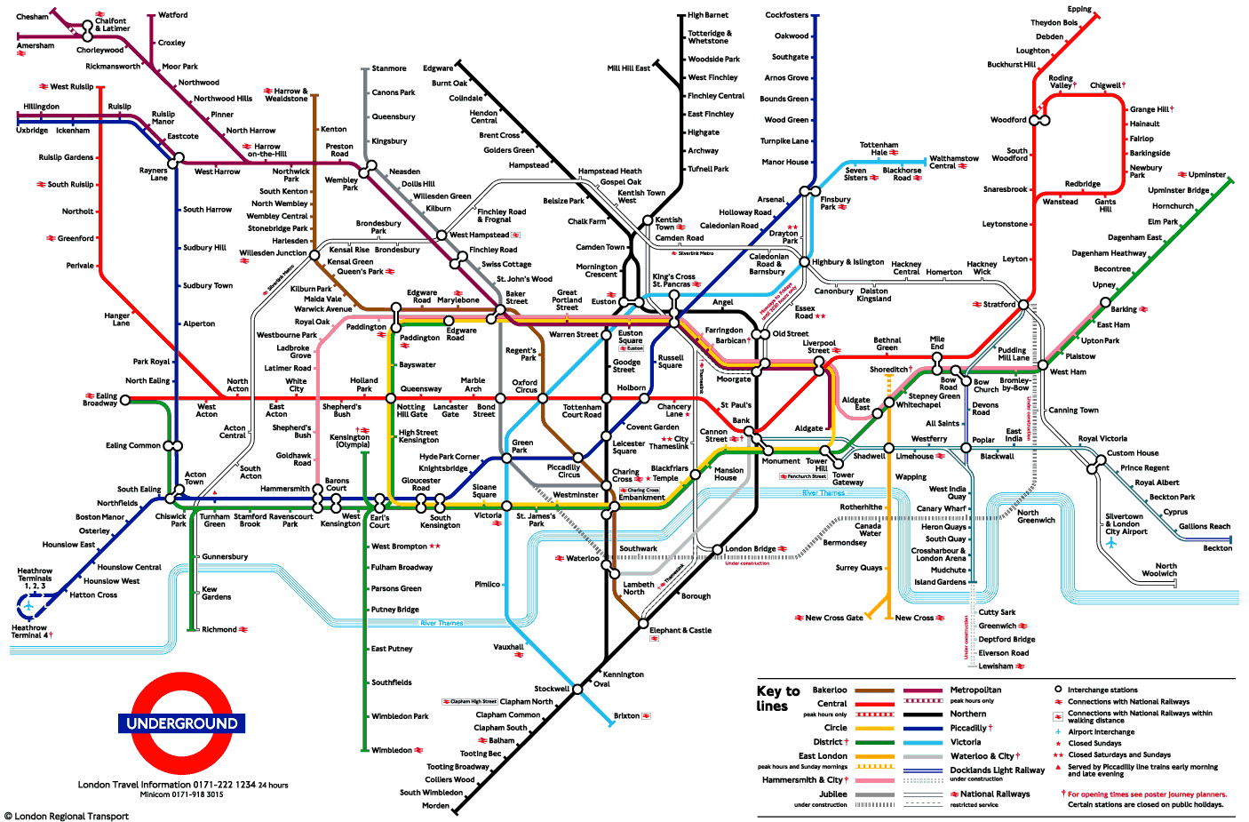
Graphs
Often we are interested in relations/connections between objects.

Slide 14
Graphs
A graph 𝐺=(𝑉,𝐸) consists of:
- a nonempty set of vertices (or nodes) denoted by V,
- and a set of edges (or arcs), denoted by E.
Usually, we deal with simple graphs (no parallel edges).

Slide 15
A walk in a graph
Fix a graph 𝐺=(𝑉,𝐸). Let u, v be two (not necessarily distinct) vertices in an undirected graph.
A 𝑢-𝑣 walk in 𝐺 is a finite sequence 𝑢=𝑢₀, 𝑒₁, 𝑢₁, 𝑒₂, 𝑢₂, 𝑒₃,…, 𝑒_{𝑛−1}, 𝑢_{𝑛−1}, 𝑒_{𝑛}, 𝑢_{𝑛}=𝑣
of vertices and edges from 𝐺, starting at vertex 𝑢 and ending at vertex 𝑣 and involving the 𝑛 edges 𝑒_{𝑖}=(𝑢_{𝑖−1}, 𝑢_{𝑖}).
The length of this walk is the number of edges in the walk.
A walk is said to be closed if it starts and ends
with the same vertex.
A path is a walk that visits each edge at most once

Slide 16
Connected components
An undirected graph G=(V,E) is said to be connected if there is a path between any two vertices in G.
If a graph is not connected we may consider its connected components:
A connected component W is a subset of vertices such that there is a path between any two vertices in W
The graph has three connected components:
{a,b,c,d,e,f}, {g}, {p,q,r,s,t}
b
c
d
p
q
r
s
a
f
e
g
t

Slide 17
Some special graphs
Complete graphs: A complete graph on n vertices, denoted by K_{n}.
It is the graph that has an edge between every two vertices.
Q: How many edges are there in K_{n}?

Slide 18
Some special graphs
Cycles graphs: A cycle graph on n vertices, denoted by C_{n}.
Q: How many edges are there in C_{n}?

Slide 19
Representation of Graphs
Lists of Vertices and Edges:
b
c
d
V = {a, b, c, d, e, f, e, g}
E = { ab, bc, af, bf, fc, be, fe, ce, cd }
a
f
e
g
b
c
d
V = {a, b, c, d, e, f, g}
E = { (b,a), (c,b), (f,a), (b,f),
(c,f), (e,b), (c,e), (d,c) }
a
f
e
g

Slide 20
Representation of Graphs
Adjacency List:
vert. | neighbours | vert. | neighbours
a | b, f | e | c, b, f
b | a, f, e, c | f | a, b, c, e
c | b, d, e, f | g
d | c
b
c
d
a
f
e
g
b
c
d
vert. | neighbours | vert. | neighbours
a |  | e | b, f
b | a, f | f | a
c | b, e, f | g
d | c
a
f
e
g

Slide 21

Representation of Graphs
Adjacency Matrix:
$$\begin{matrix} & \begin{matrix}a & b & c & e & f\end{matrix} \\ \begin{matrix}a \\ b \\ c \\ e \\ f\end{matrix} & \left(\begin{matrix}0 & 1 & 0 & 0 & 1 \\ 1 & 0 & 1 & 1 & 1 \\ 0 & 1 & 0 & 1 & 1 \\ 0 & 1 & 1 & 0 & 1 \\ 1 & 1 & 1 & 1 & 0\end{matrix}\right)\end{matrix}$$
b
c
d
a
f
e
b
c
a
f
e

Slide 22
Representation of Graphs
Ex: Draw a graphs whose adjacency matrices are:
Ex: What is the adjacency matrix of K_{n}?
Ex: What is the adjacency matrix of C_{n}?

Slide 23
Subgraphs
Sometimes we need only a part of a big graph.
A subgraph of a graph G=(V,E) is a graph H=(W,F), where 𝑊⊆𝑉 and 𝐹⊆𝐸
such that for each edge in F it endpoints are in W.
G
H

Slide 24
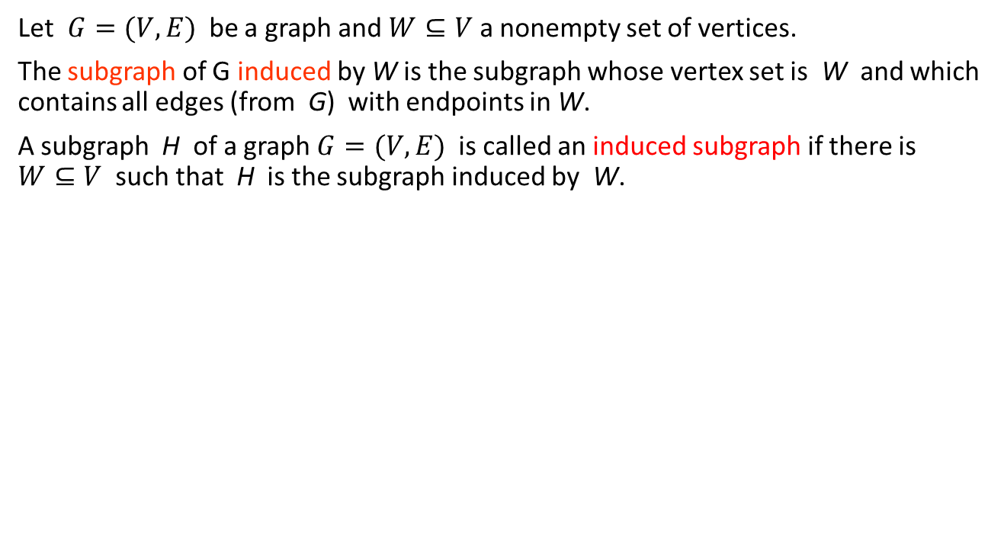
Subgraphs
Let $G=(V,E)$ be a graph and $W⊆V$ a nonempty set of vertices.
The subgraph of G induced by W is the subgraph whose vertex set is W and which contains all edges (from G) with endpoints in W.
A subgraph H of a graph $G=(V,E)$ is called an induced subgraph if there is $W⊆V$ such that H is the subgraph induced by W.
b
c
W = {a,b,c,e}:
b
c
a
f
e
a
e

Slide 25
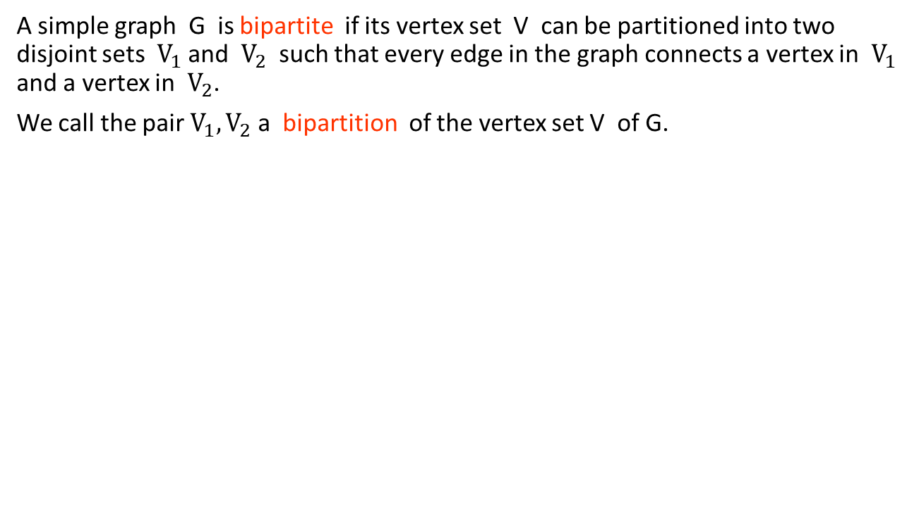
Bipartite Graphs
A simple graph G is bipartite if its vertex set V can be partitioned into two disjoint sets $V_{1}$ and $V_{2}$ such that every edge in the graph connects a vertex in $V_{1}$ and a vertex in $V_{2}$.
We call the pair $V_{1},V_{2}$ a bipartition of the vertex set V of G.

Slide 26
Complete Bipartite Graphs
The complete bipartite graph K_{m,n} is the graph that has its vertex set partitioned into two subsets of m and n vertices.
There is an edge between two vertices if and only if one vertex is in the first subset and the other vertex is in the second subset.

Slide 27
More on Bipartite Graphs
Theorem: For a graph G=(V,E) the following are equivalent:
G is bipartite
G does not contain an odd cycle
it is possible to color each vertex of G in one of two different colors so that no two adjacent vertices are colored the same color.

Slide 28
Complete Bipartite Graphs
Note that the drawing of a bipartite graph doesn’t have to be according to the bipartition

Slide 29
Questions?
Comments?

