Slide 1
C Lab 3
Masking and Shifting
Notes:
How to allocate time for the lab presentation:
Review: 10 mins
Realloc: 5 mins
Structs: 5 mins
Memory: 5 mins
Q&A: 10 mins
Release solution when there are 20 mins left in the second week lab session, so that everyone finishes the assignment

Slide 2
Goals
Review
  Shifts
  Referencing/Dereferencing
free
malloc
structs

Slide 3
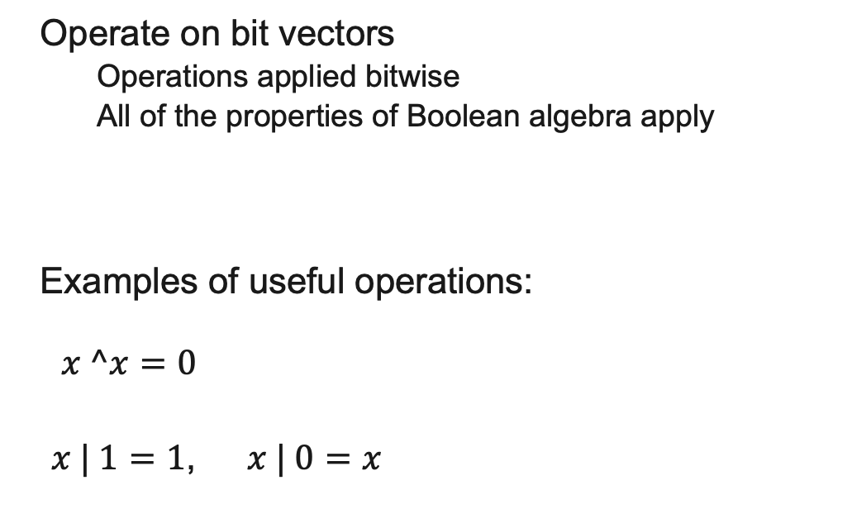
General Boolean Algebras
Operate on bit vectors
  Operations applied bitwise
  All of the properties of Boolean algebra apply
Examples of useful operations:
$x ^x=0$
  $x | 1=1$, $x | 0=x$
01101001
& 01010101
01101001
| 01010101
01101001
^ 01010101
~ 01010101
01010101
^ 01010101
00000000
01010101
| 11110000
11110101
Notes:
Now, how do we use the boolean operators?
Typically on ”bit vectors” (treat a byte, or multiple bytes) as a bit vector

Slide 4
Bit-Level Operations in C
& (AND), | (OR), ^ (XOR), ~ (NOT)
  View arguments as bit vectors, apply operations bitwise
  Apply to any “integral” data type
    long, int, short, char, unsigned
Examples with char a, b, c;
  a = (char) 0x41; // 0x41->0b 0100 0001
  b = ~a; // 0b ->0x
  a = (char) 0x69; // 0x69->0b 0110 1001
  b = (char) 0x55; // 0x55->0b 0101 0101
  c = a & b; // 0b ->0x
  a = (char) 0x41; // 0x41->0b 0100 0001
  b = a; // 0b 0100 0001
  c = a ^ b; // 0b ->0x
Notes:
Some bit-twiddling puzzles in Lab 1

Slide 5
Shift Operations
Left shift (x<<n) bit vector x by n positions
  Throw away (drop) extra bits on left
  Fill with 0s on right
Right shift (x>>n) bit-vector x by n positions
  Throw away (drop) extra bits on right
  Logical shift (for unsigned values)
    Fill with 0s on left
  Arithmetic shift (for signed values)
    Replicate most significant bit on left
    Maintains sign of x
Notes:
Useful operator when working with bit representations
Especially Lab 1
1001

Slide 6
Operators Recap
NOT: ~
  This will flip all bits in the operand
AND: &
  This will perform a bitwise AND on every pair of bits
OR: |
  This will perform a bitwise OR on every pair of bits
XOR: ^
  This will perform a bitwise XOR on every pair of bits
SHIFT: <<, >>
  This will shift the bits right or left
    logical vs. arithmetic

Slide 7
Operators Recap
NOT: !
  Evaluates the entire operand, rather than each bit
  Produces a 1 if == 0, produces 0 if nonzero
AND: &&
  Produces 1 if both operands are nonzero
OR: ||
  Produces 1 if either operand is nonzero

Slide 8
Examples
Create 0xFFFFFFFF using only one operator
Limited to constants from 0x00 to 0xFF
Naïve approach:
0xFF + (0xFF << 8) + (0xFF << 16) …
Better approach:
~0x00 = 0xFFFFFFFF

Slide 9
Examples
Replace the leftmost byte of a 32-bit integer with 0xAB
Let our integer be x
First, we want to create a mask for the lower 24 bits
  ~(0xFF << 24) will do that using just two operators
(x & mask) will zero out the leftmost 8 bits
Now, we want to OR in 0xAB to those zeroed-out bits
Final result:
  (x & mask) | (0xAB << 24)
Total operators: 5

Slide 10
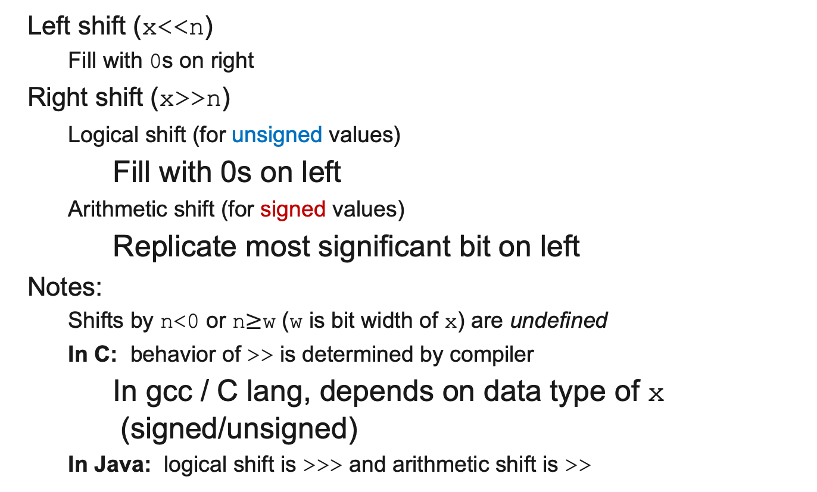
Shift Operations
Left shift (x<<n)
  Fill with 0s on right
Right shift (x>>n)
  Logical shift (for unsigned values)
    Fill with 0s on left
  Arithmetic shift (for signed values)
    Replicate most significant bit on left
Notes:
  Shifts by n<0 or n$≥$w (w is bit width of x) are undefined
  In C: behavior of >> is determined by compiler
    In gcc / C lang, depends on data type of x (signed/unsigned)
  In Java: logical shift is >>> and arithmetic shift is >>
 | x | 0010 0010
 | x<<3 | 0001 0000
logical: | x>>2 | 0000 1000
arithmetic: | x>>2 | 0000 1000
 | x | 1010 0010
 | x<<3 | 0001 0000
logical: | x>>2 | 0010 1000
arithmetic: | x>>2 | 1110 1000

Slide 11
Extract the 2nd most significant byte of an int:
  First shift, then mask: (x>>16) & 0xFF
  Or first mask, then shift: (x & 0xFF0000)>>16
x | 00000001 | 00000010 | 00000011 | 00000100
x>>16 | 00000000 | 00000000 | 00000001 | 00000010
0xFF | 00000000 | 00000000 | 00000000 | 11111111
(x>>16) & 0xFF | 00000000 | 00000000 | 00000000 | 00000010
x | 00000001 | 00000010 | 00000011 | 00000100
0xFF0000 | 00000000 | 11111111 | 00000000 | 00000000
x & 0xFF0000 | 00000000 | 00000010 | 00000000 | 00000000
(x&0xFF0000)>>16 | 00000000 | 00000000 | 00000000 | 00000010

Slide 12
Using Shifts and Masks
Extract the sign bit of a signed int:
  First shift, then mask: (x>>31) & 0x1
    Assuming arithmetic shift here, but this works in either case
    Need mask to clear 1s possibly shifted in
0
x | 00000001 | 00000010 | 00000011 | 00000100
x>>31 | 00000000 | 00000000 | 00000000 | 00000000
0x1 | 00000000 | 00000000 | 00000000 | 00000001
(x>>31) & 0x1 | 00000000 | 00000000 | 00000000 | 00000000
0
1
x | 10000001 | 00000010 | 00000011 | 00000100
x>>31 | 11111111 | 11111111 | 11111111 | 11111111
0x1 | 00000000 | 00000000 | 00000000 | 00000001
(x>>31) & 0x1 | 00000000 | 00000000 | 00000000 | 00000001
1

Slide 13
Using Shifts and Masks
Conditionals as Boolean expressions
  For int x, what does (x<<31)>>31 do?
  Can use in place of conditional:
    In C: if(x) {a=y;} else {a=z;} equivalent to a=x?y:z;
    a=(((x<<31)>>31)&y) |(((!x<<31)>>31)&z);
x=!!123 | 00000000 | 00000000 | 00000000 | 00000001
x<<31 | 10000000 | 00000000 | 00000000 | 00000000
(x<<31)>>31 | 11111111 | 11111111 | 11111111 | 11111111
!x | 00000000 | 00000000 | 00000000 | 00000000
!x<<31 | 00000000 | 00000000 | 00000000 | 00000000
(!x<<31)>>31 | 00000000 | 00000000 | 00000000 | 00000000
Notes:
Use !! to force to 0/1

