Slide 1
Scalar Loop
for (i = 0; i < N; i++){
output[i] = x[i] * y[i];
}
Vector Loop
for (i = 0; i < N; i=i+VLEN){
output[i:i+VLEN] =
x[i:i+VLEN] * y[i+VLEN];
}

Slide 2
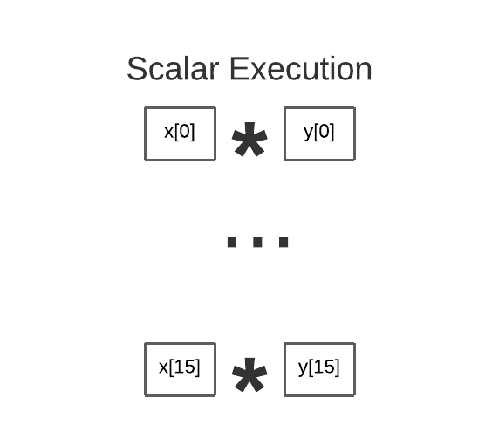
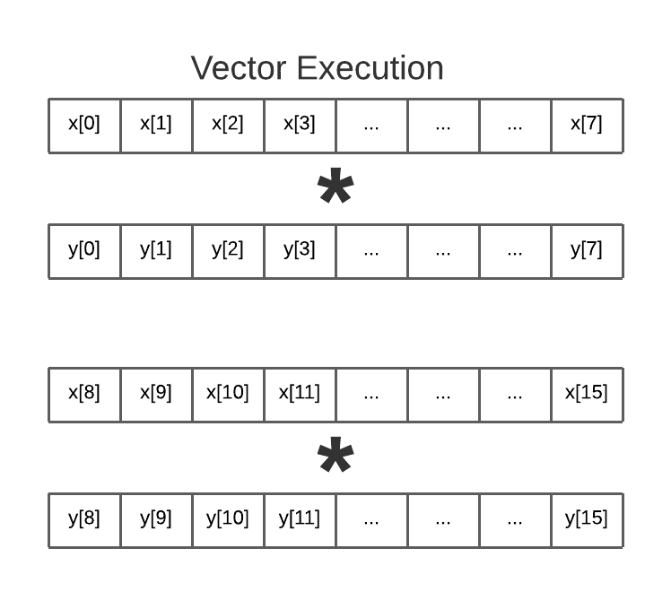

Slide 3
loop:
# load x[i] and y[i]
lw a5,0(a2)
lw a6,0(a3)
# addition
add a5,a5,a6
# store word
sw a5,0(a1)
# Bump pointers
addi a1,a0,4
addi a2,a1,4
addi a3,a2,4
addi a3,a2,4
sub a0,a0,1
bnez a0, loop
loop: # t0=VLEN
# load x[I,i+VLEN], y[] vle32.v v8, (a2)
vle32.v v16, (a3)
# addition
vadd.vv v24,v8,v16
# store res[i:i+VLEN]
vse32.v v24,(a1)
# Bump pointers
slli t1,t0,2
add a2, a2,t1
add a3,a3,t1
add a1,a1,t1
# Bump loop by vlen
sub a0,a0,t0
bnez a0, loop

Slide 4

Vector CPU: Add arithmetic units to increase compute capability
Fetch PC
vmul v4,v4,v3
Fetch Ins
Single instruction, multiple data
ALU 0
ALU 1
ALU 2
ALU 3
- Parallelism: Multiple data elements
ALU 4
ALU 5
ALU 6
ALU 7
- Efficiency: Fetch single instruction
Same instruction broadcast on all ALUs
Each instruction updates/reads multiple elements from vector register
Vector Reg
Same instruction broadcast to all ALUs Executed in parallel on all ALUs

Slide 5
Intrinsics
https://www.cs.sfu.ca/~ashriram/Courses/CS295/labs/Lab9/intrinsics.html

Slide 6
Intrinsics
  Vector types
  Vector Lane Activate
  Vector computation and store
  Vector memory ops
  Log and Debugging

Slide 7
Vector types
__cs295_vec_int / __cs295_vec_float: The implementation of the vector registers of either float or int type. Each vector register holds a VECTOR_WIDTH number of elements. These registers can be passed as parameters to the vector functions.
__cs295_mask: Masks are bool vectors of width VECTOR_WIDTH which specific whether a particular lane or index is active in an operation. We illustrate with vmult below
Vector lanes
_cs295_init_ones(width) : Return a mask initialized to 1 in the first width lanes and 0 in the others
_cs295_cntbits(mask): Count the number of 1s in maska |

Slide 8
Vector compute ops
E.g., __cs295_vec_vadd_int / __cs295_vec_vmult_int: Return calculation of (x_v + y_v) if vector lane active. x_v and y_v are of type __cs295_vec_int/float. They take a required mask parameter that activates/deactivates lanes
for i = 0 to VECTOR_WIDTH if (m[i] == 1) res[i] = x_v[i] * y_v[i];
Vector memory ops
for i = 0 to VECTOR_WIDTH if (m[element] == 1) register[element] = a[i]

