Slide 1

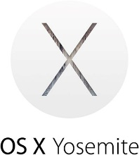

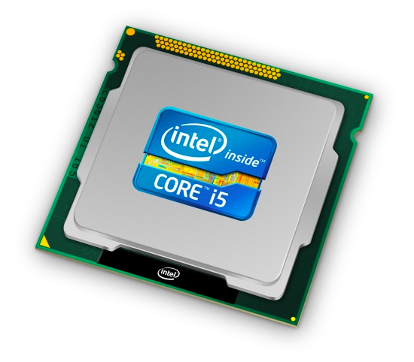
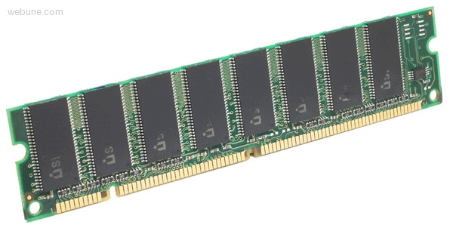
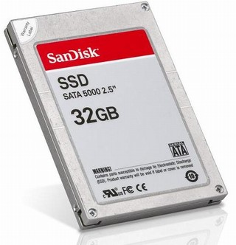
ACKNOWLEDGEMENT: These slides have been modified by your your CMPT 295 instructor and RISC-V ISA creators. However, please report all mistakes to your instructor.
C:
Java:
Memory & data
Arrays & structs
Integers & floats
RISC V assembly
Procedures & stacks
Executables
Memory & caches
Processor Pipeline
Performance
Parallelism
car *c = malloc(sizeof(car));
c->miles = 100;
c->gals = 17;
float mpg = get_mpg(c);
free(c);
Car c = new Car();
c.setMiles(100);
c.setGals(17);
float mpg =
c.getMPG();
Assembly language:
OS:
Machine code:
0111010000011000
100011010000010000000010
1000100111000010
110000011111101000011111
Computer system:

Slide 2
From Writing to Running
Compiler
Assembler
Linker
executable
program
gcc -S
gcc -c
gcc -o
sum.c
sum.s
sum.o
sum
C source
files
assembly
files
obj files
exists on
disk
loader
“It’s alive!”
When most people say “compile” they mean
the entire process:
compile + assemble + link
Executing
in
Memory
process
Notes:
C compiler produces assembly files (contain RISCV assembly, pseudo-instructions, directives, etc.)
RISCV assembler produces object files (contain RISCV machine code, missing symbols, some layout information, etc.)
RISCV linker produces executable file (contains RISCV machine code, no missing symbols, some layout information)
OS loader gets it into memory and jumps to first instruction (machine code)

Slide 3



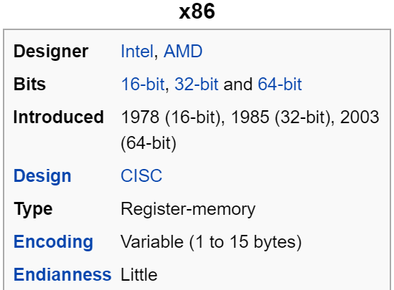
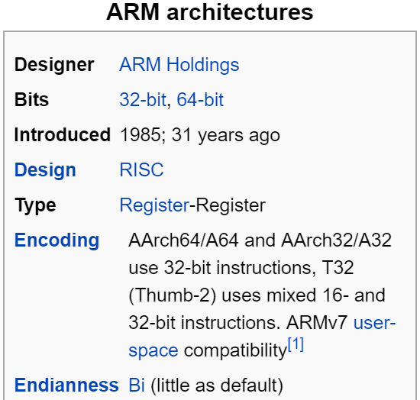
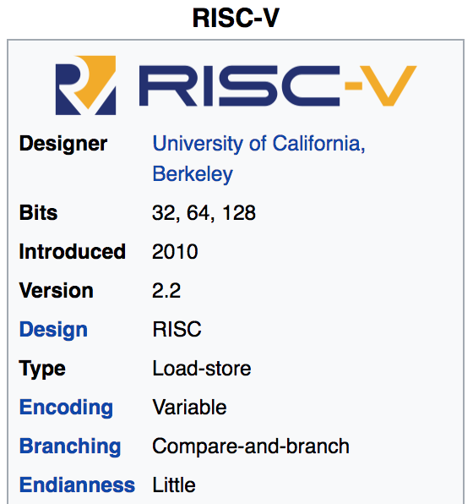
Mainstream ISAs
Macbooks & PCs
(Core i3, i5, i7, M)
x86 Instruction Set
Smartphone-like devices
(iPhone, iPad, Raspberry Pi)
ARM Instruction Set
Versatile and open-source
Relatively new, designed for cloud computing, high-end phones, small embedded sys.
RISCV Instruction Set
Notes:
We have many choices as to which assembly language we could pick:
intel x86, which is the machine language used by most of our laptops.
Why don’t we?
SUPER long and complicated
Arm, which is used in our iphone
ARM stands for Advanced RISC Machine

Slide 4
Intel x86 ISA | RISC-V ISA
Complex instructions (~800 instructions) *ptr++; (e.g., string operations, REP MOVS, etc.)- inc DWORD PTR [EAX] | Small set (~48 instructions) lw t0, 0(a0) # Read memory addi t0, t0, 1 # Increment sw t0, 0(a0) #
Multiple addressing modes (e.g., base + displacement + scaled index)- Can combine memory operands with arithmetic (e.g., ADD | Fewer addressing modes. Separates pointer access from operations on the value.
Variable length (1 to 15 bytes)- Complex encodings | Mostly fixed length (32 bits in the base ISA, with optional 16-bit compressed)

Slide 5
Registers -- Summary
In high-level languages, number of variables limited only by available memory
ISAs have a fixed, small number of operands called registers
  Special locations built directly into hardware
  Benefit: Registers are EXTREMELY FAST
  (faster than 1 billionth of a second)
  Drawback: Operations can only be performed on these predetermined number of registers
Notes:
Registers visible to compiler (or RISCV programmer).

Slide 6
Aside: Registers are Inside the Processor
Processor
Memory
Input
Control
Enable?
Read/Write
Program
Datapath
Address
PC
Bytes
Registers
Write Data
Data
Arithmetic & Logic Unit
(ALU)
Read Data
Output
Processor-Memory Interface
I/O-Memory Interfaces

Slide 7
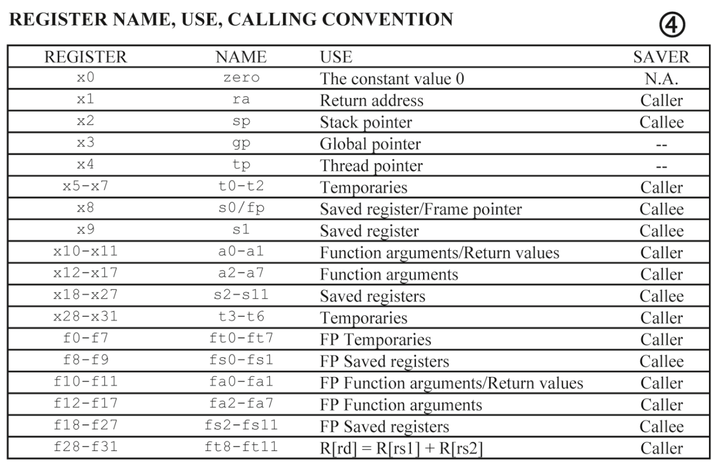
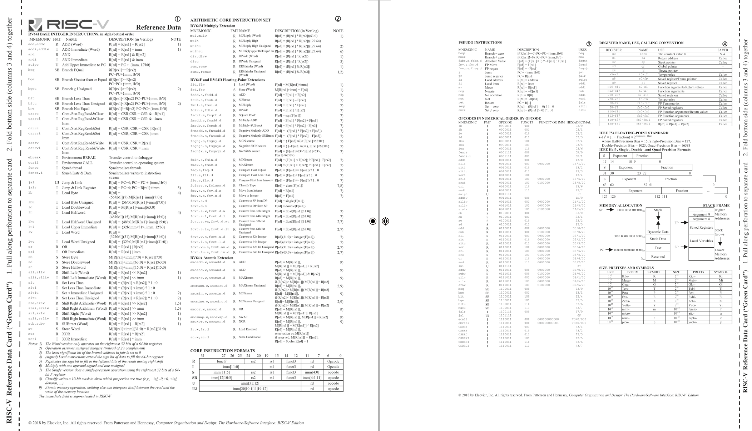
RISCV -- How Many Registers?
Tradeoff between speed and availability
  more registers → can house more variables simultaneously; all registers are slower.
RISCV has 32 registers (x0-x31)
  Each register is 32 bits wide and holds a word
Notes:
word = group of 32 bits (like how byte = group of 8 bits)
For the sake of comparison, ARM uses 16 registers.
How many bytes is a word?
what if we need more variables than that?!

Slide 8
RISC V Integer Registers – 32 bits wide
Notes:
Names are largely arbitrary, reasons behind them are not super relevant to us
But there are conventions about how they are used
One is particularly important to not misuse: %sp
Stack pointer; we’ll get to this when we talk about procedures
Each is 4-bytes wide
What if we only want 4 bytes?
We can use these alternate names to use just half of the bytes

Slide 9
Memory vs. Registers
Addresses vs. Names
  0x7FFFD024C3DC %x0
Big vs. Small
  ~ 8 GiB (16 x 8 B) = 128 B
Slow vs. Fast
  ~50-100 ns sub-nanosecond timescale
Dynamic vs. Static
  Can “grow” as needed fixed number in hardware
  while program runs

Slide 10
RISCV Registers
Register denoted by ‘x’ can be referenced by number (x0-x31) or name:
  Registers that hold programmer variables:
s0-s1 ⬌ x8-x9
s2-s11 ⬌ x18-x27
  Registers that hold temporary variables:
t0-t2 ⬌ x5-x7
t3-t6 ⬌ x28-x31
  You’ll learn about the other 13 registers later
Registers have no type (C concept); the operation being performed determines how register contents are treated

Slide 11
C, Java variables vs. registers
In C (and most High Level Languages) variables declared first and given a type. E.g.,
  int fahr, celsius;
  char a, b, c, d, e;
Each variable can ONLY represent a value of the type it was declared as (cannot mix and match int and char variables).
In Assembly Language, the registers have no type
  Operation determines how register contents are treated

Slide 12
RISCV Agenda
Basic Arithmetic Instructions
Comments
x0 (zero)
Immediates
Data Transfer Instructions
Decision Making Instructions
Bonus: C to RISCV Practice
Bonus: Additional Instructions

Slide 13
RISCV Instructions (1/2)
Instruction Syntax is rigid:
op dst, src1, src2
  1 operator, 3 operands
    op = operation name (“operator”)
    dst = register getting result (“destination”)
    src1 = first register for operation (“source 1”)
    src2 = second register for operation (“source 2”)
Keep hardware simple via regularity

Slide 14
RISCV Instructions (2/2)
One operation per instruction,
at most one instruction per line
Assembly instructions are related to C operations (=, +, -, *, /, &, |, etc.)
  Must be, since C code decomposes into assembly!
  A single line of C may break up into several lines of RISCV

Slide 15
RISCV Instructions Example
Your very first instructions!
(assume here that the variables a, b, and c are assigned to registers s1, s2, and s3, respectively)
Integer Addition (add)
  C: a = b + c
  RISCV: add s1, s2, s3
Integer Subtraction (sub)
  C: a = b - c
  RISCV: sub s1, s2, s3

Slide 16
RISCV Instructions Example
Suppose a → s0,b → s1,c → s2,d → s3 and e → s4. Convert the following C statement to RISCV:
a = (b + c) - (d + e);
add t1, s3, s4
add t2, s1, s2
sub s0, t2, t1
Ordering of instructions matters (must follow order of operations)
Utilize temporary registers
Notes:
add s0, s1, s2
add t0, s3, s4
sub s0, s0, t0
Suppose a -> s0, b->s1, c-> s2, d->s3 and e->s4. Convert the following C statement to RISCV:
a = (b + c) - (d + e);
add t1, s3, s4
add t2, s1, s2
sub s0, t2, t1

Slide 17
Assembly Instructions
In assembly language, each statement (called an Instruction), executes exactly one of a short list of simple commands
Unlike in C (and most other High Level Languages), each line of assembly code contains at most 1 instruction
Instructions are related to operations (=, +, -, *, /) in C or Java
Ok, enough already…gimme my RV32!

Slide 18
RISC V Assembly “Data Types”
Integral data of 1, 2, 4, or 8 bytes (we focus on 4 bytes)
  Data values
  Addresses
Floating point data of 4, 8, 10 or 2x8 or 4x4 or 8x2
  Different registers for those (e.g. %f0, %f31)
No aggregate types such as arrays or structures
  Just contiguously allocated bytes in memory
“AT&T”: used by our course, slides, textbook, gnu tools, …
Not covered
In 295
Notes:
Assembly program doesn’t actually have notion of “data types,” but since encoding is so different between integral and floating point data, there are actually different instructions built into assembly because the hardware needs to deal with these numbers differently when performing arithmetic.

Slide 19
Three Basic Kinds of Instructions
Transfer data between memory and register
  Load data from memory into register
    %reg = Mem[address]
  Store register data into memory
    Mem[address] = %reg
Perform arithmetic operation on register or memory data
  c = a + b; z = x << y; i = h & g;
Control flow: what instruction to execute next
  Unconditional jumps to/from procedures
  Conditional branches
    Remember: Memory is indexed just like an array of bytes!

Slide 20
Operand types
Immediate: Constant integer data
  Examples: $0x400, $-533
  Like C literal, but prefixed with ‘$’
  Encoded with 1, 2, 4, or 8 bytes
  depending on the instruction
Register: 22 integer registers
  Examples: %x9 … %x31
  But %x0-x4 and x8 reserved for special use
  Others have special uses for particular instructions
Memory: Consecutive bytes of memory at a computed address
  Simplest example: (%x18)

Slide 21
RISC-V Addition and Subtraction (1/4)
Syntax of Instructions:
  One two, three, four
  where:
  One = operation by name
  two = operand getting result (“destination”)
  three = 1st operand for operation (“source1”)
  four = 2nd operand for operation (“source2”)
Syntax is rigid:
  1 operator, 3 operands
  Why? Keep Hardware simple via regularity
add x1, x2, x3

Slide 22
Addition and Subtraction of Integers (2/4)
Addition in Assembly
  Example: add x1,x2,x3 (in RISC-V)
  Equivalent to: a = b + c (in C)
  where C variables ⇔ RISC-V registers are:
  a ⇔ x1, b ⇔ x2, c ⇔ x3
Subtraction in Assembly
  Example: sub x3,x4,x5 (in RISC-V)
  Equivalent to: d = e - f (in C)
  where C variables ⇔ RISC-V registers are:
  d ⇔ x3, e ⇔ x4, f ⇔ x5

Slide 23
Addition and Subtraction of Integers (3/4)
How to do the following C statement?
a = b + c + d - e;
Break into multiple instructions
  add x10, x1, x2 # a_temp = b + c
  add x10, x10, x3 # a_temp = a_temp + d
  sub x10, x10, x4 # a = a_temp - e
Notice: A single line of C may break up into several lines of RISC-V.
Notice: Everything after the hash mark on each line is ignored (comments). Check Apollo-11 comments!

Slide 24
Addition and Subtraction of Integers (4/4)
How do we do this?
  f = (g + h) - (i + j);
Use intermediate temporary register
  add x5, x20, x21 # a_temp = g + h
  add x6, x22, x23 # b_temp = i + j
  sub x19, x5, x6 # f = (g + h)- (i + j)

Slide 25
RISCV Agenda
Basic Arithmetic Instructions
Comments
x0 (zero)
Immediates
Data Transfer Instructions
Decision Making Instructions
Bonus: C to RISCV Practice
Bonus: Additional Instructions

Slide 26
Comments in Assembly
Another way to make your code more readable: comments!
Hash (#) is used for RISC-V comments
  anything from hash mark to end of line is a comment and will be ignored
  This is just like the C99 //
Note: Different from C.
  C comments have format
  /* comment */
  so they can span many lines

Slide 27
The Zero Register
Zero appears so often in code and is so useful that it has its own register!
Register zero (x0 or zero) always has the value 0 and cannot be changed!
  i.e. any instruction with x0 as dst has no effect
Example Uses:
  add s3, x0, x0 # c=0
  add s1, s2, x0 # a=b

Slide 28
RISCV Agenda
Basic Arithmetic Instructions
Comments
x0 (zero)
Immediates
Data Transfer Instructions
Decision Making Instructions
Bonus: C to RISCV Practice
Bonus: Additional Instructions

Slide 29
Immediates
Numerical constants are called immediates
Separate instruction syntax for immediates:
opi dst, src, imm
  Operation names end with ‘i’, replace 2nd source register with an immediate
Example Uses:
  addi s1, s2, 5 # a=b+5
  addi s3, s3, 1 # c++
Why no subi instruction?
Notes:
Goal of RISC is to minimize instruction set. subi dst, src, imm = addi dst, src, -imm.

Slide 30
Immediates
Immediates are numerical constants.
They appear often in code, so there are special instructions for them.
Add Immediate:
  addi x3,x4,10 (in RISC-V)
  f = g + 10 (in C)
  where RISC-V registers x3,x4 are associated with C variables f, g
Syntax similar to add instruction, except that last argument is a number instead of a register.

Slide 31
Immediates
There is no Subtract Immediate in RISC-V: Why?
  There are add and sub, but no addi counterpart
Limit types of operations that can be done to absolute minimum
  if an operation can be decomposed into a simpler operation, don’t include it
  addi …, -X = subi …, X => so no subi
  addi x3,x4,-10 (in RISC-V)
  f = g - 10 (in C)
  where RISC-V registers x3, x4 are associated with C variables f, g

Slide 32
Data Transfer:
Load from and Store to memory
Processor
Memory
Input
Enable?
Read/Write
Control
Program
Datapath
Address
Bytes
Much larger place
To hold values, but slower than registers!
PC
Write Data = Store to memory
Registers
Arithmetic & Logic Unit
(ALU)
Data
Read Data = Load from
memory
Output
Fast but limited place
To hold values
Processor-Memory Interface
I/O-Memory Interfaces

Slide 33
Memory Addresses are in Bytes
Data typically smaller than 32 bits, but rarely smaller than 8 bits (e.g., char type)–works fine if everything is a multiple of 8 bits
8 bit chunk is called a byte
(1 word = 4 bytes)
Memory addresses are really
in bytes, not words
Word addresses are 4 bytes apart
  Word address is same as address of
  rightmost byte – least-significant byte
  (i.e. Little-endian convention)
Least-significant byte in a word
…
…
…
…
…
3
12
13
14
15
2
8
9
10
11
1
4
5
6
7
0
0
1
2
3
7 0
15 8
23 16
31 24
Least-significant byte
gets the smallest address

Slide 34
Big Endian vs. Little Endian
en.wikipedia.org/wiki/Big_endian
The order in which BYTES are stored in memory
Bits always stored as usual. (E.g., 0xC2=0b 1100 0010)
Consider the number 1025 as we normally write it:
BYTE3 BYTE2 BYTE1 BYTE0
00000000 00000000 00000100 00000001
Big Endian
ADDR3 ADDR2 ADDR1 ADDR0
BYTE0 BYTE1 BYTE2 BYTE3
00000001 00000100 00000000 00000000
Little Endian
ADDR3 ADDR2 ADDR1 ADDR0
BYTE3 BYTE2 BYTE1 BYTE0
00000000 00000000 00000100 00000001
Big-endian and little-endian derive from Jonathan Swift's Gulliver's Travels in which the Big Endians were a political faction that broke their eggs at the large end ("the primitive way") and rebelled against the Lilliputian King who required his subjects (the Little Endians) to break their eggs at the small end.

Slide 35
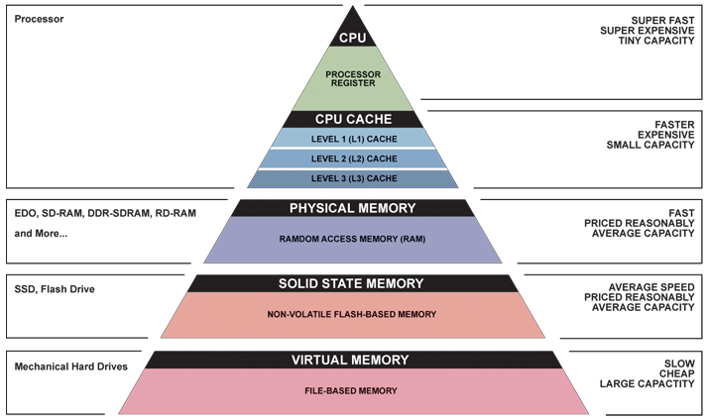
Great Idea #3: Principle of Locality / Memory Hierarchy

Slide 36
Speed of Registers vs. Memory
Given that
  Registers: 32 words (128 Bytes)
  Memory (DRAM): Billions of bytes (2 GB to 64 GB on laptop)
and physics dictates…
  Smaller is faster
How much faster are registers than DRAM??
  About 100-500 times faster! (in terms of latency of one access)

Slide 37
Load from Memory to Register
C code
int A[100];
g = h + A[3];
Using Load Word (lw) in RISC-V:
lw x10,12(x15) # Reg x10 gets A[3]
add x11,x12,x10 # g = h + A[3]
Note: x15 – base register (pointer to A[0])
12 – offset in bytes
Offset must be a constant known at assembly time
Data flow

Slide 38
Store from Register to Memory
C code
int A[100];
A[10] = h + A[3];
Using Store Word (sw) in RISC-V:
lw x10,12(x15) # Temp reg x10 gets A[3]
add x10,x12,x10 # Temp reg x10 gets h + A[3]
sw x10,40(x15) # A[10] = h + A[3]
Note: x15 – base register (pointer)
12,40 – offsets in bytes
x15+12 and x15+40 must be multiples of 4
Data flow
Notes:
80 – 5 (Clicker) – 3 (News/Administrativia) = 72 (36 slides max)
Clicker at 20 (half+)

Slide 39
Loading and Storing Bytes
In addition to word data transfers
(lw, sw), RISC-V has byte data transfers:
  load byte: lb
  store byte: sb
Same format as lw, sw
E.g., lb x10,3(x11)
  contents of memory location with address = sum of “3” + contents of register x11 is copied to the low byte position of register x10.
xxxx xxxx xxxx xxxx xxxx xxxx
zzz zzzz
x10:
x
byte
loaded
…is copied to “sign-extend”
This bit
RISC-V also has “unsigned byte” loads (lbu) which zero extends to fill register. Why no unsigned store byte sbu?

Slide 40
RISCV Agenda
Basic Arithmetic Instructions
Comments
x0 (zero)
Immediates
Data Transfer Instructions
Decision Making Instructions
Bonus: C to RISCV Practice
Bonus: Additional Instructions

Slide 41
Decision Making Instructions
Branch If Equal (beq)
  beq reg1,reg2,label
  If value in reg1 = value in reg2, go to label
Branch If Not Equal (bne)
  bne reg1,reg2,label
  If value in reg1 ≠ value in reg2, go to label
Jump (j)
  j label
  Unconditional jump to label

Slide 42
Types of Branches
Branch – change of control flow
Conditional Branch – change control flow depending on outcome of comparison
  branch if equal (beq) or branch if not equal (bne)
  Also branch if less than (blt) and branch if greater than or equal (bge)
Unconditional Branch – always branch
  a RISC-V instruction for this: jump (j), as in j label

Slide 43
Breaking Down the If Else
C Code:
RISCV (beq):
if(i==j) {
a = b /* then */
} else {
a = -b /* else */
}
In English:
If TRUE, execute the THEN block
If FALSE, execute the ELSE block
# i→s0, j→s1
# a→s2, b→s3
beq s0,s1,then
else:
sub s2, x0, s3
j end
then:
add s2, s3, x0
end:
???
???
This label unnecessary

Slide 44
Breaking Down the If Else
C Code:
RISCV (bne):
if(i==j) {
a = b /* then */
} else {
a = -b /* else */
}
In English:
If TRUE, execute the THEN block
If FALSE, execute the ELSE block
# i→s0, j→s1
# a→s2, b→s3
bne s0,s1,else
then:
add s2, s3, x0
j end
else:
sub s2, x0, s3
end:
???
???

Slide 45
Branching on Conditions other than (Not) Equal
Set Less Than (slt)
  slt dst, reg1,reg2
  If value in reg1 < value in reg2, dst = 1, else 0
Set Less Than Immediate (slti)
  slti dst, reg1,imm
  If value in reg1 < imm, dst = 1, else 0

Slide 46
Breaking Down the If Else
C Code:
RISCV (???):
if(i<j) {
a = b /* then */
} else {
a = -b /* else */
}
In English:
If TRUE, execute the THEN block
If FALSE, execute the ELSE block
# i→s0, j→s1
# a→s2, b→s3
slt t0 s0 s1
beq t0,x0,else
then:
add s2, s3, x0
j end
else:
sub s2, x0, s3
end:
???
???

Slide 47
Branching on Conditions other than (Not) Equal
Branch Less Than (blt)
  blt reg1,reg2, label
  If value in reg1 < value in reg2, go to label
Branch Greater Than or Equal (bge)
  bge reg1,reg2, label
  If value in reg1 >= value in reg2, go to label

Slide 48
Breaking Down the If Else
C Code:
RISCV (???):
if(i<j) {
a = b /* then */
} else {
a = -b /* else */
}
In English:
If TRUE, execute the THEN block
If FALSE, execute the ELSE block
# i→s0, j→s1
# a→s2, b→s3
bge s0,s1,else
then:
add s2, s3, x0
j end
else:
sub s2, x0, s3
end:
???

Slide 49
Example if Statement
Assuming translations below, compile if block
f → x10 g → x11 h → x12
i → x13 j → x14
if (i == j) bne x13,x14,Exit
f = g + h; add x10,x11,x12
Exit:
May need to negate branch condition

Slide 50
Example if-else Statement
Assuming translations below, compile
f → x10 g → x11 h → x12
i → x13 j → x14
if (i == j) bne x13,x14,Else
f = g + h; add x10,x11,x12
else j Exit
f = g – h; Else:
sub x10,x11,x12
Exit:

Slide 51
C Loop Mapped to RISC-V Assembly
int A[20];
int sum = 0;
for (int i=0; i < 20; i++)
sum += A[i];
add x9, x8, x0 # x9=&A[0]
add x10, x0, x0 # sum=0
add x11, x0, x0 # i=0
addi x13,x0, 20 # x13=20
Loop:
bge x11,x13,Done
lw x12, 0(x9) # x12=A[i]
add x10,x10,x12 # sum+=
addi x9, x9,4 # &A[i+1]
addi x11,x11,1 # i++
j Loop
Done:

Slide 52
“And in Conclusion…”
Memory is byte-addressable, but lw and sw access one word at a time.
A pointer (used by lw and sw) is just a memory address, we can add to it or subtract from it (using offset).
A Decision allows us to decide what to execute at run-time rather than compile-time.
C Decisions are made using conditional statements within if, while, do while, for.
RISC-V Decision making instructions are the conditional branches: beq and bne.
New Instructions:
  lw, sw, lb, sb, lbu, beq, bne, blt, bltu, bge, j

Slide 53
BONUS SLIDES
You are responsible for the material contained on the following slides, though we may not have enough time to get to them in lecture.
You may learn the material just by doing other coursework, but hopefully these slides will help clarify the material.

Slide 54
Pattern-based Programming
Foundation for writing efficient, maintainable, and reliable code.
Readability and Maintainability
  Assembly has no abstractions
  Patterns allow developers to quickly understand and modify code.
Debugging
  Mental model of how code should work
  Catch subtle errors

Slide 55
C to RISCV Practice
Let’s put our all of our new RISCV knowledge to use in an example: “Fast String Copy”
C code is as follows:
/* Copy string from p to q */
char *p, *q;
while((*q++ = *p++) != ‘\0’) ;
What do we know about its structure?
  Single while loop
  Exit condition is an equality test

Slide 56
C to RISCV Practice
Start with code skeleton:
# copy String p to q
# p→s0, q→s1 (pointers)
Loop: lb $t0,0($s0) # $t0 = *p
sb $t0,0($s1) # *q = $t0
addi $s0,$s0,1 # p = p + 1
addi $s1,$s1,1 # q = q + 1
beq $t0,$0,Exit # if *p==0, go to Exit
j Loop # go to Loop
Exit: # N chars in p => N*6 instructions
# t0 = *p
# *q = t0
# p = p + 1
# q = q + 1
# if *p==0, go to Exit
# go to Loop

Slide 57
C to RISCV Practice
Fill in lines:
# copy String p to q
# p→s0, q→s1 (pointers)
Loop: lb $t0,0($s0) # t0 = *p
sb $t0,0($s1) # *q = t0
addi $s0,$s0,1 # p = p + 1
addi $s1,$s1,1 # q = q + 1
beq $t0,$0,Exit # if *p==0, go to Exit
j Loop # go to Loop
Exit: # N chars in p => N*6 instructions
lb t0,0(s0)
sb t0,0(s1)
addi s0,s0,1
addi s1,s1,1
beq t0,0,Exit

Slide 58
C to RISCV Practice
Finished code:
# copy String p to q
# p→$s0, q→$s1 (pointers)
Loop: lb t0,0(s0) # t0 = *p
sb t0,0(s1) # *q = t0
addi s0,s0,1 # p = p + 1
addi s1,s1,1 # q = q + 1
beq t0,x0,Exit # if *p==0, go to Exit
j Loop # go to Loop
Exit: # N chars in p => N*6 instructions
Notes:
Is this the only way to write out this function? Of course not.

Slide 59
C to RISCV Practice
Alternate code using bne:
# copy String p to q
# p→s0, q→s1 (pointers)
Loop: lb t0,0(s0) # t0 = *p
sb t0,0(s1) # *q = t0
addi s0,s0,1 # p = p + 1
addi s1,s1,1 # q = q + 1
bne t0,x0,Loop # if *p!=0, go to Loop
# N chars in p => N*5 instructions
Notes:
Used fewer instructions!
Instead of “exit when equal to zero”, we are now using “loop when not equal to zero.”

Slide 60
RISCV to C Practice
Loop:
bge x11,x13,Done
lw x12, 0(x9)
add x10,x10,x12
addi x9, x9,4
addi x11,x11,1
j Loop
Done:

Slide 61
RISCV to C Practice
X11 : loop index I
X13 : breakout condition
for (i = ?; i < x13; i++)
Loop:
bge x11,x13,Done
lw x12, 0(x9)
add x10,x10,x12
addi x9, x9,4
addi x11,x11,1
j Loop
Done:

Slide 62
RISCV to C Practice
X11 : loop index I
X13 : breakout condition
for (i = ?; i < x13; i++)
{
lw -> array a[i].
x9 -> &a[i], x12 -> a[i]
add x9,x9,4 -> int a[i]
add x11,x11,1 -> i++
}
Loop:
bge x11,x13,Done
lw x12, 0(x9)
add x10,x10,x12
addi x9, x9,4
addi x11,x11,1
j Loop
Done:

Slide 63
RISCV to C Practice
Loop:
bge x11,x13,Done
slli x14,x11,2
addi x9,x10,x14
lw x12, 0(x9)
addi x11,x11,1
j Loop
Done:
x9 – a[i]
Addi – Base + offset
&a[0] + offset
x14 – offset. i << 2
x10 –Base address &a[0]

Slide 64
RISCV Arithmetic Instructions
Multiplication (mul and mulh)
  mul dst, src1, src2
  mulh dst, src1, src2
  src1*src2: lower 32-bits through mul, upper 32-bits in mulh
Division (div)
  div dst, src1, src2
  rem dst, src1, src2
  src1/src2: quotient via div, remainder via rem

Slide 65
RISCV Bitwise Instructions
Note: a→s1, b→s2, c→s3
Instruction | C | RISCV
And | a = b & c; | and s1,s2,s3
And Immediate | a = b & 0x1; | andi s1,s2,0x1
Or | a = b | c; | or s1,s2,s3
Or Immediate | a = b | 0x5; | ori s1,s2,0x5
Exclusive Or | a = b ^ c; | xor s1,s2,s3
Exclusive Or Immediate | a = b ^ 0xF; | xori s1,s2,0xF

Slide 66
Shifting Instructions
In binary, shifting an unsigned number left is the same as multiplying by the corresponding power of 2
  Shifting operations are faster
  Does not work with shifting right/division
Logical shift: Add zeros as you shift
Arithmetic shift: Sign-extend as you shift
  Only applies when you shift right (preserves sign)
Shift by immediate or value in a register

Slide 67
Shifting Instructions
Instruction Name | RISCV
Shift Left Logical | sll s1,s2,s3
Shift Left Logical Imm | slli s1,s2,imm
Shift Right Logical | srl s1,s2,s3
Shift Right Logical Imm | srli s1,s2,imm
Shift Right Arithmetic | sra s1,s2,s3
Shift Right Arithmetic Imm | srai s1,s2,imm
When using immediate, only values 0-31 are practical
When using variable, only lowest 5 bits are used (read as unsigned)

Slide 68
Shifting Instructions
# sample calls to shift instructions
addi t0,x0 ,-256 # t0=0xFFFFFF00
slli s0,t0,3 # s0=0xFFFFF800
srli s1,t0,8 # s1=0x00FFFFFF
srai s2,t0,8 # s2=0xFFFFFFFF
addi t1,x0 ,-22 # t1=0xFFFFFFEA
# low 5: 0b01010
sll s3,t0,t1 # s3=0xFFFC0000
# same as slli s3,t0,10

Slide 69
Shifting Instructions
Example 1:
# lb using lw: lb s1,1(s0)
lw s1,0(s0) # get word
andi s1,s1,0xFF00 # get 2nd byte
srli s1,s1,8 # shift into lowest

Slide 70
Shifting Instructions
Example 2:
# sb using sw: sb s1,3(s0)
lw t0,0(s0) # get current word
andi t0,t0,0xFFFFFF # zero top byte
slli t1,s1,24 # shift into highest
or t0,t0,t1 # combine
sw t0,0(s0) # store back

Slide 71
Shifting Instructions
Extra for Experts:
  Rewrite the two preceding examples to be more general
  Assume that the byte offset (e.g. 1 and 3 in the examples, respectively) is contained in s2
Hint:
  The variable shift instructions will come in handy
  Remember, the offset can be negative

Slide 72
Switch Statement Example
long switch_ex
(long x, long y, long z)
{
long w = 1;
switch (x) {
case 1:
w = y*z;
break;
case 2:
w = y/z;
/* Fall Through */
case 3:
w += z;
break;
case 5:
case 6:
w -= z;
break;
default:
w = 2;
}
return w;
}
Multiple case labels
  Here: 5 & 6
Fall through cases
  Here: 2
Missing cases
  Here: 4
Implemented with:
  Jump table
  Indirect jump instruction

Slide 73
Jump Table Structure
Switch Form
Jump Table
Jump Targets
switch (x) {
case val_0:
Block 0
case val_1:
Block 1
• • •
case val_n-1:
Block n–1
}
JTab:
Targ0
Targ0:
Code
Block 0
Targ1
Targ2
Targ1:
Code
Block 1
•
•
•
Targn-1
Targ2:
Code
Block 2
Approximate Translation
•
•
•
target = JTab[x];
goto target;
Targn-1:
Code
Block n–1

Slide 74

Jump Table Structure
C code:
Memory
switch (x) {
case 1: <some code>
break;
case 2: <some code>
case 3: <some code>
break;
case 5:
case 6: <some code>
break;
default: <some code>
}
Code
Blocks
Use the jump table when x $≤$ 6:
0
if (x <= 6)
target = JTab[x];
goto target;
else
goto default;
1
Jump
Table
2
3
4
5
6

Slide 75
Jump Table
declaring data, not instructions
8-byte memory alignment
Jump table
switch(x) {
case 1: // .L3
w = y*z;
break;
case 2: // .L5
w = y/z;
/* Fall Through */
case 3: // .L9
w += z;
break;
case 5:
case 6: // .L7
w -= z;
break;
default: // .L8
w = 2;
}
.section .rodata
.align 8
.L4:
.quad .L8 # x = 0
.quad .L3 # x = 1
.quad .L5 # x = 2
.quad .L9 # x = 3
.quad .L8 # x = 4
.quad .L7 # x = 5
.quad .L7 # x = 6
this data is 64-bits wide
Notes:
.rodata – read-only data section

Slide 76
Handling Fall-Through
long w = 1;
. . .
switch (x) {
. . .
case 2: // .L5
w = y/z;
/* Fall Through */
case 3: // .L9
w += z;
break;
. . .
}
case 2:
w = y/z;
goto merge;
case 3:
w = 1;
More complicated choice than “just fall-through” forced by “migration” of w = 1;
  Example compilation trade-off
merge:
w += z;

