Slide 1
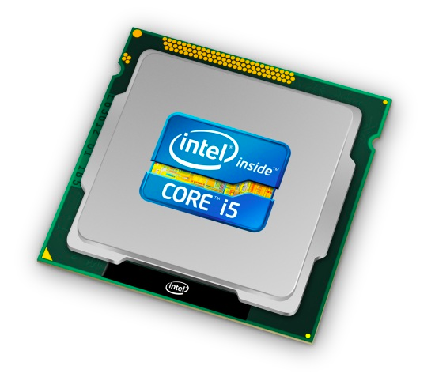
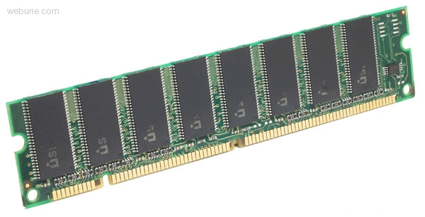
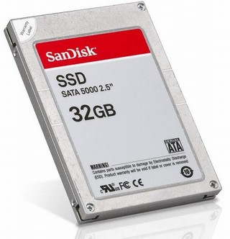
Roadmap
C:
Java:
Memory & data
Arrays & structs
Integers & floats
RISC V assembly
Procedures & stacks
Executables
Memory & caches
Processor Pipeline
Performance
Parallelism
car *c = malloc(sizeof(car));
c->miles = 100;
c->gals = 17;
float mpg = get_mpg(c);
free(c);
Car c = new Car();
c.setMiles(100);
c.setGals(17);
float mpg = c.getMPG();
Assembly language:
OS:
Machine code:
0111010000011000
100011010000010000000010
1000100111000010
110000011111101000011111
Computer system:

Slide 2
Agenda
Stored-Program Concept
R-Format
I-Format
S-Format
SB-Format
U-Format
UJ-Format

Slide 3
So how do we represent instructions?
Remember: Computer only understands 1s and 0s, so assembler string “add x10,x11,x0” is meaningless to hardware

Slide 4
Big Idea: Stored-Program Concept
INSTRUCTIONS ARE DATA
programs can be stored in memory as numbers
Before: a number can mean anything
Now: make convention for interpreting numbers as instructions

Slide 5
*Layout in 295
On actual hw code starts at
0x00400000
0xfffffffc
system reserved
top
0x80000000
0x7ffffffc
stack
dynamic data (heap)
0x10000000
static data
.data
code (text)
.text
0x00000000

Slide 6
Instructions as Numbers
By convention, RISCV instructions are each 1 word = 4 bytes = 32 bits
31
0
Divide the 32 bits of an instruction into “fields”
regular field sizes → simpler hardware
will need some variation….
Notes:
6 formats to memorize, but 4 formats to internalize (R with three registers, I with two registers and an immediate, S with two registers and an address, U with a big immediate/address)

Slide 7
The 6 Instruction Formats
R-Format: instructions using 3 register inputs
add, xor, mul —arithmetic/logical ops
I-Format: instructions with immediates, loads
addi, lw, jalr, slli
S-Format: store instructions: sw,sb
SB-Format: branch instructions: beq, bge
U-Format: instructions with upper immediates
lui, auipc —upper immediate is 20-bits
UJ-Format: the jump instruction: jal
Notes:
lui: load upper immediate
auipc: adding an upper immediate to PC and putting the result in a register

Slide 8
R-Format Example
RISCV Instruction: add x5,x6,x7
Field representation (decimal):
Field representation (binary):
31
0
0
7
6
0
5
0x33
31
0
0000000
00111
00110
000
00101
0110011
_{two}
hex representation: 0x 0073 02B3
decimal representation: 7,537,331
Called a Machine Language Instruction
Notes:
x5 = t0, x6 = t1, x7 = t2

Slide 9
I-Format Instructions (3/4)
31
0
imm[11:0]
rs1
func3
rd
opcode
opcode (7): uniquely specifies the instruction
rs1 (5): specifies a register operand
rd (5): specifies destination register that receives result of computation

Slide 10
I-Format Instructions (4/4)
31
0
imm[11:0]
rs1
func3
rd
opcode
immediate (12): 12 bit number
All computations done in words, so 12-bit immediate must be extended to 32 bits
always sign-extended to 32-bits before use in an arithmetic operation
Can represent 2¹² different immediates
imm[11:0] can hold values in range [-2¹¹ , +2¹¹)

Slide 11
I-Format Example (1/2)
addi x15,x1,-50
rd = x15
rs1 = x1
31
0
00001
???
???
01111
111111001110
?
0
???
???
0x13
imm[11:0]
rs1
func3
rd
opcode

Slide 12
Load Instructions are also I-Type
31
0
imm[11:0]
rs1
func3
rd
opcode
offset[11:0]
base
width
dst
LOAD
The 12-bit signed immediate is added to the base address in register rs1 to form the memory address
This is very similar to the add-immediate operation but used to create address, not to create final result
Value loaded from memory is stored in rd

Slide 13
I-Format Load Example
lw x14, 8(x2)
31
0
imm[11:0]
rs1
func3
rd
opcode
offset[11:0]
base
width
dst
LOAD
000000001000
00010
010
01110
0000011
imm=+8
rs1=2
LW
rd=14
LOAD

Slide 14
S-Format Used for Stores
Store needs to read two registers, rs1 for base memory address, and rs2 for data to be stored, as well as need immediate offset!
Can’t have both rs2 and immediate in same place as other instructions!
Note: stores don’t write a value to the register file, no rd!
RISC-V design decision is move low 5 bits of immediate to where rd field was in other instructions – keep rs1/rs2 fields in same place
register names more critical than immediate bits in hardware design
31
0
imm[11:5]
rs2
rs1
func3
imm[4:0]
opcode

Slide 15
S-Format Example
sw x14, 8(x2)
31
0
imm[11:5]
rs2
rs1
func3
imm[4:0]
opcode
00000000
01110
00010
010
01000
0100011
off[11:5] = 0
rs2=14
rs1=2
SW
off[4:0] = 8
STORE

Slide 16
RISC-V B-Format for Branches
B-format is mostly same as S-Format, with two register sources (rs1/rs2) and a 12-bit immediate
But now immediate represents values -2¹² to +2¹²-2 in 2-byte increments
The 12 immediate bits encode even 13-bit signed byte offsets (lowest bit of offset is always zero, so no need to store it)
31
0
imm[12|10:5]
rs2
rs1
func3
imm[4:1|11]
opcode
7
5
5
3
5
7

Slide 17
Branch Example (1/2)
RISCV Code:
Loop: beq x19,x10,End add x18,x18,x10 addi x19,x19,-1 j Loop End: <target instr>
Branch offset =
(Branch with offset of 0, branches to itself)
Start counting from instruction AFTER the branch
1
2
3
4
4×32-bit instructions = 16 bytes

Slide 18
Branch Example (1/2)
RISCV Code:
Loop: beq x19,x10,End add x18,x18,x10 addi x19,x19,-1 j Loop End: <target instr>
Start counting from instruction AFTER the branch
1
2
3
4
7
5
5
3
5
7
31
0
???????
01010
10011
000
?????
1100011
rs2=10
rs1=19
BEQ
BRANCH

Slide 19
Branch Example (1/2)
beq x19,x10,offset = 16 bytes
13-bit immediate, imm[12:0], with value 16 0000000010000
imm[0] discarded, always zero
31
0
0 000000
01010
10011
000
1000 0
1100011
imm[12|10:5]
imm[4:1|11]

Slide 20
U-Format for “Upper Immediate” instructions
31
0
imm[31:12]
rd
opcode
20
U-immediate[31:12]
5
dest
7
LUI/AUIPC
Has 20-bit immediate in upper 20 bits of 32-bit instruction word
One destination register, rd
Used for two instructions
LUI – Load Upper Immediate
AUIPC – Add Upper Immediate to PC

Slide 21
LUI to create long immediates
lui writes the upper 20 bits of the destination with the immediate value, and clears the lower 12 bits
Together with an addi to set low 12 bits, can create any 32-bit value in a register using two instructions (lui/addi).
lui x10, 0x87654 # x10 = 0x87654000
addi x10, x10, 0x321 # x10 = 0x87654321

Slide 22
UJ-Format Instructions (2/3)
31
0
imm[20|10:1|11|19:12]
rd
opcode
20
offset[31:12]
5
dest
7
JAL
jal saves PC+4 in register rd (the return address)
Set PC = PC + offset (PC-relative jump)
Target somewhere within ±2¹⁹ locations, 2 bytes apart
±2¹⁸ 32-bit instructions
Reminder: “j” jump is a pseudo-instruction—the assembler will instead use jal but sets rd=x0 to discard return address
Immediate encoding optimized similarly to branch instruction to reduce hardware cost

Slide 23
Uses of jalr
31
0
imm[11:0]
rs1
func3
rd
opcode
offset
base
0
dest
JALR
# ret and jr psuedo-instructions
ret = jr ra = jalr x0, ra, 0
# Call function at any 32-bit absolute address
lui x1, <hi 20 bits>
jalr ra, x1, <lo 12 bits>
# Jump PC-relative with 32-bit offset
auipc x1, <hi 20 bits>
jalr x0, x1, <lo 12 bits>

Slide 24
Summary of RISC-V Instruction Formats

