Slide 1
Agenda
AMAT
Multilevel Caches
Improving Cache Performance
Anatomy of a Cache Question
Example Cache Questions
Bonus: Contemporary Cache Specs

Slide 2
Access Patterns
How many hits within a single block once it is loaded into cache?
Will block still be in cache when you revisit its elements?
Are there special/edge cases to consider?
  Usually edge of block boundary or edge of cache size boundary
Sometimes you can generalise a block access pattern for the entire code chunk!

Slide 3
Anatomy of a Cache Question
Cache questions come in a few flavors:
  TIO Breakdown
  For fixed cache parameters, analyze the performance of the given code/sequence
  For fixed cache parameters, find best/worst case scenarios
  For given code/sequence, how does changing your cache parameters affect performance?
  AMAT

Slide 4
The Cache
What are the important cache parameters?
  Must figure these out from problem description
  Address size, cache size, block size, associativity, replacement policy
  Solve for TIO breakdown, # of sets, set size
Are there multiple levels?
  Mostly applies to AMAT questions
What starts in the cache?
  Not always specified (best/worst case)

Slide 5
Code: Arrays
Elements stored sequentially in memory
  Ideal for spatial locality
  Different arrays not necessarily next to each other
Remember to account for data size!
  char is 1 byte, int is 4 bytes
Pay attention to access pattern
  Touch all elements (e.g. shift, sum)
  Touch some elements (e.g. histogram, stride)
  How many times do we touch each element?
    If looping, consider “per iteration” and generalise

Slide 6
Code: Linked Lists/Structs
Nodes stored separately in memory
  Addresses of nodes may be very different
  Type and ordering of linking is important
Remember to account for size/ordering of struct elements
Pay attention to access pattern
  Generally must start from “head”
  How many struct elements are touched?
    Again: can you generalise within a loop?

Slide 7
Access Patterns
How many hits within a single block once it is loaded into cache?
Will block still be in cache when you revisit its elements?
Are there special/edge cases to consider?
  Usually edge of block boundary or edge of cache size boundary
Sometimes you can generalise a block access pattern for the entire code chunk!

Slide 8
Agenda
AMAT
Multilevel Caches
Improving Cache Performance
Anatomy of a Cache Question
Example Cache Questions
Bonus: Contemporary Cache Specs

Slide 9
Example 1
1 GiB address space, 100 cycles to go to memory. Fill in the following table:
 | L1 | L2
Cache Size | 32 KiB | 512 KiB
Block Size | 8 B | 32 B
Associativity | 4-way | Direct-mapped
Hit Time | 1 cycle | 33 cycles
Miss Rate | 10% | 2%
Write Policy | Write-through | Write-through
Replacement Policy | LRU | n/a
Tag
Index
Offset
AMAT
17
11
10
14
3
5
AMAT L1 =
1 + 0.1 * 35 = 4.5
AMAT L2 =
33 + 0.02 * 100 = 35

Slide 10
Example 1
Only use L1$: C = 32 KiB, K = 8 B, 4-way, LRU, write-through
char A[] is block aligned and SIZE = 32 MiB
char *A = (char *) malloc (SIZE*sizeof(char));
/* number of STRETCHes */
for (i = 0; i < (SIZE/STRETCH); i++) {
/* go up to STRETCH */
for(j=0;j<STRETCH;j++) sum += A[i*STRETCH+j];
/* down from STRETCH */
for(j=STRETCH-1;j>=0;j--) prod *= A[i*STRETCH+j];
}
2nd inner for loop hits same indices as 1st inner for loop, but in reverse order
Always traverse full SIZE, regardless of STRETCH

Slide 11
Example 1
Only use L1$: C = 32 KiB, K = 8 B, N = 4, LRU, write-through
char A[] is block aligned and SIZE = 32 MiB
char *A = (char *) malloc (SIZE*sizeof(char));
for (i = 0; i < (SIZE/STRETCH); i++) {
for(j=0;j<STRETCH;j++) sum += A[i*STRETCH+j];
for(j=STRETCH-1;j>=0;j--) prod *= A[i*STRETCH+j];
}
As we double our STRETCH from 1 to 2 to 4 (…etc), we notice the number of cache misses doesn’t change! What is the largest value of STRETCH before cache misses changes?
32 KiB, when STRETCH exactly equals C

Slide 12
Example 1 (But visual)
Set
A[0]
A[2¹⁵]
0
A[8]
A[2¹⁵+8]
A[2¹²-8]
A[2¹⁵+2¹²-8]
A[2¹²]
1
Cache is full after 32 KiB
[A[0], A[2¹⁵ - 1]] (green)
2¹⁰ - 1

Slide 13
Example 1
Only use L1$: C = 32 KiB, K = 8 B, N = 4, LRU, write-through
char A[] is block aligned and SIZE = 32 MiB
char *A = (char *) malloc (SIZE*sizeof(char));
for (i = 0; i < (SIZE/STRETCH); i++) {
for(j=0;j<STRETCH;j++) sum += A[i*STRETCH+j];
for(j=STRETCH-1;j>=0;j--) prod *= A[i*STRETCH+j];
}
If we double our STRETCH from (b), what is the ratio of cache hits to misses?
Now STRETCH = 64 KiB. Moving sequentially by byte, so each block for entire 1st inner loop has 1 miss and 7 hits (7:1).
Upper half of STRETCH lives in cache, so first half of 2nd inner loop is 8 hits/block (8:0). Second half is as before (7:1).

Slide 14
Example 1 (But visual)
Set
A[0]
A[2¹⁵]
0
A[8]
A[2¹⁵+8]
A[2¹²-8]
A[2¹⁵+2¹²-8]
A[2¹²]
1
Cache is full after 32 KiB
[A[0], A[2¹⁵ - 1]] (green)
Cache fills up again entirely with the remaining 32 KiB [A[2¹⁵], A[2¹⁶ - 1]] (red)
So when we go through the second iteration (in reverse), red elements (2nd half) are still in the cache and green elements (first half) will need to be loaded again.
2¹⁰ - 1

Slide 15
Example 1
Only use L1$: C = 32 KiB, K = 8 B, N = 4, LRU, write-through
char A[] is block aligned and SIZE = 32 MiB
char *A = (char *) malloc (SIZE*sizeof(char));
for (i = 0; i < (SIZE/STRETCH); i++) {
for(j=0;j<STRETCH;j++) sum += A[i*STRETCH+j];
for(j=STRETCH-1;j>=0;j++) prod += A[i*STRETCH+j];
}
If we double our STRETCH from (b), what is the ratio of cache hits to misses?
Considering the equal-sized chunks of half of each inner for loop, we have loop 1 1st (7:1), loop 1 2nd (7:1), loop 2 1st (8:0), and loop 2 2nd (7:1).
7+7+8+7 : 1+1+0+1 = 29:3

Slide 16
Example 2
32-bit RISC-V, 4 GiB memory, single L1$ of size C with block size K (C ≥ K and C is a power of 2).
A, B are arrays in different places of memory of equal size n (power of 2 and a [natural #] multiple of C), block aligned.
// sizeof(uint8_t) = 1
SwapLeft(uint8_t *A, uint8_t *B, int n) {
uint8_t tmp;
for (int i = 0; i < n; i++) {
tmp = A[i];
A[i] = B[i];
B[i] = tmp;
}
}
Array data size is 1 byte
Do n times:
Read A[i]
Read B[i], Write A[i]
Write B[i]

Slide 17
Example 2
32-bit RISC-V, 4 GiB memory, single L1$ of size C with block size K (C ≥ K and C is a power of 2).
A, B are arrays in different places of memory of equal size n (power of 2 and a [natural #] multiple of C), block aligned.
What is the worst hit:miss ratio?
Worst case is A[i] and B[i] map to same slot (conflict).
Rd A, Rd B, Wr A, Wr B → Miss, Miss, Miss, Miss (all times)
because blocks keep replacing each other
0:1 (or 0:<anything>)

Slide 18
Example 2
32-bit RISC-V, 4 GiB memory, single L1$ of size C with block size K (C ≥ K and C is a power of 2).
A, B are arrays in different places of memory of equal size n (power of 2 and a [natural #] multiple of C), block aligned.
If the cache is direct-mapped and the best hit:miss ratio is “H:1”, what is the block size in bytes?
Best case is A[i] and B[i] DON’T map to same slot.
Use every value of i ϵ [0,n) only once.
Rd A, Rd B, Wr A, Wr B → Miss, Miss, Hit, Hit (1st time)
→ Hit, Hit, Hit, Hit (K-1 times in block)
Per block:
4*(K-1)+2:2 = 4K-2:2 = 2K-1:1 = H:1 →
K = (H+1)/2

Slide 19
Example 2
Fill in code for SwapRight so that it does the same thing as SwapLeft but improves the (b) hit:miss ratio.
SwapRight(uint8_t *A, uint8_t *B, int n) {
uint8_t tmpA, tmpB;
for (int i = 0; i < n; i++) {
______________________
______________________
______________________
______________________
}
}
tmpA = A[i];
tmpB = B[i];
B[i] = tmpA;
A[i] = tmpB;
Read A[i]
Read B[i]
Write B[i]
Write A[i]
Notes:
Could also do Rd B, Rd A, Wr A, Wr B.

Slide 20
Example 2
32-bit RISC-V, 4 GiB memory, single L1$ of size C with block size K (C ≥ K and C is a power of 2).
A, B are arrays in different places of memory of equal size n (power of 2 and a [natural #] multiple of C), block aligned.
What is the worst hit:miss ratio for SwapRight?
Worst case is A[i] and B[i] map to same slot (conflict).
Rd A, Rd B, Wr B, Wr A → Miss, Miss, Hit, Miss (1st time)
→ Hit, Miss, Hit, Miss (K-1 times)
Per block:
(K-1)*2+1:(K-1)*2+3 =
2K-1:2K+1

Slide 21
Example 2
Change the cache to be 2-way set-associative. Cache size C, block size K. What is the worst hit:miss ratio for SwapLeft with the following replacement policy?
LRU and an empty cache
Even if A[i] and B[i] map to same set, they can both co-exist.
Rd A, Rd B, Wr A, Wr B → Miss, Miss, Hit, Hit (1st time)
→ Hit, Hit, Hit, Hit (K-1 times in block)
So 2K-1:1 (from part (a))

Slide 22
Peer Instruction Question
Which of the following cache statements is FALSE?
We can reduce compulsory misses by decreasing our block size
We can reduce conflict misses by increasing associativity
A write-back cache will save time for code with good temporal locality on writes
A write-through cache will always match data with the memory hierarchy level below it
We’re lost…
Notes:
A
A: smaller block size pulls fewer bytes into $ on miss
B: more options to place blocks before need to evict
C: freq used blocks rarely get evicted, so fewer write-backs
D: yes, write-through!

Slide 23
Question: How many total bits are maintained in the following cache?
  4-way SA cache, random replacement
  Cache size 1 KiB, Block size 16 B
  Write-back
  16-bit address space
(A)
2⁶ × (2⁷ + 2³ + 2¹) = 8.625 Kib
(B)
2⁴ × (2⁷ + 2³ + 2⁰) = 2.140625 Kib
(C)
2⁴ × (2⁷ + 2³ + 2¹) = 2.15625 Kib
(D)
2⁴ × (2⁷ + 6 + 2¹) = 2.125 Kib

Slide 24
Question: How many total bits are maintained in the following cache?
  4-way SA cache, random replacement
  Cache size 1 KiB, Block size 16 B
  Write-back dirty bit
  16-bit address space
# slots?
# bits per slot?
data?
tag?
valid?
dirty?
(A)
2⁶ × (2⁷ + 2³ + 2¹) = 8.625 Kib
(B)
2⁶ × (2⁷ + 2³ + 2⁰) = 2.140625 Kib
(C)
2⁴ × (2⁷ + 2³ + 2¹) = 2.15625 Kib
(D)
2⁴ × (2⁷ + 6 + 2¹) = 2.125 Kib

Slide 25
In each slot:
Data: 16B * 8 bits per byte = 128 bits = 2⁷
Question: How many total bits in cache?
  4-way SA cache, random replacement
  Cache size 1 KiB, Block size 16 B
  Write-back
  16-bit address space
# slots?
2¹⁰B ÷ 2⁴B
= 2⁶ slots
Tag? T I O:
O: log₂(16) = 4
I: 2⁶ slots / 4 ways = 2⁴ sets so I = 4
T = 16 - 4 - 4 = 8 = 2^3 bits
(A)
2⁶ × (2⁷ + 2³ + 2¹) = 8.625 Kib
(B)
2⁶ × (2⁷ + 2³ + 2⁰) = 2.140625 Kib
(C)
2⁴ × (2⁷ + 2³ + 2¹) = 2.15625 Kib
(D)
2⁴ × (2⁷ + 6 + 2¹) = 2.125 Kib
Valid and dirty: 2

Slide 26
Processor specs: 1 cycle L1 HT, 2% L1 MR,
5 cycle L2 HT, 5% L2 MR, 100 cycle main memory HT
Calcuate AMAT:
without $L2, with $L2
3 1.3
2 1.2
2 1.1
3 1.2

Slide 27
Processor specs: 1 cycle L1 HT, 2% L1 MR,
5 cycle L2 HT, 5% L2 MR, 100 cycle main memory HT
Calcuate AMAT:
Without L2$:
AMAT₁ = 1 + 0.02 × 100 = 3
With L2$:
AMAT₂ = 1 + 0.02 × (5 + 0.05 × 100) = 1.2

Slide 28
Summary
Multilevel caches reduce miss penalty
  Local vs. global miss rate
  Optimize first level to be fast (low HT)
  Optimize lower levels to not miss (minimize MP)
Cache performance depends heavily on cache design (there are many choices)
  Effects of parameters and policies
  Cost vs. effectiveness
Cache problems are hard!

Slide 29
Agenda
Multilevel Caches
Improving Cache Performance
Anatomy of a Cache Question
Example Cache Questions
Bonus: Contemporary Cache Specs

Slide 30
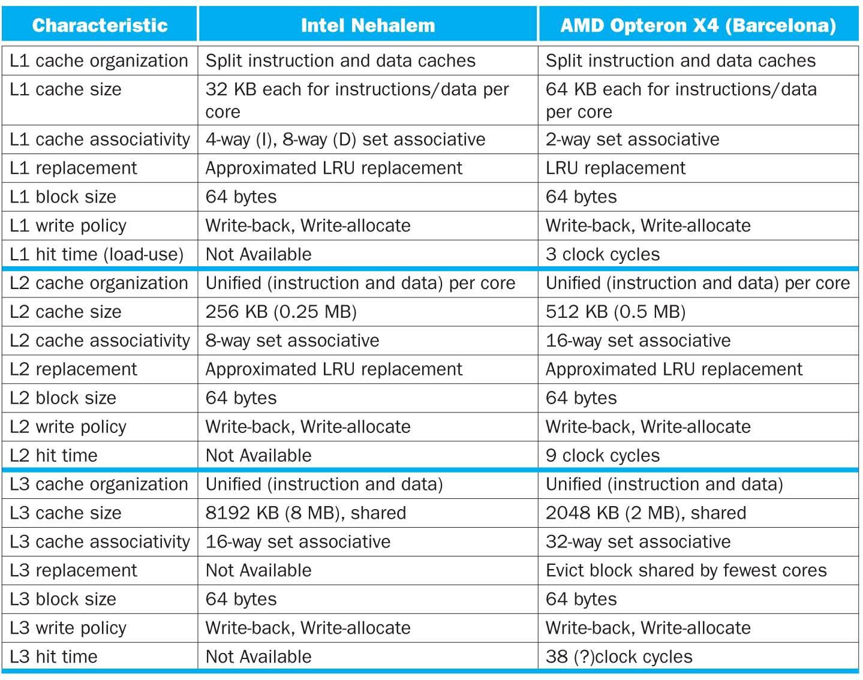

Slide 31
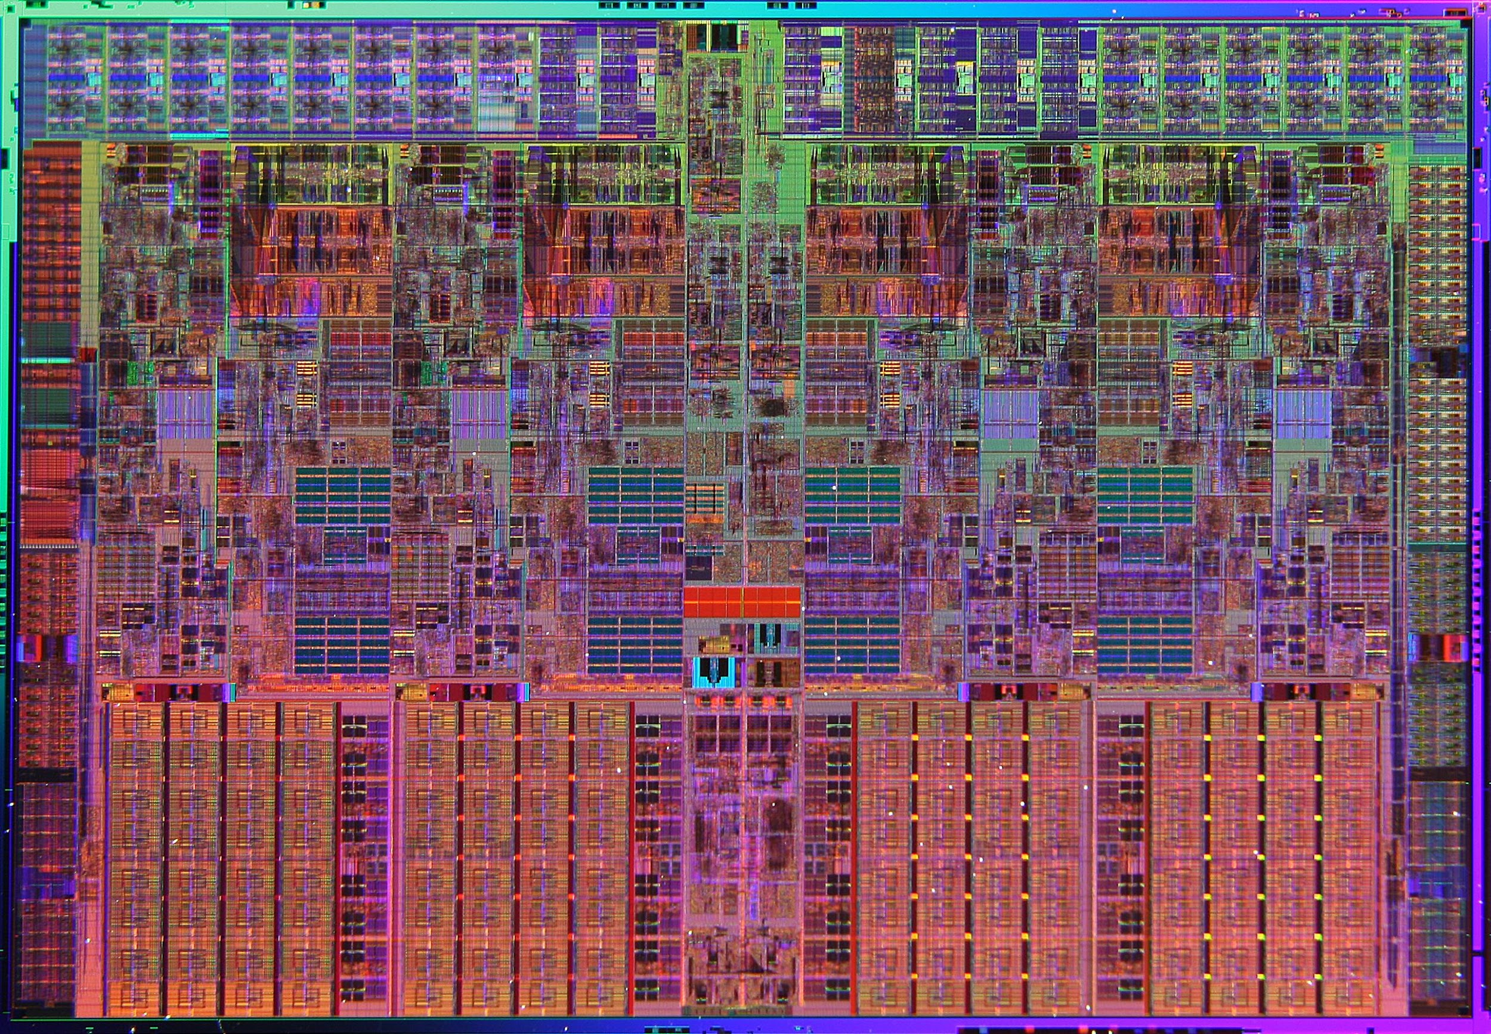
Intel Nehalem Die Photo
Memory Controller
Misc
IO
Misc
IO
Core
Core
Core
Core
13.6 mm (0.54 inch)
Memory
Queue
QPI
0
QPI
1
Shared L3 Cache
18.9 mm (0.75 inch)
Notes:
QPI – QuickPath Interconnect (for floating point)

Slide 32
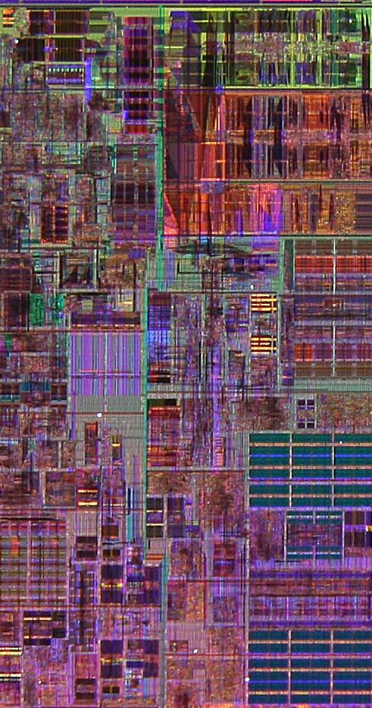
Core Area Breakdown
Memory Controller
Execution Units
32KiB I$ per core
32KiB D$ per core
512KiB L2$ per core
Share one 8-MiB L3$
L1 Data cache
L2 Cache & Interrupt Servicing
L1 Inst cache & Inst Fetch
L3 Cache
Load Store Queue

