Slide 1

Alaa
(next door)
Arrvindh (TASC 9009)

Slide 2
Why are you here ?
“Because It’s Required”
“It Might Be Easy, Right?”
“I Just Want to Get It Over With”
“Because Everyone Else Is Doing It”
“It’s Not Like I Have Anything Better to Do”

Slide 3
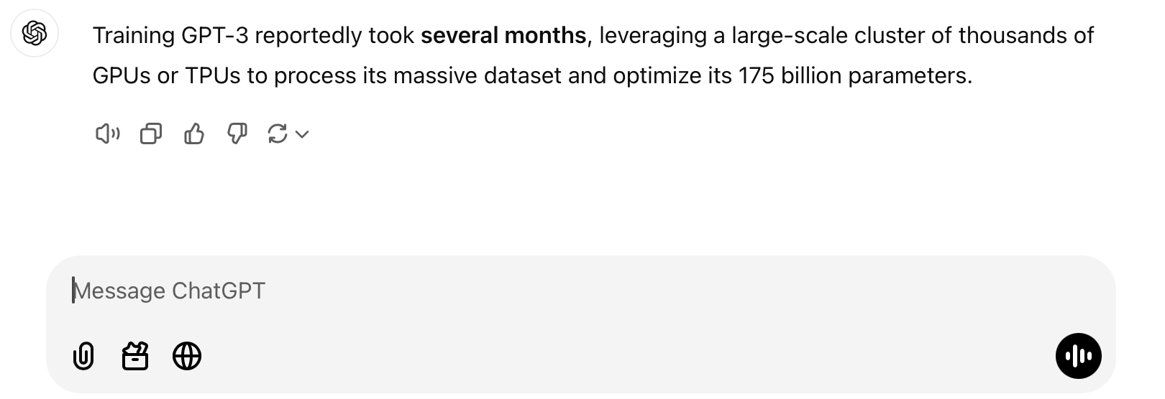

How do you get to 300 million petaflops?
In CMPT 295 you will develop a machine that does 32 Gigaflops i.e,. 32 ops/step running at 1 Ghz frequency (1 billion steps/s)

Slide 4
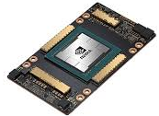
How do you get to 300 million petaflops?
1 chip = x1000 (32 teraflops)

Slide 5
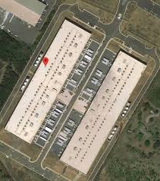
How do you get to 300 million petaflops?
x1000 (32 teraflops)
x1000 machines (32 Petaflop/s) * 60s/m*60m/h* 24h
3 million Petaflops/day
300 million/3million = 100 days
Train: 300 million/3 = 100 days

Slide 6
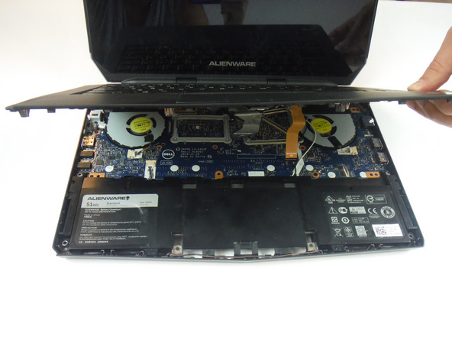

Learning from first-principles
Notes:
For the moment, we’ll leave understanding the brain to cognitive and neuroscientists, linguists and philosophers. But we will take a closer look at the computer to learn how it understands us.

Slide 7
Logistics
Assignment 1 will be released
  Need to complete Lab 0 to be able to access
Complete Lab 0 (ASAP!)
  TAs will begin Lab 1 (not 0)
  Need it before we can grade anything
SFU has informed that classes will not be recorded.
  Class slides will be available as Class.pptx on syllabus page at the end of lecture day (i.e, if you are sick please follow BCCDC instructions)

Slide 8
Abstraction
The process of removing details or attributes in the study of systems to focus attention on details of greater importance.

Slide 9
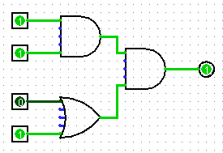
Abstraction
(Levels of Representation/Interpretation)
Python Program
Assembly
square:
addi sp,sp,-16
sw ra,12(sp)
sw s0,8(sp)
addi s0,sp, 16
sw a0,-12(s0)
lw a0,-12(s0)
addi a1,a0,2
mul a0,a1,a0
lw ra,12(sp)
lw s0,8(sp)
addi sp,sp,16
ret
def square(num):
return num * num
C Program
int square(int num):
return num * num
Binary
0x00000317
0x00830067
0xff010113
0x00112623
0x00812423
0x01010413
0xfea42a23
…….
Logic

Slide 10
Performance Cost of Abstraction
c = ( a + b ) OR c = ( a * b ) + d
c = a + b OR c = a[i] + b[i]
c = a[i] + b[i] OR c = a[c[i]] + a[c[i]]

Slide 11
Base Comparison
Why does all of this matter?
  Humans think about numbers in base 10, but computers “think” about numbers in base 2
  Binary encoding is what allows computers to do all of the amazing things that they do!
You should have this table memorized by the end of the 1st class
  Might as well start now!
Base 10 | Base 2 | Base 16
0 | 0000 | 0
1 | 0001 | 1
2 | 0010 | 2
3 | 0011 | 3
4 | 0100 | 4
5 | 0101 | 5
6 | 0110 | 6
7 | 0111 | 7
8 | 1000 | 8
9 | 1001 | 9
10 | 1010 | A
11 | 1011 | B
12 | 1100 | C
13 | 1101 | D
14 | 1110 | E
15 | 1111 | F

Slide 12
Why different number systems?
Binary System: foundation of computers (0s and 1s) because it aligns with a transistor’s switch state (off/on)
  All data in computers—text, images, sound—can ultimately be represented as binary sequences.
Hexadecimal System: compact representation; balance between human-readable and easy conversion to binary
  0xAB = 0b10101011 = 0d171.
- Memory: hexadecimal matches neatly with word/block sizes in computer architecture (e.g., 8-bit, 16-bit systems).
Realistic use: Identifying pointer properties.

Slide 13
Numerical Encoding
AMAZING FACT: You can represent anything countable using numbers!
  Need to agree on an encoding
  Kind of like learning a new language
Examples:
  Decimal Integers: 0$→$0b0, 1$→$0b1, 2$→$0b10, etc.
  English Letters: CSE$→$0x435345, yay$→$0x796179
  Emoticons: 😃 0x0, 😞 0x1, 😎 0x2, 😇 0x3, 😈 0x4, 🙋 0x5
Notes:
Base 2 is too hard for humans to read, so we use base 16 as a convenient way to hold what is effectively binary data in our brains.

Slide 14
Software (Typed) vs Hardware (No Types)
Software Variables carry meaning: int, char, pointer.
Compilers enforce rules (sizes, alignment, valid ops).
Guides debuggers, checks & optimizations.
Hardware world (untyped)
Only voltages/bits moving through wires: 0/1.
Ops or opcodes have types, not data
The same 32 bits can be treated as many things.
char c, d; int a; int b;
c = a + b ; // Compiler error/warn
c = c + d // Unsupported op
Bits: 0100 0001 (0x41)
→ as int: 65
→ as char: 'A'
→ as float: nonsense

Slide 15
Memory, Data, & Addressing I

Slide 16
Binary Encoding Additional Details
Because storage is finite in reality, everything is stored as “fixed” length
  Data is moved and manipulated in fixed-length chunks
  Multiple fixed lengths (e.g. 1 byte, 4 bytes, 8 bytes)
  Leading zeros now must be included up to “fill out” the fixed length
Example: the “eight-bit” representation of the number 4 is 0b00000100
Least Significant Bit (LSB)
Most Significant Bit (MSB)

Slide 17

Byte-Oriented Memory Organization
00•••0
FF•••F
 |  |  |  |  |  | • • •
Conceptually, memory is a single, large array of bytes,
each with a unique address (index)
  Each address is just a number represented in fixed-length binary
Programs refer to bytes in memory by their addresses
  Domain of possible addresses = address space
  Pointer: We can store addresses as data to “remember” where other data is in memory
But not all values fit in a single byte… (e.g. 295)
  Many operations actually use multi-byte values
Notes:
Address is n bit number.
Each byte can be read and written
Address space determined by how many bits in the address
So what if things don’t fit in a single byte?
How many things does 1 byte allow us to address?

Slide 18
Peer Instruction Question
If we choose to use 4-bit addresses, how big is our address space?
  i.e. How much space can we “refer to” using our addresses?
16 bits
16 bytes
4 bits
4 bytes
We’re lost…

Slide 19
Why is 1KB = 1024 bytes (not 1000 bytes)
Computers typically organize memory in powers of 2, since addressing grows as a power of 2.
Consider,
1 bit address has two values 0,1 and hence can address a memory with 2 bytes.
2 bits address can have values 0,1,2,3 and hence can address memory with 4 bytes.
10 bits address can have values 0 – 1023 and hence can address memory with 1024 bytes (1KB).

Slide 20
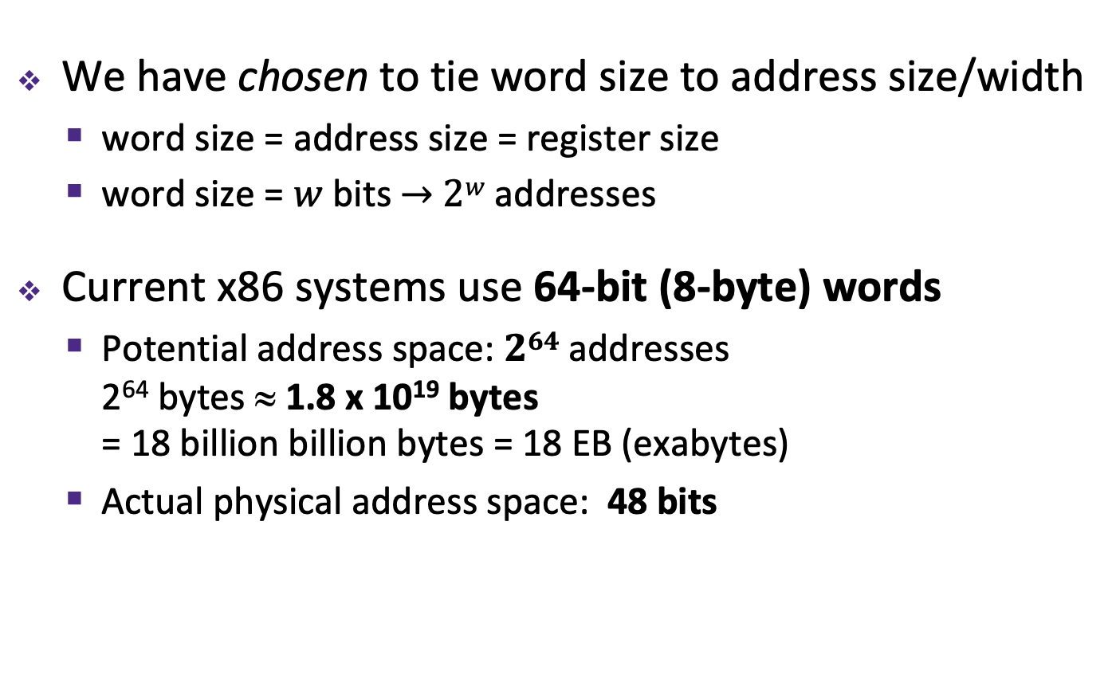
Machine “Words”
We have chosen to tie word size to address size/width
  word size = address size = register size
  word size = $w$ bits $→$ $2w$ addresses
Current x86 systems use 64-bit (8-byte) words
  Potential address space: $264$ addresses
  2⁶⁴ bytes ≈ 1.8 x 10¹⁹ bytes
  = 18 billion billion bytes = 18 EB (exabytes)
  Actual physical address space: 48 bits
Notes:
Instead, we typically talk about addresses in terms of “words”
Use same word size anywhere that you typically store addresses
You could count the world population with 33 fingers (using population number of 7.454 billion)

Slide 21
Word-Oriented Memory Organization
64-bit
Words
32-bit
Words
Addr.
(hex)
Bytes
Addresses still specify
locations of bytes in memory
  Addresses of successive words
  differ by word size (in bytes):
  e.g. 4 (32-bit) or 8 (64-bit)
  Address of word 0, 1, … 10?
0x00
Addr
=
??
0x01
0x02
Addr
=
??
0x03
0x04
Addr
=
??
0x05
0x06
0x07
0x08
Addr
=
??
0x09
0x0A
Addr
=
??
0x0B
0x0C
Addr
=
??
0x0D
0x0E
0x0F
Notes:
What do we use to address bigger chunks of bytes?

Slide 22
Word-Oriented Memory Organization
64-bit
Words
32-bit
Words
Addr.
(hex)
Bytes
Addresses still specify
locations of bytes in memory
  Addresses of successive words
  differ by word size (in bytes):
  e.g. 4 (32-bit) or 8 (64-bit)
  Address of word 0, 1, … 10?
Address of word
= address of first byte in word
  The address of any chunk of
  memory is given by the address
  of the first byte
  Alignment
0x00
Addr
=
??
0x01
0x02
0000
Addr
=
??
0x03
0x04
0000
Addr
=
??
0x05
0x06
0004
0x07
0x08
Addr
=
??
0x09
0x0A
Addr
=
??
0008
0x0B
0008
0x0C
Addr
=
??
0x0D
0x0E
0012
0x0F
Notes:
Use the first byte of the word
Still count by bytes
Aside: isn’t this wasteful?
Yes, but remember how much we can address with 64 bits? Probably don’t need to worry too much.

Slide 23
Data Representations
Sizes of data types (in bytes)
Java Data Type | C Data Type | 32-bit | x86-64
boolean | bool | 1 | 1
byte | char | 1 | 1
char |  | 2 | 2
short | short int | 2 | 2
int | int | 4 | 4
float | float | 4 | 4
 | long int | 4 | 8
double | double | 8 | 8
long | long | 8 | 8
 | long double | 8 | 16
(reference) | pointer * | 4 | 8
(reference) | pointer * | 4 | 8
address size = word size
To use “bool” in C, you must #include <stdbool.h>
Notes:
This mapping is mostly an arbitrary historical artifact except for address sizes.

Slide 24
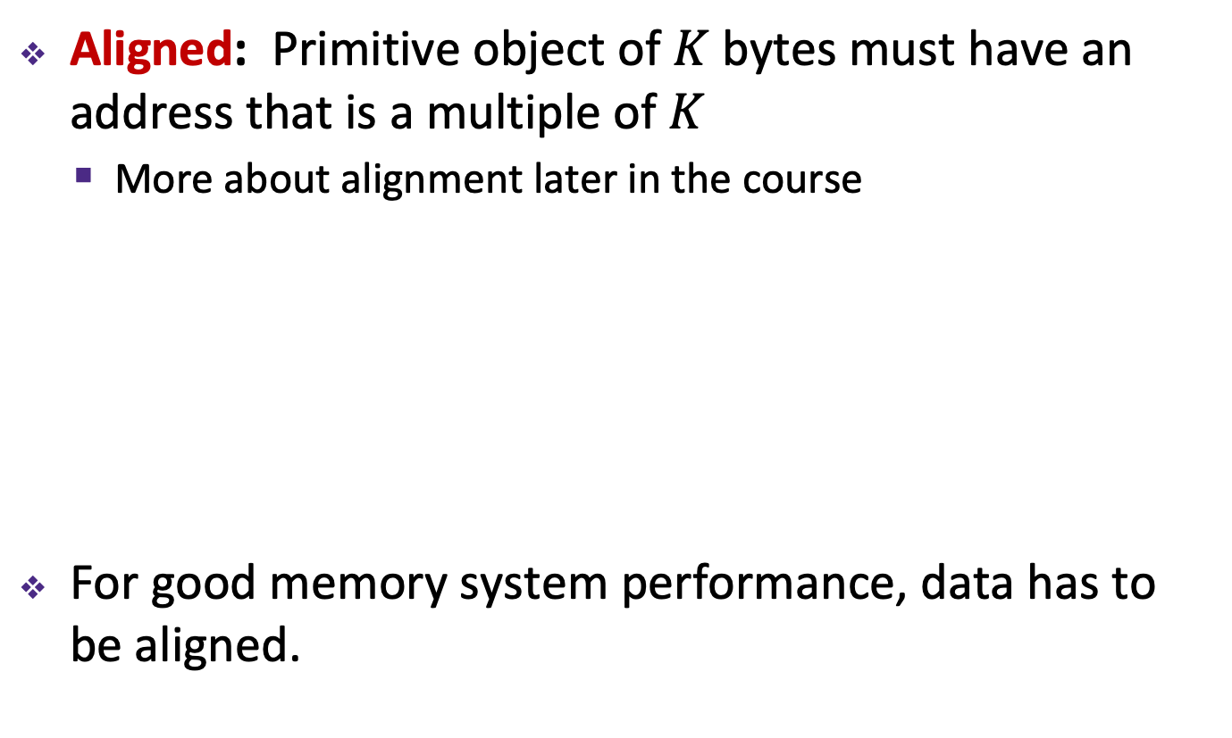
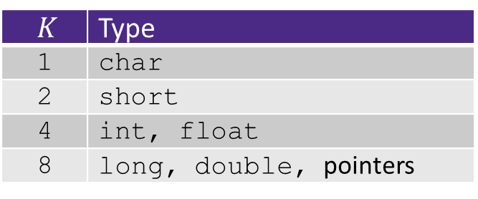
Memory Alignment
Aligned: Primitive object of $K$ bytes must have an address that is a multiple of $K$
  More about alignment later in the course
For good memory system performance, data has to be aligned.
$K$ | Type
1 | char
2 | short
4 | int, float
8 | long, double, pointers

Slide 25
Alignment REPL
https://replit.com/@ashriram/Alignment#main.cpp
int i_int;
char ch = 'a';
long long int i_long_long;
short s_num = 0xBEEF;
uintptr_t int_ptr = (uintptr_t)&i_int;
printf("Sizeof data : %ld, Address, of data %p, Addr. Binary)

Slide 26
Alignment REPL
Sizeof data : 4, Addr: 0x7ffd38f84cac, Addr Binary 0000000000000000011111111111110100111000111110000100110010101100
Sizeof data : 8, Address: 0x7ffd38f84c98, Addr in Binary 0000000000000000011111111111110100111000111110000100110010011000
Sizeof data : 1, Addr: 0x7ffd38f84c97, Addr in Binary 0000000000000000011111111111110100111000111110000100110010010111
Sizeof data : 2, Addr: 0x7ffd38f84c94, Addr in Binary 0000000000000000011111111111110100111000111110000100110010010100 

Slide 27
Byte Ordering
How should bytes within a word be ordered in memory?
  Example: store the 4-byte (32-bit) int:
  0x a1 b2 c3 d4
By convention, ordering of bytes called endianness
  The two options are big-endian and little-endian
    In which address does the least significant byte go?
    Based on Gulliver’s Travels: tribes cut eggs on different sides
    (big, little)

Slide 28
Byte Ordering
Big-endian (SPARC, z/Architecture)
  Least significant byte has highest address
Little-endian (x86, x86-64, RISC-V)
  Least significant byte has lowest address
Bi-endian (ARM, PowerPC)
  Endianness can be specified as big or little
Example: 4-byte data 0xa1b2c3d4 at address 0x100
0x100
0x101
0x102
0x103
Big-Endian
01
a1
23
b2
45
c3
67
d4
0x100
0x101
0x102
0x103
Little-Endian
67
d4
45
c3
23
b2
01
a1
Notes:
Big Endian
Most significant is first
Little Endian
Looks backwards
Let’s look at some more examples…

Slide 29
Endianness and Strings
C (char = 1 byte)
char s[6] = "12345";
IA32, x86-64
(little-endian)
SPARC
(big-endian)
String literal
0x00
31
31
0x00
'1'
0x01
32
32
0x01
'2'
0x31 = 49 decimal = ASCII ‘1’
0x02
33
33
0x02
'3'
0x03
34
34
0x03
'4'
0x04
35
35
0x04
'5'
0x05
00
00
0x05
'\0'
Byte ordering (endianness) is not an issue for 1-byte values
  The whole array does not constitute a single value
  Individual elements are values; chars are single bytes

Slide 30
Examining Data Representations
Code to print byte representation of data
  Any data type can be treated as a byte array by casting it to char
  C has unchecked casts !! DANGER !!
void show_bytes(char* start, int len) {
int i;
for (i = 0; i < len; i++)
printf("%p\t0x%.2x\n", start+i, *(start+i));
printf("\n");
}
printf directives:
%p Print pointer
\t Tab
%x Print value as hex
\n New line
Notes:
%p: prefix “0x” automatically printed

Slide 31
Show bytes demo
https://replit.com/@ashriram/ShowBytes#main.cpp

Slide 32
show_bytes Execution Example
int x = 12345; // 0x00003039
printf("int x = %d;\n",x);
show_int(x); // show_bytes((char *) &x, sizeof(int));
Result (Linux x86-64):
  Note: The addresses will change on each run (try it!), but fall in same general range
int x = 12345;
0x7fffb7f71dbc 0x39
0x7fffb7f71dbd 0x30
0x7fffb7f71dbe 0x00
0x7fffb7f71dbf 0x00

Slide 33
A Picture of Memory (64-bit view)
A “64-bit (8-byte) word-aligned” view of memory:
  In this type of picture, each row is composed of 8 bytes
  Each cell is a byte
  A 64-bit pointer
  will fit on one row
one word
0x00
0x01
0x02
0x03
0x04
0x05
0x06
0x07
Address
0x00
0x
0x
0x
0x
0x
0x
0x
0x
0x
Notes:
What’s the second row’s address going to be?
0x08
Third?
0x10

Slide 34
A Picture of Memory (64-bit view)
A “64-bit (8-byte) word-aligned” view of memory:
  In this type of picture, each row is composed of 8 bytes
  Each cell is a byte
  A 64-bit pointer
  will fit on one row
one word
0x00
0x01
0x02
0x03
0x04
0x05
0x06
0x07
Address
0x00
0x08
0x10
0x18
0x20
0x28
0x08
0x09
0x0A
0x0B
0x0C
0x0D
0x0E
0x0F
0x30
0x38
0x40
0x48

Slide 35
Addresses and Pointers
64-bit example
(pointers are 64-bits wide)
An address is a location in memory
A pointer is a data object that holds an address
  Address can point to any data
Value 504 stored at
address 0x08
  504₁₀ = 1F8₁₆
  = 0x 00 ... 00 01 F8
Pointer stored at
0x38 points to
address 0x08
big-endian
Address
0x00
0x08
00
00
00
00
00
00
01
F8
0x10
0x18
0x20
0x28
0x30
0x38
00
00
00
00
00
00
00
08
0x40
0x48
Notes:
Note that everything is just padded with extra 0s

Slide 36
Addresses and Pointers
64-bit example
(pointers are 64-bits wide)
big-endian
An address is a location in memory
A pointer is a data object that holds an address
  Address can point to any data
Pointer stored at
0x48 points to
address 0x38
  Pointer to a pointer!
Is the data stored
at 0x08 a pointer?
  Could be, depending
  on how you use it
Address
0x00
0x08
00
00
00
00
00
00
01
F8
0x10
0x18
0x20
0x28
0x30
0x38
00
00
00
00
00
00
00
08
0x40
00
00
00
00
00
0x48
00
38
00
Notes:
Note that everything is just padded with extra 0s

Slide 37
Memory, Data, & Addressing II

Slide 38
Arrays in C
Arrays are adjacent locations in memory storing the same type of data object
a (array name) returns the array’s address
Declaration: int a[6];
element type
a[1]
64-bit example
(pointers are 64-bits wide)
number of
elements
name
a[3]
a[5]
0x0
0x8
0x1
0x9
0x2
0xA
0x3
0xB
0x4
0xC
0x5
0xD
0x6
0xE
0x7
0xF
0x00
0x08
a[0]
0x10
a[2]
0x18
a[4]
0x20
0x28
0x30
0x38
0x40
0x48

Slide 39
Arrays Basics
Pitfall: An array in C does not know its own length, and its bounds are not checked!
  We can accidentally access off the end of an array
  We must pass the array and its size to any procedure that is going to manipulate it
Mistakes with array bounds cause segmentation faults and bus errors
  Be careful! These are VERY difficult to find
  (You’ll learn how to debug these in lab)

Slide 40
Arrays in C
Arrays are adjacent locations in memory storing the same type of data object
a (array name) returns the array’s address
Declaration: int a[6];
Indexing: a[0] = 0x015f;
a[5] = a[0];
&a[i] is the address of a[0] plus i times the element size in bytes
0x0
0x8
0x1
0x9
0x2
0xA
0x3
0xB
0x4
0xC
0x5
0xD
0x6
0xE
0x7
0xF
0x00
0x08
a[0]
5F
01
00
00
0x10
a[2]
0x18
a[4]
5F
01
00
00
0x20
0x28
0x30
0x38
0x40
0x48

Slide 41
Arrays in C
Arrays are adjacent locations in memory storing the same type of data object
a (array name) returns the array’s address
Declaration: int a[6];
Indexing: a[0] = 0x015f;
a[5] = a[0];
No bounds a[6] = 0xBAD;
checking: a[-1] = 0xBAD;
&a[i] is the address of a[0] plus i times the element size in bytes
0x0
0x8
0x1
0x9
0x2
0xA
0x3
0xB
0x4
0xC
0x5
0xD
0x6
0xE
0x7
0xF
0x00
AD
0B
00
00
0x08
a[0]
5F
01
00
00
0x10
a[2]
0x18
a[4]
5F
01
00
00
0x20
AD
0B
00
00
0x28
0x30
0x38
0x40
0x48

Slide 42
Arrays in C
Arrays are adjacent locations in memory storing the same type of data object
a (array name) returns the array’s address
Declaration: int a[6];
Indexing: a[0] = 0x015f;
a[5] = a[0];
No bounds a[6] = 0xBAD;
checking: a[-1] = 0xBAD;
Pointers: int* p;
p = a;
p = &a[0];
*p = 0xA;
&a[i] is the address of a[0] plus i times the element size in bytes
0x0
0x8
0x1
0x9
0x2
0xA
0x3
0xB
0x4
0xC
0x5
0xD
0x6
0xE
0x7
0xF
0x00
AD
0B
00
00
0x08
equivalent
a[0]
5F
0A
01
00
00
00
00
00
0x10
a[2]
0x18
a[4]
5F
01
00
00
0x20
AD
0B
00
00
0x28
0x30
0x38
p
10
00
00
00
00
00
00
00
0x40
0x48

Slide 43
Arrays in C
Arrays are adjacent locations in memory storing the same type of data object
a (array name) returns the array’s address
Declaration: int a[6];
Indexing: a[0] = 0x015f;
a[5] = a[0];
No bounds a[6] = 0xBAD;
checking: a[-1] = 0xBAD;
Pointers: int* p;
p = a;
p = &a[0];
*p = 0xA;
p[1] = 0xB;
*(p+1) = 0xB;
p = p + 2;
&a[i] is the address of a[0] plus i times the element size in bytes
0x0
0x8
0x1
0x9
0x2
0xA
0x3
0xB
0x4
0xC
0x5
0xD
0x6
0xE
0x7
0xF
0x00
AD
0B
00
00
0x08
equivalent
a[0]
5F
0A
01
00
00
00
00
00
0B
00
00
00
0x10
a[2]
0x18
a[4]
5F
01
00
00
0x20
array indexing = address arithmetic
(both scaled by the size of the type)
AD
0B
00
00
0x28
0x30
equivalent
0x38
p
10
00
00
00
00
00
00
00
0x40
0x48

Slide 44
Arrays in C
Arrays are adjacent locations in memory storing the same type of data object
a (array name) returns the array’s address
Declaration: int a[6];
Indexing: a[0] = 0x015f;
a[5] = a[0];
No bounds a[6] = 0xBAD;
checking: a[-1] = 0xBAD;
Pointers: int* p;
p = a;
p = &a[0];
*p = 0xA;
p[1] = 0xB;
*(p+1) = 0xB;
p = p + 2;
*p = a[1] + 1;
&a[i] is the address of a[0] plus i times the element size in bytes
0x0
0x8
0x1
0x9
0x2
0xA
0x3
0xB
0x4
0xC
0x5
0xD
0x6
0xE
0x7
0xF
0x00
AD
0B
00
00
0x08
equivalent
a[0]
0A
00
00
00
0B
00
00
00
0x10
a[2]
0C
00
00
00
0x18
a[4]
5F
01
00
00
0x20
array indexing = address arithmetic
(both scaled by the size of the type)
AD
0B
00
00
0x28
0x30
equivalent
0x38
p
18
00
00
00
00
00
00
00
0x40
0x48

Slide 45
Pointer Arithmetic
Pointer arithmetic is scaled by the size of target type
  In this example, sizeof(int) = 4
int* z = &y + 3;
  Get address of y, add 3*sizeof(int), store in z
  &y = 0x18
  24 + 3*(4) = 36
Pointer arithmetic can be dangerous!
  Can easily lead to bad memory accesses
  Be careful with data types and casting
= 1*16¹ + 8*16⁰ = 24
= 2*16¹ + 4*16⁰ = 0x24

Slide 46
Assignment in C
32-bit example
(pointers are 32-bits wide)
& = “address of”
* = “dereference”
int x, y;
x = 0;
y = 0x3CD02700;
x = y + 3;
  Get value at y, add 3, store in x
int* z = &y + 3;
  Get address of y, add 12, store in z
*z = y;
  Get value of y, put in address
  stored in z
0x00
0x01
0x02
0x03
0x00
0x04
03
27
D0
3C
x
0x08
0x0C
0x10
0x14
The target of a pointer is also a location
0x18
00
27
D0
3C
y
0x1C
0x20
24
00
00
00
z
0x24
00
27
D0
3C

Slide 47
Assignment in C
32-bit example
(pointers are 32-bits wide)
& = “address of”
* = “dereference”
left-hand side = right-hand side;
  LHS must evaluate to a location
  RHS must evaluate to a value (could be an address)
  Store RHS value at LHS location
int x, y;
x = 0;
y = 0x3CD02700;
x = y + 3;
  Get value at y, add 3, store in x
int* z = &y + 3;
  Get address of y, “add 3”, store in z
0x00
0x01
0x02
0x03
0x00
0x04
03
27
D0
3C
x
0x08
0x0C
0x10
0x14
0x18
00
27
D0
3C
y
0x1C
0x20
24
00
00
00
z
0x24
Pointer arithmetic

Slide 48
int a[6];
0x0
0x8
0x1
0x9
0x2
0xA
0x3
0xB
0x4
0xC
0x5
0xD
0x6
0xE
0x7
0xF
0x00
0x08
a[0]
0A
00
00
00
0B
00
00
00
0x10
a[2]
0x18
a[4]
5F
01
00
00
0x20
0x28
0x30
0x38
0x40
0x48
a ≈ &a[0]
a+i ≈ a[i] e.g., *(a+i) = 5 is same as a[i] = 5

Slide 49
Pointer Cast Example
[PTYPE]* ptr = &variable + offset
  PTYPE controls how many bytes are read by *ptr
  Variable type controls scaling factor k for offset
  Ptr is the integer value variable + offset*sizeof(type)
short array[4] = {0xAAAA,0xBBBB,0xCCCC,0xDDDD};
short *s_ptr = (short*)&array;
int *i_ptr = (int*)&array;
for(int i = 0; i < 4; i++)
printf("\n [%p], 0x%hx ", s_ptr+i, s_ptr[i]);
for (int i = 0; i < 2; i++)
printf("\n [%p], 0x%lx ", i_ptr+i, i_ptr[i]);

Slide 50
short array[4] =
{0xAAAA,0xBBBB,0xCCCC,0xDDDD}
0x0
0x8
0x1
0x9
0x2
0xA
0x3
0xB
0x4
0xC
0x5
0xD
0x6
0xE
0x7
0xF
0x00
0x08
AA
AA
BB
BB
CC
CC
DD
DD
0x10
0x18
0x20
0x28
0x30
0x38
0x40
0x48

Slide 51
short array[4] =
{0xAAAA,0xBBBB,0xCCCC,0xDDDD}
0x0
0x8
0x1
0x9
0x2
0xA
0x3
0xB
0x4
0xC
0x5
0xD
0x6
0xE
0x7
0xF
0x00
0x08
AA
AA
BB
BB
CC
CC
DD
DD
0x10
0x18
0x20
0x28
0x30
0x38
0x40
0x48
short *s_ptr = &array
int *i_ptr = &array

Slide 52
Pointer Cast Example
0x0
0x8
0x1
0x9
0x2
0xA
0x3
0xB
0x4
0xC
0x5
0xD
0x6
0xE
0x7
0xF
0x00
0x08
AA
AA
BB
BB
CC
CC
DD
DD
0x10
0x18
0x20
0x28
0x30
0x38
0x40
0x48
// s_ptr: as a short
// i_ptr: as a int
[0x16f716f00], 0xaaaa
[0x16f716f02], 0xbbbb
[0x16f716f04], 0xcccc
[0x16f716f06], 0xdddd
[0x16f716f00], 0xbbbbaaaa
[0x16f716f04], 0xddddcccc

Slide 53
Representing strings
C-style string stored as an array of bytes (char*)
  Elements are one-byte ASCII codes for each character
  No “String” keyword, unlike Java
32 | space |  | 48 | 0 |  | 64 | @ |  | 80 | P |  | 96 | ` |  | 112 | p
33 | ! |  | 49 | 1 |  | 65 | A |  | 81 | Q |  | 97 | a |  | 113 | q
34 | ” |  | 50 | 2 |  | 66 | B |  | 82 | R |  | 98 | b |  | 114 | r
35 | # |  | 51 | 3 |  | 67 | C |  | 83 | S |  | 99 | c |  | 115 | s
36 | $ |  | 52 | 4 |  | 68 | D |  | 84 | T |  | 100 | d |  | 116 | t
37 | % |  | 53 | 5 |  | 69 | E |  | 85 | U |  | 101 | e |  | 117 | u
38 | & |  | 54 | 6 |  | 70 | F |  | 86 | V |  | 102 | f |  | 118 | v
39 | ’ |  | 55 | 7 |  | 71 | G |  | 87 | W |  | 103 | g |  | 119 | w
40 | ( |  | 56 | 8 |  | 72 | H |  | 88 | X |  | 104 | h |  | 120 | x
41 | ) |  | 57 | 9 |  | 73 | I |  | 89 | Y |  | 105 | I |  | 121 | y
42 | * |  | 58 | : |  | 74 | J |  | 90 | Z |  | 106 | j |  | 122 | z
43 | + |  | 59 | ; |  | 75 | K |  | 91 | [ |  | 107 | k |  | 123 | {
44 | , |  | 60 | < |  | 76 | L |  | 92 | \ |  | 108 | l |  | 124 | |
45 | - |  | 61 | = |  | 77 | M |  | 93 | ] |  | 109 | m |  | 125 | }
46 | . |  | 62 | > |  | 78 | N |  | 94 | ^ |  | 110 | n |  | 126 | ~
47 | / |  | 63 | ? |  | 79 | O |  | 95 | _ |  | 111 | o |  | 127 | del
ASCII: American Standard Code for Information Interchange
Notes:
I pronounce it 'char’, you can also call it 'care’ if you care to

Slide 54
Null-Terminated Strings
Example: "Donald Trump" stored as a 13-byte array
Last character followed by a 0 byte ('\0')
(a.k.a. "null terminator")
  Must take into account when allocating space in memory
  Note that '0' ≠ '\0' (i.e. character 0 has non-zero value)
How do we compute the length of a string?
  Traverse array until null terminator encountered
Decimal:.. | 68 | 111 | 110 | 97 | 108 | 100 | 32 | 84 | 114 | 117 | 109 | 112 | 0
Hex:.. | 0x44 | 0x6F | 0x6E | 0x61 | 0x6C | 0x64 | 0x20 | 0x54 | 0x72 | 0x75 | 0x6D | 0x70 | 0x00
Text:.. | D | o | n | a | l | d |  | T | r | u | m | p | \0
Notes:
Also strlen() in #include <string.h>, though doesn’t count null-terminator

Slide 55
52352

