Slide 1


If CMPT 295 was a movie...
And I am... Morpheus — I’ll hand you the red pill, the tools, and challenges, but you have to master
If it was a game

Slide 2

CMPT 295 is 4 Credits
Assignment 1 – 3
Programming
Intensive
More lines of code
More Debugging
Assignment 4-6
Concept Intensive
Less lines of code
but need to think

Slide 3

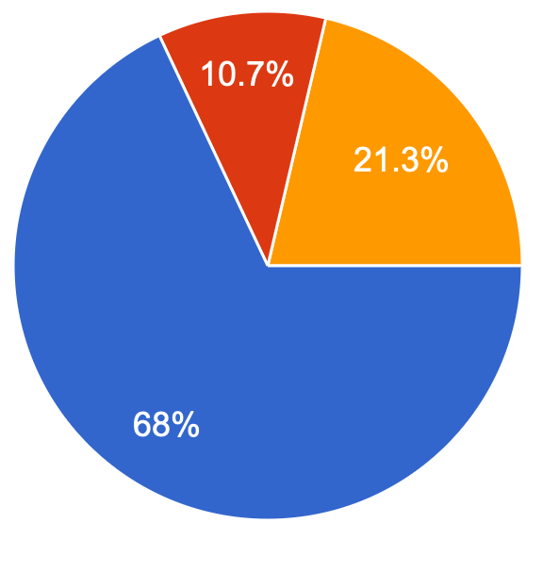
CMPT 120/125
CMPT 130/135
http://www.sfu.ca/outlines.html?2021/fall/cmpt/130/d100
https://www.sfu.ca/outlines.html?2018/summer/cmpt/120/d100
Basics of binary encoding including 2s complement
memory management, dynamic memory: pointers and addresses, and allocation of dynamic memory

Slide 4
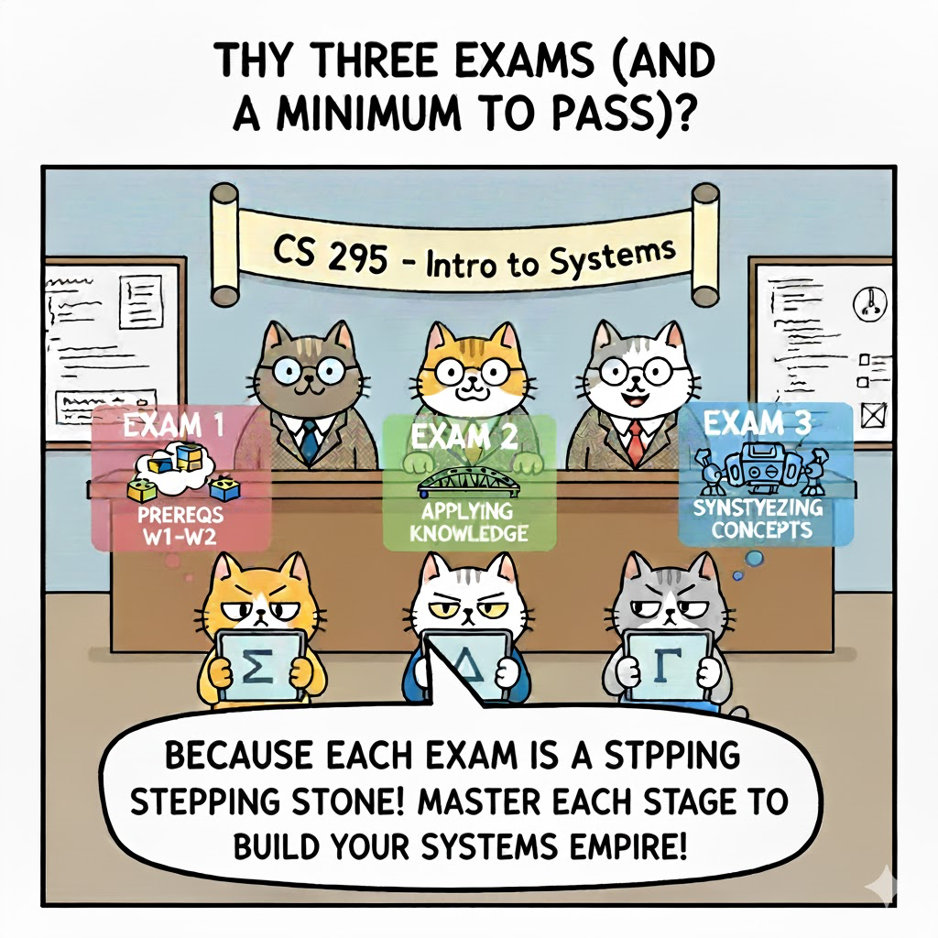

Slide 5
Continuous Feedback.
3 digital exams in CSIL. Pass/Fail criteria
Exam 1: – Must score at least 33% to continue
Exam 2: – Must score at least 40% to continue
Finals: Must score at least 50%
Read here for details and pass/fail criteria
https://www.cs.sfu.ca/~ashriram/Courses/CS295/#grading

Slide 6



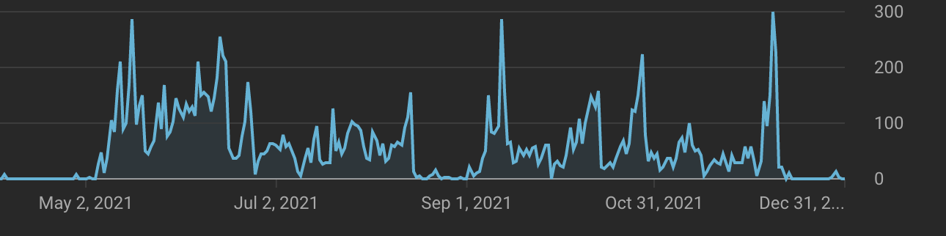
DO NOT BINGE! On Vidoes (Treat like Textbook Reading)
Midterm
Final
Midterm
Final

Slide 7

Programming low-level systems is hard (even for AI)
It's a Personal Journey
  Everyone learns differently
  Dedicate time to practicing
Take Ownership of Your Code
  The responsibility for finding and fixing bugs lies with you.

Slide 8
Questions format
Example 1: In the dictionary.c file, your code adds the vector_string.h and vector_char.h files by doing this: #include <vector_char.h> and #include <vector_string.h>. I thought this was incorrect and surely enough when I ran the code myself, I got an error because of the way these files were added. Shouldn't it be: #include "vector_char.h" and #include "vector_string.h" instead?
What command to run: FILL HERE
Have you created your own test input ? (YES/NO)
Expected behavior: FILL HERE
Observed behavior: FILL HERE
Did you refer to assignment page hints ? (YES/NO) FILL HERE

Slide 9
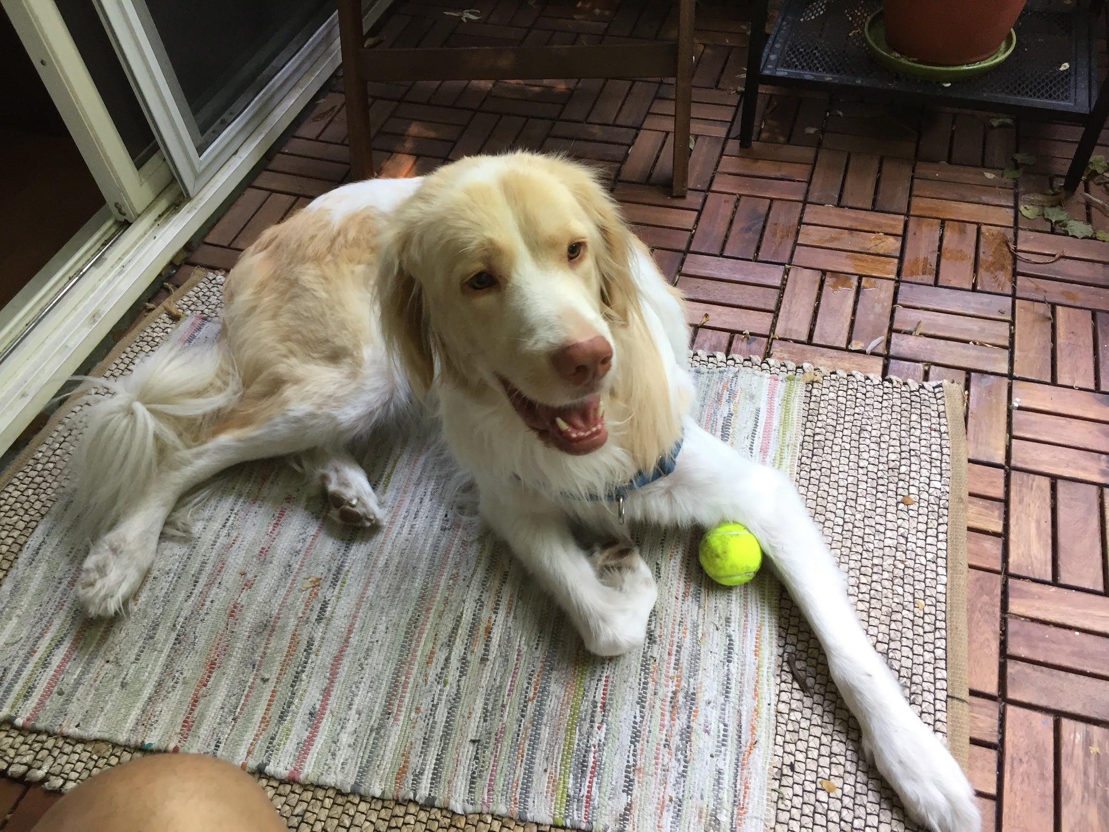
Please don’t cheat!
https://www.cs.sfu.ca/~ashriram/Courses/CS295//assignments.html

Slide 10


How to succeed in CMPT 295 ?
YOU MUST CARE!
- Attend class
- Attempt Quizes
(multiple times)
- Academic Curiosity
Practice Programming

Slide 11
Tips to succeed
Correlated from students in past offerings with grade A
Attempt weekly quiz atleast 3-4 times -> impacts how well students did on finals/midterm
Attempt quizzes regularly over the week
Assignments included median number of 5-6 commits spread out through the week
Scored evenly across all questions in midterm/final i.e., kept up with the material.
Anecdotal evidence: Regularly attended office hours

