Slide 1
Combinational Logic
Sequential Logic
CPU Datapath
CMPT 295 Week 10

Slide 2
Combinational Logic

Slide 3
Hardware Design
This week’s goals:
1. Understand how processors work
  Requires digital systems knowledge
2. Understand how code is actually executed on a computer to analyze reliability, performance & security
Layered abstractions
  Transistors → Gates → Combinational Logic → Sequential Logic → Processors → Machine Language → Assembly → High-level Programming Languages → Application programs
  At each step we can “abstract away” the lower layers

Slide 4
Synchronous Digital Systems (SDS)
Hardware of a processor (e.g., RISC-V) is an example of a Synchronous Digital System
Synchronous:
  All operations coordinated by a central clock
    “Heartbeat” of the system (processor frequency)
Digital:
  Represent all values with two discrete values
  Electrical signals are treated as 1’s and 0’s
    High/Low voltage represent True/False, 1/0

Slide 5
Moore’s Law
Original Version (1965): Since the integrated circuit was invented, the number of transistors in an integrated circuit has roughly doubled every year; this trend would continue for the foreseeable future
1975: Revised - circuit complexity doubles every two years

Slide 6
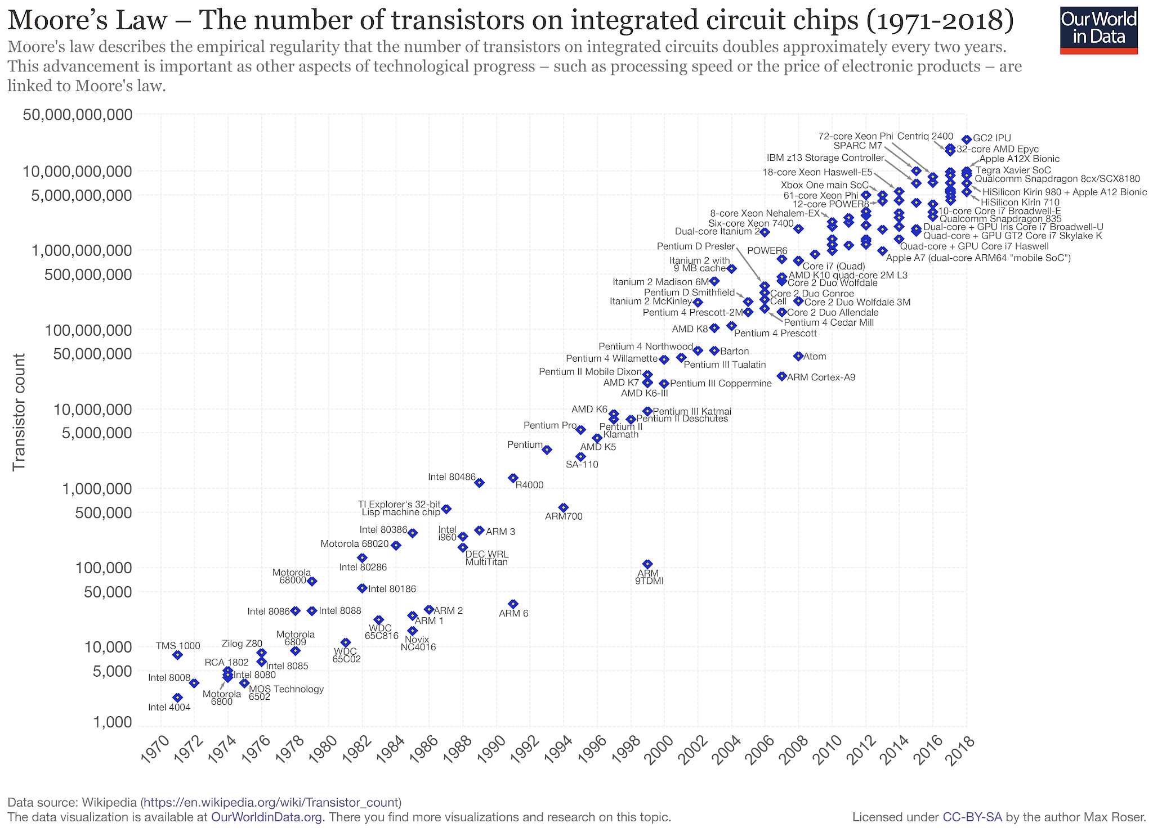

Slide 7
Moore’s Law
Original Version (1965): Since the integrated circuit was invented, the number of transistors in an integrated circuit has roughly doubled every year; this trend would continue for the foreseeable future
1975: Revised - circuit complexity doubles every two years
Hardware Trend: Hardware gets more powerful every year (due to technology advancement and the hard work of many engineers)
Software Trend: Software gets faster and uses more resources (And has to keep up with ever-changing hardware)
Digital circuits are used to build hardware

Slide 8
Transistors to Gates Example: Inverter
CMOS technology
Two transistors:
  NMOS (top): turns on when input is 0 (low V)
  PMOS (bottom): turns on when input is 1 (high V)
VDD
IN
OUT
GND

Slide 9
Transistors to Gates Example: Inverter
Input = 0
Top transistor turned on, bottom transistor turned off -> Output connected to VDD, capacitor charged
Output = 1
VDD
0
1
GND

Slide 10
Transistors to Gates Example: Inverter
Input = 1
Top transistor turned off, bottom transistor turned on -> Output connected to GND, capacitor discharged
Output = 0
VDD
1
0
GND
Inverter is commonly called “NOT gate”

Slide 11
Combinational vs. Sequential Logic
Digital Systems consist of two basic types of circuits:
  Combinational Logic (CL)
    Output is a function of the inputs only, not the history of its execution
    Example: add A, B (ALUs)
  Sequential Logic (SL)
    Circuits that “remember” or store information
    Also called “State Elements”
    Example: Memory and registers

Slide 12



Simple Logic Gates
Truth Table
Special names and symbols:
Circle means NOT!
a | NOT a
0 | 1
1 | 0
NOT
= NOT a
True if input is false
a | b | a AND b
0 | 0 | 0
0 | 1 | 0
1 | 0 | 0
1 | 1 | 1
AND
= a AND b
True if both inputs are true
a | b | A OR b
0 | 0 | 0
0 | 1 | 1
1 | 0 | 1
1 | 1 | 1
OR
= a OR b
True if at least one input is true
12

Slide 13



More Simple Logic Gates
Inverted versions are easier to implement in CMOS
a | b | a NAND b
0 | 0 | 1
0 | 1 | 1
1 | 0 | 1
1 | 1 | 0
NAND
= a NAND b
True if at least one input is false
a | b | a NOR b
0 | 0 | 1
0 | 1 | 0
1 | 0 | 0
1 | 1 | 0
NOR
= a NOR b
True if both inputs are false
a | b | a XOR b
0 | 0 | 0
0 | 1 | 1
1 | 0 | 1
1 | 1 | 0
XOR
= a XOR b
True if exactly one input is true
(or if odd number of inputs are true for > 2 inputs)

Slide 14
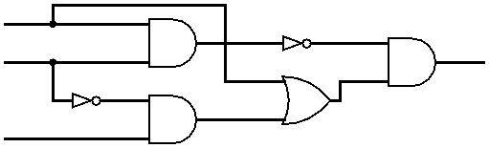
Combining Multiple Logic Gates
D = (NOT(A AND B)) AND (A OR (NOT B AND C))
A
B
D
C

Slide 15
How to Represent Combinational Logic?
Text Description
Circuit Diagram
  Transistors and wires
  Logic Gates
Truth Table
Boolean Expression
All are equivalent

Slide 16
Truth Tables
Table that relates the inputs to a combinational logic circuit to its output
  Output only depends on current inputs
  Use abstraction of 0/1 (F/T) instead of high/low Voltage
  Shows output for every possible combination of inputs
How big is a truth table with N inputs?
  0 or 1 for each of N inputs, so 2^{N} rows

Slide 17

N-input Truth Tables
A B C
Y
0 0 0
0 0 1
0 1 0
0 1 1
1 0 0
1 0 1
1 1 0
1 1 1
0
1
0
0
0
1
1
0
F(0,0,0)
F(0,0,1)
F(0,1,0)
F(0,1,1)
F(1,0,0)
F(1,0,1)
F(1,1,0)
F(1,1,1)
A
F
B
Y
C
For N inputs, how many distinct functions F do we have?
$2^{2^{N}}$
Function maps each row to 0 or 1, so possible functions
Notes:
Circle the output, use variables/animations, talk about the output as a bit combination (integer?)
Maybe 3 inputs?

Slide 18
Truth Tables with Multiple Outputs
A
F
X
B
Y
C
D
Z
For 3 outputs, just three indep. functions:
X(A,B,C,D), Y(A,B,C,D), and Z(A,B,C,D)
  Can show functions in separate columns (no additional rows)

Slide 19
Question: Which of the columns A-D is the correct output of the Truth Table for: (X XOR Y) OR (NOT Z)
X | Y | Z | (A) | (B) | (C) | (D)
0 | 0 | 0 | 1 | 1 | 1 | 1
0 | 0 | 1 | 0 | 0 | 0 | 0
0 | 1 | 0 | 1 | 1 | 1 | 1
0 | 1 | 1 | 1 | 1 | 1 | 1
1 | 0 | 0 | 0 | 1 | 1 | 1
1 | 0 | 1 | 1 | 1 | 0 | 1
1 | 1 | 0 | 1 | 1 | 1 | 0
1 | 1 | 1 | 1 | 0 | 1 | 1

Slide 20
Question: Which of the columns A-D is the correct output of the Truth Table for: (X XOR Y) OR (NOT Z)
X | Y | Z | (A) | (B) | (C) | (D)
0 | 0 | 0 | 1 | 1 | 1 | 1
0 | 0 | 1 | 0 | 0 | 0 | 0
0 | 1 | 0 | 1 | 1 | 1 | 1
0 | 1 | 1 | 1 | 1 | 1 | 1
1 | 0 | 0 | 0 | 1 | 1 | 1
1 | 0 | 1 | 1 | 1 | 0 | 1
1 | 1 | 0 | 1 | 1 | 1 | 0
1 | 1 | 1 | 1 | 0 | 1 | 1

Slide 21
More Complex Truth Tables
3-Input Majority
2-bit Adder
a | b | c | y
0 | 0 | 0 | 0
0 | 0 | 1 | 0
0 | 1 | 0 | 0
0 | 1 | 1 | 1
1 | 0 | 0 | 0
1 | 0 | 1 | 1
1 | 1 | 0 | 1
1 | 1 | 1 | 1
a₁
+
c₂
a₀
c₁
b₁
b₀
c₀
How many
rows?
A |  | B |  | C
a₁ | a₀ | b₁ | b₀ | c₂ | c₁ | c₀
 |  |  | .
 |  |  | .
 |  |  | .

Slide 22
Truth Tables Don’t Scale
Truth tables are huge
  Write out EVERY combination of inputs and outputs (thorough, but inefficient)
  Finding a particular combination of inputs involves scanning a large portion of the table
Boolean Algebra is a shorter way to represent combinational logic

Slide 23
Boolean Algebra
Represent inputs and outputs as variables
  Each variable can only take on the value 0 or 1
Overbar, ¬, ’ mean NOT: “logical complement”
  e.g., if A = 0, A = 1. If A = 1, then A = ¬A = A’ = 0
Plus (+) is 2-input OR: “logical sum”
Product (·) is 2-input AND: “logical product”
  Sometimes omitted
All other gates and logical expressions can be built from combinations of these
AB + AB == (NOT(A AND B)) OR (A AND (NOT B))

Slide 24
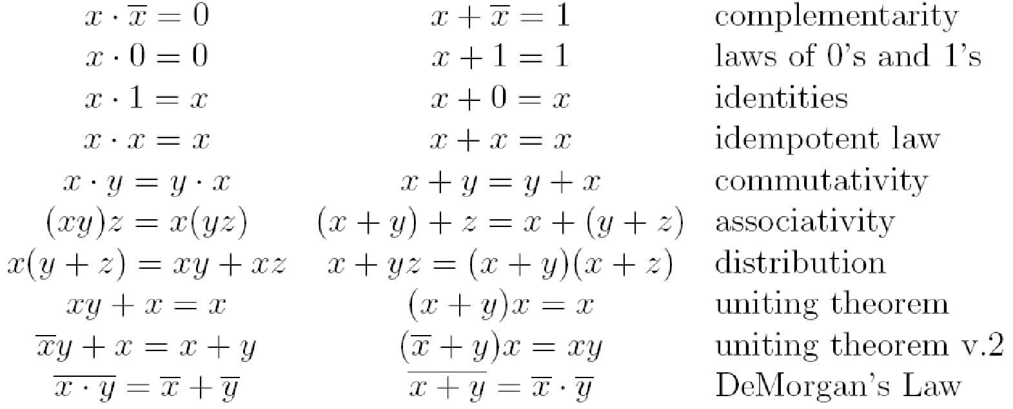
Laws of Boolean Algebra
These laws allow us to simplify Boolean expressions:
Notes:
Demorgan’s law example

Slide 25
Converting Truth Table to Boolean Expression
Read off of table
  For 1, write variable name
  For 0, write complement of variable
Sum of Products (SoP)
  Take rows with 1’s in output column,
  sum products of inputs
  c=
Product of Sums (PoS)
  Take rows with 0’s in output column, product the sum of the complements of the inputs
  c =
a | b | c
0 | 0 | 0
0 | 1 | 1
1 | 0 | 1
1 | 1 | 0
a
b
+
a
b
We can show that these
are equivalent!
(a + b) · (a + b)
Notes:
Choice between the two generally comes down to whether the output function has more 0’s or 1’s. Choosing the conversion (SoP/PoS) with less items will result in a shorter expression!
(This example happens to be balanced: 2 0’s and 2 1’s)

Slide 26
Simplifying Boolean Expressions
Logic Delay: Everything we are dealing with is just an abstraction of transistors and wires
  Inputs propagating to the outputs are voltage signals passing through transistor networks
  There is always some delay before a CL’s output updates to reflect the inputs
  Critical Path is longest delay from any input to output. Could be represented as “n gate delays”
Simpler Boolean expressions ↔ smaller transistor networks ↔ smaller circuit delays ↔ faster hardware

Slide 27
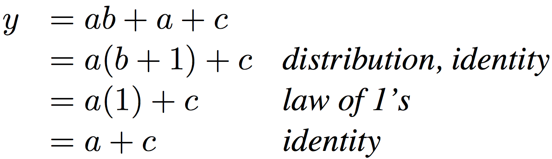
Simplifying Boolean Expressions: Example
Notes:
Do on black board
From distribution: a(b +1) + c
Froms laws of 0s and 1s: b+1 = b
= ab + c
Truth Table
a b c y
0 0 0 0
0 0 1 1
0 0 1 1

Slide 28

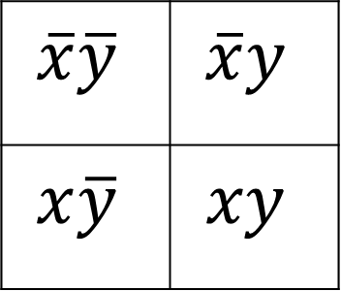
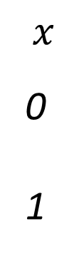
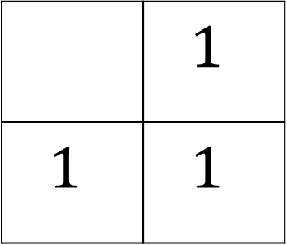

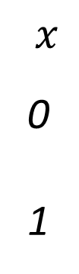
Karnaugh Maps
Used to simplify Boolean expressions of 2-4 variables
Table composed of squares each representing a unique combination of all variable (1 if true, else blank)
Two variable Map:
Example: Boolean Expression?
$$y 0 1$$
$$y 0 1$$
$$x$$
0
1
$$x$$
0
1
$$\overline{x}\overline{y}$$ | $$\overline{x}y$$
$$x\overline{y}$$ | $$xy$$
 | $$1$$
$$1$$ | $$1$$
x | y | ?
0 | 0 | 0
0 | 1 | 1
1 | 0 | 1
1 | 1 | 1
x + y

Slide 29

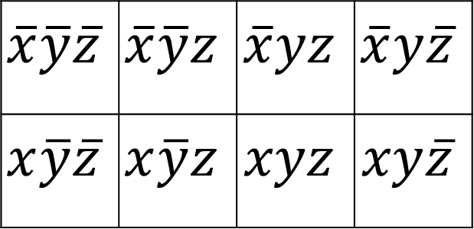

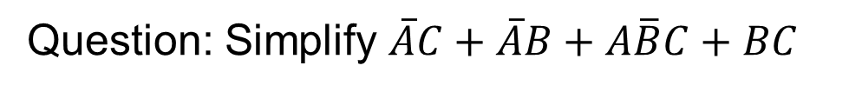

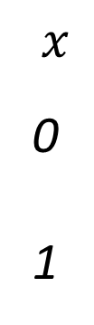

Three Variable Karnaugh Maps
$$y$$
$$yz 00 01 11 10$$
$$x$$
0
1
$$\overline{x}\overline{y}\overline{z}$$ | $$\overline{x}\overline{y}z$$ | $$\overline{x}yz$$ | $$\overline{x}y\overline{z}$$
$$x\overline{y}\overline{z}$$ | $$x\overline{y}z$$ | $$xyz$$ | $$xy\overline{z}$$
$$x$$
$$z$$
Question: Simplify $\overline{A}C+\overline{A}B+A\overline{B}C+BC$

Slide 30

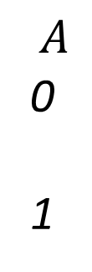


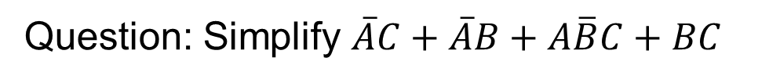


Example: Simplify 3-Variable Expression
Question: Simplify $\overline{A}C+\overline{A}B+A\overline{B}C+BC$
$$B$$
$$BC 00 01 11 10$$
$$A$$
0
1
 | 1 | 1 | 1
 | 1 | 1
$$A$$
$$C$$
Answer: $C+\overline{A}B$

Slide 31

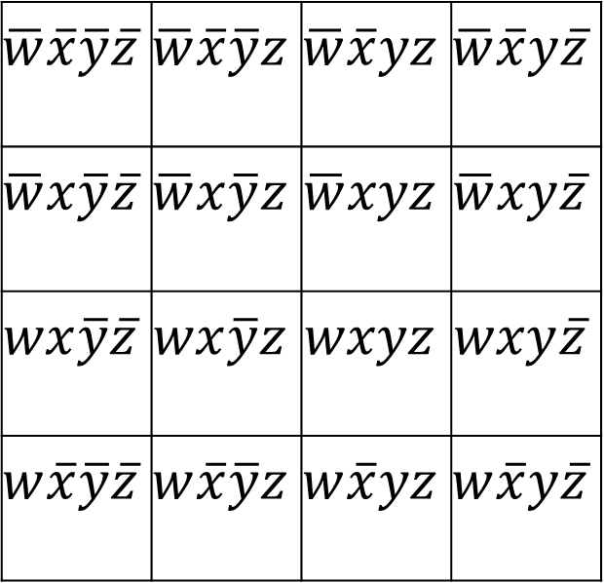



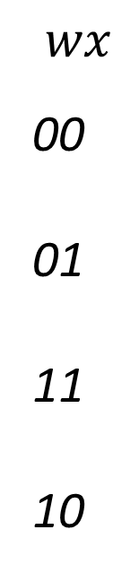

Four Variable Karnaugh Maps
$$y$$
$$yz 00 01 11 10$$
$$wx$$
00
01
11
10
$$\overline{w}\overline{x}\overline{y}\overline{z}$$ | $$\overline{w}\overline{x}\overline{y}z$$ | $$\overline{w}\overline{x}yz$$ | $$\overline{w}\overline{x}y\overline{z}$$
$$\overline{w}x\overline{y}\overline{z}$$ | $$\overline{w}x\overline{y}z$$ | $$\overline{w}xyz$$ | $$\overline{w}xy\overline{z}$$
$$wx\overline{y}\overline{z}$$ | $$wx\overline{y}z$$ | $$wxyz$$ | $$wxy\overline{z}$$
$$w\overline{x}\overline{y}\overline{z}$$ | $$w\overline{x}\overline{y}z$$ | $$w\overline{x}yz$$ | $$w\overline{x}y\overline{z}$$
$$x$$
$$w$$
$$z$$
Question: Simplify $\overline{w}y+\overline{w}z+w\overline{x}y+wxyz$

Slide 32

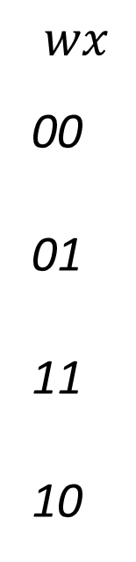






Example: Simplify 4-Variable Expression
$$y$$
Simplify $\overline{w}y+\overline{w}z+w\overline{x}y+wxyz$
$$yz 00 01 11 10$$
$$wx$$
00
01
11
10
 | 1 | 1 | 1
 | 1 | 1 | 1
 |  | 1
 |  | 1 | 1
$$x$$
$$w$$
Solution: $\overline{w}y+\overline{w}z+yz$ $+\overline{x}y$
$$z$$

Slide 33
Useful Combinational Circuits

Slide 34
Data Multiplexor (MUX)
Multiplexor (“MUX”) is a selector
  Place one of multiple inputs onto output (N-to-1)
Shown below is an n-bit 2-to-1 MUX
  Input S selects between two inputs of n bits each
A
This input is passed to output if selector bits match shown value
‘n
0
C
‘n
B
‘n
1
Represents that this input has n bits
S

Slide 35
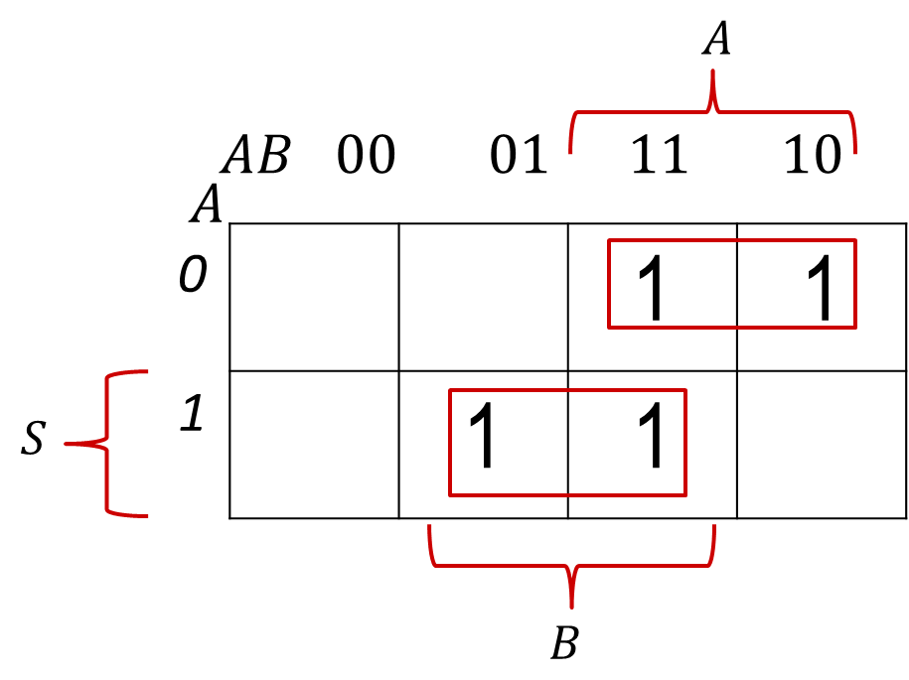
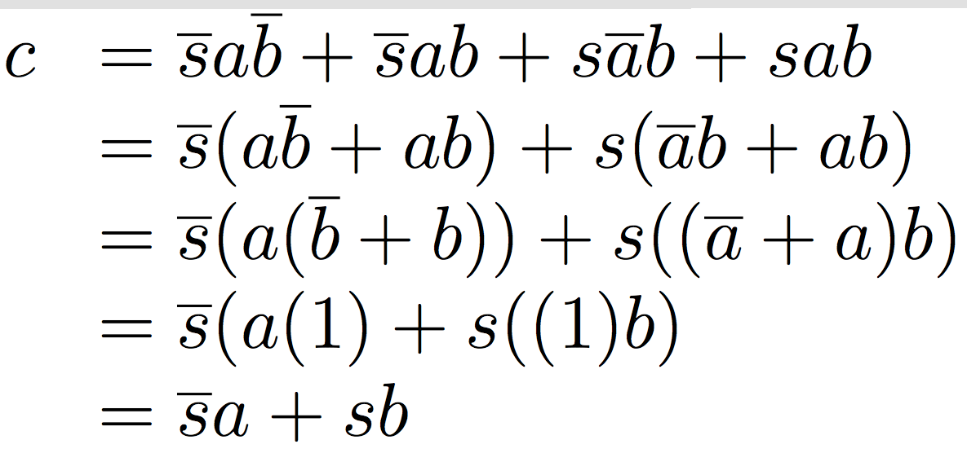
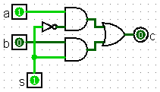
Implementing a 1-bit 2-to-1 MUX
s
Schematic:
Truth Table:
Boolean Algebra:
Circuit Diagram:
A
‘n
0
C
‘n
B
‘n
1
s | a | b | c
0 | 0 | 0 | 0
0 | 0 | 1 | 0
0 | 1 | 0 | 1
0 | 1 | 1 | 1
1 | 0 | 0 | 0
1 | 0 | 1 | 1
1 | 1 | 0 | 0
1 | 1 | 1 | 1
S

Slide 36
1-bit 4-to-1 MUX
Schematic:
Truth Table: How many rows?
Boolean Expression:
E = S₁S₀A + S₁S₀B + S₁S₀C + S₁S₀D
A
00
B
01
E
C
10
D
11
‘2
S= S₁S₀
2⁶

Slide 37
Another Design for 4-to-1 MUX
Can we leverage what we’ve previously built?
  Alternative hierarchical approach:
A
0
B
1
0
E
C
1
0
D
1
S₁
S₀

Slide 38
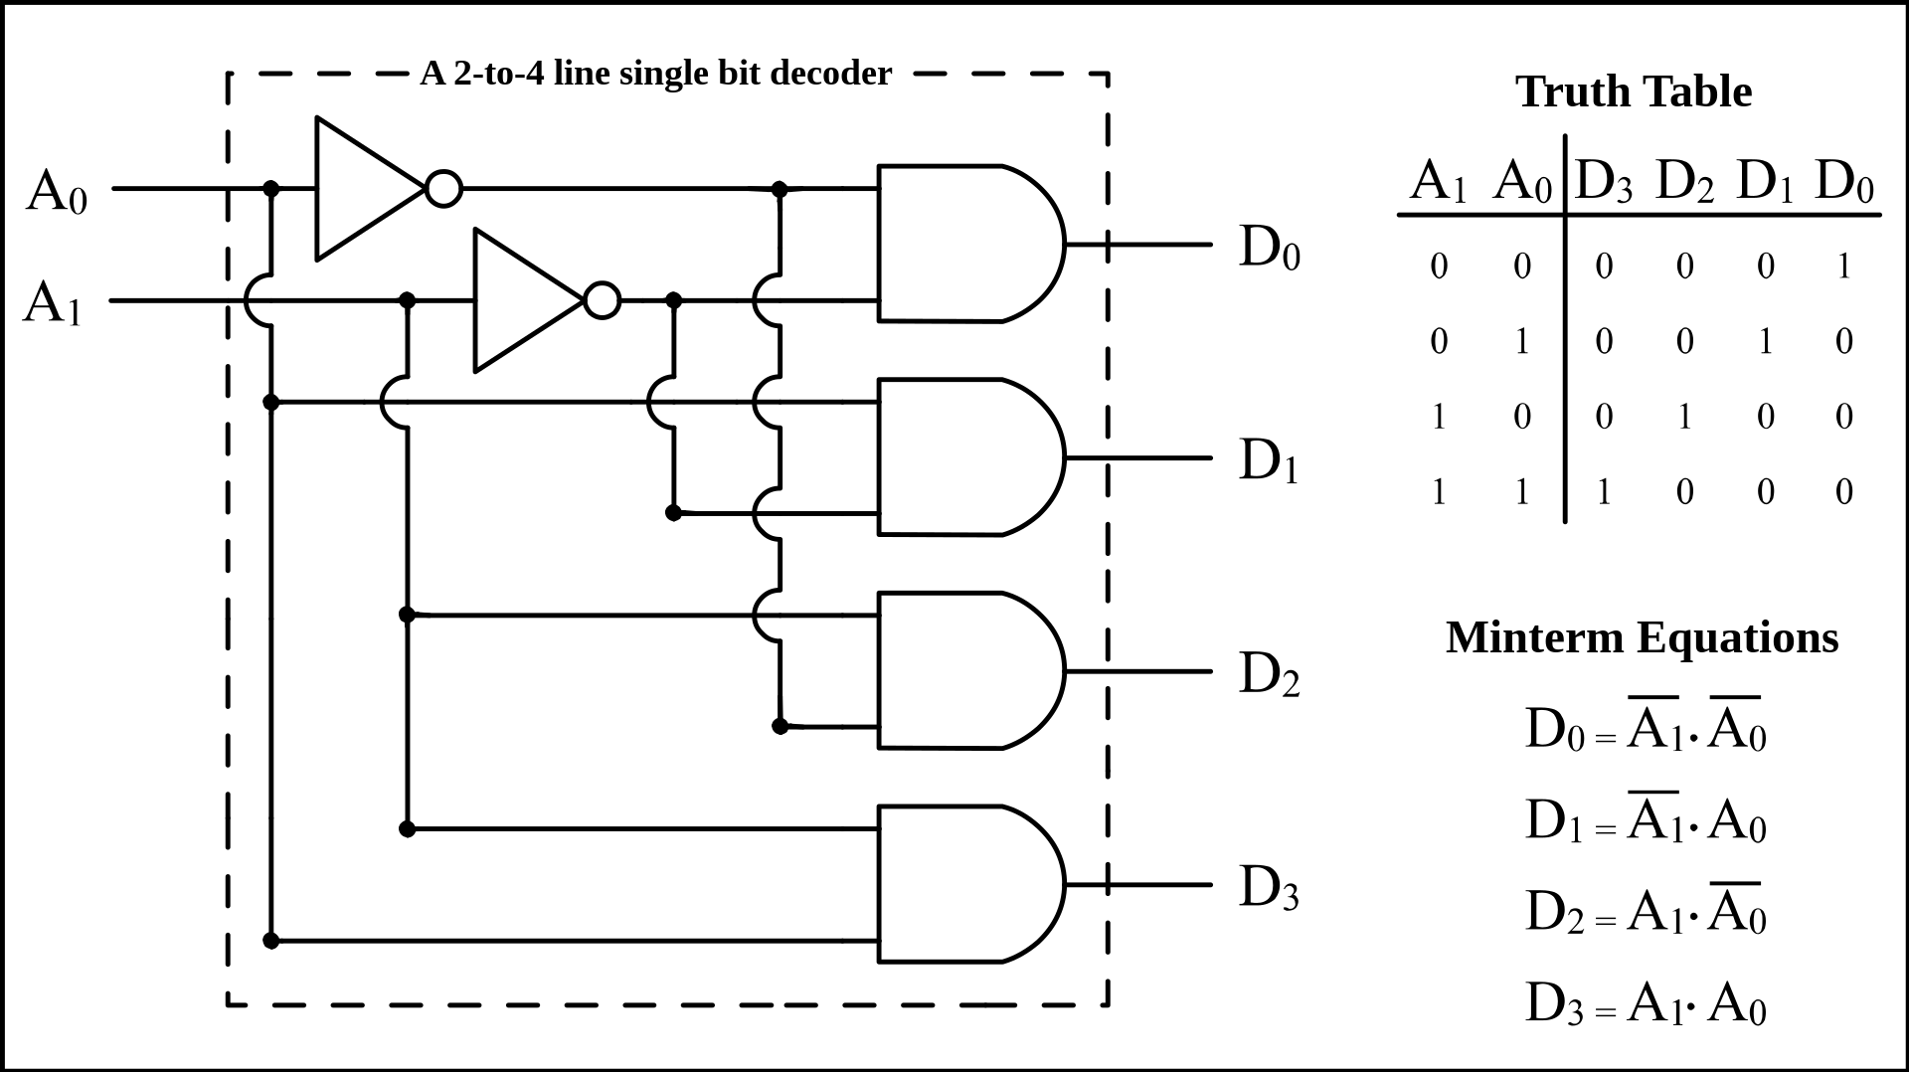
Decoder
Enable one of 2^{N} outputs based on N input
Example: 2-to-4 decoder
Use case: Choose ALU operation based on instruction op-code
By BlueJester0101, CC BY-SA 3.0, https://commons.wikimedia.org/w/index.php?curid=3668293

Slide 39
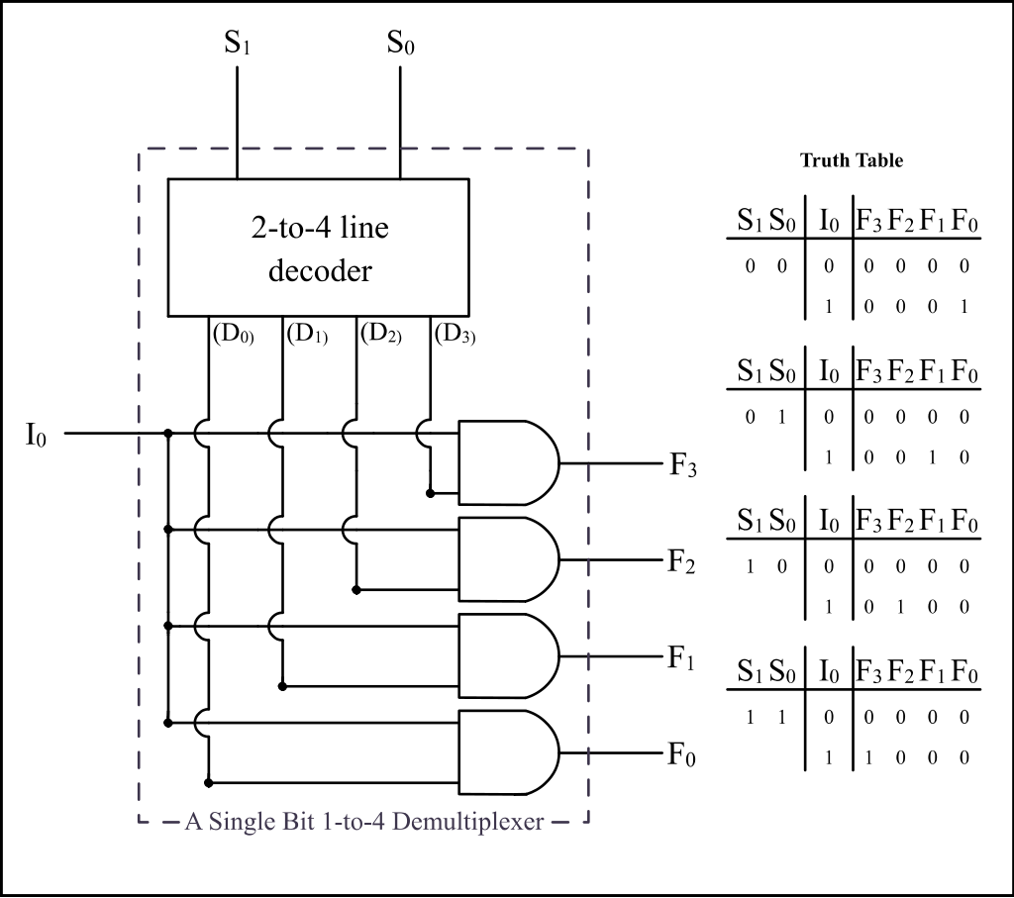
Demultiplexer (Demux)
Similar to decoder with an enable signal
By BlueJester0101, CC BY-SA 3.0, https://commons.wikimedia.org/w/index.php?curid=3668293

Slide 40
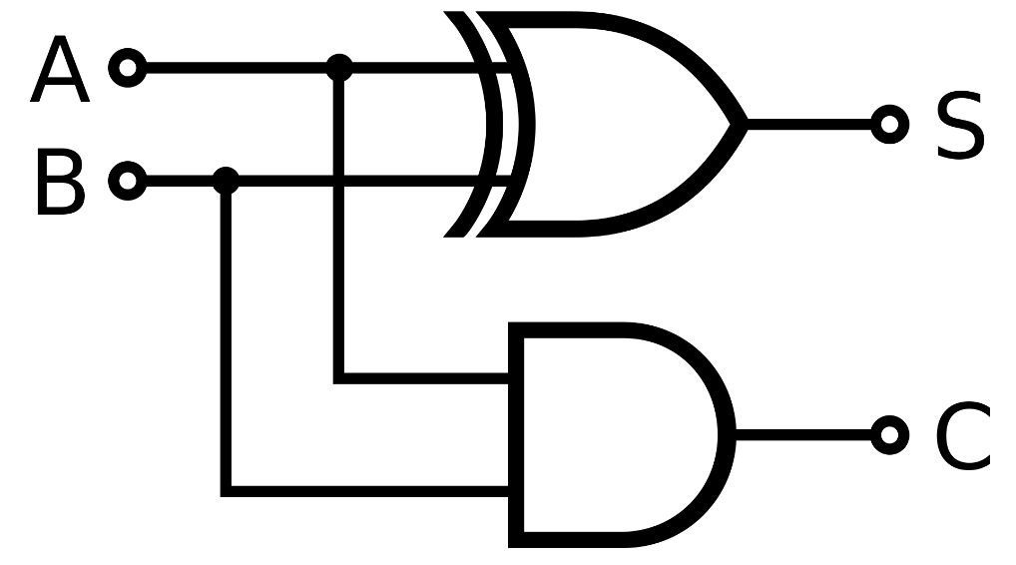
Single-Bit Binary Adder (Half Adder)
Add A + B to get Sum (S) and Carry (C)
Truth Table:
Boolean Expressions:
  S = A⊕B; C = AB
Circuit:
A | B | S | C
0 | 0 | 0 | 0
0 | 1 | 1 | 0
1 | 0 | 1 | 0
1 | 1 | 0 | 1
By inductiveload - Own work, Public Domain, https://commons.wikimedia.org/w/index.php?curid=1023090

Slide 41
What is this Circuit?
Truth table:
A
B
S
A B C
C S
0 0 0
0 0 1
0 1 0
0 1 1
1 0 0
1 0 1
1 1 0
1 1 1
0
0
0
1
0
1
1
1
0
1
1
0
1
0
0
1
Half Adder
Half Adder
C
3-bit
Addition!
C
Q. What’s the propagation delay?
Full Adder
A
B
3 gate delays (highlighted)
Q. What does the circuit accomplish?
Algebra:
FA
C
C
S = A ⊕ B ⊕ C; C = AB + C(A ⊕ B)
S
S = A ⊕ B ⊕ C

Slide 42
Computing with Combinational Circuits
Definition: A combinational circuit computes a pure function, i.e., its outputs react only based on its inputs. There are no feedback loops and no state information (memory) is maintained.
Theorem: Every Boolean function can be implemented with NAND and NOT. Circuits are modular
… a 4-bit ripple carry adder!
  Adds by columns
  Propagation delay
A₃
B₃
A₂
B₂
A₁
B₁
A₀
B₀
A
B
4
4
C₃
C₂
C₁
= 9
C₄
FA
FA
FA
FA
C₀
(2n + 1)
Adder-4
C
C
4
S₃
S₂
S₁
S₀
S
Notes:
Orally: We used to spend ⅔ of CMPT 150 on the design techniques to minimize circuit size, gate delay, etc …
The point in CMPT 295 is only that it is possible to do so, and that gate delay is a thing
Orally: This is why additions is slow. And why mul is even slower.
Orally: How to make an Adder-8?

Slide 43
Functional Unit
Hardware circuits are fixed
Can’t adjust wires / gates while running
Build control wires to parametrize its function
Function Unit:
Function Select:
FS func
0001 A + B
0010 A − B
1000 A * B
0100 A ^ B
0101 A + 1
1101 B
32
32
opA
opB
FS
4
res
32

Slide 44
Functional Unit: Adder-Subtractor
A
B
32
FS
if FS == 0 then
S = A + B
if FS == 1 then
32
32
C
Adder-32
S = A + B + 1
32
= A − B
S

Slide 45
Combinational vs. Sequential Logic
Digital Systems consist of two basic types of circuits:
  Combinational Logic (CL)
    Output is a function of the inputs only, not the history of its execution
    Example: add A, B (ALUs)
  Sequential Logic (SL)
    Circuits that “remember” or store information
    Also called “State Elements”
    Example: Memory and registers

Slide 46
Sequential Logic

Slide 47
Accumulator Example
An example of why we would need sequential logic
SUM
X_{i}
S
Want: S=0;
for X₁,X₂,X₃ over time...
S = S + X_{i}
Assume:
  Each X value is applied in succession, one per cycle
  The sum since time 1 (cycle) is present on S

Slide 48
First Try: Does this work?
X
+
S
Feedback
No!
How to control the next iteration of the ‘for’ loop?
How do we say: ‘S=0’?

Slide 49
Second Try: How About This?
X_{i}
+
S
A Register is the state element that is used here to hold up the transfer
of data to the adder
register
Load/Clk
reset

Slide 50
Uses for State Elements
Place to store values for some amount of time:
  Register files (like in RISCV)
  Memory (caches and main memory)
Help control flow of information between combinational logic blocks
  State elements are used to hold up the movement of information at the inputs to combinational logic blocks and allow for orderly passage

Slide 51
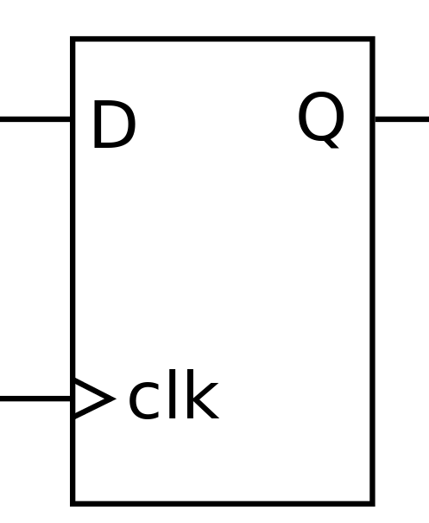
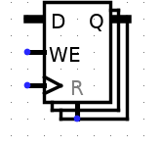
Registers
Same as registers in assembly:
Small memory storage locations
Data input
(can be various bit widths)
Data output
(can be various bit widths)
Write Enable
(can it be written to?)
Clock input
(inputs active only on a clock “tick”)
Reset
(sets value to zero)

Slide 52
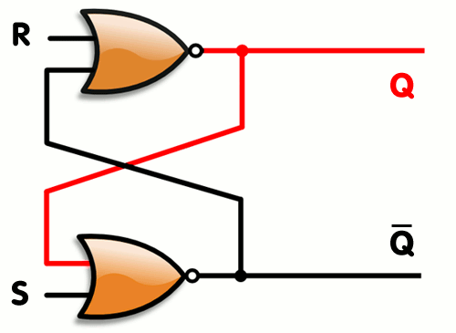
First State Element: RS Latch
When R = 1 and S = 0 → Q is 0
When S = 1 and R = 0 → Q is 1
When both S and R are 0 → Q stays the same
When both S and R are 1 → Undefined
Recall:
NOR outputs 1 if
both inputs are 0
By Napalm Llama - Modification of Wikimedia Commons file R-S.gif (shown below), CC BY 2.0, https://commons.wikimedia.org/w/index.php?curid=4845402

Slide 53
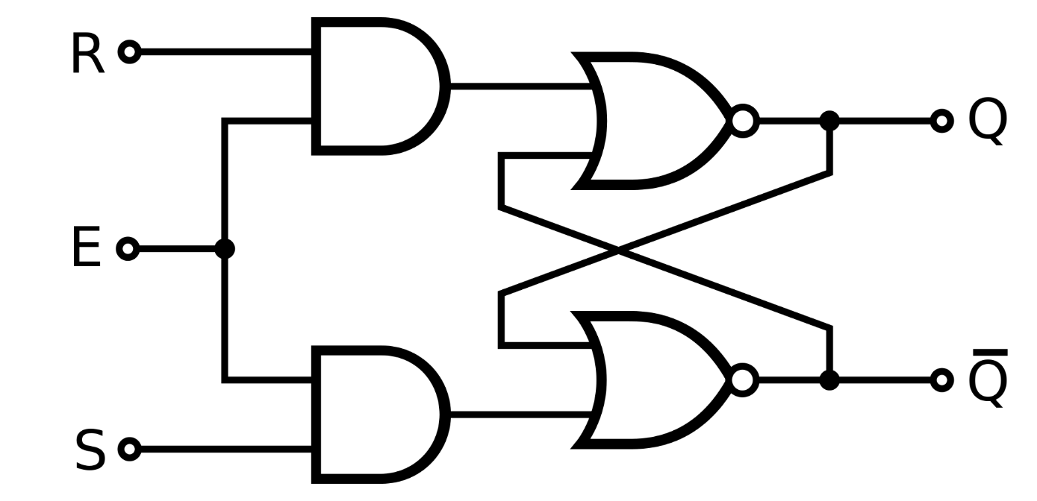
RS Latch with Enable
Only changes state when E = 1.
Stays the same when E = 0
By Inductiveload - Own Drawing in Inkscape 0.43, Public Domain, https://commons.wikimedia.org/w/index.php?curid=873598

Slide 54
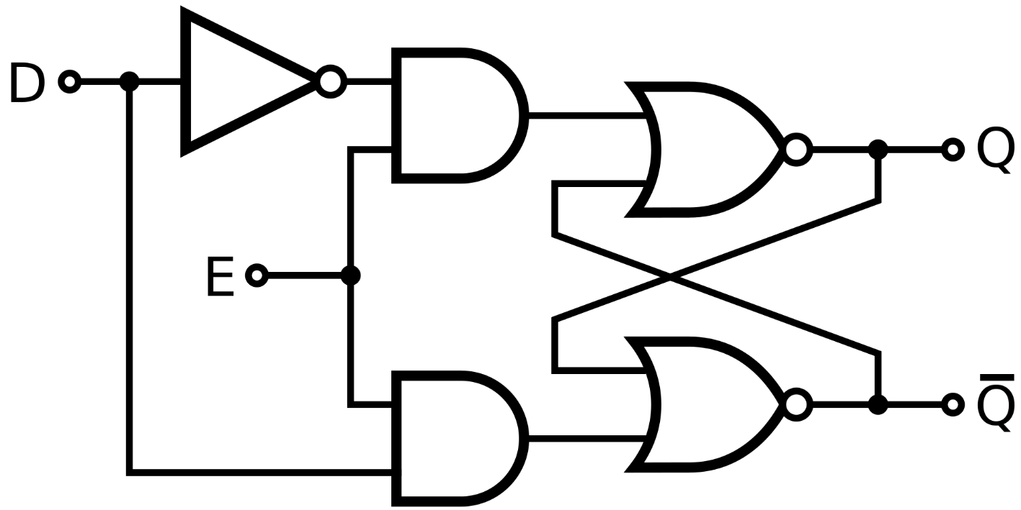
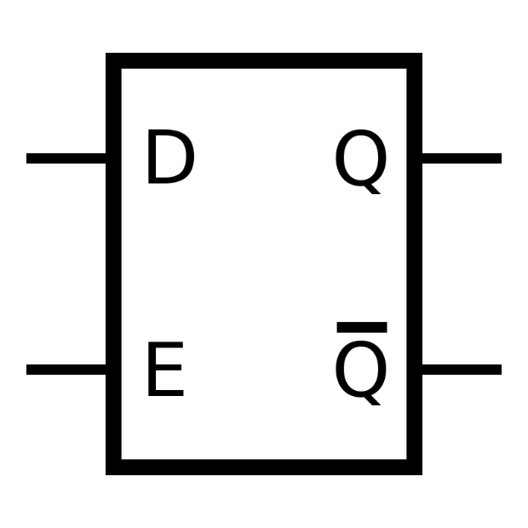
D Latch
Avoids undefined state of RS Latch when R=S=1
Q is set to D when E = 1; Q stays the same when E = 0
Circuit
Schematic
By Inductiveload - Own work, Public Domain, https://commons.wikimedia.org/w/index.php?curid=6712594
By Inductiveload - Own work, Public Domain, https://commons.wikimedia.org/w/index.php?curid=6712572

Slide 55
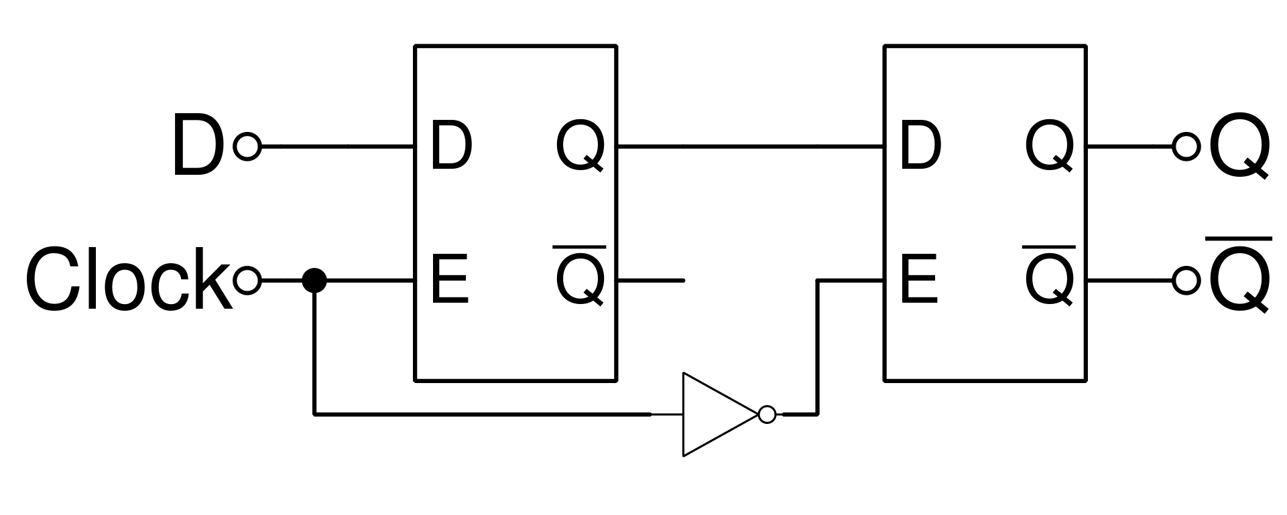
D Flip-Flop
Changes state only on falling edge of Clock (i.e., Clock changes from 1 to 0)
Use Clock to change on rising edge
By Nolanjshettle at English Wikipedia, CC BY-SA 3.0, https://commons.wikimedia.org/w/index.php?curid=40852395

Slide 56

Signals and Waveforms: Clocks
Clock period
(CPU cycle time)
Voltage
T
T = $\frac{1}{frequency}$
High
Low
Rising Edge
Falling Edge
Time
Signals transmitted over wires continuously
Transmission is effectively instantaneously
  Implies that any wire only contains one value at any given time

Slide 57
Dealing with Waveform Diagrams
Easiest to start with CLK on top
  Solve signal by signal, from inputs to outputs
  Can only draw the waveform for a signal if all of its input waveforms are drawn
When does a signal update?
  A state element updates based on CLK triggers
  A combinational element updates ANY time ANY of its inputs changes

Slide 58
Accumulator 2nd Try: How About This?
X_{i}
+
S
register
Load/Clk
reset
Load/Clk
X_{i}
X0
X1
X2
X3
S
X0
X0+X1
X0+X1+X2
X0+X1+X2+X3
Delay through Adder
Time

Slide 59
Register Internals
Register
D (n-bit)
d_{n-1}
d₁
d₀
≡
FF
…
FF
FF
CLK
CLK
CLK
CLK
Q(n-bit)
q_{n-1}
q₁
q₀
N-bit register ≡ n instances of a “Flip-Flop”
  Output flips and flops between 0 and 1
Specifically this is a “D-type Flip-Flop”
  D is “data input”, Q is “data output”
  A group of wires when interpreted as a bit field is called a bus

Slide 60
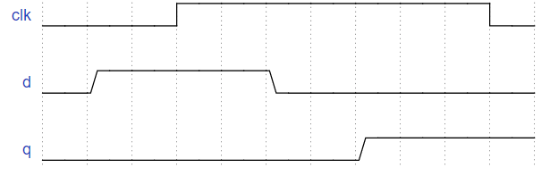
Flip-Flop Timing Behavior
CLK
d
FF
q

Slide 61
CLK
Flip-Flop Timing Behavior
d
FF
q
Setup Time

Slide 62
CLK
Flip-Flop Timing Behavior
d
FF
q
Hold Time

Slide 63
CLK
Flip-Flop Timing Behavior
d
FF
q
Clock-to-Q

Slide 64
Accumulator Revisited: Proper Timing
X_{i}
Reset signal shown
In practice X_{i} might not arrive to the adder at the same time as S_{i-1}
S_{i} temporarily is wrong, but register always captures correct value
In good circuits, instability never happens around rising edge of CLK
+
S_{i}
S_{i-1}
register
Clk
reset
Reset
“Undefined” (unknown) signal
CLK
S_{i-1}
0
X0
X0+X1
X0+X1 +X2
X_{i}
X0
X1
X2
X3
S_{i}
X0
X0+X1
X0+X1+X2
X0+X1+X2+X3

Slide 65
Timing Terms
Clock: Steady square wave that synchronizes system
Register: Several bits of state that samples on rising edge of Clock (positive edge-triggered); also has RESET
Setup Time: When input must be stable before Clock trigger
Hold Time: When input must be stable after Clock trigger
Clock-to-Q Delay: How long it takes output to change from Clock trigger
Notes:
STOP HERE

Slide 66
Digital State Machines
inputs
Memory holds state information
memory
current
state
combinational
circuit
outputs
next state
compute next state based on (current state, inputs)
compute outputs based on (current state, inputs)
Q. What does this imply about the clock period?
clock period must exceed (t_{pd} of combinational circuit + t_{pd} of registers) where t_{pd} is propagational delay

Slide 67

Waveform Example: RS Latch
By Napalm Llama - Modification of Wikimedia Commons file R-S.gif (shown below), CC BY 2.0, https://commons.wikimedia.org/w/index.php?curid=4845402
a | b | a NOR b
0 | 0 | 1
0 | 1 | 0
1 | 0 | 0
1 | 1 | 0
Q
$$\overline{Q}$$
R
S
Time

Slide 68

Waveform Example: D Flip-Flop
By Nolanjshettle at English Wikipedia, CC BY-SA 3.0, https://commons.wikimedia.org/w/index.php?curid=40852395
Q
$$\overline{Q}$$
D
Clock
Time

Slide 69
CPU Hardware
Goal: Given an instruction set architecture, construct a machine that reliably executes instructions.
Design choices will influence speed of instructions:
Some instructions will be faster than others
Order of instructions may matter
Order of memory accesses may matter
“conflicts” or “hazards”

Slide 70
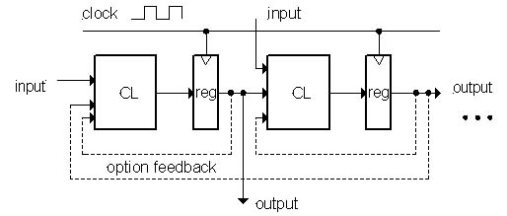
Model for Synchronous Systems
Combinational logic blocks separated by registers
  Clock signal connects only to sequential logic elements
  Feedback is optional depending on application
How do we ensure proper behavior?
  How fast can we run our clock?

Slide 71
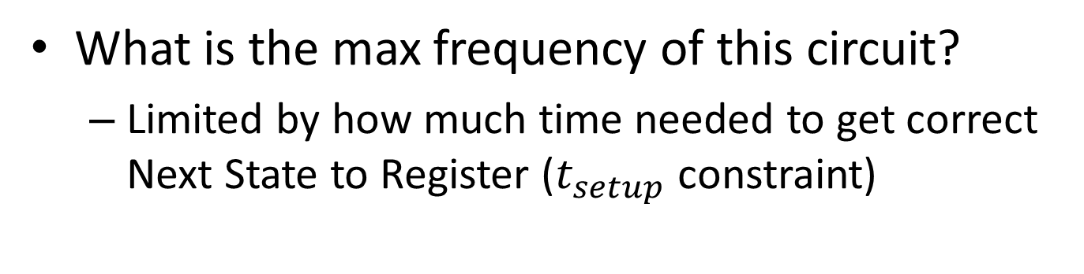
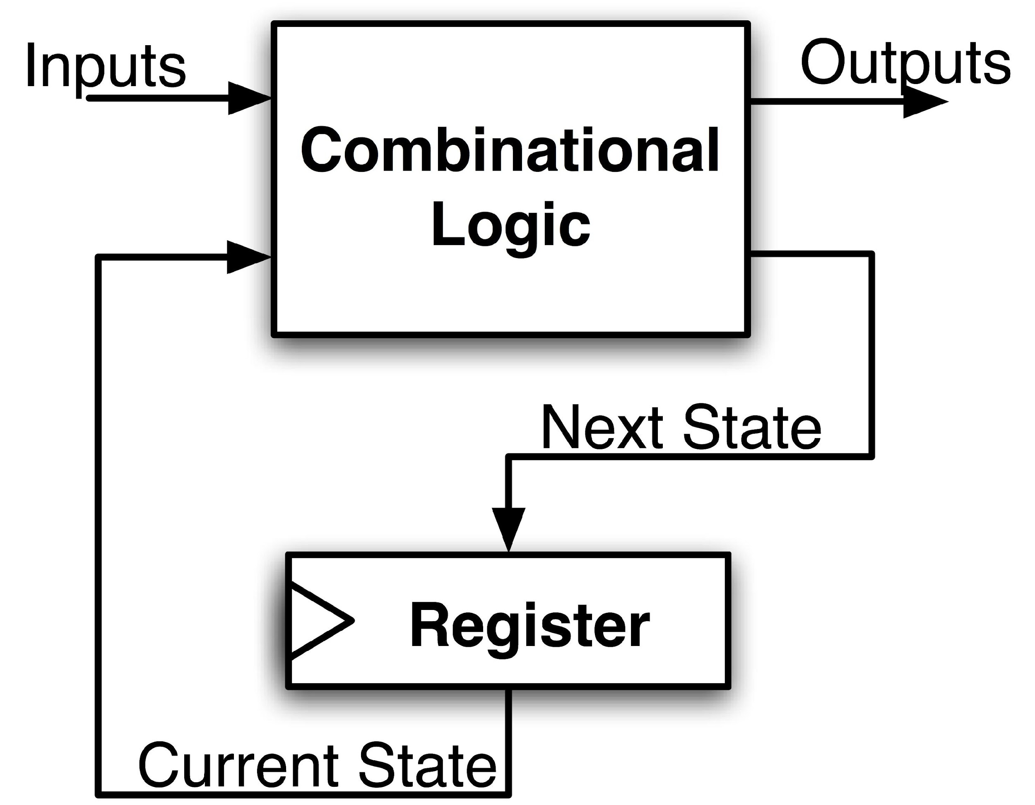
Maximum Clock Frequency
Assumes Max Delay > Hold Time
Max Delay =
Min Period = Max Delay
Max Freq = 1/Min Period
CLK-to-Q Delay
+ CL Delay
+ Setup Time
Notes:
Hold time is included in CLK-to-Q delay.
Make sure to shift thinking for setup time for next clock trigger (one clock cycle).

Slide 72
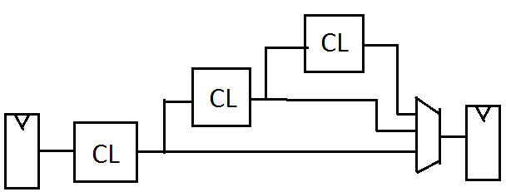
The Critical Path
The critical path is the longest delay between any two registers in a circuit
The clock period must be longer than this critical path, or the signal will not propagate properly to that next register
+
Reg
Reg
72

Slide 73
How to get faster clock frequency?
Pipelining!
Split operation into smaller parts and add registers between each two consecutive parts (next week).

Slide 74
RISC-V CPU Datapath, Control Intro
Notes:
Podcast link: https://gimletmedia.com/tags/6dug/super-tech-support

Slide 75
CPU Design Principles
Analyze instruction set →
datapath requirements
Select set of datapath
components & establish
clock methodology
Assemble datapath meeting
the requirements
Analyze implementation of each instruction to determine setting of control points that effects the register transfer
Assemble the control logic
  Formulate Logic Equations
  Design Circuits
Processor
Input
Control
Memory
Datapath
Output

Slide 76
RISC-V Single-Cycle CPU
Universal datapath
  Capable of executing all RISC-V instructions in one cycle each
  Not all units (hardware) used by all instructions
5 Phases of execution
  IF (Instruction Fetch), ID (Instruction Decode), EX (Execute), MEM (Memory), WB (Write Back)
  Not all instructions are active in all phases (except for loads!)
Controller specifies how to execute instructions

Slide 77
RISC-V CPU in two parts
Central Processing Unit (CPU):
  Datapath: Contains the hardware necessary to perform operations required by the processor
    Reacts to what the controller tells it. (i.e., “I was told to do an add, so I”ll feed these arguments through an adder)
  Control: Decides what each piece of the datapath should do
    What operation am I performing? Do I need to get info from memory? Should I write to a register? Which register?
    Has to make decisions based on the input instruction only.

Slide 78
Design Principles
Determining control signals
  Any time a datapath element has an input that changes behavior, it requires a control signal
  (e.g. ALU operation, read/write)
  Any time you need to pass a different input based on the instruction, add a MUX with a control signal as the selector
  (e.g. next PC, ALU input, register to write to)
Control signals will change based on exact datapath
Datapath will change based on ISA

Slide 79
Storage Element: Register File
RW
RA
RB
Write Enable
5
5
5
Register File consists of 32 registers:
  Output ports portA and portB
  Input port portW
Register selection
  Place data of register RA (number) onto portA
  Place data of register RB (number) onto portB
  Store data on portW into register RW (number) when Write Enable is 1
Clock input (CLK)
  CLK is passed to all internal registers so they can be written to if they match RW and Write Enable is 1
portA
portW
32 x 32-bit
Registers
32
32
portB
Clk
32

Slide 80
Implementing R-Types
31
25 24
20 19
15 14
12 11
7 6
0
func7(7)
rs2(5)
rs1(5)
Func3(3)
rd(5)
opcode(7)
Perform operation
New hardware: ALU (Arithmetic Logic Unit)
Abstraction for adders, multipliers, dividers, etc.
How do we know what operation to execute?
  Our first control bit! ALUSel(ect)
+4
Reg[]
pc
IMEM
inst[11:7]
AddrD
ALU
R[rs1]
inst[19:15]
DataA
AddrA
inst[24:20]
AddrB
DataB
R[rs2]
inst[31:0]
Control
ALUSel = add

Slide 81
Implementing R-Types
31
25 24
20 19
15 14
12 11
7 6
0
func7(7)
rs2(5)
rs1(5)
Func3(3)
rd(5)
opcode(7)
Perform operation
Write ALU result to rd
+4
Reg[]
pc
DataD
IMEM
inst[11:7]
AddrD
ALU
R[rs1]
inst[19:15]
DataA
alu
AddrA
inst[24:20]
AddrB
DataB
R[rs2]
inst[31:0]
Control
RegWEn=1
ALUSel = add
ALUSel = add

Slide 82
Adding addi to datapath
31
20 19
15 14
12 11
7 6
0
imm(12)
rs1(5)
Func3(3)
rd(5)
opcode(7)
+4
Reg[]
pc
DataD
ALU
alu
IMEM
inst[11:7]
AddrD
Reg[rs1]
pc+4
DataA
0
inst[19:15]
AddrA
Reg[rs2]
inst[24:20]
AddrB
DataB
1
Also works for all other I-format arithmetic instruction (slti,sltiu,andi,ori,xori,slli,srli,srai) just by changing ALUSel
inst[31:20]
Imm.
Gen
imm[31:0]
Control Logic
inst[31:0]
ImmSel=I
RegWEn=1
BSel=1
ALUSel=Add
82

Slide 83
Adding lw to datapath
31
20 19
15 14
12 11
7 6
0
offset(12)
base
width
dst
opcode
+4
Reg[]
alu
pc
wb
DataD
Reg[rs1]
ALU
DMEM
1
IMEM
inst[11:7]
AddrD
Reg[rs2]
Addr
wb
pc+4
inst[19:15]
AddrA
DataA
0
DataR
0
1
mem
inst[24:20]
AddrB
DataB
inst[31:20]
Imm.
Gen
imm[31:0]
inst[31:0]
ImmSel=I
RegWEn=1
Bsel=1
ALUSel=Add
MemRW=Read
WBSel=0

Slide 84
Storage Element: Idealized Memory
Memory (idealized)
  One input port: Data In
  One output port: Data Out
Memory access:
  Read: Write Enable = 0, data at Address is placed on Data Out
  Write: Write Enable = 1, Data In written to Address
Clock input (CLK)
  CLK input is a factor ONLY during write operation
  During read, behaves as a combinational logic block: Address valid → Data Out valid after “access time”
Write Enable
Address
Data In
DataOut
32
32
CLK

Slide 85
Current Datapath
+4
Reg[]
ALU
pc
wb
DataD
Reg[rs1]
ALU
1
DMEM
IMEM
inst[11:7]
AddrD
Addr
pc+4
Reg[rs2]
DataR
wb
inst[19:15]
AddrA
DataA
0
0
mem
inst[24:20]
AddrB
DataB
1
inst[31:20]
Imm.
Gen
imm[31:0]
inst[31:0]
ImmSel
BSel
ALUSel
MemRW
WBSel

Slide 86
Adding sw to datapath
31
25 24
20 19
15 14
12 11
7 6
0
imm(11:5)
rs2
rs1
func3
imm(4:0)
opcode
+4
Reg[]
alu
pc
wb
DataD
Reg[rs1]
ALU
DMEM
pc+4
IMEM
inst[11:7]
AddrD
Reg[rs2]
Addr
1
wb
inst[19:15]
AddrA
DataA
0
DataR
0
1
DataW
mem
inst[24:20]
AddrB
DataB
inst[31:7]
Imm.
Gen
imm[31:0]
inst[31:0]
ImmSel=S
RegWEn=0
Bsel=1
ALUSel=Add
MemRW=Write
WBSel=*
*= “Don’t Care”
86

Slide 87
Adding branches to datapath
31
25 24
20 19
15 14
12 11
7 6
0
imm(12|10:5)
rs2
rs1
func3
imm(4:1|11)
opcode
alu
+4
Reg[]
pc
alu
pc
wb
DataD
1
1
Reg[rs1]
ALU
DMEM
IMEM
inst[11:7]
AddrD
0
1
0
Branch Comp.
Reg[rs2]
Addr
DataR
0
wb
pc+4
inst[19:15]
AddrA
DataA
0
DataW
mem
inst[24:20]
AddrB
DataB
1
inst[31:7]
Imm.
Gen
imm[31:0]
PCSel=taken/not-taken
inst[31:0]
ImmSel=B
RegWEn=0
BrUn
BrEq
BrLT
Bsel=1
ASel=1
MemRW=Read
WBSel=*
ALUSel=Add
87

Slide 88
Adding jalr to datapath
31
20 19
15 14
12 11
7 6
0
offset
base
Func3
dest
opcode
+4
Reg[]
pc
alu
pc+4
alu
pc
wb
1
1
DataD
Reg[rs1]
ALU
DMEM
2
IMEM
inst[11:7]
AddrD
0
1
pc+4
0
Branch Comp.
Reg[rs2]
Addr
DataR
0
wb
inst[19:15]
AddrA
DataA
0
DataW
mem
inst[24:20]
AddrB
DataB
1
inst[31:7]
Imm.
Gen
imm[31:0]
PCSel
inst[31:0]
ImmSel=I
RegWEn=1
Bsel=1
Asel=0
MemRW=Read
WBSel=2
BrEq=*
ALUSel=Add
BrUn=*
BrLT=*
Writes PC+4 to dest (return address)
Sets PC = base + offset
88

Slide 89
Adding jal to datapath
31
12 11
7 6
0
imm[20|10:1|11|19:12]
rd
opcode
+4
Reg[]
pc
alu
pc+4
alu
pc
wb
1
1
DataD
Reg[rs1]
ALU
DMEM
2
IMEM
inst[11:7]
AddrD
0
1
pc+4
0
Branch Comp.
Reg[rs2]
Addr
DataR
0
wb
inst[19:15]
AddrA
DataA
0
DataW
mem
inst[24:20]
AddrB
DataB
1
inst[31:7]
Imm.
Gen
imm[31:0]
PCSel
inst[31:0]
ImmSel=J
RegWEn=1
Bsel=1
Asel=1
MemRW=Read
WBSel=2
BrEq=*
ALUSel=Add
BrUn=*
BrLT=*
jal saves PC+4 in register rd (the return address)
Set PC = PC + offset (PC-relative jump)
89

Slide 90
Implementing lui
31
12 11
7 6
0
imm[31:12]
rd
opcode
+4
Reg[]
pc
pc+4
pc
wb
1
alu
alu
1
DataD
Reg[rs1]
ALU
DMEM
2
IMEM
inst[11:7]
AddrD
0
1
pc+4
0
Branch Comp.
Reg[rs2]
Addr
DataR
0
wb
inst[19:15]
AddrA
DataA
0
DataW
mem
inst[24:20]
AddrB
DataB
1
inst[31:7]
Imm.
Gen
imm[31:0]
PCSel=pc+4
inst[31:0]
ImmSel=U
RegWEn=1
Bsel=1
Asel=*
ALUSel=B
MemRW=Read
WBSel=1
BrUn=*
BrE=*
BrLT=*
lui writes the upper 20 bits of the destination with the immediate value, and clears the lower 12 bits
90

Slide 91
Implementing auipc
31
12 11
7 6
0
imm[31:12]
rd
opcode
+4
Reg[]
pc
pc+4
pc
wb
1
alu
alu
1
DataD
Reg[rs1]
ALU
DMEM
2
IMEM
inst[11:7]
AddrD
0
1
pc+4
0
Branch Comp.
Reg[rs2]
Addr
DataR
0
wb
inst[19:15]
AddrA
DataA
0
DataW
mem
inst[24:20]
AddrB
DataB
1
inst[31:7]
Imm.
Gen
imm[31:0]
PCSel=pc+4
inst[31:0]
ImmSel=U
RegWEn=1
Bsel=1
Asel=1
ALUSel=Add
MemRW=0
WBSel=1
BrUn=*
BrE=*
BrLT=*
Adds upper immediate value to PC and places result in destination register
91

