Slide 1
Combinational Logic
Sequential Logic
CPU Datapath
CMPT 295 Week 10

Slide 2
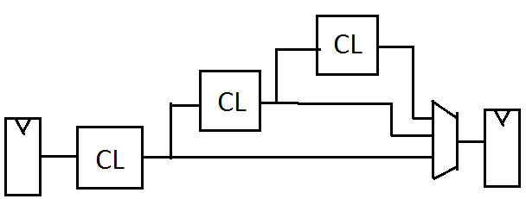
Software vs. Hardware
tmp1 = f1(arg1)
tmp2 = f2(tmp1)
tmp3 = f3(tmp2)
return f(tmp1,tmp2,tmp3)
arg1
Hardware is all about signals (0/1) flowing through gates.
  Each gate/block is like a pure function.
Wires are the “plumbing” that move signals between blocks (ala. Args or return values)
Larger circuits are built up by combining blocks, just like software is built by calling functions
Memory elements (flip-flops, registers) hold state, much like variables do in code (more on this later…).
f1()
tmp1
f2()
tmp2
f3()
tmp3
return
 | Software | Hardware
Basic operation | Functions (input → output) | Gates/Block (I/O wires)
Wiring | Function calls or passing arguments | Wires that carry 0/1 signals between gates
Composition | Compose functions f(g(x)) | Organize flow of blocks
State | Variables, memory | Flip-flops, registers
Execution | Step-by-step | Continous flow except at clocked edge (more later)

Slide 3
Software vs. Hardare
No conditional statements
Software
Hardware
  Do all statements and pick
switch (instruction.rtype.funct3) {
case 0x0:
switch (instruction.rtype.funct7) {
case 0x0:
// Add
processor->R[instruction.rtype.rd] =
((sWord)processor->R[instruction.rtype.rs1]) +
((sWord)processor->R[instruction.rtype.rs2]);
break;
case 0x1:
// Mul
processor->R[instruction.rtype.rd] =
((sWord)processor->R[instruction.rtype.rs1]) *
((sWord)processor->R[instruction.rtype.rs2]);
break;
Tmp1 =
((sWord)processor->R[instruction.rtype.rs1]) +
((sWord)processor->R[instruction.rtype.rs2]);
// Mul
Tmp2 =
((sWord)processor->R[instruction.rtype.rs1]) *
((sWord)processor->R[instruction.rtype.rs2]);
Select(tmp1,tmp2….) # SEL

Slide 4
int32_t getImmediate(uint32_t instr) {
// Common bitfields
uint32_t ins_31 = (instr >> 31) & 0x1; // sign bit
uint32_t ins_30_= (instr >> 25) & 0x3F; // shared upper field for I/S/B
uint32_t ins_24_21 = (instr >> 21) & 0xF; // used in J-type
uint32_t ins_20 = (instr >> 20) & 0x1; // shared mid-bit (I/J)
uint32_t ins_19_12 = (instr >> 12) & 0xFF; // U/J upper byte
uint32_t ins_11_8 = (instr >> 8) & 0xF; // B-type middle nibble
uint32_t ins_7 = (instr >> 7) & 0x1; // S/B lower link
imm_i = ins_31 << 11 | (ins_30_25 << 5) | (ins_20 << 4) | ((instr >> 21) & 0xF);
imm_s = (ins_30_25 << 5) | ((instr >> 7) & 0x1F);
Field | Shared Among | Bits | Notes
instr[31] | I/S/B/J | sign bit | sign-extend source
instr[30:25] | I/S/B | high field | common for load/store/branch
instr[11:7] | S | low field | destination offset
instr[19:12] | U/J | upper byte | long immediates
instr[20] | I/J | single control bit | mid-immediate for JAL/JALR

Slide 5
Synchronous Digital Systems (SDS)
Hardware of a processor (e.g., RISC-V) is an example of a Synchronous Digital System
Synchronous:
  All operations coordinated by a central clock
    “Heartbeat” of the system (processor frequency)
Digital:
  Represent all values with two discrete values
  Electrical signals are treated as 1’s and 0’s
    High/Low voltage represent True/False, 1/0

Slide 6
Combinational vs. Sequential Logic
Digital Systems consist of two basic types of circuits:
  Combinational Logic (CL)
    Output is a function of the inputs only, not the history of its execution
    Example: add A, B (ALUs)
  Sequential Logic (SL)
    Circuits that “remember” or store information
    Also called “State Elements”
    Example: Memory and registers

Slide 7



Simple Logic Gates
Truth Table
Special names and symbols:
Circle means NOT!
a | NOT a
0 | 1
1 | 0
NOT
= NOT a
True if input is false
a | b | a AND b
0 | 0 | 0
0 | 1 | 0
1 | 0 | 0
1 | 1 | 1
AND
= a AND b
True if both inputs are true
a | b | A OR b
0 | 0 | 0
0 | 1 | 1
1 | 0 | 1
1 | 1 | 1
OR
= a OR b
True if at least one input is true
7

Slide 8



More Simple Logic Gates
Inverted versions are easier to implement in CMOS
a | b | a NAND b
0 | 0 | 1
0 | 1 | 1
1 | 0 | 1
1 | 1 | 0
NAND
= a NAND b
True if at least one input is false
a | b | a NOR b
0 | 0 | 1
0 | 1 | 0
1 | 0 | 0
1 | 1 | 0
NOR
= a NOR b
True if both inputs are false
a | b | a XOR b
0 | 0 | 0
0 | 1 | 1
1 | 0 | 1
1 | 1 | 0
XOR
= a XOR b
True if exactly one input is true
(or if odd number of inputs are true for > 2 inputs)

Slide 9
Computing with Combinational Circuits
Definition: A combinational circuit computes a pure function, i.e., its outputs react only based on its inputs. There are no feedback loops and no state information (memory) is maintained.
Theorem: Every Boolean function can be implemented with NAND and NOT. Circuits are modular
… a 4-bit ripple carry adder!
  Adds by columns
  Propagation delay
A₃
B₃
A₂
B₂
A₁
B₁
A₀
B₀
A
B
4
4
C₃
C₂
C₁
= 9
C₄
FA
FA
FA
FA
C₀
(2n + 1)
Adder-4
C
C
4
S₃
S₂
S₁
S₀
S
Notes:
Orally: We used to spend ⅔ of CMPT 150 on the design techniques to minimize circuit size, gate delay, etc …
The point in CMPT 295 is only that it is possible to do so, and that gate delay is a thing
Orally: This is why additions is slow. And why mul is even slower.
Orally: How to make an Adder-8?

Slide 10
How to Represent Combinational Logic?
Text Description
Circuit Diagram
  Transistors and wires
  Logic Gates
Truth Table
Boolean Expression
All are equivalent

Slide 11
Combinational vs. Sequential Logic
Digital Systems consist of two basic types of circuits:
  Combinational Logic (CL)
    Output is a function of the inputs only, not the history of its execution
    Example: add A, B (ALUs)
  Sequential Logic (SL)
    Circuits that “remember” or store information
    Also called “State Elements”
    Example: Memory and registers

Slide 12
The Critical Path
The critical path is the longest delay between any two registers in a circuit
The clock period must be longer than this critical path, or the signal will not propagate properly to that next register
+
Reg
Reg

Slide 13
How do we go faster?
Pipelining!
Split operation into smaller parts and add a register between each one.

Slide 14
The Critical Path
The critical path is the longest delay between any two registers in a circuit
The clock period must be longer than this critical path, or the signal will not propagate properly to that next register
+
Reg
Reg

Slide 15
Uses for State Elements
Place to store values for some amount of time:
  Register files (like in RISCV)
  Memory (caches and main memory)
Help control flow of information between combinational logic blocks
  State elements are used to hold up the movement of information at the inputs to combinational logic blocks and allow for orderly passage

Slide 16
Accumulator Example
An example of why we would need sequential logic
SUM
X_{i}
S
Want: S=0;
for X₁,X₂,X₃ over time...
S = S + X_{i}
Assume:
  Each X value is applied in succession, one per cycle
  The sum since time 1 (cycle) is present on S

Slide 17
First Try: Does this work?
X
+
S
Feedback
No!
How to control the next iteration of the ‘for’ loop?
How do we say: ‘S=0’?

Slide 18
Second Try: How About This?
X_{i}
+
S
A Register is the state element that is used here to hold up the transfer
of data to the adder
register
Load/Clk
reset

Slide 19
Accumulator Revisited: Proper Timing
X_{i}
Reset signal shown
In practice X_{i} might not arrive to the adder at the same time as S_{i-1}
S_{i} temporarily is wrong, but register always captures correct value
In good circuits, instability never happens around rising edge of CLK
+
S_{i}
S_{i-1}
register
Clk
reset
Reset
“Undefined” (unknown) signal
CLK
S_{i-1}
0
X0
X0+X1
X0+X1 +X2
X_{i}
X0
X1
X2
X3
S_{i}
X0
X0+X1
X0+X1+X2
X0+X1+X2+X3

Slide 20
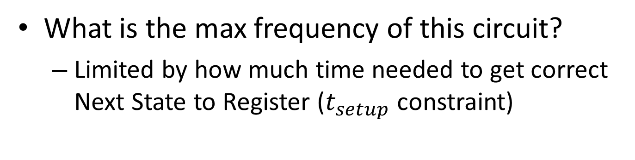
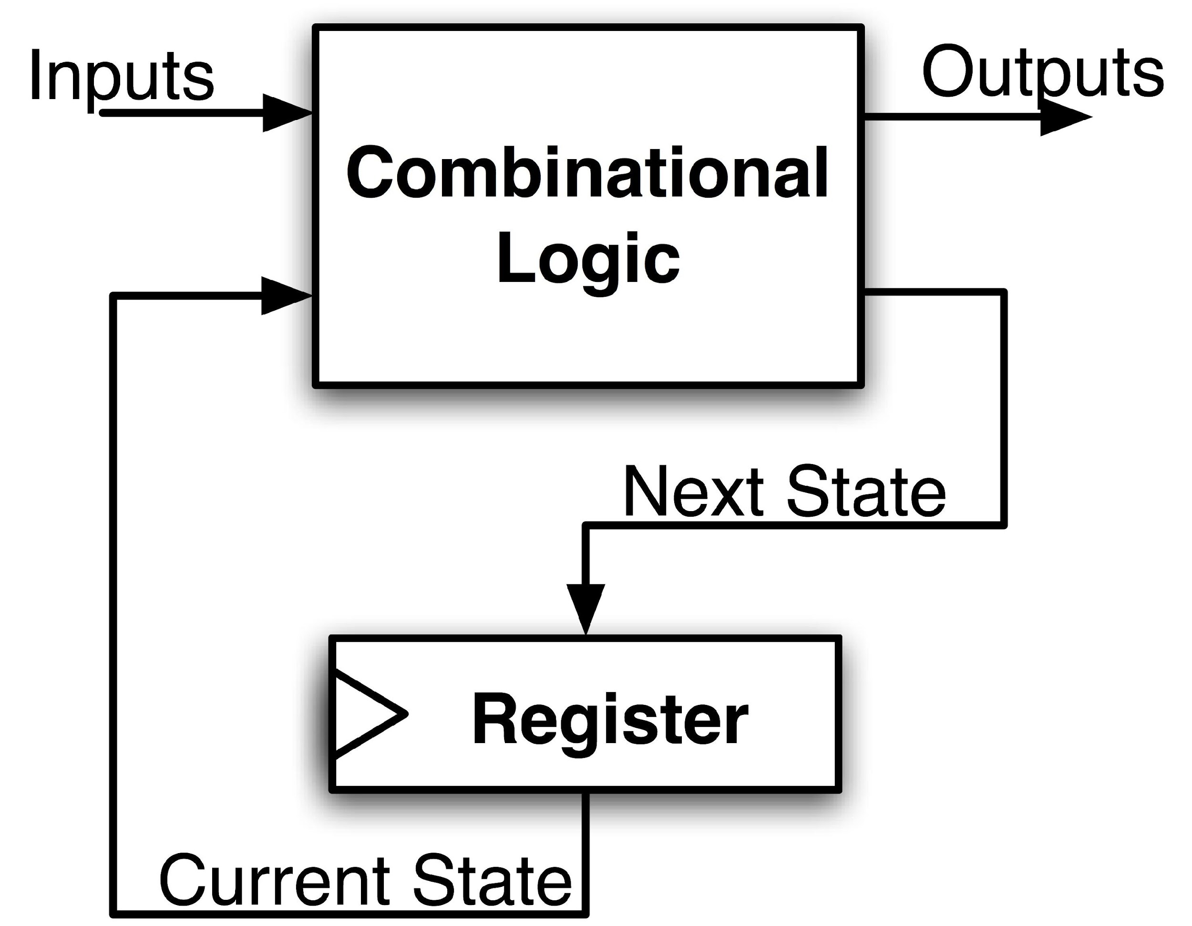
Maximum Clock Frequency
Assumes Max Delay > Hold Time
Max Delay =
Min Period = Max Delay
Max Freq = 1/Min Period
CLK-to-Q Delay
+ CL Delay
+ Setup Time
Notes:
Hold time is included in CLK-to-Q delay.
Make sure to shift thinking for setup time for next clock trigger (one clock cycle).

Slide 21
RISC-V CPU Datapath, Control Intro
Notes:
Podcast link: https://gimletmedia.com/tags/6dug/super-tech-support

Slide 22
Design Principles
Five steps to design a processor:
  Analyze instruction set →
  datapath requirements
  Select set of datapath
  components & establish
  clock methodology
  Assemble datapath meeting
  the requirements
  Analyze implementation of each instruction to determine setting of control points that effects the register transfer
  Assemble the control logic
    Formulate Logic Equations
    Design Circuits
Processor
Input
Control
Memory
Datapath
Output

Slide 23
Summary !
Universal datapath
  Capable of executing all RISC-V instructions in one cycle each
  Not all units (hardware) used by all instructions
5 Phases of execution
  IF (Instruction Fetch), ID (Instruction Decode), EX (Execute), MEM (Memory), WB (Write Back)
  Not all instructions are active in all phases (except for loads!)
Controller specifies how to execute instructions
  Worth thinking about: what new instructions can be added with just most control?

Slide 24
Your CPU in two parts
Central Processing Unit (CPU):
  Datapath: contains the hardware necessary to perform operations required by the processor
    Reacts to what the controller tells it! (ie. “I was told to do an add, so I”ll feed these arguments through an adder)
  Control: decides what each piece of the datapath should do
    What operation am I performing? Do I need to get info from memory? Should I write to a register? Which register?
    Has to make decisions based on the input instruction only!

Slide 25
Design Principles
Determining control signals
  Any time a datapath element has an input that changes behavior, it requires a control signal
  (e.g. ALU operation, read/write)
  Any time you need to pass a different input based on the instruction, add a MUX with a control signal as the selector
  (e.g. next PC, ALU input, register to write to)
Your control signals will change based on your exact datapath
Your datapath will change based on your ISA

Slide 26
Functional Unit/ALU
Hardware circuits are fixed
Can’t adjust wires / gates while running
Build control wires to parametrize its function
Function Unit:
Function Select:
FS func
0001 A + B
0010 A − B
1000 A * B
0100 A ^ B
0101 A + 1
1101 B
32
32
opA
opB
FS
4
res
32

Slide 27
Data Multiplexor (MUX): Router/Selector
Multiplexor (“MUX”) is a selector
  Place one of multiple inputs onto output (N-to-1)
Shown below is an n-bit 2-to-1 MUX
  Input S selects between two inputs of n bits each
A
This input is passed to output if selector bits match shown value
‘n
0
C
‘n
B
‘n
1
Represents that this input has n bits
S

Slide 28
Another Design for 4-to-1 MUX
Can we leverage what we’ve previously built?
  Alternative hierarchical approach:
A
0
B
1
0
E
C
1
0
D
1
S₁
S₀

Slide 29
Storage Element: Register File
RW
RA
RB
Write Enable
5
5
5
Register File consists of 31 registers:
  Output ports portA and portB
  Input port portW
Register selection
  Place data of register RA (number) onto portA
  Place data of register RB (number) onto portB
  Store data on portW into register RW (number) when Write Enable is 1
Clock input (CLK)
  CLK is passed to all internal registers so they can be written to if they match RW and Write Enable is 1
portA
portW
32 x 32-bit
Registers
32
32
portB
Clk
32

Slide 30
Storage Element: Memory
Address
Read/Write
32
Memory consists of byte array:
  1 input and output port
  1 address port
  1 bit read/write
Read Operation
  Place address on address port; Read data of register RB (number) onto portB
Write Operation
  Place address on address port; place data to be written on output portB.
Write Data
Read
# Words * Word Size
32
32
Clk

Slide 31
Implementing R-Types
31
25 24
20 19
15 14
12 11
7 6
0
func7(7)
rs2(5)
rs1(5)
Func3(3)
rd(5)
opcode(7)
New hardware: ALU (Arithmetic Logic Unit)
Abstraction for adders, multipliers, dividers, etc.
How do we know what operation to execute?
  Our first control bit! ALUSel(ect)
+4
Reg[]
pc
IMEM
inst[11:7]
AddrD
ALU
R[rs1]
inst[19:15]
AddrA
DataA
inst[24:20]
R[rs2]
AddrB
DataB
inst[31:0]
Control
ALUSel

Slide 32
Inst[31:0] |  |  |  |  |  |  |  |  | ALUSel
add |  |  |  |  |  |  |  |  | Add
sub |  |  |  |  |  |  |  |  | Sub
(R-R Op) |  |  |  |  |  |  |  |  | (Op)

Slide 33
Adding addi to datapath
+4
Reg[]
pc
DataD
ALU
IMEM
inst[11:7]
AddrD
Reg[rs1]
alu
pc+4
0
inst[19:15]
AddrA
DataA
Reg[rs2]
inst[24:20]
AddrB
DataB
1
Also works for all other I-format arithmetic instruction (slti,sltiu,andi,ori,xori,slli,srli,srai) just by changing ALUSel
inst[31:20]
Imm.
Gen
imm[31:0]
Control Logic
inst[31:0]
ImmSel=I
RegWEn=1
BSel=1
ALUSel=Add

Slide 34
Inst[31:0] |  | ImmSel |  |  |  |  | BSel |  | ALUSel
add |  | * |  |  |  |  | Reg |  | Add
sub |  | * |  |  |  |  | Reg |  | Sub
(R-R Op) |  | * |  |  |  |  | Reg |  | (Op)
addi |  | I |  |  |  |  | Imm |  | Add

Slide 35
Adding lw to datapath
+4
Reg[]
alu
pc
wb
DataD
Reg[rs1]
ALU
DMEM
1
IMEM
inst[11:7]
AddrD
Reg[rs2]
Addr
wb
pc+4
inst[19:15]
AddrA
DataA
0
DataR
0
1
mem
inst[24:20]
AddrB
DataB
inst[31:20]
Imm.
Gen
imm[31:0]
inst[31:0]
ImmSel=I
RegWEn=1
Bsel=1
ALUSel=Add
MemRW=Read
WBSel=0

Slide 36
Inst[31:0] |  | ImmSel |  |  |  |  | BSel | ASel | ALUSel | MemRW | WBSel
add |  | * |  |  |  |  | Reg | Reg | Add | Read | ALU
sub |  | * |  |  |  |  | Reg | Reg | Sub | Read | ALU
(R-R Op) |  | * |  |  |  |  | Reg | Reg | (Op) | Read | ALU
addi |  | I |  |  |  |  | Imm | Reg | Add | Read | ALU
lw |  | I |  |  |  |  | Imm | Reg | Add | Read | Mem

Slide 37
Storage Element: Idealized Memory
Memory (idealized)
  One input port: Data In
  One output port: Data Out
Memory access:
  Read: Write Enable = 0, data at Address is placed on Data Out
  Write: Write Enable = 1, Data In written to Address
Clock input (CLK)
  CLK input is a factor ONLY during write operation
  During read, behaves as a combinational logic block: Address valid → Data Out valid after “access time”
Write Enable
Address
Data In
DataOut
32
32
CLK

Slide 38
Current Datapath
+4
Reg[]
ALU
pc
wb
DataD
Reg[rs1]
ALU
1
DMEM
IMEM
inst[11:7]
AddrD
Addr
pc+4
Reg[rs2]
DataR
wb
inst[19:15]
AddrA
DataA
0
0
mem
inst[24:20]
AddrB
DataB
1
inst[31:20]
Imm.
Gen
imm[31:0]
inst[31:0]
ImmSel
BSel
ALUSel
MemRW
WBSel

Slide 39
Adding sw to datapath
+4
Reg[]
alu
pc
wb
DataD
Reg[rs1]
ALU
DMEM
pc+4
IMEM
inst[11:7]
AddrD
Reg[rs2]
Addr
1
wb
inst[19:15]
AddrA
DataA
0
DataR
0
1
DataW
mem
inst[24:20]
AddrB
DataB
inst[31:7]
Imm.
Gen
imm[31:0]
inst[31:0]
ImmSel=S
RegWEn=0
Bsel=1
ALUSel=Add
MemRW=Write
WBSel=*
*= “Don’t Care”

Slide 40
Inst[31:0] | PCSel | ImmSel | RegWEn | BrUn | BrEq | BrLT | BSel | ASel | ALUSel | MemRW | WBSel
add | +4 | * | 1 (Y) | * | * | * | Reg | Reg | Add | Read | ALU
sub | +4 | * | 1 | * | * | * | Reg | Reg | Sub | Read | ALU
(R-R Op) | +4 | * | 1 | * | * | * | Reg | Reg | (Op) | Read | ALU
addi | +4 | I | 1 | * | * | * | Imm | Reg | Add | Read | ALU
lw | +4 | I | 1 | * | * | * | Imm | Reg | Add | Read | Mem
sw | +4 | S | 0 (N) | * | * | * | Imm | Reg | Add | Write | *

Slide 41
Inst[31:0] | PCSel | ImmSel | RegWEn | BrUn | BrEq | BrLT | BSel | ASel | ALUSel | MemRW | WBSel
add | +4 | * | 1 (Y) | * | * | * | Reg | Reg | Add | Read | ALU
sub | +4 | * | 1 | * | * | * | Reg | Reg | Sub | Read | ALU
(R-R Op) | +4 | * | 1 | * | * | * | Reg | Reg | (Op) | Read | ALU
addi | +4 | I | 1 | * | * | * | Imm | Reg | Add | Read | ALU
lw | +4 | I | 1 | * | * | * | Imm | Reg | Add | Read | Mem
sw | +4 | S | 0 (N) | * | * | * | Imm | Reg | Add | Write | *
beq | +4 | B | 0 | * | 0 | * | Imm | PC | Add | Read | *
beq | ALU | B | 0 | * | 1 | * | Imm | PC | Add | Read | *
bne | ALU | B | 0 | * | 0 | * | Imm | PC | Add | Read | *
bne | +4 | B | 0 | * | 1 | * | Imm | PC | Add | Read | *
blt | ALU | B | 0 | 0 | * | 1 | Imm | PC | Add | Read | *
bltu | ALU | B | 0 | 1 | * | 1 | Imm | PC | Add | Read | *
jalr | ALU | I | 1 | * | * | * | Imm | Reg | Add | Read | PC+4
jal | ALU | J | 1 | * | * | * | Imm | PC | Add | Read | PC+4
auipc | +4 | U | 1 | * | * | * | Imm | PC | Add | Read | ALU

Slide 42
Adding branches to datapath
alu
+4
Reg[]
pc
alu
pc
wb
DataD
1
1
Reg[rs1]
ALU
DMEM
IMEM
inst[11:7]
AddrD
0
1
0
Branch Comp.
Reg[rs2]
Addr
DataR
0
wb
pc+4
inst[19:15]
AddrA
DataA
0
DataW
mem
inst[24:20]
AddrB
DataB
1
inst[31:7]
Imm.
Gen
imm[31:0]
PCSel=taken/not-taken
inst[31:0]
ImmSel=B
RegWEn=0
BrUn
BrEq
BrLT
Bsel=1
ASel=1
MemRW=Read
WBSel=*
ALUSel=Add

Slide 43
Adding jalr to datapath
+4
Reg[]
pc
alu
pc+4
alu
pc
wb
1
1
DataD
Reg[rs1]
ALU
DMEM
2
IMEM
inst[11:7]
AddrD
0
1
pc+4
0
Branch Comp.
Reg[rs2]
Addr
DataR
0
wb
inst[19:15]
AddrA
DataA
0
DataW
mem
inst[24:20]
AddrB
DataB
1
inst[31:7]
Imm.
Gen
imm[31:0]
PCSel
inst[31:0]
ImmSel=B
RegWEn=1
Bsel=1
Asel=0
MemRW=Read
WBSel=2
BrEq=*
ALUSel=Add
BrUn=*
BrLT=*

Slide 44
Adding jal to datapath
+4
Reg[]
pc
alu
pc+4
alu
pc
wb
1
1
DataD
Reg[rs1]
ALU
DMEM
2
IMEM
inst[11:7]
AddrD
0
1
pc+4
0
Branch Comp.
Reg[rs2]
Addr
DataR
0
wb
inst[19:15]
AddrA
DataA
0
DataW
mem
inst[24:20]
AddrB
DataB
1
inst[31:7]
Imm.
Gen
imm[31:0]
PCSel
inst[31:0]
ImmSel=J
RegWEn=1
Bsel=1
Asel=1
MemRW=Read
WBSel=2
BrEq=*
ALUSel=Add
BrUn=*
BrLT=*

Slide 45
Implementing lui
+4
Reg[]
pc
pc+4
pc
wb
1
alu
alu
1
DataD
Reg[rs1]
ALU
DMEM
2
IMEM
inst[11:7]
AddrD
0
1
pc+4
0
Branch Comp.
Reg[rs2]
Addr
DataR
0
wb
inst[19:15]
AddrA
DataA
0
DataW
mem
inst[24:20]
AddrB
DataB
1
inst[31:7]
Imm.
Gen
imm[31:0]
PCSel=pc+4
inst[31:0]
ImmSel=U
RegWEn=1
Bsel=1
Asel=*
ALUSel=B
MemRW=Read
WBSel=1
BrUn=*
BrE=*
BrLT=*

Slide 46
Implementing auipc
+4
Reg[]
pc
pc+4
pc
wb
1
alu
alu
1
DataD
Reg[rs1]
ALU
DMEM
2
IMEM
inst[11:7]
AddrD
0
1
pc+4
0
Branch Comp.
Reg[rs2]
Addr
DataR
0
wb
inst[19:15]
AddrA
DataA
0
DataW
mem
inst[24:20]
AddrB
DataB
1
inst[31:7]
Imm.
Gen
imm[31:0]
PCSel=pc+4
inst[31:0]
ImmSel=U
RegWEn=1
Bsel=1
Asel=1
ALUSel=Add
MemRW=0
WBSel=1
BrUn=*
BrE=*
BrLT=*

