Slide 1
Combinational Logic
CMPT 295 Week 10.1

Slide 2
Hardware Design
Understand how processors work
  Requires digital systems knowledge
Understand how code is actually executed on a computer to analyze:
  Reliability
  Performance
  Security
Layered abstractions
  Transistors → Combinational Logic → Sequential Logic → Processors → Machine Language → Assembly → High-level Programming Languages → Application programs
  At each step we can “abstract away” the lower layers

Slide 3
Synchronous Digital Systems (SDS)
Hardware of a processor (e.g., RISC-V) is an example of a Synchronous Digital System
Synchronous:
  All operations coordinated by a central clock
    “Heartbeat” of the system (processor frequency)
Digital:
  Represent all values with two discrete values
  Electrical signals are treated as 1’s and 0’s
    High/Low voltage represent True/False, 1/0

Slide 4
Moore’s Law
Original Version (1965): Since the integrated circuit was invented, the number of transistors in an integrated circuit has roughly doubled every year; this trend would continue for the foreseeable future
1975: Revised - circuit complexity doubles every two years

Slide 5
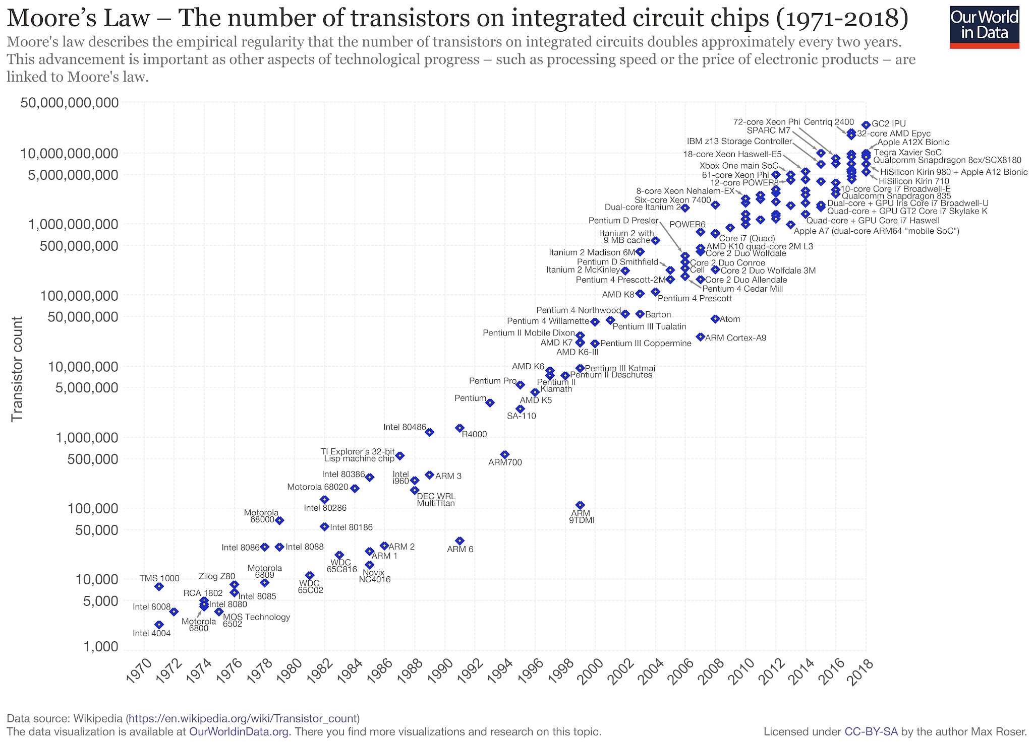

Slide 6
Moore’s Law
Original Version (1965): Since the integrated circuit was invented, the number of transistors in an integrated circuit has roughly doubled every year; this trend would continue for the foreseeable future
1975: Revised - circuit complexity doubles every two years
Hardware Trend: Hardware gets more powerful every year (due to technology advancement and the hard work of many engineers)
Software Trend: Software gets faster and uses more resources (And has to keep up with ever-changing hardware)
Digital circuits are used to build hardware

Slide 7
Combinational vs. Sequential Logic
Digital Systems consist of two basic types of circuits:
  Combinational Logic (CL)
    Output is a function of the inputs only, not the history of its execution
    Example: add A, B (ALUs)
  Sequential Logic (SL)
    Circuits that “remember” or store information
    Also called “State Elements”
    Example: Memory and registers

Slide 8



Simple Logic Gates
Truth Table
Special names and symbols:
Circle means NOT!
a | NOT a
0 | 1
1 | 0
NOT
= NOT a
True if input is false
a | b | a AND b
0 | 0 | 0
0 | 1 | 0
1 | 0 | 0
1 | 1 | 1
AND
= a AND b
True if both inputs are true
a | b | A OR b
0 | 0 | 0
0 | 1 | 1
1 | 0 | 1
1 | 1 | 1
OR
= a OR b
True if at least one input is true

Slide 9



More Simple Logic Gates
Inverted versions are easier to implement in CMOS
a | b | a NAND b
0 | 0 | 1
0 | 1 | 1
1 | 0 | 1
1 | 1 | 0
NAND
= a NAND b
True if at least one input is false
a | b | a NOR b
0 | 0 | 1
0 | 1 | 0
1 | 0 | 0
1 | 1 | 0
NOR
= a NOR b
True if both inputs are false
a | b | a XOR b
0 | 0 | 0
0 | 1 | 1
1 | 0 | 1
1 | 1 | 0
XOR
= a XOR b
True if exactly one input is true

Slide 10
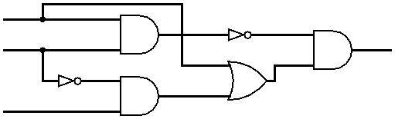
Combining Multiple Logic Gates
D = (NOT(A AND B)) AND (A OR (NOT B AND C))
A
B
D
C

Slide 11
How to Represent Combinational Logic?
Text Description
Circuit Diagram
  Transistors and wires
  Logic Gates
Truth Table
Boolean Expression
All are equivalent

Slide 12
Truth Tables
Table that relates the inputs to a combinational logic circuit to its output
  Output only depends on current inputs
  Use abstraction of 0/1 (F/T) instead of high/low Voltage
  Shows output for every possible combination of inputs
How big is a truth table with N inputs?
  0 or 1 for each of N inputs, so 2^{N} rows

Slide 13

N-input Truth Tables
A B C
Y
0 0 0
0 0 1
0 1 0
0 1 1
1 0 0
1 0 1
1 1 0
1 1 1
0
1
0
0
0
1
1
0
F(0,0,0)
F(0,0,1)
F(0,1,0)
F(0,1,1)
F(1,0,0)
F(1,0,1)
F(1,1,0)
F(1,1,1)
A
F
B
Y
C
For N inputs, how many distinct functions F do we have?
$2^{2^{N}}$
Function maps each row to 0 or 1, so possible functions
Notes:
Circle the output, use variables/animations, talk about the output as a bit combination (integer?)
Maybe 3 inputs?

Slide 14
Truth Tables with Multiple Outputs
A
F
X
B
Y
C
D
Z
For 3 outputs, just three indep. functions:
X(A,B,C,D), Y(A,B,C,D), and Z(A,B,C,D)
  Can show functions in separate columns (no additional rows)

Slide 15
Question: Which of the columns A-D is the correct output of the Truth Table for: (X XOR Y) OR (NOT Z)
X | Y | Z | (A) | (B) | (C) | (D)
0 | 0 | 0 | 1 | 1 | 1 | 1
0 | 0 | 1 | 0 | 0 | 0 | 0
0 | 1 | 0 | 1 | 1 | 1 | 1
0 | 1 | 1 | 1 | 1 | 1 | 1
1 | 0 | 0 | 0 | 1 | 1 | 1
1 | 0 | 1 | 1 | 1 | 0 | 1
1 | 1 | 0 | 1 | 1 | 1 | 0
1 | 1 | 1 | 1 | 0 | 1 | 1

Slide 16
Question: Which of the columns A-D is the correct output of the Truth Table for: (X XOR Y) OR (NOT Z)
X | Y | Z | (A) | (B) | (C) | (D)
0 | 0 | 0 | 1 | 1 | 1 | 1
0 | 0 | 1 | 0 | 0 | 0 | 0
0 | 1 | 0 | 1 | 1 | 1 | 1
0 | 1 | 1 | 1 | 1 | 1 | 1
1 | 0 | 0 | 0 | 1 | 1 | 1
1 | 0 | 1 | 1 | 1 | 0 | 1
1 | 1 | 0 | 1 | 1 | 1 | 0
1 | 1 | 1 | 1 | 0 | 1 | 1

Slide 17
More Complex Truth Tables
3-Input Majority
2-bit Adder
a | b | c | y
0 | 0 | 0 | 0
0 | 0 | 1 | 0
0 | 1 | 0 | 0
0 | 1 | 1 | 1
1 | 0 | 0 | 0
1 | 0 | 1 | 1
1 | 1 | 0 | 1
1 | 1 | 1 | 1
a₁
+
c₂
a₀
c₁
b₁
b₀
c₀
How many
rows?
A |  | B |  | C
a₁ | a₀ | b₁ | b₀ | c₂ | c₁ | c₀
 |  |  | .
 |  |  | .
 |  |  | .

Slide 18
Truth Tables Don’t Scale
Truth tables are huge
  Write out EVERY combination of inputs and outputs (thorough, but inefficient)
  Finding a particular combination of inputs involves scanning a large portion of the table
Boolean Algebra is a shorter way to represent combinational logic

Slide 19
Boolean Algebra
Represent inputs and outputs as variables
  Each variable can only take on the value 0 or 1
Overbar or ¬ is NOT: “logical complement”
  e.g. if A is 0, A is 1. If A is 1, then ¬A is 0
Plus (+) is 2-input OR: “logical sum”
Product (·) is 2-input AND: “logical product”
  Sometimes omitted
All other gates and logical expressions can be built from combinations of these
AB + AB == (NOT(A AND B)) OR (A AND (NOT B))

Slide 20
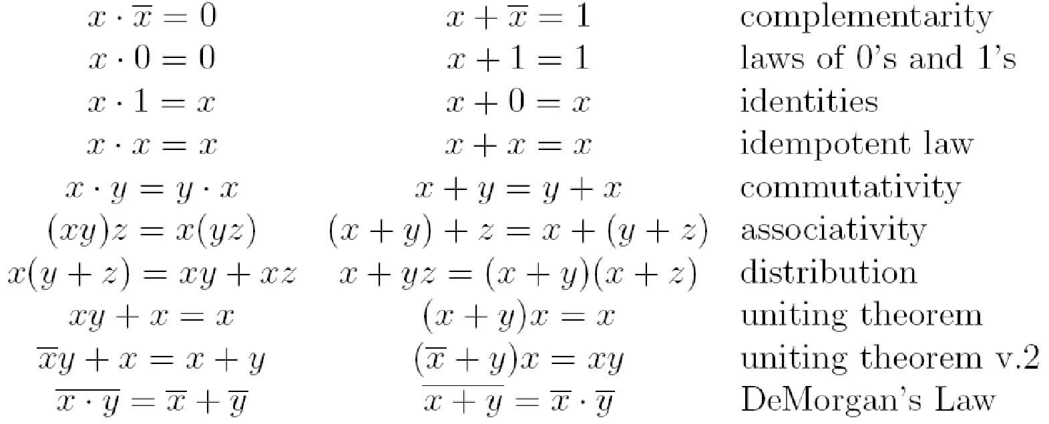
Laws of Boolean Algebra
These laws allow us to simplify Boolean expressions:
Notes:
Demorgan’s law example

Slide 21
Converting Truth Table to Boolean Expression
Read off of table
  For 1, write variable name
  For 0, write complement of variable
Sum of Products (SoP)
  Take rows with 1’s in output column,
  sum products of inputs
  c=
Product of Sums (PoS)
  Take rows with 0’s in output column, product the sum of the complements of the inputs
  c =
a | b | c
0 | 0 | 0
0 | 1 | 1
1 | 0 | 1
1 | 1 | 0
a
b
+
a
b
We can show that these
are equivalent!
(a + b) · (a + b)
Notes:
Choice between the two generally comes down to whether the output function has more 0’s or 1’s. Choosing the conversion (SoP/PoS) with less items will result in a shorter expression!
(This example happens to be balanced: 2 0’s and 2 1’s)

Slide 22
Simplifying Boolean Expressions
Logic Delay: Everything we are dealing with is just an abstraction of transistors and wires
  Inputs propagating to the outputs are voltage signals passing through transistor networks
  There is always some delay before a CL’s output updates to reflect the inputs
  Critical Path is longest delay from any input to output. Could be represented as “n gate delays”
Simpler Boolean expressions ↔ smaller transistor networks ↔ smaller circuit delays ↔ faster hardware

Slide 23
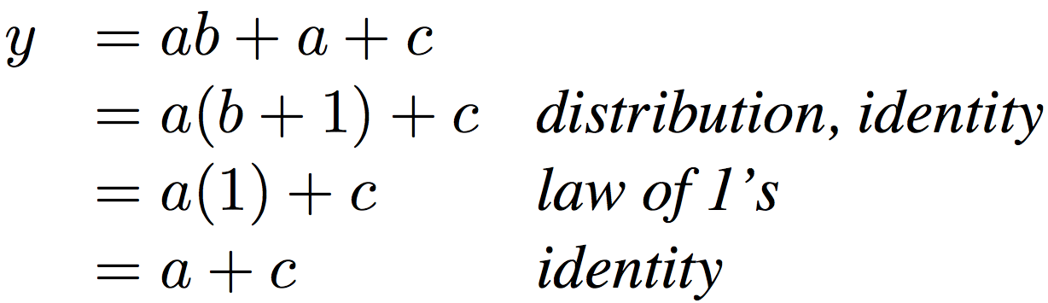
Simplifying Boolean Expressions: Example
Notes:
Do on black board
From distribution: a(b +1) + c
Froms laws of 0s and 1s: b+1 = b
= ab + c
Truth Table
a b c y
0 0 0 0
0 0 1 1
0 0 1 1

Slide 24

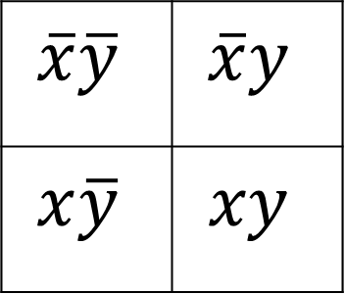
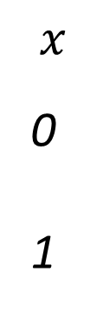
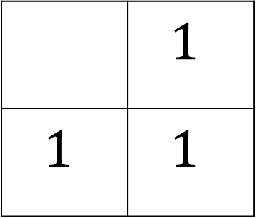

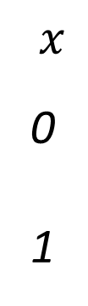
Karnaugh Maps
Used to simplify Boolean expressions of 2-4 variables
Table composed of squares each representing a unique combination of all variable (1 if true, else blank)
Two variable Map:
Example: Boolean Expression?
$$y 0 1$$
$$y 0 1$$
$$x$$
0
1
$$x$$
0
1
$$\overline{x}\overline{y}$$ | $$\overline{x}y$$
$$x\overline{y}$$ | $$xy$$
 | $$1$$
$$1$$ | $$1$$
x + y

Slide 25

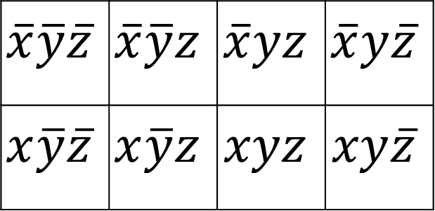

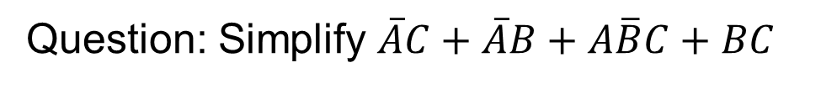

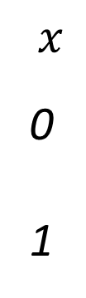

Three Variable Karnaugh Maps
$$y$$
$$yz 00 01 11 10$$
$$x$$
0
1
$$\overline{x}\overline{y}\overline{z}$$ | $$\overline{x}\overline{y}z$$ | $$\overline{x}yz$$ | $$\overline{x}y\overline{z}$$
$$x\overline{y}\overline{z}$$ | $$x\overline{y}z$$ | $$xyz$$ | $$xy\overline{z}$$
$$x$$
$$z$$
Question: Simplify $\overline{A}C+\overline{A}B+A\overline{B}C+BC$

Slide 26

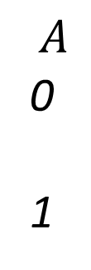


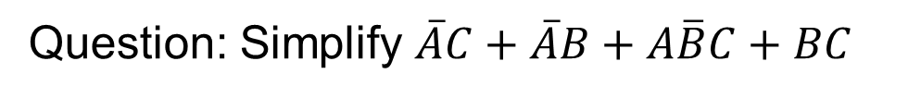


Example: Simplify 3-Variable Expression
Question: Simplify $\overline{A}C+\overline{A}B+A\overline{B}C+BC$
$$B$$
$$BC 00 01 11 10$$
$$A$$
0
1
 | 1 | 1 | 1
 | 1 | 1
$$A$$
$$C$$
Answer: $C+\overline{A}B$

Slide 27

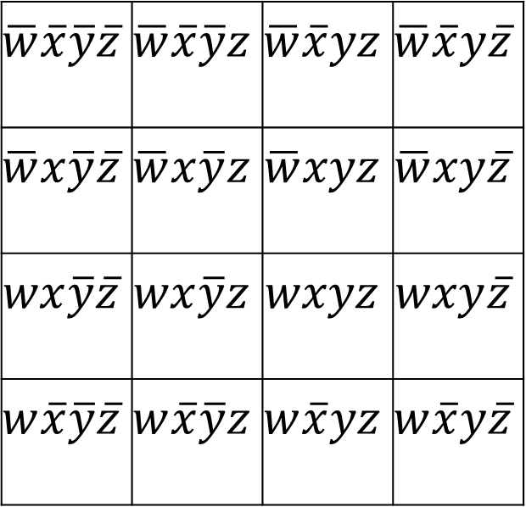



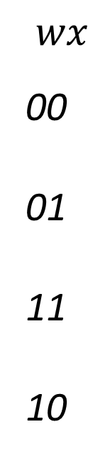

Four Variable Karnaugh Maps
$$y$$
$$yz 00 01 11 10$$
$$wx$$
00
01
11
10
$$\overline{w}\overline{x}\overline{y}\overline{z}$$ | $$\overline{w}\overline{x}\overline{y}z$$ | $$\overline{w}\overline{x}yz$$ | $$\overline{w}\overline{x}y\overline{z}$$
$$\overline{w}x\overline{y}\overline{z}$$ | $$\overline{w}x\overline{y}z$$ | $$\overline{w}xyz$$ | $$\overline{w}xy\overline{z}$$
$$wx\overline{y}\overline{z}$$ | $$wx\overline{y}z$$ | $$wxyz$$ | $$wxy\overline{z}$$
$$w\overline{x}\overline{y}\overline{z}$$ | $$w\overline{x}\overline{y}z$$ | $$w\overline{x}yz$$ | $$w\overline{x}y\overline{z}$$
$$x$$
$$w$$
$$z$$
Question: Simplify $\overline{w}y+\overline{w}z+w\overline{x}y+wxyz$

Slide 28

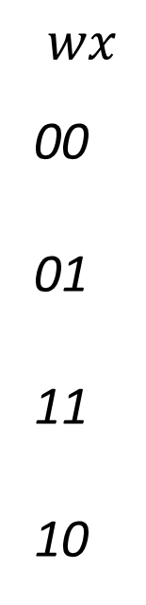






Example: Simplify 4-Variable Expression
$$y$$
Simplify $\overline{w}y+\overline{w}z+w\overline{x}y+wxyz$
$$yz 00 01 11 10$$
$$wx$$
00
01
11
10
 | 1 | 1 | 1
 | 1 | 1 | 1
 |  | 1
 |  | 1 | 1
$$x$$
$$w$$
Solution: $\overline{w}y+\overline{w}z+yz$ $+\overline{x}y$
$$z$$

Slide 29
Useful Combinational Circuits

Slide 30
Data Multiplexor (MUX)
Multiplexor (“MUX”) is a selector
  Place one of multiple inputs onto output (N-to-1)
Shown below is an n-bit 2-to-1 MUX
  Input S selects between two inputs of n bits each
A
This input is passed to output if selector bits match shown value
‘n
0
C
‘n
B
‘n
1
Represents that this input has n bits
S

Slide 31
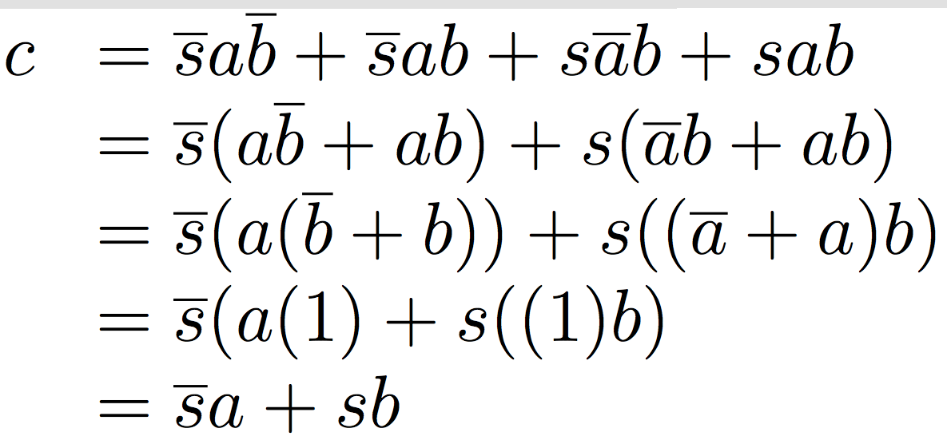
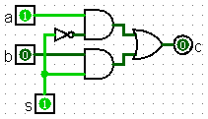
Implementing a 1-bit 2-to-1 MUX
Schematic:
Truth Table:
Boolean Algebra:
Circuit Diagram:
A
‘n
0
C
‘n
B
‘n
1
s | a | b | c
0 | 0 | 0 | 0
0 | 0 | 1 | 0
0 | 1 | 0 | 1
0 | 1 | 1 | 1
1 | 0 | 0 | 0
1 | 0 | 1 | 1
1 | 1 | 0 | 0
1 | 1 | 1 | 1
S

Slide 32
1-bit 4-to-1 MUX
Schematic:
Truth Table: How many rows?
Boolean Expression:
E = S₁S₀A + S₁S₀B + S₁S₀C + S₁S₀D
A
00
B
01
E
C
10
D
11
‘2
S= S₁S₀
2⁶

Slide 33
Another Design for 4-to-1 MUX
Can we leverage what we’ve previously built?
  Alternative hierarchical approach:
A
0
B
1
0
E
C
1
0
D
1
S₁
S₀

Slide 34
Full Adder
function table:
  basically a truth table
A
B
S
A B C
C S
0 0 0
0 0 1
0 1 0
0 1 1
1 0 0
1 0 1
1 1 0
1 1 1
0
0
0
1
0
1
1
1
0
1
1
0
1
0
0
1
Half Adder
Half Adder
C
3-bit
Addition!
C
Q. What’s the propagation delay?
Full Adder
A
B
3 gate delays (highlighted)
Q. What does the circuit accomplish?
Algebra:
FA
C
C
S = A ^ B ^ C
; C = (A & B) | (C & (A ^ B))
S = A ⊕ B ⊕ C; C = AB + C(A ⊕ B)
S
S = A ⊕ B ⊕ C

