Slide 1
Class Review
CMPT 295 Week 12

Slide 2
Caches and Virtual Memory
Notes:
Podcast link: https://gimletmedia.com/tags/6dug/super-tech-support

Slide 3
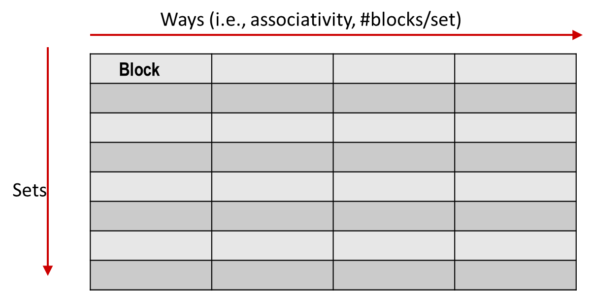
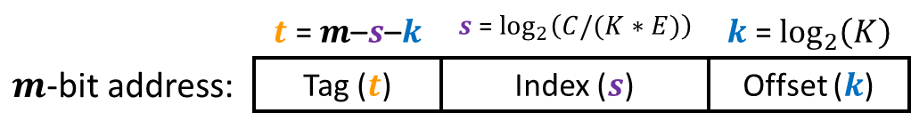
Cache Organization
C
  Cache Size = #Blocks x Block Size
  = #Sets x Associativity x Block Size
  If we know any three values, we can compute the fourth
E
K

Slide 4
Cache Code Analysis Problem
Cache-A Direct-mapped, 4KB, 64 sets
Cache-B Set-associative, 4KB, 2 ways, 32 sets
int size = 4096; // int is 4 bytes
int a[size];
long long int a_long[size]; // long long int is 8 bytes
/* loop 1 */
for (int i = 0; i < size; i++) {
a[i] = i;
}
/* loop 2 */
for (long long int i = 0; i < size; i++) {
a_long[i] = i;
}
/* loop 3 */
for (int i = 0; i < size/2; i += 1) {
a[(size/2)+i] = a[i];
}
Question: What are hit rates for loop1, loop 2 (assume loop 1 has run), loop3 (assume both previous loops have run).
Notes:
k = 6 bits
8 / 2 = 4 sets
s = 2 bits
t = 12 – 5 – 2 = 5 bits
0x800 = 0b 1000 0000 0000
8 bytes per elem
4 longs fit in a block
¼ miss rate (missed are compulsory)

Slide 5
Sources of Cache Misses: The 3Cs
Compulsory: (Many names: cold start, process migration (switching processes), 1st reference)
  First access to block impossible to avoid;
  Effect is small for long running programs
Capacity:
  Cache cannot contain all blocks accessed by the program, so full associativity won’t hold all blocks
Conflict: (collision)
  Multiple memory locations mapped to the same cache location, so there is a lack of associativity

Slide 6
Virtual to Physical Address Translation
request from CPU:
$n$-bit virtual address
split to access TLB:
TLB Tag
TLB Index
Page Offset
(on TLB miss) access PT:
Virtual Page Number
Page offset
TRANSLATION
$m$-bit physical address:
Physical Page Number
Page offset
split to access cache:
Cache Tag
Cache Index
Offset
Notes:
Need to restart instruction.
Soft and hard page faults.

Slide 7
Summary of Address Translation Symbols
Basic Parameters
  $N=2^{n}$ Number of addresses in virtual address space
  $M=2^{m}$ Number of addresses in physical address space
  $P=2^{p}$ Page size (bytes)
Components of the virtual address (VA)
  VPO Virtual page offset
  VPN Virtual page number
  TLBI TLB index
  TLBT TLB tag
Components of the physical address (PA)
  PPO Physical page offset (same as VPO)
  PPN Physical page number

Slide 8
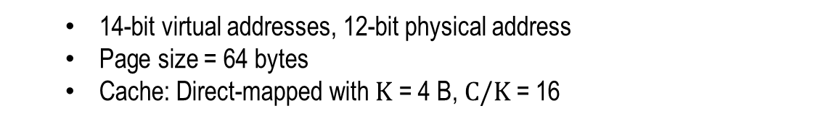
Cache & VM Problem
  14-bit virtual addresses, 12-bit physical address
  Page size = 64 bytes
  Cache: Direct-mapped with $K$ = 4 B, $C/K$ = 16
Page table (partial):
VPN | PPN | V
0 | 28 | 1
1 | – | 0
2 | 33 | 1
3 | 02 | 1
4 | – | 0
5 | 16 | 1
6 | – | 0
7 | – | 0
VPN | PPN | V
8 | 13 | 1
9 | 17 | 1
A | 09 | 1
B | – | 0
C | – | 0
D | 2D | 1
E | – | 0
F | 0D | 1
TLB:
Set | Tag | PPN | V | Tag | PPN | V | Tag | PPN | V | Tag | PPN | V
0 | 03 | – | 0 | 09 | 0D | 1 | 00 | – | 0 | 07 | 02 | 1
1 | 03 | 2D | 1 | 02 | – | 0 | 04 | – | 0 | 0A | – | 0
2 | 02 | – | 0 | 08 | – | 0 | 06 | – | 0 | 03 | – | 0
3 | 07 | – | 0 | 03 | 0D | 1 | 0A | 34 | 1 | 02 | – | 0
Cache:
Index | Tag | V | B0 | B1 | B2 | B3
0 | 19 | 1 | 99 | 11 | 23 | 11
1 | 15 | 0 | – | – | – | –
2 | 1B | 1 | 00 | 02 | 04 | 08
3 | 36 | 0 | – | – | – | –
4 | 32 | 1 | 43 | 6D | 8F | 09
5 | 0D | 1 | 36 | 72 | F0 | 1D
6 | 31 | 0 | – | – | – | –
7 | 16 | 1 | 11 | C2 | DF | 03
Index | Tag | V | B0 | B1 | B2 | B3
8 | 24 | 1 | 3A | 00 | 51 | 89
9 | 2D | 0 | – | – | – | –
A | 2D | 1 | 93 | 15 | DA | 3B
B | 0B | 0 | – | – | – | –
C | 12 | 0 | – | – | – | –
D | 16 | 1 | 04 | 96 | 34 | 15
E | 13 | 1 | 83 | 77 | 1B | D3
F | 14 | 0 | – | – | – | –

Slide 9
Memory Request Example #1
Note: It is just coincidence that the PPN is the same width as the cache Tag
Virtual Address: 0x03D4
Physical Address:
TLBT
TLBI
13
12
11
10
9
8
7
6
5
4
3
2
1
0
0
0
0
0
1
1
1
1
0
1
0
1
0
0
VPN
VPO
VPN ______ | TLBT _____ | TLBI _____ | TLB Hit? ___ | Page Fault? ___ | PPN _____
CT
CI
CO
11
10
9
8
7
6
5
4
3
2
1
0
PPN
PPO
CT ______ | CI _____ | CO _____ | Cache Hit? ___ | Data (byte) _______
Notes:
TLB Hit, Cache Hit

Slide 10
Memory Request Example #2
Note: It is just coincidence that the PPN is the same width as the cache Tag
Virtual Address: 0x038F
Physical Address:
TLBT
TLBI
13
12
11
10
9
8
7
6
5
4
3
2
1
0
0
0
0
0
1
1
1
0
0
0
1
1
1
1
VPN
VPO
VPN ______ | TLBT _____ | TLBI _____ | TLB Hit? ___ | Page Fault? ___ | PPN _____
CT
CI
CO
11
10
9
8
7
6
5
4
3
2
1
0
PPN
PPO
CT ______ | CI _____ | CO _____ | Cache Hit? ___ | Data (byte) _______
Notes:
TLB Miss, page fault

Slide 11
Memory Request Example #3
Note: It is just coincidence that the PPN is the same width as the cache Tag
Virtual Address: 0x0020
Physical Address:
TLBT
TLBI
13
12
11
10
9
8
7
6
5
4
3
2
1
0
0
0
0
0
0
0
0
0
1
0
0
0
0
0
VPN
VPO
VPN ______ | TLBT _____ | TLBI _____ | TLB Hit? ___ | Page Fault? ___ | PPN _____
CT
CI
CO
11
10
9
8
7
6
5
4
3
2
1
0
PPN
PPO
CT ______ | CI _____ | CO _____ | Cache Hit? ___ | Data (byte) _______
Notes:
TLB Miss, Page Table Hit, Cache Miss

Slide 12
Memory Request Example #4
Note: It is just coincidence that the PPN is the same width as the cache Tag
Virtual Address: 0x036B
Physical Address:
TLBT
TLBI
13
12
11
10
9
8
7
6
5
4
3
2
1
0
0
0
0
0
1
1
0
1
1
0
1
0
1
1
VPN
VPO
VPN ______ | TLBT _____ | TLBI _____ | TLB Hit? ___ | Page Fault? ___ | PPN _____
CT
CI
CO
11
10
9
8
7
6
5
4
3
2
1
0
PPN
PPO
CT ______ | CI _____ | CO _____ | Cache Hit? ___ | Data (byte) _______
Notes:
TLB Hit, Cache Hit

Slide 13
Digital Logic
Notes:
Podcast link: https://gimletmedia.com/tags/6dug/super-tech-support

Slide 14
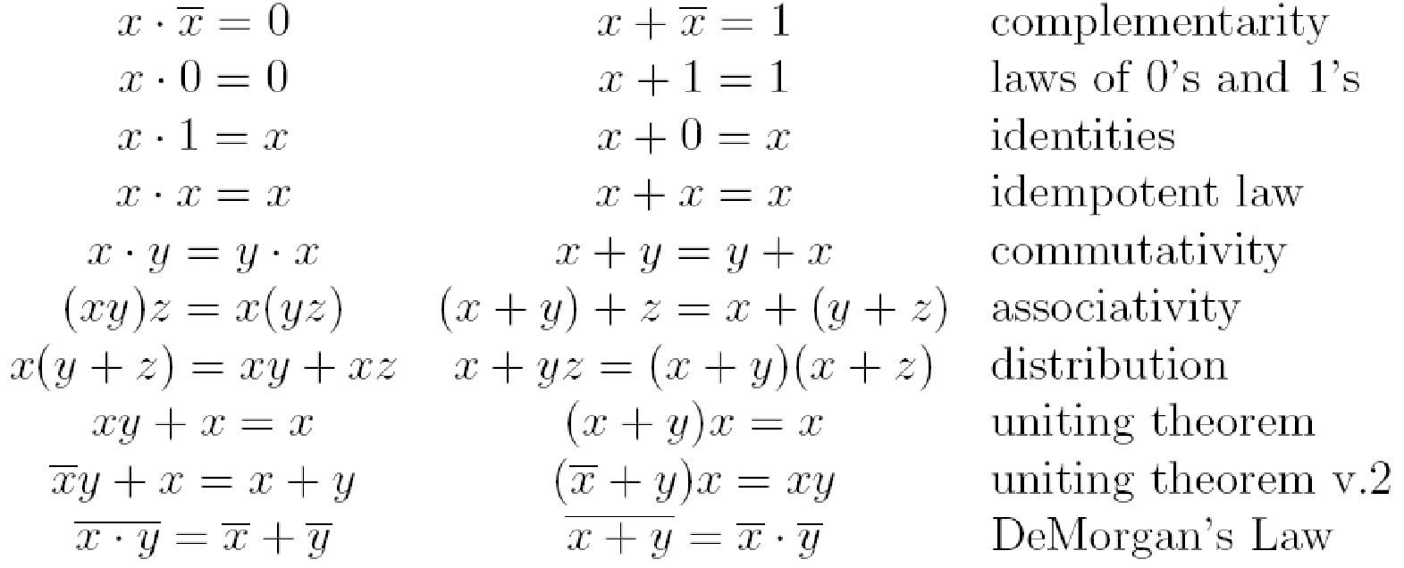
Laws of Boolean Algebra
These laws allow us to simplify Boolean expressions:
Notes:
Demorgan’s law example

Slide 15
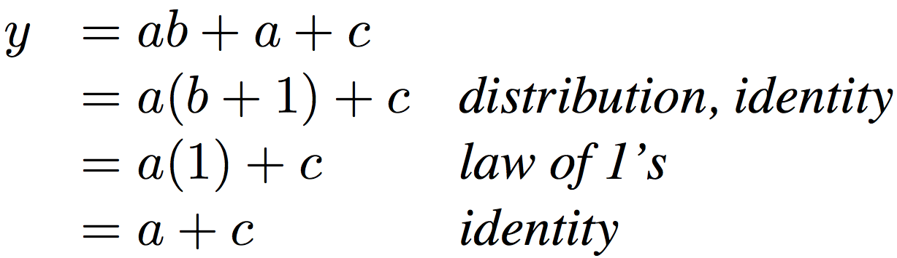
Simplifying Boolean Expressions: Example
Notes:
Do on black board
From distribution: a(b +1) + c
Froms laws of 0s and 1s: b+1 = b
= ab + c
Truth Table
a b c y
0 0 0 0
0 0 1 1
0 0 1 1

Slide 16

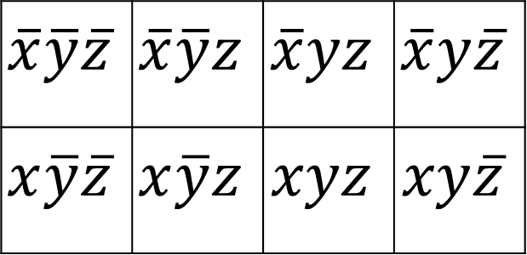


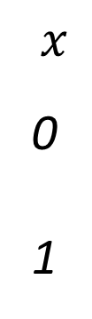

Three Variable Karnaugh Maps
$$y$$
$$yz 00 01 11 10$$
$$x$$
0
1
$$\overline{x}\overline{y}\overline{z}$$ | $$\overline{x}\overline{y}z$$ | $$\overline{x}yz$$ | $$\overline{x}y\overline{z}$$
$$x\overline{y}\overline{z}$$ | $$x\overline{y}z$$ | $$xyz$$ | $$xy\overline{z}$$
$$x$$
$$z$$

Slide 17

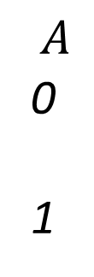


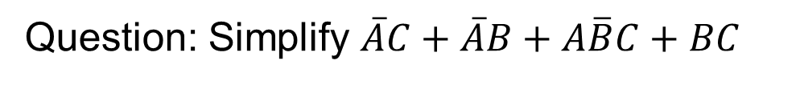


Example: Simplify 3-Variable Expression
Question: Simplify $\overline{A}C+\overline{A}B+A\overline{B}C+BC$
$$B$$
$$BC 00 01 11 10$$
$$A$$
0
1
 | 1 | 1 | 1
 | 1 | 1
$$A$$
$$C$$
Answer: $C+\overline{A}B$

Slide 18

Example: Simplify 3-Variable Expression
Question: Simplify $AB+A+A\overline{B}C+C$
$$B$$
$$BC 00 01 11 10$$
$$A$$
0
1
$$A$$
$$C$$

Slide 19
Data Multiplexor (MUX)
Multiplexor (“MUX”) is a selector
  Place one of multiple inputs onto output (N-to-1)
Shown below is an n-bit 2-to-1 MUX
  Input S selects between two inputs of n bits each
A
This input is passed to output if selector bits match shown value
‘n
0
C
‘n
B
‘n
1
Represents that this input has n bits
S

Slide 20
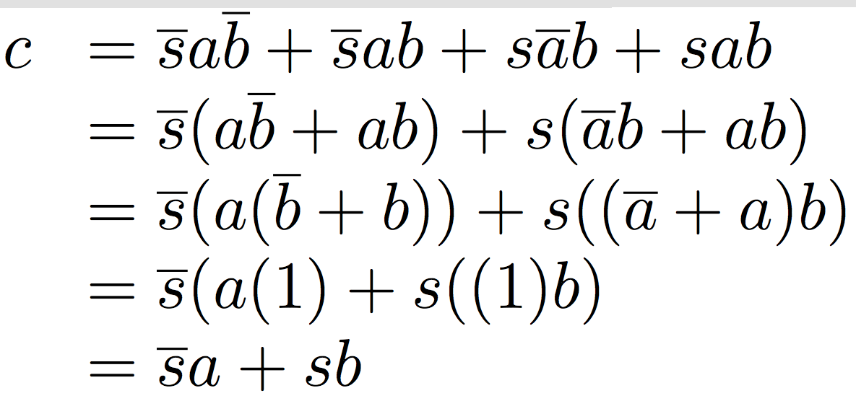
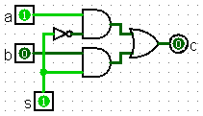
Implementing a 1-bit 2-to-1 MUX
Schematic:
Truth Table:
Boolean Algebra:
Circuit Diagram:
A
‘n
0
C
‘n
B
‘n
1
s | a | b | c
0 | 0 | 0 | 0
0 | 0 | 1 | 0
0 | 1 | 0 | 1
0 | 1 | 1 | 1
1 | 0 | 0 | 0
1 | 0 | 1 | 1
1 | 1 | 0 | 0
1 | 1 | 1 | 1
S

Slide 21
1-bit 4-to-1 MUX
Schematic:
A
00
B
01
E
C
10
D
11
‘2
S= S₁S₀

Slide 22
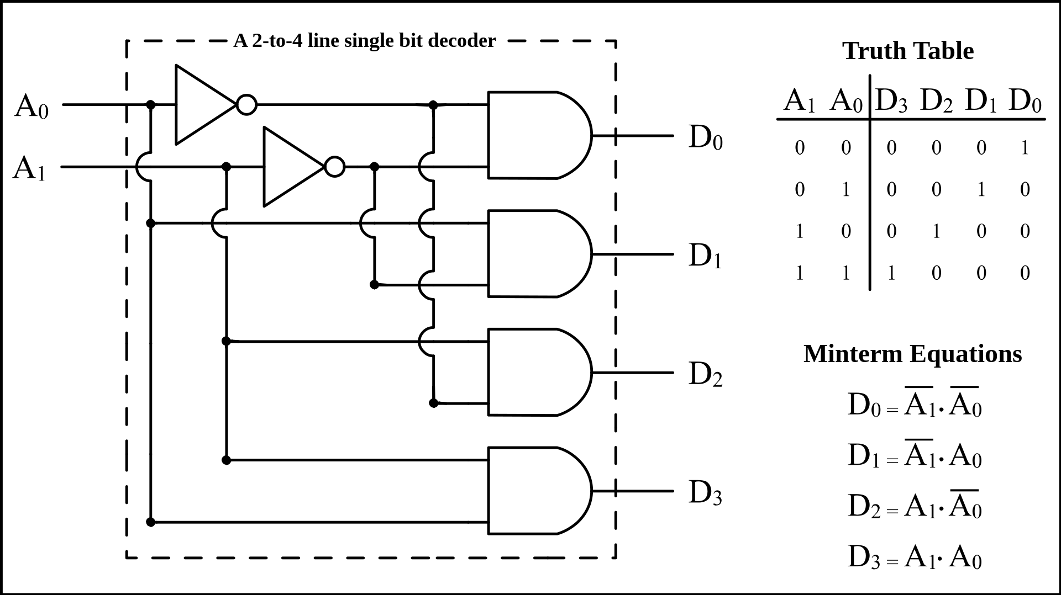
Decoder
Enable one of 2^{N} outputs based on N input
Example: 2-to-4 decoder
Use case: Choose ALU operation based on instruction op-code
By BlueJester0101, CC BY-SA 3.0, https://commons.wikimedia.org/w/index.php?curid=3668293

Slide 23
Functional Unit
Hardware circuits are fixed
Can’t adjust wires / gates while running
Build control wires to parametrize its function
Function Unit:
Function Select:
FS func
0001 A + B
0010 A − B
1000 A * B
0100 A ^ B
0101 A + 1
1101 B
32
32
opA
opB
FS
4
res
32

Slide 24
Functional Unit: Adder-Subtractor
A
B
32
FS
if FS == 0 then
S = A + B
if FS == 1 then
32
32
C
Adder-32
S = A + B + 1
32
= A − B
S

Slide 25
Sequential Circuits: Registers
Register
D (n-bit)
d_{n-1}
d₁
d₀
≡
FF
…
FF
FF
CLK
CLK
CLK
CLK
Q(n-bit)
q
q
q
N-bit register ≡ n instances of a “Flip-Flop”
  Output flips and flops between 0 and 1
Specifically this is a “D-type Flip-Flop”
  D is “data input”, Q is “data output”
  A group of wires when interpreted as a bit field is called a bus

Slide 26
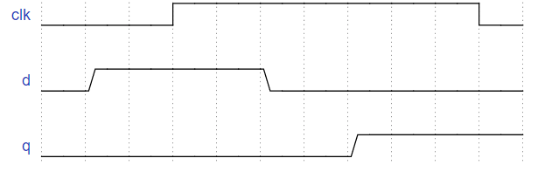
Flip-Flop Timing Behavior
CLK
d
FF
q

Slide 27
CLK
Flip-Flop Timing Behavior
d
FF
q
Setup Time

Slide 28
CLK
Flip-Flop Timing Behavior
d
FF
q
Hold Time

Slide 29
CLK
Flip-Flop Timing Behavior
d
FF
q
Clock-to-Q

Slide 30
Timing Terms
Clock: Steady square wave that synchronizes system
Register: Several bits of state that samples on rising edge of Clock (positive edge-triggered); also has RESET
Setup Time: When input must be stable before Clock trigger
Hold Time: When input must be stable after Clock trigger
Clock-to-Q Delay: How long it takes output to change from Clock trigger
Notes:
STOP HERE

Slide 31
Digital State Machines
inputs
Memory holds state information
memory
current
state
combinational
circuit
outputs
next state
compute next state based on (current state, inputs)
compute outputs based on (current state, inputs)
Q. What does this imply about the clock period?
clock period must exceed (t_{pd} of combinational circuit + t_{pd} of registers) where t_{pd} is propagational delay

Slide 32
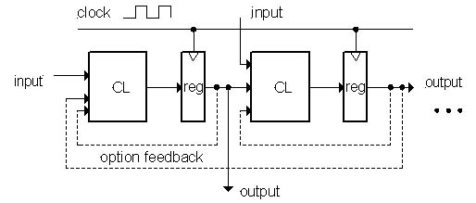
Model for Synchronous Systems
Combinational logic blocks separated by registers
  Clock signal connects only to sequential logic elements
  Feedback is optional depending on application
How do we ensure proper behavior?
  How fast can we run our clock?

Slide 33
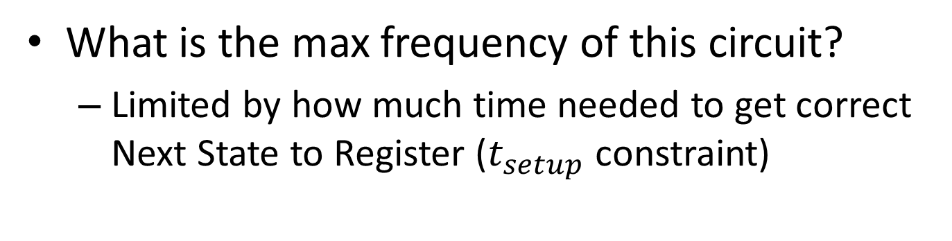
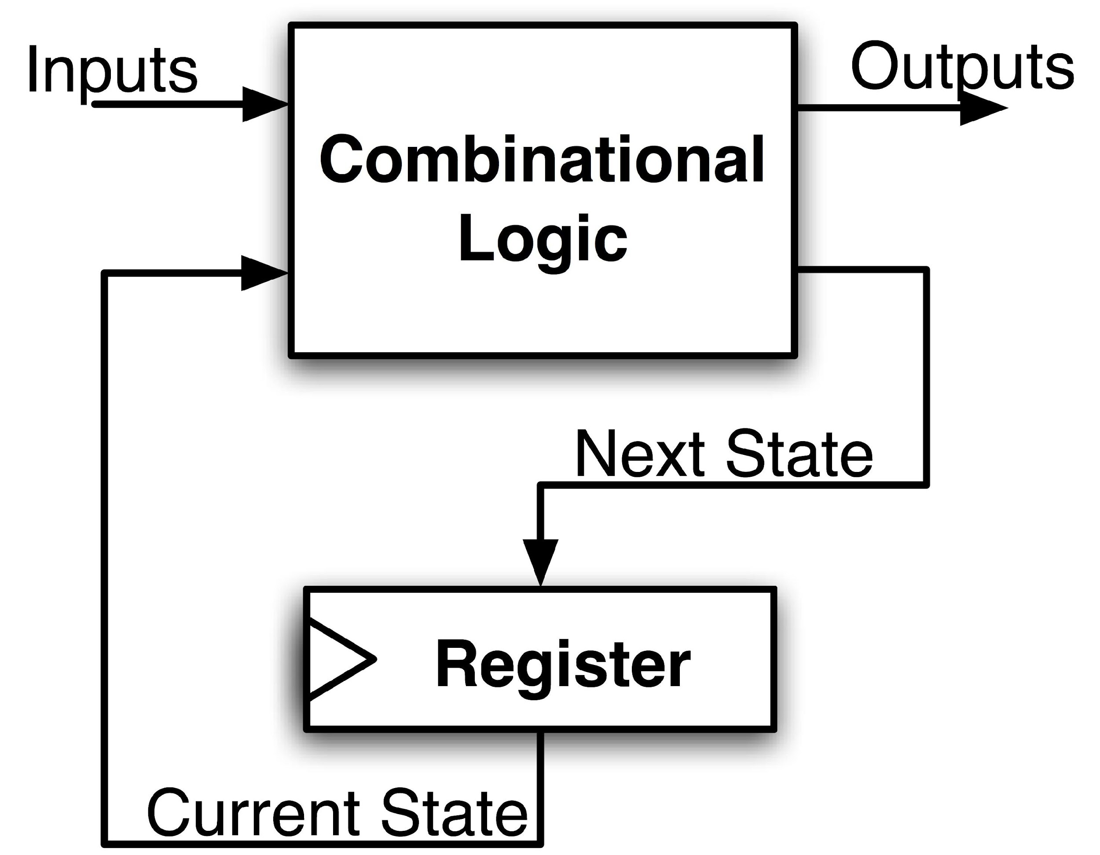
Maximum Clock Frequency
Assumes Max Delay > Hold Time
Max Delay =
Min Period = Max Delay
Max Freq = 1/Min Period
CLK-to-Q Delay
+ CL Delay
+ Setup Time
Notes:
Hold time is included in CLK-to-Q delay.
Make sure to shift thinking for setup time for next clock trigger (one clock cycle).

Slide 34
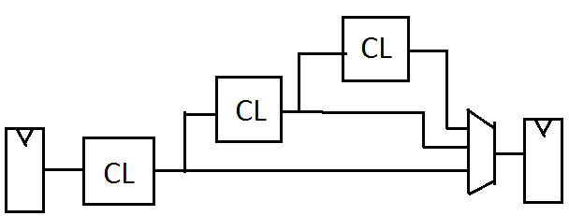
The Critical Path
The critical path is the longest delay between any two registers in a circuit
The clock period must be longer than this critical path, or the signal will not propagate properly to that next register
+
Reg
Reg

Slide 35
RISC-V CPU Datapath, Control Intro
Notes:
Podcast link: https://gimletmedia.com/tags/6dug/super-tech-support

Slide 36
Storage Element: Register File
RW
RA
RB
Write Enable
5
5
5
Register File consists of 32 registers:
  Output ports portA and portB
  Input port portW
Register selection
  Place data of register RA (number) onto portA
  Place data of register RB (number) onto portB
  Store data on portW into register RW (number) when Write Enable is 1
Clock input (CLK)
  CLK is passed to all internal registers so they can be written to if they match RW and Write Enable is 1
portA
portW
32 x 32-bit
Registers
32
32
portB
Clk
32

Slide 37
Implementing R-Types
31
25 24
20 19
15 14
12 11
7 6
0
func7(7)
rs2(5)
rs1(5)
Func3(3)
rd(5)
opcode(7)
Perform operation
New hardware: ALU (Arithmetic Logic Unit)
Abstraction for adders, multipliers, dividers, etc.
How do we know what operation to execute?
  Our first control bit! ALUSel(ect)
+4
Reg[]
pc
IMEM
inst[11:7]
AddrD
ALU
R[rs1]
inst[19:15]
DataA
AddrA
inst[24:20]
AddrB
DataB
R[rs2]
inst[31:0]
Control
ALUSel = add

Slide 38
Implementing R-Types
31
25 24
20 19
15 14
12 11
7 6
0
func7(7)
rs2(5)
rs1(5)
Func3(3)
rd(5)
opcode(7)
Perform operation
Write ALU result to rd
+4
Reg[]
pc
DataD
IMEM
inst[11:7]
AddrD
ALU
R[rs1]
inst[19:15]
DataA
alu
AddrA
inst[24:20]
AddrB
DataB
R[rs2]
inst[31:0]
Control
RegWEn=1
ALUSel = add
ALUSel = add

Slide 39
Adding addi to datapath
31
20 19
15 14
12 11
7 6
0
imm(12)
rs1(5)
Func3(3)
rd(5)
opcode(7)
+4
Reg[]
pc
DataD
ALU
alu
IMEM
inst[11:7]
AddrD
Reg[rs1]
pc+4
DataA
0
inst[19:15]
AddrA
Reg[rs2]
inst[24:20]
AddrB
DataB
1
Also works for all other I-format arithmetic instruction (slti,sltiu,andi,ori,xori,slli,srli,srai) just by changing ALUSel
inst[31:20]
Imm.
Gen
imm[31:0]
Control Logic
inst[31:0]
ImmSel=I
RegWEn=1
BSel=1
ALUSel=Add
39

Slide 40
Adding lw to datapath
31
20 19
15 14
12 11
7 6
0
offset(12)
base
width
dst
opcode
+4
Reg[]
alu
pc
wb
DataD
Reg[rs1]
ALU
DMEM
1
IMEM
inst[11:7]
AddrD
Reg[rs2]
Addr
wb
pc+4
inst[19:15]
AddrA
DataA
0
DataR
0
1
mem
inst[24:20]
AddrB
DataB
inst[31:20]
Imm.
Gen
imm[31:0]
inst[31:0]
ImmSel=I
RegWEn=1
Bsel=1
ALUSel=Add
MemRW=Read
WBSel=0

Slide 41
Adding sw to datapath
31
25 24
20 19
15 14
12 11
7 6
0
imm(11:5)
rs2
rs1
func3
imm(4:0)
opcode
+4
Reg[]
alu
pc
wb
DataD
Reg[rs1]
ALU
DMEM
pc+4
IMEM
inst[11:7]
AddrD
Reg[rs2]
Addr
1
wb
inst[19:15]
AddrA
DataA
0
DataR
0
1
DataW
mem
inst[24:20]
AddrB
DataB
inst[31:7]
Imm.
Gen
imm[31:0]
inst[31:0]
ImmSel=S
RegWEn=0
Bsel=1
ALUSel=Add
MemRW=Write
WBSel=*
*= “Don’t Care”
41

Slide 42
Adding branches to datapath
31
25 24
20 19
15 14
12 11
7 6
0
imm(12|10:5)
rs2
rs1
func3
imm(4:1|11)
opcode
alu
+4
Reg[]
pc
alu
pc
wb
DataD
1
1
Reg[rs1]
ALU
DMEM
IMEM
inst[11:7]
AddrD
0
1
0
Branch Comp.
Reg[rs2]
Addr
DataR
0
wb
pc+4
inst[19:15]
AddrA
DataA
0
DataW
mem
inst[24:20]
AddrB
DataB
1
inst[31:7]
Imm.
Gen
imm[31:0]
PCSel=taken/not-taken
inst[31:0]
ImmSel=B
RegWEn=0
BrUn
BrEq
BrLT
Bsel=1
ASel=1
MemRW=Read
WBSel=*
ALUSel=Add
42

Slide 43
Adding jalr to datapath
31
20 19
15 14
12 11
7 6
0
offset
base
Func3
dest
opcode
+4
Reg[]
pc
alu
pc+4
alu
pc
wb
1
1
DataD
Reg[rs1]
ALU
DMEM
2
IMEM
inst[11:7]
AddrD
0
1
pc+4
0
Branch Comp.
Reg[rs2]
Addr
DataR
0
wb
inst[19:15]
AddrA
DataA
0
DataW
mem
inst[24:20]
AddrB
DataB
1
inst[31:7]
Imm.
Gen
imm[31:0]
PCSel
inst[31:0]
ImmSel=I
RegWEn=1
Bsel=1
Asel=0
MemRW=Read
WBSel=2
BrEq=*
ALUSel=Add
BrUn=*
BrLT=*
Writes PC+4 to dest (return address)
Sets PC = base + offset
43

Slide 44
Adding jal to datapath
31
12 11
7 6
0
imm[20|10:1|11|19:12]
rd
opcode
+4
Reg[]
pc
alu
pc+4
alu
pc
wb
1
1
DataD
Reg[rs1]
ALU
DMEM
2
IMEM
inst[11:7]
AddrD
0
1
pc+4
0
Branch Comp.
Reg[rs2]
Addr
DataR
0
wb
inst[19:15]
AddrA
DataA
0
DataW
mem
inst[24:20]
AddrB
DataB
1
inst[31:7]
Imm.
Gen
imm[31:0]
PCSel
inst[31:0]
ImmSel=J
RegWEn=1
Bsel=1
Asel=1
MemRW=Read
WBSel=2
BrEq=*
ALUSel=Add
BrUn=*
BrLT=*
jal saves PC+4 in register rd (the return address)
Set PC = PC + offset (PC-relative jump)
44

Slide 45
Implementing lui
31
12 11
7 6
0
imm[31:12]
rd
opcode
+4
Reg[]
pc
pc+4
pc
wb
1
alu
alu
1
DataD
Reg[rs1]
ALU
DMEM
2
IMEM
inst[11:7]
AddrD
0
1
pc+4
0
Branch Comp.
Reg[rs2]
Addr
DataR
0
wb
inst[19:15]
AddrA
DataA
0
DataW
mem
inst[24:20]
AddrB
DataB
1
inst[31:7]
Imm.
Gen
imm[31:0]
PCSel=pc+4
inst[31:0]
ImmSel=U
RegWEn=1
Bsel=1
Asel=*
ALUSel=B
MemRW=Read
WBSel=1
BrUn=*
BrE=*
BrLT=*
lui writes the upper 20 bits of the destination with the immediate value, and clears the lower 12 bits
45

Slide 46
Implementing auipc
31
12 11
7 6
0
imm[31:12]
rd
opcode
+4
Reg[]
pc
pc+4
pc
wb
1
alu
alu
1
DataD
Reg[rs1]
ALU
DMEM
2
IMEM
inst[11:7]
AddrD
0
1
pc+4
0
Branch Comp.
Reg[rs2]
Addr
DataR
0
wb
inst[19:15]
AddrA
DataA
0
DataW
mem
inst[24:20]
AddrB
DataB
1
inst[31:7]
Imm.
Gen
imm[31:0]
PCSel=pc+4
inst[31:0]
ImmSel=U
RegWEn=1
Bsel=1
Asel=1
ALUSel=Add
MemRW=0
WBSel=1
BrUn=*
BrE=*
BrLT=*
Adds upper immediate value to PC and places result in destination register
46

Slide 47
ADD: Control Signals
Here are the signals and values we’ve compiled for our ADD instruction:
(green = left 3 cols = control INPUTS)
(orange = right 9 cols = control OUTPUTS)
Inst[31:0] | BrEq | BrLT | PCSel | ImmSel | BrUn | ASel | BSel | ALUSel | MemRW | RegWEn | WBSel
add | * | * | +4 | * | * | Reg | Reg | Add | Read | 1 (Y) | ALU

Slide 48
addi datapath
+4
Reg[]
pc
pc+4
pc
wb
1
alu
1
DataD
Reg[rs1]
ALU
2
alu
0
DMEM
0
IMEM
inst[11:7]
AddrD
Addr
1
pc+4
Branch Comp.
Reg[rs2]
DataR
wb
inst[19:15]
AddrA
DataA
0
0
DataW
mem
inst[24:20]
AddrB
DataB
1
inst[31:7]
Imm.
Gen
imm[31:0]
Control Logic
PCSel
inst[31:0]
ImmSel
RegWEn
BrUn
BrEq
BrLT
BSel
ASel
ALUSel
MemRW
WBSel
Inst[31:0] | PCSel | ImmSel | RegWEn | BrUn | BrLT | BrEq | BSel | ASel | ALUSel | MemRW | WBSel
addi | +4 | I | 1 | * | * | * | Imm | Reg | Add | Read | ALU

Slide 49
lw datapath
+4
Reg[]
pc
pc+4
pc
wb
1
alu
1
DataD
Reg[rs1]
ALU
2
alu
0
DMEM
0
IMEM
inst[11:7]
AddrD
Addr
1
pc+4
Branch Comp.
Reg[rs2]
DataR
wb
inst[19:15]
AddrA
DataA
0
0
DataW
mem
inst[24:20]
AddrB
DataB
1
inst[31:7]
Imm.
Gen
imm[31:0]
PCSel
inst[31:0]
ImmSel
RegWEn
BrUn
BrEq
BrLT
BSel
ASel
ALUSel
MemRW
WBSel
Inst[31:0] | PCSel | ImmSel | RegWEn | BrUn | BrEq | BrLT | BSel | ASel | ALUSel | MemRW | WBSel
lw | +4 | I | 1 | * | * | * | Imm | Reg | Add | Read | Mem

Slide 50
Br datapath
+4
Reg[]
pc
pc+4
pc
wb
1
alu
1
DataD
Reg[rs1]
ALU
2
alu
0
DMEM
0
IMEM
inst[11:7]
AddrD
Addr
1
pc+4
Branch Comp.
Reg[rs2]
DataR
wb
inst[19:15]
AddrA
DataA
0
0
DataW
mem
inst[24:20]
AddrB
DataB
1
inst[31:7]
Imm.
Gen
imm[31:0]
PCSel
inst[31:0]
ImmSel
RegWEn
BrUn
BrEq
BrLT
BSel
ASel
ALUSel
MemRW
WBSel
Inst[31:0] | PCSel | ImmSel | RegWEn | BrUn | BrEq | BrLT | BSel | ASel | ALUSel | MemRW | WBSel
beq | +4 | B | 0 | * | 0 | * | Imm | PC | Add | Read | *
beq | ALU | B | 0 | * | 1 | * | Imm | PC | Add | Read | *

Slide 51
jal datapath
+4
Reg[]
pc
pc+4
pc
wb
1
alu
1
DataD
Reg[rs1]
ALU
2
alu
0
DMEM
0
IMEM
inst[11:7]
AddrD
Addr
1
pc+4
Branch Comp.
Reg[rs2]
DataR
wb
inst[19:15]
AddrA
DataA
0
0
DataW
mem
inst[24:20]
AddrB
DataB
1
inst[31:7]
Imm.
Gen
imm[31:0]
PCSel
inst[31:0]
ImmSel
RegWEn
BrUn
BrEq
BrLT
BSel
ASel
ALUSel
MemRW
WBSel
Inst[31:0] | PCSel | ImmSel | RegWEn | BrUn | BrEq | BrLT | BSel | ASel | ALUSel | MemRW | WBSel
jal | ALU | J | 1 | * | * | * | Imm | PC | Add | Read | PC+4

Slide 52
Inst[31:0] | PCSel | ImmSel | RegWEn | BrUn | BrEq | BrLT | BSel | ASel | ALUSel | MemRW | WBSel
add | +4 | * | 1 (Y) | * | * | * | Reg | Reg | Add | Read | ALU
sub | +4 | * | 1 | * | * | * | Reg | Reg | Sub | Read | ALU
(R-R Op) | +4 | * | 1 | * | * | * | Reg | Reg | (Op) | Read | ALU
addi | +4 | I | 1 | * | * | * | Imm | Reg | Add | Read | ALU
lw | +4 | I | 1 | * | * | * | Imm | Reg | Add | Read | Mem
sw | +4 | S | 0 (N) | * | * | * | Imm | Reg | Add | Write | *
beq | +4 | B | 0 | * | 0 | * | Imm | PC | Add | Read | *
beq | ALU | B | 0 | * | 1 | * | Imm | PC | Add | Read | *
bne | ALU | B | 0 | * | 0 | * | Imm | PC | Add | Read | *
bne | +4 | B | 0 | * | 1 | * | Imm | PC | Add | Read | *
blt | ALU | B | 0 | 0 | * | 1 | Imm | PC | Add | Read | *
bltu | ALU | B | 0 | 1 | * | 1 | Imm | PC | Add | Read | *
jalr | ALU | I | 1 | * | * | * | Imm | Reg | Add | Read | PC+4
jal | ALU | J | 1 | * | * | * | Imm | PC | Add | Read | PC+4
auipc | +4 | U | 1 | * | * | * | Imm | PC | Add | Read | ALU

Slide 53
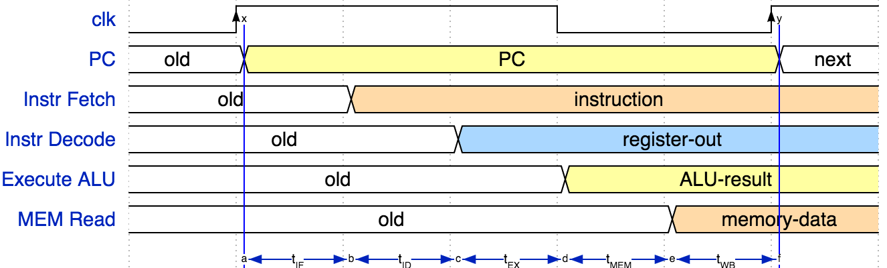
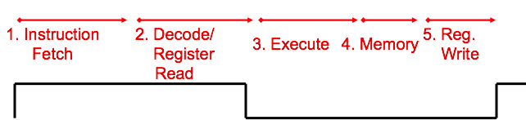
Instruction Timing
IF | ID | EX | MEM | WB | Total
IMEM | Reg Read | ALU | DMEM | Reg W
200 ps | 100 ps | 200 ps | 200 ps | 100 ps | 800 ps

Slide 54
Instruction Timing
Instr | IF = 200ps | ID = 100ps | ALU = 200ps | MEM=200ps | WB = 100ps | Total
add | X | X | X |  | X | 600ps
beq | X | X | X |  |  | 500ps
jal | X | X | X |  | X | 600ps
lw | X | X | X | X | X | 800ps
sw | X | X | X | X |  | 700ps
Maximum clock frequency
  f_{max} = 1/800ps = 1.25 GHz
Most blocks idle most of the time! ex. “IF” active every 600ps
Instruction 1
Instruction 2
IF
ID
ALU
MEM
WB
IF
ID
ALU
MEM
WB
Clk

Slide 55
“Iron Law” of Processor Performance
Time = Instructions Cycles Time
Program Program * Instruction * Cycle

Slide 56

RISC-V Pipeline
t_{instruction} = 1000 ps
Resource use in a particular time slot
add t0, t1, t2
Resource use by instruction over time
or t3, t4, t5
slt t6, t0, t3
instruction sequence
sw t0, 4(t3)
lw t0, 8(t3)
t_{cycle}
= 200 ps
addi t2, t2, 1

Slide 57
Each stage operates on different instruction
lw t0, 8(t3)
sw t0, 4(t3)
slt t6, t0, t3
or t3, t4, t5
add t0, t1, t2
pc_{X}
pc_{M}
pc_{F}
pc_{D}
+4
+4
Reg[]
rs1_{X}
1
DataD
ALU
alu_{X}
DMEM
0
AddrD
alu_{M}
Addr
pc_{F}+4
IMEM
Branch Comp.
DataR
AddrA
DataA
DataW
DataB
AddrB
inst_{D}
rs2_{X}
rs2_{M}
imm_{X}
Imm.
inst_{X}
inst_{M}
inst_{W}
Pipeline registers separate stages, hold data for each instruction in flight

Slide 58
RISC-V Pipeline Example
Address | Inst | Cycle | 0 | 1 | 2 | 3 | 4 | 5 | 6 | 7
0x00 | add a1,a2,a3 | IF | ID | EX | MEM | WB
0x04 | addi a4,a5,0x2f7 |  | IF | ID | EX | MEM | WB
0x08 | sub s4,s0,s3 |  |  | IF | ID | EX | MEM | WB
0x0C | or s1,s2,s5 |  |  |  | IF | ID | EX | MEM | WB

Slide 59
Question: Assume the stage times shown below.
Suppose we remove loads and stores from our ISA. Consider going from a single-cycle implementation to a 4-stage pipelined version.
The latency will be 1.33x slower.
The throughput will be 3x faster.
Instr Fetch | Reg Read | ALU Op | Mem Access | Reg Write
200ps | 100 ps | 200ps | 200ps | 100 ps
Notes:
1/600
4/800 = 1/200
1/200*600/1 = 3x faster throughput
800/600 = 4/3 = 1.33!!

Slide 60
Pipeline Hazards
A hazard is a situation that prevents starting the next instruction in the next clock cycle
Structural hazard
  A required resource is busy
  (e.g. needed in multiple stages)
Data hazard
  Data dependency between instructions
  Need to wait for previous instruction to complete its data write
Control hazard
  Flow of execution depends on previous instruction

Slide 61
Structural Hazard: Register File
RegFile: Used in ID and WB
Time (clock cycles)
I
n
s
t
r
O
r
d
e
r
Load
Add
Store
Sub
Or

Slide 62
RISC-V Pipeline: Regfile Structural Hazard
Addr | Inst | Cycle | 0 | 1 | 2 | 3 | 4 | 5 | 6 | 7 | 8 | 9 | 10
0x00 | addi a0, zero, 5 | IF | ID | EX | MM | WB
0x04 | addi a1, a4, 5 |  | IF | ID | EX | MM | WB
0x08 | addi a2, a5, 5 |  |  | IF | ID | EX | MM | WB
0x0C | addi a3, a6, 5 |  |  |  | IF | ID | ID | EX | MM | WB

Slide 63
Data Hazard: Read after Write
Addr | Inst | Cycle | 0 | 1 | 2 | 3 | 4 | 5 | 6 | 7 | 8 | 9 | 10
0x00 | add s0, s1, s2 | IF | ID | EX | MM | WB
0x04 | sub s4, s0, s3 |  | IF | ID | - | - | EX | MM | WB
0x08 | and s5, s0, s6 |  |  | IF | - | - | ID | EX | MM | WB
0x0C | or s7, s0, s8 |  |  |  |  |  | IF | ID | EX | MM | WB

Slide 64
Data Hazard Solution: Forwarding
Forward result as soon as it is available, even though it’s not stored in RegFile yet
add s0, s1, s2
sub s4, s0, s3
and s5, s0, s6
or s7, s0, s8
xor s9, s0, s10
Forwarding: get operand from pipeline stage, rather than register file

Slide 65
Data Hazard with Forwarding
Addr | Inst | Cycle | 0 | 1 | 2 | 3 | 4 | 5 | 6 | 7 | 8 | 9 | 10
0x00 | add s0, s1, s2 | IF | ID | EX | MM | WB
0x04 | sub s4, s0, s3 |  | IF | ID | EX | MM | WB
0x08 | and s5, s0, s6 |  |  | IF | ID | EX | MM | WB
0x0C | or s7, s0, s8 |  |  |  | IF | ID | EX | MM | WB

Slide 66
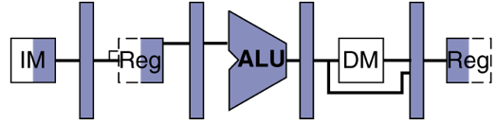
Data Hazard: Loads
Recall: Dataflow backwards in time are hazards
Can’t solve all cases with forwarding
  Must stall instruction dependent on load (sub), then forward after the load is done (more hardware)
lw t0, 0(t1)
sub t3, t0, t2

Slide 67
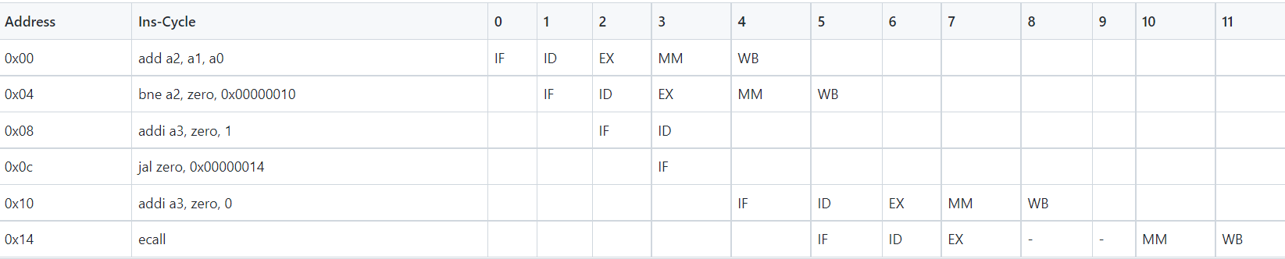
Control Hazards: Taken Branch & ecall

Slide 68
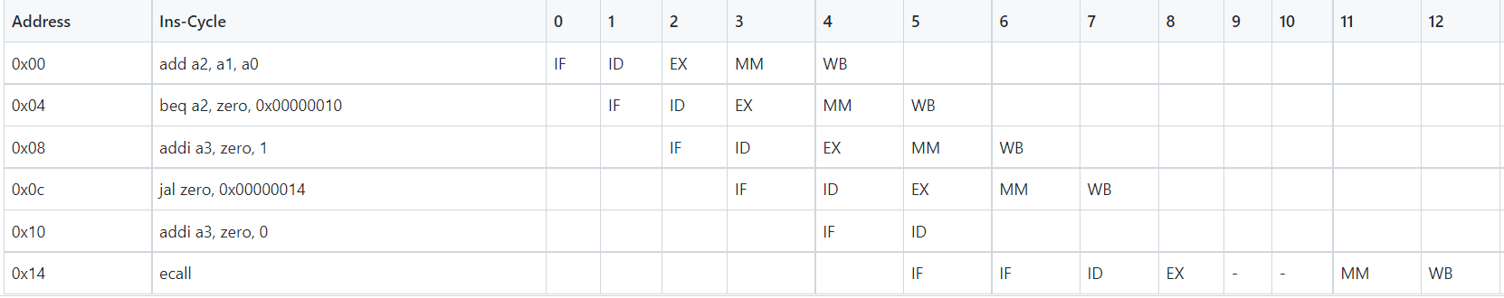
Not-Taken Branch

