Slide 1
Data Structures in Assembly
Arrays
  One-dimensional
  Multi-dimensional (nested)
  Multi-level
Structs
  Alignment
Notes:
Compare all the arrays

Slide 2
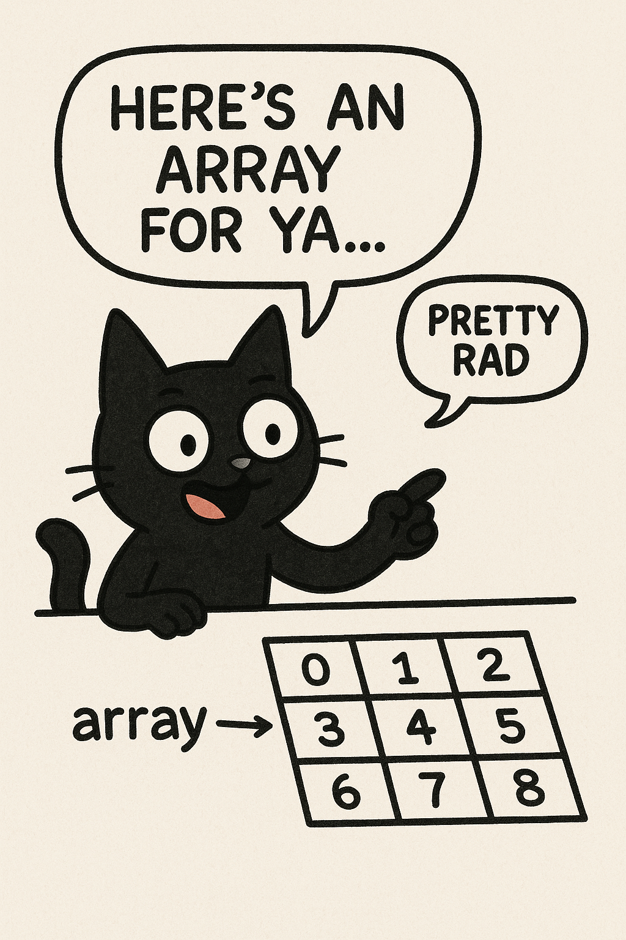

Slide 3
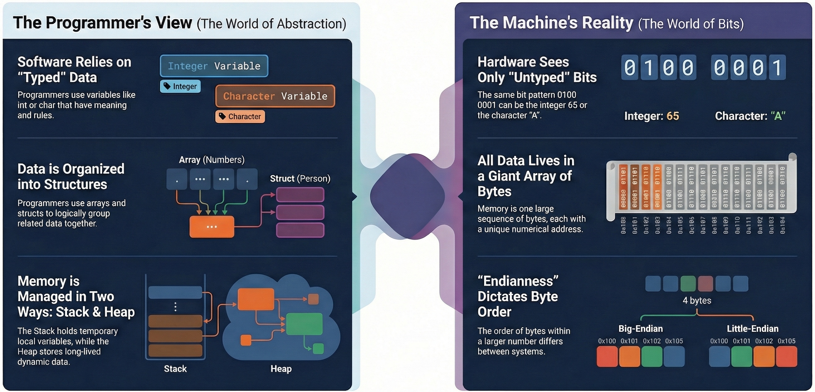

Slide 4

Array Access
Basic Principle
  T A[N]; $→$ array of data type T and length N
  Identifier A returns address of array (type T*)
Reference Type Value
int x[5];
3
7
1
9
5
a
a+4
a+8
a+12
a+16
a+20
x[4] | int | 5
x | int* | a
x+1 | int* | a + 4
&x[2] | int* | a + 8
x[5] | int | ?? (whatever’s in memory at addr x+20)
*(x+1) | int | 7
x+i | int* | a + 4*i
Notes:
Arrays explain the funky part of pointer arithmetic

Slide 5
Referencing Examples
typedef int vec5[5];
vec5 cmu;
1
5
2
1
3
16
20
24
28
32
36
vec5 sfu;
9
8
1
9
5
36
40
44
48
52
56
vec5 ucb;
9
4
7
2
0
56
60
64
68
72
76
Reference Address Value Guaranteed?
  sfu[3]
  sfu[6]
  sfu[-1]
  cmu[15]
36 + 4* 3 = 48 9 Yes
36 + 4* 6 = 60 4 No
36 + 4*-1 = 32 3 No
16 + 4*15 = 76 ?? No
No bounds checking
Example arrays happened to be allocated in successive 20 byte blocks
  Not guaranteed to happen in general

Slide 6
Nested Array Example
typedef int vec5[5];
vec5 sea[4] =
{{ 9, 8, 1, 9, 5 },
{ 9, 8, 1, 0, 5 },
{ 9, 8, 1, 0, 3 },
{ 9, 8, 1, 1, 5 }};
Remember, T A[N] is an array with elements of type T, with length N
same as:
What is the layout in memory?
int sea[4][5];

Slide 7
How is a 2D array packed into memory?
1D Array | 2D Array
int array[10]; Elements in sequence | int array[10][10]; What is the layout?
a[i] = &a[0]+i Byte offset: i*sizeof(int) | a[i][j] ? Byte offset: ?

Slide 8
Two-Dimensional (Nested) Arrays
Declaration: T A[R][C];
  2D array of data type T
  R rows, C columns
  Each element requires
  sizeof(T) bytes
Array size:
  R*C*sizeof(T) bytes
Arrangement: row-major ordering
A[0][0]
• • •
A[0][C-1]
•
•
•
•
•
•
A[R-1][0]
• • •
A[R-1][C-1]
int A[R][C];
• • •
A
[0]
[0]
A
[0]
[C-1]
• • •
A
[1]
[0]
A
[1]
[C-1]
• • •
• • •
A
[R-1]
[0]
A
[R-1]
[C-1]
4*R*C bytes
Notes:
Memory is linear

Slide 9
Nested Array Example
typedef int vec5[5];
vec5 sea[4] =
{{ 9, 8, 1, 9, 5 },
{ 9, 8, 1, 0, 5 },
{ 9, 8, 1, 0, 3 },
{ 9, 8, 1, 1, 5 }};
Remember, T A[N] is an array with elements of type T, with length N
sea[3][2];
Row 0
Row 1
Row 2
Row 3
9
8
1
9
5
9
8
1
0
5
9
8
1
0
3
9
8
1
1
5
76
96
116
136
156
“Row-major” ordering of all elements
Elements in the same row are contiguous
Guaranteed (in C)

Slide 10
Address calculation
2D array: int a[3][4]. Find offset of a[1][1] in elements i=1,j=1
a[0][0] |  | a[0][1] |  | a[0][2] |  | a[0][3]
a[1][0] |  | a[1][1] |  | a[1][2] |  | a[1][3]
a[2][0] |  | a[2][1] |  | a[2][2] |  | a[2][3]
a [0] [0] | a [0] [1] | a [0] [2] | a [0] [3] | a [1] [0] | a [1] [1] | a [1] [2] | a [1] [3] | a [2] [0] | a [2] [1] | a [2] [2] | a [2] [3]
{
4 elem
1
a[1][1] = Address of A[1][0] + 1
= 1*# of elem/1D array + 1
= 1 * 4 + 1
= 5 elems from start = 20 bytes (if int)

Slide 11
Address calculation
2D array: int a[3][4]. Find offset of a[2][1] in elements i=1,j=1
a[0][0] |  | a[0][1] |  | a[0][2] |  | a[0][3]
a[1][0] |  | a[1][1] |  | a[1][2] |  | a[1][3]
a[2][0] |  | a[2][1] |  | a[2][2] |  | a[2][3]
a [0] [0] | a [0] [1] | a [0] [2] | a [0] [3] | a [1] [0] | a [1] [1] | a [1] [2] | a [1] [3] | a [2] [0] | a [2] [1] | a [2] [2] | a [2] [3]
{
2*4 elem = 8 elem
1
a[2][1] = Address of A[2][0] + 1
= 2*# of elem/1D array + 1
= 2 * 4 + 1
= 9 elems from start = 36 bytes (if int)

Slide 12

for (i = 0; i < 4){
for(j = 0; < 4) {
A[i][j]
for (i = 0; i < 4){
for(j = 0; < 4) {
A[j][i]

Slide 13
Stride
Difference in address of two consecutive access to an array e.g., a[0] and a[1] (assume int a[]). Stride is 4.
a[0,0],a[0,1]……
Addr: 0,4,8,12
Stride = 4
a[0,0],a[1,0]……
Addr: 0,16,32…
Stride = 16
for (i = 0; i < 4){
for(j = 0; < 4) {
A[i, j]
for (i = 0; i < 4){
for(j = 0; < 4) {
A[j, i]

Slide 14
Layouts
Row Major
• • •
A
[0]
[0]
A
[0]
[C-1]
• • •
A
[1]
[0]
A
[1]
[C-1]
• • •
• • •
A
[R-1]
[0]
A
[R-1]
[C-1]
Col Major
A
[0]
[0]
A
[1]
[0]
• • •
A
[R-1]
[0]
A
[0]
[C-1]
A
[1]
[C-1]
• • •
• • •

Slide 15
3D array
3D array: int a[2][3][4]. A[0][1][1] or A[1][1][1]
a[0][0] |  | a[0][1] |  | a[0][2] |  | a[0][3]
a[1][0] |  | a[1][1] |  | a[1][2] |  | a[1][3]
a[2][0] |  | a[2][1] |  | a[2][2] |  | a[2][3]
a[0][0] |  | a[0][1] |  | a[0][2] |  | a[0][3]
a[1][0] |  | a[1][1] |  | a[1][2] |  | a[1][3]
a[2][0] |  | a[2][1] |  | a[2][2] |  | a[2][3]
a[1][1][1] = 1*([3][4]) + 1 * ([4]) + 1 elem
a[1][1][1] = 1*12 + 1*4 + 1 = 17 elem
a [0] [0] | a [0] [1] | a [0] [2] | a [0] [3] | a [1] [0] | a [1] [1] | a [1] [2] | a [1] [3] | a [2] [0] | a [2] [1] | a [2] [2] | a [2] [3]
a [0] [0] | a [0] [1] | a [0] [2] | a [0] [3] | a [1] [0] | a [1] [1] | a [1] [2] | a [1] [3] | a [2] [0] | a [2] [1] | a [2] [2] | a [2] [3]
{
12 elem
4 elem
1

Slide 16
Multi-Level Array Example
Multi-Level Array Declaration(s):
int cmu[5] = { 1, 5, 2, 1, 3 };
int sfu[5] = { 9, 8, 1, 9, 5 };
int ucb[5] = { 9, 4, 7, 2, 0 };
int* univ[3] = {sfu, cmu, ucb};
Is a multi-level array the
same thing as a 2D array?
NO
2D Array Declaration:
vec5 univ2D[3] = {
{ 9, 8, 1, 9, 5 },
{ 1, 5, 2, 1, 3 },
{ 9, 4, 7, 2, 0 }
};
One array declaration = one contiguous block of memory

Slide 17
Multi-Level Referencing Examples
cmu
1
5
2
1
3
univ
16
20
24
28
32
36
160
36
sfu
V
5
H
4
S
168
16
ucb
36
40
44
48
52
56
176
60
9
4
7
2
0
60
64
68
72
76
80
Reference Address Value Guaranteed?
  univ[2][3]
  univ[1][5]
  univ[2][-2]
  univ[3][-1]
  univ[1][12]
  C code does not do any bounds checking
  Location of each lower-level array in memory is not guaranteed
Notes:
72 2 yes
36 9 no
52 5 no
?? ?? No
64 4 no

Slide 18
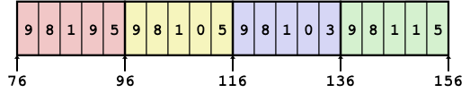
Array Element Accesses
Nested array
Multi-level array
int get_sea_digit
(int index, int digit)
{
return sea[index][digit];
}
int get_univ_digit
(int index, int digit)
{
return univ[index][digit];
}
cmu
univ
1
5
2
1
3
160
36
sfu
16
20
24
28
32
36
168
16
9
8
1
9
5
176
60
ucb
36
40
44
48
52
56
9
4
7
2
0
60
64
68
72
76
80
Access looks the same, but it isn’t:
Mem[sea+20*index+4*digit]
Mem[Mem[univ+8*index]+4*digit]
Notes:
Depends on how array is declared, look at type
Multi-dimensional arrays are a special construct!

Slide 19
C Structure Representation
struct rec {
int a[4];
long i;
struct rec *next;
};
struct rec *r;
r
a
i
next
0
16
24
32
Structure represented as block of memory
  Big enough to hold all of the fields
Fields ordered according to declaration order
  Even if another ordering would be more compact
Compiler determines overall size + positions of fields
  Machine-level program has no understanding of the structures in the source code
Notes:
No structs or field names in assembly! Just offsets

Slide 20
Accessing a Structure Member
struct rec {
int a[4];
long i;
struct rec *next;
};
struct rec *r;
r
r->i
a
i
next
0
16
24
32
long get_i(struct rec *r)
{
return r->i;
}
Compiler knows the offset of each member within a struct
  Compute as *(r+offset)
    Referring to absolute offset, so no pointer arithmetic
add a0, a1, 16 # Coming up in Week 3
ret

Slide 21
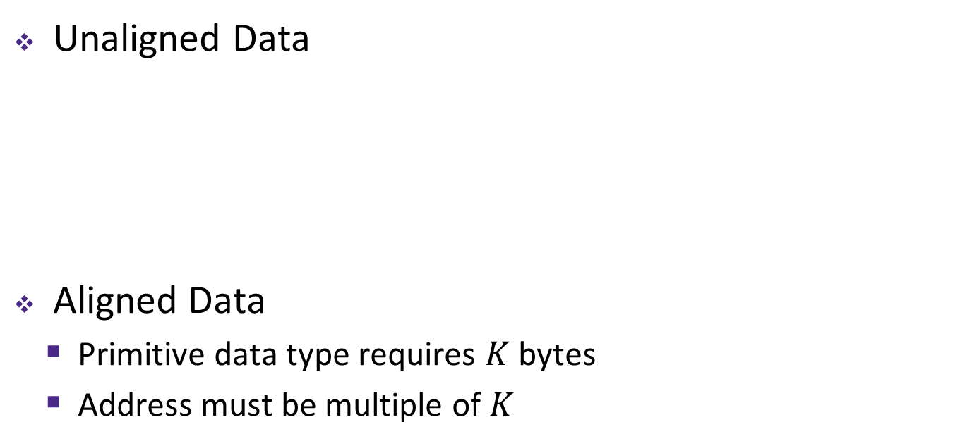
Structures & Alignment
Unaligned Data
Aligned Data
  Primitive data type requires $K$ bytes
  Address must be multiple of $K$
struct S1 {
char c;
int i[2];
double v;
} *p;
c
i[0]
i[1]
v
p
p+1
p+5
p+9
p+17
c
3 bytes
i[0]
i[1]
4 bytes
v
p+0
p+4
p+8
p+16
p+24
Multiple of 4
Multiple of 8
Multiple of 8
internal fragmentation
Multiple of 8
Notes:
struct S1 { … } *p; - this defines a new type “struct S1”, and creates a variable p with type “struct S1 *”
#include <stddef.h>// for offsetof
printf("sizeof p = %d\n", (int) sizeof(p));
printf("offset of v in p = %d\n", (int) offsetof(struct S1, v));

Slide 22

Arrays of Structures
Overall structure length multiple of $K_{max}$
Satisfy alignment requirement
for every element in array
struct S2 {
double v;
int i[2];
char c;
} a[10];
 | a[0] |  |  |  |  | a[1] |  |  |  |  | a[2] |  |  |  |  | • • •
a+0 |  |  |  |  | a+24 |  |  |  |  | a+48 |  |  |  |  | a+72
 | v |  |  |  |  |  |  | i[0] |  |  |  | i[1] |  |  |  | c | 7 bytes
a+24 |  |  |  |  |  |  | a+32 |  |  |  |  |  |  |  | a+40 |  |  |  |  |  |  |  | a+48
external fragmentation
Notes:
struct S2 { … } a[10]; - declares a new type “struct S2”, then declares an array a that contains 10 “struct S2” elements

Slide 23
Nested Struct
struct foo {
long a;
long b;
struct bar my_bar;
};
struct bar {
long x;
long y;
};
struct foo *f;
&f->my_bar
&f->my_bar.y
a
b
x
y
0
8
16
24
32
Notes:
Note the difference of -> and .

Slide 24
Nested Struct
struct foo {
long a;
long b;
struct foo my_foo;
};
a
b
?????????
0
8
16
Notes:
Infinite struct!!!
This is why you need a pointer

Slide 25
Array in Struct vs. Array of structs
struct struct_w_array {
int id; // offset 0
float data[4]; offset 4
};
struct_w_arry object;
# obj.data[i]
addr_data_i = &object
+ 4 // offset of data[0]
+ i * sizeof(float); //ith elem
};
struct aos {
int id; // offset 0
float data; offset 4
};
aos obj[4];
# obj[i].data
addr_data_i = &obj[0] + i * 8 // size of aos including padding etc
+ 4 // offset data within it
};

Slide 26
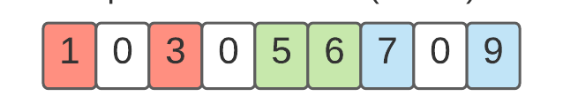
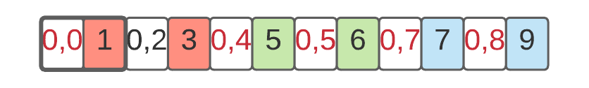
Sparse Arrays (Array of Structs)
Arrays
Array of structures (non zeros)
struct coo { int row; int col; int val; } // each non-zero
int nnz // number of non zeros
struct coo_array[nnz] // Array of non zeros
for i = 0 to nnz
int* base = &coo[i]
int r = *base
int c = *(base+1)
int val = *(base+2)

Slide 27
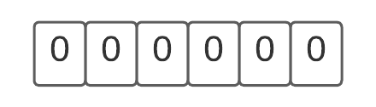
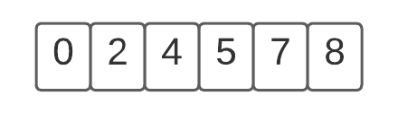
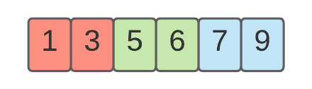
Sparse Arrays (Structs of Arrays)
int row[nnz]
int col[nnz]
int val[nnz]
for i = 0 to nnz
int r = row[i]
int c = col[i]
int val = val[i]

Slide 28
Multiple Ways to Store Program Data

Slide 29
Multiple Ways to Store Program Data
Static global data
  Fixed size at compile-time
  Entire lifetime of the program
  (loaded from executable)
  Portion is read-only
  (e.g. string literals)
Stack-allocated data
  Local/temporary variables
    Can be dynamically sized (in some versions of C)
  Known lifetime (deallocated on return)
Dynamic (heap) data
  Size known only at runtime (i.e. based on user-input)
  Lifetime known only at runtime (long-lived data structures)
int array[1024];
void foo(int n) {
int tmp;
int local_array[n];
int* dyn =
(int*)malloc(n*sizeof(int));
}

Slide 30
C Memory Layout
Program’s address space
contains 4 regions:
  Stack: local variables, grows downward
  Heap: space requested via malloc() and used with pointers; resizes dynamically, grows upward
  Static Data: global and static variables, does not grow or shrink
  Code: loaded when program
  starts, does not change
~ FFFF FFFF_{hex}
stack
heap
static data
code
~ 0_{hex}
OS prevents accesses
between stack and heap
(via virtual memory)

Slide 31
The Stack
Function call:
Function returns:
Each stack frame is a contiguous block of memory holding the local variables of a single procedure
A stack frame includes:
  Location of caller function
  Function arguments
  Space for local variables
Stack pointer (SP) tells where lowest (current) stack frame is
When procedure ends, stack pointer is moved back (but data remains (garbage!)); frees memory for future stack frames;
frame
frame
SP
frame
frame
SP
…

Slide 32
The Stack
  void func2() {
  int d = 0;
  }
  void func1() {
  int c = 99;
  func2();
  }
  int main(int argc, char *argv[]) {
  int a = 42;
  int b = 17;
  func1();
  printf("Done.");
  return 0;
  }
Memory
Main
argc:
argv:
Stack
1
0xfff0
0x0

Slide 33
The Stack
  void func2() {
  int d = 0;
  }
  void func1() {
  int c = 99;
  func2();
  }
  int main(int argc, char *argv[]) {
  int a = 42;
  int b = 17;
  func1();
  printf("Done.");
  return 0;
  }
Memory
main
a: argc:
b: argv:
Stack
42
1
17
0xfff0
0x0

Slide 34
The Stack
  void func2() {
  int d = 0;
  }
  void func1() {
  int c = 99;
  func2();
  }
  int main(int argc, char *argv[]) {
  int a = 42;
  int b = 17;
  func1();
  printf("Done.");
  return 0;
  }
Memory
main
a: argc:
b: argv:
Stack
42
1
17
0xfff0
0x0

Slide 35
The Stack
  void func2() {
  int d = 0;
  }
  void func1() {
  int c = 99;
  func2();
  }
  int main(int argc, char *argv[]) {
  int a = 42;
  int b = 17;
  func1();
  printf("Done.");
  return 0;
  }
Memory
main
a: argc:
b: argv:
Stack
42
1
17
0xfff0
func1
0x0

Slide 36
The Stack
  void func2() {
  int d = 0;
  }
  void func1() {
  int c = 99;
  func2();
  }
  int main(int argc, char *argv[]) {
  int a = 42;
  int b = 17;
  func1();
  printf("Done.");
  return 0;
  }
Memory
main
a: argc:
b: argv:
Stack
42
1
17
0xfff0
func1
c:
99
0x0

Slide 37
The Stack
  void func2() {
  int d = 0;
  }
  void func1() {
  int c = 99;
  func2();
  }
  int main(int argc, char *argv[]) {
  int a = 42;
  int b = 17;
  func1();
  printf("Done.");
  return 0;
  }
Memory
main
a: argc:
b: argv:
Stack
42
1
17
0xfff0
func1
c:
99
0x0

Slide 38
The Stack
  void func2() {
  int d = 0;
  }
  void func1() {
  int c = 99;
  func2();
  }
  int main(int argc, char *argv[]) {
  int a = 42;
  int b = 17;
  func1();
  printf("Done.");
  return 0;
  }
Memory
main
a: argc:
b: argv:
Stack
42
1
17
0xfff0
func1
c:
99
func2
0x0

Slide 39
The Stack
  void func2() {
  int d = 0;
  }
  void func1() {
  int c = 99;
  func2();
  }
  int main(int argc, char *argv[]) {
  int a = 42;
  int b = 17;
  func1();
  printf("Done.");
  return 0;
  }
Memory
main
a: argc:
b: argv:
Stack
42
1
17
0xfff0
func1
c:
99
func2
d:
0
0x0

Slide 40
The Stack
  void func2() {
  int d = 0;
  }
  void func1() {
  int c = 99;
  func2();
  }
  int main(int argc, char *argv[]) {
  int a = 42;
  int b = 17;
  func1();
  printf("Done.");
  return 0;
  }
Memory
main
a: argc:
b: argv:
Stack
42
1
17
0xfff0
func1
c:
99
func2
d:
0
0x0

Slide 41
The Stack
  void func2() {
  int d = 0;
  }
  void func1() {
  int c = 99;
  func2();
  }
  int main(int argc, char *argv[]) {
  int a = 42;
  int b = 17;
  func1();
  printf("Done.");
  return 0;
  }
Memory
main
a: argc:
b: argv:
Stack
42
1
17
0xfff0
func1
c:
99
0x0

Slide 42
The Stack
  void func2() {
  int d = 0;
  }
  void func1() {
  int c = 99;
  func2();
  }
  int main(int argc, char *argv[]) {
  int a = 42;
  int b = 17;
  func1();
  printf("Done.");
  return 0;
  }
Memory
main
a: argc:
b: argv:
Stack
42
1
17
0xfff0
func1
c:
99
0x0

Slide 43
The Stack
Each function call has its own stack frame for its own copy of variables.
  int factorial(int n) {
  if (n == 1) {
  return 1;
  } else {
  return n * factorial(n – 1);
  }
  }
  int main(int argc, char *argv[]) {
  printf("%d", factorial(4));
  return 0;
  }
Memory
main
argc:
argv:
Stack
1
0xfff0
0x0

Slide 44
The Stack
Each function call has its own stack frame for its own copy of variables.
  int factorial(int n) {
  if (n == 1) {
  return 1;
  } else {
  return n * factorial(n – 1);
  }
  }
  int main(int argc, char *argv[]) {
  printf("%d", factorial(4));
  return 0;
  }
Memory
main
argc:
argv:
Stack
1
0xfff0
0x0

Slide 45
The Stack
Each function call has its own stack frame for its own copy of variables.
  int factorial(int n) {
  if (n == 1) {
  return 1;
  } else {
  return n * factorial(n – 1);
  }
  }
  int main(int argc, char *argv[]) {
  printf("%d", factorial(4));
  return 0;
  }
Memory
main
argc:
argv:
Stack
1
0xfff0
factorial
n:
4
0x0

Slide 46
The Stack
Each function call has its own stack frame for its own copy of variables.
  int factorial(int n) {
  if (n == 1) {
  return 1;
  } else {
  return n * factorial(n – 1);
  }
  }
  int main(int argc, char *argv[]) {
  printf("%d", factorial(4));
  return 0;
  }
Memory
main
argc:
argv:
Stack
1
0xfff0
factorial
n:
4
0x0

Slide 47
The Stack
Each function call has its own stack frame for its own copy of variables.
  int factorial(int n) {
  if (n == 1) {
  return 1;
  } else {
  return n * factorial(n – 1);
  }
  }
  int main(int argc, char *argv[]) {
  printf("%d", factorial(4));
  return 0;
  }
Memory
main
argc:
argv:
Stack
1
0xfff0
factorial
n:
4
factorial
n:
3
0x0

Slide 48
The Stack
Each function call has its own stack frame for its own copy of variables.
  int factorial(int n) {
  if (n == 1) {
  return 1;
  } else {
  return n * factorial(n – 1);
  }
  }
  int main(int argc, char *argv[]) {
  printf("%d", factorial(4));
  return 0;
  }
Memory
main
argc:
argv:
Stack
1
0xfff0
factorial
n:
4
factorial
n:
3
0x0

Slide 49
The Stack
Each function call has its own stack frame for its own copy of variables.
  int factorial(int n) {
  if (n == 1) {
  return 1;
  } else {
  return n * factorial(n – 1);
  }
  }
  int main(int argc, char *argv[]) {
  printf("%d", factorial(4));
  return 0;
  }
Memory
main
argc:
argv:
Stack
1
0xfff0
factorial
n:
4
factorial
n:
3
factorial
n:
2
0x0

Slide 50
The Stack
Each function call has its own stack frame for its own copy of variables.
  int factorial(int n) {
  if (n == 1) {
  return 1;
  } else {
  return n * factorial(n – 1);
  }
  }
  int main(int argc, char *argv[]) {
  printf("%d", factorial(4));
  return 0;
  }
Memory
main
argc:
argv:
Stack
1
0xfff0
factorial
n:
4
factorial
n:
3
factorial
n:
2
0x0

Slide 51
The Stack
Each function call has its own stack frame for its own copy of variables.
  int factorial(int n) {
  if (n == 1) {
  return 1;
  } else {
  return n * factorial(n – 1);
  }
  }
  int main(int argc, char *argv[]) {
  printf("%d", factorial(4));
  return 0;
  }
Memory
main
argc:
argv:
Stack
1
0xfff0
factorial
n:
4
factorial
n:
3
factorial
n:
2
factorial
n:
1
0x0

Slide 52
The Stack
Each function call has its own stack frame for its own copy of variables.
  int factorial(int n) {
  if (n == 1) {
  return 1;
  } else {
  return n * factorial(n – 1);
  }
  }
  int main(int argc, char *argv[]) {
  printf("%d", factorial(4));
  return 0;
  }
Memory
main
argc:
argv:
Stack
1
0xfff0
factorial
n:
4
factorial
n:
3
factorial
n:
2
Returns 1
factorial
n:
1
0x0

Slide 53
The Stack
Each function call has its own stack frame for its own copy of variables.
  int factorial(int n) {
  if (n == 1) {
  return 1;
  } else {
  return n * factorial(n – 1);
  }
  }
  int main(int argc, char *argv[]) {
  printf("%d", factorial(4));
  return 0;
  }
Memory
main
argc:
argv:
Stack
1
0xfff0
factorial
n:
4
factorial
n:
3
Returns 2
factorial
n:
2
0x0

Slide 54
The Stack
Each function call has its own stack frame for its own copy of variables.
  int factorial(int n) {
  if (n == 1) {
  return 1;
  } else {
  return n * factorial(n – 1);
  }
  }
  int main(int argc, char *argv[]) {
  printf("%d", factorial(4));
  return 0;
  }
Memory
main
argc:
argv:
Stack
1
0xfff0
factorial
n:
4
Returns 6
factorial
n:
3
0x0

Slide 55
The Stack
Each function call has its own stack frame for its own copy of variables.
  int factorial(int n) {
  if (n == 1) {
  return 1;
  } else {
  return n * factorial(n – 1);
  }
  }
  int main(int argc, char *argv[]) {
  printf("%d", factorial(4));
  return 0;
  }
Memory
main
argc:
argv:
Stack
1
0xfff0
Returns 24
factorial
n:
4
0x0

Slide 56
The Stack
Each function call has its own stack frame for its own copy of variables.
  int factorial(int n) {
  if (n == 1) {
  return 1;
  } else {
  return n * factorial(n – 1);
  }
  }
  int main(int argc, char *argv[]) {
  printf("%d", factorial(4));
  return 0;
  }
Memory
main
argc:
argv:
Stack
1
0xfff0
0x0

Slide 57
The Stack
Each function call has its own stack frame for its own copy of variables.
  int factorial(int n) {
  if (n == 1) {
  return 1;
  } else {
  return n * factorial(n – 1);
  }
  }
  int main(int argc, char *argv[]) {
  printf("%d", factorial(4));
  return 0;
  }
Memory
main
argc:
argv:
Stack
1
0xfff0
0x0

Slide 58
The Stack
The stack behaves like a…well…stack! A new function call pushes on a new frame. A completed function call pops off the most recent frame.
Interesting fact: C does not clear out memory when a function’s frame is removed. Instead, it just marks that memory as usable for the next function call. This is more efficient!
A stack overflow is when you use up all stack memory. E.g. a recursive call with too many function calls.
What are the limitations of the stack?

Slide 59
The Heap
The heap is a part of memory that you can manage yourself.
The heap is a part of memory below the stack that you can manage yourself. Unlike the stack, the memory only goes away when you delete it yourself.
Unlike the stack, the heap grows upwards as more memory is allocated.
The heap is dynamic memory – memory that can be allocated, resized, and freed during program runtime.
Notes:
We control the lifetime of how they meet in the middle

Slide 60
The Heap
char *create_string(char ch, int num) {
char *new_str = malloc(sizeof(char) * (num + 1));
for (int i = 0; i < num; i++) {
new_str[i] = ch;
}
new_str[num] = '\0';
return new_str;
}
int main(int argc, char *argv[]) {
char *str = create_string('a', 4);
printf("%s", str); // want "aaaa"
return 0;
}
Memory
main
argc: str:
argv:
Stack
1
0xfff0
create_string
new_str:
0xed0
'\0'
'a'
'a'
'a'
'a'
Heap
0x0
'a'
4

Slide 61
The Heap
char *create_string(char ch, int num) {
char *new_str = malloc(sizeof(char) * (num + 1));
for (int i = 0; i < num; i++) {
new_str[i] = ch;
}
new_str[num] = '\0';
return new_str;
}
int main(int argc, char *argv[]) {
char *str = create_string('a', 4);
printf("%s", str); // want "aaaa"
return 0;
}
Memory
main
argc: str:
argv:
Stack
1
0xfff0
Returns e.g. 0xed0
create_strin
new_str:
0xed0
'\0'
'a'
'a'
'a'
'a'
Heap
0x0
'a'
4

Slide 62
The Heap
char *create_string(char ch, int num) {
char *new_str = malloc(sizeof(char) * (num + 1));
for (int i = 0; i < num; i++) {
new_str[i] = ch;
}
new_str[num] = '\0';
return new_str;
}
int main(int argc, char *argv[]) {
char *str = create_string('a', 4);
printf("%s", str); // want "aaaa"
return 0;
}
Memory
main
argc: str:
argv:
Stack
1
0xed0
0xfff0
Returns e.g. 0xed0
create_
new_str:
0xed0
'\0'
'a'
'a'
'a'
'a'
Heap
0x0

Slide 63
The Heap
char *create_string(char ch, int num) {
char *new_str = malloc(sizeof(char) * (num + 1));
for (int i = 0; i < num; i++) {
new_str[i] = ch;
}
new_str[num] = '\0';
return new_str;
}
int main(int argc, char *argv[]) {
char *str = create_string('a', 4);
printf("%s", str); // want "aaaa"
return 0;
}
Memory
main
argc: str:
argv:
Stack
1
0xed0
0xfff0
'\0'
'a'
'a'
'a'
'a'
Heap
0x0

Slide 64
Demo: Stack vs Heap Performance

Slide 65
Bit-Level Operations in C
& (AND), | (OR), ^ (XOR), ~ (NOT)
  View arguments as bit vectors, apply operations bitwise
  Apply to any “integral” data type
    long, int, short, char, unsigned
Examples with char a, b, c;
  a = (char) 0x41; // 0x41->0b 0100 0001
  b = ~a; // 0b ->0x
  a = (char) 0x69; // 0x69->0b 0110 1001
  b = (char) 0x55; // 0x55->0b 0101 0101
  c = a & b; // 0b ->0x
  a = (char) 0x41; // 0x41->0b 0100 0001
  b = a; // 0b 0100 0001
  c = a ^ b; // 0b ->0x
Notes:
Some bit-twiddling puzzles in Lab 2 and 3

Slide 66
NOT
AND
a | b | a & b
0 | 0 | 0
0 | 1 | 0
1 | 0 | 0
1 | 1 | 1
a | ~ a
0 | 1
1 | 0
a | b | a OR b
0 | 0 | 0
0 | 1 | 1
1 | 0 | 1
1 | 1 | 1
a | b | a ^ b
0 | 0 | 0
0 | 1 | 1
1 | 0 | 1
1 | 1 | 0
XOR

Slide 67
Demo: Bit vector vs Bool Array

Slide 68
Intuition for logical operators
Operator
Input
Output
& 1 : Copy
1001 & 1111
1001
|
1 :
Set
1001 |
1111
1111
&
0 : Reset
1001 |0000
0000
|
0 : Copy
1
001 | 0000
1001
^
1
: Flip
1001 ^
1111
0110
^ : Match
1001 ^ 1001
0000
e.g., extract bits at position 3 and 2 from number
number & 1100 - Copy positions 3 and 2. Reset positions 1 and 0
1001 & 1100 = 1000
1000
--10

Slide 69
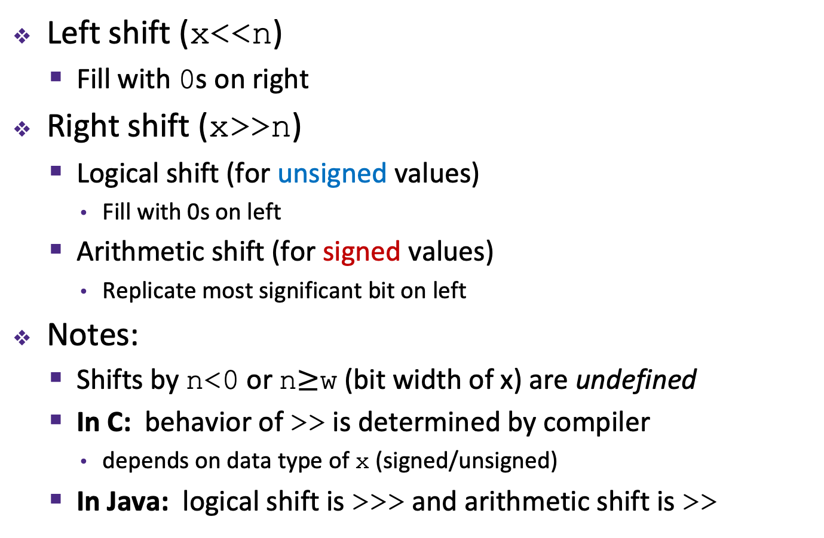
Shift Operations (also watch Lab 3 video)
 | x | 0010 0010
 | x<<3 | 0001 0000
logical: | x>>2 | 0000 1000
arithmetic: | x>>2 | 0000 1000
Left shift (x<<n)
  Fill with 0s on right
Right shift (x>>n)
  Logical shift (for unsigned values)
    Fill with 0s on left
  Arithmetic shift (for signed values)
    Replicate most significant bit on left
Notes:
  Shifts by n<0 or n$≥$w (bit width of x) are undefined
  In C: behavior of >> is determined by compiler
    depends on data type of x (signed/unsigned)
  In Java: logical shift is >>> and arithmetic shift is >>
 | x | 1010 0010
 | x<<3 | 0001 0000
logical: | x>>2 | 0010 1000
arithmetic: | x>>2 | 1110 1000
Notes:
8 bit example
Undefined is BAD, eats your laundry

Slide 70
Extract and Concat
Two numbers: A: 0xC(1101) and B: 0xA (1010)
Question: Extract bits 3 and 2, and concatenate
i.e., 1101 concat 1010 -> 1110 (red: bits of interest, black bits are dropped)
Step 1: Extract bits from each
  1101 & (3<<2) = 1101 & (0b0011 << 2) = 1101 & 1100 = 1100
  1010 & (3<<2) = 1010 & (0b0011 << 2) = 1010 & 1100 = 1000
Step 2: Prepare for concat:
  1100 >> 2 = 0011 (A), 1000 >>2 = 0010 (B)
Step 3: Concat: A.B. Place B in 0th position, Place A in 2nd bit position = 0011 << 2 | 0010 => 1110

Slide 71
C bitfields vs. Packing
struct BitFields {
unsigned int bit1 : 1;
unsigned int bit2 : 1;
unsigned int bit3 : 1;
};
Bitfield packed
packed.bit3 = 1
unsigned int packed = 0;
// Example 1: Setting 3rd bit
// Shift + OR
packed = packed | (1 << 2);
 | Bitfields | Int packing
Space | Compiler chooses | User chooses
Speed | Potentially slower; compiler generates. | Generally faster; user creates.
Readability | Yes; like struct | No; very low level
Use Case | Network packets | Instruction rep

Slide 72
Printing bitfield vs packed
Cast and print
Move and print
Bitfield packed
packed.bit3 = 1
printf(“%u”,
(unsigned int) packed.bit3);
unsigned int packed = 0;
// Example 1: Setting 3rd bit
// Copy down bit3
bit3 = packed & (1 << 2);
// Move it the LSB.
Result = bit3 >> 2;
printf(“%u”,
(unsigned int) result);
https://replit.com/@ashriram/Extract-and-Print#main.c

Slide 73
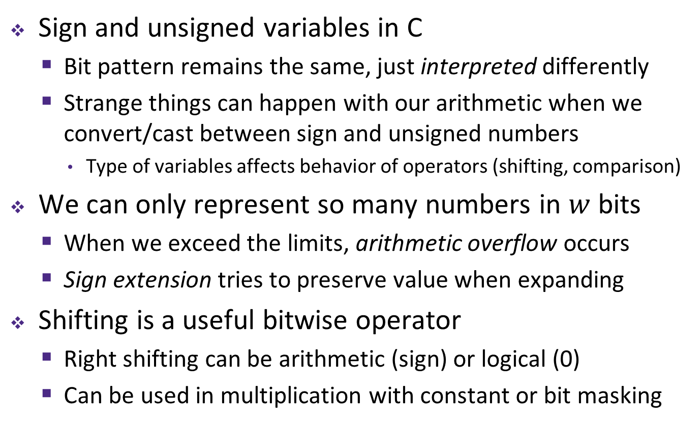
Integers
Sign and unsigned variables in C
  Bit pattern remains the same, just interpreted differently
  Strange things can happen with our arithmetic when we convert/cast between sign and unsigned numbers
    Type of variables affects behavior of operators (shifting, comparison)
We can only represent so many numbers in $w$ bits
  When we exceed the limits, arithmetic overflow occurs
  Sign extension tries to preserve value when expanding
Shifting is a useful bitwise operator
  Right shifting can be arithmetic (sign) or logical (0)
  Can be used in multiplication with constant or bit masking

Slide 74
Sign and Magnitude
MSB is the sign bit, rest of the bits are magnitude
Drawbacks?
15
0
– 7
+ 0
14
1111
0000
1
– 6
1111
0000
+ 1
13
1110
0001
2
– 5
1110
0001
+ 2
1101
0010
1101
0010
12
3
– 4
1100
0011
+ 3
1100
0011
Sign and Magnitude
Unsigned
11
1011
0100
4
– 3
1011
0100
+ 4
1010
0101
1010
0101
10
1001
0110
5
– 2
1001
0110
+ 5
9
1000
0111
6
– 1
1000
0111
+ 6
8
7
– 0
+ 7
Notes:
To help visualize these numbers, we’ll use this number wheel
Binary goes up clockwise
See how we start with +0 – +7 on right side
Then the left side, which starts with 1, are all negative, starting with -0 .. -7

Slide 75


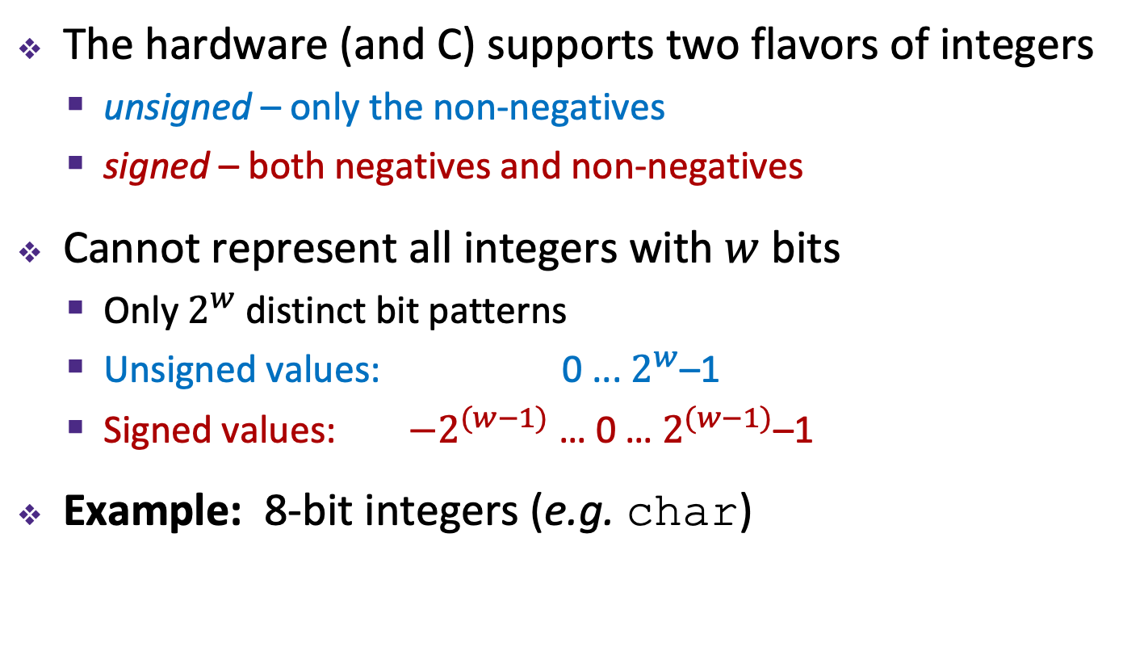








Encoding Integers
The hardware (and C) supports two flavors of integers
  unsigned – only the non-negatives
  signed – both negatives and non-negatives
Cannot represent all integers with $w$ bits
  Only $2^{w}$ distinct bit patterns
  Unsigned values: 0 ... $2^{w}$–1
  Signed values: $−2^{(w−1)}$ … 0 … $2^{(w−1)}$–1
Example: 8-bit integers (e.g. char)
-$∞$
+$∞$
$$−128$$
$$0$$
$$+128$$
$$+256$$
$${−2}^{8−1}$$
$$0$$
$${+2}^{8−1}$$
$$+2^{8}$$
Notes:
Okay, so now let’s talk some more about how we represent numbers, or integers to be specific
Multiple sizes of integers, using different numbers of bytes
But for each size, there are two ways of interpreting the bits…
Same width, just shifted

Slide 76
Sign and Magnitude
MSB is the sign bit, rest of the bits are magnitude
Drawbacks:
  Two representations of 0 (bad for checking equality)
  Arithmetic is cumbersome
    Example: 4-3 != 4+(-3)
    Negatives “increment” in wrong
    direction!
– 7
+ 0
– 6
1111
0000
+ 1
– 5
1110
0001
+ 2
4
- 3
1
0100
- 0011
0001
4
+ -3
-7
0100
+ 1011
1111
1101
0010
– 4
1100
0011
+ 3
Sign and Magnitude
– 3
1011
0100
+ 4
✓
✗
1010
0101
– 2
1001
0110
+ 5
– 1
1000
0111
+ 6
– 0
+ 7
Notes:
Arithmetic is cumbersome
4 – 3 should be 1, as we see on the left
But 4 + -3 should be equivalent, but if we naively add the two together, it doesn’t work
We have to make sure we change all plus-negatives to subtractions
So, how do we solve these problems?
It turns out there’s a really clever other way of interpreting the MSB

Slide 77
Why Two’s Complement is So Great
Roughly same number of (+) and (–) numbers
Positive number encodings match unsigned
Simple arithmetic (x + -y = x – y)
Single zero
All zeros encoding = 0
Simple negation procedure:
  Get negative representation
  of any integer by taking
  bitwise complement and
  then adding one!
  ( ~x + 1 == -x )
– 1
+ 0
– 2
1111
0000
+ 1
– 3
1110
0001
+ 2
1101
0010
– 4
1100
0011
+ 3
Two’s
Complement
– 5
1011
0100
+ 4
1010
0101
– 6
1001
0110
+ 5
– 7
1000
0111
+ 6
– 8
+ 7
Notes:
Memorize this trick. It’s very handy

Slide 78
3 bit
4 bit
000 | 0
001 | 1
010 | 2
011 | 3
100 | -4
101 | -3
110 | -2
111 | -1
0000 | 0
… | …
0100 | 4
…
0111 | 7
1000 | -8
… | …
1111 | -1
Notes:
Memorize this trick. It’s very handy

Slide 79








Sign Extension
Task: Given a $w$-bit signed integer $X$, convert it to $w$+$k$-bit signed integer $X′$ with the same value
Rule: Add $k$ copies of sign bit
  Let $x_{i}$ be the $i$-th digit of $X$ in binary
  $X^{′}=x_{w−1},…,x_{w−1},x_{w−1},x_{w−2},…,x_{1},x_{0}$
$k$ copies of MSB
original $X$
$$w$$
$X$
• • •
• • •
$$Xʹ$$
• • •
• • •
$$k$$
$$w$$
Notes:
General algorithm for any number of bits
Formula is complicated, but visually simple

Slide 80
44444

