Slide 1
YOUR CODE IS YOUR RESPONSIBILITY
DEBUGGING IS PART OF YOUR DUTY
NO PSEUDOCODE/CODE ON PIAZZA
e.g., my while loop does not work etc
https://www.cs.sfu.ca/~ashriram/Courses/CS295//policy.html#assignment-ta-help-policy
https://www.cs.sfu.ca/~ashriram/Courses/CS295//assignments.html#obtaining-help-from-tainstructor

Slide 2


Slide 3
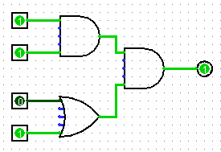
Abstraction
(Levels of Representation/Interpretation)
Python Program
Assembly
square:
addi sp,sp,-16
sw ra,12(sp)
sw s0,8(sp)
addi s0,sp, 16
sw a0,-12(s0)
lw a0,-12(s0)
addi a1,a0,2
mul a0,a1,a0
lw ra,12(sp)
lw s0,8(sp)
addi sp,sp,16
ret
def square(num):
return num * num
C Program
int square(int num):
return num * num
Binary
0x00000317
0x00830067
0xff010113
0x00112623
0x00812423
0x01010413
0xfea42a23
…….
Logic

Slide 4
From Writing to Running
Compiler
Assembler
Linker
executable
program
gcc -S
gcc -c
gcc -o
sum.c
sum.s
sum.o
sum
C source
files
assembly
files
obj files
exists on
disk
loader
“It’s alive!”
When most people say “compile” they mean
the entire process:
compile + assemble + link
Executing
in
Memory
process
Notes:
C compiler produces assembly files (contain RISCV assembly, pseudo-instructions, directives, etc.)
RISCV assembler produces object files (contain RISCV machine code, missing symbols, some layout information, etc.)
RISCV linker produces executable file (contains RISCV machine code, no missing symbols, some layout information)
OS loader gets it into memory and jumps to first instruction (machine code)

Slide 5
Aside: Registers are Inside the Processor
Processor
Memory
Input
Control
Enable?
Read/Write
Program
Datapath
Address
PC
Bytes
Registers
Write Data
Data
Arithmetic & Logic Unit
(ALU)
Read Data
Output
Processor-Memory Interface
I/O-Memory Interfaces

Slide 6
Registers -- Summary
In high-level languages, number of variables limited only by available memory
ISAs have a fixed, small number of operands called registers
  Special locations built directly into hardware
  Benefit: Registers are EXTREMELY FAST
  (faster than 1 billionth of a second)
  Drawback: Operations can only be performed on these predetermined number of registers
Notes:
Registers visible to compiler (or RISCV programmer).

Slide 7
Memory vs. Registers
Addresses vs. Names
  0x7FFFD024C3DC %x0
Big vs. Small
  ~ 8 GiB (16 x 8 B) = 128 B
Slow vs. Fast
  ~50-100 ns sub-nanosecond timescale
Dynamic vs. Static
  Can “grow” as needed fixed number in hardware
  while program runs

Slide 8
RISC V Integer Registers – 32 bits wide
Notes:
Names are largely arbitrary, reasons behind them are not super relevant to us
But there are conventions about how they are used
One is particularly important to not misuse: %sp
Stack pointer; we’ll get to this when we talk about procedures
Each is 4-bytes wide
What if we only want 4 bytes?
We can use these alternate names to use just half of the bytes

Slide 9
RISCV Instructions (1/2)
Instruction Syntax is rigid:
op dst, src1, src2
  1 operator, 3 operands
    op = operation name (“operator”)
    dst = register getting result (“destination”)
    src1 = first register for operation (“source 1”)
    src2 = second register for operation (“source 2”)
Keep hardware simple via regularity

Slide 10



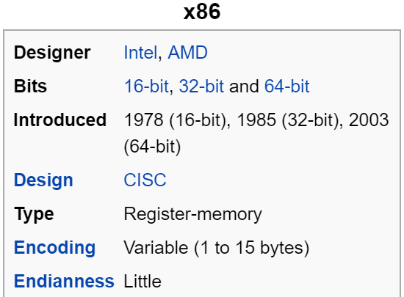
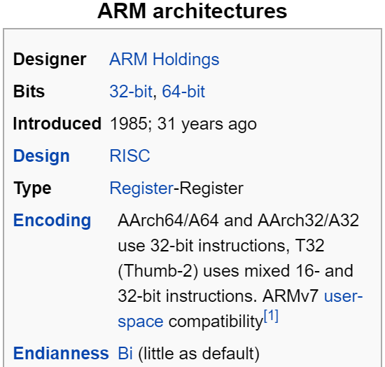
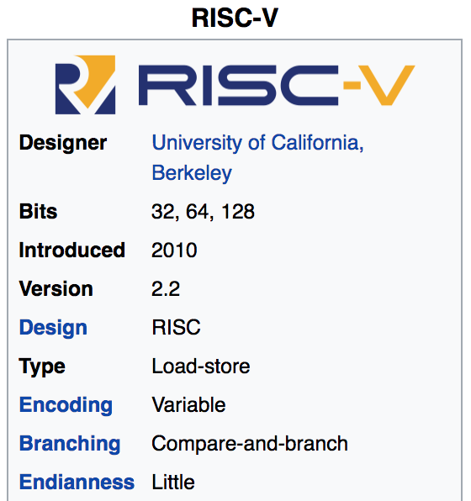
Mainstream ISAs
PCs
(Core i3, i5, i7, M)
x86 Instruction Set
Smartphones, Laptop, Tablet
(iPhone, Macbook, iPad)
ARM Instruction Set
Versatile and open-source
Relatively new, designed for cloud computing, high-end phones, small embedded sys.
RISCV Instruction Set
Notes:
We have many choices as to which assembly language we could pick:
intel x86, which is the machine language used by most of our laptops.
Why don’t we?
SUPER long and complicated
Arm, which is used in our iphone
ARM stands for Advanced RISC Machine

Slide 11
Intel x86 ISA | RISC-V ISA
Complex instructions (~800 instructions) *ptr++; (e.g., string operations, REP MOVS, etc.)- inc DWORD PTR [EAX] | Small set (~48 instructions) lw t0, 0(a0) # Read memory addi t0, t0, 1 # Increment sw t0, 0(a0) #
Multiple addressing modes (e.g., base + displacement + scaled index)- Can combine memory operands with arithmetic (e.g., ADD | Fewer addressing modes. Separates pointer access from operations on the value.
Variable length (1 to 15 bytes)- Complex encodings | Mostly fixed length (32 bits in the base ISA, with optional 16-bit compressed)

Slide 12
RISCV Instructions (1/2)
Instruction Syntax is rigid:
op dst, src1, src2
  1 operator, 3 operands
    op = operation name (“operator”)
    dst = register getting result (“destination”)
    src1 = first register for operation (“source 1”)
    src2 = second register for operation (“source 2”)
Keep hardware simple via regularity

Slide 13
RISCV Instructions Example
Your very first instructions!
(assume here that the variables a, b, and c are assigned to registers s1, s2, and s3, respectively)
Integer Addition (add)
  C: a = b + c
  RISCV: add s1, s2, s3
Integer Subtraction (sub)
  C: a = b - c
  RISCV: sub s1, s2, s3

Slide 14
C example 1
Suppose a → s0,b → s1,c → s2,d → s3 and e → s4. Convert the following C statement to RISCV:
a = (b + c) - (d + e);
add t1, s3, s4
add t2, s1, s2
sub s0, t2, t1
Ordering of instructions matters (must follow order of operations)
Utilize temporary registers
Notes:
add s0, s1, s2
add t0, s3, s4
sub s0, s0, t0
Suppose a -> s0, b->s1, c-> s2, d->s3 and e->s4. Convert the following C statement to RISCV:
a = (b + c) - (d + e);
add t1, s3, s4
add t2, s1, s2
sub s0, t2, t1

Slide 15
Three Basic Kinds of Instructions
Transfer data between memory and register
  Load data from memory into register
    %reg = Mem[address]
  Store register data into memory
    Mem[address] = %reg
Perform arithmetic operation on register or memory data
  c = a + b; z = x << y; i = h & g;
Control flow: what instruction to execute next
  Unconditional jumps to/from procedures
  Conditional branches
    Remember: Memory is indexed just like an array of bytes!

Slide 16
Addition and Subtraction of Integers (3/4)
How to do the following C statement?
a = b + c + d - e;
Break into multiple instructions
  add x10, x1, x2 # a_temp = b + c
  add x10, x10, x3 # a_temp = a_temp + d
  sub x10, x10, x4 # a = a_temp - e
Notice: A single line of C may break up into several lines of RISC-V.
Notice: Everything after the hash mark on each line is ignored (comments). Check Apollo-11 comments!

Slide 17
Addition and Subtraction of Integers (4/4)
How do we do this?
  f = (g + h) - (i + j);
Use intermediate temporary register
  add x5, x20, x21 # a_temp = g + h
  add x6, x22, x23 # b_temp = i + j
  sub x19, x5, x6 # f = (g + h)- (i + j)

Slide 18
C example 2
Suppose a → s0,e → s4. Convert the following C statement to RISCV:
e = (a + 10);
addi s4, s0, 10
Since second operand is a literal value, no need to use separate register.
Notes:
add s0, s1, s2
add t0, s3, s4
sub s0, s0, t0
Suppose a -> s0, b->s1, c-> s2, d->s3 and e->s4. Convert the following C statement to RISCV:
a = (b + c) - (d + e);
add t1, s3, s4
add t2, s1, s2
sub s0, t2, t1

Slide 19
Immediates
Numerical constants are called immediates
Separate instruction syntax for immediates:
opi dst, src, imm
  Operation names end with ‘i’, replace 2nd source register with an immediate
Example Uses:
  addi s1, s2, 5 # a=b+5
  addi s3, s3, 1 # c++
Why no subi instruction?
Notes:
Goal of RISC is to minimize instruction set. subi dst, src, imm = addi dst, src, -imm.

Slide 20
Data Transfer:
Load from and Store to memory
Processor
Memory
Input
Enable?
Read/Write
Control
Program
Datapath
Address
Bytes
Much larger place
To hold values, but slower than registers!
PC
Write Data = Store to memory
Registers
Arithmetic & Logic Unit
(ALU)
Data
Read Data = Load from
memory
Output
Fast but limited place
To hold values
Processor-Memory Interface
I/O-Memory Interfaces

Slide 21
Speed of Registers vs. Memory
Given that
  Registers: 32 words (128 Bytes)
  Memory (DRAM): Billions of bytes (2 GB to 64 GB on laptop)
and physics dictates…
  Smaller is faster
How much faster are registers than DRAM??
  About 100-500 times faster! (in terms of latency of one access)

Slide 22
C Example 3: Load Memory to Register
C code
int A[100];
g = h + A[3];
Using Load Word (lw) in RISC-V:
lw x10,12(x15) # Reg x10 gets A[3]
add x11,x12,x10 # g = h + A[3]
Note: x15 – base register (pointer to A[0])
12 – offset in bytes
Offset must be a constant known at assembly time
Data flow

Slide 23
C Example 4: Store Register to Memory
C code
int A[100];
A[10] = h + A[3];
Using Store Word (sw) in RISC-V:
lw x10,12(x15) # Temp reg x10 gets A[3]
add x10,x12,x10 # Temp reg x10 gets h + A[3]
sw x10,40(x15) # A[10] = h + A[3]
Note: x15 – base register (pointer)
12,40 – offsets in bytes
x15+12 and x15+40 must be multiples of 4
Data flow
Notes:
80 – 5 (Clicker) – 3 (News/Administrativia) = 72 (36 slides max)
Clicker at 20 (half+)

Slide 24
Loading and Storing Bytes
In addition to word data transfers
(lw, sw), RISC-V has byte data transfers:
  load byte: lb
  store byte: sb
Same format as lw, sw
E.g., lb x10,3(x11)
  contents of memory location with address = sum of “3” + contents of register x11 is copied to the low byte position of register x10.
xxxx xxxx xxxx xxxx xxxx xxxx
zzz zzzz
x10:
x
byte
loaded
…is copied to “sign-extend”
This bit
RISC-V also has “unsigned byte” loads (lbu) which zero extends to fill register. Why no unsigned store byte sbu?

Slide 25
RISCV Agenda
Basic Arithmetic Instructions
Comments
x0 (zero)
Immediates
Data Transfer Instructions
Decision Making Instructions
Bonus: C to RISCV Practice
Bonus: Additional Instructions

Slide 26
C Loop Mapped to RISC-V Assembly
int A[20];
int sum = 0;
for (int i=0; i < 20; i++)
sum += A[i];
=>
Start:
If (i>=20) goto end;
i++
Sum = sum + A[i]
goto start;
End:
while(); // Infinite Loop

Slide 27
C Loop Mapped to RISC-V Assembly
int A[20];
int sum = 0;
for (int i=0; i < 20; i++)
sum += A[i];
while(); // Infinite Loop
Loop:
j Loop
Done:

Slide 28
C Loop Mapped to RISC-V Assembly
int A[20];
int sum = 0;
for (int i=0; i < 20; i++)
int A[20];
int sum = 0;
int i = 0;
while(i<20) {
i++
}
add s1, s0, x0 # s1=&A[0]
add a0, x0, x0 # sum=0
add a1, x0, x0 # i=0
addi a3,x0, 20 # a3=20
Loop:
bge a1,a3,Done
addi a1,a1, 1
j Loop
Done:

Slide 29
C Loop Mapped to RISC-V Assembly
int A[20];
int sum = 0;
for (int i=0; i < 20; i++)
sum += A[i];
add s1, s0, x0 # a1=&A[0]
add a0, x0, x0 # sum=0
add a1, x0, x0 # i=0
addi a3,x0, 20 # a3=20
Loop:
bge a1,a3,Done
lw a2, 0(s1) # a2=A[i]
add a0, a0, a2 # sum+=
addi s1, s1,4 # &A[i+1]
addi a1, a1, 1 # i++
j Loop
Done:
int A[20];
int sum = 0;
ptr = &A[0]
while (i<20) {
sum += *ptr;
ptr++;
i++;
}

Slide 30
Decision Making Instructions
Branch If Equal (beq)
  beq reg1,reg2,label
  If value in reg1 = value in reg2, go to label
Branch If Not Equal (bne)
  bne reg1,reg2,label
  If value in reg1 ≠ value in reg2, go to label
Jump (j)
  j label
  Unconditional jump to label

Slide 31
C Example 5: If Else
C Code:
RISCV (beq):
if(i==j) {
a = b /* then */
} else {
a = -b /* else */
}
In English:
If TRUE, execute the THEN block
If FALSE, execute the ELSE block
# i→s0, j→s1
# a→s2, b→s3
beq s0,s1,then
else:
sub s2, x0, s3
j end
then:
add s2, s3, x0
end:
???
???
This label unnecessary

Slide 32
Breaking Down the If Else
C Code:
RISCV (bne):
if(i==j) {
a = b /* then */
} else {
a = -b /* else */
}
In English:
If TRUE, execute the THEN block
If FALSE, execute the ELSE block
# i→s0, j→s1
# a→s2, b→s3
bne s0,s1,else
then:
add s2, s3, x0
j end
else:
sub s2, x0, s3
end:
???
???

Slide 33
Branching on Conditions other than (Not) Equal
Set Less Than (slt)
  slt dst, reg1,reg2
  If value in reg1 < value in reg2, dst = 1, else 0
Set Less Than Immediate (slti)
  slti dst, reg1,imm
  If value in reg1 < imm, dst = 1, else 0

Slide 34
Breaking Down the If Else
C Code:
RISCV (???):
if(i<j) {
a = b /* then */
} else {
a = -b /* else */
}
In English:
If TRUE, execute the THEN block
If FALSE, execute the ELSE block
# i→s0, j→s1
# a→s2, b→s3
slt t0 s0 s1
beq t0,x0,else
then:
add s2, s3, x0
j end
else:
sub s2, x0, s3
end:
???
???

Slide 35
C Loop Mapped to RISC-V Assembly
int A[20];
int sum = 0;
for (int i=0; i < 20; i++)
sum += A[i];
add s1, s0, x0 # a1=&A[0]
add a0, x0, x0 # sum=0
add a1, x0, x0 # i=0
addi a3,x0, 20 # a3=20
Loop:
bge a1,a3,Done
slli t0,a1,2 # i*4
addi t0,s1,t0 # &A[0]+i*4
lw a2, 0(t0) # a2=A[i]
add a0, a0, a2 # sum+=
addi a1, a1, 1 # i++
j Loop
Done:
int A[20];
int sum = 0;
ptr = &A[0]
for (int i=0; i < 20; i++) {
int tmp = i*4
sum += *(ptr+tmp);
}

Slide 36
Other Common Assembly Patterns
1D Array access without optimization
la t0, array # Load base address of array into t0
li t1, 5 # Number of elements in the array
li t2, 0 # i = 0
loop:
bge t2, t1, end # If i >= number of elements, exit loop
slli t3, t2, 2 # Calculate offset (index * 4, assuming 4-byte elements)
add t3, t0, t3 # Calculate address of array[index]
lw t5, 0(t3) # Load array[index] into t6
addi t2, t2, 1 # i++
j loop
end:

Slide 37
Other Common Assembly Patterns
For a 2D array with rows and cols, the address of array[i][j] is calculated as:
Address = base_address + (i*#col+j)*sizeof(type)
t0= &array, t1 = # of cols t2=i, t3=j . X = a[i][j]
mul t5, t2, t1 # Row offset (row * cols)
add t5, t5, t3 # Add column index
slli t5, t5, 2 # Multiply by sizeof(type). Assume int here.
add t6, t0, t5 # Base_address + absolute offset.
lw t7, 0(t6) # Load array[row][col] into t7

Slide 38
C to RISCV Practice
Let’s put our all of our new RISCV knowledge to use in an example: “Fast String Copy”
C code is as follows:
/* Copy string from p to q */
char *p, *q;
while((*q++ = *p++) != ‘\0’) ;
What do we know about its structure?
  Single while loop
  Exit condition is an equality test

Slide 39
C to RISCV Practice
Start with code skeleton:
# copy String p to q
# p→s0, q→s1 (pointers)
Loop: lb $t0,0($s0) # $t0 = *p
sb $t0,0($s1) # *q = $t0
addi $s0,$s0,1 # p = p + 1
addi $s1,$s1,1 # q = q + 1
beq $t0,$0,Exit # if *p==0, go to Exit
j Loop # go to Loop
Exit: # N chars in p => N*6 instructions
# t0 = *p
# *q = t0
# p = p + 1
# q = q + 1
# if *p==0, go to Exit
# go to Loop

Slide 40
C to RISCV Practice
Fill in lines:
# copy String p to q
# p→s0, q→s1 (pointers)
Loop: lb $t0,0($s0) # t0 = *p
sb $t0,0($s1) # *q = t0
addi $s0,$s0,1 # p = p + 1
addi $s1,$s1,1 # q = q + 1
beq $t0,$0,Exit # if *p==0, go to Exit
j Loop # go to Loop
Exit: # N chars in p => N*6 instructions
lb t0,0(s0)
sb t0,0(s1)
addi s0,s0,1
addi s1,s1,1
beq t0,0,Exit

Slide 41
C to RISCV Practice
Finished code:
# copy String p to q
# p→$s0, q→$s1 (pointers)
Loop: lb t0,0(s0) # t0 = *p
sb t0,0(s1) # *q = t0
addi s0,s0,1 # p = p + 1
addi s1,s1,1 # q = q + 1
beq t0,x0,Exit # if *p==0, go to Exit
j Loop # go to Loop
Exit: # N chars in p => N*6 instructions
Notes:
Is this the only way to write out this function? Of course not.

Slide 42
C to RISCV Practice
Alternate code using bne:
# copy String p to q
# p→s0, q→s1 (pointers)
Loop: lb t0,0(s0) # t0 = *p
sb t0,0(s1) # *q = t0
addi s0,s0,1 # p = p + 1
addi s1,s1,1 # q = q + 1
bne t0,x0,Loop # if *p!=0, go to Loop
# N chars in p => N*5 instructions
Notes:
Used fewer instructions!
Instead of “exit when equal to zero”, we are now using “loop when not equal to zero.”

Slide 43
45499

