Slide 1






Roadmap
C:
Java:
Memory & data
Arrays & structs
Integers & floats
RISC V assembly
Procedures & stacks
Executables
Memory & caches
Processor Pipeline
Performance
Parallelism
car *c = malloc(sizeof(car));
c->miles = 100;
c->gals = 17;
float mpg = get_mpg(c);
free(c);
Car c = new Car();
c.setMiles(100);
c.setGals(17);
float mpg =
c.getMPG();
Assembly language:
OS:
Machine code:
0111010000011000
100011010000010000000010
1000100111000010
110000011111101000011111
Computer system:

Slide 2

Agenda
Stored-Program Concept
R-Format
I-Format
S-Format
SB-Format
U-Format
UJ-Format

Slide 3
*Layout in 295
On actual hw code starts at
0x00400000
0xfffffffc
system reserved
top
0x80000000
0x7ffffffc
stack
dynamic data (heap)
0x10000000
static data
.data
code (text)
.text
0x00000000

Slide 4
Assembler demo

Slide 5
Big Idea: Stored-Program Concept
INSTRUCTIONS ARE DATA
programs can be stored in memory as numbers
Before: a number can mean anything
Now: make convention for interpreting numbers as instructions

Slide 6
Instructions as Numbers
By convention, RISCV instructions are each
1 word = 4 bytes = 32 bits
31
0
Divide the 32 bits of an instruction into “fields”
  regular field sizes → simpler hardware
  will need some variation….
Notes:
6 formats to memorize, but 4 formats to internalize (R with three registers, I with two registers and an immediate, S with two registers and an address, U with a big immediate/address)

Slide 7
So how do we represent instructions?
  Remember: Computer only understands 1s and 0s, so assembler string “add x10,x11,x0” is meaningless to hardware

Slide 8
The 6 Instruction Formats
R-Format: instructions using 3 register inputs
  add, xor, mul —arithmetic/logical ops
I-Format: instructions with immediates, loads
  addi, lw, jalr, slli
S-Format: store instructions: sw,sb
SB-Format: branch instructions: beq, bge
U-Format: instructions with upper immediates
  lui, auipc —upper immediate is 20-bits
UJ-Format: the jump instruction: jal
Notes:
lui: load upper immediate
auipc: adding an upper immediate to PC and putting the result in a register

Slide 9
R-Format Assembler Example
add t0,t1,t2 => add x5,x6,x7
  Field representation (decimal):
  Field representation (binary):
31
0
0
7
6
0
5
0x33
31
0
0000000
00111
00110
000
00101
0110011
_{two}
  hex representation: 0x 0073 02B3
  Called a Machine Language Instruction
Notes:
x5 = t0, x6 = t1, x7 = t2

Slide 10
Processor/Emulator Interprets Machine Ins
  0x007302B3
R-Type
00000000011100110000001010110011
31
0
f7
rs2
rs1
func3
rd
opcode
31
0
0000000
00111
00110
000
00101
0110011
31
0
0
7
6
0
5
0x33
Rd = x5, rs1 = x6 rs2 = x7. f3 = 0 and f7 = 0, opcode = 0x33 => so add x5 = x6 + x7

Slide 11
I-Format Instructions (3/4)
31
0
imm[11:0]
rs1
func3
rd
opcode
opcode (7): uniquely specifies the instruction
rs1 (5): specifies a register operand
rd (5): specifies destination register that receives result of computation

Slide 12
I-Format Instructions (4/4)
31
0
imm[11:0]
rs1
func3
rd
opcode
immediate (12): 12 bit number
  All computations done in words, so 12-bit immediate must be extended to 32 bits
  always sign-extended to 32-bits before use in an arithmetic operation
Can represent 2¹² different immediates
  imm[11:0] can hold values in range [-2¹¹ , +2¹¹)

Slide 13
I-Format Example (1/2)
  addi x15,x1,-50
rd = x15
rs1 = x1
31
0
00001
???
???
01111
111111001110
?
0
???
???
0x13
imm[11:0]
rs1
func3
rd
opcode

Slide 14
Processor/Emulator Interprets Machine Ins
  0x3F382793
I-Type
111111001110000010011110010011
imm[11:0]
rs1
func3
rd
opcode
111111001110
00001
0
01111
0x13
???
Imm: 111111001110 (12 bit 2s comp.)
Sign extend it before the math
To write decimal: -ve (~Imm+1)

Slide 15
Load Instructions are also I-Type
31
0
imm[11:0]
rs1
func3
rd
opcode
offset[11:0]
base
width
dst
LOAD
The 12-bit signed immediate is added to the base address in register rs1 to form the memory address
  This is very similar to the add-immediate operation but used to create address, not to create final result
Value loaded from memory is stored in rd

Slide 16
S-Format Used for Stores
Store needs to read two registers, rs1 for base memory address, and rs2 for data to be stored, as well as need immediate offset!
Can’t have both rs2 and immediate in same place as other instructions!
Note: stores don’t write a value to the register file, no rd!
RISC-V design decision is move low 5 bits of immediate to where rd field was in other instructions – keep rs1/rs2 fields in same place
register names more critical than immediate bits in hardware design
31
0
imm[11:5]
rs2
rs1
func3
imm[4:0]
opcode

Slide 17
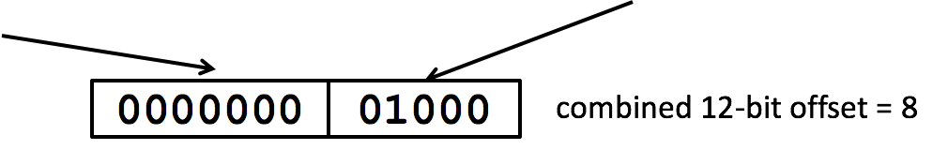
S-Format Example
sw x14, 8(x2)
31
0
imm[11:5]
rs2
rs1
func3
imm[4:0]
opcode
00000000
01110
00010
010
01000
0100011
off[11:5] = 0
rs2=14
rs1=2
SW
off[4:0] = 8
STORE

Slide 18
RISC-V B-Format for Branches
B-format is mostly same as S-Format, with two register sources (rs1/rs2) and a 12-bit immediate
But now immediate represents values -2¹² to +2¹²-2 in 2-byte increments
The 12 immediate bits encode even 13-bit signed byte offsets (lowest bit of offset is always zero, so no need to store it)
31
0
imm[12|10:5]
rs2
rs1
func3
imm[4:1|11]
opcode
7
5
5
3
5
7

Slide 19
Branch Example (1/2)
RISCV Code:
  Loop: beq x19,x10,End
  add x18,x18,x10
  addi x19,x19,-1
  j Loop
  End: <target instr>
Branch offset =
(Branch with offset of 0, branches to itself)
Start counting from instruction AFTER the branch
1
2
3
4
4×32-bit instructions = 16 bytes

Slide 20
Branch Example (1/2)
RISCV Code:
  Loop: beq x19,x10,End
  add x18,x18,x10
  addi x19,x19,-1
  j Loop
  End: <target instr>
Start counting from branch
1
2
3
4
7
5
5
3
5
7
31
0
???????
01010
10011
000
?????
1100011
rs2=10
rs1=19
BEQ
BRANCH

Slide 21
Branch Example (1/2)
  beq x19,x10,offset = 16 bytes
  13-bit immediate, imm[12:0], with value 16
  0000000010000
imm[0] discarded, always zero
31
0
0 000000
01010
10011
000
1000 0
1100011
imm[12|10:5]
imm[4:1|11]

Slide 22
U-Format for “Upper Immediate” instructions
31
0
imm[31:12]
rd
opcode
20
U-immediate[31:12]
5
dest
7
LUI/AUIPC
Has 20-bit immediate in upper 20 bits of 32-bit instruction word
One destination register, rd
Used for two instructions
  LUI – Load Upper Immediate
  AUIPC – Add Upper Immediate to PC

Slide 23
LUI to create long immediates
lui writes the upper 20 bits of the destination with the immediate value, and clears the lower 12 bits
Together with an addi to set low 12 bits, can create any 32-bit value in a register using two instructions (lui/addi).
lui x10, 0x87654 # x10 = 0x87654000
addi x10, x10, 0x321 # x10 = 0x87654321

Slide 24
jalr
31
0
imm[11:0]
rs1
func3
rd
opcode
offset
base
0
dest
JALR
# ret and jr psuedo-instructions
ret = jr ra = jalr x0, ra, 0
# Call function at any 32-bit absolute address
lui x1, <hi 20 bits>
jalr ra, x1, <lo 12 bits>
# Jump PC-relative with 32-bit offset
auipc x1, <hi 20 bits>
jalr x0, x1, <lo 12 bits>

Slide 25
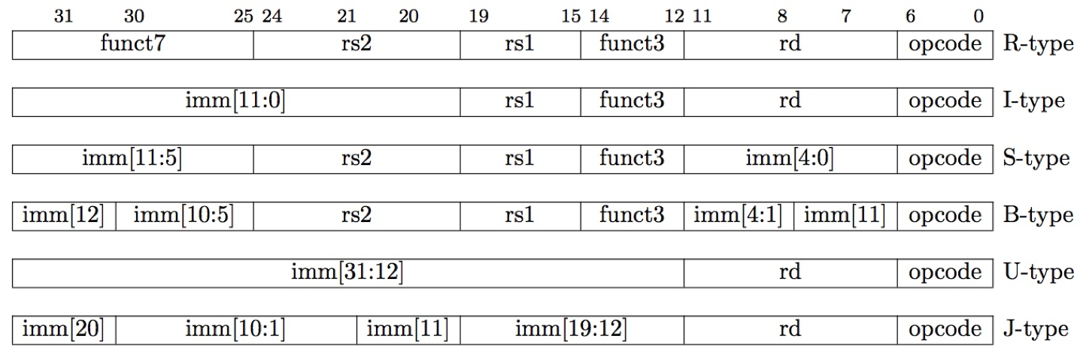
Summary of RISC-V Instruction Formats

Slide 26
Agenda
Function calls and Jumps
Call Stack
Register Convention
Program memory layout

Slide 27
Calling Convention for Procedure Calls
Transfer Control
  Caller → Routine
  Routine → Caller
Pass Arguments to and from the routine
  fixed length, variable length, recursively
  Get return value back to the caller
Manage Registers
  Allow each routine to use registers
  Prevent routines from clobbering each others’ data

Slide 28
Six Steps of Calling a Function
Put arguments in a place where the function can access them
Transfer control to the function
The function will acquire any (local) storage resources it needs
The function performs its desired task
The function puts return value in an accessible place and “cleans up”
Control is returned to you

Slide 29
Jumps are not enough
1
main:
j myfn
after1:
add x1,x2,x3
myfn:
…
…
j after1
2
Jumps to the callee
Jumps back
Notes:
Jumps and branches can transfer control to the callee (called procedure)
Jumps and branches can transfer control back

Slide 30
Jumps are not enough
1
main:
j myfn
after1:
add x1,x2,x3
j myfn
after2:
sub x3,x4,x5
myfn:
…
…
3
2
j after2
j after1
4
??? Change target
on the fly ???
Jumps to the callee
Jumps back
What about multiple sites?
Notes:
Jumps and branches can transfer control to the callee (called procedure)
Jumps and branches can transfer control back

Slide 31
Takeaway 1: Need Jump And Link
JAL (Jump And Link) instruction moves a new value into the PC, and simultaneously saves the old value in register x1 (aka $ra or return address)
Thus, can get back from the subroutine to the instruction immediately following the jump by transferring control back to PC in register x1

Slide 32
Jump-and-Link / Jump Register
First call
x1
after1
1
main:
jal myfn
after1:
add x1,x2,x3
jal myfn
after2:
sub x3,x4,x5
myfn:
…
…
jr x1
2
JAL saves the PC in register $31
Subroutine returns by jumping to $31

Slide 33
Jump-and-Link / Jump Register
Second call
x1
after2
after1
1
main:
jal myfn
after1:
add x1,x2,x3
jal myfn
after2:
sub x3,x4,x5
myfn:
…
…
jr x1
3
2
4
JAL saves the PC in register x1
Subroutine returns by jumping to x1
What happens for recursive invocations?

Slide 34
JAL / JR for Recursion?
int main (int argc, char* argv[ ]) {
int n = 9;
int result = myfn(n);
}
int myfn(int n) {
if(n > 0) {
return n * myfn(n - 1);
} else {
return 1;
}
}

Slide 35
JAL / JR for Recursion?
First call
x1
after1
1
main:
jal myfn
after1:
add x1,x2,x3
myfn:
if (test)
jal myfn
after2:
jr x1
Problems with recursion:
overwrites contents of x1

Slide 36
JAL / JR for Recursion?
Recursive Call
x1
after2
after1
1
2
main:
jal myfn
after1:
add x1,x2,x3
myfn:
if (test)
jal myfn
after2:
jr x1
Problems with recursion:
overwrites contents of x1

Slide 37
JAL / JR for Recursion?
Return from Recursive Call
x1
after2
1
2
main:
jal myfn
after1:
add x1,x2,x3
myfn:
if (test)
jal myfn
after2:
jr x1
3
Problems with recursion:
overwrites contents of x1

Slide 38
JAL / JR for Recursion?
Return from Original Call???
x1
after2
1
2
main:
jal myfn
after1:
add x1,x2,x3
myfn:
if (test)
jal myfn
after2:
jr x1
3
4
Stuck!
Problems with recursion:
overwrites contents of x1

Slide 39
JAL / JR for Recursion?
Return from Original Call???
x1
after2
1
2
main:
jal myfn
after1:
add x1,x2,x3
myfn:
if (test)
jal myfn
after2:
jr x1
3
4
Stuck!
Problems with recursion:
overwrites contents of x1
Need a way to save and restore register contents

Slide 40
Agenda
Function calls and Jumps
Call Stack
Register Convention
Program memory layout

Slide 41
Takeaway2: Need a Call Stack
JAL (Jump And Link) instruction moves a new value into the PC, and simultaneously saves the old value in register x1 (aka ra or return address) Thus, can get back from the subroutine to the instruction immediately following the jump by transferring control back to PC in register x1
Need a Call Stack to return to correct calling procedure. To maintain a stack, need to store an activation record (aka a “stack frame”) in memory. Stacks keep track of the correct return address by storing the contents of x1 in memory (the stack).

Slide 42
Need a “Call Stack”
Call stack
  contains activation records (aka stack frames)
Each activation record contains
  the return address for that invocation
  the local variables for that procedure
A stack pointer (sp) keeps track of the top of the stack
  dedicated register (x2) on the RISC-V
Manipulated by push/pop operations
  push: move sp down, store
  pop: load, move sp up

Slide 43
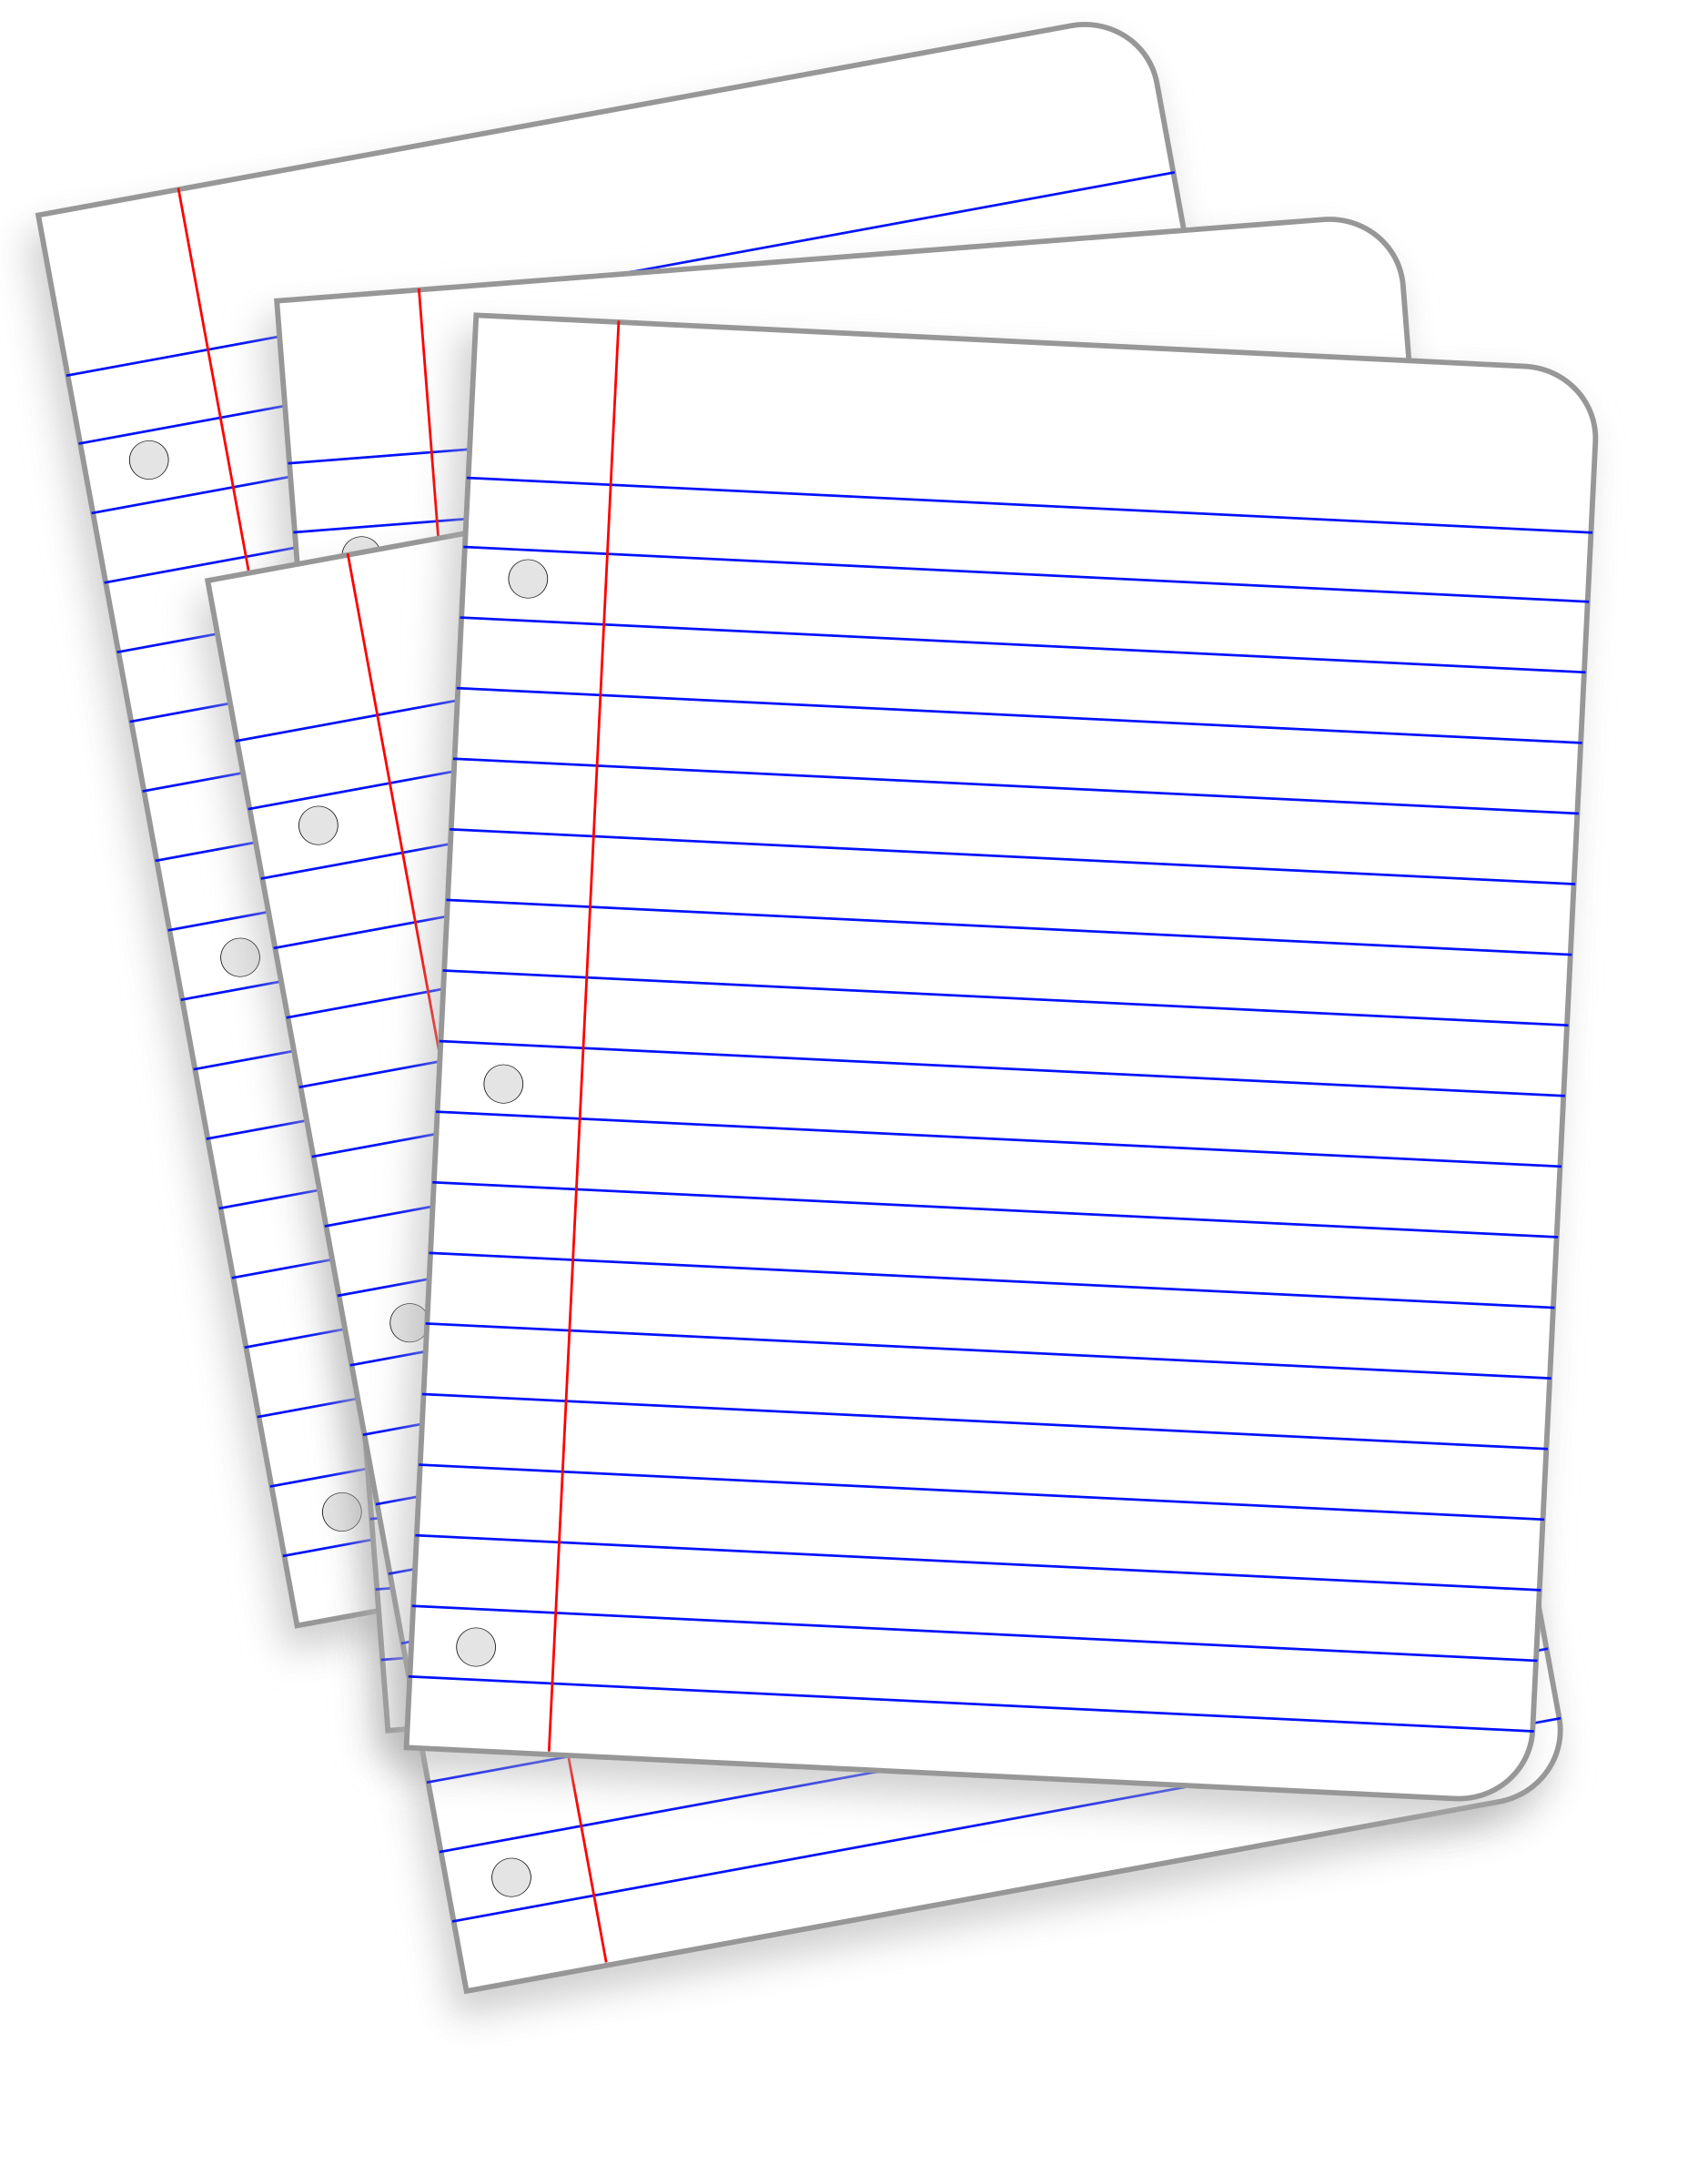
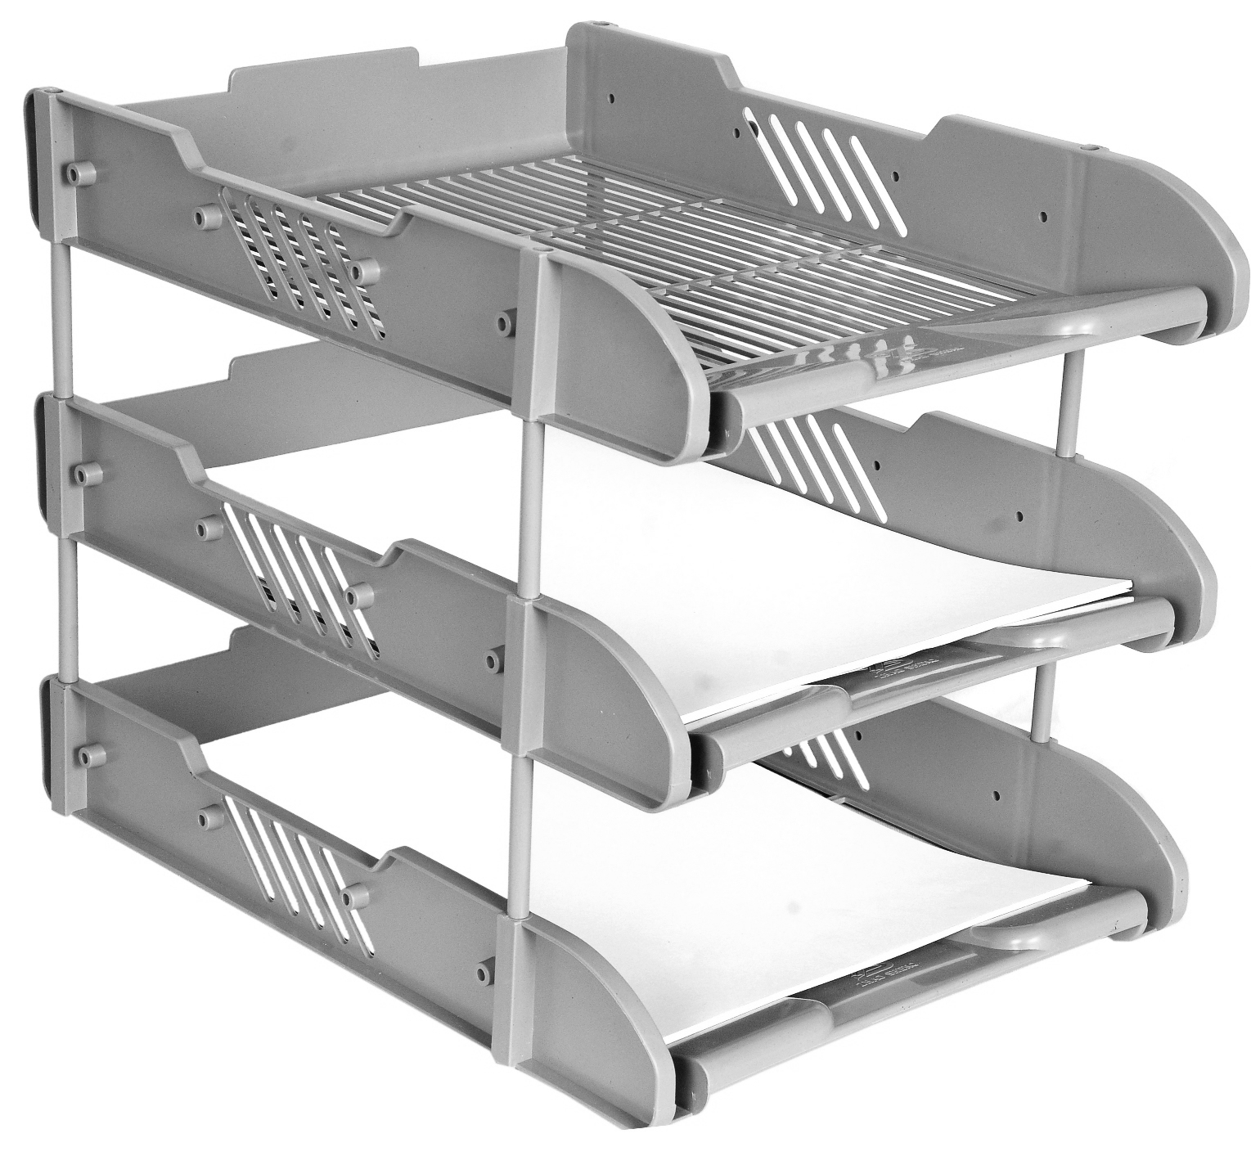

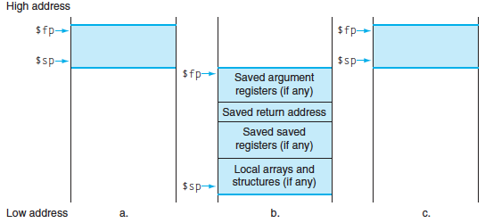

Stack Before, During, After Call
ra
Notes:
Exact ordering of saved registers is up to you (make sure you keep track, though!).
(actually don’t need to save argument registers)

Slide 44
Local Variables and Arrays
Any local variables the compiler cannot assign to registers will be allocated as part of the stack frame (Recall: spilling to memory)
Locally declared arrays and structs are also allocated as part of the stack frame
Stack manipulation is same as before
  Move sp down an extra amount and use the space it created as storage

Slide 45
Function Call Example
int Leaf(int g, int h, int i, int j) {
int f;
f = (g + h) – (i + j);
return f;
}
Parameter variables g, h, i, and j in argument registers a0, a1, a2, and a3, and f in s0
Assume need one temporary register s1

Slide 46
RISC-V Code for Leaf()
Leaf: addi sp,sp,-8 # adjust stack for 2 items
sw s1, 4(sp) # save s1 for use afterwards
sw s0, 0(sp) # save s0 for use afterwards
add s0,a0,a1 # f = g + h
add s1,a2,a3 # s1 = i + j
sub a0,s0,s1 # return value (g + h) – (i + j)
lw s0, 0(sp) # restore register s0 for caller
lw s1, 4(sp) # restore register s1 for caller
addi sp,sp,8 # adjust stack to delete 2 items
jr ra # jump back to calling routine

Slide 47
Stack Before, During, After Function
Need to save old values of s0 and s1
sp
sp
Saved s1
Saved s1
sp
Saved s0
Saved s0
Before call
During call
After call

Slide 48
Agenda
Function calls and Jumps
Call Stack
Register Convention
Program memory layout

Slide 49
Register Conventions
CalleR: the calling function
CalleE: the function being called
When callee returns from executing, the caller needs to know which registers may have changed and which are guaranteed to be unchanged.
Register Conventions: A set of generally accepted rules as to which registers will be unchanged after a procedure call (jal) and which may be changed.

Slide 50
Basic Structure of a Function
func_label:
addi sp,sp, -framesize
sw ra, <framesize-4>(sp)
save other regs if need be
restore other regs if need be
lw ra, <framesize-4>(sp)
addi sp,sp, framesize
jr ra
Prologue
$ra
Body (call other functions…)
...
...
Epilogue
ra
$ra
stack
Notes:
Substitute the proper immediate for <framesize-4>.
Can order registers on stack however you want to, but must make sure to restore them properly.

Slide 51
Using Stack to Backup Registers
Limited number of registers for everyone to use (limited desk space)
All functions use the same conventions -- look for arguments/return addresses in the same places
  What happens if a function calls another function?
  (ra would get overwritten!)
To reduce expensive loads and stores from spilling and restoring registers, RISC-V function-calling convention divides registers into two categories:

Slide 53


Saved Registers
These registers are expected to be the same before and after a function call
  If calleE uses them, it must restore values before returning
  This means save the old values, use the registers, then reload the old values back into the registers
s0-s11 (saved registers)
sp (stack pointer)
  If not in same place, the caller won’t be able to properly restore values from the stack
ra (return address)
ra

Slide 54

Volatile Registers
These registers can be freely changed by the calleE
  If calleR needs them, it must save those values before making a procedure call
t0-t6 (temporary registers)
a0-a7 (return address and arguments)
  These will change if calleE invokes another function (nested function means calleE is also a calleR)
$t
a

Slide 55
Example: sumSquare
int sumSquare(int x, int y) {
return mult(x,x)+ y; }
What do we need to save?
  Call to mult will overwrite ra, so save it
  Reusing a1 to pass 2nd argument to mult, but need current value (y) later, so save a1
To save something to the Stack, move sp down the required amount and fill the “created” space
Notes:
In general, you would also want to save $a0 to the Stack, in case the function you call calls another function can overwrites $a0.

Slide 56
Example: sumSquare
  int sumSquare(int x, int y) {
  return mult(x,x)+ y; }
sumSquare:
addi sp,sp,-8 # make space on stack
sw ra, 4(sp) # save ret addr
sw a1, 0(sp) # save y
add a1,a0,x0 # set 2nd mult arg
jal mult # call mult
lw a1, 0(sp) # restore y
add a0,a0,a1 # ret val = mult(x,x)+y
lw ra, 4(sp) # get ret addr
addi sp,sp,8 # restore stack
jr ra
mult: ...
“push”
“pop”

Slide 57
Choosing Your Registers
Minimize register footprint
  Optimize to reduce number of registers you need to save by choosing which registers to use in a function
  Only save when you absolutely have to
Function does NOT call another function
  Use only t0-t6 and there is nothing to save!
Function calls other function(s)
  Values you need throughout go in s0-s11, others go in t0-t6
  At each function call, check number arguments and return values for whether you or not you need to save
Notes:
Recall: memory is MUCH slower than registers.
The more you know about the internals of the other functions you call, the more you can get away with (e.g. using temporary registers that you know the other functions don’t use, so you don’t bother saving them across function calls).

Slide 58
Pros of Argument Passing Convention
Consistent way of passing arguments to and from subroutines
Creates single location for all arguments
  Caller makes room for a0-a7 on stack
  Callee must copy values from a0-a7 to stack
  → callee may treat all args as an array in memory
  Particularly helpful for functions w/ variable length inputs: printf(“Scores: %d %d %d\n”, 1, 2, 3);
Aside: not a bad place to store inputs if callee needs to call a function (your input cannot stay in $a0 if you need to call another function!)

Slide 59
Agenda
Function calls and Jumps
Call Stack
Register Convention
Program memory layout

Slide 60
Stack contains stack frames (aka “activation records”)
  1 stack frame per dynamic function
  Exists only for the duration of function
Grows down, “top” of stack is sp, x2
Example: lw x5, 0(sp) puts word at top of stack into x5
Each stack frame contains:
  Local variables, return address (later), register
  backups (later)
main stack frame
myfn stack frame
int main(…) {
...
myfn(x);
}
int myfn(int n) {
...
myfn();
}
system reserved
stack
myfn stack frame
$sp→
heap
static data
code
system reserved

Slide 61
Frame Pointer
It is often cumbersome to keep track of location of data on the stack
  The offsets change as new values are pushed onto and popped off of the stack
Keep a pointer to the bottom of the top stack frame
  Simplifies the task of referring to items on the stack
A frame pointer, x8, aka fp/s0
  Value of sp upon procedure entry
  Can be used to restore sp on exit

Slide 62
The Heap
Heap holds dynamically allocated memory
Program must maintain pointers to anything allocated
  Example: if x5 holds x
  lw x6, 0(x5) gets first word x points to
Data exists from malloc() to free()
system reserved
stack
X
Y
z
void some_function() {
int *x = malloc(1000);
int *y = malloc(2000);
free(y);
int *z = malloc(3000);
}
3000 bytes
2000 bytes
heap
static data
1000 bytes
code
system reserved

Slide 63
Data Segment
Data segment contains global variables
  Exist for all time, accessible to all routines
Accessed w/global pointer
  gp, x3, points to middle of segment
  Example: lw x5, 0(gp) gets middle-most word
  (here, max_players)
system reserved
int max_players = 4;
int main(...) {
...
}
stack
gp→
4
heap
static data
code
system reserved

Slide 64
Variables Visibility Lifetime Location
Function-Local
Global
Dynamic
int n = 100;
int main (int argc, char* argv[ ]) {
int i, m = n, sum = 0;
int* A = malloc(4*m + 4);
for (i = 1; i <= m; i++) {
sum += i; A[i] = sum; }
printf ("Sum 1 to %d is %d\n", n, sum);
}
Where is n ?
Stack
Heap
Global Data
Text
Where is i ?
Stack
Heap
Global Data
Text
Where is main ?
Stack
Heap
Global Data
Text
Notes:
function / func invocation / stack
file or prog / prog execution / data segment
undef / malloc to free / heap
bug in this code

Slide 65
0xfffffffc
system reserved
top
0x80000000
0x7ffffffc
stack
“Data Memory”
dynamic data (heap)
0x10000000
static data
code (text)
“Program Memory”
0x00400000
0x00000000
bottom
system reserved

Slide 66
Variables Visibility Lifetime Location
Function-Local
Global
Dynamic
function
invocation
w/in function
stack
i, m, sum, A
program
execution
n, str
whole program
.data
Anywhere that
has a pointer
b/w malloc
and free
*A
heap
int n = 100;
int main (int argc, char* argv[ ]) {
int i, m = n, sum = 0;
int* A = malloc(4*m + 4);
for (i = 1; i <= m; i++) {
sum += i; A[i] = sum; }
printf ("Sum 1 to %d is %d\n", n, sum);
}
Notes:
function / func invocation / stack
file or prog / prog execution / data segment
undef / malloc to free / heap
bug in this code

Slide 67
Global and Locals
How does a function load global data?
  global variables are just above 0x10000000
Convention: global pointer
  x3 is gp (pointer into middle of global data section)
  gp = 0x10000800
  Access most global data using LW at gp +/- offset
  LW t0, 0x800(gp)
  LW t1, 0x7FF(gp)
Notes:
# data at 0x10000000
# data at 0x10000FFF
(4KB range)

Slide 68
Anatomy of an executing program
0xfffffffc
system reserved
top
0x80000000
0x7ffffffc
stack
dynamic data (heap)
$gp
0x10000000
static data
code (text)
0x00400000
0x00000000
bottom
system reserved

Slide 69
Big Idea: Stored-Program Concept
INSTRUCTIONS ARE DATA
WE CAN POINT TO THEM i.e., FUNCTION POINTERS
WE CAN MODIFY THEM ON THE FLY AS THE PROGRAM IS RUNNING (POST COMPILATION)

Slide 70
59084

Slide 71
Switch Statement Example
long switch_ex
(long x, long y, long z)
{
long w = 1;
switch (x) {
case 1:
w = y*z;
break;
case 2:
w = y/z;
/* Fall Through */
case 3:
w += z;
break;
case 5:
case 6:
w -= z;
break;
default:
w = 2;
}
return w;
}
Multiple case labels
  Here: 5 & 6
Fall through cases
  Here: 2
Missing cases
  Here: 4
Implemented with:
  Jump table
  Indirect jump instruction

Slide 72
Jump Table Structure
Switch Form
Jump Table
Jump Targets
switch (x) {
case val_0:
Block 0
case val_1:
Block 1
• • •
case val_n-1:
Block n–1
}
JTab:
Targ0
Targ0:
Code
Block 0
Targ1
Targ2
Targ1:
Code
Block 1
•
•
•
Targn-1
Targ2:
Code
Block 2
Approximate Translation
•
•
•
target = JTab[x];
goto target;
Targn-1:
Code
Block n–1

Slide 73
Jump Table Structure
C code:
Memory
switch (x) {
case 1: <some code>
break;
case 2: <some code>
case 3: <some code>
break;
case 5:
case 6: <some code>
break;
default: <some code>
}
Code
Blocks
Use the jump table when x $≤$ 6:
0
if (x <= 6)
target = JTab[x];
goto target;
else
goto default;
1
Jump
Table
2
3
4
5
6

Slide 74
Jump Table
declaring data, not instructions
8-byte memory alignment
Jump table
switch(x) {
case 1: // .L3
w = y*z;
break;
case 2: // .L5
w = y/z;
/* Fall Through */
case 3: // .L9
w += z;
break;
case 5:
case 6: // .L7
w -= z;
break;
default: // .L8
w = 2;
}
.section .rodata
.align 8
.L4:
.quad .L8 # x = 0
.quad .L3 # x = 1
.quad .L5 # x = 2
.quad .L9 # x = 3
.quad .L8 # x = 4
.quad .L7 # x = 5
.quad .L7 # x = 6
this data is 64-bits wide
Notes:
.rodata – read-only data section

Slide 75
SMC Demo

Slide 76
84159

