Slide 1
Caches and Memory Hierarchy
CMPT 295 Week 7

Slide 2
Aside: Registers are Inside the Processor
Processor
Memory
Input
Control
Enable?
Read/Write
Program
Datapath
Address
PC
Bytes
Registers
Write Data
Data
Arithmetic & Logic Unit
(ALU)
Read Data
Output
Processor-Memory Interface
I/O-Memory Interfaces

Slide 3
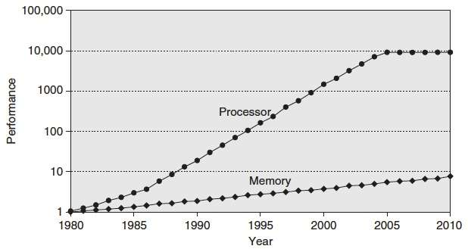
Processor-Memory Gap
“Moore’s Law”
µProc
55%/year
(2X/1.5yr)
Processor-Memory
Performance Gap
(grows 50%/year)
DRAM
7%/year
(2X/10yrs)
1989 first Intel CPU with cache on chip
1998 Pentium III has two cache levels on chip
Notes:
How fast you can crunch stuff
How fast you can get stuff

Slide 4
C Loop Mapped to RISC-V Assembly
add s1, s0, x0 # a1=&A[0]
add a0, x0, x0 # sum=0
add a1, x0, x0 # i=0
addi a3,x0, 20 # a3=20
Loop:
bge a1,a3,Done
slli t0,a1,2 # i*4
addi t0,s1,t0 # &A[0]+i*4
lw a2, 0(t0) # a2=A[i]
add a0, a0, a2 # sum+=
addi a1, a1, 1 # i++
j Loop
Done:
int A[20];
int sum = 0;
for (int i=0; i < 20; i++)
sum += A[i];

Slide 5
for(i=0;i < 4)
sum += var
for(i=0;i < 4)
sum += A[i]

Slide 6

for (i = 0; i < 4){
for(j = 0; < 4) {
A[i][j]
for (i = 0; i < 4){
for(j = 0; < 4) {
A[j][i]
52 microseconds
253 microseconds

Slide 7
Two-Dimensional (Nested) Arrays
A[0][0]
• • •
A[0][C-1]
•
•
•
•
•
•
A[R-1][0]
• • •
A[R-1][C-1]
• • •
A
[0]
[0]
A
[0]
[C-1]
• • •
A
[1]
[0]
A
[1]
[C-1]
• • •
• • •
A
[R-1]
[0]
A
[R-1]
[C-1]
4*R*C bytes
Notes:
Memory is linear

Slide 8
Problem: Processor-Memory Bottleneck
Processor performance
doubled about
every 18 months
Bus latency / bandwidth
evolved much slower
Main Memory
CPU
Reg
Problem: lots of waiting on memory
Notes:
What is a cycle
Only 2 hard problems in computer science: cache invalidation, naming things, and off-by-one errors.
I can process avocados very quickly
It takes me a long time to get them

Slide 9
Problem: Processor-Memory Bottleneck
Processor performance
doubled about
every 18 months
Bus latency / bandwidth
evolved much slower
Main Memory
CPU
Reg
Cache
Solution: caches
Smaller memories, closer to CPU → faster
Notes:
Avocado cache

Slide 10



Block based access from main memory
$m−k$ bits
$k$ bits
Block Number (4 bits)
2 bits
Main Memory (64bytes, 16 blocks)
$$Byte Pointer$$
Byte Number (6 bits for 64 byte memory)

Slide 11
General Cache Mechanics
Smaller, faster, more expensive memory
Caches a subset of the blocks
Cache
7
9
14
3
Data is copied in block-sized transfer units
Memory
0
1
2
3
Larger, slower, cheaper memory.
Viewed as partitioned into “blocks”
4
5
6
7
8
9
10
11
12
13
14
15
Note: Cache “blocks” can also be referred to as cache “lines”

Slide 12
General Cache Concepts: Hit
CPU. Lw/sw address.
Data in block b is needed
Request BLOCK(Address): 14
Block b is in cache:
Hit!
Cache
7
9
14
3
14
Data is returned to CPU
Memory
0
1
2
3
4
5
6
7
8
9
10
11
12
13
14
15

Slide 13
General Cache Concepts: Miss
CPU
Data in block b is needed
Request: 12
Block b is not in cache:
Miss!
Cache
7
9
14
3
12
Block b is fetched from
memory
12
Request: 12
Block b is stored in cache
Placement policy:
determines where b goes
Replacement policy:
determines which block
gets evicted (victim)
Memory
0
1
2
3
4
5
6
7
8
9
10
11
12
12
13
14
15
Data is returned to CPU

Slide 14
Why Caches Work
Locality: Programs tend to use data and instructions with addresses near or equal to those they have used recently
Temporal locality:
  Recently referenced items are likely
  to be referenced again in the near future
Spatial locality:
  Items with nearby addresses tend
  to be referenced close together in time
How do caches take advantage of this?
block
block
Notes:
Near

Slide 15
Example: Any Locality?
sum = 0;
for (i = 0; i < n; i++) {
sum += a[i];
}
return sum;
Data:
  Temporal: sum referenced in each iteration
  Spatial: array a[] accessed in stride-1 pattern
Instructions:
  Temporal: Cycle through loop repeatedly
  Spatial: Reference instructions in sequential order

Slide 16
What Impacts Cache Hits/Misses?
Access Pattern
for (i = 0; i < 8; i++) vs. for (i = 0; i < 8; i=i+2)
Data layout
int a[8] vs. short a[8]
int a[8] vs. int a[16]
Cache Geometry
Direct mapped vs. Set Associative (more later..)

Slide 17
DEMO

Slide 18
Int. Stride 1
// Block size 64 bytes
int a[8];
for (i = 0; i < 8; i++) {
tmp = a[i];
Number of elements per block = 64/4 = 16
Hit:Access = 7:8 (Hit Rate)
Miss:Access = 1:8 (Miss Rate)
If we change loop to “i<16” and change array definition to int a[16], how would hit rate change?

Slide 19
Short Stride 1
// Block size 64 bytes
short a[20];
for (i = 0; i < 20; i++) {
tmp = a[i];
Number of elements per block = 64/2 = 32
Hit:Access = 19:20
Miss:Access = 1:20

Slide 20
Int Stride 2
// Block size 64 bytes
int a[16];
for (i = 0; i < 16; i=i+2) {
tmp = a[i];
Number of elements per block = 64/4 = 16
Accessed Elements per block = 16/2 = 8
Hit:Access = 7:8
Miss:Access = 1:8

Slide 21
Caching Basics
Caching in general
  Successively higher levels contain “most used” data from lower levels
  Exploits temporal and spatial locality
  Caches are intermediate storage levels used to optimize data transfers between any system elements with different characteristics
Cache Performance
  Ideal case: found in cache (hit)
  Bad case: not found in cache (miss), search in next level
  Average Memory Access Time (AMAT) = HT + MR × MP
    Hurt by Miss Rate and Miss Penalty

Slide 22

Tiled
for (i = 0; i < 2; i++)
for (j = 0; j < 2; j++)
for (ii = 0; ii < 4; ii++)
for (jj = 0; jj < 4; jj++)
A[i*2+ii][j*2+jj]

Slide 23

Producer
Consumer
for (i = 0; i < 4; i++) {
for (j = 0; j < 4; j++){
b[i][j] = tmp[i,j]+
tmp[i+1,j]+
tmp[i,j+1]+
tmp[i+1,j+1]
for (i = 0; i < 5; i++) {
for (j = 0; j < 5; j++){
tmp[i][j] = 1.5*a[i,j];
Consumer
Loads: 64
Stores: 16
Add : 48
Producer
Loads: 25
Stores: 25
Mul : 25

Slide 24

Fused
for (i = 0; i < 4; i++) {
for (j = 0; j < 4; j++){
b[i][j] = 1.5*tmp[i,j]+
1.5*tmp[I+1,j]+
1.5*tmp[i,j+1]+
1.5*tmp[I+1,j+1]
Loads: 64
Stores: 16
Mul : 64

Slide 25
Tiled Producer-Consumer

Slide 26
An Example Memory Hierarchy
explicitly program-controlled (e.g. refer to exactly %t1, %t2)
registers
on-chip L1
cache (SRAM)
Smaller,
faster,
more expensive
per byte
program sees “memory”;
hardware manages caching
transparently
off-chip L2
cache (SRAM)
Larger,
slower,
cheaper
per byte
main memory
(DRAM)
local secondary storage
(local disks)
remote secondary storage
(distributed file systems, web servers)

Slide 27
Example Cache Hierarchy
Processor package
Core 0
Core 3
Block size:
64 bytes for all caches
L1 I-cache and D-cache:
  32 KiB, 8-way,
  Access: 4 cycles
L2 unified cache:
  256 KiB, 8-way,
  Access: 11 cycles
L3 unified cache:
  8 MiB, 16-way,
  Access: 30-40 cycles
Regs
Regs
L1 D$
L1 I$
L1 D$
L1 I$
…
L2 unified cache
L2 unified cache
L3 unified cache
(shared by all cores)
Main memory
Notes:
i$ d$

Slide 28
Cache Performance
Time for a memory operation depends on cache parameters:
  Hit time: Time to access cache on a cache hit
  Miss rate: Average misses per memory instruction
  Miss Penalty: Time to get data after a miss
  Average Memory Access Time (AMAT): average time to access memory considering both hits and misses
  AMAT = Hit time + Miss rate × Miss penalty
  (abbreviated AMAT = HT + MR × MP)
99% hit rate can be twice as good as 97% hit rate!
  Assume HT of 1 ns and MP of 100 ns
  97%: AMAT = 1 + 0.03 x 100 = 4 ns
  99%: AMAT = 1 + 0.01 x 100 = 2 ns

Slide 29
Can we have more than one cache?
Why?
  Avoid going to memory, reduce miss penalty
Typical performance numbers:
  Miss Rate
    L1 MR = 3-10%
    L2 Global MR = Quite small (e.g. < 1%), depending on parameters, etc.
    L2 (Local) MR typically larger than L1 MR (filtered by L1 hits)
  Hit Time
    L1 HT = 4 clock cycles
    L2 HT = 10 clock cycles
  Miss Penalty
    MP = 50-200 cycles for missing in L2 & going to main memory
    Trend: increasing!

Slide 30
Internal Cache Organization
We want to store data efficiently in the cache.
We also need to quickly find data in the cache when we need it.
Address Splitting:
  Determine where data goes in the cache.
  Check if the data is already in the cache.
  Access the exact piece of data we need.

Slide 31
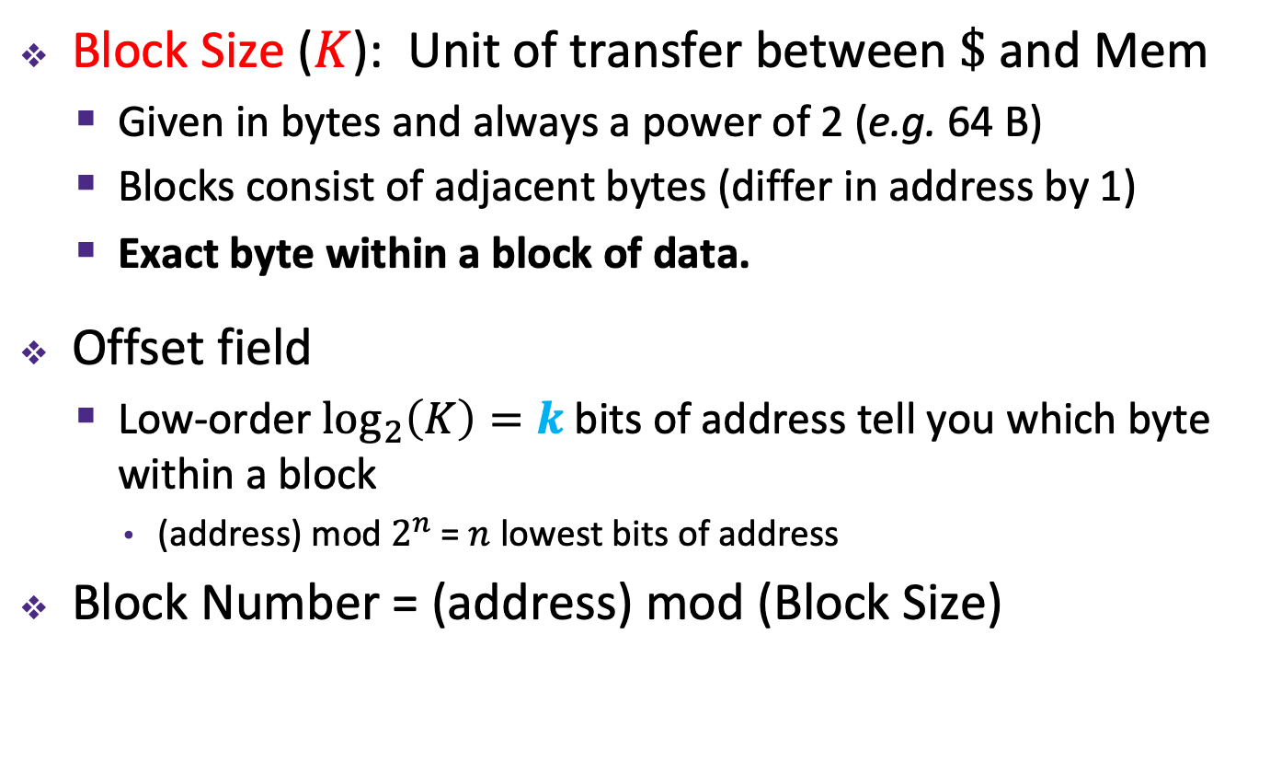
Cache Organization
Block Size ($K$): Unit of transfer between $\$$ and Mem
  Given in bytes and always a power of 2 (e.g. 64 B)
  Blocks consist of adjacent bytes (differ in address by 1)
  Exact byte within a block of data.
Offset field
  Low-order $\log_{2}\left(K\right)=k$ bits of address tell you which byte within a block
    (address) mod $2^{n}$ = $n$ lowest bits of address
Block Number = (address) mod (Block Size)
$m−k$ bits
$k$ bits
$m$-bit address:
(refers to byte in memory)
Block Number
Block Offset

Slide 32
Block based Addressing vs Byte Addressing
$m−k$ bits
$k$ bits
Block Number (4 bits)
2 bits
Main Memory (64bytes, 16 blocks)
$$Byte Pointer$$
Byte Number (6 bits for 64 byte memory)

Slide 33
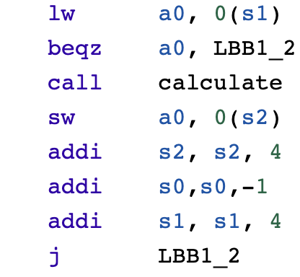
How to identify different blocks in cache?
i = 0 – 0x000000 Block: 0000
i = 1 - 0x000004 Block: 0001
i = 2 - 0x000008 Block: 0002
……………
for i = 0 to N
Calculate(A[i])
Cache (16 bytes, 4 blocks)
Block size: 4B
Cache size: 16B
Main Memory (64bytes, 16 blocks)

Slide 34




Mapping Memory Address to Cache
CPU sends load/store address, address breakdown:
  Set Index field tells you where to look in cache
  Tag field lets you check that data is the block you want
  Offset field selects specified start byte within block
  k = log₂(K); s = log₂(C/(K*E)); t = m - s - k
  K: Block Size (bytes), E: Associativity; C: Cache Size (bytes)
Book Shelf Analogy
  Block: page within a book
  Set Index: Which shelf took look at
  Tag: Unique QRcode or Barcode for every book
$m$-bit address:
Tag ($t$)
Set ($s$)
Offset ($k$)
Block Number
Think of this as similar to a bookshelf with multiple sections. The set index tells you which section of the shelf you should look in.

Slide 35
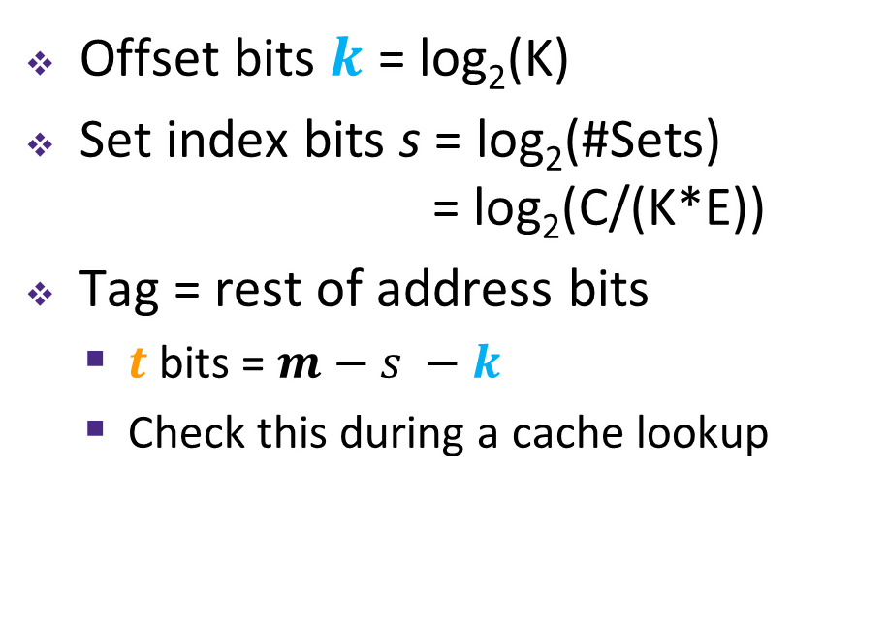
Tags Differentiate Blocks in Cache
Memory
Cache
Block Addr | Block Data
0000
0001
0010
0011
0100
0101
0110
0111
1000
1001
1010
1011
1100
1101
1110
1111
0000
Block size (K) = 4B
Associativity (E) = 1
Cache size (C) = 16B
#Blocks = C/K = 4
0100
1010
1111
Offset bits $k$ = log₂(K)
Set index bits s = log₂(#Sets) = log₂(C/(K*E))
Tag = rest of address bits
  $t$ bits = $m−s −k$
  Check this during a cache lookup
Notes:
Possible analogies for Tag:
Hash by first name, tag by last name
Hash by 7-digit phone number, tag by area code
Again, don’t memorize m – s – k

Slide 36



Cache Organization
  Cache Size = #Blocks x Block Size
  = #Sets x Associativity x Block Size
Tag ($t$)
Set ($s$)
Offset ($k$)
Match ==
Ways (i.e., associativity, #blocks/set)
Block
Sets

Slide 37
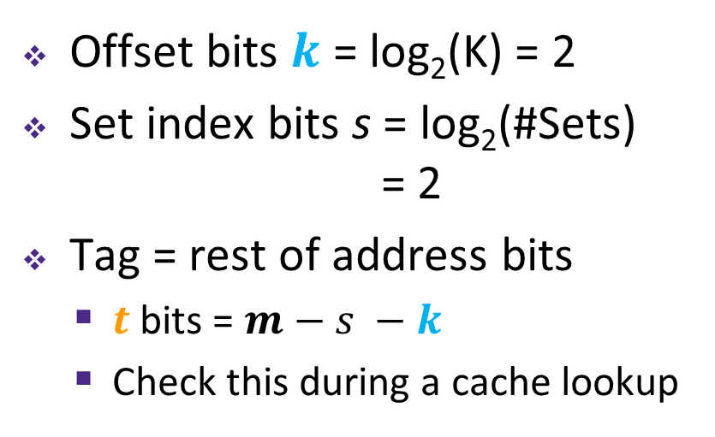
Tags Differentiate Blocks in Same Index
Memory
Cache
Block Addr | Block Data
0000
0001
0010
0011
0100
0101
0110
0111
1000
1001
1010
1011
1100
1101
1110
1111
Index | Tag |  | Block Data
00 | 00
01
10 | 01
11 | 01
Here $K$ = 4 B
and $C/K$ = 4
Offset bits $k$ = log₂(K) = 2
Set index bits s = log₂(#Sets) = 2
Tag = rest of address bits
  $t$ bits = $m−s −k$
  Check this during a cache lookup
Notes:
Possible analogies for Tag:
Hash by first name, tag by last name
Hash by 7-digit phone number, tag by area code
Again, don’t memorize m – s – k

Slide 38





Example Placement
block size: | 16 B
capacity: | 8 blocks
address: | 16 bits
Where would data from address 0x1833 be placed?
  Binary: 0b 0001 1000 0011 0011
$t$ = $m$–$s$–$k$
$s$ = $\log_{2}\left(C/(K∗E)\right)$
$k$ = $\log_{2}\left(K\right)$
$m$-bit address:
Tag ($t$)
Index ($s$)
Offset ($k$)
$s$ = ?
$s$ = ?
$s$ = ?
$s$ = 0
Direct-mapped
2-way set associative
4-way set associative
Fully associative
Set | Tag | Data
0
1
2
3
4
5
6
7
Set | Tag | Data
0
1
2
3
Set | Tag | Data
0
1
Set | Tag | Data
0
Notes:
38
k = 4
E = 1; s = 3; idx = 3. s : number of bits. Idx: actual value.
E = 2; s = 2; idx = 3
E = 4; s = 1; idx = 1
E =8; s = 0; idx = 0

Slide 39
Cache Read
Locate set
Check if any line in set
is valid and has
matching tag: hit
Locate data starting
at offset
$E$ = blocks/lines per set
Address of byte in memory:
$t$ bits
$s$ bits
$k$ bits
$S$ = # sets
= $2^{s}$
tag
set
index
block
offset
data begins at this offset
v
tag
0
1
2
K-1
valid bit
$K$ = bytes per block

Slide 40
Example: Direct-Mapped Cache ($E$ = 1)
Direct-mapped: One line per set
Block Size $K$ = 8 B
Address of int:
v
tag
0
1
2
3
4
5
6
7
$t$ bits
0…01
100
v
tag
0
1
2
3
4
5
6
7
find set
$S$ = $2^{s}$ sets
v
tag
0
1
2
3
4
5
6
7
v
tag
0
1
2
3
4
5
6
7

Slide 41
Example: Direct-Mapped Cache ($E$ = 1)
Direct-mapped: One line per set
Block Size $K$ = 8 B
Address of int:
valid? +
match?: yes = hit
$t$ bits
0…01
100
v
tag
0
1
2
3
4
5
6
7
block offset

Slide 42
Example: Direct-Mapped Cache ($E$ = 1)
Direct-mapped: One line per set
Block Size $K$ = 8 B
Address of int:
valid? +
match?: yes = hit
$t$ bits
0…01
100
v
tag
0
1
2
3
4
5
6
7
block offset
int (4 B) is here
This is why we want alignment!
No match? Then old line gets evicted and replaced

Slide 43
Example: Set-Associative Cache ($E$ = 2)
2-way: Two lines per set
Block Size $K$ = 8 B
Address of short int:
$t$ bits
0…01
100
v
tag
0
1
2
3
4
5
6
7
v
tag
0
1
2
3
4
5
6
7
v
tag
0
1
2
3
4
5
6
7
v
tag
0
1
2
3
4
5
6
7
find set
v
tag
0
1
2
3
4
5
6
7
v
tag
0
1
2
3
4
5
6
7
v
tag
0
1
2
3
4
5
6
7
v
tag
0
1
2
3
4
5
6
7
Notes:
1 fewer s bit, 2x fewer sets

Slide 44
Example: Set-Associative Cache ($E$ = 2)
2-way: Two lines per set
Block Size $K$ = 8 B
Address of short int:
compare both
$t$ bits
0…01
100
valid? +
match: yes = hit
v
tag
tag
0
1
2
3
4
5
6
7
v
tag
0
1
2
3
4
5
6
7
block offset

Slide 45
Example: Set-Associative Cache ($E$ = 2)
2-way: Two lines per set
Block Size $K$ = 8 B
Address of short int:
compare both
$t$ bits
0…01
100
valid? +
match: yes = hit
v
tag
0
1
2
3
4
5
6
7
v
tag
0
1
2
3
4
5
6
7
block offset
short int (2 B) is here
No match?
One line in set is selected for eviction and replacement
Replacement policies: random, least recently used (LRU), …

Slide 46
Example Code Analysis Problem
Assuming the cache starts cold (all blocks invalid) and sum is stored in a register, calculate the miss rate:
  $m$ = 12 bits, $C$ = 256 B, $K$ = 32 B, $E$ = 2
#define SIZE 8
long ar[SIZE][SIZE], sum = 0; // &ar=0x800
for (int i = 0; i < SIZE; i++)
for (int j = 0; j < SIZE; j++)
sum += ar[i][j];
Notes:
k = 5 bits
256 / 32 = 8 blocks
8 / 2 = 4 sets
s = 2 bits
t = 12 – 5 – 2 = 5 bits
0x800 = 0b 1000 0000 0000
8 bytes per elem
4 longs fit in a block
¼ miss rate (missed are compulsory)

Slide 47
Row Major
for (i = 0; i < 4; i++) {
for (j = 0; j < 4; j++) {
A[i][j]
Cache: 256 bytes. 16x256 image
Hits: N-1 (N: number of elements per block)
Misses: 1024

Slide 48
int sum_array_rows(int a[M][N])
{
int i, j, sum = 0;
for (i = 0; i < M; i++)
for (j = 0; j < N; j++)
sum += a[i][j];
return sum;
}
M = 3, N=4
a[0][0] |  | a[0][1] |  | a[0][2] |  | a[0][3]
a[1][0] |  | a[1][1] |  | a[1][2] |  | a[1][3]
a[2][0] |  | a[2][1] |  | a[2][2] |  | a[2][3]
Access Pattern:
stride = ?
1) | a[0][0]
2) | a[0][1]
3) | a[0][2]
4) | a[0][3]
5) | a[1][0]
6) | a[1][1]
7) | a[1][2]
8) | a[1][3]
9) | a[2][0]
10) | a[2][1]
11) | a[2][2]
12) | a[2][3]
Layout in Memory
a [0] [0] | a [0] [1] | a [0] [2] | a [0] [3] | a [1] [0] | a [1] [1] | a [1] [2] | a [1] [3] | a [2] [0] | a [2] [1] | a [2] [2] | a [2] [3]
76
92
108
Notes:
Stride of 1 (4 bytes)

Slide 49
Column Major
for (i = 0; i < 4; i++) {
for (j = 0; j < 4; j++) {
A[j][i]
Cache: 256 bytes. 16x256 image
Hits: 0
Misses: 4096

Slide 50
int sum_array_cols(int a[M][N])
{
int i, j, sum = 0;
for (j = 0; j < N; j++)
for (i = 0; i < M; i++)
sum += a[i][j];
return sum;
}
M = 3, N=4
a[0][0] |  | a[0][1] |  | a[0][2] |  | a[0][3]
a[1][0] |  | a[1][1] |  | a[1][2] |  | a[1][3]
a[2][0] |  | a[2][1] |  | a[2][2] |  | a[2][3]
Access Pattern:
stride = ?
1) | a[0][0]
2) | a[1][0]
3) | a[2][0]
4) | a[0][1]
5) | a[1][1]
6) | a[2][1]
7) | a[0][2]
8) | a[1][2]
9) | a[2][2]
10) | a[0][3]
11) | a[1][3]
12) | a[2][3]
Layout in Memory
a [0] [0] | a [0] [1] | a [0] [2] | a [0] [3] | a [1] [0] | a [1] [1] | a [1] [2] | a [1] [3] | a [2] [0] | a [2] [1] | a [2] [2] | a [2] [3]
76
92
108
Notes:
Stride of 4

Slide 51
Cache Organization
  Cache Size = #Blocks x Block Size
  = #Sets x Associativity x Block Size
Tag ($t$)
Set ($s$)
Offset ($k$)
Match ==
Ways (i.e., associativity, #blocks/set)
Block
Sets

Slide 52
Peer Instruction Question
We have a cache of size 2 KiB with block size of 128 B. If our cache has 2 sets, what is its associativity?
2
4
8
16
We’re lost…
If addresses are 16 bits wide, how wide is the Tag field?
Notes:
C = 2^11 B
K = 2^7 B
2^4 = 16 blocks
16 / 2 = 8 E
k = 7; s = 1; t = 16 – 7 – 1 = 8

Slide 53
Other Questions
We have a cache with block size of 128 B. Cache is 4-way set-associative and has 8 sets. How big is the cache? (What is the cache capacity)?

Slide 54
Other Questions
A 4KB Cache is 4-way set associative with 64 B blocks. Which bits are used for set index? (Also: How many sets does the cache have?)

Slide 55
Other Questions
A 32KB Cache is 8-way set associative and has 16 sets. Which bits are used for byte offset? (Also: What is the block size?)

Slide 56
Other Questions
A direct-mapped cache uses 4 bits for set index and 6 bits for byte offset. How big is the cache?

Slide 57
Cache Miss Classification: The 3Cs
Compulsory: (Many names: cold start, process migration (switching processes), 1st reference)
  First access to block impossible to avoid;
  Effect is small for long running programs
Capacity:
  Cache cannot contain all blocks accessed by the program, i.e., misses in a fully associative cache.
Conflict: (collision)
  Multiple memory locations mapped to the same cache set (not enough associativity)

Slide 58
Hit, Compulsory, Capacity or Conflict Miss
• 0x00000004
• 0x00000005
• 0x00000068
• 0x000000C8
• 0x00000068
• 0x000000DD
• 0x00000045
• 0x00000004
• 0x000000C8
Assume we have a direct-mapped byte-addressed cache with capacity 32B and block size of 8B.

Slide 59
Hit, Compulsory, Capacity or Conflict Miss
• 0x00000004, Compulsory
• 0x00000005
• 0x00000068, Compulsory
• 0x000000C8, Compulsory
• 0x00000068
• 0x000000DD, Compulsory
• 0x00000045, Compulsory
• 0x00000004
• 0x000000C8

Slide 60
Hit, Compulsory, Capacity or Conflict Miss
• 0x00000004, Compulsory
• 0x00000005
• 0x00000068, Compulsory
• 0x000000C8, Compulsory
• 0x00000068
• 0x000000DD, Compulsory
• 0x00000045, Compulsory
• 0x00000004, Capacity
• 0x000000C8, Capacity

Slide 61
Hit, Compulsory, Capacity or Conflict Miss
• 0x00000004, Compulsory
• 0x00000005, Hit
• 0x00000068, Compulsory
• 0x000000C8, Compulsory
• 0x00000068
• 0x000000DD, Compulsory
• 0x00000045, Compulsory
• 0x00000004, Capacity
• 0x000000C8, Capacity

Slide 62
Hit, Compulsory, Capacity or Conflict Miss
• 0x00000004, Compulsory
• 0x00000005, N/A
• 0x00000068, Compulsory
• 0x000000C8, Compulsory
• 0x00000068, Conflict
• 0x000000DD, Compulsory
• 0x00000045, Compulsory
• 0x00000004, Capacity
• 0x000000C8, Capacity

Slide 63
Cache Code Analysis Problem
Cache-A Direct-mapped, 4KB, 64 sets
Cache-B Set-associative, 4KB, 2 ways, 32 sets
int size = 4096; // int is 4 bytes
int a[size];
long long int a_long[size]; // long long int is 8 bytes
/* loop 1 */
for (int i = 0; i < size; i++) {
a[i] = i;
}
/* loop 2 */
for (long long int i = 0; i < size; i++) {
a_long[i] = i;
}
/* loop 3 */
for (int i = 0; i < size/2; i += 1) {
a[(size/2)+i] = a[i];
}
Question: What are hit rates for loop1, loop 2 (assume loop 1 has run), loop3 (assume both previous loops have run).
Notes:
k = 6 bits
8 / 2 = 4 sets
s = 2 bits
t = 12 – 5 – 2 = 5 bits
0x800 = 0b 1000 0000 0000
8 bytes per elem
4 longs fit in a block
¼ miss rate (missed are compulsory)

