Slide 1
Caches and Virtual Memory
CMPT 295 Week 8

Slide 2
Processes
A process is an instance of a running program
  Provided by the OS
    OS uses a data structure (PCB) to represent each process
  Maintains the interface between the program and the underlying hardware (CPU + memory)
“Process” provides each program with two key abstractions:
  Logical control flow
    Each program seems to have exclusive use of the CPU
    Provided by kernel mechanism called context switching
  Private address space
    Each program seems to have exclusive use of main memory
    Provided by kernel mechanism called virtual memory
Memory
Stack
Heap
Data
Code
CPU
Registers

Slide 3
What is a Process?
It’s an illusion!
Computer
Process 3
Process 2
“Memory”
Stack
“Memory”
Heap
Process 1
Data
Process 4
Stack
Code
Heap
“CPU”
“Memory”
Data
“Memory”
Code
Registers
Stack
“CPU”
Stack
Heap
Heap
Data
Registers
Data
Code
Code
CPU
“CPU”
“CPU”
Registers
Registers
Disk
/Applications/
Chrome.exe
Slack.exe
PowerPoint.exe

Slide 4
What is a Process?
It’s an illusion!
Computer
Process 3
Process 2
“Memory”
Stack
“Memory”
Heap
Process 1
Data
Process 4
Stack
Code
Heap
“CPU”
“Memory”
Data
“Memory”
Code
Registers
Stack
“CPU”
Stack
Heap
Heap
Data
Registers
Data
Code
Code
CPU
“CPU”
“CPU”
Operating
System
Registers
Registers
Disk
/Applications/
Chrome.exe
Slack.exe
PowerPoint.exe

Slide 5
Multiprocessing: The Illusion
Memory
Memory
Memory
Stack
Stack
Stack
Heap
Heap
…
Heap
Data
Data
Data
Code
Code
Code
CPU
CPU
CPU
Registers
Registers
Registers
Computer runs many processes simultaneously
  Applications for one or more users
    Web browsers, email clients, editors, …
  Background tasks
    Monitoring network & I/O devices

Slide 6
Multiprocessing: The Reality
Memory
Stack
Stack
Stack
Heap
Heap
…
Heap
Data
Data
Data
Code
Code
Code
Saved registers
Saved registers
Saved registers
CPU
Registers
Single processor executes multiple processes concurrently
  Process executions interleaved, CPU runs one at a time
  Address spaces managed by virtual memory system (today’s lecture)
  Execution context (register values, stack, …) for other processes saved in memory

Slide 7
Multiprocessing
Memory
Stack
Stack
Stack
Heap
Heap
…
Heap
Data
Data
Data
Code
Code
Code
Saved registers
Saved registers
Saved registers
CPU
Registers
Context switch
  Save current registers in memory

Slide 8
Multiprocessing
Memory
Stack
Stack
Stack
Heap
Heap
…
Heap
Data
Data
Data
Code
Code
Code
Saved registers
Saved registers
Saved registers
CPU
Registers
Context switch
  Save current registers in memory
  Schedule next process for execution

Slide 9
Multiprocessing
Memory
Stack
Stack
Stack
Heap
Heap
…
Heap
Data
Data
Data
Code
Code
Code
Saved registers
Saved registers
Saved registers
CPU
Registers
Context switch
  Save current registers in memory
  Schedule next process for execution
  Load saved registers and switch address space

Slide 10
Multiprocessing on Multicore Processors
Memory
Stack
Stack
Stack
Heap
Heap
…
Heap
Data
Data
Data
Code
Code
Code
Saved registers
Saved registers
Saved registers
CPU
CPU
Multicore processors
  Multiple CPUs (“cores”) on single chip
  Share main memory (and some of the caches)
  Each can execute a separate process
    Kernel schedules processes to cores
    Still constantly swapping processes
Registers
Registers

Slide 11
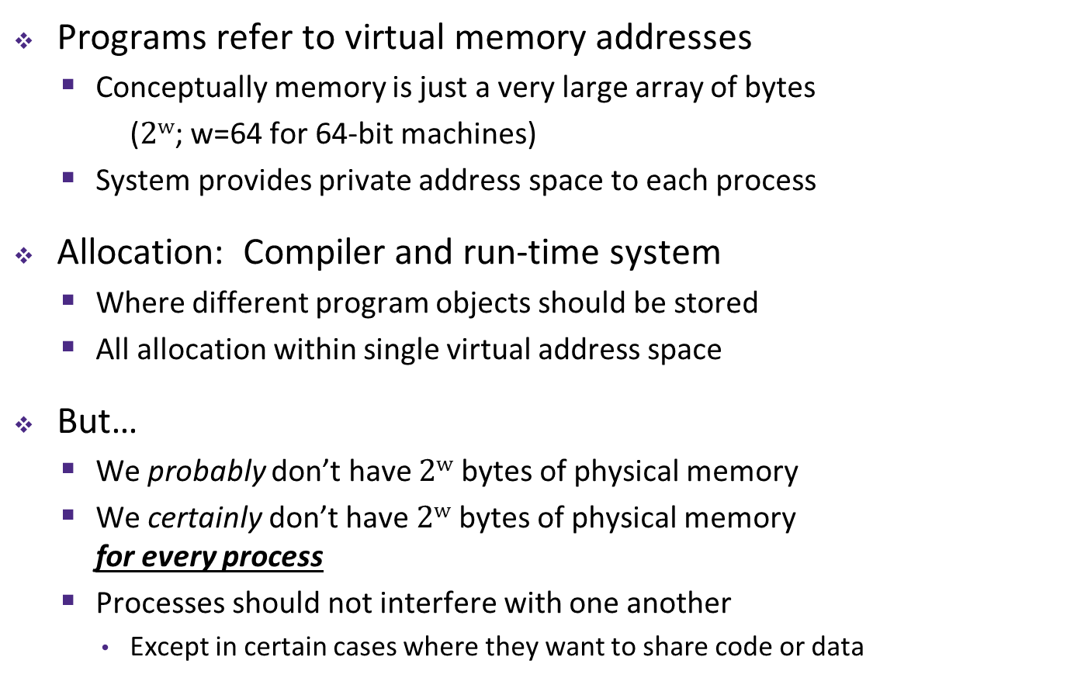
Memory as we know it so far… is virtual!
0xFF∙∙∙∙∙∙F
Programs refer to virtual memory addresses
  Conceptually memory is just a very large array of bytes
  ($2w$; w=64 for 64-bit machines)
  System provides private address space to each process
Allocation: Compiler and run-time system
  Where different program objects should be stored
  All allocation within single virtual address space
But…
  We probably don’t have $2w$ bytes of physical memory
  We certainly don’t have $2w$ bytes of physical memory
  for every process
  Processes should not interfere with one another
    Except in certain cases where they want to share code or data
0x00∙∙∙∙∙∙0

Slide 12
Why Virtual Memory (VM)?
Efficient use of limited main memory
  Use main memory as a cache for parts of a virtual address space
    Some non-cached parts stored on disk
    Some (unallocated) non-cached parts stored nowhere
  Keep only active areas of virtual address space in memory
    Transfer data back and forth as needed
Simplifies memory management for programmers
  Each process “gets” the same full, private linear address space
Isolates address spaces (protection)
  One process can’t interfere with another’s memory
    They operate in different address spaces
  User process cannot access privileged information
    Different sections of address spaces have different permissions
Notes:
Adds disks to memory hierarchy
Simplifies memory for processes & programmers
Security/protection

Slide 13
A System Using Virtual Addressing
Main memory
0:
CPU Chip
1:
Virtual address
(VA)
Physical address
(PA)
2:
CPU
MMU
3:
4:
0x4100
0x4
5:
6:
7:
8:
Memory Management Unit
...
M-1:
Data (int/float)
Physical addresses are completely invisible to programs
  Used in all modern desktops, laptops, servers, smartphones…
  One of the great ideas in computer science

Slide 14
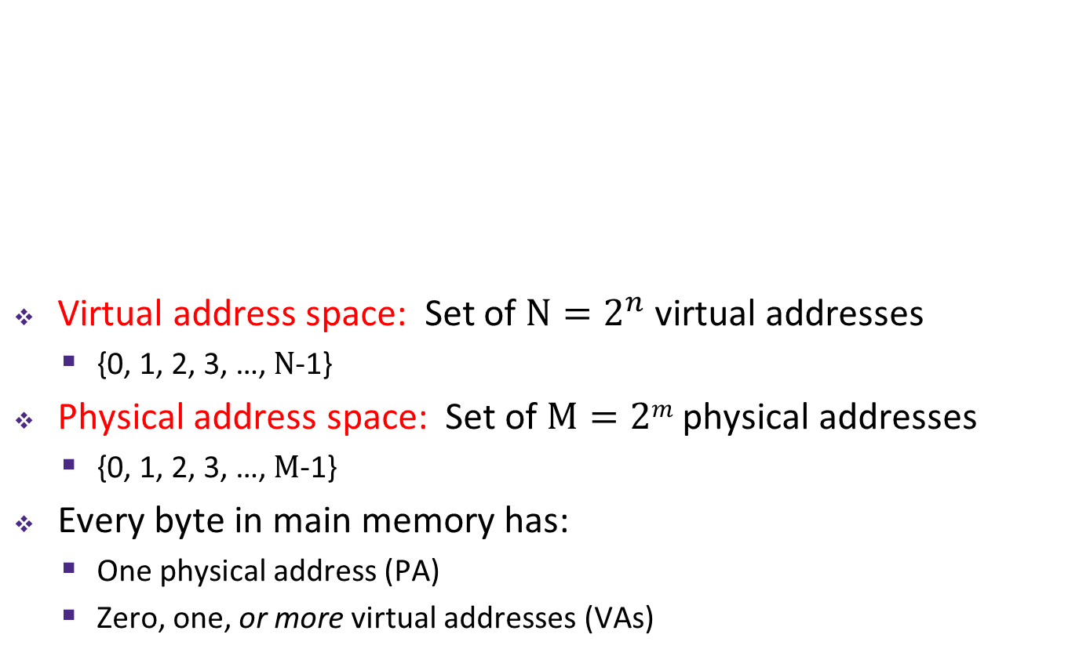

Indirection and Address Spaces
Virtual memory
mapping
Virtual address space: Set of $N=2^{n}$ virtual addresses
  {0, 1, 2, 3, …, $N$-1}
Physical address space: Set of $M=2m$ physical addresses
  {0, 1, 2, 3, …, $M$-1}
Every byte in main memory has:
  One physical address (PA)
  Zero, one, or more virtual addresses (VAs)
Process 1
Physical memory
Virtual memory
Process $k$

Slide 15
The Page
LD t1, 0 (sp)
Disk
requested 32-bits
Page
Main memory
(DRAM)
CPU
Cache
Page
Line
MMU
Block
TLB
Cache<->Mem.: Block/Line (~64B): Unit of lookup/allocation. Managed by HW
Memory<->Disk: Page (~4KB). Unit of lookup/allocation. Managed by OS

Slide 16
Address Translation
How do we perform the virtual $→$ physical address translation?
Main memory
0:
CPU Chip
1:
Virtual address
(VA)
Physical address
(PA)
2:
CPU
MMU
3:
4:
0x4100
0x4
5:
6:
7:
8:
Memory Management Unit
...
M-1:
Data (int/float)

Slide 17
Address Translation: Page Tables
CPU-generated address can be split into:
  Request is Virtual Address (VA), want Physical Address (PA)
  Note that Physical Offset = Virtual Offset (page-aligned)
Use lookup table called the Page Table (PT)
  Replace Virtual Page Number (VPN) with Physical Page Number (PPN) to generate Physical Address
  Index PT using VPN: Page Table Entry (PTE) stores the PPN plus management bits (e.g. Valid, Dirty, access rights)
  Has an entry for every virtual page
$n$-bit address:
Virtual Page Number
Page Offset

Slide 18
Page Hit
Page hit: VM reference is in physical memory
Page Table (DRAM)
Physical memory
(DRAM)
Virtual address
Valid
PPN/Disk Addr
PTE 0
0
null
VP 1
PP 0
1
VP 2
1
VP 7
0
VP 4
PP 3
1
0
null
0
Virtual memory
(DRAM/disk)
PTE 7
1
...
...
VP 1
VP 2
Example: Page size = 4 KiB
VP 3
VP 4
Virtual Addr:
0x00740b
Physical Addr:
VP 6
VP 7
VPN:
PPN:
Notes:
4kB page = 2^12
3 hex digits

Slide 19
Page Fault
Page fault: VM reference is NOT in physical memory
Page Table (DRAM)
Physical memory
(DRAM)
Virtual address
Valid
PPN/Disk Addr
PTE 0
0
null
VP 1
PP 0
1
VP 2
1
VP 7
0
VP 4
PP 3
1
0
null
0
Virtual memory
(DRAM/disk)
PTE 7
1
...
...
VP 1
VP 2
Example: Page size = 4 KiB
Provide a virtual address request (in hex) that results in this particular page fault:
VP 3
VP 4
VP 6
VP 7
Virtual Addr:

Slide 20
Address Translation: Page Hit
2
Cache/
Memory
CPU Chip
MMU
PTEA
1
PTE
CPU
VA
3
PA
4
Data
5
1) Processor sends virtual address to MMU (memory management unit)
2-3) MMU fetches PTE from page table in cache/memory
(Uses PTBR to find beginning of page table for current process)
4) MMU sends physical address to cache/memory requesting data
5) Cache/memory sends data to processor
VA = Virtual Address PTEA = Page Table Entry Address PTE= Page Table Entry
PA = Physical Address Data = Contents of memory stored at VA originally requested by CPU

Slide 21
Address Translation: Page Fault
Exception
Page fault handler
4
CPU Chip
2
Cache/
Memory
Disk
MMU
PTEA
Victim page
1
5
CPU
VA
PTE
7
3
New page
6
1) Processor sends virtual address to MMU
2-3) MMU fetches PTE from page table in cache/memory
4) Valid bit is zero, so MMU triggers page fault exception
5) Handler identifies victim (and, if dirty, pages it out to disk)
6) Handler pages in new page and updates PTE in memory
7) Handler returns to original process, restarting faulting instruction

Slide 22
TLB Hit
TLB
VPN
→
PTE
VPN
→
PTE
VPN
→
PTE
CPU Chip
TLB
2
PTE
VPN
3
Cache/
Memory
1
MMU
CPU
VA
PA
4
Data
5
A TLB hit eliminates a memory access!

Slide 23
Address Translation Is Slow
The MMU accesses memory twice: once to get the PTE for translation, and then again for the actual memory request
  The PTEs may be cached in L1 like any other memory word
    But they may be evicted by other data references
    And a hit in the L1 cache still requires 3-4 cycles
What can we do to make this faster?
  Solution: add another cache!

Slide 24






Cache and Phy. Addr.
TLB and Virt. Addr.
Block Number
Virt. Page Number
Tag ($t$)
Set ($s$)
Offset ($k$)
TLB Tag ($t$)
TLB Set ($s$)
Page Off ($k$)
Match ==
Match ==
Ways
Ways
Block
2^k bytes
PPN
PPN (phy page number)
0x……
Sets
Sets
Address = PPN . Off

Slide 25
Speeding up Translation with a TLB
Translation Lookaside Buffer (TLB):
  Small hardware cache in MMU
    Split VPN into TLB Tag and TLB Index based on # of sets in TLB
  Maps virtual page numbers to physical page numbers
  Stores page table entries for a small number of pages
  Much faster than a page table lookup in cache/memory
Set
0
1
TLB
Virtual Page Number
Page offset
V
TLBT
PTE
V
TLBT
PTE
TLBT
TLBI
V
TLBT
PTE
V
TLBT
PTE
Notes:
“The architecture of the IBM System/370” R.P. Case and A. Padegs Communications of the ACM. 21:1, 73-96, January 1978.
Perhaps the first paper to use the term translation lookaside buffer. The name arises from the historical name for a cache, which was a lookaside buffer as called by those developing the Atlas system at the University of Manchester; a cache of address translations thus became a translation lookaside buffer. Even though the term lookaside buffer fell out of favor, TLB seems to have stuck, for whatever reason.
“x86info -c” on Intel Core2 Duo CPU:
L1 Data TLB: 4KB pages, 4-way set associative, 16 entries
Data TLB: 4K pages, 4-way associative, 256 entries.
L1 Data TLB: 4MB pages, 4-way set associative, 16 entries
Data TLB: 4MB pages, 4-way associative, 32 entries

Slide 26
Address Translation and Memory Access
Virtual Address
TLB Lookup
TLB Miss
TLB Hit
Check the
Page Table
Update
TLB
Protection
Check
Page not
in Mem
Page
in Mem
Access
Denied
Access
Permitted
Page Fault
(OS loads page)
Protection
Fault
Physical
Address
Check Cache
Find in Disk
Find in Mem
SIGSEGV
Miss
Hit
Get data
from Mem
Get data
from Cache
Notes:
Need to restart instruction.
Soft and hard page faults.

Slide 27
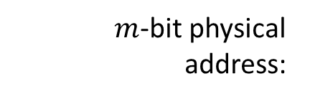

Address Manipulation
request from CPU:
$n$-bit virtual address
split to access TLB:
TLB Tag
TLB Index
Page Offset
(on TLB miss) access PT:
Virtual Page Number
Page offset
TRANSLATION
$m$-bit physical address:
Physical Page Number
Page offset
split to access cache:
Cache Tag
Cache Index
Offset
Notes:
Need to restart instruction.
Soft and hard page faults.

Slide 28
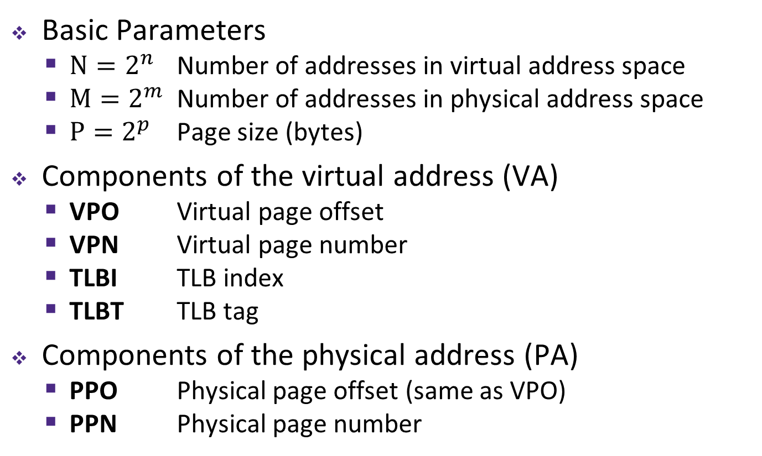
Summary of Address Translation Symbols
Basic Parameters
  $N=2^{n}$ Number of addresses in virtual address space
  $M=2^{m}$ Number of addresses in physical address space
  $P=2^{p}$ Page size (bytes)
Components of the virtual address (VA)
  VPO Virtual page offset
  VPN Virtual page number
  TLBI TLB index
  TLBT TLB tag
Components of the physical address (PA)
  PPO Physical page offset (same as VPO)
  PPN Physical page number

Slide 29
Peer Question
How many bits wide are the following fields?
  16 KiB pages
  48-bit virtual addresses
  16 GiB physical memory
VPN PPN
(A)
34 24
(B)
32 18
(C)
30 20
(D)
34 20

Slide 30
Some VM Topics Not Covered in 295
Supporting more than one page size
  Small pages lead to more TLB misses; large pages lead to fragmentation
  Modern CPUs support >1 page size (e.g., 4KB, 2MB, 1GB)
Multi-level page tables
  Needed to support large VM address space
  https://en.wikipedia.org/wiki/Intel_5-level_paging
TLB hierarchy
  Modern CPUs have more than one level in TLB
  L1 usually split into two structures, one for instructions (iTLB) and another for data (dTLB). Entries 32-256
  L2 TLB unified (instructions and data), 512-2048 entries

Slide 31
Simple Memory System Example (small)
Addressing
  14-bit virtual addresses
  12-bit physical address
  Page size = 64 bytes
13
12
11
10
9
8
7
6
5
4
3
2
1
0
VPN
VPO
Virtual Page Number
Virtual Page Offset
11
10
9
8
7
6
5
4
3
2
1
0
PPN
PPO
Physical Page Number
Physical Page Offset

Slide 32
Simple Memory System: Page Table
Only showing first 16 entries (out of _____)
  Note: Showing 2 hex digits for PPN even though only 6 bits
  Note: Other management bits not shown, but part of PTE
VPN | PPN | Valid
0 | 28 | 1
1 | – | 0
2 | 33 | 1
3 | 02 | 1
4 | – | 0
5 | 16 | 1
6 | – | 0
7 | – | 0
VPN | PPN | Valid
8 | 13 | 1
9 | 17 | 1
A | 09 | 1
B | – | 0
C | – | 0
D | 2D | 1
E | – | 0
F | 0D | 1
Notes:
Size of page table = 2^(n-p) entries

Slide 33
Simple Memory System: TLB
16 entries total
4-way set associative
Why does the TLB ignore the page offset?
TLB tag
TLB index
13
12
11
10
9
8
7
6
5
4
3
2
1
0
virtual page number
virtual page offset
Set
Tag
PPN
Valid
Tag
PPN
Valid
Tag
PPN
Valid
Tag
PPN
Valid
0
03
–
0
09
0D
1
00
–
0
07
02
1
1
03
2D
1
02
–
0
04
–
0
0A
–
0
2
02
–
0
08
–
0
06
–
0
03
–
0
3
07
–
0
03
0D
1
0A
34
1
02
–
0
Notes:
Calculate VPN for valid TLB entry using Tag & Set

Slide 34
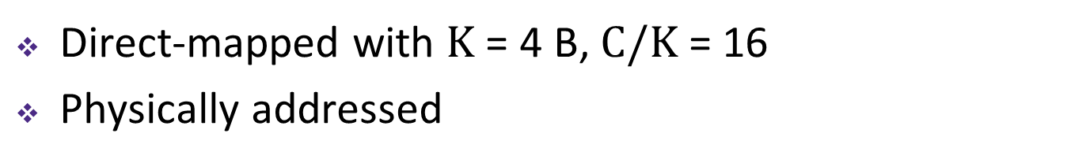
Simple Memory System: Cache
Note: It is just coincidence that the PPN is the same width as the cache Tag
Direct-mapped with $K$ = 4 B, $C/K$ = 16
Physically addressed
cache tag
cache index
cache offset
11
10
9
8
7
6
5
4
3
2
1
0
physical page number
physical page offset
Index | Tag | Valid | B0 | B1 | B2 | B3
0 | 19 | 1 | 99 | 11 | 23 | 11
1 | 15 | 0 | – | – | – | –
2 | 1B | 1 | 00 | 02 | 04 | 08
3 | 36 | 0 | – | – | – | –
4 | 32 | 1 | 43 | 6D | 8F | 09
5 | 0D | 1 | 36 | 72 | F0 | 1D
6 | 31 | 0 | – | – | – | –
7 | 16 | 1 | 11 | C2 | DF | 03
Index | Tag | Valid | B0 | B1 | B2 | B3
8 | 24 | 1 | 3A | 00 | 51 | 89
9 | 2D | 0 | – | – | – | –
A | 2D | 1 | 93 | 15 | DA | 3B
B | 0B | 0 | – | – | – | –
C | 12 | 0 | – | – | – | –
D | 16 | 1 | 04 | 96 | 34 | 15
E | 13 | 1 | 83 | 77 | 1B | D3
F | 14 | 0 | – | – | – | –

Slide 35
Current State of Memory System
Page table (partial):
TLB:
VPN | PPN | V
0 | 28 | 1
1 | – | 0
2 | 33 | 1
3 | 02 | 1
4 | – | 0
5 | 16 | 1
6 | – | 0
7 | – | 0
VPN | PPN | V
8 | 13 | 1
9 | 17 | 1
A | 09 | 1
B | – | 0
C | – | 0
D | 2D | 1
E | – | 0
F | 0D | 1
Set | Tag | PPN | V | Tag | PPN | V | Tag | PPN | V | Tag | PPN | V
0 | 03 | – | 0 | 09 | 0D | 1 | 00 | – | 0 | 07 | 02 | 1
1 | 03 | 2D | 1 | 02 | – | 0 | 04 | – | 0 | 0A | – | 0
2 | 02 | – | 0 | 08 | – | 0 | 06 | – | 0 | 03 | – | 0
3 | 07 | – | 0 | 03 | 0D | 1 | 0A | 34 | 1 | 02 | – | 0
Cache:
Index | Tag | V | B0 | B1 | B2 | B3
0 | 19 | 1 | 99 | 11 | 23 | 11
1 | 15 | 0 | – | – | – | –
2 | 1B | 1 | 00 | 02 | 04 | 08
3 | 36 | 0 | – | – | – | –
4 | 32 | 1 | 43 | 6D | 8F | 09
5 | 0D | 1 | 36 | 72 | F0 | 1D
6 | 31 | 0 | – | – | – | –
7 | 16 | 1 | 11 | C2 | DF | 03
Index | Tag | V | B0 | B1 | B2 | B3
8 | 24 | 1 | 3A | 00 | 51 | 89
9 | 2D | 0 | – | – | – | –
A | 2D | 1 | 93 | 15 | DA | 3B
B | 0B | 0 | – | – | – | –
C | 12 | 0 | – | – | – | –
D | 16 | 1 | 04 | 96 | 34 | 15
E | 13 | 1 | 83 | 77 | 1B | D3
F | 14 | 0 | – | – | – | –
Notes:
TLB and Cache are separate pieces of hardware; page table stored in memory
Show correlation between TLB & page table (VPN 0x0D and 0x0F in particular)

Slide 36
Memory Request Example #1
Note: It is just coincidence that the PPN is the same width as the cache Tag
Virtual Address: 0x03D4
Physical Address:
TLBT
TLBI
13
12
11
10
9
8
7
6
5
4
3
2
1
0
0
0
0
0
1
1
1
1
0
1
0
1
0
0
VPN
VPO
VPN ______ | TLBT _____ | TLBI _____ | TLB Hit? ___ | Page Fault? ___ | PPN _____
CT
CI
CO
11
10
9
8
7
6
5
4
3
2
1
0
PPN
PPO
CT ______ | CI _____ | CO _____ | Cache Hit? ___ | Data (byte) _______
Notes:
TLB Hit, Cache Hit

Slide 37
Memory Request Example #2
Note: It is just coincidence that the PPN is the same width as the cache Tag
Virtual Address: 0x038F
Physical Address:
TLBT
TLBI
13
12
11
10
9
8
7
6
5
4
3
2
1
0
0
0
0
0
1
1
1
0
0
0
1
1
1
1
VPN
VPO
VPN ______ | TLBT _____ | TLBI _____ | TLB Hit? ___ | Page Fault? ___ | PPN _____
CT
CI
CO
11
10
9
8
7
6
5
4
3
2
1
0
PPN
PPO
CT ______ | CI _____ | CO _____ | Cache Hit? ___ | Data (byte) _______
Notes:
TLB Miss, page fault

Slide 38
Memory Request Example #3
Note: It is just coincidence that the PPN is the same width as the cache Tag
Virtual Address: 0x0020
Physical Address:
TLBT
TLBI
13
12
11
10
9
8
7
6
5
4
3
2
1
0
0
0
0
0
0
0
0
0
1
0
0
0
0
0
VPN
VPO
VPN ______ | TLBT _____ | TLBI _____ | TLB Hit? ___ | Page Fault? ___ | PPN _____
CT
CI
CO
11
10
9
8
7
6
5
4
3
2
1
0
PPN
PPO
CT ______ | CI _____ | CO _____ | Cache Hit? ___ | Data (byte) _______
Notes:
TLB Miss, Page Table Hit, Cache Miss

Slide 39
Memory Request Example #4
Note: It is just coincidence that the PPN is the same width as the cache Tag
Virtual Address: 0x036B
Physical Address:
TLBT
TLBI
13
12
11
10
9
8
7
6
5
4
3
2
1
0
0
0
0
0
1
1
0
1
1
0
1
0
1
1
VPN
VPO
VPN ______ | TLBT _____ | TLBI _____ | TLB Hit? ___ | Page Fault? ___ | PPN _____
CT
CI
CO
11
10
9
8
7
6
5
4
3
2
1
0
PPN
PPO
CT ______ | CI _____ | CO _____ | Cache Hit? ___ | Data (byte) _______
Notes:
TLB Hit, Cache Hit

Slide 40
Practice VM Question
Our system has the following properties
  1 MiB of physical address space
  4 GiB of virtual address space
  32 KiB page size
  4-entry fully associative TLB with LRU replacement
Fill in the following blanks:
________ | Entries in a page table | ________ | Minimum bit-width of PTBR
________ | TLBT bits | ________ | Max # of valid entries in a page table

Slide 41
Practice VM Question
One process uses a page-aligned square matrix mat[] of 32-bit integers in the code shown below:
#define MAT_SIZE = 2048
for(int i = 0; i < MAT_SIZE; i++)
mat[i*(MAT_SIZE+1)] = i;
What is the largest stride (in bytes) between successive memory accesses (in the VA space)?

Slide 42
Practice VM Question
One process uses a page-aligned square matrix mat[] of 32-bit integers in the code shown below:
#define MAT_SIZE = 2048
for(int i = 0; i < MAT_SIZE; i++)
mat[i*(MAT_SIZE+1)] = i;
Assuming all of mat[] starts on disk, what are the following hit rates for the execution of the for-loop?
________ | TLB Hit Rate | ________ | Page Table Hit Rate

