Slide 1
Parallelism and Vector Instructions
CMPT 295 Week 9

Slide 2
Parallelism and Vector Instructions
WARNING: Lab 9 and Assignment 5 work with fixed-length
vector intrinsics, not RISC-V
  Most concepts carry over, if not programming details
  RISC-V supports variable length vectors, but Lab 9 and Assignment 5 do not

Slide 3



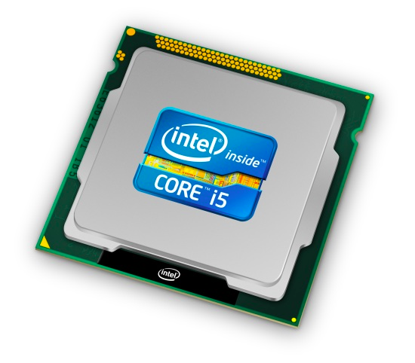
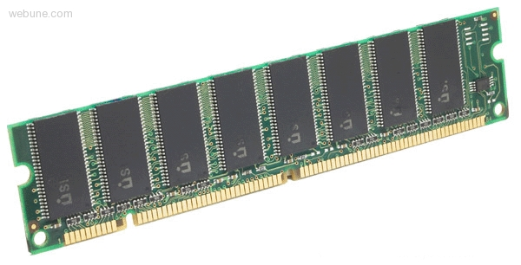

Roadmap
C:
Java:
Memory & data
Arrays & structs
Integers & floats
RISC V assembly
Procedures & stacks
Executables
Memory & caches
Parallelism
Processor Pipeline
Performance
car *c = malloc(sizeof(car));
c->miles = 100;
c->gals = 17;
float mpg = get_mpg(c);
free(c);
Car c = new Car();
c.setMiles(100);
c.setGals(17);
float mpg =
c.getMPG();
Assembly language:
OS:
Machine code:
0111010000011000
100011010000010000000010
1000100111000010
110000011111101000011111
Computer system:

Slide 4
What is a computer program?
for (int i = 0; i < N; i++){
output[i] = x[i] * y[i];
}

Slide 5
What is a (sequential) computer program?
Processor executes instruction referenced by the program counter (PC)
(executing the instruction will modify machine state: contents of registers, memory, CPU state, etc.)
# a0: &x[0], a1: &y[0], a2: &output[0], a5: N
# t1 = 0: loop index i
loop:
# load x[i] and y[i]
lw a4,0(a0)
lw a3,0(a1)
# multiplication
mul a4,a4,a3
# store word
sw a4,0(a2)
# Bump pointers
addi a0,a0,4
addi a1,a1,4
addi a2,a2,4
addi t1,t1,1
bne t1,a5,loop
Move to next instruction …
Then execute it…
And so on…
PC

Slide 6
Scalar Loop
We don’t have to do ops one-at-a-time
for (i = 0; i < N; i++){
output[i] = x[i] * y[i];
}
Vector Loop (data parallelism)
for (i = 0; i < N; i=i+VLEN){
output[i:i+VLEN-1] =
x[i:i+VLEN-1]*y[i:i+VLEN-1];
}

Slide 7
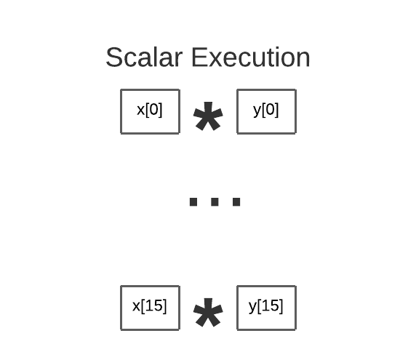
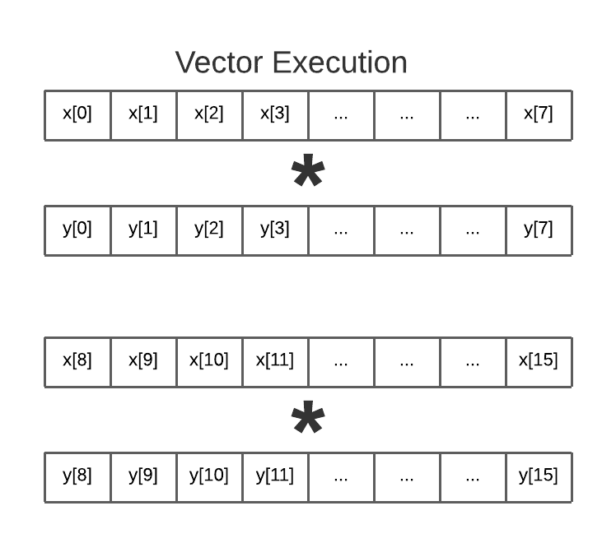

Slide 8
# a0: &x[0], a1: &y[0], a2: &output[0], a5: N
# t1 = 0: loop index i
loop:
# load x[i] and y[i]
lw a4,0(a0)
lw a3,0(a1)
# multiplication
mul a4,a4,a3
# store word
sw a4,0(a2)
# Bump pointers
addi a0,a0,4
addi a1,a1,4
addi a2,a2,4
addi t1,t1,1
bne t1,a5,loop
for (i = 0; i < N; i++){
output[i] = x[i] * y[i];
}
How many total inst?
  9 * N
How many useful inst?
  4 * N (LD,LD,MUL,ST)
How many useless (maintenance) inst?
  5 * N

Slide 9
for (i = 0; i < N; i=i+VLEN){
output[i:i+VLEN-1] =
x[i:i+VLEN-1] * y[i:i+VLEN-1];
}
VLEN : Vector length
How many total inst?
9 * N / VLEN
How many useful inst?
4 * N / VLEN
How many useless inst?
5 * N / VLEN

Slide 10
Parallel Model: Vector Processing
Vector processors have high-level operations that work on linear arrays of numbers: "vectors"
SCALAR
(1 operation)
VECTOR
(N operations)
r1
r2
v1
v2
+
+
r3
v3
vector
length
add r3, r1, r2
add.vv v3, v1, v2
Notes:
25

Slide 11
Parallel Model: Vector Processing
Vector processors have high-level operations that work on linear arrays of numbers: "vectors"
SCALAR
(1 operation)
VECTOR
(N operations)
r1
r2
v1
v2
+
+
r3
v3
vector
length
add r3, r1, r2
add.vv v3, v1, v2
out[0] = x[0]+y[0]
out[1] = x[1]+y[1]
….
out[0:VLEN-1] = x[0:VLEN-1] + Y[0:VLEN-1]
out[VLEN:2*VLEN-1] = x[VLEN:2*VLEN-1]
+ y[VLEN:2*VLEN-1] …
Notes:
25

Slide 12
Why Parallelism?
Why Efficiency?

Slide 13
A parallel computer is a collection of processing elements that cooperate to solve problems quickly
We care about performance
and efficiency
We’re going to use multiple
processing elements to get it

Slide 14
Speedup
One major motivation of using parallel processing: Speedup
For a given problem:
execution time using 1 element
speedup =
execution time using P elements

Slide 15
Vector Registers
32 vector data registers, v0-v31, each VLEN bits long
Vector length register vl
Vector type register vtype
Vector data registers
VLEN bits per vector register, (implementation-dependent)
Vector register file
  Each register is an array of elements
  Size of each register determines maximum vector length
  Vector length register determines vector length for a particular operation
Multiple parallel execution units = “lanes”
(sometimes called “pipelines” or “pipes”)
v0
v31
Vector length register
vl
Vector type register
vtype

Slide 16
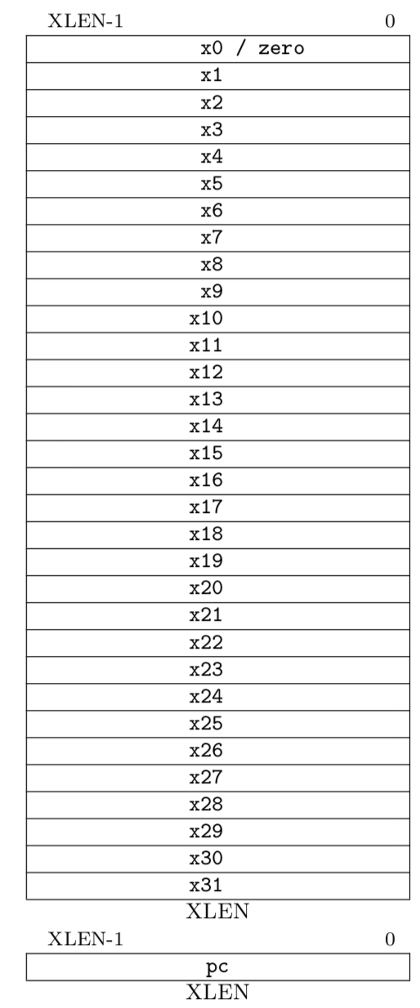
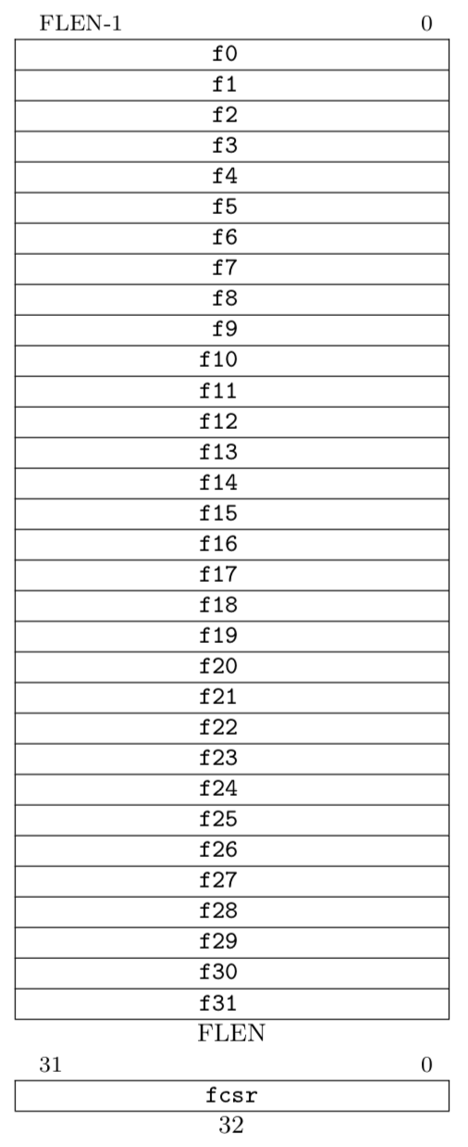
RISC-V Scalar State
Program counter (pc)
32x32/64-bit integer registers (x0-x31)
x0 always contains a 0
Floating-point (FP), adds 32 registers (f0-f31)
each can contain a single- or double-precision FP value (32-bit or 64-bit IEEE FP)
FP status register (fcsr), used for FP rounding mode & exception reporting
ISA string options:
RV32I (XLEN=32, no FP)
RV32IF (XLEN=32, FLEN=32)
RV32ID (XLEN=32, FLEN=64)
RV64I (XLEN=64, no FP)
RV64IF (XLEN=64, FLEN=32)
RV64ID (XLEN=64, FLEN=64)

Slide 17
Vector Extension Additional State
32 vector data registers, v0-v31, each VLEN bits long
Vector length register vl
Vector type register vtype
Other control registers:
  vstart
    For trap handling
  vrm/vxsat
    Fixed-point rounding mode/saturation
    Also appear in separate vcsr
  vlenb
    Gives vector length in bytes (read-only)
Vector data registers
VLEN bits per vector register, (implementation-dependent)
v0
v31
Vector length register
vl
Vector type register
vtype

Slide 18

Baseline CPU
Fetch PC
mul a4,a4,a3
ALU 0
(scalar)
Scalar Reg

Slide 19
Vector CPU: Add arithmetic units to increase compute capability
Fetch PC
vmul v4,v4,v3
Fetch Inst
Single instruction, multiple data
ALU 0
ALU 1
ALU 2
ALU 3
- Parallelism: Multiple data elements
ALU 4
ALU 5
ALU 6
ALU 7
- Efficiency: Fetch single instruction
Same instruction broadcast on all ALUs
Each instruction updates/reads multiple elements from vector register
Vector Reg

Slide 20
Virtual Processor Vector Model
Vector operations are SIMD
(single instruction multiple data) operations
Each element is computed by a virtual processor (VP)
Number of VPs given by vector length
  Vector control register
Notes:
26

Slide 21
Vector Architectural State
Virtual Processors (#vir)
VP₀
VP₁
VP_{#vlr-1}
General
Purpose
Registers
vr₀
Control
Registers
vr₁
vr₃₁
vcr₀
#vdw bits
vcr₁
vf₀
Flag
Registers
(32)
vf₁
vcr₃₁
32 bits
vf₃₁
1 bit
Notes:
27

Slide 22
Vector Terminology:
4 lanes, 2 vector functional units
(Vector
Functional
Unit)
Notes:
34

Slide 23
Vector Code
Scalar Code
for (i = 0; i < N; i++){
output[i] = x[i] + y[i];
}
for (i = 0; i < N;i=i+VLEN){
output[i:i+VLEN] =
x[i:i+VLEN] + y[i:i+VLEN];
}
loop:
# load x[i] and y[i]
lw a5,0(a2)
lw a6,0(a3)
# addition
add a5,a5,a6
# store word
sw a5,0(a1)
# Bump pointers
addi a1,a0,4
addi a2,a1,4
addi a3,a2,4
addi a3,a2,4
sub a0,a0,1
bnez a0, loop
loop: # t0=VLEN
# load x[I,i+VLEN], y[] vle32.v v8, (a2)
vle32.v v16, (a3)
# addition
vadd.vv v24,v8,v16
# store res[i:i+VLEN]
vse32.v v24,(a1)
# Bump pointers
slli t1,t0,2
add a2, a2,t1
add a3,a3,t1
add a1,a1,t1
# Bump loop by vlen
sub a0,a0,t0
bnez a0, loop

Slide 24
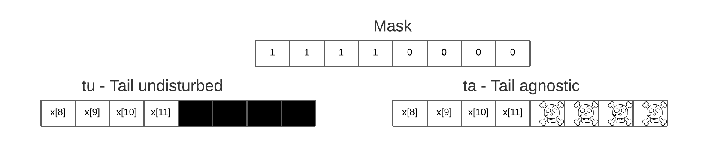
Agnostic vs Undisturbed
vsetvli t0, a0, e32, m1, ta, ma
ta – Tail agnostic
tu – Tail undisturbed
ma – Mask agnostic
mu – Mask undisturbed

Slide 25
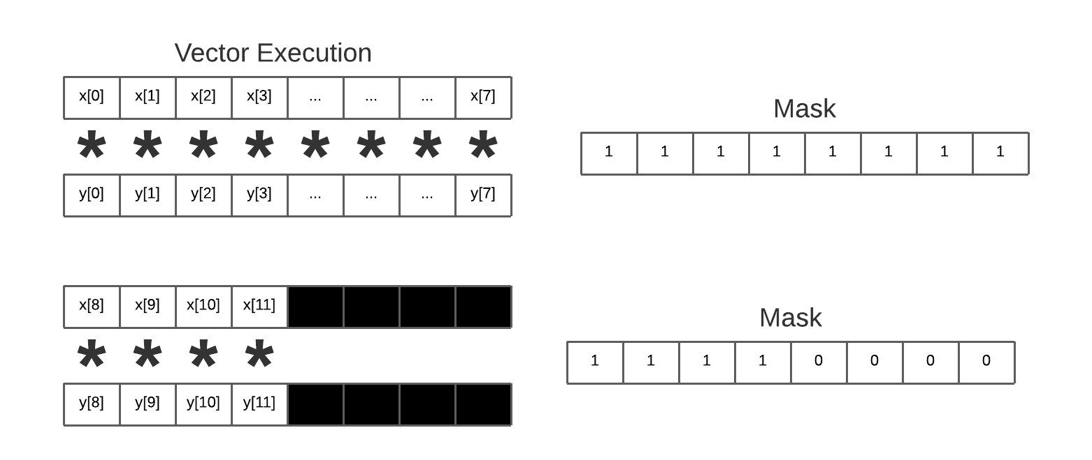
Tail Processing 1: VLEN
loop:
vsetvli t0, a0, e32 # Set VLEN
# load x[I,i+VLEN], y[] vle32.v v8, (a2)
vle32.v v16, (a3)
# addition
vadd.vv v24,v8,v16
# store res[i:i+VLEN]
vse32.v v24,(a1)
# Bump pointers
slli t1,t0,2
add a2, a2,t1
add a3,a3,t1
add a1,a1,t1
# Bump loop by vlen
sub a0,a0,t0
bnez a0, loop
Remaining = N
for (i = 0; i < N;){
int VLEN;
if (N-i > MAX_VLEN)
VLEN = MAX_VLEN
else
VLEN = N-i
setvl(VLEN)
res[i:i+VLEN] =
x[i:i+VLEN] + y[i:i+VLEN];
}

Slide 26
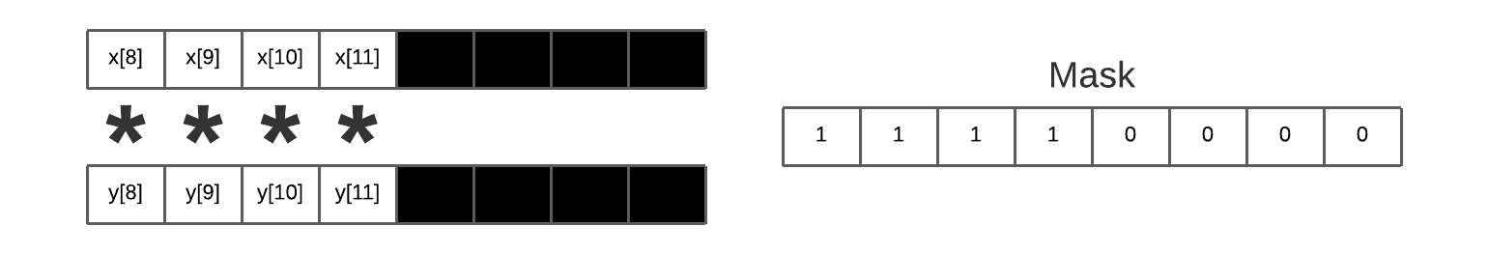
Masking and Conditional Ops
Why?
Disable unwanted vector lanes
Conditional branches where different operations are executed for different vector elements
Handling tail/left-over elements when software array length not multiple of vector width.

Slide 27
Tail Processing 2 : Masks
for (i = 0; i + VLEN < N; i = i+VLEN){
res[i:i+VLEN] =
x[i:i+VLEN] + y[i:i+VLEN];
}
Bool msk1[VLEN] = {0};
while(i<VLEN) {
msk1[i] = 1
i++;
}
res[i:i+VLEN] = x[i:i+VLEN]+y[i:i+VLEN];#msk1
}

Slide 28
Mask lanes based on condition
for (i = 0; i < N){
if (x[i] != y[i])
res[i] = x[i] + y[i]
else
res[i] = x[i] * 2
}

Slide 29
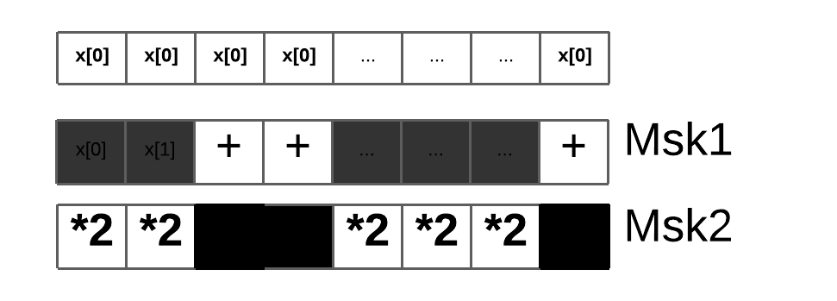
Mask Processing
Mask lanes based on condition
for (i = 0; i < N; i = i+VLEN){
Bool msk1[VLEN], msk2[VLEN];
for i = i to i+VLEN;
if x[i]!=y[i] msk1[i]=true
if x[i]!=y[i] msk2[i]=true
res[i:i+VLEN] = x[i:i+VLEN]+y[i:i+VLEN];#msk1
res[i:i+VLEN] = x[i:i+VLEN]*2;#msk2
}

Slide 30
Utilization
for (i = 0; i + VLEN < N; i = i+VLEN){
res[i:i+VLEN] =
x[i:i+VLEN] + y[i:i+VLEN];
}
Bool msk1[VLEN] = {0};
// Calculate mask
res[i:i+VLEN] = x[i:i+VLEN]+y[i:i+VLEN];#msk1
}
VLEN (hardware) = 8. N (Array size) = 12.
First Iteration: 100% utilization.
Utilization =
MASK(# of 1s)/VLEN
Second Iteration: 50% utilization.

Slide 31



What about conditional branches?
Time
1 2 . . . . . . 8
ALU 1 ALU 2 . . . . . . ALU 8
Assume logic below is to be executed for each element in input array ‘A’ producing output into array ‘result’
<unconditional code>
float x = A[i]; if (x > 0) {
float tmp = exp(x,5.f);
tmp *= kMyConst1;
x = tmp + kMyConst2;
} else {
float tmp = kMyConst1;
x = 2.f * tmp;
}
<resume unconditional code>
result[i] = x;

Slide 32
What about conditional branches?
Time
1 2 . . . . . . 8
ALU 1 ALU 2 . . . . . . ALU 8
Assume logic below is to be executed for each element in input array ‘A’ producing output into array ‘result’
<unconditional code>
float x = A[i]; if (x > 0) {
float tmp = exp(x,5.f);
tmp *= kMyConst1;
x = tmp + kMyConst2;
} else {
float tmp = kMyConst1;
x = 2.f * tmp;
}
<resume unconditional code>
result[i] = x;
T T F T F F F F

Slide 33







Mask discard output of ALUs
Time
1 2 . . . . . . 8
ALU 1 ALU 2 . . . . . . ALU 8
Assume logic below is to be executed for each element in input array ‘A’ producing output into array ‘result’
<unconditional code>
float x = A[i]; if (x > 0) {
} else {
}
<resume unconditional code>
result[i] = x;
T T F T F F F F
float tmp = exp(x,5.f);
tmp *= kMyConst1;
x = tmp + kMyConst2;
float tmp = kMyConst1;
x = 2.f * tmp;
Not All ALUs do useful work
Worst case: 1/8 peak performance

Slide 34

After branch continue normal execution
Time
1 2 . . . . . . 8
ALU 1 ALU 2 . . . . . . ALU 8
Assume logic below is to be executed for each element in input array ‘A’ producing output into array ‘result’
<unconditional code>
float x = A[i]; if (x > 0) {
} else {
}
<resume unconditional code>
result[i] = x;
T T F T F F F F
float tmp = exp(x,5.f);
tmp *= kMyConst1;
x = tmp + kMyConst2;
float tmp = kMyConst1;
x = 2.f * tmp;

Slide 35
Terminology
Instruction stream coherence (“coherent execution”)
  Same instruction sequence applies to all elements operated upon simultaneously
  Coherent execution is necessary for eﬃcient use of SIMD processing resources
  Coherent execution IS NOT necessary for eﬃcient parallelization across cores, since each core has the capability to fetch/decode a diﬀerent instruction stream
“Divergent” execution
  A lack of instruction stream coherence

Slide 36
New RISC-V “V” Vector Extension
Standard extension to the RISC-V ISA
  An updated form of Cray-style vectors for modern microprocessors
  Appearing in commercial implementations from Alibaba, Andes, Semidynamics, SiFive, …
  Basis of European supercomputer initiative (EPI)
Following slides present short tutorial on current standard
  https://github.com/riscv/riscv-v-spec

Slide 37
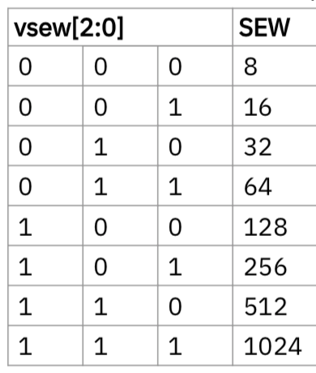
Vector Type Register (vtype)
Ideally, info would be in instruction encoding, but no space in 32-bit instructions.
Planned 64-bit encoding extension would add these as instruction bits.
vsew[2:0] field encodes standard element width (SEW) in bits of elements in vector register (SEW = 8*2^{vsew} )
vlmul[2:0] encodes vector register length multiplier (LMUL = 2^{vlmul} = 1/8 - 8)
vta specifies tail-agnostic
vma specifies mask-agnostic

Slide 38
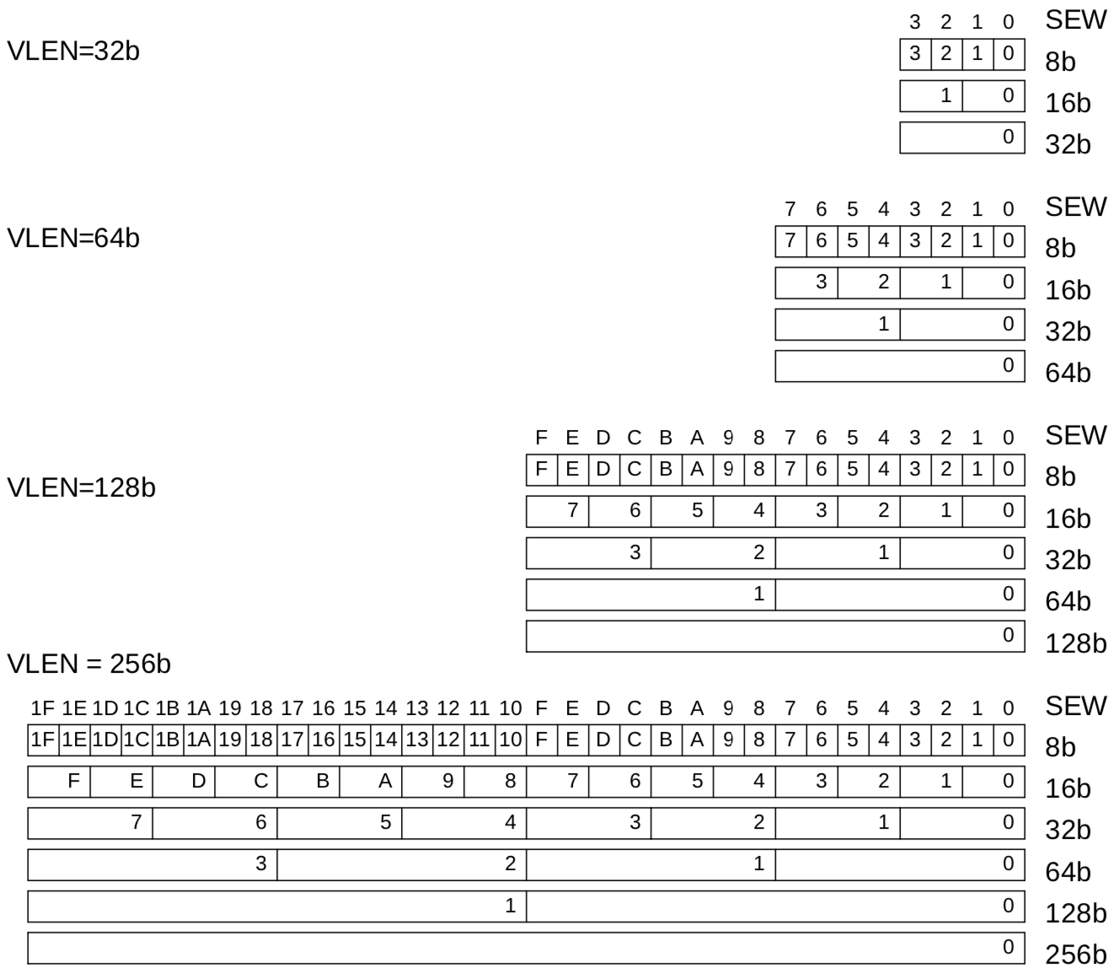
Example Vector Register Data Layouts (LMUL=1)

Slide 39
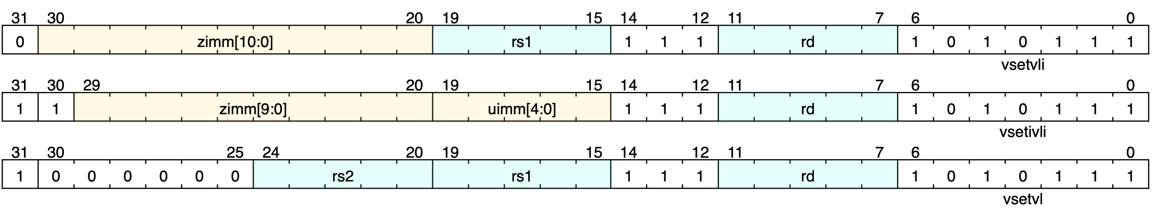
Setting vector configuration, vsetvli/vsetivli/vsetvl
The vset{i}vl{i} configuration instructions set the vtype register, and also set the vl register, returning the vl value in a scalar register
vsetvli rd, rs1, e8 # Set SEW=8, vl=min(VLEN/SEW,rs1), rd=vl
vtype parameters (SEW,LMUL,TA,MA) encoded as immediate in instruction
Resulting machine vector length setting
Requested application vector length
Instruction encoding
Usually use register-immediate form, vsetvli, to set vtype parameters.
Immediate-immediate form, vsetivli, used when vector length known statically
The register-register version vsetvl is usually used only for context save/restore

Slide 40


Vector Length Multiplier, LMUL
Gives fewer but longer vector registers
  Called “vector register groups” – operate as single vectors
  Must use even register names only for LMUL=2 (v0,v2,..), and every fourth register for LMUL=4 (v0,v4, …), etc.
What is LMUL used for?
  1) To increase efficiency by using longer vectors
  2) To accommodate mixed-width operations (e.g., masks)
LMUL=2
LMUL=4

Slide 41
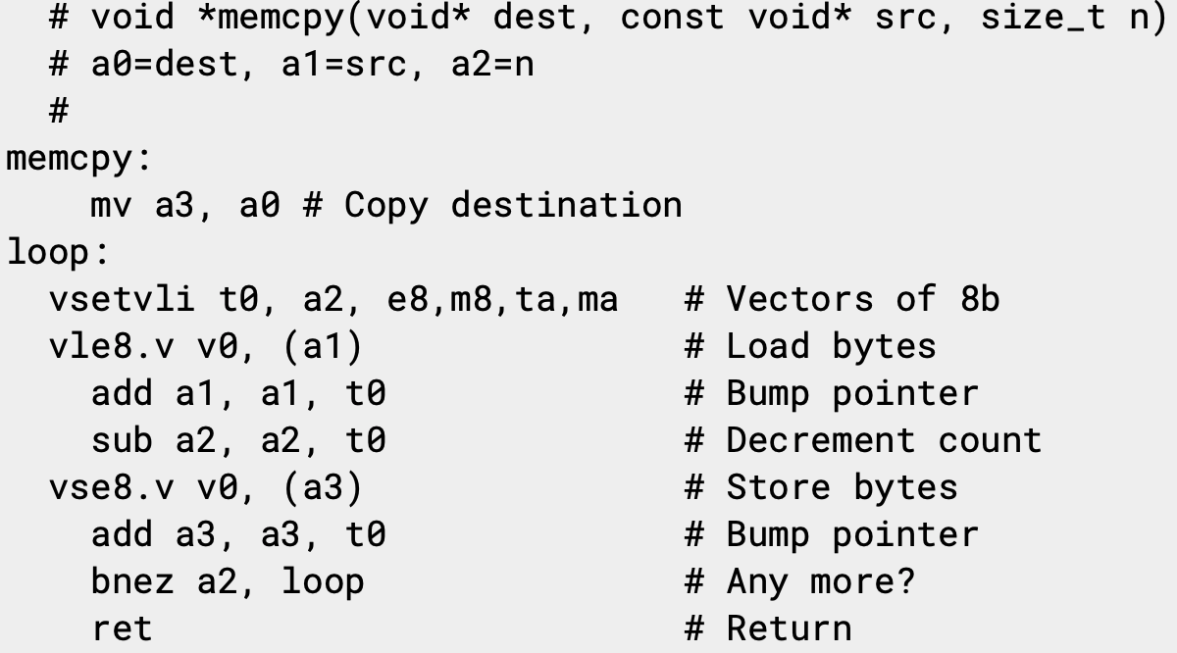
Simple stripmined vector memcpy example
Set configuration, calculate vector strip length
Unit-stride vector load elements (bytes)
Unit-stride vector store elements (bytes)
Same binary machine code can run on machines with any VLEN!

Slide 42
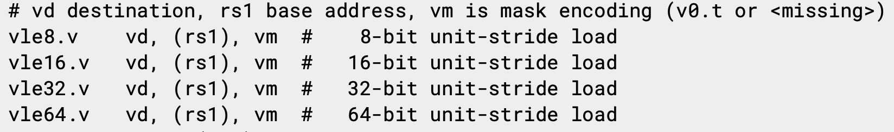
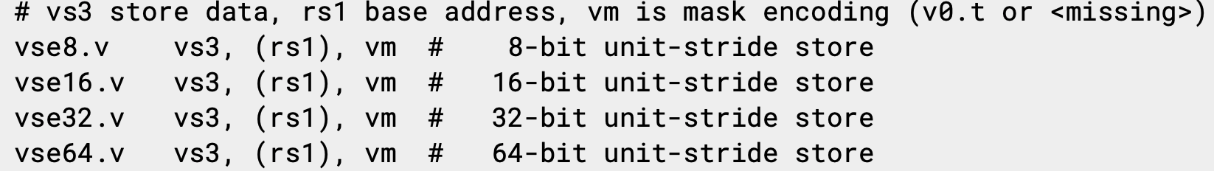
Vector Unit-Stride Loads/Stores
for i = 0 to VLEN - 1
vd[i] = load(rs1 + i)

Slide 43
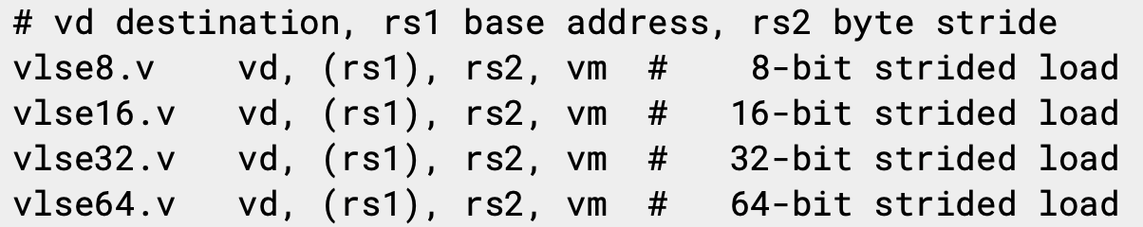
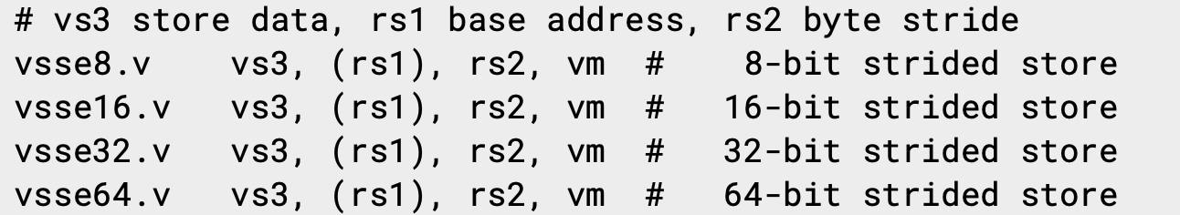
Vector Strided Load/Store Instructions
for i = 0 to VLEN - 1
vd[i] = load(rs1 + i*rs2)

Slide 44
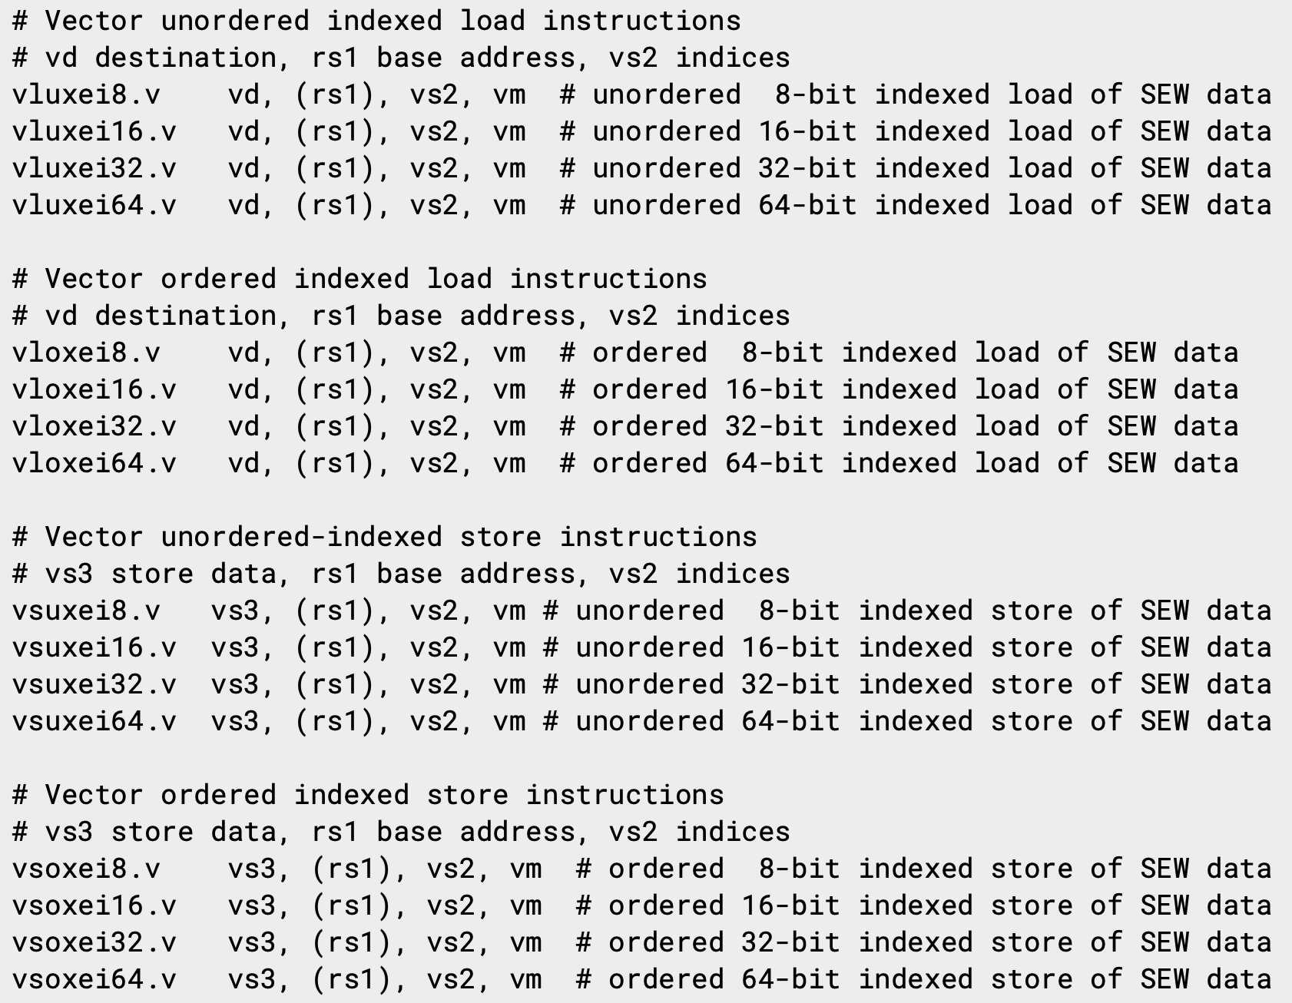
Vector Indexed Loads/Stores
for i = 0 to VLEN - 1
vd[i] = load(rs1 + vs2[i])
Index data width encoded in instruction, while data size encoded in vtype.vsew field

Slide 45
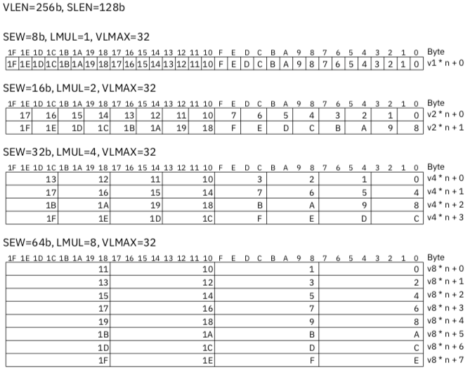

Slide 46
LMUL=8 stripmined vector memcpy example
Combine eight vector registers into group
(v0,v1,…,v7)
Set configuration, calculate vector strip length
Unit-stride vector load bytes
Unit-stride vector store bytes
Binary machine code can run on machines with any VLEN!

Slide 47
Masking
Nearly all operations can be optionally under a mask (or predicate) held in vector register v0
A single vm bit in instruction encoding selects whether unmasked or under control of v0
Integer and FP compare instructions provided to set masks into any vector register
Can perform mask logical operations between any vector registers

Slide 48
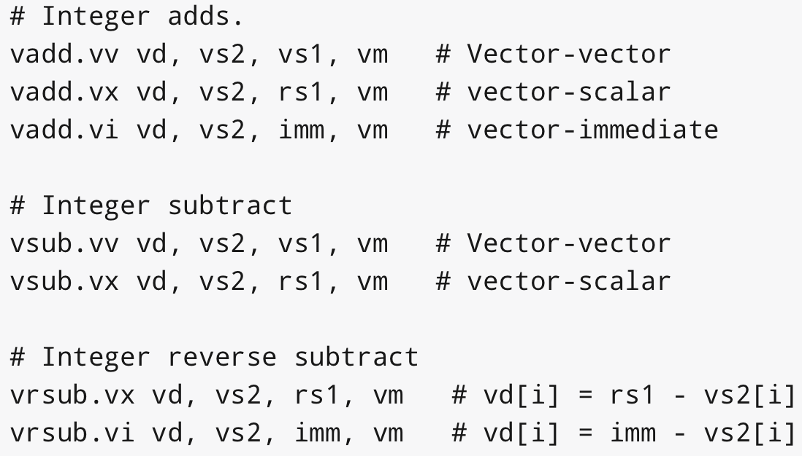
Vector Integer Add Instructions

Slide 49
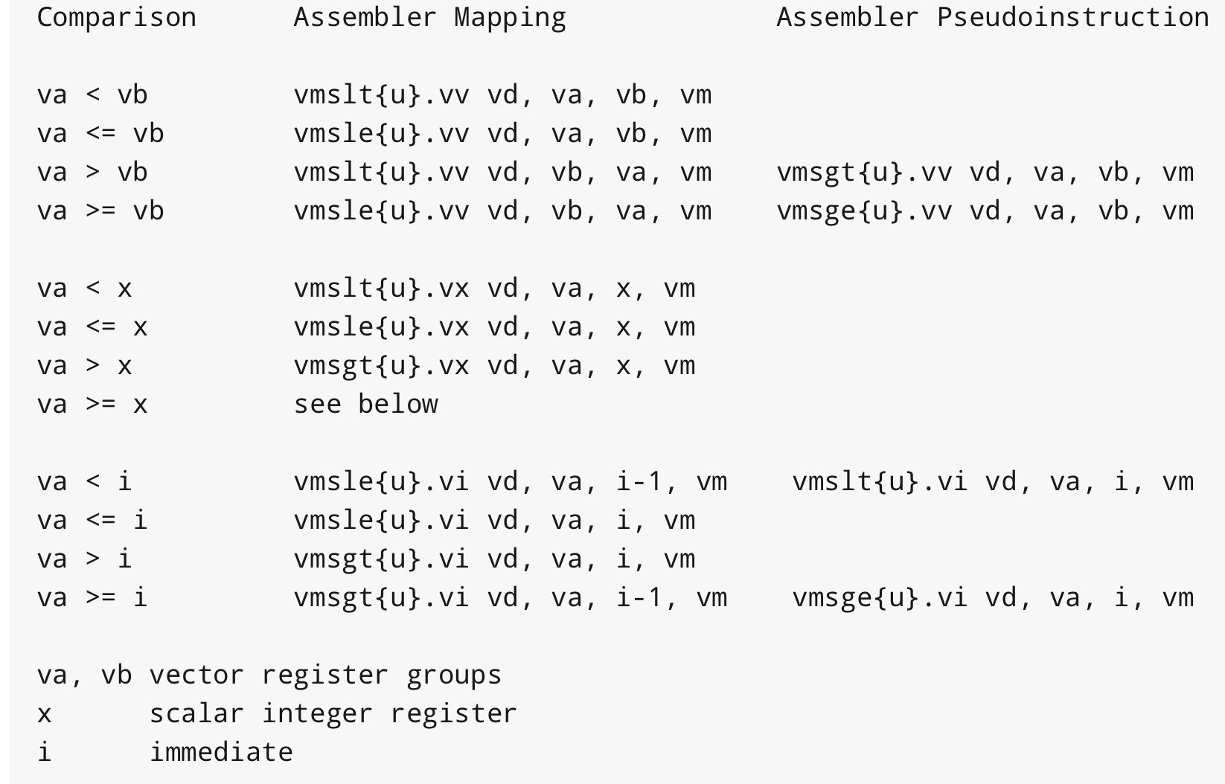
Integer Compare Instructions

Slide 50
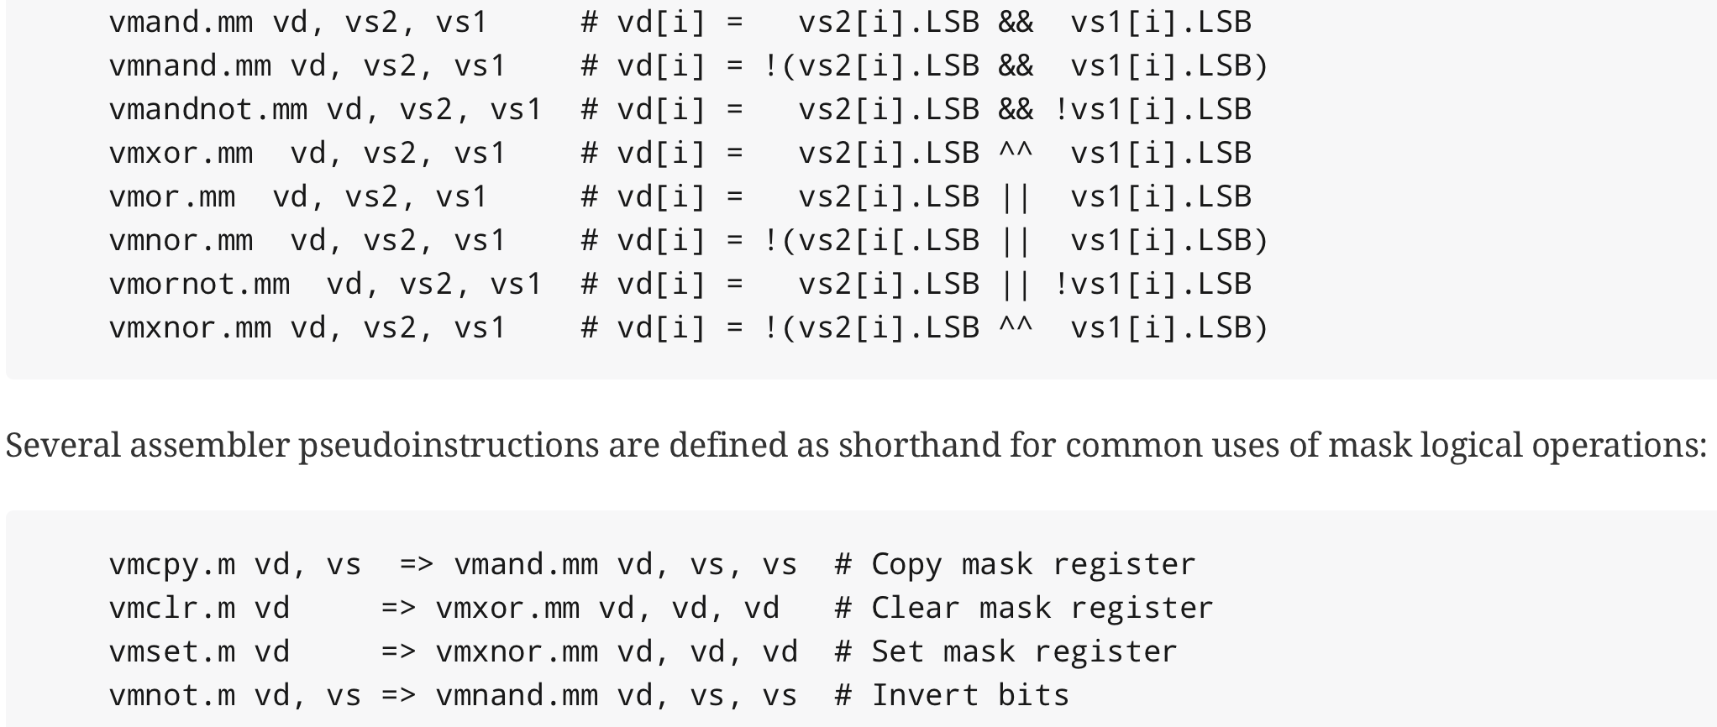
Mask Logical Operations

Slide 51
Agnostic vs Undisturbed
vsetvli t0, a0, e32, m1, ta, ma
ta – Tail agnostic
tu – Tail undisturbed
ma – Mask agnostic
mu – Mask undisturbed

