Slide 1
School of Computing Science
Simon Fraser University
CMPT 300: Operating Systems I
Virtual Memory

Slide 2
Motivation
Instructions must be in physical memory to be executed
Limits program size to physical memory size
Limits multiprogramming
Entire program is typically not need
Unusual exception handling
Arrays, lists, etc. have only some values which are heavily used
Can we hold partial programs in memory?
Yes, using Virtual Memory

Slide 3
Virtual Memory
Separates logical memory from physical memory
Only part of program needs to be in memory for execution
Logical address space can therefore be much larger than physical address space
Allows address spaces to be shared by several processes
Allows for more efficient process creation
Why?
Virtual memory implemented via Demand Paging

Slide 4
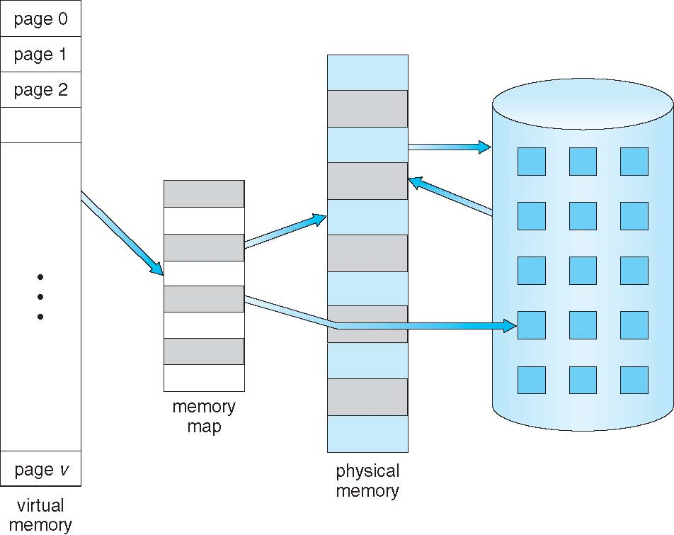
Virtual Memory Can be Larger than Physical Memory
⇒

Slide 5
Process Virtual Address Space
Gap between heap and stack belongs to process, but physical memory allocated only if heap/stack grows
Can be used to dynamically load shared libraries or share memory for communication

Slide 6
Demand Paging
A page is brought into memory only when needed
Benefits?
Less I/O needed
Faster response, because we load only first few pages
More processes can be admitted to the system
How?
Process generates logical (virtual) addresses which are mapped to physical addresses using a page table
If the requested page is not in memory, kernel brings it from hard disk
How do we know whether a page is in memory?

Slide 7
Valid-Invalid Bit
Each page table entry has a valid–invalid bit:
v ⇒ in-memory
i ⇒ not-in-memory
Initially set to i for all entries
During address translation, if valid–invalid bit is i, then it could be:
Illegal reference (outside address space) ⇒ abort process
Legal reference but not in memory ⇒ page fault (bring the page from disk)
Frame #
valid-invalid bit
v
v
v
v
i
….
i
i
page table

Slide 8
Handling Page Fault
OS looks at table to figure out:
Invalid reference ➔ abort process
Just not in memory ➔ bring page in
Locate page on disk
Find a free frame
Swap page from disk to frame (I/O operation)
Reset page table, set validation bit = v
Restart the instruction that caused page fault
3
Page is on backing store
OS
2
Restart instruction
Trap
…
Load x
…
6
i
1
v
Program
4
Page Table
Bring in missing page
(I/O)
5
Free Frame
Reset page table
Physical Memory

Slide 9
Page Fault: Detailed Steps (Worst Case)
Trap to the operating system
Save the user registers and process state
Determine that the interrupt was a page fault
Check that the page reference was legal and determine the location of the page on the disk
Issue a read from the disk to a free frame:
Wait in a queue for this device until the read request is serviced
Wait for the device seek and/or latency time
Begin the transfer of the page to a free frame
While waiting, allocate the CPU to some other process
Receive an interrupt from the disk I/O subsystem (I/O completed)
Save the registers and process state for the other process
Determine that the interrupt was from the disk
Correct the page table and other tables to show page is now in memory
Wait for the CPU to be allocated to this process again
Restore the user registers, process state, and new page table, and then resume the interrupted instruction

Slide 10
Handling a Page Fault (cont’d)
Restarting an instruction: e.g., C ← A + B
Let’s say page fault occurs when accessing C (after adding A and B)
Bring page that has C in memory (I/O: so process may be suspended)
(Again) Fetch ADD instruction
(Again) Fetch A and B
(Again) Perform addition of A and B
Then store result in C
Restarting an instruction can be complicated, e.g.,
MVC (Move Character) instruction in IBM 360/370 systems
Can move up to 256 bytes from one location to another, possibly overlapping
Page fault may occur in the middle of copying
Issues?
Some data may be overwritten so restarting instruction won’t work
Solution?
Maintain previous values in registers so that work can be undone
Hardware attempts to access ends of both blocks; if any is not in memory, a page fault occurs before executing instruction
Bottom line: Demanding paging may raise subtle problems and they must be addressed

Slide 11
Performance of Demand Paging
Page Fault Rate 0 ≤ p ≤ 1.0
0 = no page faults; 1 = every reference is a fault
Effective Access Time?
= (1 – p) x memory access time
+ p x page fault time
page fault time = service page-fault interrupt (~microseconds)
+ read in requested page (~milliseconds)
+ restart process (~microseconds)
Note: Reading in requested page may require writing another page to disk if there is no free frame

Slide 12
Demand Paging: Example
Memory access time = 200 nanoseconds
Average page fault time = 8 milliseconds
(disk latency, seek and transfer time)
Effective access time?
= (1 – p) x 200 (nsec) + p x 8 (msec)
= (1 – p) x 200 + p x 8,000,000
= 200 + p x 7,999,800 (nsec)
For p = 0.001 (1 page fault every 1,000 memory references):
Effective Access Time = 8200 nsec (40X slowdown)
Bottom line: We should minimize number of page faults because they are very very costly

Slide 13
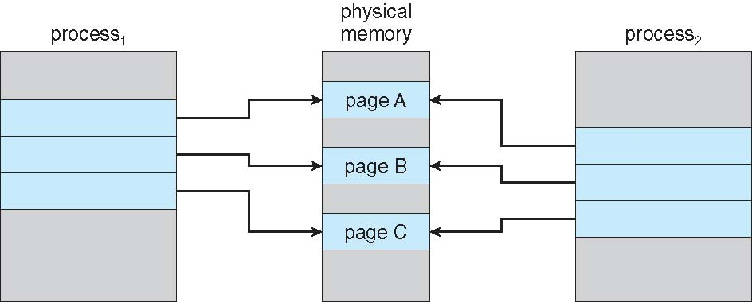
Virtual Memory and Process Creation
VM allows faster/efficient process creation using
Copy-on-Write (COW) technique
COW allows both parent and child processes to initially share the same pages in memory (during fork())

Slide 14
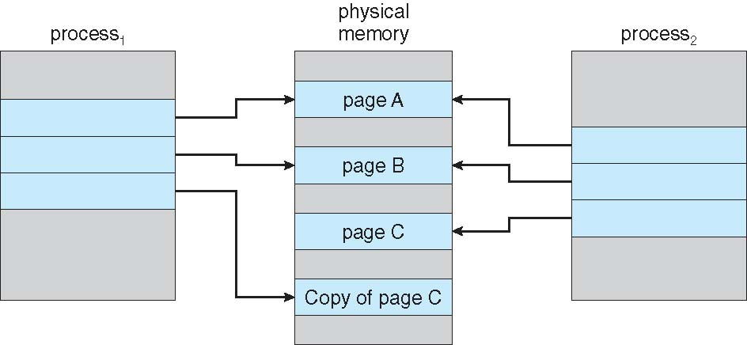
Virtual Memory and Process Creation
VM allows faster/efficient process creation using
Copy-on-Write (COW) technique
COW allows both parent and child processes to initially share the same pages in memory (during fork())
If either process modifies a shared page, page is copied

Slide 15
Minor v/s Major Page Faults
Major Page fault
Need to bring page from disk
Expensive, includes I/O
Minor Page Fault
Does not need to bring page from disk
Very fast (just updates the page table)
Examples:
Shared pages (which already in memory) but not linked with the process address space yet
Dynamic memory allocation (malloc) where kernel may not actually allocate physical memory until it is accessed

Slide 16
Linux Commands to Explore
ps -eo min_flt,maj_flt,pid,cmd
Prints minor and major page faults for all (-e) processes running in the system with the format (-o) specified
/usr/bin/time -v ls
Prints details running a command (“ls” in this case) including minor/major page faults
vmstat
reports information about processes, memory, paging, IO, traps, and cpu activity
getconf PAGESIZE
Displays the page size
top
Press ‘f’ while running, then chose nMaj and nMin to show major and minor page faults
Notes:
Use below to clear cache so that major fault changes for “ls”
sudo sync ; sudo sh -c "/bin/echo 3 > /proc/sys/vm/drop_caches";
Vmstat 2 6 === report every 2 seconds for 6 iterations

Slide 17
Page Replacement: Overview
When Page fault occurs, OS needs to bring requested page from disk to memory
Find location of the requested page on disk
Find a free frame:
If there is a free frame, use it
Else use page replacement algorithm to select a victim page to evict from memory
Bring requested page into the free frame
Update the page table and free frame list
Resume the process
Notes:
Don’t need to kill an entire process

Slide 18
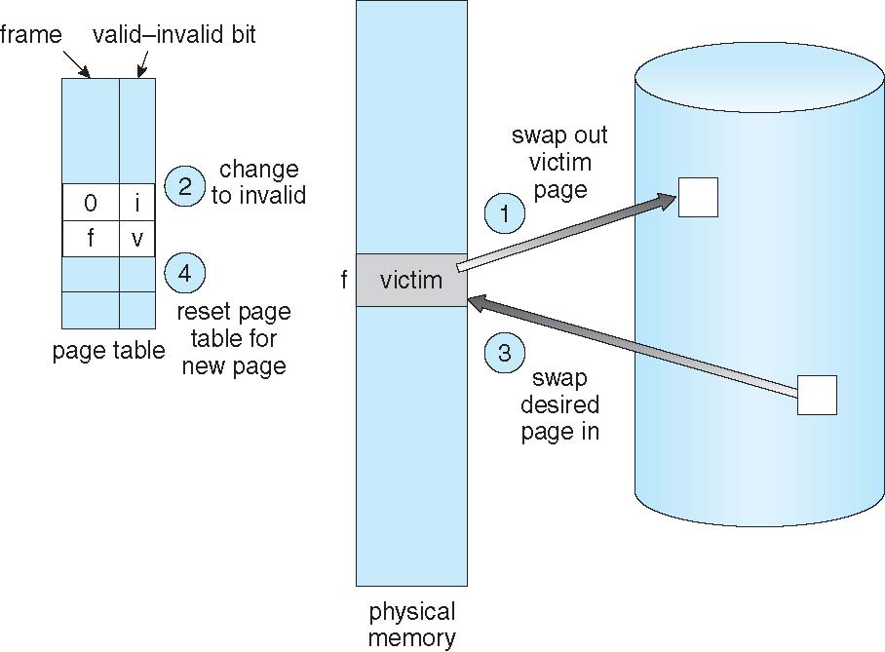
Page Replacement: Overview (cont’d)
We can save swap out overhead if victim page was NOT modified
Significant savings (I/O operation)
Associate a dirty (modify) bit with each page to indicate whether a page has been modified
How do we choose the victim page? What would be the goal of this selection algorithm?

Slide 19
Page Replacement Algorithms
Objective: minimize page-fault rate
Algorithm evaluation
Take a particular string of memory references, and
Compute number of page faults on that string
The reference string looks like:
1, 2, 3, 4, 1, 2, 5, 1, 2, 3, 4, 5
Notes
We use page numbers
The address sequence could have been: 100, 250, 270, 301, 490, 100, … Assuming a page of size 100 bytes.
References 250 and 270 are in the same page (page 2); only the first one may cause a page fault.

Slide 20
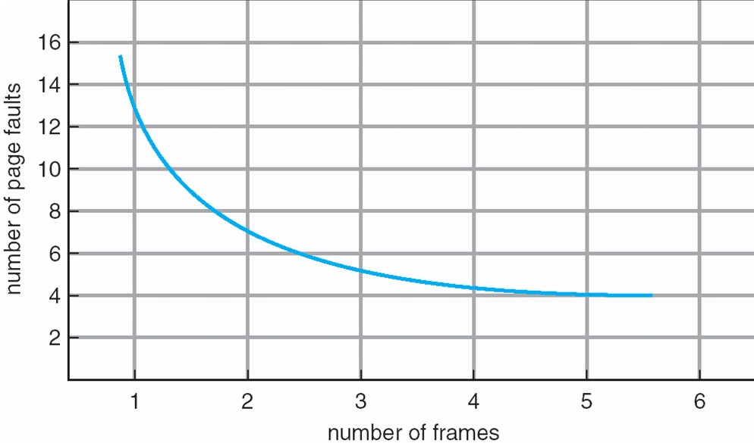
Page Faults vs. Number of Frames
We expect number of page faults to decrease as number of physical frames allocated to process increases

Slide 21
Page Replacement: First-In-First-Out (FIFO)
Reference string: 1, 2, 3, 4, 1, 2, 5, 1, 2, 3, 4, 5
3 frames (3 pages can be in memory at any time)
Let’s work it out
On every page fault, we show memory contents
Number of page faults: 9
1, 2, 3, 4, 1, 2, 5, 1, 2, 3, 4, 5
1
1
1
4
4
4
5
5
5
2
2
2
1
1
1
3
3
3
3
3
2
2
2
4

Slide 22
Page Replacement: First-In-First-Out (FIFO)
Reference string: 1, 2, 3, 4, 1, 2, 5, 1, 2, 3, 4, 5
4 frames (4 pages can be in memory at any time)
Let’s work it out
Number of page faults: 10
1, 2, 3, 4, 1, 2, 5, 1, 2, 3, 4, 5
Anything odd?
1
1
1
1
5
5
5
5
4
4
2
2
2
2
1
1
1
1
5
3
3
3
3
2
2
2
2
4
4
4
4
3
3
3

Slide 23
FIFO: Belady’s Anomaly
More frames may result in more page faults!

Slide 24
Page Replacement: First-In-First-Out (FIFO)
Pros
Easy to understand and implement
Cons
Performance may not always be good:
May replace a page that is used heavily
Belady’s anomaly

Slide 25
Optimal Page Replacement Algorithm
Can you guess the optimal replacement algorithm?
Replace page that will not be used for longest period of time
4-frame example: 1, 2, 3, 4, 1, 2, 5, 1, 2, 3, 4, 5
6 page faults
How do we implement this policy in practice?
Cannot, because we can’t know the future
Used as benchmark for comparing algorithms
1
1
1
1
1
4
2
2
2
2
2
3
3
3
3
4
5
5

Slide 26
Least Recently Used (LRU) Algorithm
Try to approximate Optimal policy: look at past to infer future
Replace page that has not been used for longest period
Rationale: this page may not be needed anymore (e.g., pages of initialization module)
4-frame example: 1, 2, 3, 4, 1, 2, 5, 1, 2, 3, 4, 5
8 page faults (compared to: optimal 6, FIFO 10)
LRU and Optimal do not suffer from Belady’s anomaly
1
1
1
1
1
1
1
5
2
2
2
2
2
2
2
3
3
5
5
4
4
4
4
3
3
3
Notes:
Stack Algorithms:
Can be shown that set of pages in memory with n frames will be subset of those with n + 1 frames

Slide 27
LRU Implementation (1): Counters
Every page-table entry has a time-of-use (counter) field
Upon page reference, copy CPU logical clock into this field
CPU clock is maintained in a register and incremented with every memory access
Need to replace a page, search for the page with smallest (oldest) counter value
Cons?
Search time
Updating the time-of-use fields (writing to memory!)
Clock overflow
Needs hardware support (increment clock and update time-of-use field)
Not common in practice

Slide 28
LRU Implementation (2): Stack
Keep stack of page numbers in a doubly-linked list
If a page is referenced, move it to the top
The least recently used page sinks to the bottom
Cons
Each memory reference is bit expensive (requires updating 6 pointers in worst case)
Pros
No search for replacement
Also needs hardware support to update the stack

Slide 29
LRU Implementation (cont’d)
Can we implement LRU without hardware support?
Say by using interrupts, i.e., when hardware needs to update stack or counters, it issues an interrupt and an ISR does the update?
NO! Too costly, it will slow every memory reference by a factor of at least 10

Slide 30
Second-chance (Clock) Replacement
An approximation of LRU
Each page has a reference bit (ref_bit), initially = 0
When page is referenced, ref_bit is set to 1 (by hardware)
Maintain a moving pointer to next (candidate) victim
When choosing a page to replace, check ref_bit of victim:
If ref_bit == 0, replace it
Else set ref_bit to 0
leave page in memory (give it another chance)
move pointer to next page
repeat till a victim is found

Slide 31
Counting Replacement Algorithms
Keep a counter of number of references that have been made to each page
LFU (Least Frequently Used) Algorithm: replace page with smallest count
Argument: page with smallest count is not used often
Problem?
Some pages were heavily used at earlier time, but are no longer needed, will stay in (and waste) memory
MFU (Most Frequently Used) Algorithm: replace page with highest count
Argument: page with the smallest count was probably just brought in and is yet to be used
Problem?
A heavily used module becomes a good candidate for eviction
LFU and MFU are not common in practice

Slide 32
Allocation of Frames
Each process needs a minimum number of pages
Defined by the computer architecture (hardware)
Instruction width and number of address indirection levels
Consider an instruction that takes one operand and allows one level of indirection. What is the minimum number of frames needed to execute it?
load p[addr]
Answer: 3 (load is in a page, addr is in another page, p[addr] is in a third page)
Maximum number of frames allocated to a process is determined by the OS

Slide 33
Frame Allocation
Equal allocation: All processes get the same number of frames
m frames, n processes, so each process gets m/n frames
Proportional allocation: Allocate according to the size of process
Priority: Use proportional allocation using priorities rather than size

Slide 34
Global vs. Local Frame Replacement
Upon page fault, where to pick frame from?
Two ways: global & local
Global replacement
Selects a replacement frame from set of all frames
Process can take frames from another process
Commonly used in operating systems
Pros
Better throughput (process can use any available frame)
Cons
A process cannot control its own page-fault rate

Slide 35
Global vs. Local Frame Replacement (cont’d)
Local replacement
Select from only process’s own set of allocated frames
Pros
Process not impacted by paging behavior of other processes
Cons
Process may suffer from high page-fault rate even though there are lightly used frames allocated to other processes

Slide 36
Thrashing
What happens if a process does not have “enough” frames to maintain its active set of pages in memory?
Page-fault rate is very high. This leads to:
Low CPU utilization, which
Makes OS think that it needs to increase the degree of multiprogramming, thus
OS admits another process to the system (making it even worse!)
Thrashing ≡ a process is busy swapping pages in and out more than executing

Slide 37
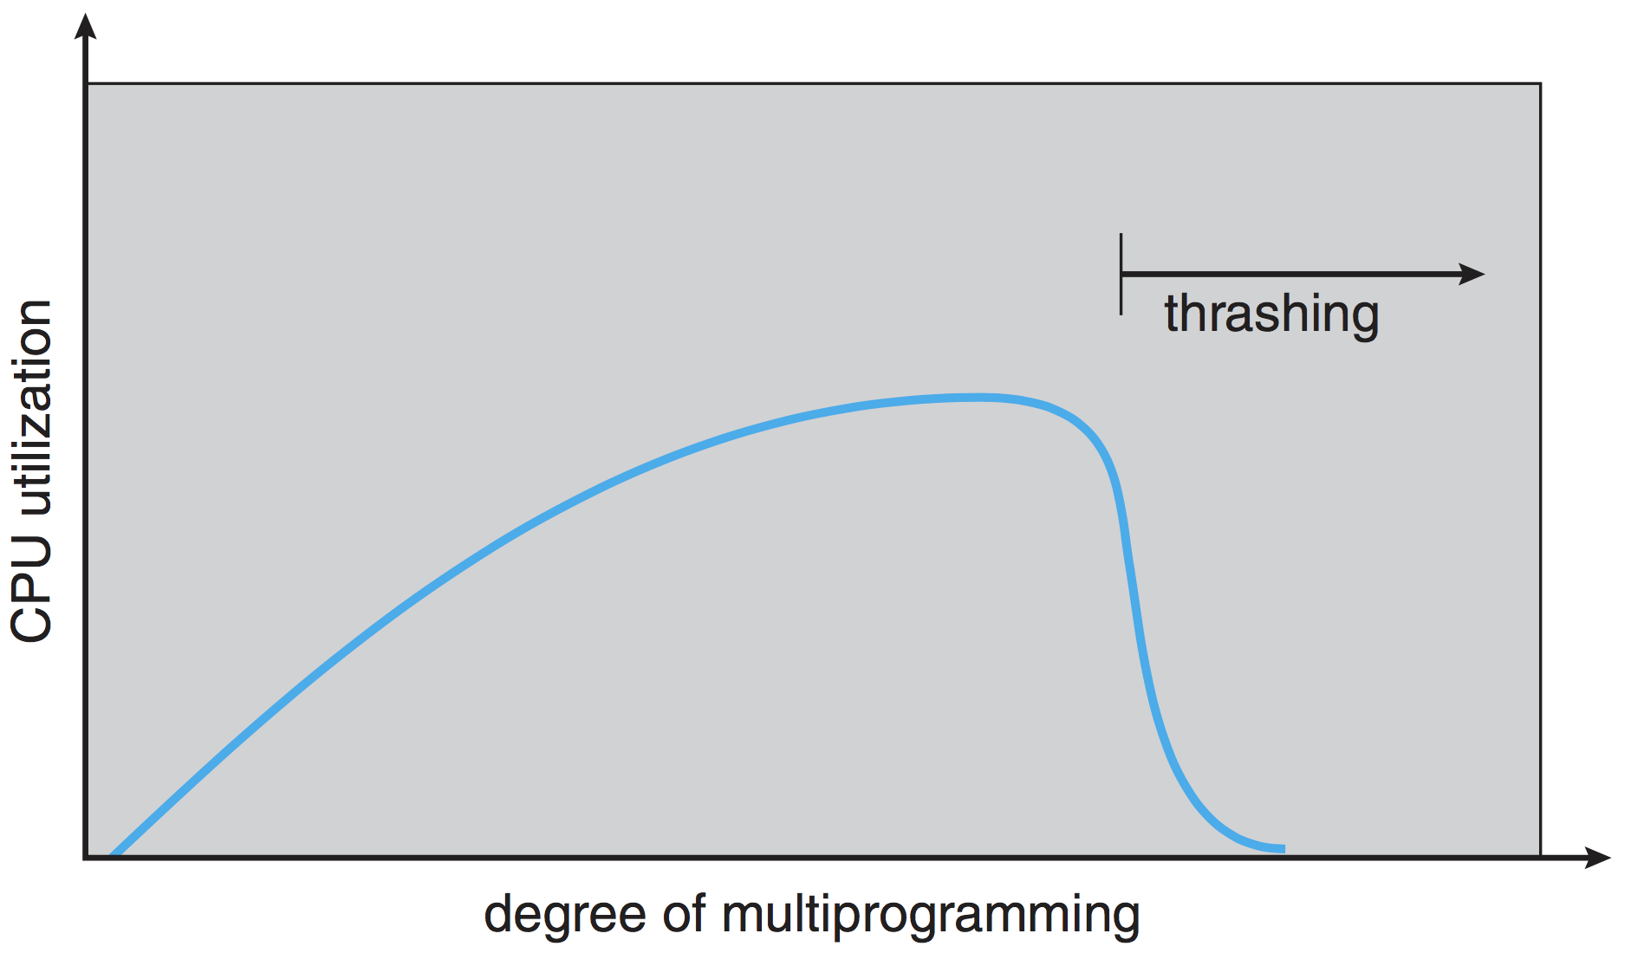
Thrashing (cont'd)

Slide 38
Thrashing (cont'd)
To prevent thrashing, process should have as many frames as it needs
How do we know how many frames a process actually needs?
Programs are composed of several functions or modules
When executing a function, memory references are made to instructions, local and global variables
Idea: Keep pages needed to execute current function
After finishing a function, we execute another function. Then, we bring in pages needed by the new function
This is called the Locality Model

Slide 39
Locality Model
As process executes, it moves from locality to locality
Locality is a set of pages actively used together
Not restricted to functions/modules
Can be a segment of code within/across functions
Example: a loop touching portion of array
How can we know the size of a locality?
Working-Set model

Slide 40
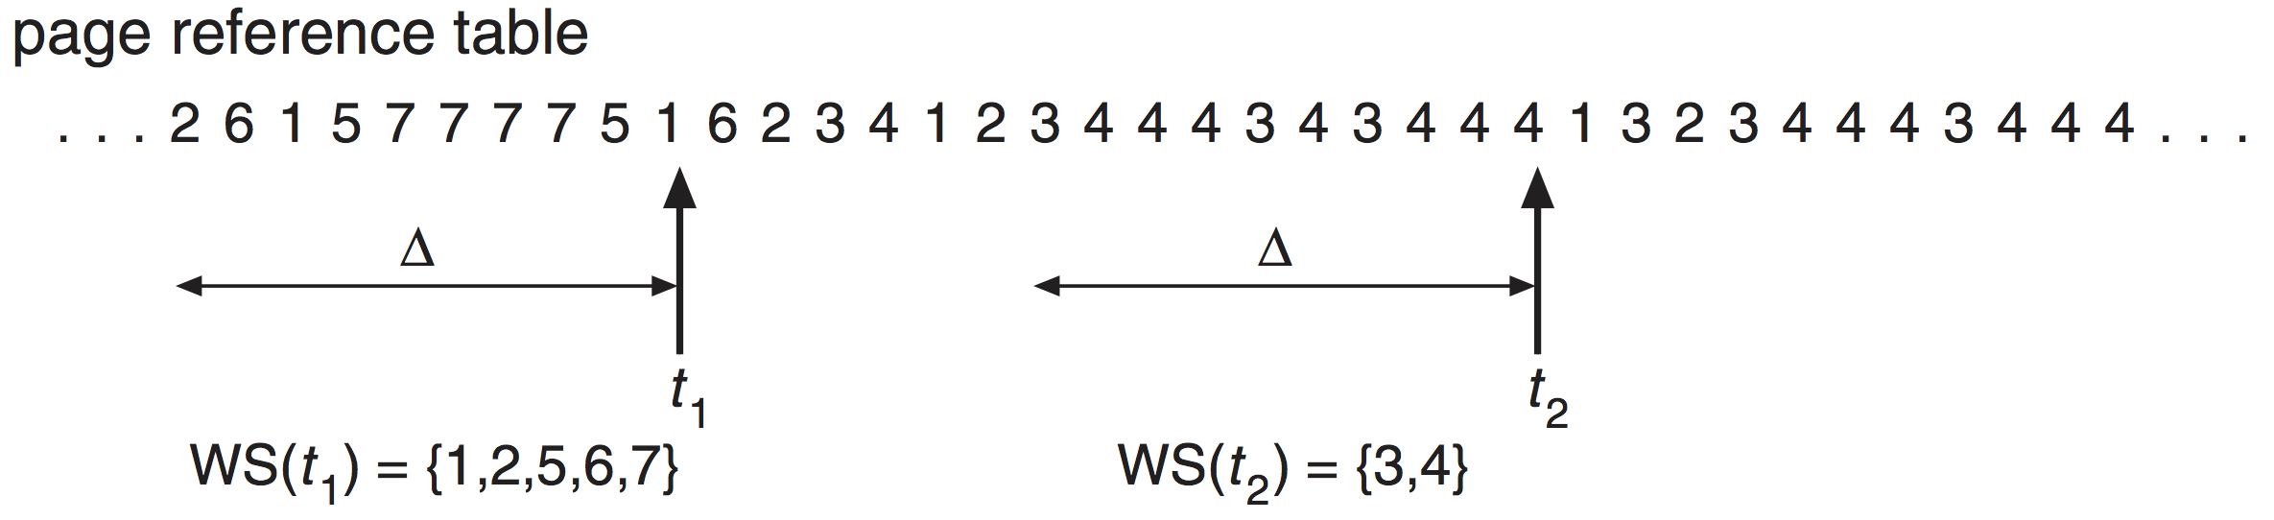
Working-Set Model
Set of pages in most recent Δ memory references is called the working set (WS)
WS is a moving window
At each reference, a new reference is added at one end, and another is dropped off the other

Slide 41
Working-Set Model (cont’d)
Accuracy of WS model depends on choosing Δ
if Δ is too small, it will not encompass entire locality
if Δ is too large, it will encompass several localities
if Δ = ∞, it will encompass entire program
Using WS model
OS monitors the WS of each process
It allocates number of frames = WS size to that process
If we have more memory frames available, another process can be started

Slide 42
Keeping Track of the Working Set
Maintaining the entire working set is costly
Approximate with interval timer + reference bit
(ref_bit is set 1 when a page is referenced)
Example: Δ = 10,000 memory references
Timer interrupts every 5,000 memory references
Keep 2 bits for each page in memory
Whenever timer interrupts
Copy ref_bit into memory bits, and reset ref_bit
Upon page fault, check the three bits (ref_bit, 2 in-memory)
If any of them is 1
Page was used in the last 10,000 to 15,000 references
Put the page in working set
Notes:
Why is this not completely accurate?
We do not know where, within an interval of 5,000, a reference occurred
Improvement ➔ 10 in-memory bits and interrupt every 1000 time units

Slide 43
Thrashing Control Using WS Model
WSS_{i} ≡ working set size of process P_{i}
Total number of pages referenced in most recent Δ
m ≡ memory size in frames
D = Σ WSS_{i} ≡ total demand in frames
If D > m ⇒ Thrashing
Policy: If D > m, then suspend one of the processes
But, maintaining WS is costly! Is there an easier way to control thrashing?

Slide 44
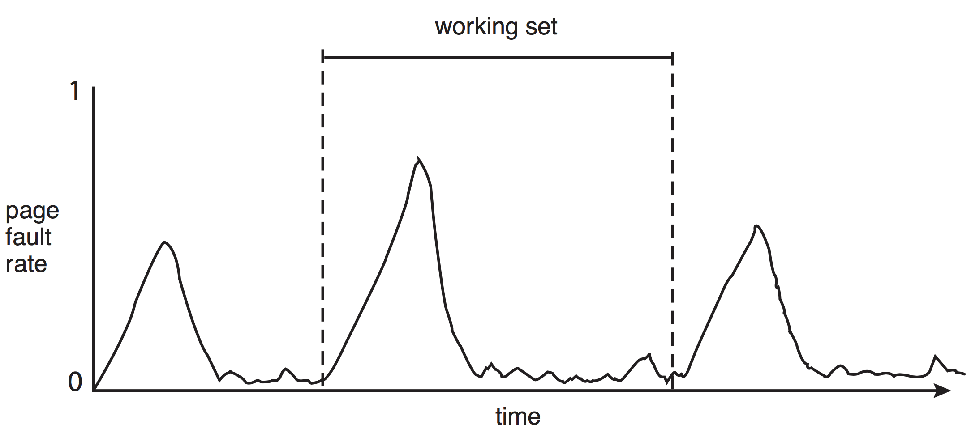
Working Sets and Page Fault Rates
Direct relationship between working set of a process and its page-fault rate
Working set changes over time

Slide 45
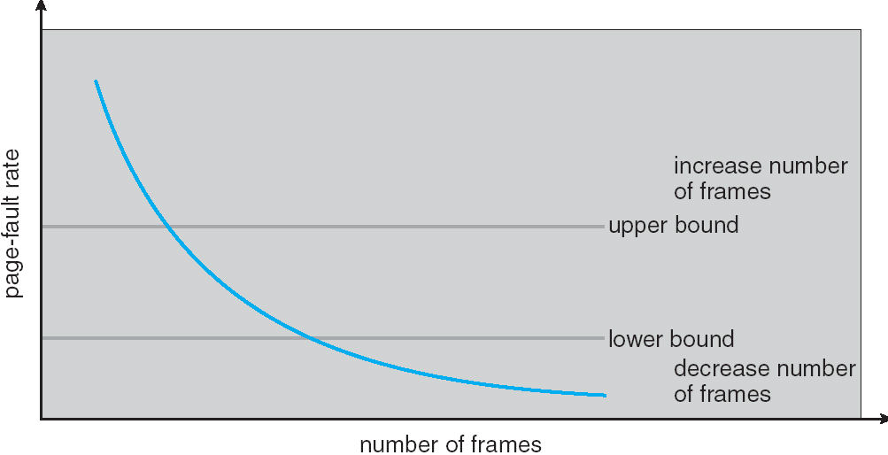
Thrashing Control using Page Fault Rate
Monitor page-fault rate and increase/decrease allocated frames accordingly
Establish “acceptable” page-fault rate range (upper/lower bounds)
If actual rate too low, process loses frame
If actual rate too high, process gains frame

Slide 46
Allocating Kernel Memory
Treated differently from user memory. Why?
Kernel requests memory for structures of varying sizes
Process descriptors (PCB), semaphores, file descriptors, …
Some kernel memory needs to be contiguous
Some hardware devices interact directly with physical memory
Virtual memory may just be too expensive for the kernel (cannot afford a page fault)
Often, a free-memory pool is dedicated to kernel from which it allocates the needed memory.
Examples (Unix/Linux)
Buddy system
Slab allocation

Slide 47
Buddy System
Allocates memory from fixed-size segment consisting of physically-contiguous pages
Memory allocated using power-of-2 sizes
When smaller allocation needed than is available, chunk split into two buddies of next-lower power of 2
Continue until appropriate sized chunk available
Adjacent chunks (“buddies”) are combined together to form a large segment

Slide 48
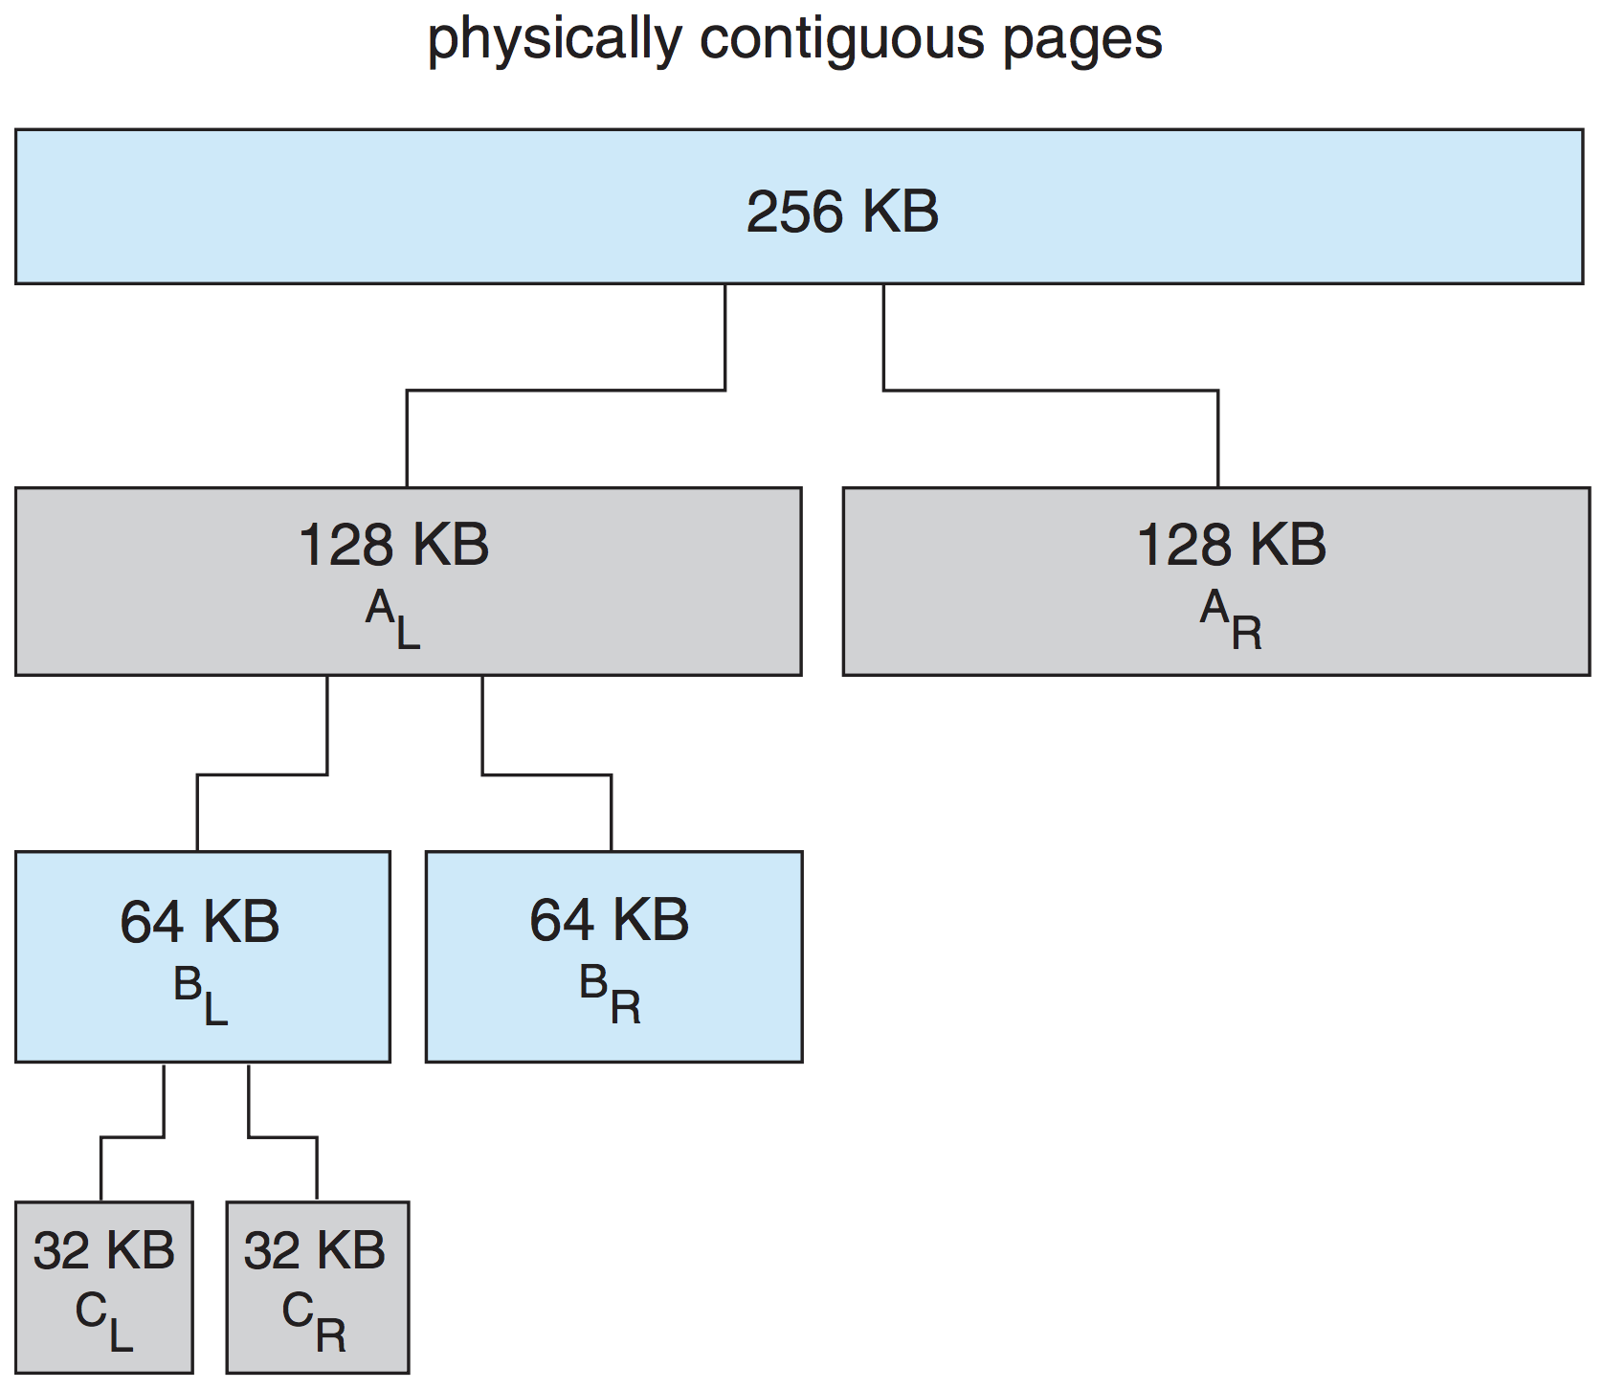
Buddy System Allocator
Issues?
Internal fragmentation (up to 50%)

Slide 49
Slab Allocator
Slab allocator
Creates 'caches', each consisting of one or more slabs
Slab is one or more physically contiguous pages
A cache for each unique kernel data structure
Each cache is filled with object instantiations
Objects are initially marked as free
When structures stored, objects marked as used
Benefits
No fragmentation
Fast memory allocation
Notes:
Current Linux uses SLUB (optimized ver of SLAB) – page 439

Slide 50
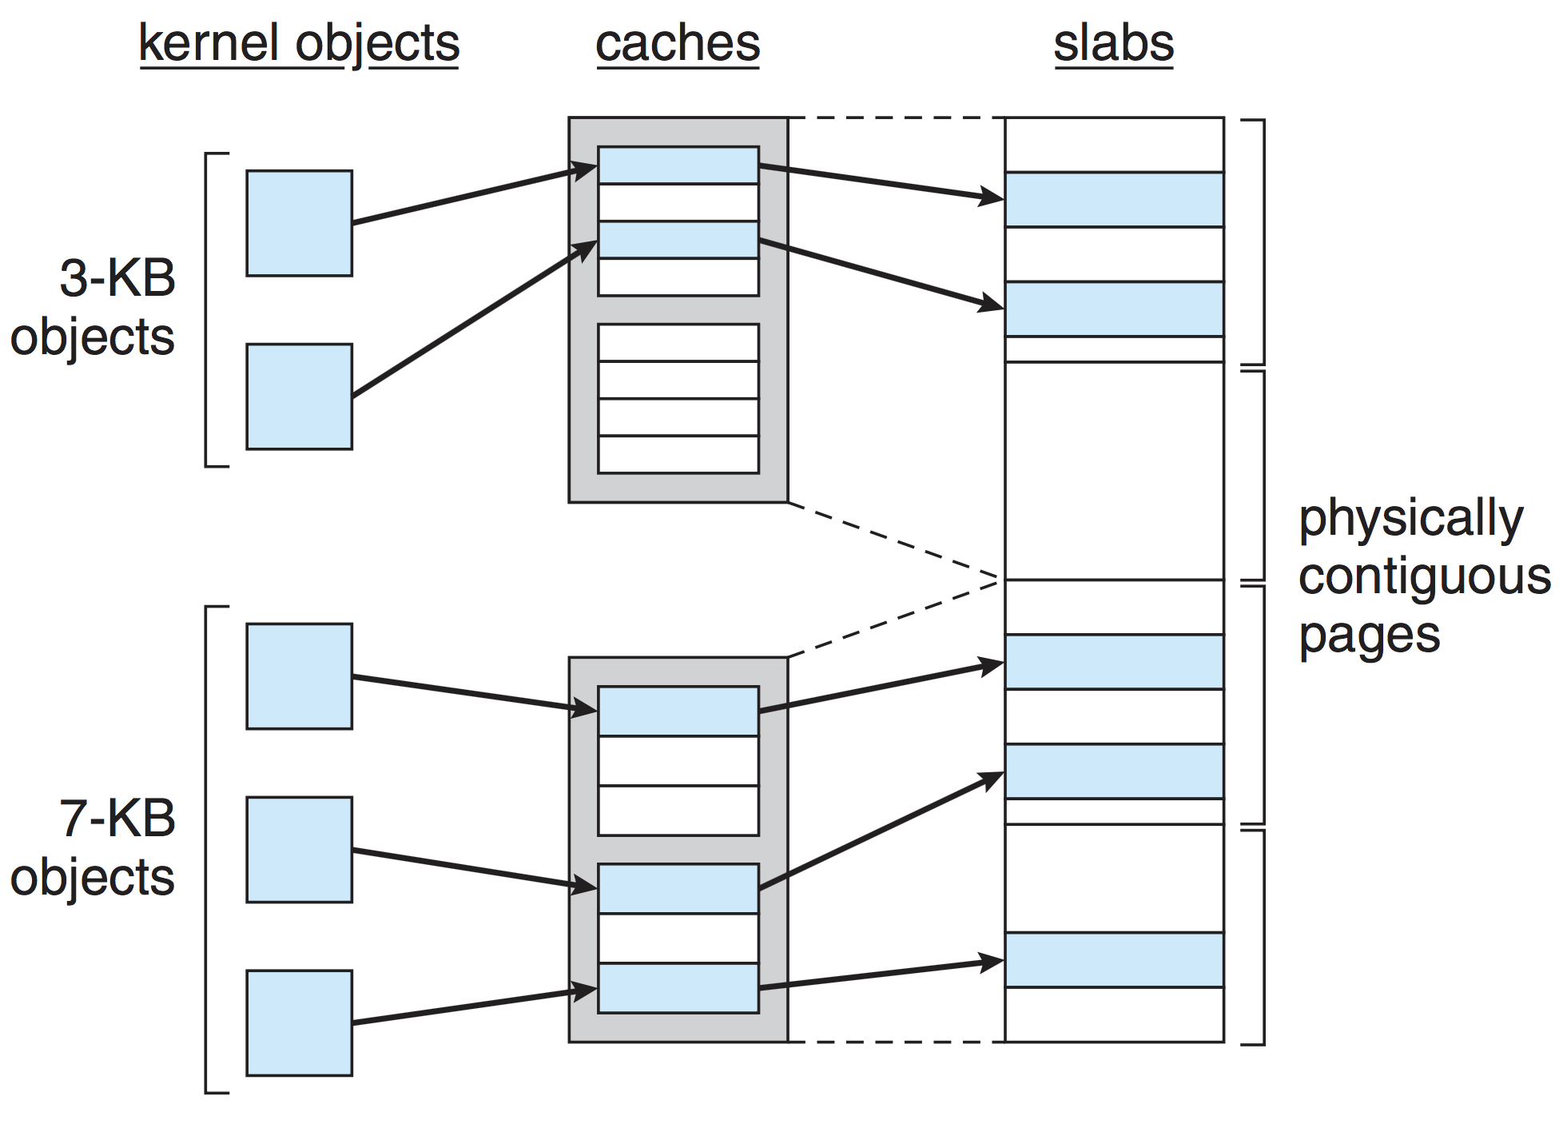
Slab Allocation

Slide 51
Memory-Mapped Files
Mapping a file to the memory address space
How?
A page-sized portion of the file is read from the file system into a physical frame
Subsequent reads/writes to/from file are treated as ordinary memory accesses
Example: mmap() on Unix systems
Why?
Efficient: memory accesses are less costly than I/O system calls
Simplicity: I/O operations (e.g., read(), write()) on files are treated as memory accesses
One way of implementing shared memory for IPC

Slide 52
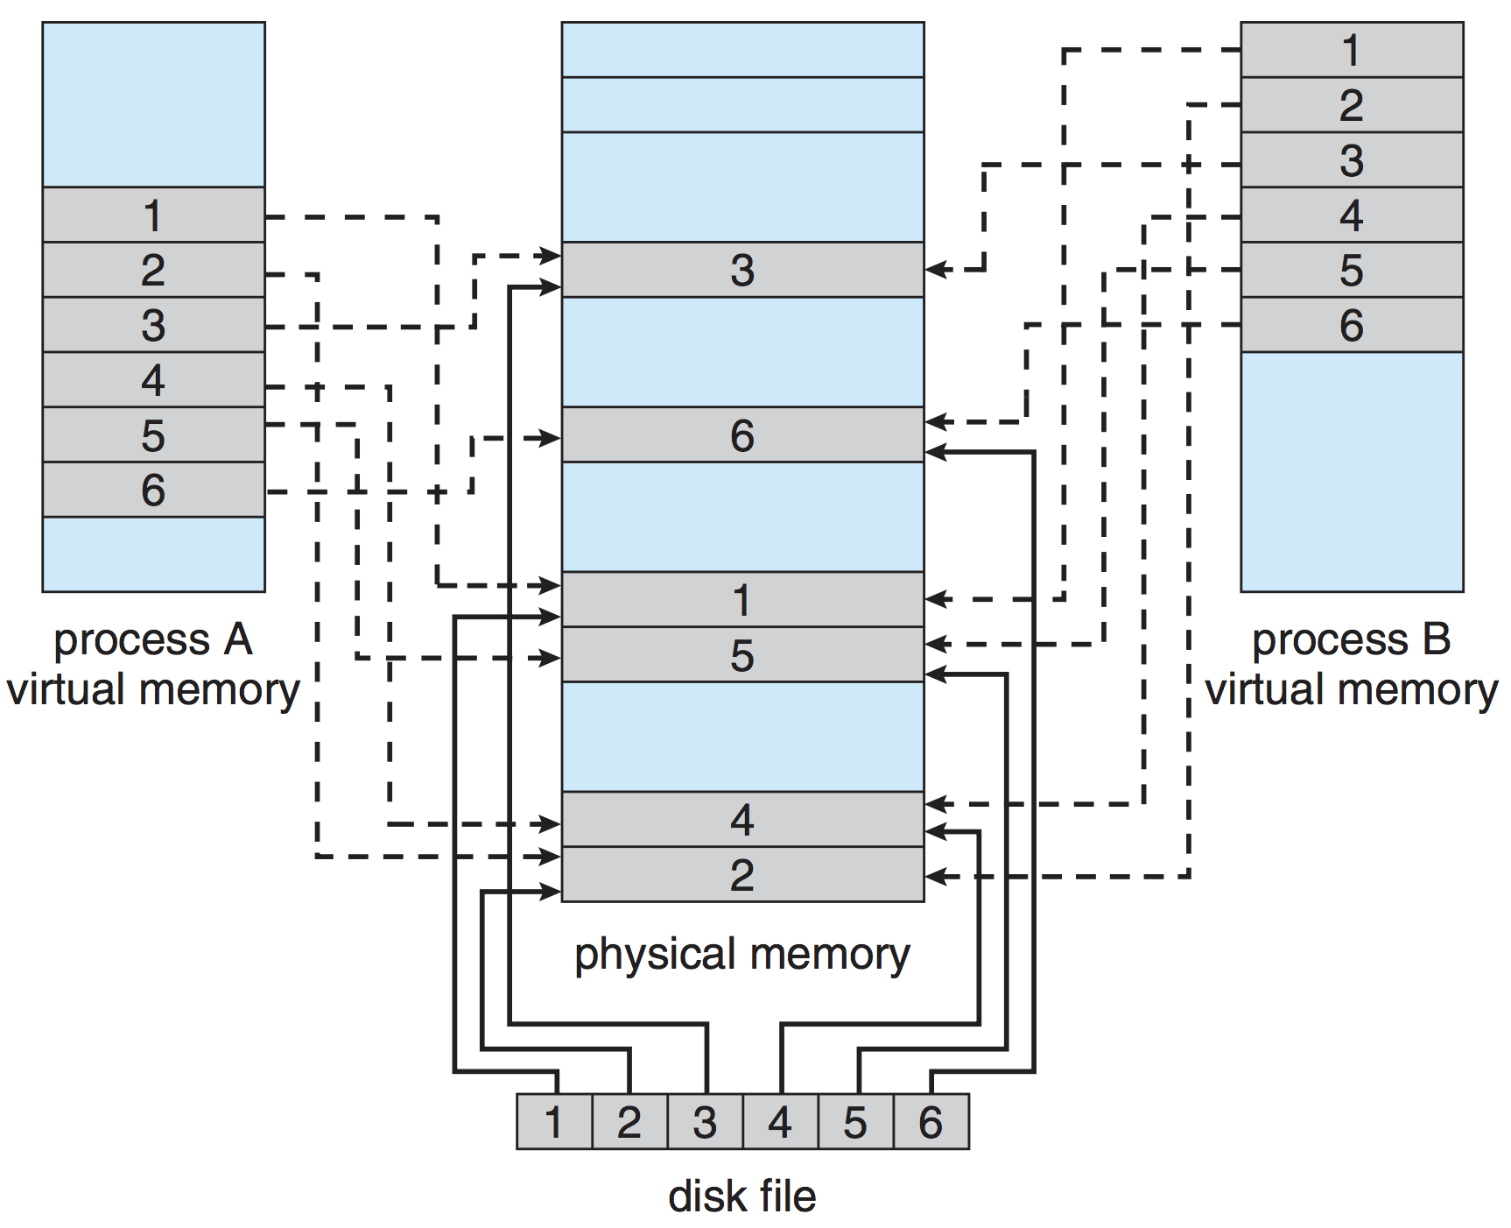
Memory-Mapped Files and Shared Memory
Notes:
Several processes can share same files

Slide 53
VM Issues: Page size and Pre-paging
Page size selection impacts
Fragmentation
Page table size
I/O overhead
Locality
Pre-paging
Bring in some (or all) of the pages a process will need, before they are referenced
Tradeoff
Reduce number of page faults at process startup
But, may waste memory and I/O because some of the prepaged pages may not be used

Slide 54
VM Issues: Program Structure
int data [128][128];
Each row is stored in one page; page size = 128 (ints)
How many page faults in the following program?
Program 1
for (i = 0; i < 128; i++) for (j = 0; j < 128; j++) data[i][j] = 0;
#page faults: 128
Program 2
for (j = 0; j < 128; j++) for (i = 0; i < 128; i++) data[i][j] = 0;
#page faults: 128 x 128 = 16,384

Slide 55
VM Issues: I/O interlock
Consider the following scenario
A process allocates buffer for I/O request (in its own address space)
The process issues I/O request and waits (blocks) for it
Meanwhile, CPU is given to another process, which makes page fault
The page that contains the buffer as a victim!
Later, the I/O device sends an interrupt signaling the request is ready
But the frame that contains buffer is now used by different process!
Solutions?
Lock the (buffer) page in memory (I/O Interlock)
Make I/O in kernel memory (not in user memory): data is first transferred to kernel buffers then copied to user space
Other scenarios
Lock kernel pages to avoid page faults in kernel
Lock page which got brought in recently but hasn’t been used yet

Slide 56
Summary
Virtual memory: Map a large logical address space onto a smaller physical address space
Demand paging: bring pages into memory when needed
Allows: running large programs in small physical memory, page sharing, efficient process creation, and simplifies programming
Page fault: occurs when a referenced page is not in memory
Page replacement algorithms
FIFO, OPT, LRU, second-chance, etc.
Frame allocation: proportional, global and local page replacement
Thrashing
Process doesn’t have sufficient frames ➔ too many page faults
Locality and working-set models
Kernel memory
Buddy system, slab allocator
Issues and tradeoffs: page size, pre-paging, I/O interlock, etc.

Slide 57
OS Example: Windows
Uses demand paging with clustering
Clustering brings in pages surrounding the faulting page
Processes are assigned
working set minimum: guaranteed #pages in memory
working set maximum: maximum #pages in memory
Working set trimming
If free memory in the system falls below a threshold, OS removes pages from processes that have more than their working set minimums

