Slide 1
School of Computing Science
Simon Fraser University
CMPT 300: Operating Systems I
Storage & I/O Management
Chapters 10 (up to 10.4) & 13 (up to 13.3)

Slide 2
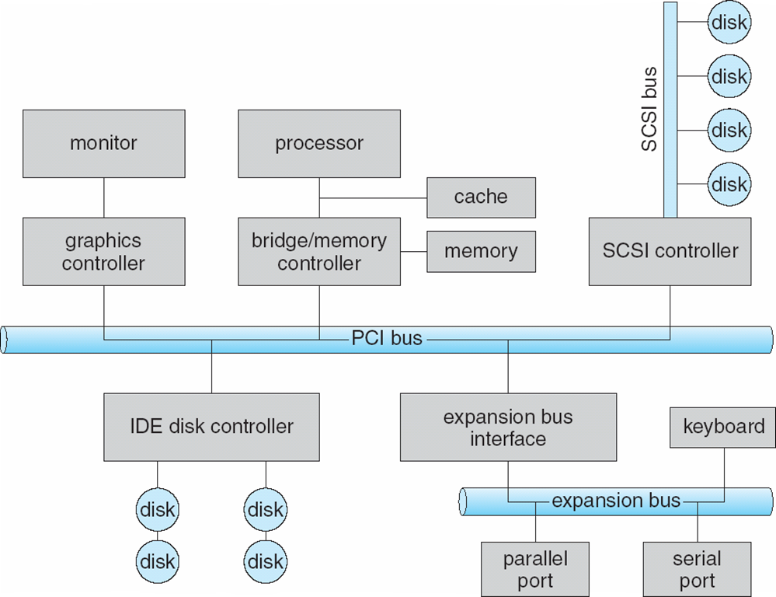
I/O Architecture
High speed bus
High performance disks
I/O bus
Slow I/O
Regular disks
Notes:
Buses, ports, controllers
Communicate through signals
Different speeds
Standardization

Slide 3
I/O Hardware
I/O instructions control devices
Devices usually have registers where device driver places commands, addresses, and data to write, or read data from registers after command execution
Data-in register, data-out register, status register, control register
Devices addressed by
Direct I/O instructions
Memory-mapped I/O
Device’s data and command registers mapped to processor address space
Especially for large address spaces (graphics)

Slide 4
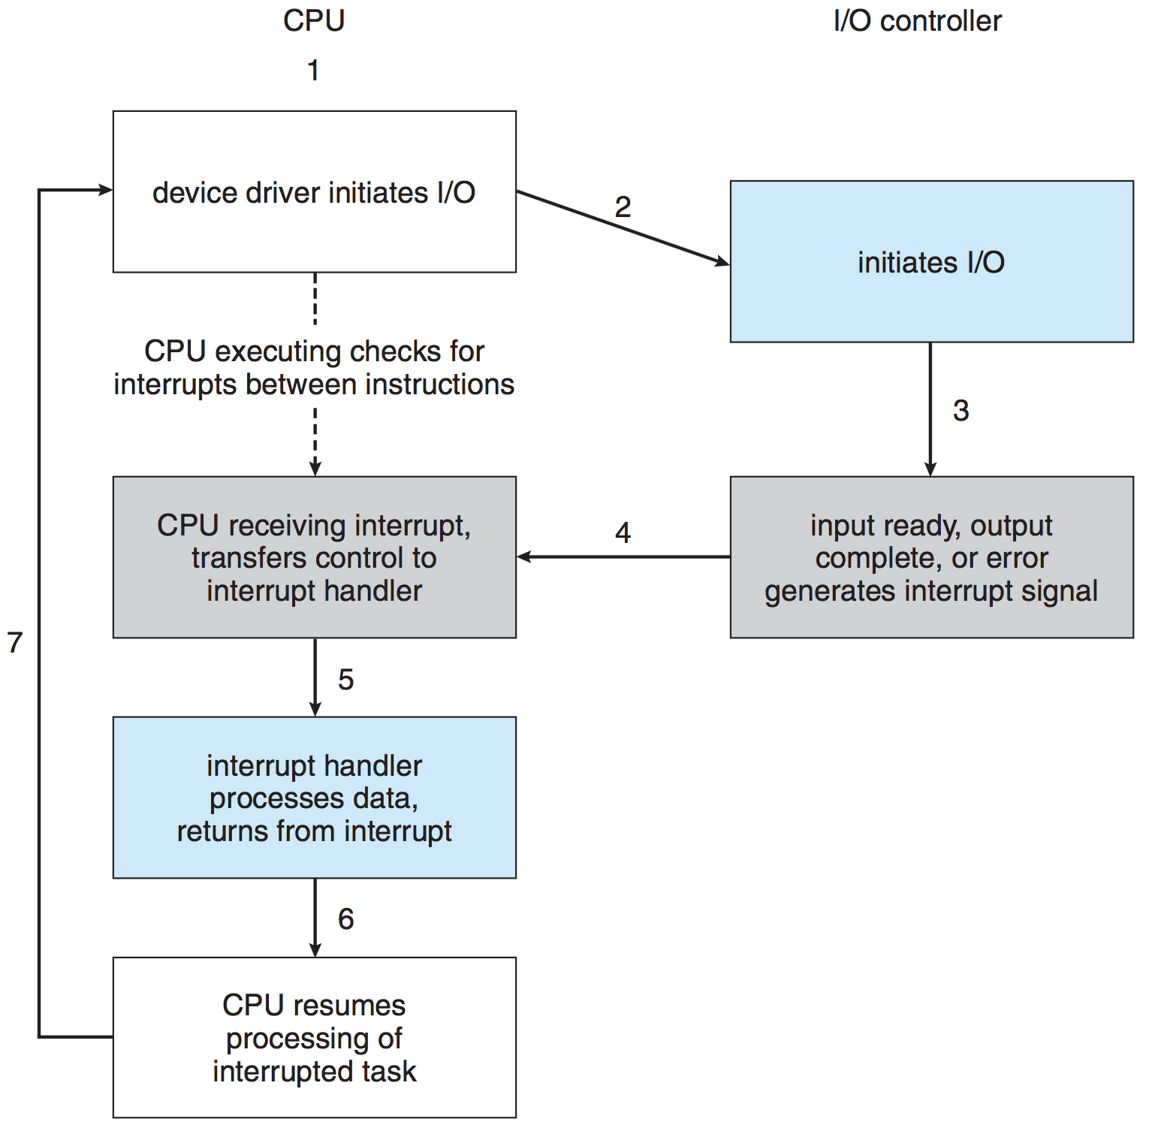
Interrupt-Driven I/O Cycle

Slide 5
Direct Memory Access (DMA)
Used for large data movement
Requires DMA controller
Transfers data directly between I/O device and memory, without overloading CPU
Notes:
DMAC seizes the memory bus
Cycle stealing

Slide 6
Nonblocking and Asynchronous I/O
Blocking - process suspended until I/O completed
Easy to use and understand
Inefficient for some needs
Insufficient for some needs
Nonblocking - I/O call returns as much as available
Example: data copy (buffered I/O), user interface
Implemented via multi-threading
Returns quickly with count of bytes read or written
select() to find if data ready then read() or write() to transfer
Asynchronous - process runs while I/O executes
I/O subsystem signals process when I/O completed
Difficult to use

Slide 7
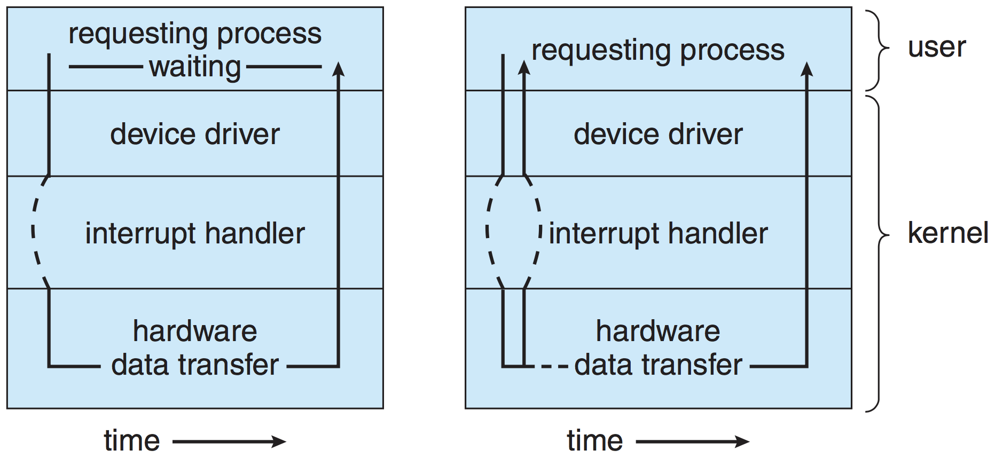
Synchronous v/s Asynchronous I/O

Slide 8
Disk Physical Structure
Platters, tracks, sectors, cylinders
Head moves horizontally from one track to another
Disk rotates at high speed (60-250 times/sec)
Relates to RPM
Notes:
Several platters, each is divided into circular tracks, which are subdivided into sectors
Tracks accessed at same head position make a cylinder

Slide 9
Disk Logical Structure
Disk is viewed as a one-dimensional array of logical blocks
The logical block is the smallest unit of transfer
Block = sector
Array of blocks is mapped into sequential sectors on disk
Block 0 is at the first sector of first track on the outermost cylinder
Mapping proceeds in order through that track
Then the rest of the tracks in that cylinder
Then through the rest of the cylinders from outermost to innermost
Block Address: <cylinder, track, sector>
This structure is created through low-level formatting of disk

Slide 10
Disk Scheduling
Processes issue disk read/write requests
Kernel maps these requests to logical block addresses
These requests are sent to disk controller
Problem: If there are multiple outstanding requests (in a disk queue), which one should be serviced first?
Objectives
Fast disk access time
High disk bandwidth
Bytes transferred per sec between disk and memory
Fairness (may be!)

Slide 11
Disk Operation
Accessing (reading/writing) a block
Move the head to desired track (seek time)
Wait for desired sector to rotate under the head (rotational latency time)
Transfer the block to a local buffer, then to main memory (transfer time)
We try to minimize the seek time, which is proportional to the seek distance (distance moved by the head)

Slide 12
Disk Scheduling Algorithms
Several disk scheduling algorithms
FCFS
SSTF
SCAN, C-SCAN
LOOK, C-LOOK
We illustrate them with a request queue (0 -199 cylinders)
98, 183, 37, 122, 14, 124, 65, 67
Assume initial head position at cylinder 53

Slide 13
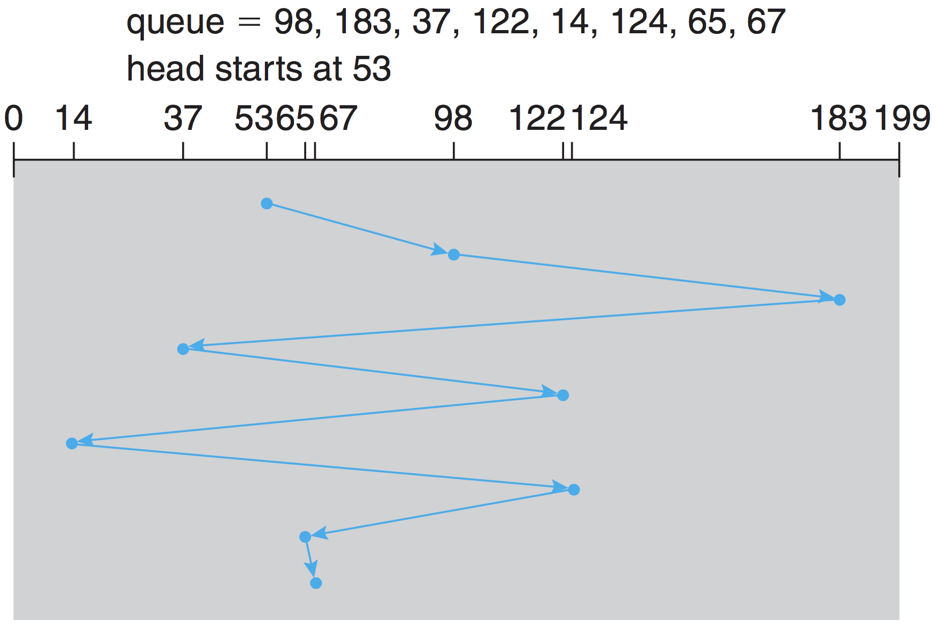
First Come First Served
Issue requests in order of arrival
Total head movements = 640 cylinders

Slide 14
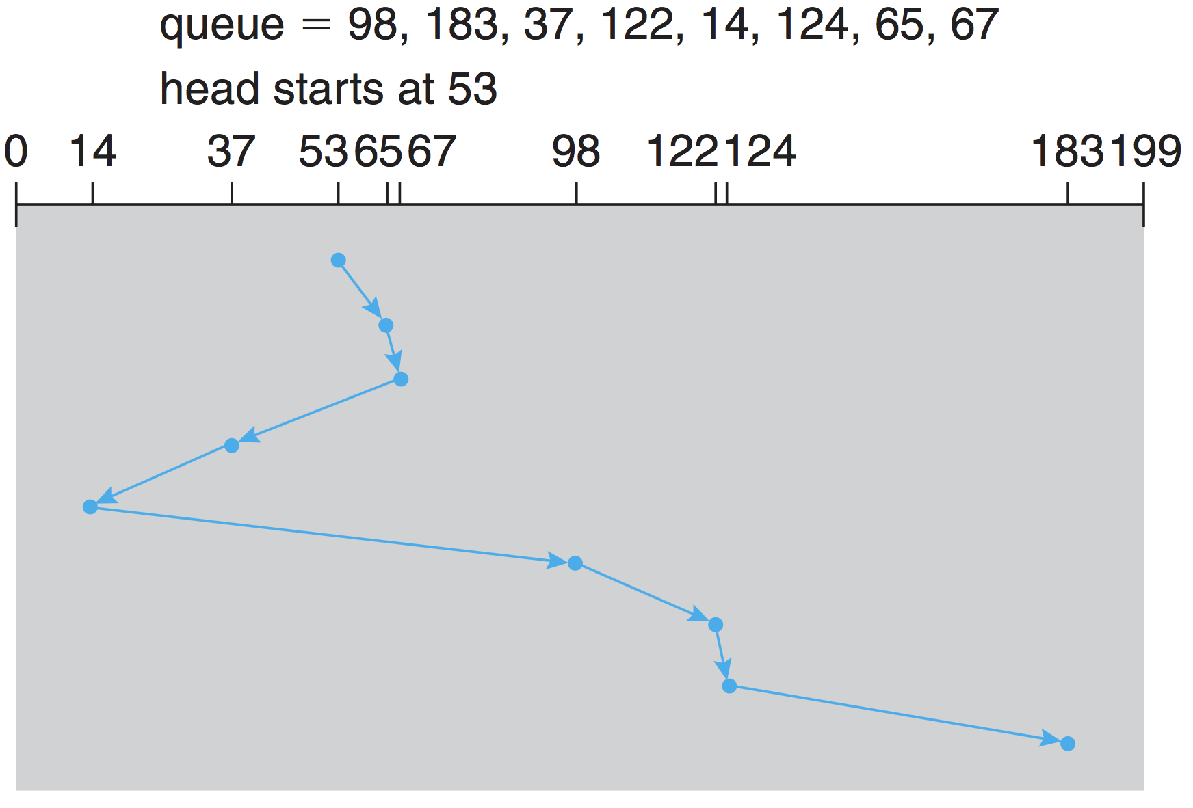
Shortest Seek Time First
Select request with minimum seek time from current position
Issues?
Starvation!
Total head movements = 236 cylinders

Slide 15
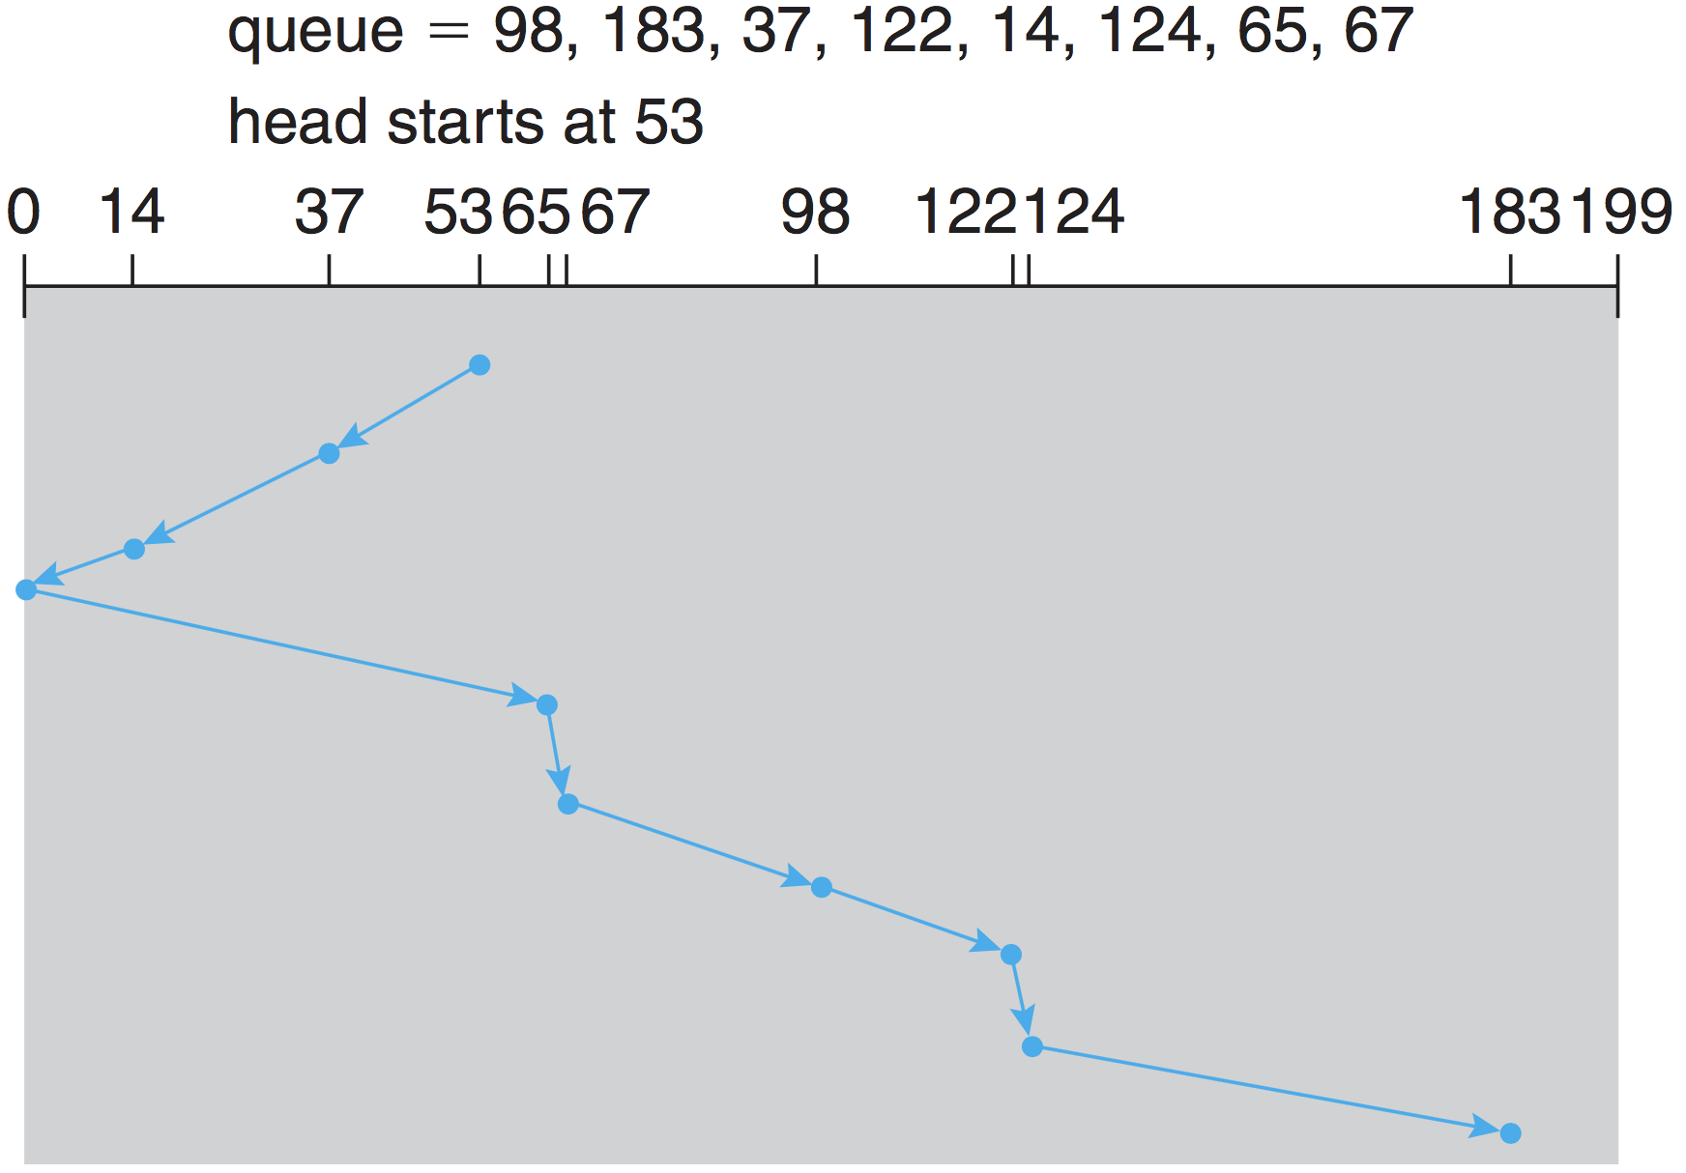
SCAN
Disk arm moves from one end to other servicing requests
Total head movements = 208 cylinders
Notes:
When it gets to the other end, movement is reversed

Slide 16
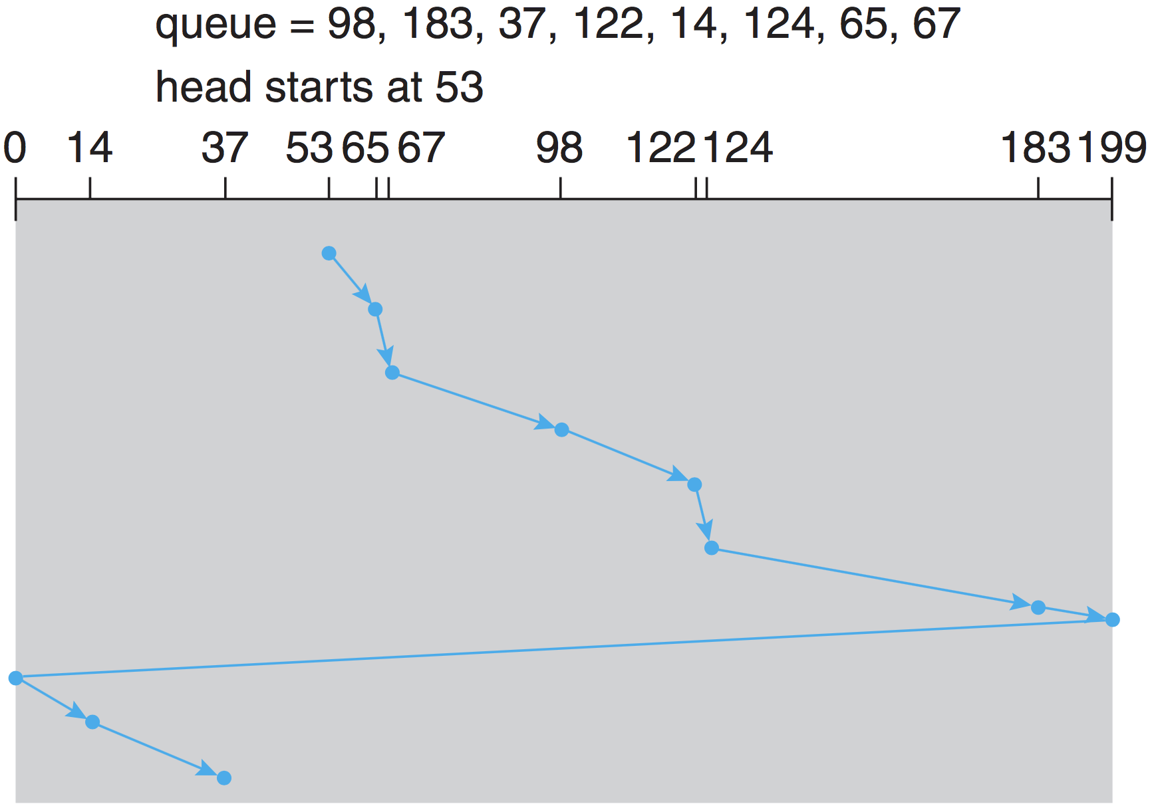
Circular SCAN (C-SCAN)
Treats cylinders as circular lists
Provides a more uniform wait time than SCAN
Notes:
When it gets to the other end, movement is reversed

Slide 17
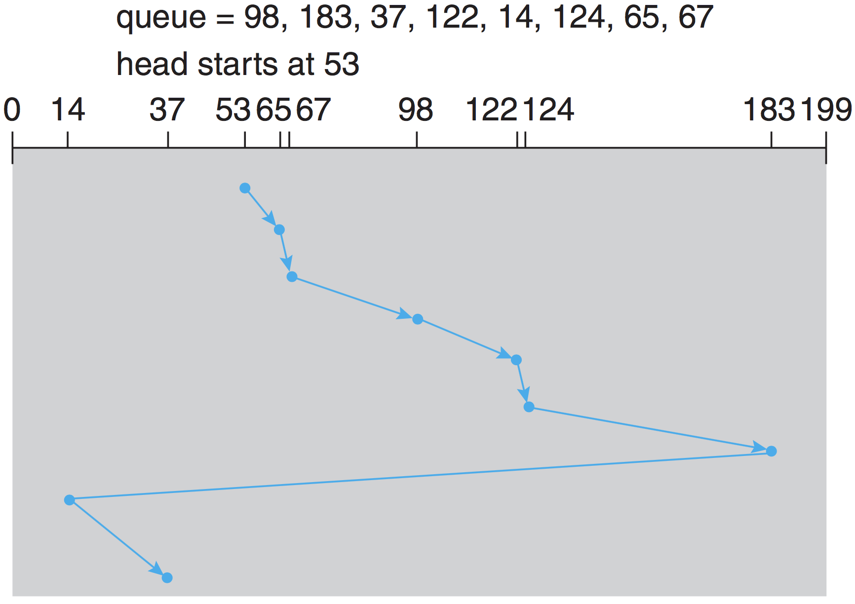
C-LOOK
Arm only goes as far as the last request in each direction
Notes:
When it gets to the other end, movement is reversed

Slide 18
Selecting a Disk-Scheduling Algorithm
Performance depends on the number and types of requests
Requests for I/O can be influenced by file-allocation method
SSTF is common and has a natural appeal
SCAN and C-SCAN perform better for systems that place a heavy load on the disk
SSTF and C-LOOK are reasonable choice as default algorithm

Slide 19
Summary
Interrupt driven I/O
Direct Memory Access (DMA)
Transfers data directly between I/O device and memory
Synchronous v/s Asynchronous I/O
Blocking, non-blocking, asynchronous
Disk structure
Cylinders, tracks, sectors, logical blocks
Transfer time and positioning time (latency + seek)
Disk scheduling
To minimize seek time (head movements)
FCFC, SSTF, SCAN, C-SCAN, C-LOOK

