Slide 1
School of Computing Science
Simon Fraser University
CMPT 300: Operating Systems I
Storage Management
Chapters 10 (up to 10.4)

Slide 2
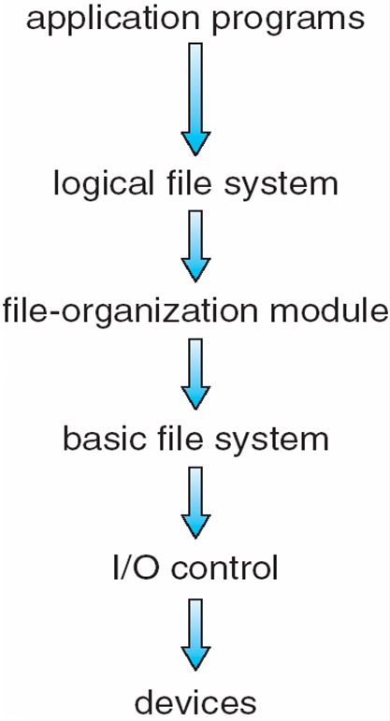
File System: Layered Structure
View files as logical blocks
Maintain metadata
Maps logical blocks to physical blocks
View data as physical blocks present in devices
Device drivers and device-specific instructions
Read/write bit patterns to device controller

Slide 3
Disk Physical Structure
Platters, tracks, sectors, cylinders
Head moves horizontally from one track to another
Disk rotates at high speed (60-250 times/sec)
Relates to RPM
Notes:
Several platters, each is divided into circular tracks, which are subdivided into sectors
Tracks accessed at same head position make a cylinder

Slide 4
Disk Logical Structure
Disk is viewed as a one-dimensional array of logical blocks
The logical block is the smallest unit of transfer
Block = sector
Array of blocks is mapped into sequential sectors on disk
Block 0 is at the first sector of first track on the outermost cylinder
Mapping proceeds in order through that track
Then the rest of the tracks in that cylinder
Then through the rest of the cylinders from outermost to innermost
Block Address: <cylinder, track, sector>
This structure is created through low-level formatting of disk

Slide 5
Disk Scheduling
Processes issue disk read/write requests
Kernel maps these requests to logical block addresses
These requests are sent to disk controller
Problem: If there are multiple outstanding requests (in a disk queue), which one should be serviced first?
Objectives
Fast disk access time
High disk bandwidth
Bytes transferred per sec between disk and memory
Fairness (may be!)

Slide 6
Disk Operation
Accessing (reading/writing) a block
Move the head to desired track (seek time)
Wait for desired sector to rotate under the head (rotational latency time)
Transfer the block to a local buffer, then to main memory (transfer time)
We try to minimize the seek time, which is proportional to the seek distance (distance moved by the head)

Slide 7
Disk Scheduling Algorithms
Several disk scheduling algorithms
FCFS
SSTF
SCAN, C-SCAN
LOOK, C-LOOK
Illustrate them with a request queue (0 -199 cylinders)
98, 183, 37, 122, 14, 124, 65, 67
Assume initial head position at cylinder 53

Slide 8
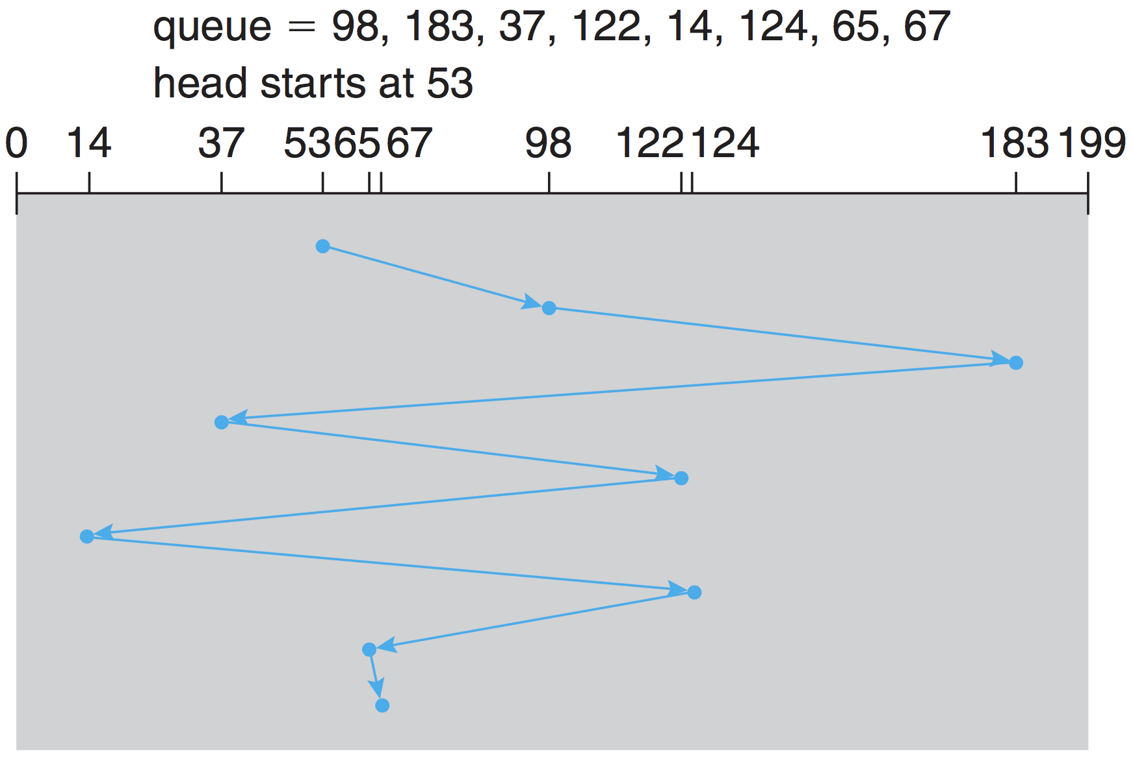
First Come First Served
Issue requests in order of arrival
Total head movements = 640 cylinders

Slide 9
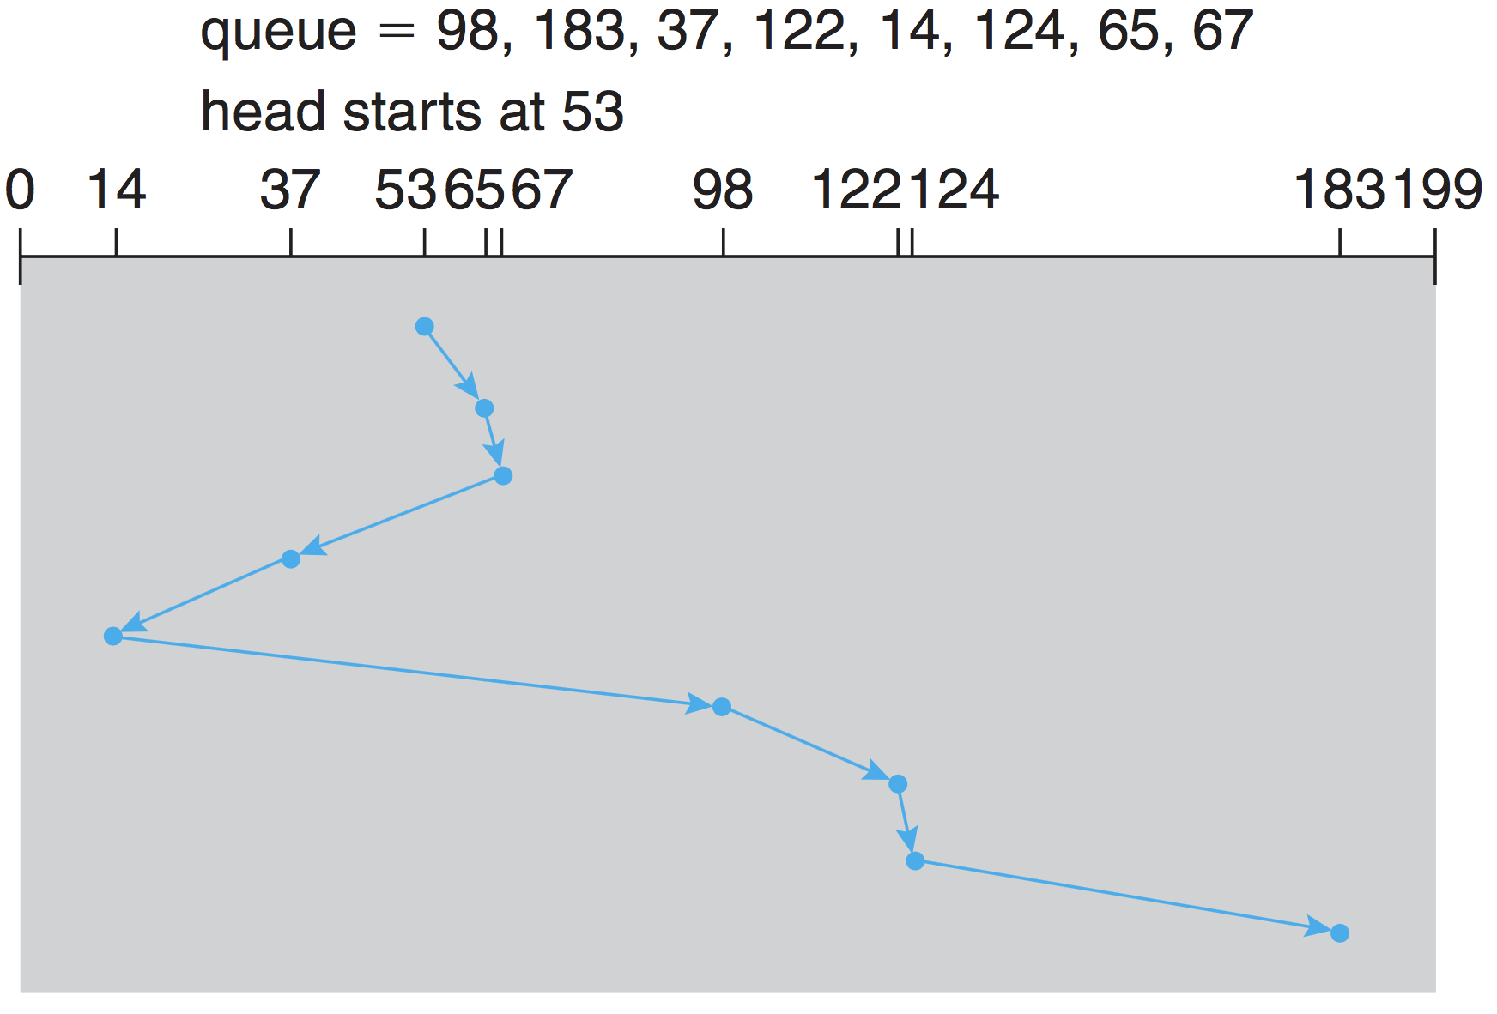
Shortest Seek Time First
Select request with minimum seek time from current position
Issues?
Starvation!
Total head movements = 236 cylinders

Slide 10
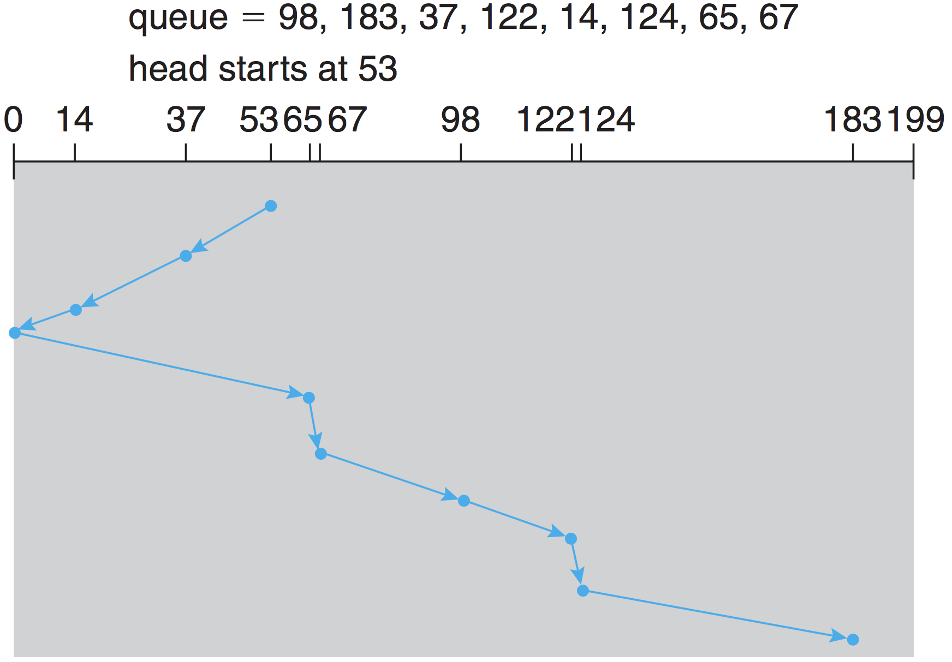
SCAN
Disk arm moves from one end to other servicing requests
Total head movements = 236 cylinders
Notes:
When it gets to the other end, movement is reversed

Slide 11
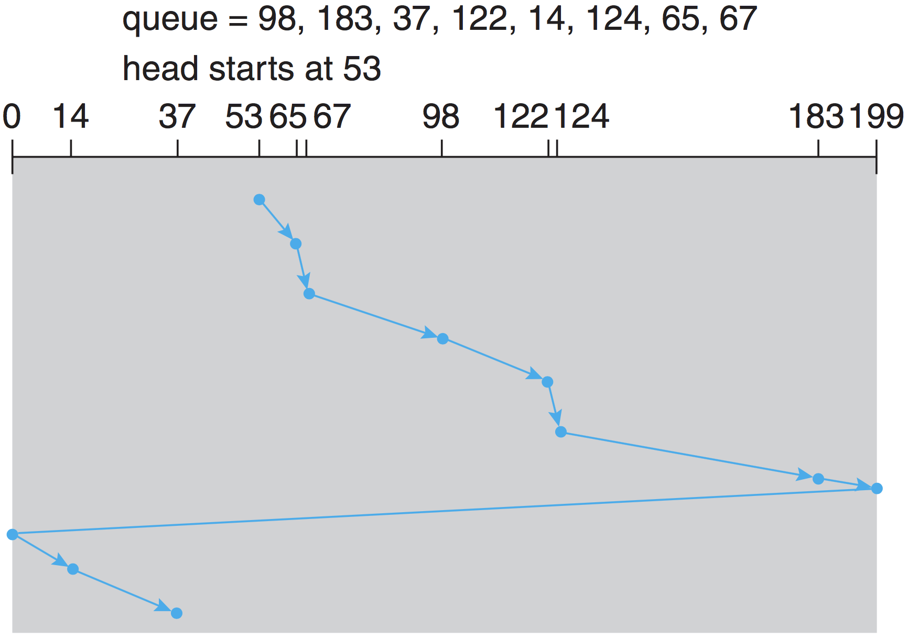
Circular SCAN (C-SCAN)
Treats cylinders as circular lists
Provides a more uniform wait time than SCAN
Notes:
When it gets to the other end, movement is reversed

Slide 12
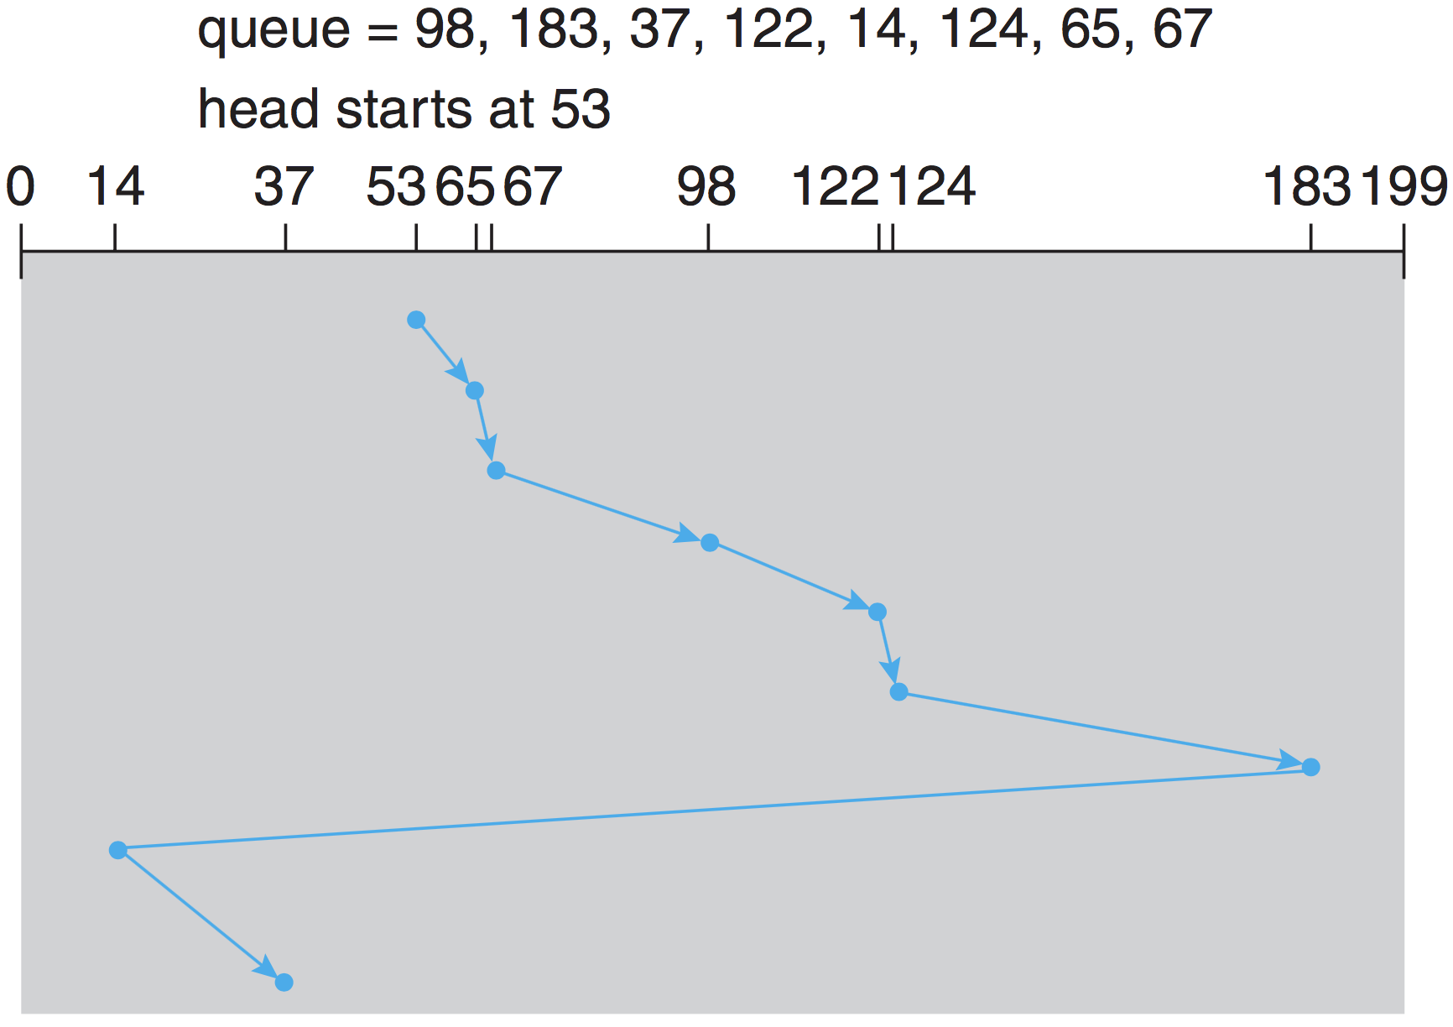
C-LOOK
Arm only goes as far as the last request in each direction
Notes:
When it gets to the other end, movement is reversed

Slide 13
Selecting a Disk-Scheduling Algorithm
Performance depends on the number and types of requests
Requests for I/O can be influenced by file-allocation method
SSTF is common and has a natural appeal
SCAN and C-SCAN perform better for systems that place a heavy load on the disk
SSTF and C-LOOK are reasonable choice as default algorithm

Slide 14
Summary
Disk structure
Physical: cylinders, tracks, sectors
Logical: logical blocks
Transfer time and positioning time (latency + seek)
Disk scheduling
To minimize seek time (head movements)
FCFS
SSTF
SCAN
C-SCAN
C-LOOK

