Slide 1
School of Computing Science
Simon Fraser University
CMPT 300: Operating Systems I
File System Management
Chapters 11-12

Slide 2
Secondary Storage Systems
Various storage media
  Magnetic disks, tapes
  Optical disks
  Flash sticks
Each medium has different physical characteristics
  Storing bits on disks is different from storing them on CDs
OS provides a uniform view of storage to users
OS creates file systems on storage media
  Efficiently store and retrieve data
  Enable logical view of data
    Files & directories

Slide 3
File System Challenges
File systems involve two design problems
Interface: how file system looks to users
  Define a “file”, file attributes, operations on files, and how files are organized into directories
Implementation: data structures and algorithms to map logical file system onto physical devices
  Block allocation, free-space management, searching a directory, data caching, …

Slide 4
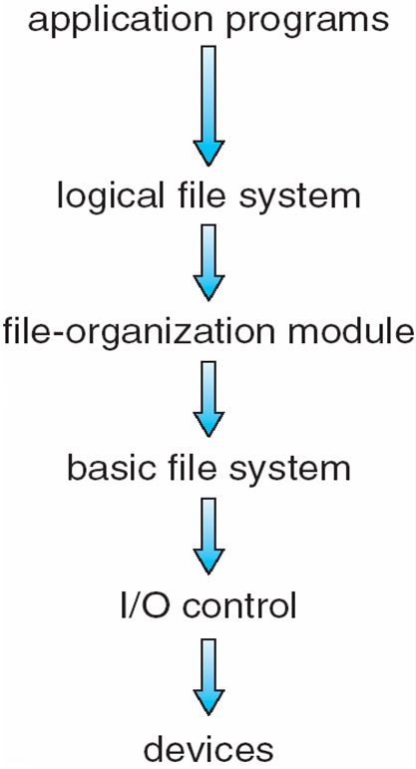
File System: Layered Structure
Goal: Efficiently support different types of devices and file systems
View files as logical blocks
Maintain metadata
Maps logical blocks to physical blocks
View data as physical blocks present in devices
Device drivers and device-specific instructions
Read/write bit patterns to device controller

Slide 5
File System Interface: File Concept
From user’s perspective, a file is a storage unit
A file is a named collection of related information recorded on a secondary storage
Information stored in a file could be of various types:
  Text, numeric data
  Binary data
  Source code
  Executable programs
  …..

Slide 6
File Attributes
Name – only information kept in human-readable form
Identifier – unique tag (number) identifies file within file system
Type – needed for systems that support different types
Location – pointer to file location on device
Size – current file size
Protection – controls who can do reading, writing, executing
Time, date, and user identification – for protection, security, and usage monitoring
Information about files are kept in a directory, which is maintained on the disk as well
  Each file has an entry in the directory

Slide 7
File Operations
Create
Write
Read
Reposition within file
Delete
Truncate
More operations (e.g., copy) can be composed of these primitives
To perform these operations, we open the file (details later)
Notes:
Per process read pointer and write pointer
Reposition – seek
Truncate is to erase contents but use same meta-data

Slide 8
File System Interface: Directory Concept
Directory is a logical grouping of files
  A directory contains an entry for each file under it
  Some systems (e.g., UNIX) treat directories just as files
    In fact, UNIX treats everything as a file
Operations on a directory
  Search for a file
  Create a file
  Delete a file
  List a directory
  Rename a file
  Traverse the file system

Slide 9
Directory Structure
Design the directory structure to achieve
  Efficiency – locating a file quickly
  Naming – convenient to users
    Two users can have same name for different files
    The same file can have several different names (aliases, links)
  Grouping – logical grouping of files by properties
  (e.g., all Java programs, all games, …)
Suggestions?
Tree-structured directories are the most common
  Paths are intuitive for users

Slide 10
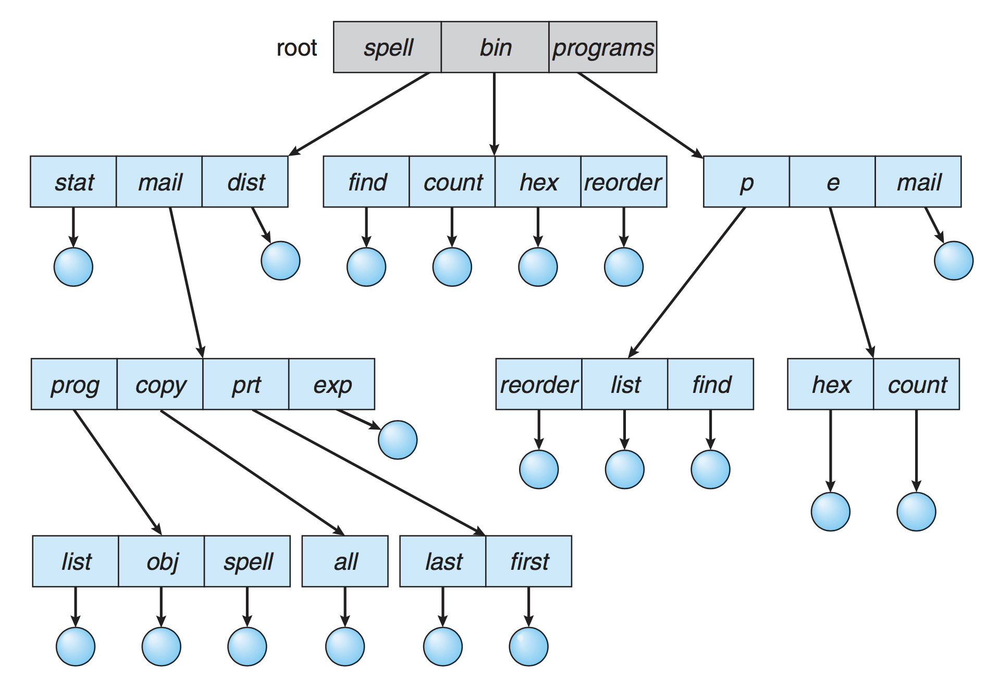
Tree-Structured Directories

Slide 11
Tree-Structured Directories (cont’d)
Efficient searching
Smarter grouping
  Sub-directories
Things get complicated with links – Why?
  Directory is no longer a tree

Slide 12
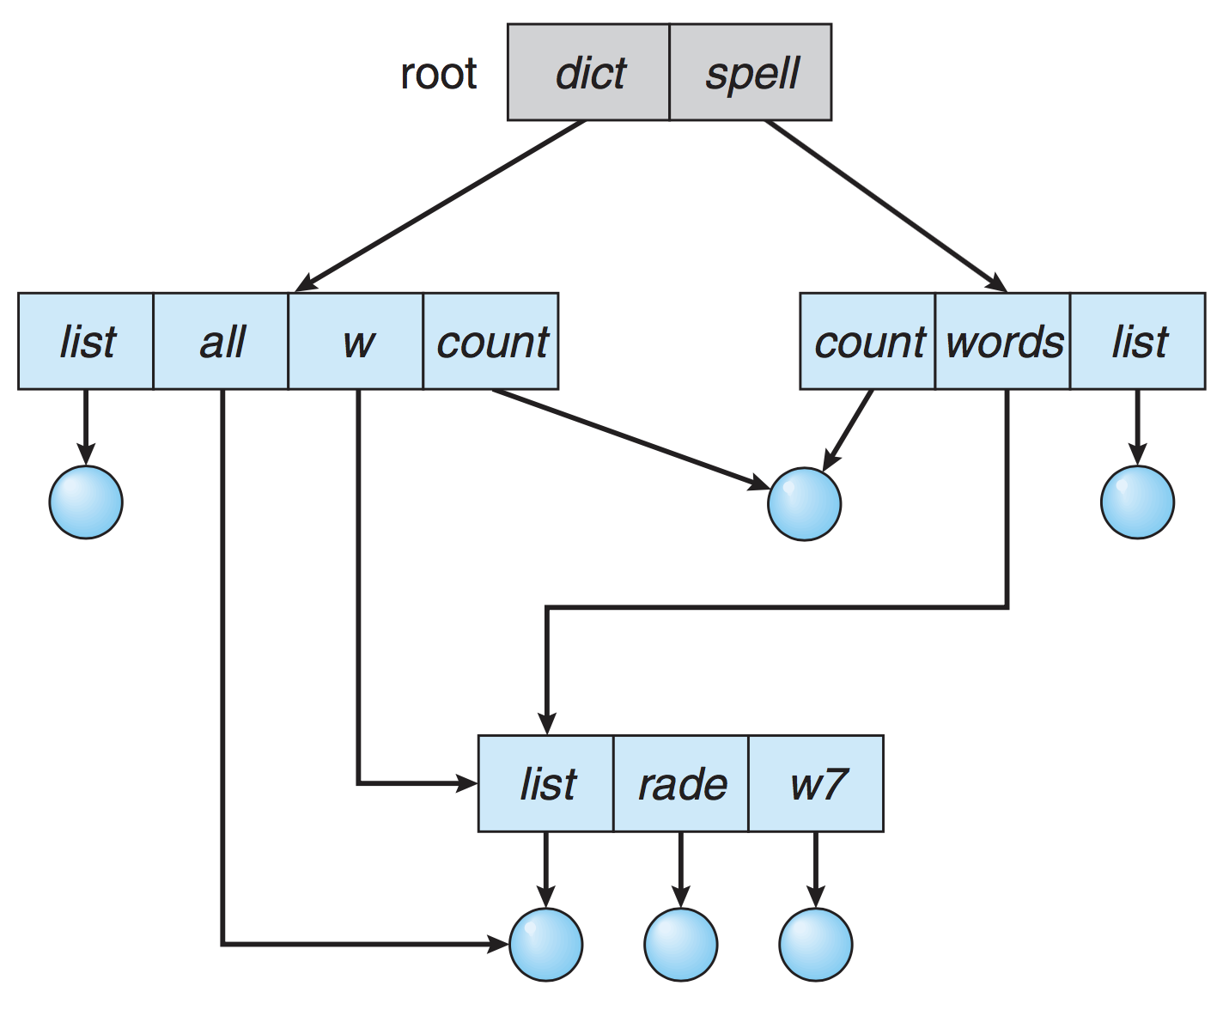
Acyclic-Graph Directories
When files get deleted, links may still point to it
  Dangling pointers!

Slide 13
Acyclic-Graph Directories (cont’d)
Solution for dangling links in Unix
  Symbolic link
    Just leave the dangling pointer for the user to delete
    Try on Linux:
      $ ln –s file.txt file_symLink.txt
      ls –li
      rm file.txt
      ls –li (note: ‘i' option displays inode of file)
  Hard link
    Keep a reference count on the file
    Only delete the physical file when all links to it are deleted
    Try:
      $ ln file.txt file_link.txt
      ls –li
      rm file.txt
      ls –li
Links may even create a cycles

Slide 14
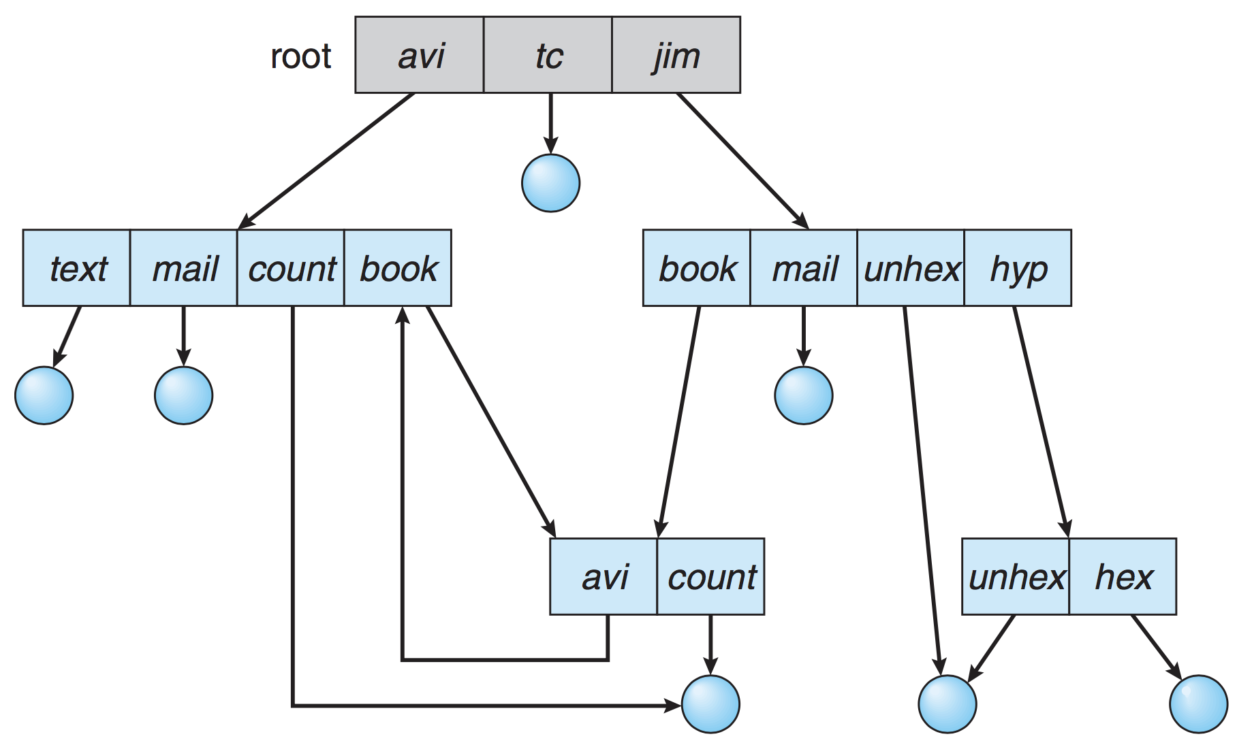
General Graph Directory

Slide 15
General Graph Directory (cont’d)
Search for a file through directory – Issues?
Backup entire file system – Issues?
  We may visit the same subdirectory several times!
  We may even loop for ever if we have cycles!
Solution?
  Bypass links during directory traversal!

Slide 16
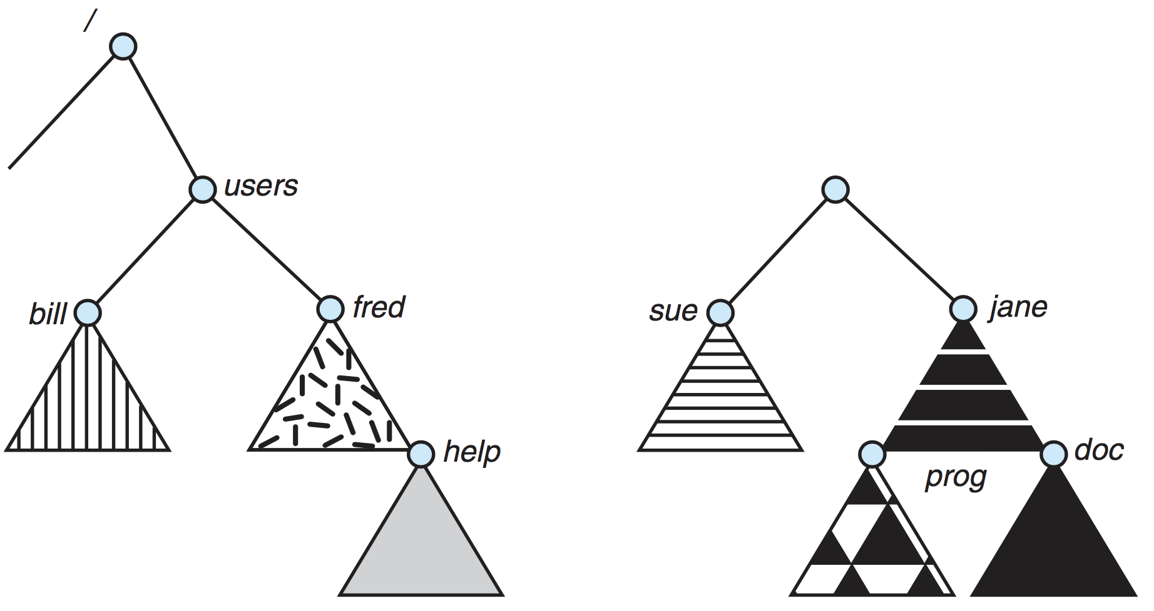
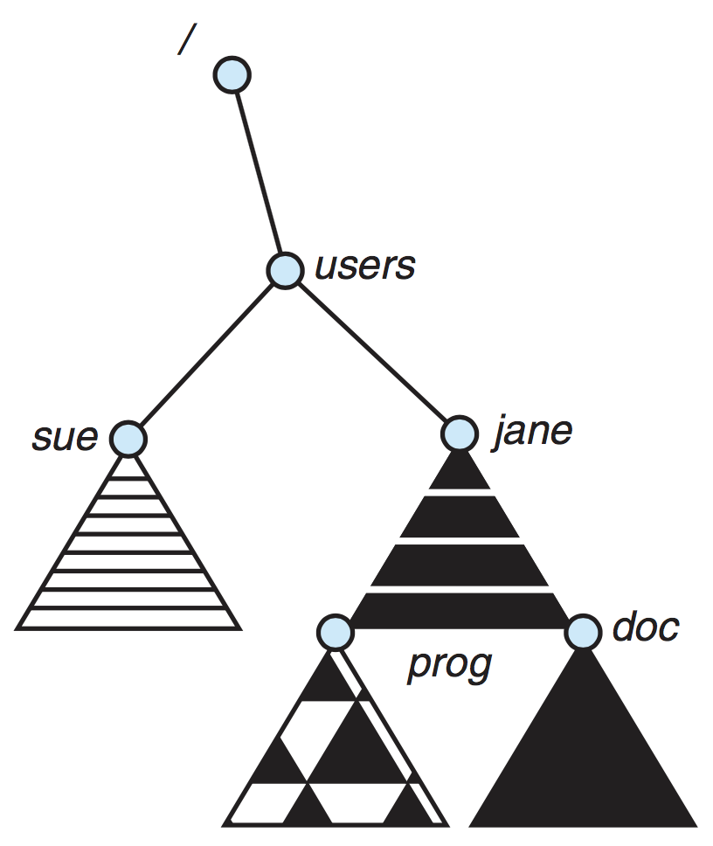
File System Mounting
A file system must be mounted before it can be accessed
  OS is given name of the device and a mount point
  OS checks device to make sure it has a valid file system
  Then, OS makes the new file system available

Slide 17
Virtual File Systems
Multiple file systems can be mounted at same time (typical)
  Disk: UFS (Unix), NTFS (Windows), ext3 (Linux), …
  CD: iso9660
  File systems on other machines
    Network File System (NFS)
Each file system has its own file and directory structure, allocation methods, algorithms and data structure, …
To shield users from all these differences, OS implements a virtual file system (VFS) layer
VFS provides a common interface (API) to all file systems
  E.g., applications use open(), read(), write(), etc.
  No worry about which file system is being used

Slide 18
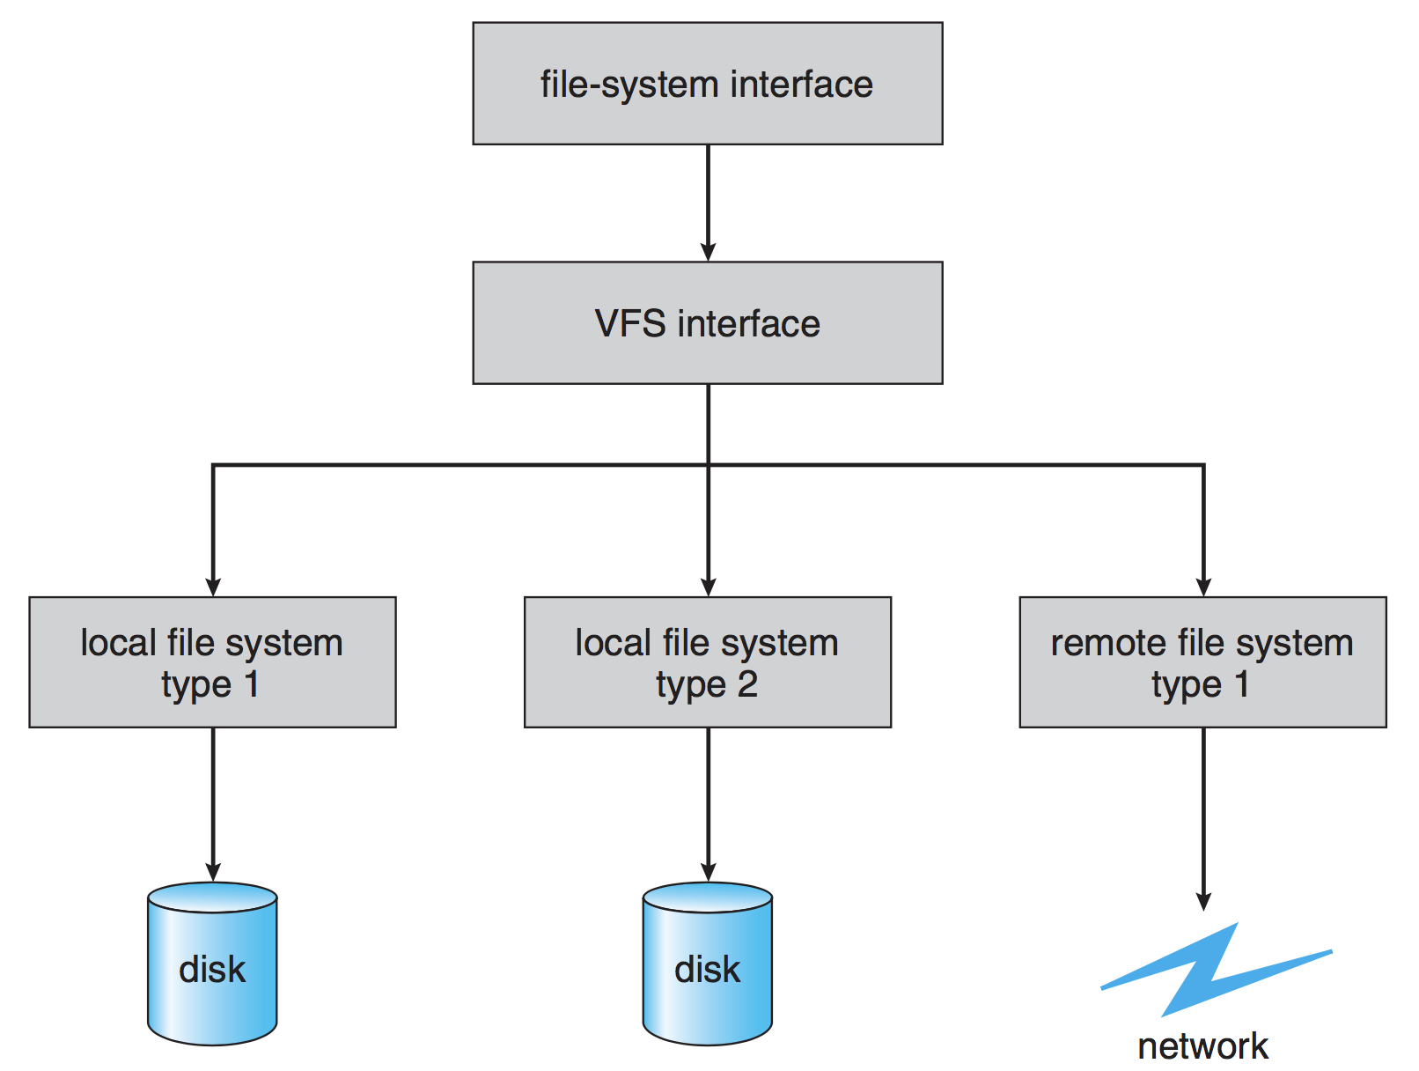
Virtual File Systems

Slide 19
File System Implementation
To implement a file system, we need
On-disk structures, e.g.,
  Directory structure, number of blocks, location of free blocks, boot information, …
  (In addition to data blocks, of course)
In-memory structures to:
  Improve performance (caching)
  Manage file system

Slide 20
On-disk Structures
Boot block: information to boot the OS
Volume control block: information about the volume (partition)
  Number of blocks, block size, free block count, …
  UFS calls it superblock
  NTFS calls it master file table
Directory structure: how files are organized into directories
  UFS uses inodes
  NTFS stores this info in the master file table
File control block (FCB): per file, details about the file
  Size, location of data blocks, file permissions, ownership
  UFS calls it inode
  NTFS stores this info in the master file table

Slide 21
On-disk Structures
Free block
Boot block
Superblock
Directory structure
File
File control block
Data block

Slide 22
In-memory Structures
Mount table: Info on each mounted volume (partition)
Directory-structure cache: info on recently accessed directories
System-wide open-file table:
  Copy of the FCB of each open file in the system
  Info on which process currently using which file
Per-process open-file table: contains an entry for each file opened by this process, which has
  Pointer to entry in the system-wide open file table
  Info regarding the usage of the file by this process, e.g., current file pointer, open mode (read, write), ..

Slide 23
Opening a File
Search the directory to find the file control block
  May need to bring (from disk) multiple directory blocks into memory, if they are not already cached
Create an entry in the per-process open-file table (PFT)
Check whether the system-wide open-file table has an entry for this file
  If it does
    Increment its reference count
    Make the entry in PFT point to this entry
  If it does not
    Create a new entry, set its reference count to 1
    Make the entry in PFT point to the new entry
Return a pointer (file descriptor) to the entry in PFT
  Successive file operations (read, write, …) use the file descriptor

Slide 24
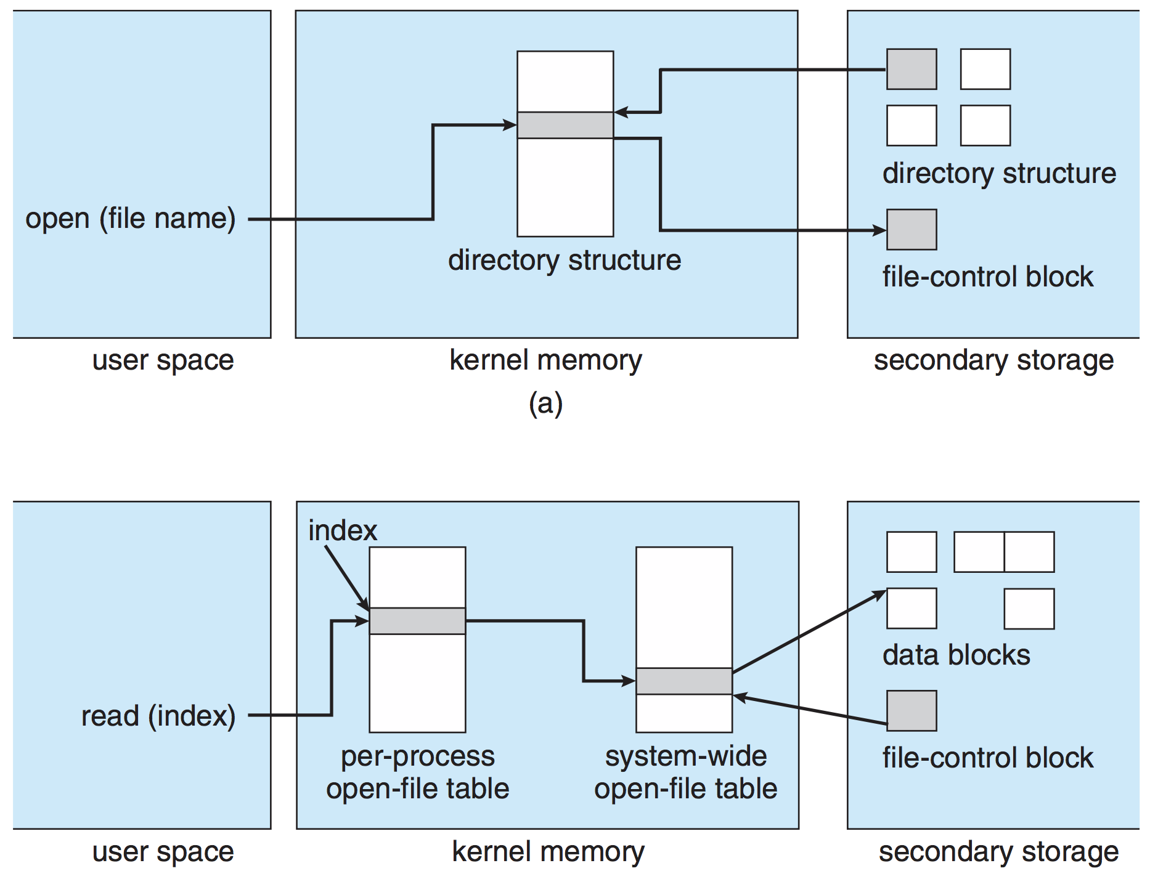
Opening & Reading from a File

Slide 25
Creating a File
Allocate a new file control block (FCB)
  For faster file creation, FCBs are usually pre-allocated
    Upon create, find a free FCB
Read relevant directory blocks in memory
  Update them to reflect the new file, write them back to disk
Allocate free blocks for the data of the file
How do we allocate free blocks to files?
How do we know where the free blocks are?

Slide 26
Allocation Methods
Problem: Allocate free blocks to files
Given: Disks allow random access of blocks
Objectives: Efficient disk space utilization, and fast file access
Three common allocation methods
  Contiguous
  Linked
  Indexed

Slide 27
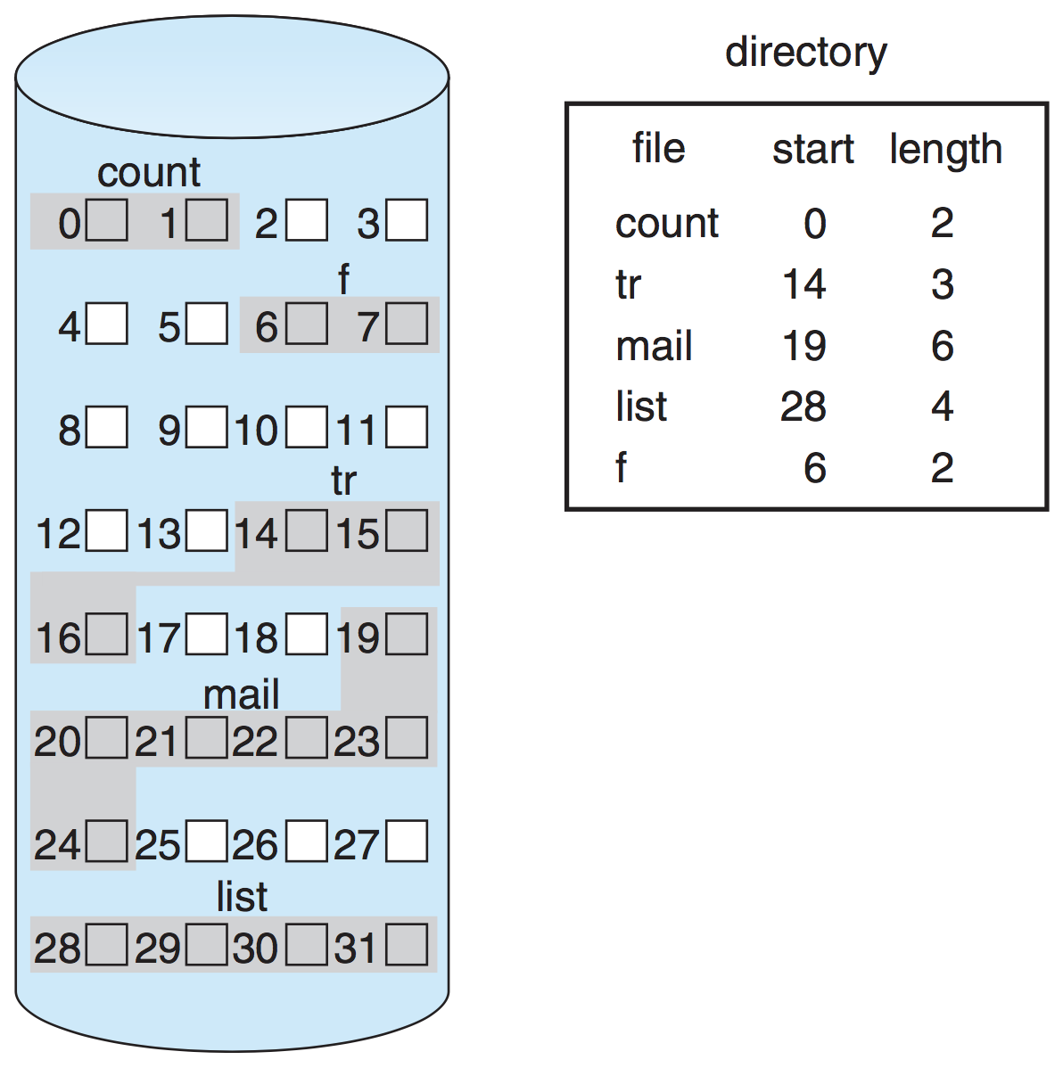
Contiguous Allocation
Each file occupies a set of contiguous blocks
Needs only start address (block #) and length (number of blocks)
Pros
  Simple
  Efficient sequential & random access
  (minimal disk head seeks)
Cons
  External fragmentation
  Files may not be able to grow
Compaction is possible but expensive!

Slide 28
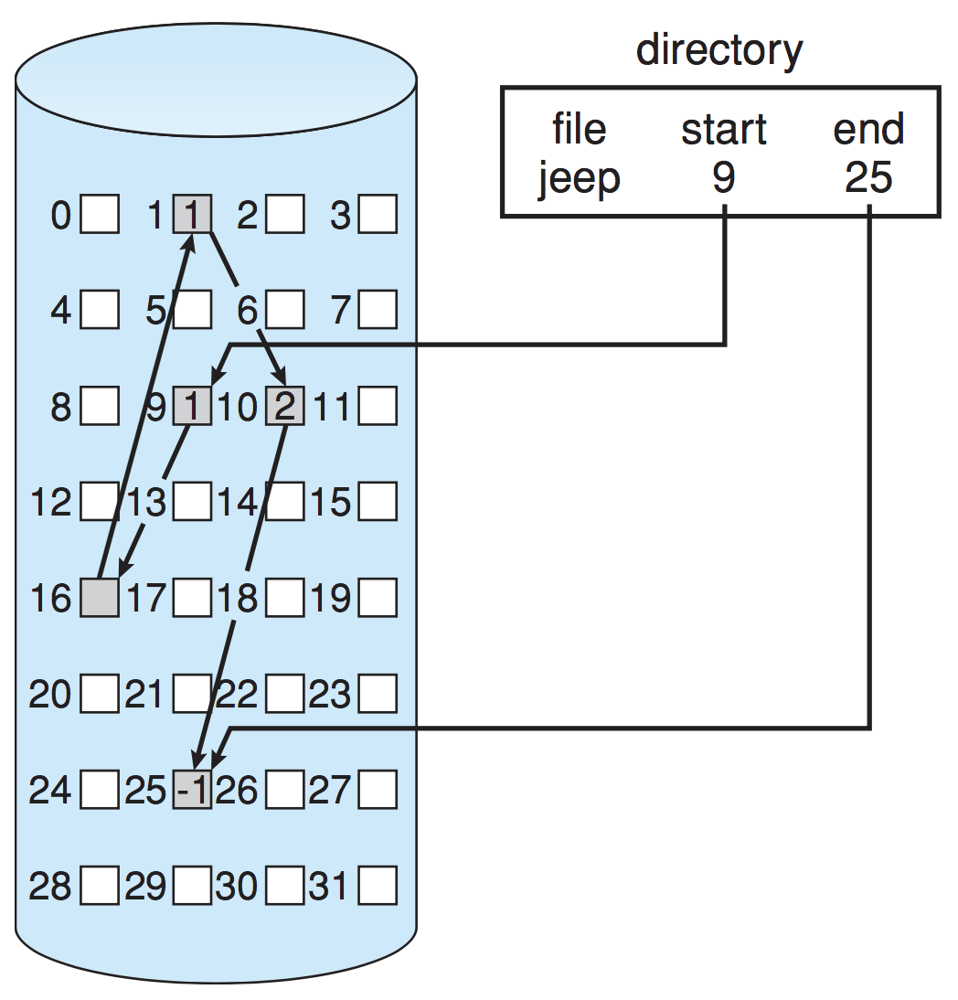

Linked Allocation
A file is a linked list of blocks
Blocks could be anywhere
Each block has a pointer to the next block
Need start block and end block (to append to file)
Let’s say address is at Q^{th} block in the chain, how do we get to it?
  Traverse the chain!

Slide 29
Linked Allocation (cont’d)
Pros
  Simple: need only start and end addresses
  Doesn’t waste space (except for pointers)
  Supports dynamically growing files
Cons
  Expensive random access
  (need to follow pointers from the start)
  Reliability: if one block is corrupted, the chain is broken

Slide 30
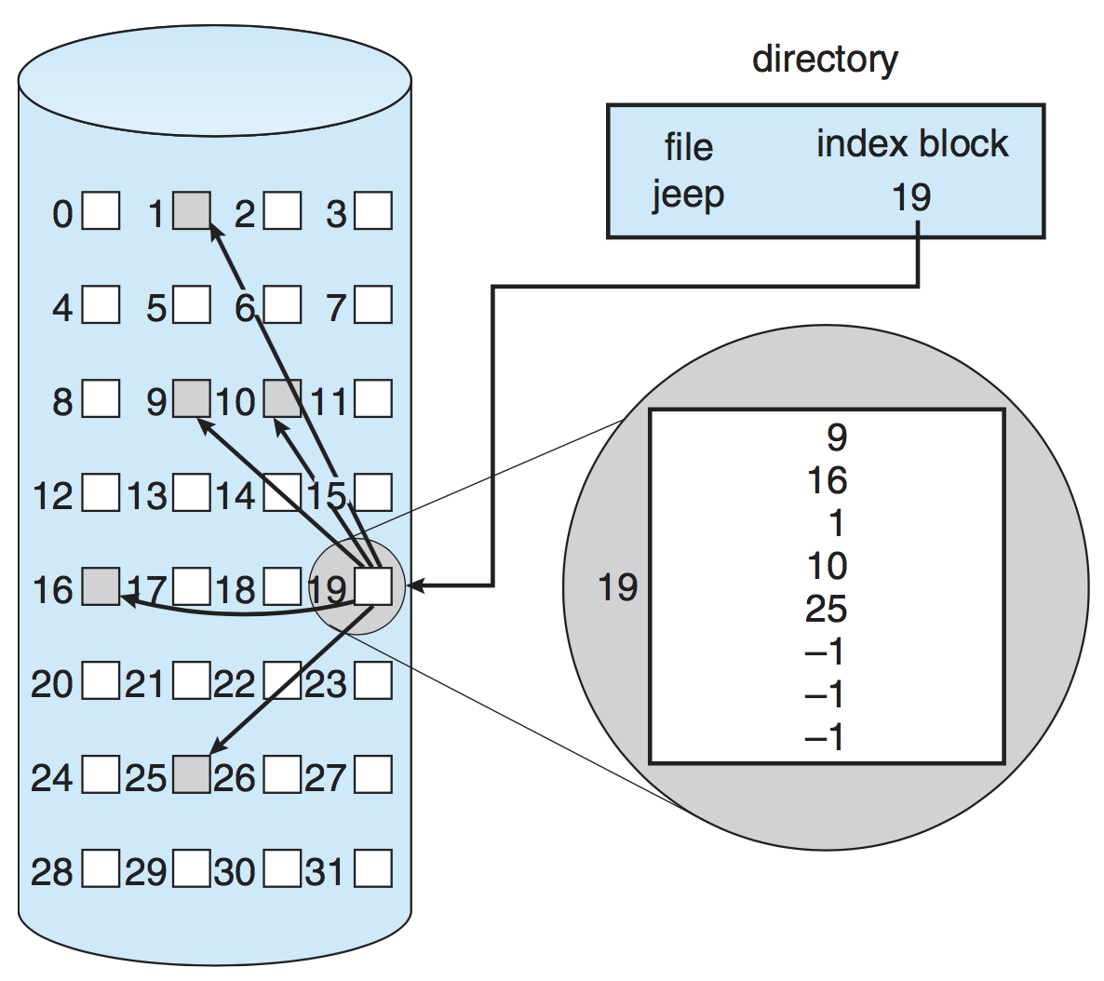
Indexed Allocation
Bring all pointers together into an index block
Pros
  Supports random access
  Supports dynamic growing of files
  No external fragmentation
Cons
  Overhead of index blocks
    File of one or a few data blocks would also need an entire index block
  How do we choose the size of index blocks?

Slide 31
Indexed Allocation (cont’d)
Consider a file with one index block
Assume each pointer takes 4 bytes, and block size is 512 bytes
What is the maximum file size supported?
  Index block may have up to 512 / 4 = 128 entries
  Max file size = 128 x 512 = 64 KB
How do we support larger files?
  Increase size of index blocks
    But that wastes space for small files
  Better solutions?

Slide 32
Indexed Allocation (cont’d)
Linked index blocks
    Last word in index block points to another index block
    May need to traverse the index linked list (long access time)
Multilevel index
  First-level index block points to a set of second-level index blocks which refer to data blocks
    Shorter access time but more space overhead
Combined (used in Unix File System)
  Multilevel and linked
  Each file has an index block (inode), which contains
    Pointers that point to data blocks directly (for small files)
    Pointers that point to index blocks, which in turn may point to either data blocks or another level of index blocks
      UNIX supports up to three level of index blocks

Slide 33
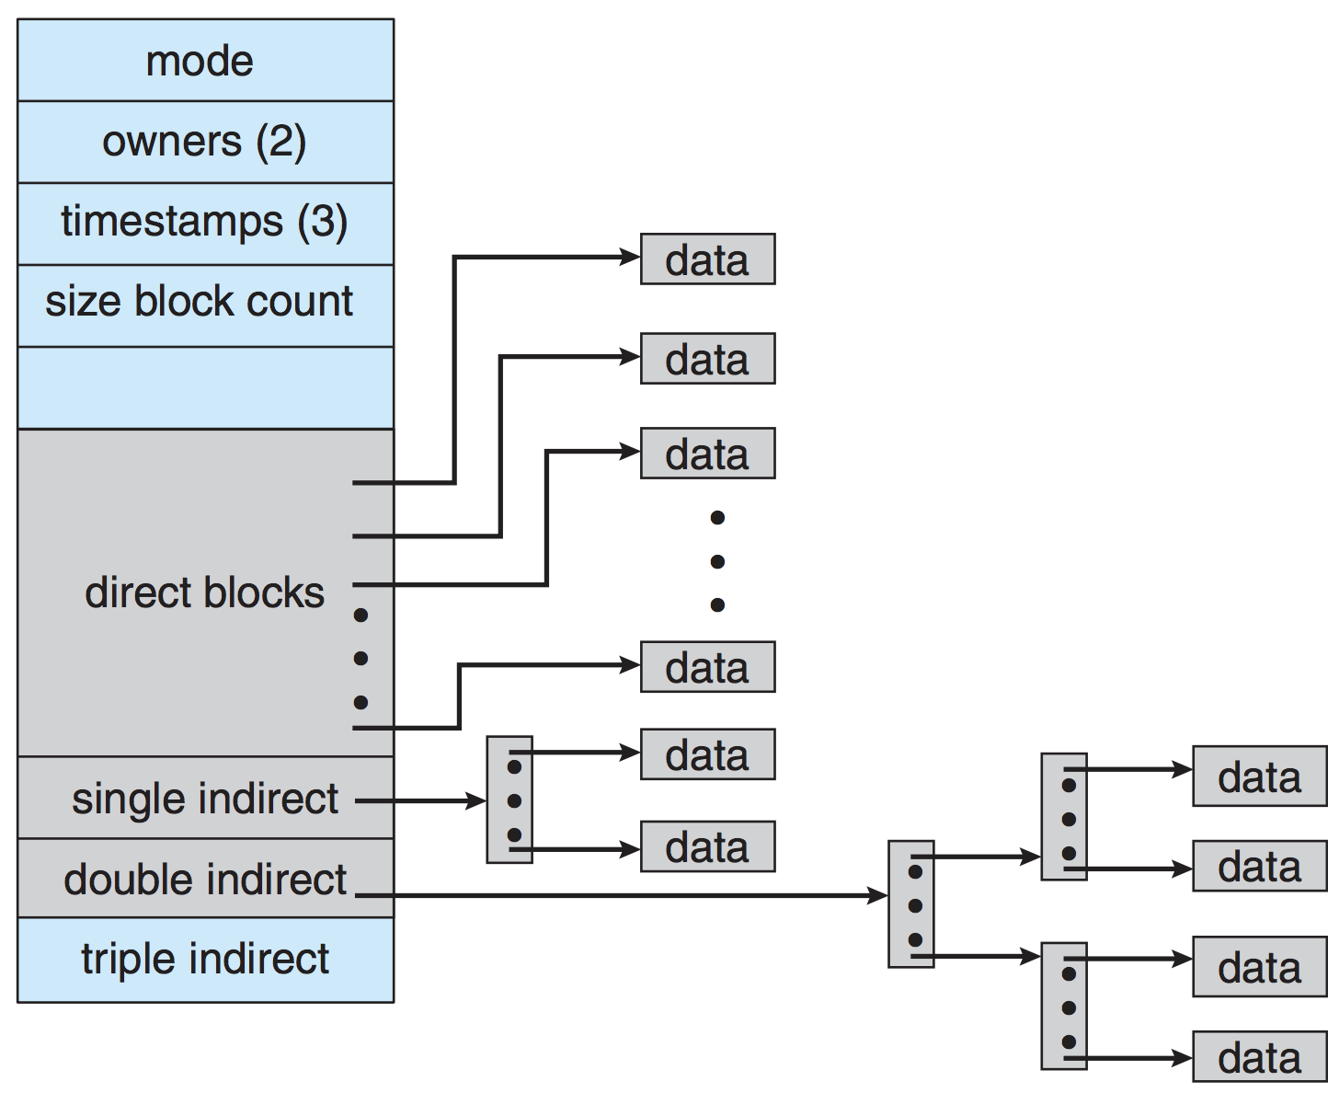
Combined Scheme: UNIX inode
Small file
Medium file
Large file
Huge file
Assume block size of 4KB, 4-byte pointers, 12 direct entries, 1 single,
1 double and 1 triple indirect, what is the max file size supported?
(12 + 1024 + 1024 x 1024 + 1024 x 1024 x 1024) x 4KB = 4+ TB!
Notes:
Important slide

Slide 34
Example: UNIX inode
fptr = open ("/pub/data/file1.txt", "read");
2. read (fptr, buf, 4); // read 4 bytes
How many disk operations each of the above line takes?
Line 1: 7
  For “/”, 2 read operations: 1 to get the inode and another to get that data block that contains info about sub directory
  Similarly, for /pub and /pub/data ➔ each needs 2 read operations
  Then we need to read the inode of file1.txt
Line 2: 1 (read one data block)
Reading different parts of the file may need reading multiple inodes, seek(fptr, 12*1024*4 + 4);
read(fptr, buf, 4);
  Need to read first level index node, then data

Slide 35
How Do We Know Where Free Blocks Are?
Bit map
  One bit for each block: 0 = occupied, 1 = free
  00011110 01100000 00001111 1………..1
  Easy to find contiguous blocks
  Supported by hardware
    Single instruction to find offset of first bit with value 1 in a word (of 32 bits) ➔ fast searching
  Disadvantages?
    Bit map is stored on disk ➔ slow to access
      Solution: cache it in memory
      But bit maps are not small for large disks
      Example: 400 GB disk with 1 KB blocks ➔ 400 M blocks
      ➔ 50 MB bitmap ➔ difficult to cache the entire bitmap
      May group multiple free blocks to reduce bitmap size

Slide 36
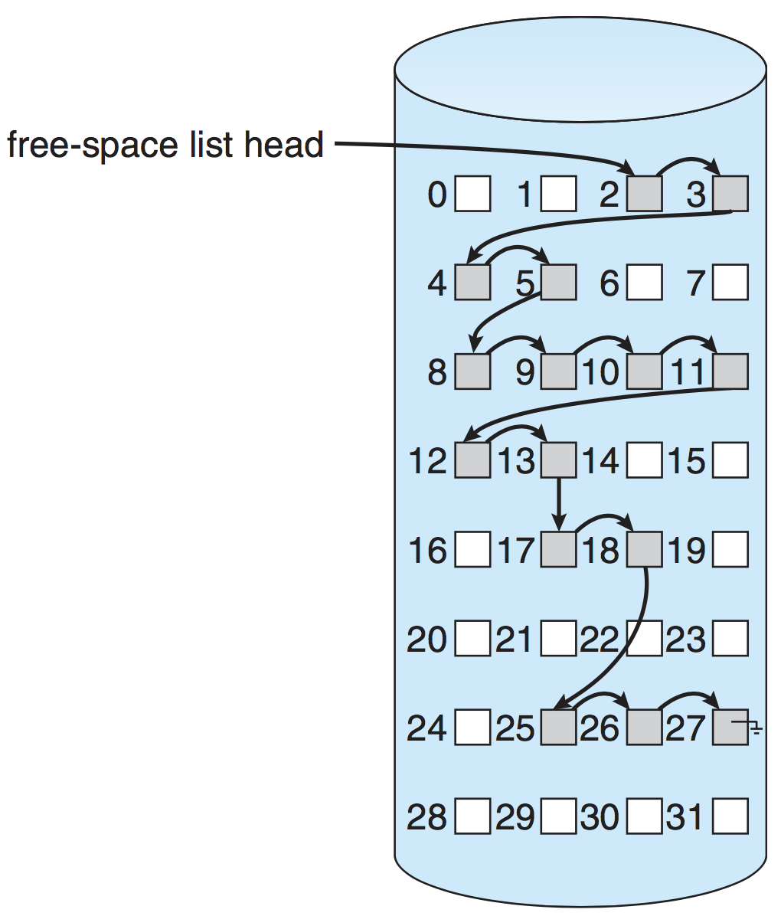
Free-Space Management
Linked List
  No waste of disk space
  Not easy to get contiguous space

Slide 37
Free-Space Management (cont’d)
Grouping
  Addresses of n free blocks are stored in the first block
  The last block contains addresses to the following n free blocks
Counting
  Keep address of 1st free block & count of following free blocks
      <addrFirstFreeBlock, count>

Slide 38
Recovery
System failures occur anytime
  Hardware defects, software bugs, external events
Crashes can leave file system in inconsistent state
  E.g., incorrect metadata, lost data
File systems should have recovery mechanisms
Simple consistency checking
  Set a bit (on disk) before metadata is to be update;
  reset it after metadata update is complete
  Upon reboot: if the bit is set, then crash occurred and invoke consistency checking
    Try to reconstruct metadata and data

Slide 39
Log Structured File Systems
Log structured (journaling) file systems
  Used to recover from crashes (failed updates to the FS)
Each metadata update to FS is a “transaction”
  Which is written (sequentially) to a log
  Considered committed once written to the log
  (even if file system is not yet updated)
Transactions in the log are asynchronously written
to the file system structures
  When the file system structures are modified on disk, the transaction is removed from the log
If file system crashes, transactions in log are replayed
  Because they were pending operations before crash

Slide 40
Network File System (NFS)
Enables accessing files on remote machines
Supports different machines, OS, and networks
Mounts remote directory over local FS directory
  Subject to access rights
Once mounted, remote directory is accessed transparently
  Looks like local directory, yet all operations are sent over the network
Heterogeneity
  RPC (remote procedure call) primitives over
  XDR (External Data Representation) protocol
  Check out textbook for details

Slide 41
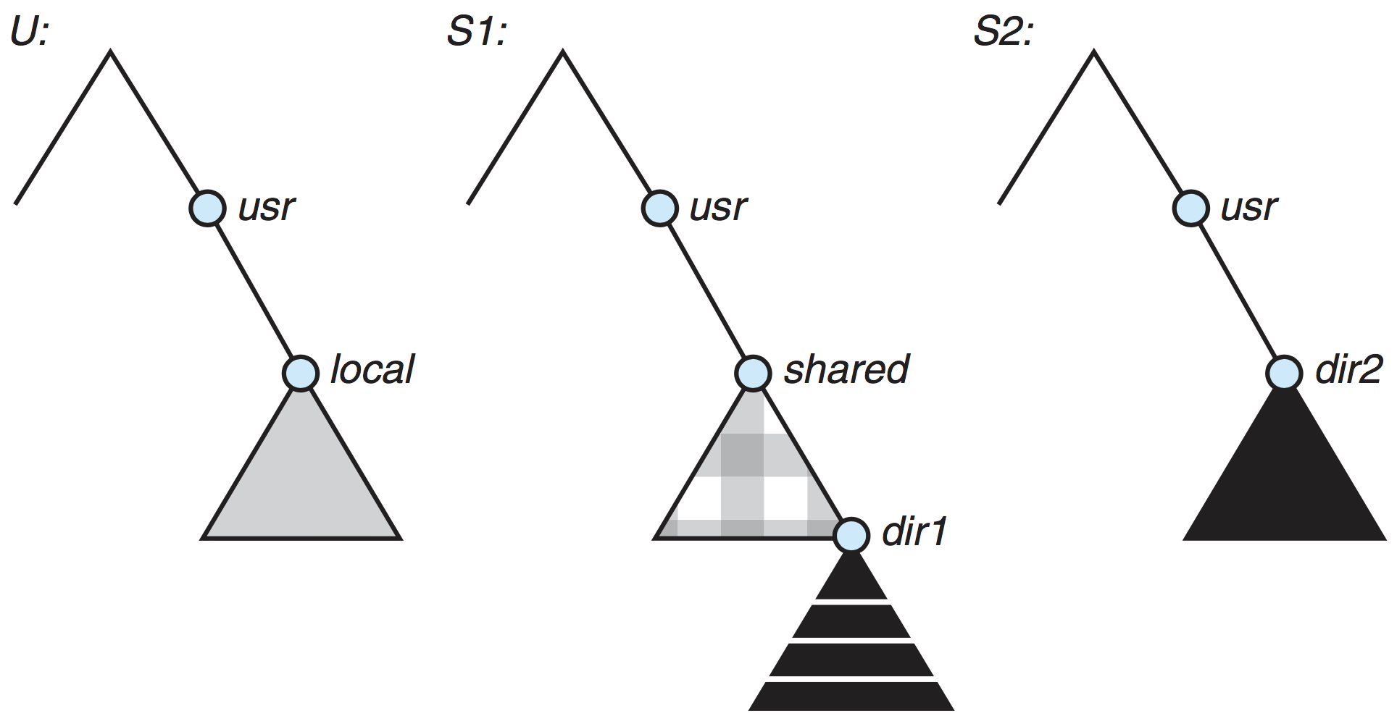
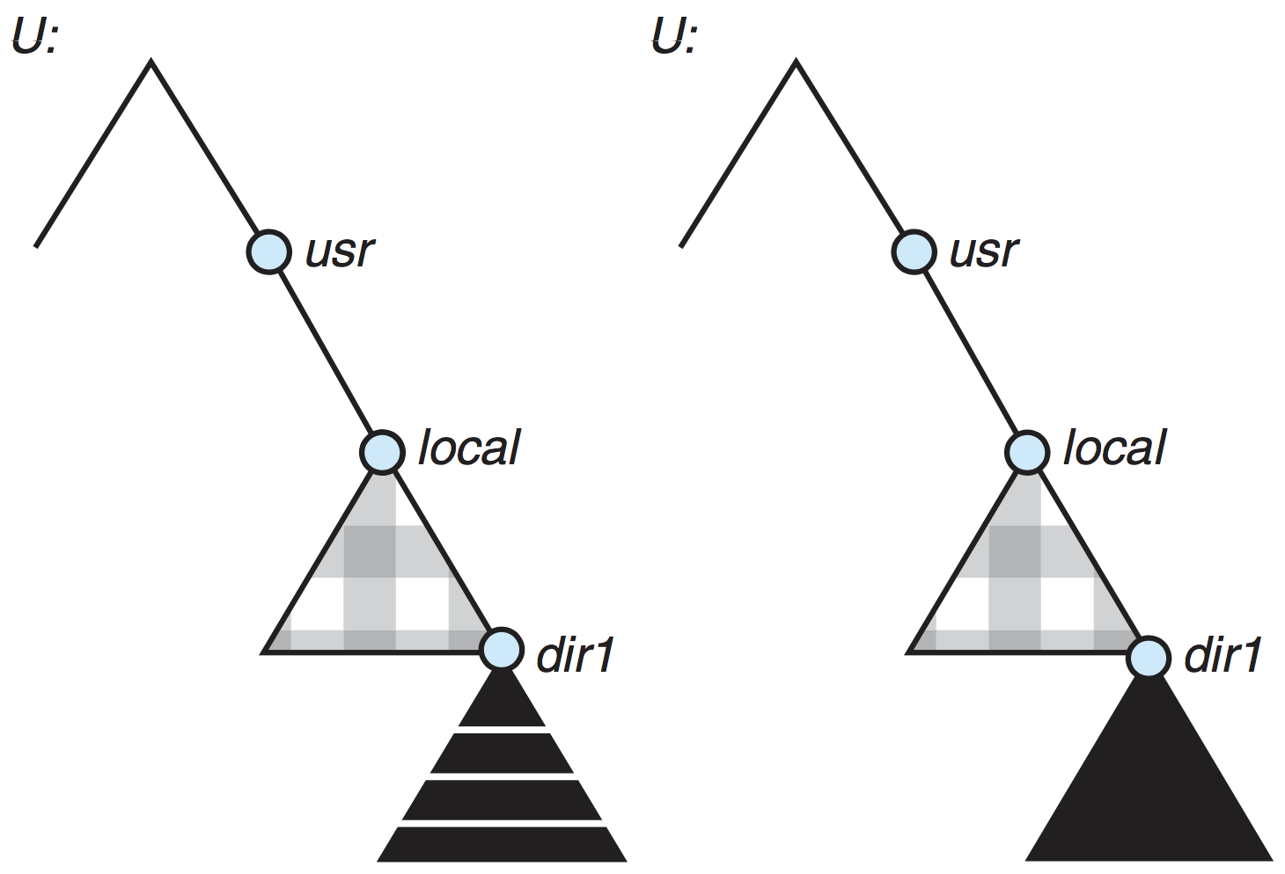
NFS: Mounting Remote Directory
Cascading
mounts

Slide 42
Summary
File system interface: File and Directory concepts
  Directory Structure: tree and general graph
  Multiple file systems: common interface using Virtual FS
File system implementation
  On-disk structures: directory structure, FCB, superblock, …
  In-memory structures: caches, open-file tables
  Opening, closing, accessing, and creating files
Block allocation: contiguous, linked, indexed
Free-space management: bitmap, linked list
Recovery, Log Structured File Systems
Network File Systems

Slide 43
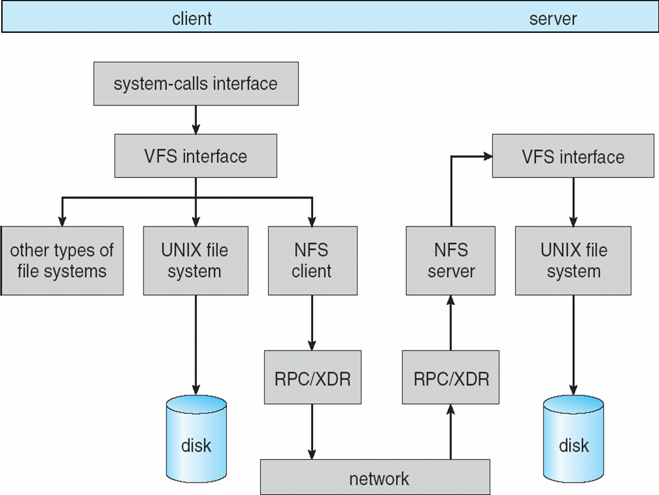
NFS Architecture
Notes:
Each machine acts as client and server
Link this to CSIL lab and their home directories.

