Slide 1
Parallel Programming on Graphs + How Memory Works

Slide 2
Today’s topics
Programming abstractions for processing graphs
More examples of “domain-specific” programming systems
Common optimizations when processing graphs
How memory (DRAM) works
Today is a good lecture to talk about memory since graph
algorithms are often bandwidth bound!

Slide 3
Last time: increasing acceptance of domain-specific programming systems
Challenge to programmers: modern computers are parallel, heterogeneous machines (HW architects striving for high area and power eﬃciency)
Trend: domain-specific programming system design: give up generality in space of programs that can be expressed in exchange for achieving high productivity and high performance
“Performance portability” is a key goal: programs should execute eﬃciently on a variety of parallel platforms
- Good implementations of same program for diﬀerent systems require diﬀerent data structures, algorithms, and approaches to parallelization — not just diﬀerences in low-level code generation (optimization is not only a matter of generating SSE vs. AVX vs ARM Neon vs. NVIDIA PTX instructions)

Slide 4
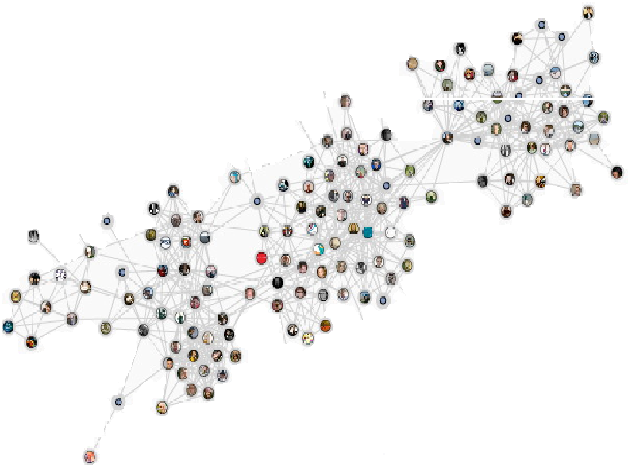









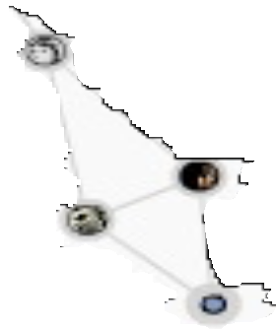
Today’s topic: analyzing big graphs
Many modern applications:
- Web search results, recommender systems, influence determination, advertising, anomaly detection, etc.
Public dataset examples:
Twitter social graph, Wikipedia term occurrences, IMDB actors, Netflix, Amazon communities
Good source of public graphs: https://snap.stanford.edu/data/

Slide 5
Thought experiment: if we wanted to design a programming system for computing on graphs, where might we begin?
What abstractions do we need?

Slide 6

Whenever I’m trying to assess the importance of a new programming system, I ask two questions:
“What tasks/problems does the system take oﬀ the programmer’s hands? (are these problems challenging or tedious enough that I feel the system is adding suﬃcient value for me to want to use it?)”
“What problems does the system leave as the responsibility for the programmer?” (usually because the programmer is better at these tasks)
Halide (recall previous class):
Programmer’s responsibility:
Describing image processing algorithm as pipeline of operations on images
Describing the schedule for executing the pipeline (e.g., “block this loop, “parallelize this loop”, “fuse these stages”)
Halide system’s responsibility:
Implementing the schedule using mechanisms available on the target machine (spawning pthreads, allocating temp buﬀers, emitting vector instructions, loop indexing code)
A good exercise: carry out this evaluation for another programming system: like OpenGL, SQL, MapReduce, etc.

Slide 7
Programming system design questions:
What are the fundamental operations we want to be easy to express AND eﬃcient to execute?
What are the key optimizations used when authoring the best implementations of these operations?
(high-level abstractions provided by a programming system should not stand in the way of these optimizations, and maybe even allow the system to perform them for the application)

Slide 8
Example graph computation: Page Rank
Page Rank: iterative graph algorithm Graph nodes = web pages
Graph edges = links between pages
discount
1 — ↵
R[i] = + ↵
X
R[j] Outlinks[j]
N
j links to i
Rank of page i
Weighted combination of rank of pages that link to it

Slide 9
GraphLab

Slide 10

GraphLab
Low et al. 2010 www.graphlab.org
A system for describing iterative computations on graphs
Implemented as a C++ library
Runs on shared memory machines or distributed across clusters
- GraphLab runtime takes responsibility for scheduling work in parallel, partitioning graphs across clusters of machines, communication between master, etc.

Slide 11
GraphLab programs: state
The graph: G = (V, E)
Application defines data blocks on each vertex and directed edge
Dv = data associated with vertex v
Du→v = data associated with directed edge u→v
Read-only global data
Can think of this as per-graph data, rather than per vertex or per-edge data)
Notice: I always first describe program state
And then describe what operations are available to manipulate this state

Slide 12
GraphLab operations: the “vertex program”
Defines per-vertex operations on the vertex’s local neighborhood
Neighborhood (aka “scope”) of vertex:
The current vertex
Adjacent edges
Adjacent vertices
current vertex
= vertex or edge data “in scope” of red vertex (graph data that can be accessed when executing a vertex program at the current (red) vertex)

Slide 13
Simple example: PageRank *
1 — ↵
R[i] = + ↵
X
R[j] Outlinks[j]
N
j links to i
PageRank_vertex_program(vertex i) {
// (Gather phase) compute the sum of my neighbors rank double sum = 0;
foreach(vertex j : in_neighbors(i)) {
sum = sum + j.rank / num_out_neighbors(j);
}
Let alpha = 0.85
// (Apply phase) Update my rank (i)
i.rank = (1-0.85)/num_graph_vertices() + 0.85*sum;
}
Programming in GraphLab amounts to defining how to update graph state at each vertex. The system takes responsibility for scheduling and parallelization.
* This is made up syntax for slide simplicity: actual syntax is C++, as we’ll see on the next slide

Slide 14
GraphLab: data access
The application’s vertex program executes per-vertex
The vertex program defines:
What adjacent edges are inputs to the computation
What computation to perform per edge
How to update the vertex’s value
What adjacent edges are modified by the computation
How to update these output edge values
Note how GraphLab requires the program to tell it all data that will be accessed, and whether it is read or write access

Slide 15
PageRank: GraphLab vertex program (C++ code)
struct web_page { std::string pagename; double pagerank;
web_page(): pagerank(0.0) { }
}
Graph has record of type web_page per vertex, and no data on edges
typedef graphlab::distributed_graph<web_page, graphlab::empty> graph_type;
class pagerank_program : public graphlab::ivertex_program …
{
public:
// we are going to gather over all the in-edges edge_dir_type gather_edges(icontext_type& context,
const vertex_type& vertex) const {
return graphlab::IN_EDGES;
}
Define edges to gather over in “gather phase”
// for each in-edge gather the weighted sum of the edge.
double gather(icontext_type& context, const vertex_type& vertex, edge_type& edge) const {
return edge.source().data().pagerank / edge.source().num_out_edges();
}
Compute value to accumulate for each edge
// Use the total rank of adjacent pages to update this page void apply(icontext_type& context, vertex_type& vertex,
const gather_type& total) {
double newval = total * 0.85 + 0.15; vertex.data().pagerank = newval;
}
Update vertex rank
// No scatter needed. Return NO_EDGES
edge_dir_type scatter_edges(icontext_type& context,
const vertex_type& vertex) const { return graphlab::NO_EDGES;
}
};
PageRank example performs no scatter

Slide 16
Running the program
graphlab::omni_engine<pagerank_program> engine(dc, graph, "sync"); engine.signal_all();
engine.start();
GraphLab runtime provides “engines” that manage scheduling of vertex programs
engine.signal_all() marks all vertices for execution
You can think of the GraphLab runtime as a work queue scheduler.
And invoking a vertex program on a vertex as a task that is placed in the work queue.
So it’s reasonable to read the code above as: “place all vertices into the work queue” Or as: “foreach vertex” run the vertex program.

Slide 17
Vertex signaling: GraphLab’s mechanism for generating new work
1 — ↵
R[i] = + ↵
X
R[j] Outlinks[j]
N
j links to i
Iteratively update all R[i]’s 10 times
Uses generic “signal” primitive (could also wrap code on previous slide in a for loop)
struct web_page { std::string pagename;
Per-vertex “counter”
double int
pagerank; counter;
web_page(): pagerank(0.0),counter(0) { }
}
// Use the total rank of adjacent pages to update this page void apply(icontext_type& context, vertex_type& vertex,
const gather_type& total) { double newval = total * 0.85 + 0.15; vertex.data().pagerank = newval;
vertex.data().counter++;
if (vertex.data().counter < 10) vertex.signal();
If counter < 10, signal to scheduler to run the vertex program on the vertex again at some point in the future
}

Slide 18
Signal: general primitive for scheduling work
Parts of graph may converge at diﬀerent rates
(iterate PageRank until convergence, but only for vertices that need it)
class pagerank_program: public graphlab::ivertex_program
private:
bool perform_scatter;
Private variable set during apply phase, used during scatter phase
public:
// Use the total rank of adjacent pages to update this page void apply(icontext_type& context, vertex_type& vertex,
const gather_type& total) { double newval = total * 0.85 + 0.15; double oldval = vertex.data().pagerank; vertex.data().pagerank = newval;
perform_scatter = (std::fabs(prevval - newval) > 1E-3);
Check for convergence
}
// Scatter now needed if algorithm has not converged edge_dir_type scatter_edges(icontext_type& context,
const vertex_type& vertex) const {
if (perform_scatter) return graphlab::OUT_EDGES; else return graphlab::NO_EDGES;
}
// Make sure surrounding vertices are scheduled
void scatter(icontext_type& context, const vertex_type& vertex, edge_type& edge) const {
context.signal(edge.target());
}
};
Schedule update of neighbor vertices

Slide 19
Synchronizing parallel execution
Local neighborhood of vertex (vertex’s “scope”) can be read and written to by a vertex program
Programs specify what granularity of atomicity
current vertex
they want GraphLab to provide: this determines amount of available parallelism
“Full”: implementation ensures no other execution reads or writes to data in scope of v when vertex program for v is running.
“Edge”: no other execution reads or writes any data in v or in edges adjacent to v
“Vertex”: no other execution reads or writes to data in v ...
= vertex or edge data in scope of red vertex

Slide 20
GraphLab: work scheduling order
GraphLab implements several work scheduling policies
Synchronous: update all vertices simultaneously (vertex programs observe no updates from programs run on other vertices in same “round”)
Round-robin: vertex programs observe most recent updates
Dynamic: based on new work created by signal
- Several implementations: fifo, priority-based, “splash” ...
Application developer has flexibility for choosing atomicity guarantee and scheduling policy
Implication: choice of schedule impacts program’s correctness/output

Slide 21
Summary: GraphLab concepts
Program state: data on graph vertices and edges + globals
Operations: per-vertex update programs and global reduction functions (reductions not discussed today)
Simple, intuitive description of work (follows mathematical formulation)
Graph restricts data access in vertex program to local neighborhood
Asynchronous execution model: application creates work dynamically by “signaling vertices” (enable lazy execution, work eﬃciency on real graphs)
Choice of scheduler and atomicity implementation
In this domain, the order in which nodes are processed can be critical property for both performance and quality of result
Application responsible for choosing right scheduler for its needs

Slide 22
Ligra
(eﬃcient data-parallel graph processing for shared memory multi-cores)

Slide 23
Ligra
[Shun 2013]
A simple framework for parallel graph operations on shared memory multi-core machines
Motivating example: breadth-first search
parents = {-1, ..., -1}
// | d | = | dst: | vertex | to | “update” | (just | encountered)
// | s | = | src: | vertex | on | frontier | with | edge to d
procedure UPDATE(s, d)
return compare-and-swap(parents[d], -1, s);
procedure COND(i)
return parents[i] == -1;
procedure BFS(G, r) parents[r] = r; frontier = {r};
while (size(frontier) != 0) do:
frontier = EDGEMAP(G, frontier, UPDATE, COND);
Semantics of EDGEMAP:
foreach vertex i in frontier, call UPDATE for all neighboring vertices j
for which COND(j) is true. Add j to returned set if UPDATE(i, j) returns true

Slide 24
Implementing edgemap
Assume vertex subset U (frontier in previous example) is represented sparsely:
- e.g., three vertex subset U of 10 vertex graph G=(E,V): U ⊂ V = {0, 4, 9}
graph
set of vertices
procedure EDGEMAP_SPARSE(G, U, F, C): result = {}
parallel foreach v in U do:
parallel foreach v2 in out_neighbors(v) do: if (C(v2) == 1 and F(v,v2) == 1) then
add v2 to result remove duplicates from result
condition check on neighbor vertex update function on neighbor vertex
return result;
parents = {-1, ..., -1}
procedure UPDATE(s, d)
return compare-and-swap(parents[d], -1, s);
procedure COND(i)
return parents[i] == -1;
procedure BFS(G, r) parents[r] = r; frontier = {r};
while (size(frontier) != 0) do:
frontier = EDGEMAP(G, frontier, UPDATE, COND);
Cost of EDGEMAP_SPARSE?
O(|U| + sum of outgoing edges from U)

Slide 25
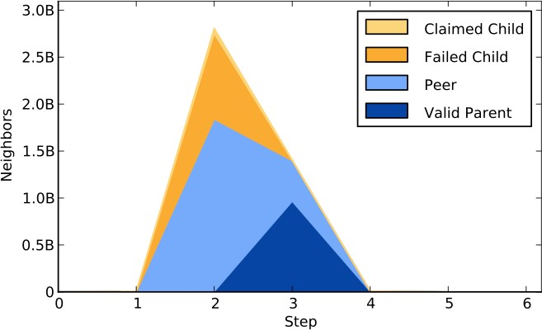
Visiting every edge on frontier can be wasteful
Each step of BFS, every edge on frontier is visited
Frontier can grow quickly for social graphs (few steps to visit all nodes)
Most edge visits are wasteful! (they don’t lead to a successful “update”)
claimed child: edge points to unvisited vertex (useful work)
failed child: edge points to vertex found in this step via another edge
peer: edge points to a vertex that was added to frontier in same step as current vertex
valid parent: edge points to vertex found in previous step
[Credit: Beamer et al. SC12]

Slide 26
Implementing edgemap for dense vertex subsets
Assume vertex subset (frontier in previous example) is represented densely with a bitvector:
- e.g., vertex subset U of 10 vertex graph G=(E,V): U ⊂ V = {1,0,0,0,1,0,0,0,0,1}
procedure EDGEMAP_SPARSE(G, U, F, C): result = {}
parallel foreach v in U do:
parallel foreach v2 in out_neighbors(v) do: if (C(v2) == 1 and F(v,v2) == 1) then
add v2 to result remove duplicates from result return result;
procedure EDGEMAP_DENSE(G, U, F, C): result = {}
parallel for i in {0,...,|V|-1} do: if (C(i) == 1) then:
foreach v in in_neighbors(i) do: if v ∈ U and F(v, i) == 1 then:
add i to result; if (C(i) == 0)
break; return result;
Cost of EDGEMAP_DENSE?
For each unvisited vertex, quit searching as soon as some parent is found Could be as low as O(|V|)
Also no synchronization needed (“gather” results rather than “scatter”)

Slide 27
Ligra on one slide
Entities:
Graphs
Vertex subsets (represented sparsely or densely by system)
EDGEMAP and VERTEXMAP functions
procedure EDGEMAP(G, U, F, C):
if (|U| + sum of out degrees > threshold) return EDGEMAP_DENSE(G, U, F, C);
else
return EDGEMAP_SPARSE(G, U, F, C);
Iterate over all vertices adjacent to vertices in set U
Choose right algorithm for the job
procedure VERTEXMAP(U, F): result = {}
parallel for u ∈ U do: if (F(u) == 1) then:
add u to result; return result;
Iterate over all vertices in set U

Slide 28
Page rank in Ligra
r_cur = {1/|V|, ... 1/|V|};
r_next = {0,...,0}; diff = {}
procedure PRUPDATE(s, d):
atomicIncrement(&r_next[d], r_cur[s] / vertex_degree(s));
procedure PRLOCALCOMPUTE(i):
r_next[i] = alpha * r_next[i] + (1 - alpha) / |V|; diff[i] = |r_next[i] - r_cur[i]|;
r_cur[i] = 0;
return 1;
Question: can you implement the iterate until convergence optimization we previously discussed in GraphLab?
procedure COND(i): return 1;
(if so, what GraphLab scheduler implementation is the result equivalent to?)
procedure PAGERANK(G, alpha, eps): frontier = {0, ... , |V|-1} error = HUGE;
while (error > eps) do:
frontier = EDGEMAP(G, frontier, PRUPDATE, COND); frontier = VERTEXMAP(frontier, PRLOCALCOMPUTE);
error = sum of per-vertex diffs swap(r_cur, r_next);
return err
// this is a parallel reduce

Slide 29
Ligra summary
System abstracts graph operations as data-parallel operations over vertices and edges
Emphasizes graph traversal (potentially small subset of vertices operated on in a data parallel step)
These basic operations permit a surprisingly wide space of graph algorithms:
Betweenness centrality
Connected components
Shortest paths
See Ligra: a Lightweight Framework for Graph Processing for Shared Memory [Shun and Blelloch 2013]

Slide 30
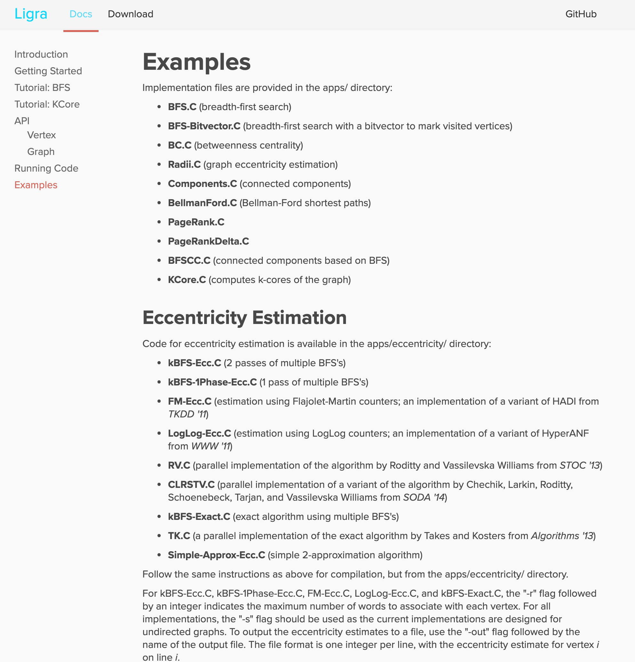
Ligra
Simple library with many useful examples

Slide 31
Elements of good domain-specific programming system design

Slide 32
#1: good systems identify the most important cases, and provide most benefit in these situations
Structure of code mimics the natural structure of problems in the domain
Halide: pixel-wise view of filters: pixel(x,y) computed as expression of
these input pixel values
Graph processing algorithms are designed in terms of per-vertex
operations
Eﬃcient expression: common operations are easy and intuitive to express
Eﬃcient implementation: the most important optimizations in the domain are performed by the system for the programmer
My experience: a parallel programming system with “convenient” abstractions that precludes best-known implementation strategies will almost always fail

Slide 33
#2: good systems are usually simple systems
They have a small number of key primitives and operations
Ligra: only two operations! (vertexmap and edgemap)
GraphLab: run computation per vertex, trigger new work by signaling
- But GraphLab gets messy with all the scheduling options
Halide: a few scheduling primitives for describing loop nests
Hadoop: map + reduce
Allows compiler/runtime to focus on optimizing these primitives
Provide parallel implementations, utilize appropriate hardware
Common question that good architects ask: “do we really need that?” (can this concept be reduced to a primitive we already have?)
For every domain-specific primitive in the system: there better be a strong performance or expressivity justification for its existence

Slide 34
#3: good primitives compose
Composition of primitives allows for wide application scope, even if scope remains limited to a domain
e.g., frameworks discussed today support a wide variety of graph algorithms
Halide’s loop ordering + loop interleaving schedule primitives allow for expression
of wide range of schedules
Composition often allows optimization to generalizable
- If system can optimize A and optimize B, then it can optimize programs that combine A and B
Sign that a feature should not be added (or added in a diﬀerent way):
The new feature does not compose with all existing features in the system
Sign of a good design:
System ultimately is used for applications original designers never anticipated

Slide 35
Optimizing graph computations
(now we are talking about implementation)

Slide 36

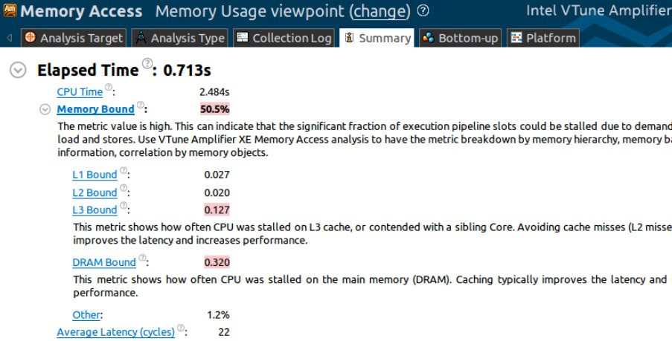
Wait a minute…
So far in this lecture, we’ve discussed issues such as parallelism, synchronization …
But you may recall from your assignment that graph processing is typically has low arithmetic intensity
VTune profiling results from Asst 4: Memory bandwidth bound!
Walking over edges accesses information from “random” graph vertices
Or just consider PageRank: ~ 1 multiply-accumulate per iteration of summation loop
1 — ↵
R[i] = + ↵
X
R[j] Outlinks[j]
N
j links to i

Slide 37
Two ideas to increase the performance of operations on large graphs *
Reorganize graph structure to increase locality
Compress the graph
* Both optimizations might be performed by a framework without application knowledge

Slide 38
Recall: directed graph representation
Vertex Id | 1 |  | 2 |  | 3 |  |  |  | 4 |  | 5 |  |  |  | 6
Outgoing Edges | 2 | 3 | 3 | 5 | 2 | 4 | 5 | 6 | 1 | 5 | 1 | 2 | 3 | 6 | 2 | 4
Vertex Id Incoming Edges
1 2 3 4
4 5 1 3 5 6 1 2 5 3 6 2 3 4 3 6
5
6
1
2
6
3
5
4

Slide 39
Memory footprint challenge of large graphs
Challenge: cannot fit all edges in memory for large graphs
Consider representation of graph from your programming assignment:
Each edge represented twice in graph structure (as incoming/outgoing edge)
8 bytes per edge to represent adjacency
May also need to store per-edge values (e.g., 4 bytes for a per-edge weight)
1 billion edges (modest): ~12 GB of memory for edge information
Algorithm may need multiple copies of per-edge structures (current, prev data, etc.)
Could employ cluster of machines to store graph in memory
Rather than store graph on disk
Would prefer to process large graphs on a single machine
Managing clusters of machines is diﬃcult
Partitioning graphs is expensive (also needs a lot of memory) and diﬃcult

Slide 40
“Streaming” graph computations
Graph operations make “random” access to graph data (edges adjacent to vertex v may distributed arbitrarily throughout storage)
- Single pass over graph’s edges might make billions of fine-grained accesses to disk
Streaming data access pattern
Processor
-
-
Make large, predictable data accesses to slow storage (achieve high bandwidth data transfer)
Load data from slow storage into fast storage*, then reuse it as much as possible before discarding it (achieve high arithmetic intensity)
Can we modify the graph data structure so that data access requires only a small number of eﬃcient bulk loads/stores from slow storage?
Fast storage
(low latency, high BW, low capacity)
-
Slow storage
(high latency, low BW, high capacity)
Disk, SSD, etc.
* By fast storage, in this context I mean DRAM. However, techniques for streaming from disk into memory would also apply to streaming from memory into a processor’s cache

Slide 41
Sharded graph representation
GraphChi: Large-scale graph computation on just a PC [Kryola et al. 2013]
-
-
-
Partition graph vertices into intervals (sized so that subgraph for interval fits in memory) Vertices and only incoming edges to these vertices are stored together in a shard
Sort edges in a shard by source vertex id
Shard 1:
vertices (1-2)
Shard 2:
vertices (3-4)
Shard 3:
vertices (5-6)
1
src | dst | value
1 | 2 | 0.3
3 | 2 | 0.2
4 | 1 | 0.8
5 | 1 | 0.25
 | 2 | 0.6
6 | 2 | 0.1
src | dst | value
1 | 3 | 0.4
2 | 3 | 0.9
3 | 4 | 0.15
5 | 3 | 0.2
6 | 4 | 0.9
src | dst | value
2 | 5 | 0.6
3 | 5 | 0.9
 | 6 | 0.85
4 | 5 | 0.3
5 | 6 | 0.2
2
6
3
5
Yellow = data required to process subgraph containing vertices in shard 1
4
Notice: to construct subgraph containing vertices in shard 1 and their incoming and outgoing edges, only need to load contiguous information from other P-1 shards
Writes to updated outgoing edges require P-1 bulk writes

Slide 42
Sharded graph representation
GraphChi: Large-scale graph computation on just a PC [Kryola et al. 2013]
-
-
-
Partition graph vertices into intervals (sized so that subgraph for interval fits in memory) Vertices and only incoming edges to these vertices are stored together in a shard
Sort edges in a shard by source vertex id
Shard 1:
vertices (1-2)
Shard 2:
vertices (3-4)
Shard 3:
vertices (5-6)
1
src | dst | value
1 | 2 | 0.3
3 | 2 | 0.2
4 | 1 | 0.8
5 | 1 | 0.25
 | 2 | 0.6
6 | 2 | 0.1
src | dst | value
1 | 3 | 0.4
2 | 3 | 0.9
3 | 4 | 0.15
5 | 3 | 0.2
6 | 4 | 0.9
src | dst | value
2 | 5 | 0.6
3 | 5 | 0.9
 | 6 | 0.85
4 | 5 | 0.3
5 | 6 | 0.2
2
6
3
5
Yellow = data required to process subgraph containing vertices in shard 2
4

Slide 43
Sharded graph representation
GraphChi: Large-scale graph computation on just a PC [Kryola et al. 2013]
-
-
-
Partition graph vertices into intervals (sized so that subgraph for interval fits in memory) Vertices and only incoming edges to these vertices are stored together in a shard
Sort edges in a shard by source vertex id
Shard 1:
vertices (1-2)
Shard 2:
vertices (3-4)
Shard 3:
vertices (5-6)
1
src | dst | value
1 | 2 | 0.3
3 | 2 | 0.2
4 | 1 | 0.8
5 | 1 | 0.25
 | 2 | 0.6
6 | 2 | 0.1
src | dst | value
1 | 3 | 0.4
2 | 3 | 0.9
3 | 4 | 0.15
5 | 3 | 0.2
6 | 4 | 0.9
src | dst | value
2 | 5 | 0.6
3 | 5 | 0.9
 | 6 | 0.85
4 | 5 | 0.3
5 | 6 | 0.2
2
6
3
5
Yellow = data required to process subgraph containing vertices in shard 3
4
Observe: due to sorting of incoming edges, iterating over all intervals results in contiguous sliding window over the shards

Slide 44
Putting it all together: looping over all graph edges
For each partition i of vertices:
Load shard i (contains all incoming edges)
For each other shard s
- Load section of s containing data for edges leaving i and entering s
Construct subgraph in memory
Do processing on subgraph
Note: a good implementation could hide disk I/O by prefetching data for next iteration of loop

Slide 45



Performance on a Mac mini (8 GB RAM)
₃ x 10
7
₁₄ x 10
6
Throughput (edges/sec)
Pagerank
Throughput (edges/sec)
Disk IO
Graph construction
Exec. updates
2.5
12
Pagerank
2500
2
Conn. comp.
10
Conn. comp.
2000
1.5
8
1500
1
6
1000
WebBP
WebBP
500
0.5
0
2 4 6
Number of edges
8
4
0
2
4
6
8
x 10
9
Number of edges
x 10
9
0
1 thread 2 threads 4 threads
(c) Runtime breakdown
(a) Performance: SSD
(b) Performance : Hard drive
Throughput (edges/sec) remains stable as graph size is increased
- Desirable property: throughput (edges/sec) largely invariant of dataset size

Slide 46
Graph compression
Recall: graph operations are often bandwidth bound
Implication: using additional CPU instructions to reduce BW requirements can benefit overall performance (the processor would be waiting on memory anyway, so use it to decompress data!)
Idea: store graph compressed in memory, decompress on-the-
fly when operation wants to read data

Slide 47
Compressing an edge list
Vertex Id | 32
Outgoing Edges | 1001 | 10 | 5 | 30 | 6 | 1025 | 200000 | 1010 | 1024 | 100000 | 1030 | 275000
Sort edges for each vertex
5 6 10 30 1001 1010 1024 1025 1030 100000 200000 275000
Compute diﬀerences
5 6 10 30 1001 1010 1024 1025 1030 100000 200000 275000
0 1 4 20 971 9 14 1 5 98070 100000 75000
Group into sections requiring same number of bytes
relative to | 5 | 6 | 10 | 30 | 1001 | 1010 | 1024 | 1025 | 1030 | 100000 | 200000 | 275000
vertex index | -27 | 1 | 4 | 20 | 971 | 9 | 14 | 1 | 5 | 98070 | 100000 | 75000
1 byte
2 bytes 1 byte
Uncompressed encoding: 12 edges x 4 bytes = 48 bytes Compressed encoding: 26 bytes
4 bytes
4. Encode deltas
1-byte group header
[ONE_BYTE, | 4], | -27, | 1, | 4, | 20 | (5 bytes)
[TWO_BYTE, | 1], | 971 |  |  |  | (3 bytes)
6 bits: number of edges in group
2 bits: encoding width (1, 2, 4 bytes)
(5 bytes)
(13 bytes)
[ONE_BYTE, 4], 9, 14, 1, 5
[FOUR_BYTE, 3], 98070, 100000, 75000

Slide 48
Performance impact of graph compression
[Shun et al. DDC 2015]
Running time on one core (relative to no compression)
Running time on 40 cores (relative to no compression)
2.4
2.2
2
1.8
1.6
1.4
1.2
1
0.8
1.8
1.6
1.4
1.2
1
0.8
original Ligra
byte
byte-RLE
nibble
original Ligra
byte
byte-RLE
nibble
Relative runtime
Relative runtime
BFS
BC
Radii
PageRank
BFS
BC
Radii
PageRank
Components
Bellman-Ford
Components
Bellman-Ford
▪
Benefit of graph compression increases with higher core count, since computation is increasingly bandwidth bound
Performance improves even if graphs already fit in memory
- Added benefit is that compression enables larger graphs to fit in memory
▪
* Diﬀerent data points on graphs are diﬀerent compression schemes (byte-RLE is the scheme on the previous slide)

Slide 49
Summary
Analyzing large graphs is a workload of high interest
High performance execution requires
Parallelism (complexity emerges from need to synchronize updates to shared vertices or edges)
Locality optimizations (restructure graph for eﬃcient I/O)
Graph compression (reduce amount memory BW or disk I/O)
Graph-processing frameworks handle many of these details, while presenting the application programmer with domain- specific abstractions that make it easy to express graph analysis operations

Slide 50
How memory works

Slide 51
Memory bandwidth limits
So far in this course, we’ve stressed the need for reducing bandwidth costs…

Slide 52
Well written programs exploit locality to avoid redundant data transfers between CPU and memory
(Key idea: place frequently accessed data in caches/buﬀers near processor)
Core
L1
L2
Core
L1
Memory
Core
L1
Core
L1
Modern processors have high-bandwidth (and low latency) access to on-chip local storage
Computations featuring data access locality can reuse data in this storage
Common software optimization technique: reorder computation so that cached data is accessed many times before it is evicted (“blocking”, “loop fusion”, etc.)
Performance-aware programmers go to great eﬀort to improve the cache locality of programs
What are good examples from this class?

Slide 53




Example 1: restructuring loops for locality
Program 1
void add(int n, float* A, float* B, float* C) { for (int i=0; i<n; i++)
Two loads, one store per math op (arithmetic intensity = 1/3)
Two loads, one store per math op (arithmetic intensity = 1/3)
C[i] = A[i] + B[i];
}
void mul(int n, float* A, float* B, float* C) { for (int i=0; i<n; i++)
C[i] = A[i] * B[i];
}
float* A, *B, *C, *D, *E, *tmp1, *tmp2;
// assume arrays are allocated here
// compute E = D + ((A + B) * C) add(n, A, B, tmp1);
mul(n, tmp1, C, tmp2);
Overall arithmetic intensity = 1/3
add(n, tmp2, D, E);
Program 2
void fused(int n, float* A, float* B, float* C, float* D, float* E) { for (int i=0; i<n; i++)
E[i] = D[i] + (A[i] + B[i]) * C[i];
Four loads, one store per 3 math ops (arithmetic intensity = 3/5)
}
// compute E = D + (A + B) * C fused(n, A, B, C, D, E);
The transformation of the code in program 1 to the code in program 2 is called “loop fusion”

Slide 54
Example 2: restructuring loops for locality
int WIDTH = 1024; int HEIGHT = 1024;
Program 1 Program 2
input (W+2)x(H+2)
float input[(WIDTH+2) * (HEIGHT+2)]; float tmp_buf[WIDTH * (HEIGHT+2)]; float output[WIDTH * HEIGHT];
int WIDTH = 1024; int HEIGHT = 1024;
float input[(WIDTH+2) * (HEIGHT+2)]; float tmp_buf[WIDTH * (CHUNK_SIZE+2)]; float output[WIDTH * HEIGHT];
input (W+2)x(H+2)
tmp_buf W x (H+2)
tmp_buf
float weights[] = {1.0/3, 1.0/3, 1.0/3};
Wx(CHUNK_SIZE+2)
// blur image horizontally
for (int j=0; j<(HEIGHT+2); j++) for (int i=0; i<WIDTH; i++) {
float tmp = 0.f;
for (int ii=0; ii<3; ii++)
tmp += input[j*(WIDTH+2) + i+ii] * w tmp_buf[j*WIDTH + i] = tmp;
}
float weights[] = {1.0/3, 1.0/3, 1.0/3};
output W x H
for (int j=0; j<HEIGHT; j+CHUNK_SIZE) {
output W x H
// blur region of image horizontally for (int j2=0; j2<CHUNK_SIZE+2; j2++)
for (int i=0; i<WIDTH; i++) { float tmp = 0.f;
for (int ii=0; ii<3; ii++)
tmp += input[(j+j2)*(WIDTH+2) + i+ii] * weights[ii]; tmp_buf[j2*WIDTH + i] = tmp;
eights[ii]
;
// blur tmp_buf vertically for (int j=0; j<HEIGHT; j++) {
for (int i=0; i<WIDTH; i++) { float tmp = 0.f;
for (int jj=0; jj<3; jj++)
tmp += tmp_buf[(j+jj)*WIDTH + i] * weights[jj]; output[j*WIDTH + i] = tmp;
}
}
// blur tmp_buf vertically
for (int j2=0; j2<CHUNK_SIZE; j2++) for (int i=0; i<WIDTH; i++) {
float tmp = 0.f;
for (int jj=0; jj<3; jj++)
tmp += tmp_buf[(j2+jj)*WIDTH + i] * weights[jj]; output[(j+j2)*WIDTH + i] = tmp;
}
}

Slide 55
Example 3: restructuring loops for locality
Recall Apache Spark:
Programs are sequences of operations on collections (called RDDs)
var lines = spark.textFile(“hdfs://15418log.txt”); var lower = lines.map(_.toLower());
var mobileViews = lower.filter(x => isMobileClient(x)); var howMany = mobileViews.count();
Actual execution order of computation for the above lineage is similar to this…
int count = 0;
while (inputFile.eof()) {
string line = inputFile.readLine(); string lower = line.toLower;
if (isMobileClient(lower)) count++;
}

Slide 56
Data movement has high energy cost
Rule of thumb in mobile system design: always seek to reduce amount of data transferred from memory
- Earlier in class we discussed minimizing communication to reduce stalls (poor performance).
Now, we wish to reduce communication to reduce energy consumption
“Ballpark” numbers
[Sources: Bill Dally (NVIDIA), Tom Olson (ARM)]
Integer op: ~ 1 pJ *
Floating point op: ~20 pJ *
Reading 64 bits from small local SRAM (1mm away on chip): ~ 26 pJ
Reading 64 bits from low power mobile DRAM (LPDDR): ~1200 pJ
Implications
Suggests that recomputing values, rather than storing and reloading them, is a better answer when optimizing code for energy eﬃciency!
- Reading 10 GB/sec from memory: ~1.6 watts
Entire power budget for mobile GPU: ~1 watt (remember phone is also running CPU, display,
radios, etc.)
iPhone 6 battery: ~7 watt-hours (note: my Macbook Pro laptop: 99 watt-hour battery)
Exploiting locality matters!!!
* Cost to just perform the logical operation, not counting overhead of instruction decode, load data from registers, etc.

Slide 57


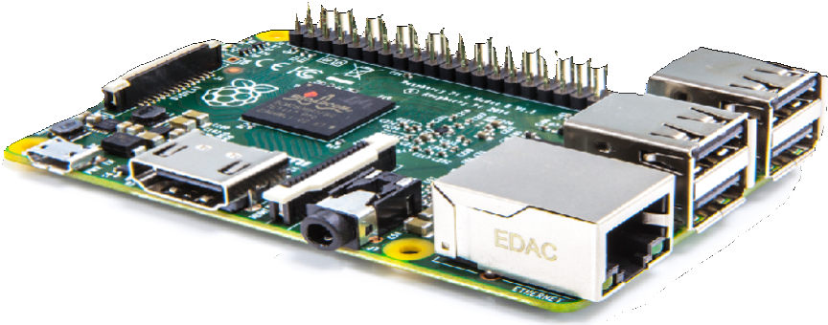


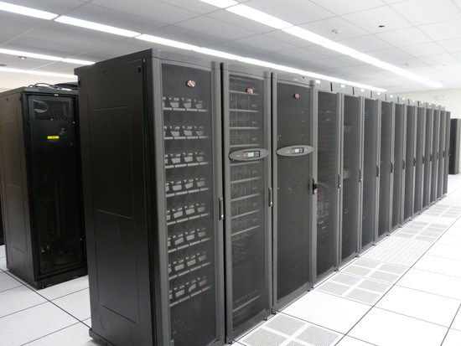
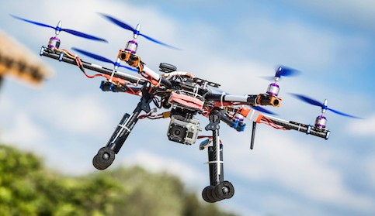
Moving data is costly!
Data movement limits performance
Many processing elements…
= higher overall rate of memory requests
= need for more memory bandwidth (result: bandwidth-limited execution)
Data movement has high energy cost
~ 0.9 pJ for a 32-bit floating-point math op *
~ 5 pJ for a local SRAM (on chip) data access
~ 640 pJ to load 32 bits from LPDDR memory
Core
Core | Memory bus | Memory
Core
Core
CPU
* Source: [Han, ICLR 2016], 45 nm CMOS assumption

Slide 58
Accessing DRAM
(a basic tutorial on how DRAM works)

Slide 59


The memory system
DRAM
64 bit memory bus
Memory Controller
sends commands to DRAM
Last-level cache (LLC)
issues memory requests to memory controller
Core
issues loads and store instructions
CPU

Slide 60
DRAM array
1 transistor + capacitor per “bit”
2 Kbits per row
(Recall: a capacitor stores charge)
 |  |  |  |  |  |  |  |  |  |  |  |  |  |  |  |  |  |  |  |  |  |  |  |  |  |  |  |  |  |  |  |  |  |  |  |  | Data pins (8 bits)
Row buﬀer (2 Kbits)
(to memory controller…)

Slide 61


DRAM operation (load one byte)
Estimated latencies are in units of memory clocks: DDR3-1600 (Kayvon’s laptop)
DRAM array
2 Kbits per row
We want to read this byte
2. Row activation (~ 10 ns)
Transfer
row
1. Precharge: ready bit lines (~10 ns)
Row buﬀer (2 Kbits)
(~ 10 ns)
3. Column selection
4. Transfer data onto bus
Data pins (8 bits)
(to memory controller…)

Slide 62

Load next byte from (already active) row
Lower latency operation: can skip precharge and row activation steps
2 Kbits per row
Row buﬀer (2 Kbits)
~ 9 cycles
1. Column selection
2. Transfer data onto bus
Data pins (8 bits)
(to memory controller…)

Slide 63
DRAM access latency is not fixed
Best case latency: read from active row
Column access time (CAS)
Worst case latency: bit lines not ready, read from new row
Precharge (PRE) + row activate (RAS) + column access (CAS)
Precharge readies bit lines and writes row buﬀer contents back into DRAM array (read was destructive)
Question 1: when to execute precharge?
After each column access?
Only when new row is accessed?
Question 2: how to handle latency of DRAM access?

Slide 64
Problem: low pin utilization due to latency of access
Access 1
Access 2
Access 3
Access 4
PRE RAS CAS
CAS PRE RAS CAS PRE RAS CAS
time
Data pins in use only a small fraction of time (red = data pins busy)
This is bad since they are the scarcest resource!
Data pins (8 bits)

Slide 65
DRAM burst mode
Access 1
PRE RAS CAS rest of transfer
Access 2
PRE RAS CAS rest of transfer
time
Idea: amortize latency over larger transfers
Each DRAM command describes bulk transfer Bits placed on output pins in consecutive clocks
Data pins (8 bits)

Slide 66


DRAM chip consists of multiple banks
▪
▪
All banks share same pins (only one transfer at a time) Banks allow for pipelining of memory requests
Precharge/activate rows/send column address to one bank while transferring data from another
Achieves high data pin utilization
Bank 0
Bank 1
Bank 2
PRE RAS CAS
PRE RAS PRE
CAS
RAS
CAS
time
Banks 0-2
Data pins (8 bits)

Slide 67



Organize multiple chips into a DIMM
Example: Eight DRAM chips (64-bit memory bus)
Note: DIMM appears as a single, higher capacity, wider interface DRAM module to the memory controller. Higher aggregate bandwidth, but minimum transfer granularity is now 64 bits.
64 bit memory bus
Memory controller
Read bank B, row R, column 0
Last-level cache (LLC)
CPU

Slide 68
Reading one 64-byte (512 bit) cache line (the wrong way)
Assume: consecutive physical addresses mapped to same row of same chip Memory controller converts physical address to DRAM bank, row, column
bits 0:7
64 bit memory bus
Memory controller
Read bank B, row R, column 0
Last-level cache (LLC)
Request line /w physical address X
CPU

Slide 69
Reading one 64-byte (512 bit) cache line (the wrong way)
All data for cache line serviced by the same chip Bytes sent consecutively over same pins
bits 8:15
64 bit memory bus
Memory controller
Read bank B, row R, column 0
Last-level cache (LLC)
Request line /w physical address X
CPU

Slide 70
Reading one 64-byte (512 bit) cache line (the wrong way)
All data for cache line serviced by the same chip Bytes sent consecutively over same pins
bits 16:23
64 bit memory bus
Memory controller
Read bank B, row R, column 0
Last-level cache (LLC)
Request line /w physical address X
CPU

Slide 71
Reading one 64-byte (512 bit) cache line
Memory controller converts physical address to DRAM bank, row, column Here: physical addresses are interleaved across DRAM chips at byte granularity DRAM chips transmit first 64 bits in parallel
bits 0:7
bits 8:15
bits 16:23
bits 24:31
bits 32:39
bits 40:47
bits 48:55
bits 56:63
64 bit memory bus
Memory controller
Read bank B, row R, column 0
Last-level cache (LLC)
Cache miss of line X
CPU

Slide 72

Reading one 64-byte (512 bit) cache line
DRAM controller requests data from new column * DRAM chips transmit next 64 bits in parallel
bits 64:71
bits 72:79
bits 80:87
bits 88:95
bits 96:103
bits 104:111
bits 112:119 bits 120:127
64 bit memory bus
Memory controller
Read bank B, row R, column 8
Last-level cache (LLC)
Cache miss of line X
CPU
* Recall modern DRAM’s support burst mode transfer of multiple consecutive columns, which would be used here

Slide 73

Memory controller is a memory request scheduler
▪
▪
Receives load/store requests from LLC Conflicting scheduling goals
Maximize throughput, minimize latency, minimize energy consumption
Common scheduling policy: FR-FCFS (first-ready, first-come-first-serve)
Service requests to currently open row first (maximize row locality)
Service requests to other rows in FIFO order
Controller may coalesce multiple small requests into large contiguous requests (to take
advantage of DRAM “burst modes”)
64 bit memory bus (to DRAM)
Memory controller
bank 0 request queue bank 2 request queue
bank 1 request queue bank 3 request queue
Requests from system’s last level cache (e.g., L3)

Slide 74
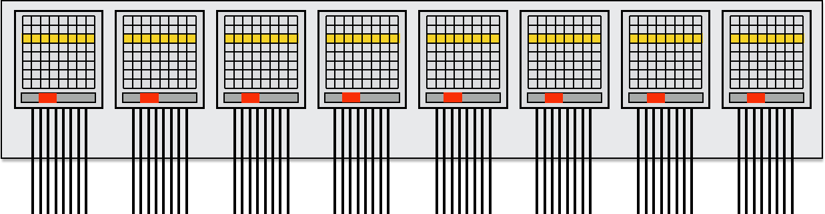
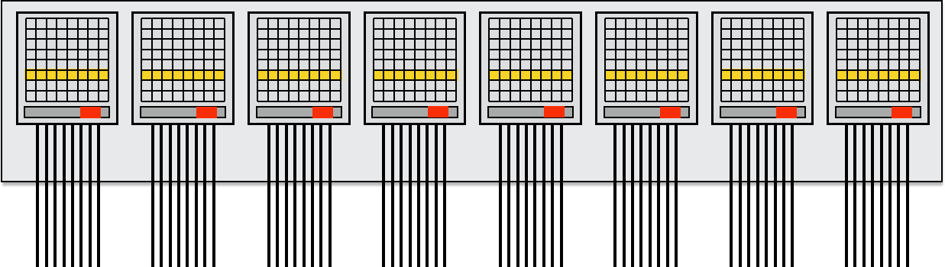

Dual-channel memory system
▪
▪
Increase throughput by adding memory channels (eﬀectively widen bus) Below: each channel can issue independent commands
Diﬀerent row/column is read in each channel
Simpler setup: use single controller to drive same command to multiple channels
CPU
Memory controller (channel 0)
Memory controller (channel 1)
Last-level cache (LLC)

Slide 75
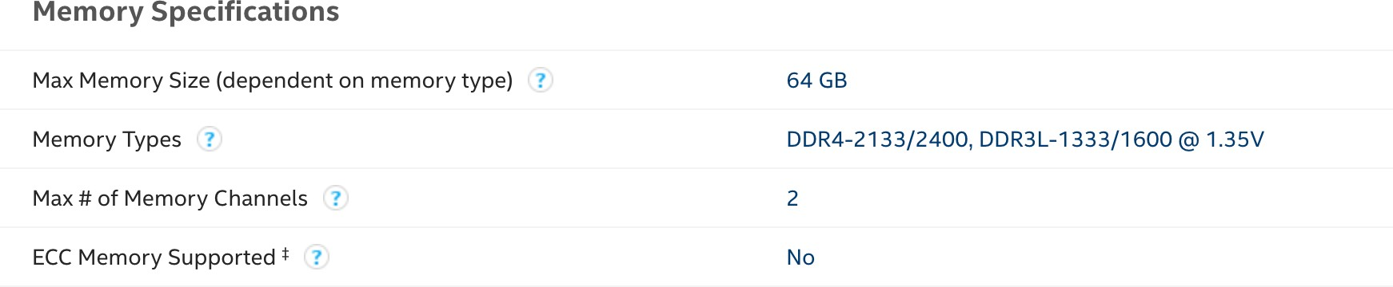
Example: DDR4 memory
Processor: Intel® Core™ i7-7700K Processor (in Myth cluster) Memory system details from Intel’s site:
https://ark.intel.com/content/www/us/en/ark/products/97129/intel-core-i7-7700k-processor-8m-cache-up-to-4-50-ghz.html
DDR4 2400
64-bit memory bus x 1.2GHz x 2 transfers per clock* = 19.2GB/s per channel
2 channels = 38.4 GB/sec
~13 nanosecond CAS
* DDR stands for “double data rate”

Slide 76
DRAM summary
DRAM access latency can depend on many low-level factors
Discussed today:
State of DRAM chip: row hit/miss? is recharge necessary?
Buﬀering/reordering of requests in memory controller
Significant amount of complexity in a modern multi-core processor has moved into the design of memory controller
Responsible for scheduling ten’s to hundreds of outstanding memory requests
Responsible for mapping physical addresses to the geometry of DRAMs
Area of active computer architecture research

Slide 77
Modern architecture challenge: improving memory performance:
Decrease distance data must move by locating memory closer to processors
(enables shorter, but wider interfaces)

Slide 78
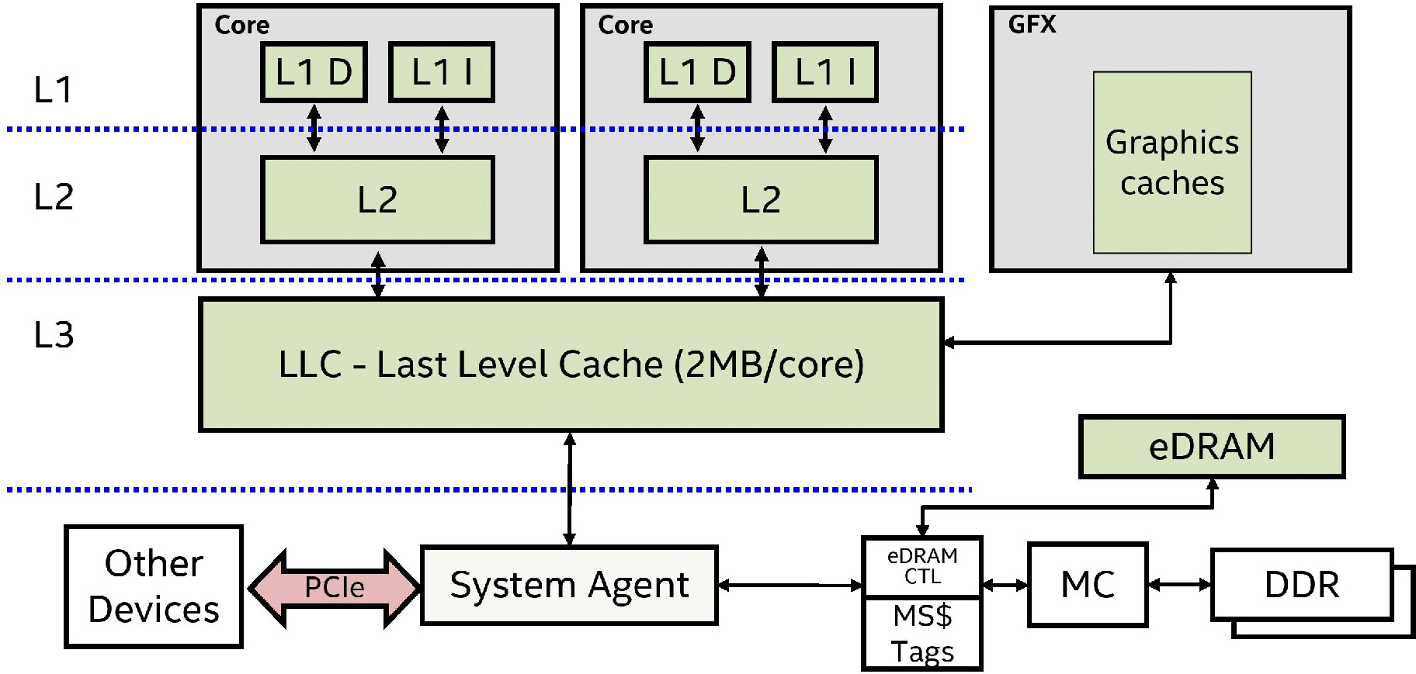

Embedded DRAM (eDRAM): another level of the memory hierarchy
Some Intel Broadwell/Skylake processors featured 128 MB of embedded DRAM (eDRAM) in the CPU package
- 50 GB/sec read + 50 GB/sec write
IBM Power 7 server CPUs feature eDRAM
GPU in XBox 360 had 10 MB of embedded DRAM to store the frame buﬀer Attractive in mobile SoC setting
Image credit: Intel

Slide 79
















Increase bandwidth, reduce power by chip stacking
Enabling technology: 3D stacking of DRAM chips
- DRAMs connected via through-silicon-vias (TSVs) that run through the chips
- TSVs provide highly parallel connection between logic layer and DRAMs
- Base layer of stack “logic layer” is memory controller, manages requests from processor
- Silicon “interposer” serves as high-bandwidth interconnect between DRAM stack and processor
HBM DRAM Die
HBM DRAM Die HBM DRAM Die HBM DRAM Die
Logic Die
TSV
Microbump
PHY
PHY
GPU/CPU/Soc Die
Interposer
Package Substrate
Technologies:
Micron/Intel Hybrid Memory Cube (HBC)
High-bandwidth memory (HBM) - 1024 bit interface to stack
Image credit: AMD

Slide 80
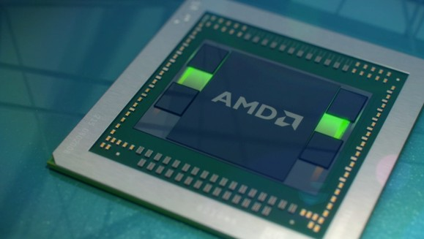
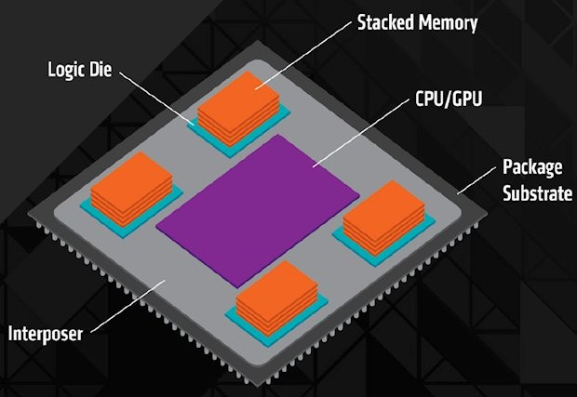
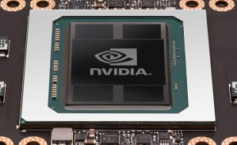
GPUs are adopting HBM technologies
AMD Radeon Fury GPU (2015)
4096-bit interface: 4 HBM chips x 1024 bit interface per chip
512 GB/sec BW
NVIDIA P100 GPU (2016)
4096-bit interface: 4 HBM2 chips x 1024 bit interface per chip 720 GB/sec peak BW
4 x 4 GB = 16 GB capacity

Slide 81
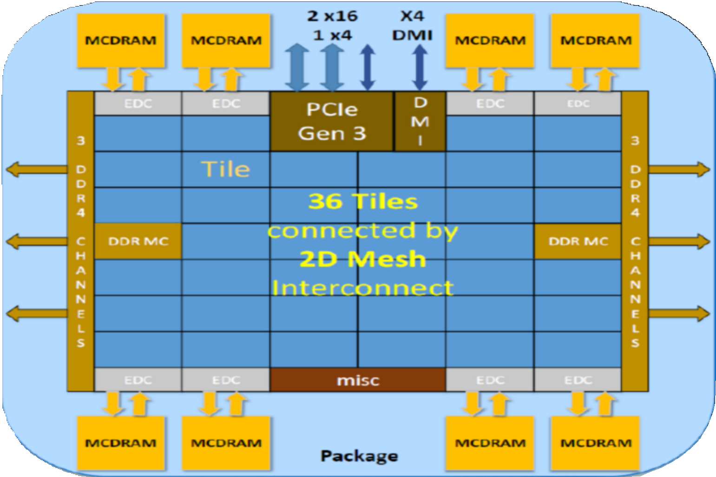
Xeon Phi (Knights Landing) MCDRAM
16 GB in package stacked DRAM
Can be treated as a 16 GB last level cache
Or as a 16 GB separate address space (“flat mode”)
Intel’s claims:
~ same latency at DDR4
~5x bandwidth of DDR4
~5x less energy cost per bit transferred
// allocate buffer in MCDRAM (“high bandwidth” memory malloc) float* foo = hbw_malloc(sizeof(float) * 1024);

Slide 82
Summary: the memory bottleneck is being addressed in many ways
By the application programmer
Schedule computation to maximize locality (minimize required data movement)
By new hardware architectures
Intelligent DRAM request scheduling
Bringing data closer to processor (deep cache hierarchies, eDRAM)
Increase bandwidth (wider memory systems, 3D memory stacking)
Ongoing research in locating limited forms of computation “in” or near memory
Ongoing research in hardware accelerated compression (not discussed today)
General principles
Locate data storage near processor
Move computation to data storage
Data compression (trade-oﬀ extra computation for less data transfer)

