Slide 1


Matrix multiplication
෍
𝑘
(𝑖, 𝑗)
C
(𝑖, 𝑘) →
A
B

Slide 2
Matrix multiplication (matmul)
Simple C++ implementation:
/* Find element based on row-major ordering */ #define RM(r, c, width) ((r) * (width) + (c))
// Standard multiplication
void multMatrixSimple(int N, float *matA, float *matB, float *matC) { for (int i = 0; i < N; i++)
for (int j = 0; j < N; j++) {
float sum = 0.0;
for (int k = 0; k < N; k++)
sum += matA[RM(i,k,N)] * matB[RM(k,j,N)]; matC[RM(i,j,N)] = sum;
}
}

Slide 3
Translating matmul to CUDA
SPMD (single program, multiple data) parallelism
“Map this function to all of this data”: map(𝑓, 𝑑𝑎𝑡𝑎)
Similar to SIMD, but doesn’t require lockstep execution
What this means: You write the “inner loop”,
compiler + GPU execute it in parallel

Slide 4
Translating matmul to CUDA
Simple CUDA implementation:
/* Find element based on row-major ordering */ #define RM(r, c, width) ((r) * (width) + (c))
// Standard multiplication
void multMatrixSimple(int N, float *matA, float *matB, float *matC) { for (int i = 0; i < N; i++)
for (int j = 0; j < N; j++) {
float sum = 0.0;
for (int k = 0; k < N; k++)
sum += matA[RM(i,k,N)] * matB[RM(k,j,N)]; matC[RM(i,j,N)] = sum;
1. Find the inner loop
}
}

Slide 5
Translating matmul to CUDA
Simple CUDA implementation:
global void
cudaSimpleOldKernel(int N, float* dmatA, float* dmatB, float * dmatC) {
int i = blockIdx.x * blockDim.x + threadIdx.x;
int j = blockIdx.y * blockDim.y + threadIdx.y; if (i >= N || j >= N)
return; float sum = 0.0;
for (int k = 0; k < N; k++) {
sum += dmatA[RM(i,k,N)] * dmatB[RM(k,j,N)];
}
dmatC[RM(i,j,N)] = sum;
2. Write it as a separate function
}

Slide 6
Translating matmul to CUDA
Simple CUDA implementation:
global void
cudaSimpleOldKernel(int N, float*
dmatA, float* dmatB, float * dmatC) {
int i = blockIdx.x * blockDim.x + threadIdx.x;
int j = blockIdx.y * blockDim.y + threadIdx.y; if (i >= N || j >= N)
return; float sum = 0.0;
for (int k = 0; k < N; k++) {
sum += dmatA[RM(i,k,N)] * dmatB[RM(k,j,N)];
}
dmatC[RM(i,j,N)] = sum;
3. Compute loop index + test bound (no outer loop)
}

Slide 7
Invoking CUDA matmul
Setup memory (from CPU to GPU)
Invoke CUDA with special syntax
Get results (from GPU to CPU)

Slide 8
Invoking CUDA matmul
Setup memory (from CPU to GPU)
These addresses are only valid on GPU
cudaMalloc((void **) &aDevData, N*N * sizeof(float)); cudaMalloc((void **) &bDevData, N*N * sizeof(float)); cudaMalloc((void **) &cDevData, N*N * sizeof(float));
Need to move data manually (separate address spaces)
cudaMemcpy(aDevData, aData, N*N * sizeof(float), cudaMemcpyHostToDevice);
cudaMemcpy(bDevData, bData, N*N * sizeof(float), cudaMemcpyHostToDevice);
Invoke CUDA with special syntax
Get results (from GPU to CPU)

Slide 9
Invoking CUDA matmul
Setup memory (from CPU to GPU)
Invoke CUDA with special syntax
#define N 1024
#define LBLK 32
dim3 threadsPerBlock(LBLK, LBLK);
dim3 blocks(updiv(N, LBLK), updiv(N, LBLK)); // updiv() divides + rounds up cudaSimpleKernelOld<<<blocks, threadsPerBlock>>>(N, aDevData, bDevData, cDevData);
These addresses are only valid on GPU
Get results (from GPU to CPU)

Slide 10
Invoking CUDA matmul
Setup memory (from CPU to GPU)
Invoke CUDA with special syntax
Get results (from GPU to CPU)
Need to move data manually (separate address spaces)
tHostData = (float *) calloc(N*N, sizeof(float));
cudaMemcpy(tHostData, tDevData, N*N*sizeof(float), cudaMemcpyDeviceToHost);
cudaFree(aDevData); cudaFree(bDevData); cudaFree(cDevData);

Slide 11
Compiling + running CUDA
CUDA code is in separate *.cu file (cudaMatrix.cu)
Compiled like:
nvcc cudaMatrix.cu –O3 –c –o cudaMatrix.o
(See assignment 6 for $PATH, etc)
Linked with gcc + flags, e.g.:
g++ –O3 –L/path/to/cuda –lcudart –o matrix *.o
Run like a normal program, e.g.:
./matrix

Slide 12
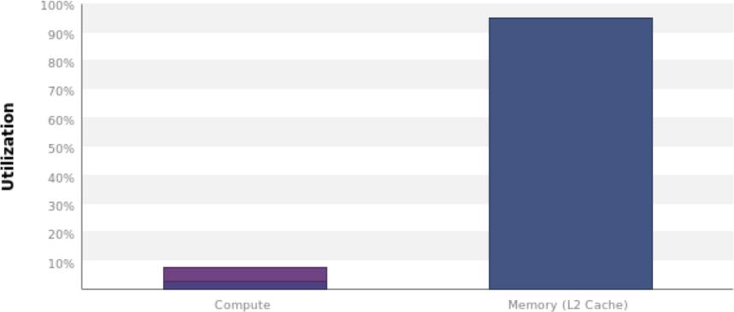
Profiling Results
matmul is memory bound!

Slide 13
Improving matmul memory usage
Why is matmul accessing memory so much?
global void
cudaSimpleOldKernel(int N, float* dmatA,
float* dmatB, float * dmatC) { int i = blockIdx.x * blockDim.x + threadIdx.x; int j = blockIdx.y * blockDim.y + threadIdx.y; if (i >= N || j >= N)
return; float sum = 0.0;
for (int k = 0; k < N; k++) {
sum += dmatA[RM(i,k,N)] * dmatB[RM(k,j,N)];
}
dmatC[RM(i,j,N)] = sum;
}

Slide 14
Improving matmul memory usage: Peeking under the hood
Need to think about how threads within a warp
access memory…
(This is bad – warps aren’t part of programming model)
X➔
CUDA maps threads -> warps row-major: Same y values, consecutive x values
Warp 0:
(0,0) (1,0) (2,0) … (31,0)
⬅ Y

Slide 15
Improving matmul memory usage: Warp memory access pattern
What memory locations does warp 0 access?
int i = blockIdx.x * blockDim.x + threadIdx.x; int j = blockIdx.y * blockDim.y + threadIdx.y;
Access: dmatA[RM(i,k,N)], dmatB[RM(k,j,N)], dmatC[RM(i,j,N)] where RM(i,j,N) = i*N + j
Threads have same y + consecutive x ➔
Threads accesses the same col + consecutive i ➔
Threads access memory at stride of N floats ➔
1 reads + 1 writes per thread

Slide 16
Improving matmul memory usage: Better spatial locality
What if we flipped it around?
int i = blockIdx.y * blockDim.y + threadIdx.y; int j = blockIdx.x * blockDim.x + threadIdx.x;
Threads have same y + consecutive x ➔
Threads access the same i + consecutive j ➔
Threads access memory at stride of 1 ➔
GPU coalesces reads + writes to memory block ➔
1 read + 1 write per warp (if large memory blocks)

Slide 17
Benchmarking improved simple CUDA matmul
./matrix -n 1024 -N 1024 -m csimple
Simple C++: 1300 ms, 1.6 Gflops
Simple CUDA: 33 ms, 65 Gflops
Simple++ CUDA: 2.4 ms, 900 Gflops

Slide 18
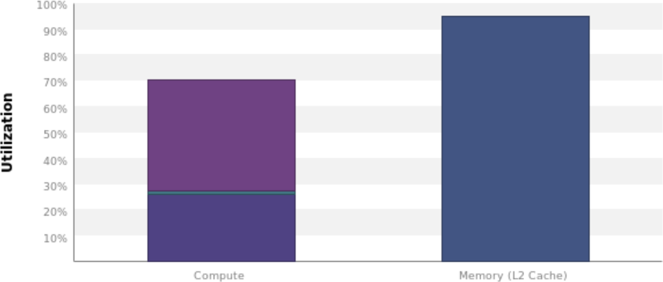
Profiling improved simple CUDA matmul ***
nvprof --analysis-metrics -f -o csimple.nvprof
./matrix -n 1024 -N 1024 -m csimple
nvvp csimple.nvprof
Doing better!
…Still memory bound, though
*** - Using deprecated profiling tools

Slide 19
CUDA disassembly + its limits
You can look at PTX assembly:
cuobjdump --dump-ptx matrix
…But you will not see difference in this case
(Coalescing done by hardware, not compiler)
.visible .entry _Z19cudaSimpleKernelOldiPfS_S_(
...
ld.global.f32 %f6, [%rd9]; ld.global.f32 %f7, [%rd7];
...
st.global.f32 [%rd12], %f9;
...
.visible .entry _Z19cudaSimpleKerneliPfS_S_(
...
ld.global.f32 %f6, [%rd9]; ld.global.f32 %f7, [%rd7];
...
st.global.f32 [%rd12], %f9;
...

Slide 20
Blocked matmul: Even better memory usage
Problem: Entire matrix doesn’t fit in local cache
෍ ෍
𝑘 𝑏𝑘
B
C
A
Classic solution: Block into sub-matrices that do fit in cache, and then multiply and sum sub-matrices
(This is just a re-association of the original computation)

Slide 21
C
 |  | A
 |  | B
 |  | A
 |  | B
 |  | A
 |  | B
 |  | B
A

Slide 22
Blocked matmul: C++ version
void multMatrixBlocked(int N, float *matA, float *matB, float *matC) {
/* Zero out C */
memset(matC, 0, N * N * sizeof(float)); int i, j, k;
for (i = 0; i <= N-SBLK; i+= SBLK) {
for (j = 0; j <= N-SBLK; j+= SBLK) {
Outer loops iterate over submatrices in
steps of SBLK
for (k = 0; k <= N-SBLK; k+= SBLK) {
for (int bi = 0; bi < SBLK; bi++) {
for (int bj = 0; bj < SBLK; bj++) { float sum = 0.0;
for (int bk =0; bk < SBLK; bk++) sum += matA[RM(i+bi,k+bk,N)]
* matB[RM(k+bk,j+bj,N)]; matC[RM(i+bi,j+bj,N)] += sum;
}
Inner bi, bj loops iterate over sub- matrix and accumulate into output matrix
} } } } }
Note: This code assumes SBLK evenly divides N; need extra loops for “leftovers” in general

Slide 23
Benchmarking blocked matmul in C++
./matrix -n 1024 -N 1024 -m block
Simple C++: 1300 ms, 1.6 Gflops
Simple CUDA: 33 ms, 65 Gflops
Simple++ CUDA: 2.4 ms, 900 Gflops
Block C++: 500 ms, 4.3 Gflops

Slide 24
Blocked matmul: CUDA version
Find the inner loop
Write it as a separate function
Compute indices from block/thread id

Slide 25
Blocked matmul: Attempt #1
global void
cudaBlockKernelCoarse(int N, float *dmatA, float *dmatB, float *dmatC) {
int i = blockIdx.y * blockDim.y + threadIdx.y; i *= LBLK; _{Map threads across}
int j = blockIdx.x * blockDim.x + threadIdx.x; j *= LBLK;
submatrices
for (int bi = 0; bi < LBLK; bi++) for (int bj = 0; bj < LBLK; bj++)
dmatC[RM(i+bi,j+bi,N)] = 0;
for (int k = 0; k <= N-LBLK; k+=LBLK) { for (int bi = 0; bi < LBLK; bi++) {
for (int bj = 0; bj < LBLK; bj++) {
Compute submatrix product
float sum = 0.0;
for (int bk = 0; bk < LBLK; bk++) {
sum += dmatA[RM(i+bi,k+bk,N)]
* dmatB[RM(k+bk,j+bj,N)];
}
dmatC[RM(i+bi,j+bj,N)] += sum;
} } } }

Slide 26
Blocked matmul: Attempt #1 + Local memory
global void cudaBlockKernelCoarse(int N, float *dmatA, float *dmatB, float *dmatC) {
int i = blockIdx.y * blockDim.y + threadIdx.y; i *= LBLK;
int j = blockIdx.x * blockDim.x + threadIdx.x; j *= LBLK; float subA[LBLK * LBLK];
Keep a local copy
of submatrix
float subB[LBLK * LBLK]; float subC[LBLK * LBLK];
for (int bi = 0; bi < LBLK; bi++) /* Zero out C */ for (int bj = 0; bj < LBLK; bj++)
subC[RM(bi,bj,LBLK)] = 0;
for (int k = 0; k <= N-LBLK; k+=LBLK) { for (int bi = 0; bi < LBLK; bi++) {
for (int bj = 0; bj < LBLK; bj++) {
Explicitly read from
subA[RM(bi,bj,LBLK)] = dmatA[RM(i+bi,k+bj,N)];
subB[RM(bi,bj,LBLK)] = dmatB[RM(k+bi,j+bj,N)]; global to local memory
} }
for (int bi = 0; bi < LBLK; bi++) { for (int bj = 0; bj < LBLK; bj++) {
float sum = 0.0;
for (int bk = 0; bk < LBLK; bk++) {
Only reference
sum += subA[RM(bi,bk,LBLK)] * subB[RM(bk,bj,LBLK)];
} local copy in loop
subC[RM(bi,bj,LBLK)] += sum;
} } }
for (int bi = 0; bi < LBLK; bi++)
Explicitly write from
for (int bj = 0; bj < LBLK; bj++)
dmatC[RM(i+bi,j+bj,N)] = subC[RM(bi,bj,LBLK)]; local to global memory
}

Slide 27
Benchmarking blocked matmul
./matrix -n 1024 -N 1024 -m block
Simple C++: 1300 ms, 1.6 Gflops
Simple CUDA: 33 ms, 65 Gflops
Simple++ CUDA: 2.4 ms, 900 Gflops
Block C++: 500 ms, 4.4 Gflops
Block CUDA: 107 ms, 20 Gflops ☹

Slide 28
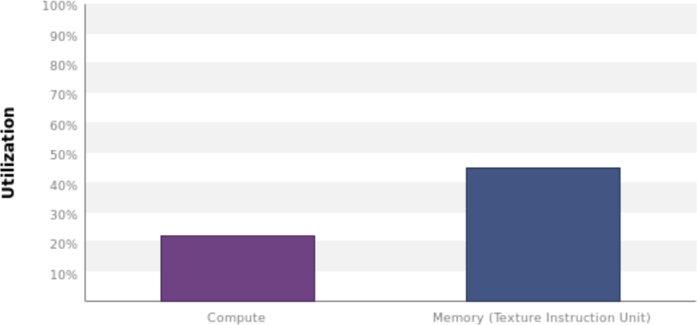
Profiling blocked matmul ***
nvprof --analysis-metrics -f -o ccblock.nvprof
./matrix -n 1024 -N 1024 -m ccblock
nvvp ccblock.nvprof
Huh…
*** - Using deprecated profiling tools

Slide 29
Blocked matmul: What went wrong?
How much parallelism is there in our first attempt?
Each thread generates 32 × 32 output elements
Each thread block is 32 × 32 threads
There are 1024 × 1024 output elements
➔ We only spawn one thread block!
Need to split loops across more threads

Slide 30
Blocked matmul: Attempt #2
Original matmul had one thread for each output element: 1024 × 1024 threads
1 thread for each 𝑖, 𝑗 loop iteration in C++ code
Idea: Unroll the inner bi & bj loops in Attempt #1 across a threads in a block
➔ Thread block shares a single copy of submatrix

Slide 31
Blocked matmul: Attempt #2
global void cudaBlockKernel(int N, float *dmatA, float *dmatB, float *dmatC) {
int i = blockIdx.y * blockDim.y + threadIdx.y; Each thread responsible for one output
int j = blockIdx.x * blockDim.x + threadIdx.x;
_{int bi = threadIdx.y;} But now mapped within
element (like original CUDA code)
int bj = threadIdx.x; _{a LBLK × LBLK block}
shared float subA[LBLK * LBLK]; Keep a block-shared
shared float subB[LBLK * LBLK]; _{copy of submatrix}
float sum = 0;
for (int k = 0; k < N; k += LBLK) {
Explicitly read from
subA[RM(bi,bj,LBLK)] = dmatA[RM(i,k+bj,N)];
subB[RM(bi,bj,LBLK)] = dmatB[RM(k+bi,j,N)]; _{global to shared memory}
for (int bk = 0; bk < LBLK; bk++) {
sum += subA[RM(bi,bk,LBLK)] * subB[RM(bk,bj,LBLK)];
}
Only reference shared
copy in loop
}
dmatC[RM(i,j,N)] = sum; ^{Explicitly write from}
local to global memory
Is this code correct?
}

Slide 32
Blocked matmul: Attempt #2
global void cudaBlockKernel(int N, float *dmatA, float *dmatB, float *dmatC) { int i = blockIdx.y * blockDim.y + threadIdx.y;
int j = blockIdx.x * blockDim.x + threadIdx.x;
int bi = threadIdx.y; int bj = threadIdx.x;
shared float subA[LBLK * LBLK];
shared float subB[LBLK * LBLK]; float sum = 0;
for (int k = 0; k < N; k += LBLK) { subA[RM(bi,bj,LBLK)] = dmatA[RM(i,k+bj,N)];
subB[RM(bi,bj,LBLK)] = dmatB[RM(k+bi,j,N)];
Need barriers across thread block to ensure subA/subB are ready to be read/updated
syncthreads();
for (int bk = 0; bk < LBLK; bk++) {
sum += subA[RM(bi,bk,LBLK)] * subB[RM(bk,bj,LBLK)];
}
syncthreads();
(A block is executed as multiple warps, which can proceed at different rates through the kernel)
}
dmatC[RM(i,j,N)] = sum;
}

Slide 33
Benchmarking improved blocked matmul
./matrix -n 1024 -N 1024 -m cblock
Simple C++: 1300 ms, 1.6 Gflops
Simple CUDA: 33 ms, 65 Gflops
Simple++ CUDA: 2.4 ms, 900 Gflops
Block C++: 500 ms, 4.4 Gflops
Block CUDA: 100 ms, 20 Gflops
Block++ CUDA: 1.9ms, 1130 Gflops

Slide 34
Benchmarking at 2048 × 2048 (8 × more work)
./matrix -n 2048 -N 2048 -m ...
Big drop-off—data falls out
Simple C++: 44000 ms, 0.4 Gflops
Simple CUDA: 208 ms, 82 Gflops
Simple++ CUDA: 18 ms, 940 Gflops
of L3 cache
Block C++: 5500 ms, 3.2 Gflops
Block CUDA: 206 ms, 83 Gflops
Block++ CUDA: 15ms, 1180 Gflops
Big improvement—increased
parallelism

Slide 35
Debugging tips and pitfalls
printf() is available, but will reorder or lose output
So be cautious using printf() for debugging!
Check your error codes
#define CHK(ans) gpuAssert((ans), FILE ,
LINE );
void gpuAssert(CUDAError_t code, const char *file,
int line){
if (code != CUDASuccess)
fprintf(stderr, "GPUassert: %s %s %s\n", CUDAGetErrorString(code), file, line);
}
#define POSTKERNEL CHK(CUDAPeekAtLastError())

Slide 36
Debugging tips and pitfalls
Write reference version on host in C++
Watch out for out-of-bounds memory errors (all kinds of crazy stuff will happen)
Don’t assume stuff about N (e.g., that it’s a multiple
of LBLK)
cuda-gdb lets you step through + inspect code

Slide 37
Debugging tips and pitfalls
What will happen here?
for (int k = 0; k < N; k+= LBLK) { if (i >= N || j >= N) continue;
// Some computation
syncthreads();
// Some more computation
syncthreads();
}

Slide 38
Optimization advice
Get the high-level abstraction + implementation first
Don’t start with low-level optimizations
Use nvprof to figure out where your bottleneck is
Low utilization of compute + memory ➔ no parallelism
Low utilization of compute ➔ memory bound
Low utilization of memory ➔ compute bound
Memory is often key
E.g., when to use local/shared/global memory

Slide 39
CUDA syntax
shared / global : Place variable in block-
/device-shared memory
cudaMalloc/cudaMemcpy/cudaFree: Manage device memory (flag sets to/from device)
syncthreads(): Barrier within a thread block
kernel<<<blocks,threadsPerBlock>>>(): Invoke kernel on device
blockIdx/threadIdx: current block/thread idx
blockDim/gridDim: Num threads per block/blocks per grid

Slide 40
CUDA as a vector processor
NVIDIA has abused architecture terminology badly
CUDA/GPU Terminology | Classic vector terminology
Grid | Vectorizable loop
Thread | Loop iteration
Block | ??
Warp | Thread
GPU/Device | Vector multicore
SM (streaming multiprocessor) | Core
Core | (Vector) Lane
Global memory | Memory
Shared memory | Local memory
Local memory | Registers

