Slide 1
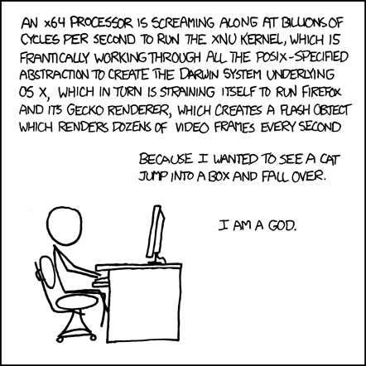
Introduction to Computer Systems
CMPT 295
http://xkcd.com/676/
Notes:
This comic illustrates how complex computer systems are, and all the things that have to happen for a program to execute
By the end of this course, you’ll understand, mm, almost half of that, but it’s the good bits

Slide 2
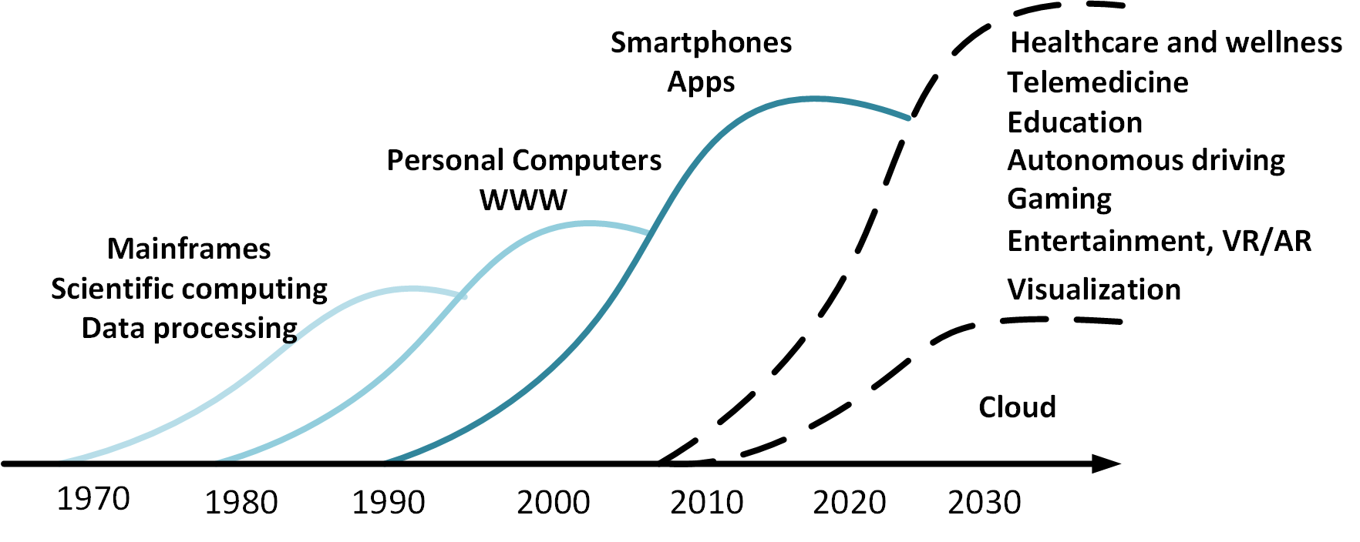
Why is computer systems exciting today?
Number of deployed devices continues growing, but no single killer app
  Diversification of needs, architectures
Notes:
295 serves as the foundation for these things.
Goal: fast programs, low cost (power dissipation)
Moore’s law
Past: clock speed increased every year → programs automatically got faster
Today: Clock speed stays constant → only creativity can make programs faster
E.g. parallel processing
295: learn how to increase speed by over 100x for some algorithms
Combination of architectural innovations and programming innovations

Slide 3
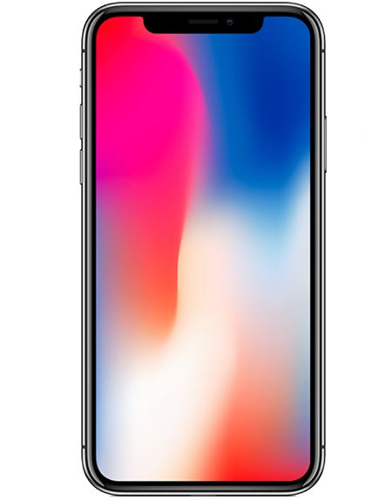
Personal Mobile Devices
Network
Edge
Devices
Personal Mobile Devices

Slide 4
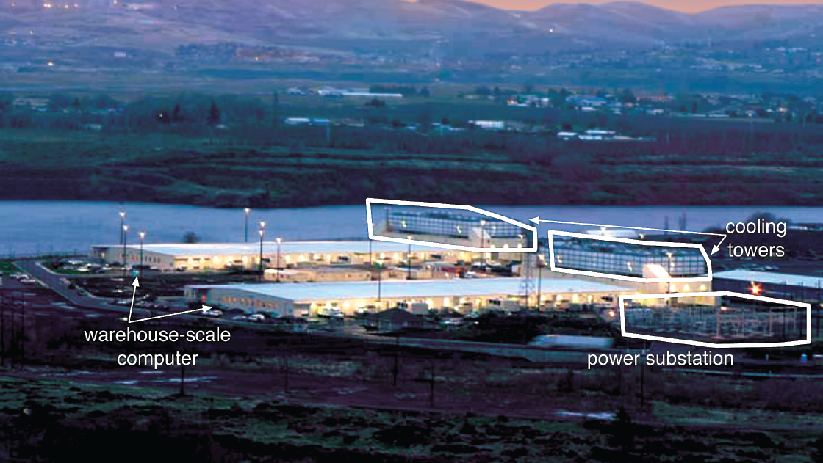

Slide 5
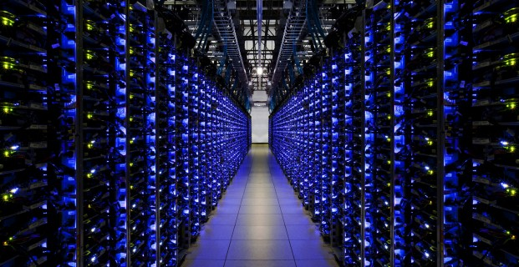
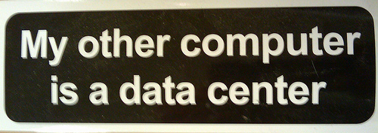

Slide 6
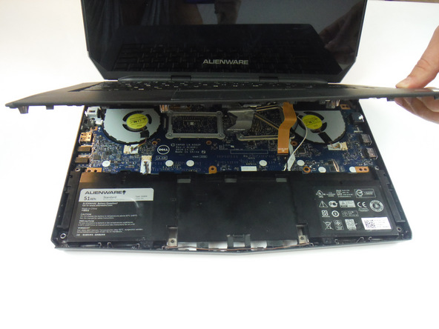
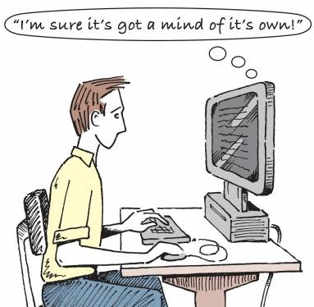
Notes:
When I started studying computer science, I was incredibly troubled by the very concept of writing programs. I was completely mind-blown every time the staff showed us something new you could do on the computer, and I remember sitting in shock and wondering “how does the computer know what I’m telling it to do….” The staff refused to answer my questions -- they said with indignation “you don’t need to know how to build a car in order to drive it!” The computer was like a box of magic -- a piece of metal that could somehow understand complex concepts like “truth” and recursion -- concepts that philosophers and students have been struggling with for centuries.
But what was perhaps more astonishing than that was that the computer knew how to reach these concepts from my words. I had actually just taken an entire philosophy class called “The Theory of Meaning” where we basically concluded that it wasn’t possible for humans to consistently communicate ideas through words, so how could the computer possibly interpret those words?!
As it turns out, since humans designed computers, it’s a lot easier to understand the way computers interpret words than the way we do.
For the moment, we’ll leave understanding the brain to cognitive and neuroscientists, linguists and philosophers. But we will take a closer look at the computer to learn how it understands us.

Slide 7
CMPT 295 is NOT about C Programming
It is about the hardware-software interface
  What does the programmer need to know to achieve the highest possible performance
Languages like C are closer to the underlying hardware, unlike languages like Snap!, Python, Java
  We can talk about hardware features in higher-level terms
  Allows programmer to explicitly harness underlying hardware parallelism for high performance

Slide 8

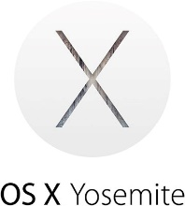

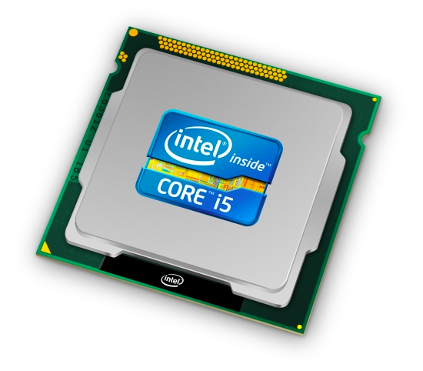
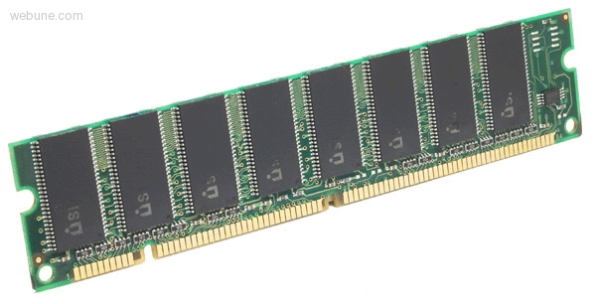
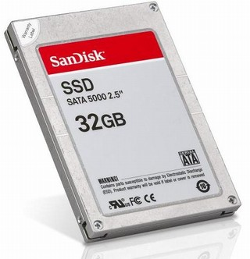
Roadmap
C:
Java:
Memory & data
Arrays & structs
Integers & floats
RISC V assembly
Procedures & stacks
Executables
Memory & caches
Processor Pipeline
Performance
Parallelism
car *c = malloc(sizeof(car));
c->miles = 100;
c->gals = 17;
float mpg = get_mpg(c);
free(c);
Car c = new Car();
c.setMiles(100);
c.setGals(17);
float mpg =
c.getMPG();
Assembly language:
OS:
Machine code:
0111010000011000
100011010000010000000010
1000100111000010
110000011111101000011111
Computer system:
Notes:
All program fragments are equivalent
You’d rather write C! (more human-friendly)
Hardware executes strings of bits
In reality everything is voltages
The machine instructions are actually much shorter than the number of bits we would need to represent the characters in the assembly language

Slide 9
Course Perspective
CMPT 295 will make you a better programmer
  Purpose is to show how software really works
    Understanding of some of the abstractions that exist between programs and the hardware they run on, why they exist, and how they build upon each other
  Understanding the underlying system makes you more effective
    Better debugging
    Better basis for evaluating performance
    How multiple activities work in concert (e.g. OS and user programs)
  “Stuff everybody learns and uses and forgets not knowing”
CMPT 295 presents a world-view that will empower you
  The intellectual and software tools to understand the trillions+ of 1s and 0s that are “flying around” when your program runs
Notes:
Not just a course for hardware enthusiasts!
What every programmer needs to know (plus many more details)

Slide 10

What is this class really about ?
4 Great Ideas in Computer Science

Slide 11
Layers of Abstraction
Locality/Memory Hierarchy
Parallelism
Performance Measurement

Slide 12
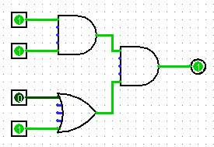
Great Idea #1: Abstraction
(Levels of Representation/Interpretation)
C Program
Assembly
int square(int num) {
return num * num;
}
Binary
0x00000317
0x00830067
0xff010113
0x00112623
0x00812423
0x01010413
0xfea42a23
…….
Logic

Slide 13
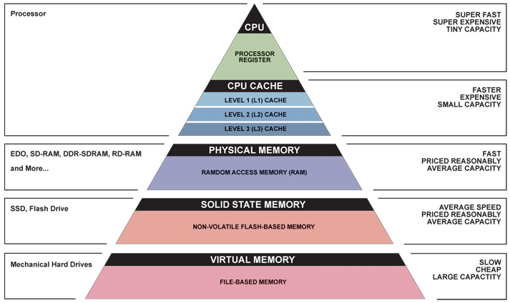
Great Idea #2: Principle of Locality/
Memory Hierarchy

Slide 14
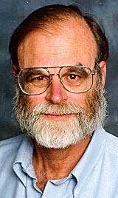
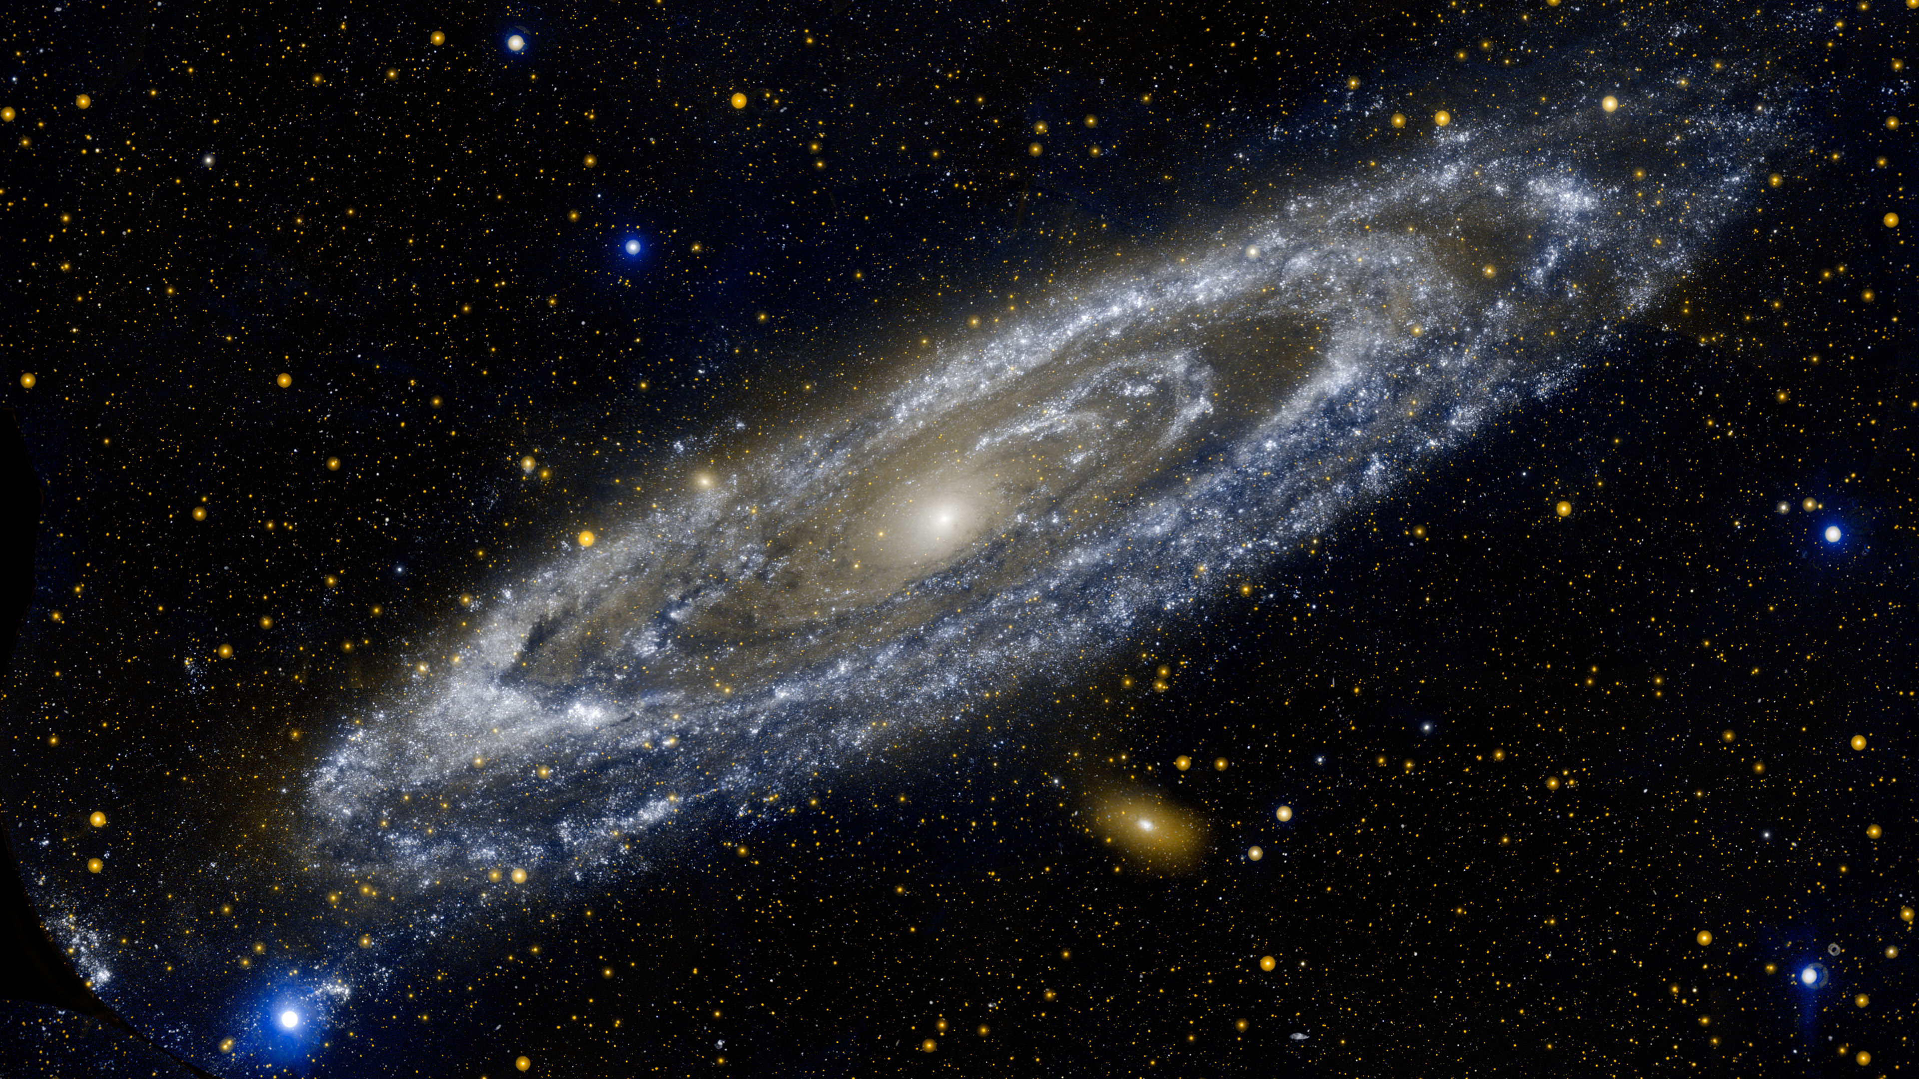
Jim Gray’s Storage Latency Analogy:
How Far Away is the Data?
9
10
Tape /Optical
Andromeda
2,000 Years
Jim Gray
Turing Award
Robot
Pluto
2 Years
6
Disk
10
Whistler
1.5 hr
100
Memory
10
On Board Cache
This Campus
10 min
2
On Chip Cache
This Room
(ns)
1
Registers
My Head
1 min

Slide 15
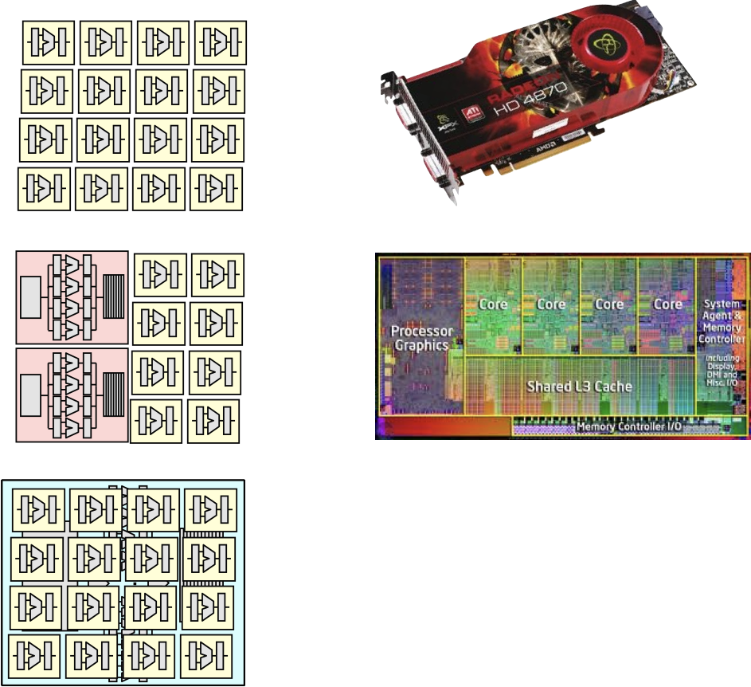
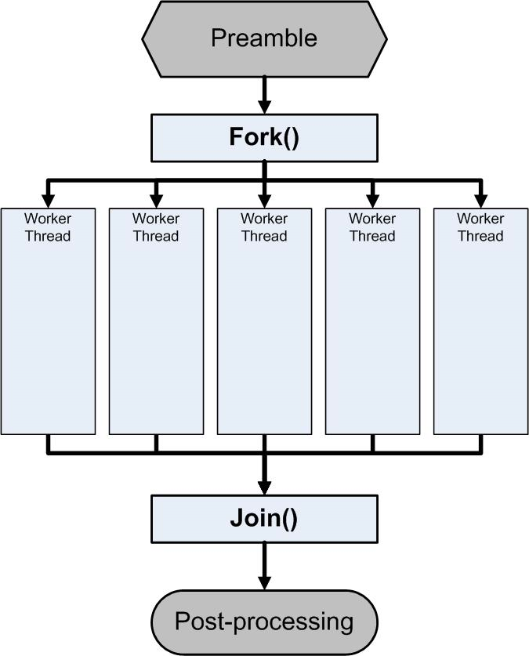
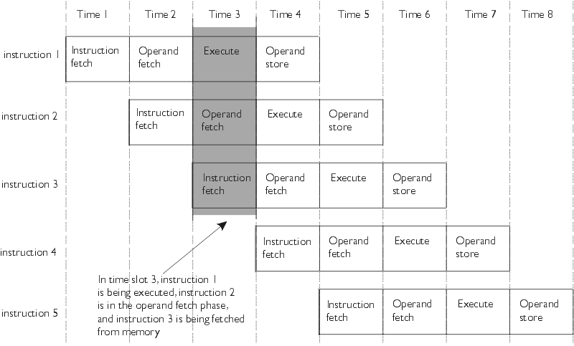
Great Idea #3: Parallelism

Slide 16
Great Idea #4: Performance Measurement and Improvement
Matching application to underlying hardware to exploit:
  Locality
  Parallelism
  Special hardware features, like specialized instructions (e.g., matrix manipulation)
Latency
  How long to set the problem up
  How much faster does it execute once it gets going
  It is all about time to finish

Slide 17
Bookmarks
Course Website: http://cs.sfu.ca/~ashriram/Courses/CS295/
  Schedule, policies, materials, videos, assignments, etc.
Discussion in groups (link in course Website):
  Announcements made here
  Ask and answer questions – staff will monitor and contribute
Github: Homework/Assignments and Labs

Slide 18
Textbooks
Essential books
A good C book
  All about Programming (Hilton and Bracy)
    Lecture readings
Computer Architecture (RISC V edition)
  David Patterson John Hennessy
  Lecture readings
Extra (some modules, which we will provide)
Computer Systems: A Programmer’s Perspective
  Randal E. Bryant and David R. O’Hallaron
  Some labs

Slide 19
My goal as an instructor
To make your experience in CMPT 295 as enjoyable & informative as possible
  Humor, enthusiasm & technology-in-the-news in lecture
  Fun, challenging projects & HW
  Pro-student policies (exam clobbering)
I know I speak fast when I get excited about material. I’m told every semester. Help me slow when I go toooo fast.
  Please give feedback so we can improve! We will listen!!

Slide 20
Grading (Online version specific)
Assignments/Homework: 50% total
  Autograded; Individual work only
Labs: 2.5%
  Graded by TAs
Exams: Midterm (15%) and Final (30%)
Weekly quiz participation: 2.5%
EPA – 2% Extra credit. Read course page.

Slide 21
Tips for Success in 295
Attend all lectures and sections
  Avoid devices during lecture please
Do the textbook readings ahead of time
Learn by doing
  Can answer many questions by writing small programs
Visit piazza often
  Ask questions and try to answer fellow students’ questions
Go to labs (required and count for grade)
Find a study and homework group
Start assignments early
Don’t be afraid to ask questions
Notes:
http://www.npr.org/2016/04/17/474525392/attention-students-put-your-laptops-away

Slide 22
Introductions: You!
~100-400 students registered, single lecture
CS majors, and more
  Most of you will find almost everything in the course new
Get to know each other and help each other out!
  Learning is much more fun with friends
  Working well with others is a valuable life skill
  Diversity of perspectives expands your horizons

Slide 23
Collaboration and Academic Integrity
All submissions are expected to be yours and yours alone
You are encouraged to discuss your assignments with other students (ideas), but we expect that what you turn in is yours
It is NOT acceptable to copy solutions from other students or to copy (or start your) solutions from the Web (including Github)
Our goal is that *YOU* learn the material so you will be prepared for exams, interviews, and the future

Slide 24
Some fun topics that we will touch on
Which of the following seems the most interesting to you?
What is a GFLOP and why is it used in computer benchmarks?
How and why does running many programs for a long time eat into your memory (RAM)?
What is stack overflow and how does it happen?
Why does your computer slow down when you run out of disk space?
What is the meaning behind the different CPU specifications? (e.g. # of cores, # and size of cache, supported memory types)

