Slide 1
Lecture Outline
Binary
  Decimal, Binary, and Hexadecimal
  Base Conversion
  Binary Encoding
Notes:
since all information a computer is
represented as a sequence of numbers
so first let's deal with a numbering
system that we are all familiar with the
decimal system

Slide 2

Decimal Numbering System
Ten symbols: 0, 1, 2, 3, 4, 5, 6, 7, 8, 9
Represent larger numbers as a sequence of digits
  Each digit is one of the available symbols
Example: 7061 in decimal (base 10)
  7061₁₀ = (7 $×$ 10³) + (0 $×$ 10²) + (6 $×$ 10¹) + (1 $×$ 10⁰)
Notes:
Ones digit, Tens digit, Hundreds digit, etc.
in the decimal system there is a
total of 10 symbols digits
to 9 and larger numbers are represented

Slide 3
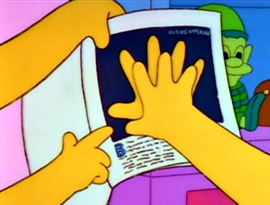
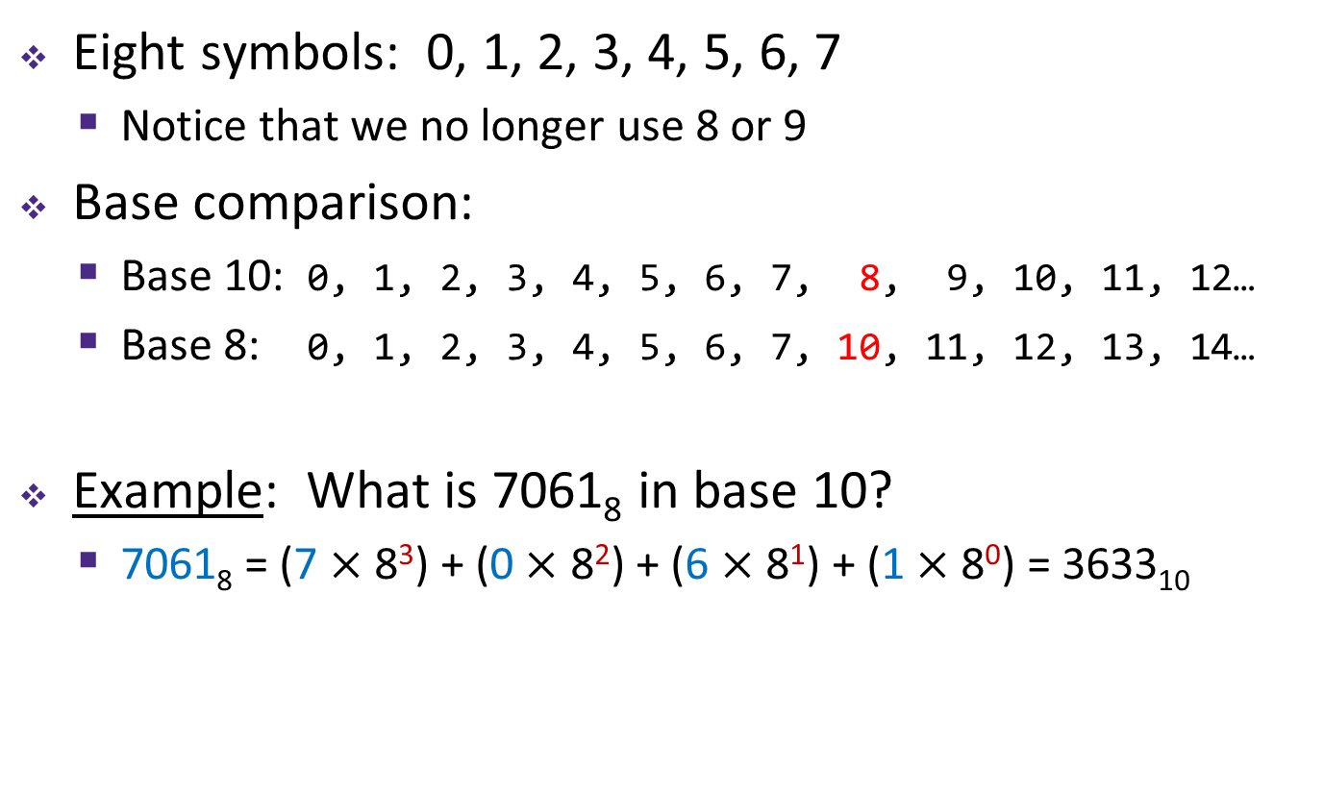
Octal Numbering System
Eight symbols: 0, 1, 2, 3, 4, 5, 6, 7
  Notice that we no longer use 8 or 9
Base comparison:
  Base 10: 0, 1, 2, 3, 4, 5, 6, 7, 8, 9, 10, 11, 12…
  Base 8: 0, 1, 2, 3, 4, 5, 6, 7, 10, 11, 12, 13, 14…
Example: What is 7061₈ in base 10?
  7061₈ = (7 $×$ 8³) + (0 $×$ 8²) + (6 $×$ 8¹) + (1 $×$ 8⁰) = 3633₁₀
Notes:
octal number system where the base is
which means that you can get rid of the
symbols 8 and 9 and you can only have
symbols in total from 0 to 7 now let's
look at a number and see how we
For base 8, beyond 8 we need two digits to represent the number. In general to represent a number 8^n < X < 8^(n+1). We need n+1 digits. To represent number 0-8 8 < 64

Slide 4
Warmup Question
What is 34₈ in base 10?
32₁₀
34₁₀
7₁₀
28₁₀
35₁₀

Slide 5
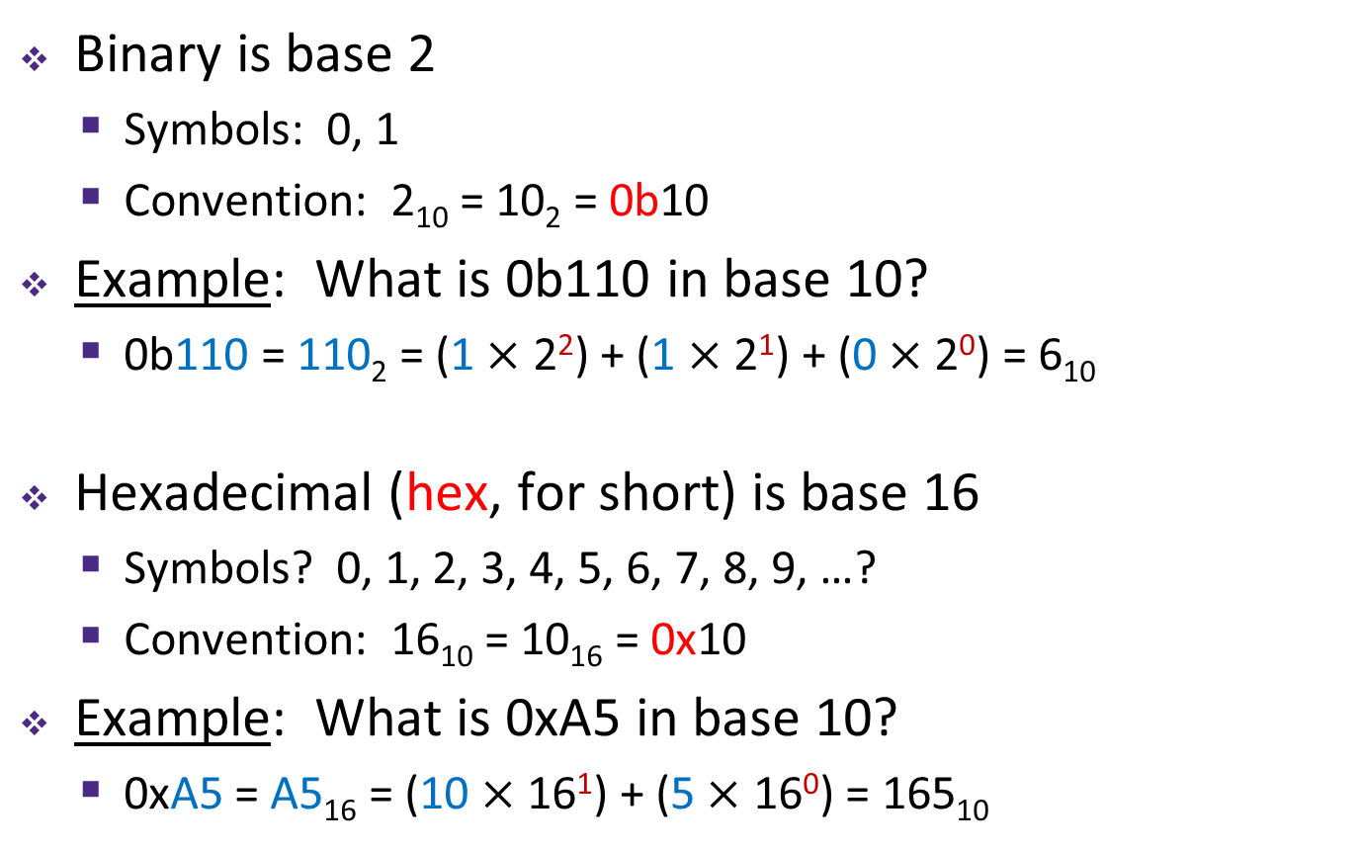
Binary and Hexadecimal
Binary is base 2
  Symbols: 0, 1
  Convention: 2₁₀ = 10₂ = 0b10
Example: What is 0b110 in base 10?
  0b110 = 110₂ = (1 $×$ 2²) + (1 $×$ 2¹) + (0 $×$ 2⁰) = 6₁₀
Hexadecimal (hex, for short) is base 16
  Symbols? 0, 1, 2, 3, 4, 5, 6, 7, 8, 9, …?
  Convention: 16₁₀ = 10₁₆ = 0x10
Example: What is 0xA5 in base 10?
  0xA5 = A5₁₆ = (10 $×$ 16¹) + (5 $×$ 16⁰) = 165₁₀
9, A, B, C, D, E, F

Slide 6
Peer Instruction Question
Which of the following orderings is correct?
0xC < 0b1010 < 11
0xC < 11 < 0b1010
11 < 0b1010 < 0xC
0b1010 < 11 < 0xC
0b1010 < 0xC < 11

Slide 7
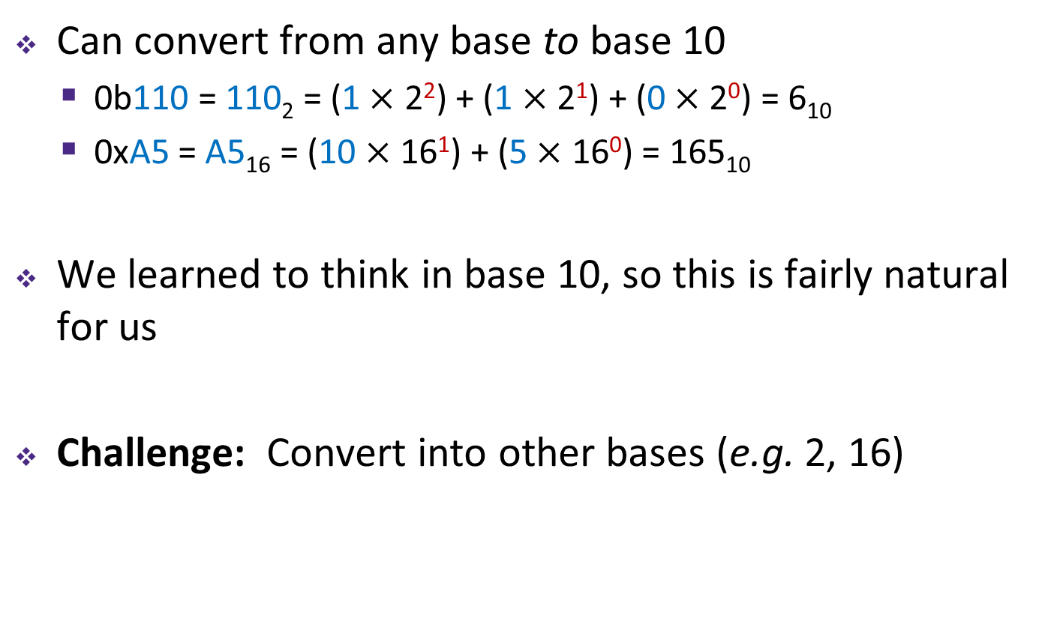
Converting to Base 10
Can convert from any base to base 10
  0b110 = 110₂ = (1 $×$ 2²) + (1 $×$ 2¹) + (0 $×$ 2⁰) = 6₁₀
  0xA5 = A5₁₆ = (10 $×$ 16¹) + (5 $×$ 16⁰) = 165₁₀
We learned to think in base 10, so this is fairly natural for us
Challenge: Convert into other bases (e.g. 2, 16)

Slide 8
Challenge Question
Convert 13₁₀ into binary
Hints:
  2³ = 8
  2² = 4
  2¹ = 2
  2⁰ = 1

Slide 9
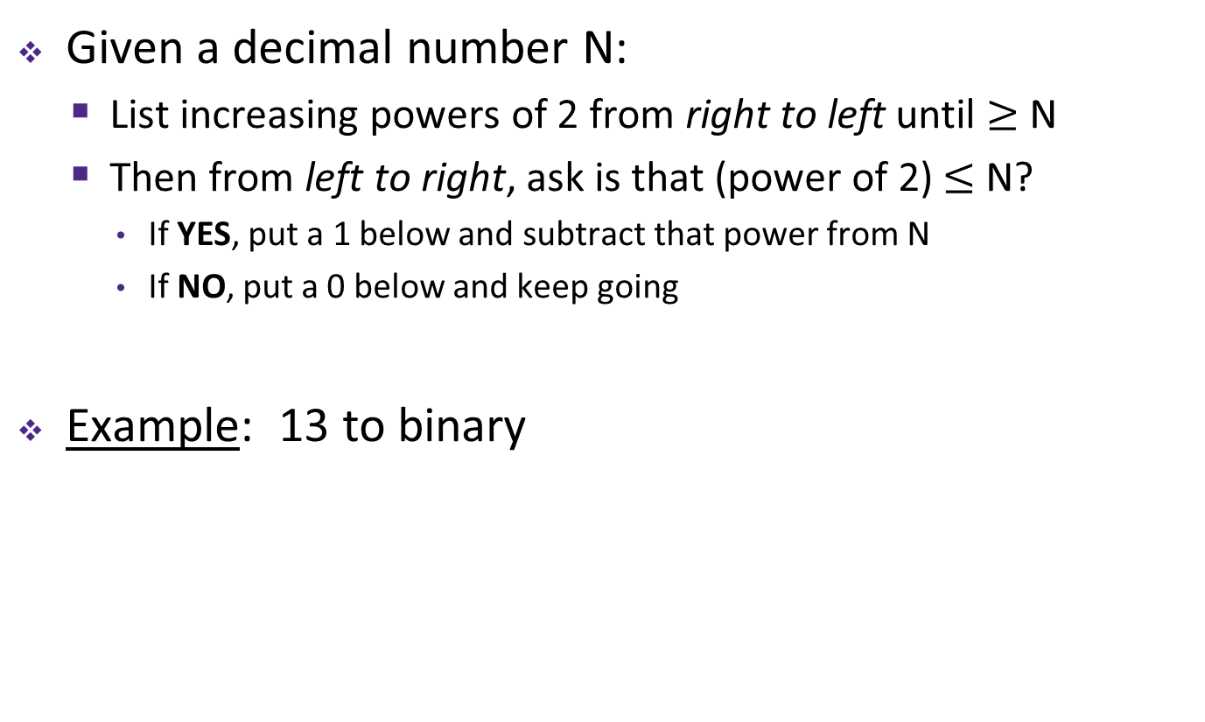
Converting from Decimal to Binary
Given a decimal number N:
  List increasing powers of 2 from right to left until $≥$ N
  Then from left to right, ask is that (power of 2) $≤$ N?
    If YES, put a 1 below and subtract that power from N
    If NO, put a 0 below and keep going
Example: 13 to binary
2⁴=16 | 2³=8 | 2²=4 | 2¹=2 | 2⁰=1

Slide 10
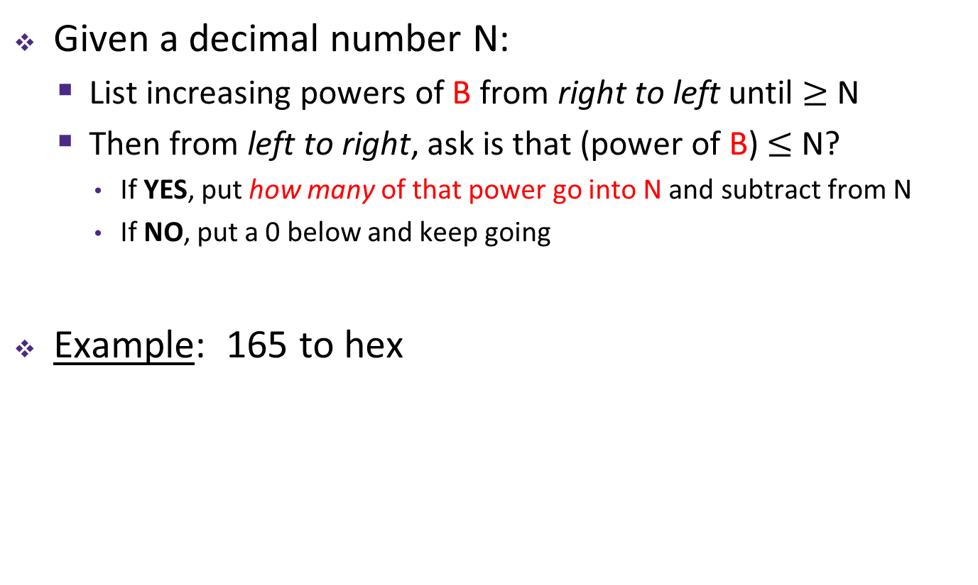
Converting from Decimal to Base B
Given a decimal number N:
  List increasing powers of B from right to left until $≥$ N
  Then from left to right, ask is that (power of B) $≤$ N?
    If YES, put how many of that power go into N and subtract from N
    If NO, put a 0 below and keep going
Example: 165 to hex
16²=256 | 16¹=16 | 16⁰=1

Slide 11
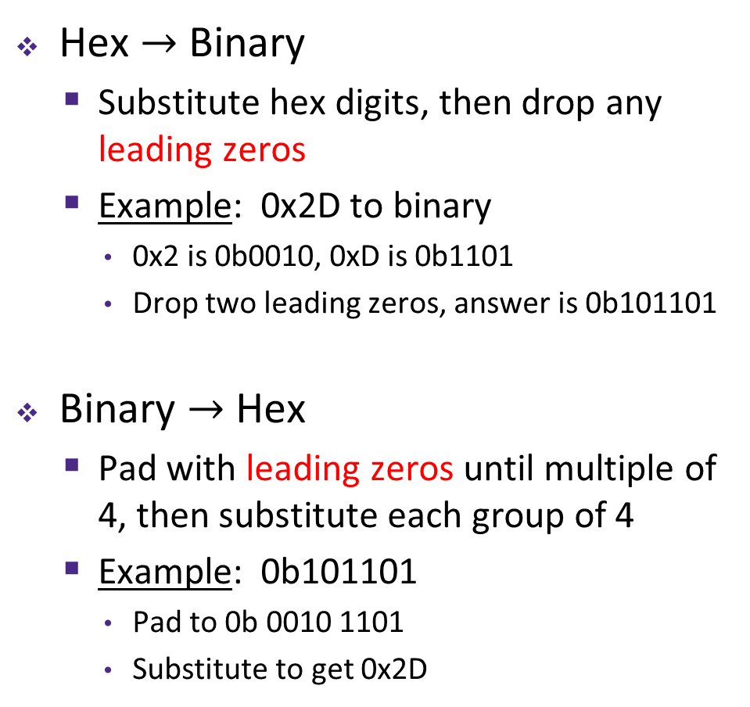

Converting Binary $↔$ Hexadecimal
Hex $→$ Binary
  Substitute hex digits, then drop any leading zeros
  Example: 0x2D to binary
    0x2 is 0b0010, 0xD is 0b1101
    Drop two leading zeros, answer is 0b101101
Binary $→$ Hex
  Pad with leading zeros until multiple of 4, then substitute each group of 4
  Example: 0b101101
    Pad to 0b 0010 1101
    Substitute to get 0x2D
Base 10 | Base 2 | Base 16
0 | 0000 | 0
1 | 0001 | 1
2 | 0010 | 2
3 | 0011 | 3
4 | 0100 | 4
5 | 0101 | 5
6 | 0110 | 6
7 | 0111 | 7
8 | 1000 | 8
9 | 1001 | 9
10 | 1010 | A
11 | 1011 | B
12 | 1100 | C
13 | 1101 | D
14 | 1110 | E
15 | 1111 | F

Slide 12
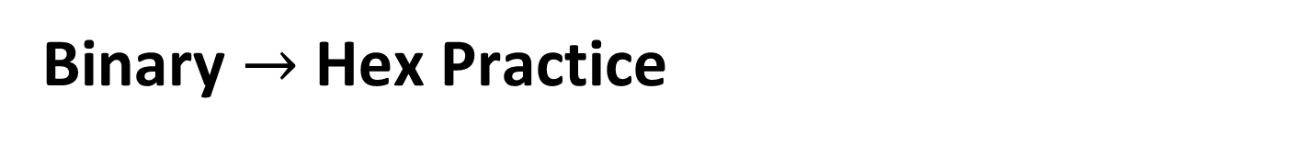
Binary $→$ Hex Practice
Convert 0b100110110101101
  How many digits?
  Pad:
  Substitute:
Base 10 | Base 2 | Base 16
0 | 0000 | 0
1 | 0001 | 1
2 | 0010 | 2
3 | 0011 | 3
4 | 0100 | 4
5 | 0101 | 5
6 | 0110 | 6
7 | 0111 | 7
8 | 1000 | 8
9 | 1001 | 9
10 | 1010 | A
11 | 1011 | B
12 | 1100 | C
13 | 1101 | D
14 | 1110 | E
15 | 1111 | F

Slide 13
Base Comparison
Why does all of this matter?
  Humans think about numbers in base 10, but computers “think” about numbers in base 2
  Binary encoding is what allows computers to do all of the amazing things that they do!
You should have this table memorized by the end of the class
  Might as well start now!
Base 10 | Base 2 | Base 16
0 | 0000 | 0
1 | 0001 | 1
2 | 0010 | 2
3 | 0011 | 3
4 | 0100 | 4
5 | 0101 | 5
6 | 0110 | 6
7 | 0111 | 7
8 | 1000 | 8
9 | 1001 | 9
10 | 1010 | A
11 | 1011 | B
12 | 1100 | C
13 | 1101 | D
14 | 1110 | E
15 | 1111 | F

Slide 14
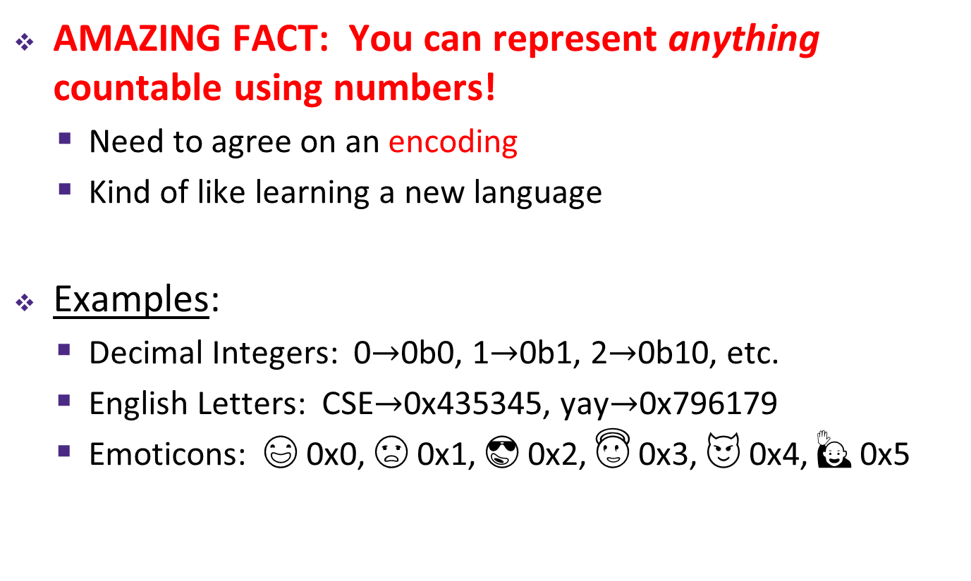
Numerical Encoding
AMAZING FACT: You can represent anything countable using numbers!
  Need to agree on an encoding
  Kind of like learning a new language
Examples:
  Decimal Integers: 0$→$0b0, 1$→$0b1, 2$→$0b10, etc.
  English Letters: CSE$→$0x435345, yay$→$0x796179
  Emoticons: 😃 0x0, 😞 0x1, 😎 0x2, 😇 0x3, 😈 0x4, 🙋 0x5
Notes:
Base 2 is too hard for humans to read, so we use base 16 as a convenient way to hold what is effectively binary data in our brains.

Slide 15
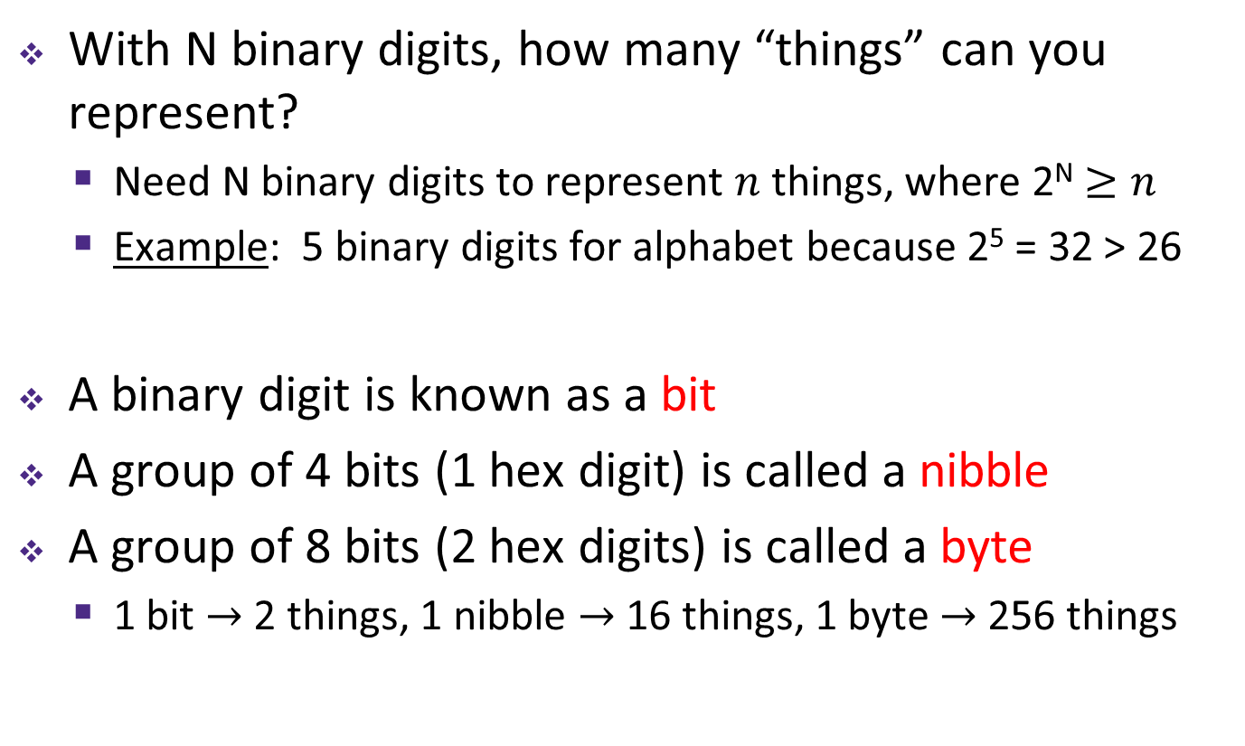
Binary Encoding
With N binary digits, how many “things” can you represent?
  Need N binary digits to represent $n$ things, where 2^{N} $≥n$
  Example: 5 binary digits for alphabet because 2⁵ = 32 > 26
A binary digit is known as a bit
A group of 4 bits (1 hex digit) is called a nibble
A group of 8 bits (2 hex digits) is called a byte
  1 bit $→$ 2 things, 1 nibble $→$ 16 things, 1 byte $→$ 256 things

Slide 16
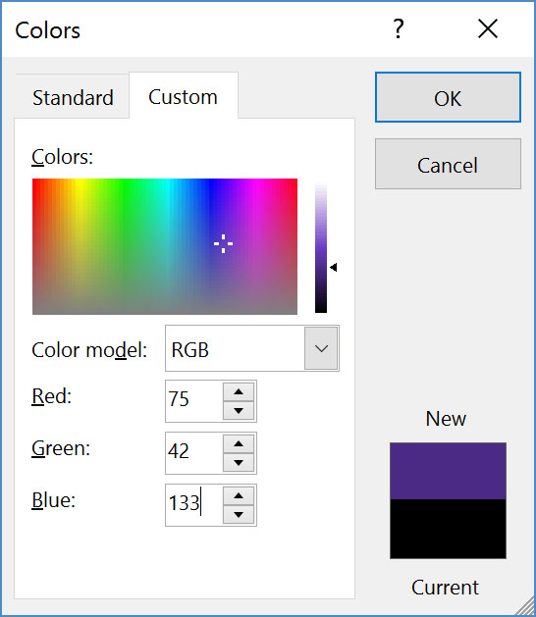
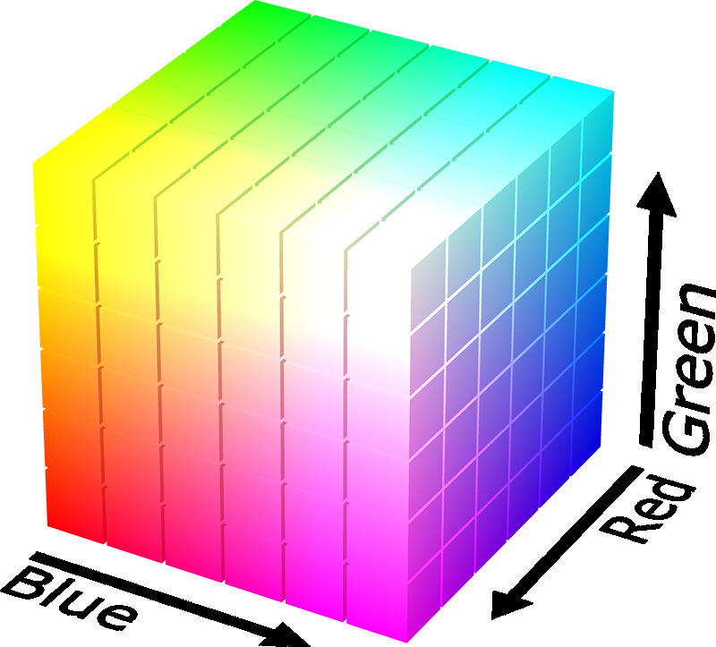

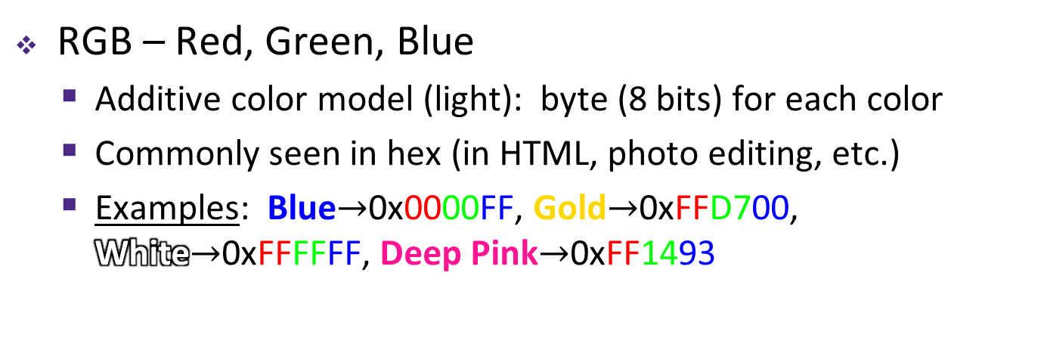
Binary Encoding – Colors
RGB – Red, Green, Blue
  Additive color model (light): byte (8 bits) for each color
  Commonly seen in hex (in HTML, photo editing, etc.)
  Examples: Blue$→$0x0000FF, Gold$→$0xFFD700, White$→$0xFFFFFF, Deep Pink$→$0xFF1493

Slide 17
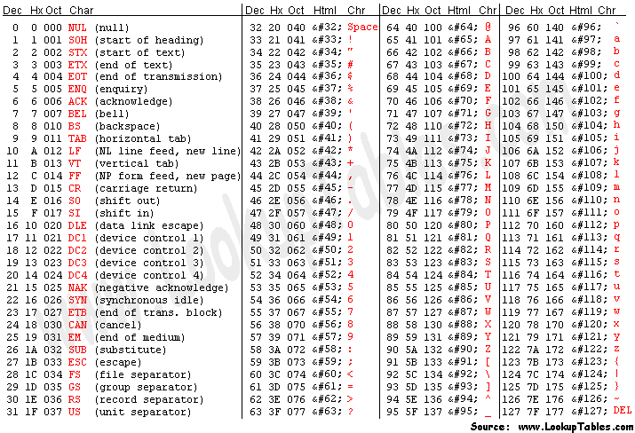
Binary Encoding – Characters/Text
ASCII Encoding (www.asciitable.com)
  American Standard Code for Information Interchange

Slide 18
Binary Encoding – Files and Programs
At the lowest level, all digital data is stored as bits!
Layers of abstraction keep everything comprehensible
  Data/files are groups of bits interpreted by program
  Program is actually groups of bits being interpreted by your CPU

Slide 19
Summary
Humans think about numbers in decimal; computers think about numbers in binary
  Base conversion to go between them
  Hexadecimal is more human-readable than binary
All information on a computer is binary
Binary encoding can represent anything!
  Computer/program needs to know how to interpret the bits

