Slide 1
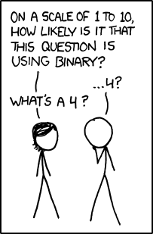

Memory, Data, & Addressing I
http://xkcd.com/953/

Slide 2
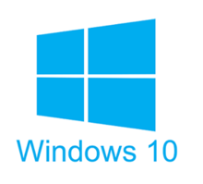





Roadmap
C:
Java:
Memory & data
Arrays & structs
Integers & floats
RISC V assembly
Procedures & stacks
Executables
Memory & caches
Processor Pipeline
Performance
Parallelism
car *c = malloc(sizeof(car));
c->miles = 100;
c->gals = 17;
float mpg = get_mpg(c);
free(c);
Car c = new Car();
c.setMiles(100);
c.setGals(17);
float mpg =
c.getMPG();
Assembly language:
OS:
Machine code:
0111010000011000
100011010000010000000010
1000100111000010
110000011111101000011111
Computer system:

Slide 3
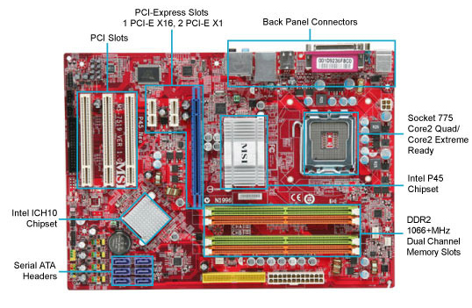
Hardware: Physical View
USB…
Bus connections
CPU
(empty slot)
I/O
controller
Memory
Storage connections
Notes:
CPU
Looks funny because of heat sink

Slide 4
Hardware: Logical View
Memory
CPU
Bus
Disks
USB
Etc.
Net
Notes:
CPU: all computations done here
Memory: big array of bytes
Big pipe between CPU and memory, in order to keep CPU fed
Bus: connect everything else to each other
Bus just means you broadcast on it (to everyone)
Same root as the other kind of “bus”
Disks bigger storage, slower, farther away, persistent
Network, etc.

Slide 5
Hardware: 295 View (version 0)
Memory
?
CPU
The CPU executes instructions
Memory stores data
Binary encoding!
  Instructions are just data
How are data and instructions represented?
Notes:
The CPU and Memory are what this course focuses on.

Slide 6
Binary Encoding Additional Details
Because storage is finite in reality, everything is stored as “fixed” length
  Data is moved and manipulated in fixed-length chunks
  Multiple fixed lengths (e.g. 1 byte, 4 bytes, 8 bytes)
  Leading zeros now must be included up to “fill out” the fixed length
Example: the “eight-bit” representation of the number 4 is 0b00000100
Least Significant Bit (LSB)
Most Significant Bit (MSB)

Slide 7
Hardware: 295 View (version 0)
Memory
instructions
?
data
CPU
To execute an instruction, the CPU must:
  Fetch the instruction
  (if applicable) Fetch data needed by the instruction
  Perform the specified computation
  (if applicable) Write the result back to memory
Notes:
The CPU and Memory are what this course focuses on.

Slide 8
Hardware: 295 View (version 1)
Memory
instructions
take 300
data
CPU
registers
We will start by learning about Memory
How does a program find its data in memory?

Slide 9
Byte-Oriented Memory Organization
00•••0
FF•••F
 |  |  |  |  |  | • • •
Conceptually, memory is a single, large array of bytes,
each with a unique address (index)
  Each address is just a number represented in fixed-length binary
Programs refer to bytes in memory by their addresses
  Domain of possible addresses = address space
  We can store addresses as data to “remember” where other data is in memory
But not all values fit in a single byte… (e.g. 295)
  Many operations actually use multi-byte values
Notes:
Address is n bit number.
Each byte can be read and written
Address space determined by how many bits in the address
So what if things don’t fit in a single byte?
How many things does 1 byte allow us to address?

Slide 10
Peer Instruction Question
If we choose to use 4-bit addresses, how big is our address space?
  i.e. How much space can we “refer to” using our addresses?
16 bits
16 bytes
4 bits
4 bytes
We’re lost…

Slide 11
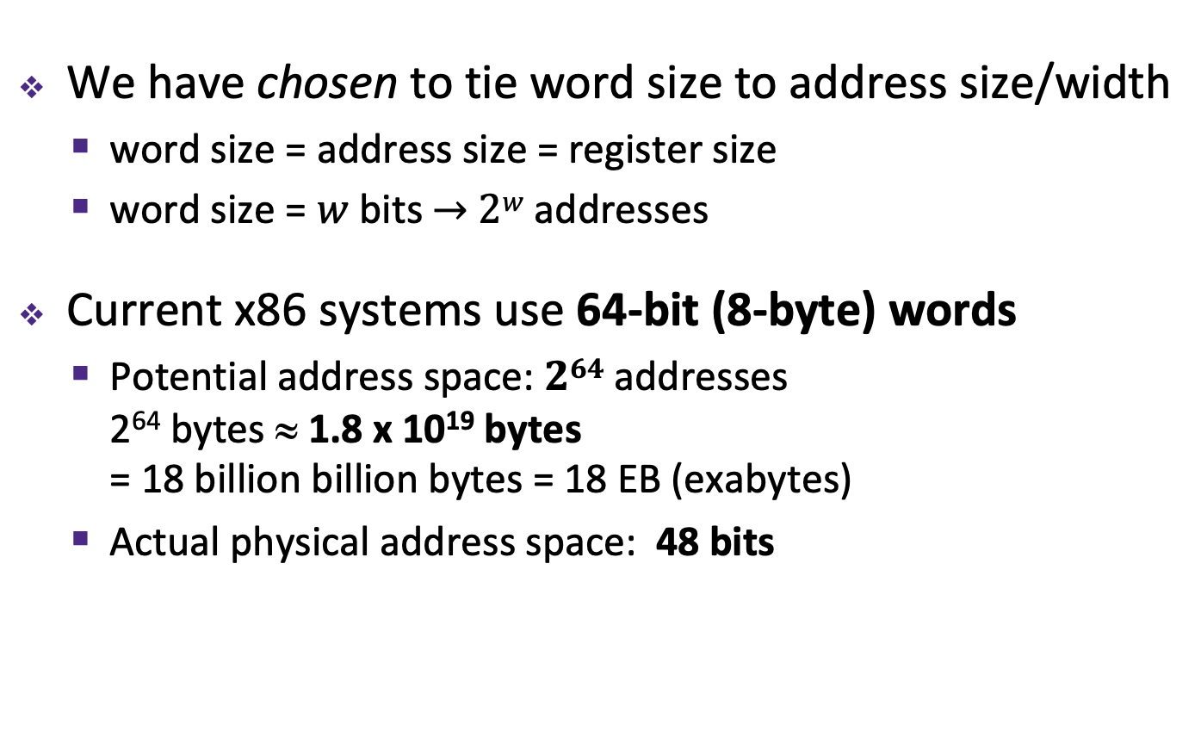
Machine “Words”
We have chosen to tie word size to address size/width
  word size = address size = register size
  word size = $w$ bits $→$ $2w$ addresses
Current x86 systems use 64-bit (8-byte) words
  Potential address space: $264$ addresses
  2⁶⁴ bytes ≈ 1.8 x 10¹⁹ bytes
  = 18 billion billion bytes = 18 EB (exabytes)
  Actual physical address space: 48 bits
Notes:
Instead, we typically talk about addresses in terms of “words”
Use same word size anywhere that you typically store addresses
You could count the world population with 33 fingers (using population number of 7.454 billion)

Slide 12
Word-Oriented Memory Organization
64-bit
Words
32-bit
Words
Addr.
(hex)
Bytes
Addresses still specify
locations of bytes in memory
  Addresses of successive words
  differ by word size (in bytes):
  e.g. 4 (32-bit) or 8 (64-bit)
  Address of word 0, 1, … 10?
0x00
Addr
=
??
0x01
0x02
Addr
=
??
0x03
0x04
Addr
=
??
0x05
0x06
0x07
0x08
Addr
=
??
0x09
0x0A
Addr
=
??
0x0B
0x0C
Addr
=
??
0x0D
0x0E
0x0F
Notes:
What do we use to address bigger chunks of bytes?

Slide 13
Word-Oriented Memory Organization
64-bit
Words
32-bit
Words
Addr.
(hex)
Bytes
Addresses still specify
locations of bytes in memory
  Addresses of successive words
  differ by word size (in bytes):
  e.g. 4 (32-bit) or 8 (64-bit)
  Address of word 0, 1, … 10?
Address of word
= address of first byte in word
  The address of any chunk of
  memory is given by the address
  of the first byte
  Alignment
0x00
Addr
=
??
0x01
0x02
0000
Addr
=
??
0x03
0x04
0000
Addr
=
??
0x05
0x06
0004
0x07
0x08
Addr
=
??
0x09
0x0A
Addr
=
??
0008
0x0B
0008
0x0C
Addr
=
??
0x0D
0x0E
0012
0x0F
Notes:
Use the first byte of the word
Still count by bytes
Aside: isn’t this wasteful?
Yes, but remember how much we can address with 64 bits? Probably don’t need to worry too much.

Slide 14
A Picture of Memory (64-bit view)
A “64-bit (8-byte) word-aligned” view of memory:
  In this type of picture, each row is composed of 8 bytes
  Each cell is a byte
  A 64-bit pointer
  will fit on one row
one word
0x00
0x01
0x02
0x03
0x04
0x05
0x06
0x07
Address
0x00
0x
0x
0x
0x
0x
0x
0x
0x
0x
Notes:
What’s the second row’s address going to be?
0x08
Third?
0x10

Slide 15
A Picture of Memory (64-bit view)
A “64-bit (8-byte) word-aligned” view of memory:
  In this type of picture, each row is composed of 8 bytes
  Each cell is a byte
  A 64-bit pointer
  will fit on one row
one word
0x00
0x01
0x02
0x03
0x04
0x05
0x06
0x07
Address
0x00
0x08
0x10
0x18
0x20
0x28
0x08
0x09
0x0A
0x0B
0x0C
0x0D
0x0E
0x0F
0x30
0x38
0x40
0x48

Slide 16
Addresses and Pointers
64-bit example
(pointers are 64-bits wide)
big-endian
An address is a location in memory
A pointer is a data object that holds an address
  Address can point to any data
Value 504 stored at
address 0x08
  504₁₀ = 1F8₁₆
  = 0x 00 ... 00 01 F8
Pointer stored at
0x38 points to
address 0x08
Address
0x00
00
00
00
00
00
00
01
F8
0x08
0x10
0x18
0x20
0x28
0x30
00
00
00
00
00
00
00
08
0x38
0x40
0x48
Notes:
Note that everything is just padded with extra 0s

Slide 17
Addresses and Pointers
64-bit example
(pointers are 64-bits wide)
big-endian
An address is a location in memory
A pointer is a data object that holds an address
  Address can point to any data
Pointer stored at
0x48 points to
address 0x38
  Pointer to a pointer!
Is the data stored
at 0x08 a pointer?
  Could be, depending
  on how you use it
Address
0x00
00
00
00
00
00
00
01
F8
0x08
0x10
0x18
0x20
0x28
0x30
00
00
00
00
00
00
00
08
0x38
0x40
00
00
00
00
00
00
00
38
0x48
Notes:
Note that everything is just padded with extra 0s

Slide 18
Data Representations
Sizes of data types (in bytes)
Java Data Type | C Data Type | 32-bit | x86-64
boolean | bool | 1 | 1
byte | char | 1 | 1
char |  | 2 | 2
short | short int | 2 | 2
int | int | 4 | 4
float | float | 4 | 4
 | long int | 4 | 8
double | double | 8 | 8
long | long | 8 | 8
 | long double | 8 | 16
(reference) | pointer * | 4 | 8
(reference) | pointer * | 4 | 8
address size = word size
To use “bool” in C, you must #include <stdbool.h>
Notes:
This mapping is mostly an arbitrary historical artifact except for address sizes.

Slide 19
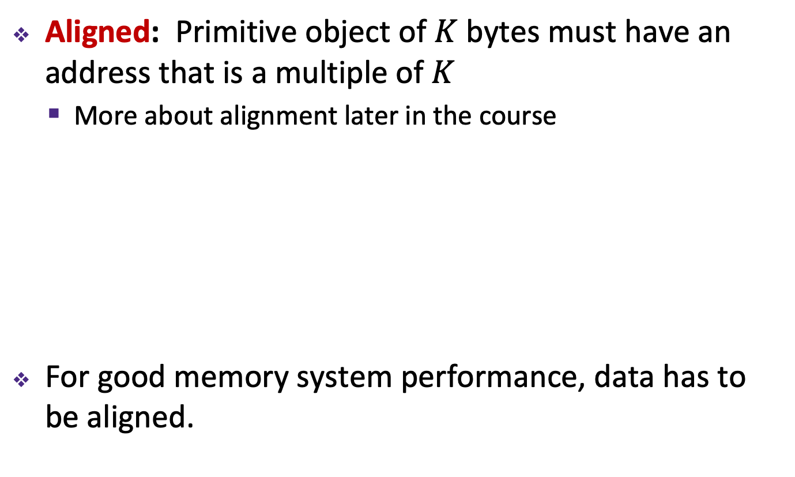
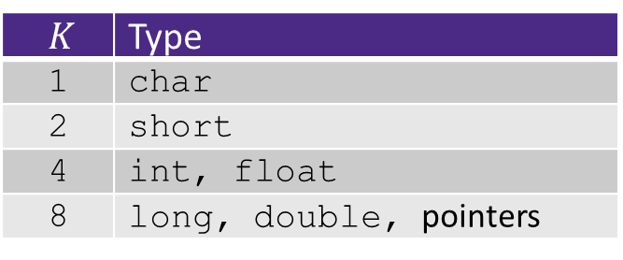
Memory Alignment
Aligned: Primitive object of $K$ bytes must have an address that is a multiple of $K$
  More about alignment later in the course
For good memory system performance, data has to be aligned.
$K$ | Type
1 | char
2 | short
4 | int, float
8 | long, double, pointers

Slide 20
Byte Ordering
How should bytes within a word be ordered in memory?
  Example: store the 4-byte (32-bit) int:
  0x a1 b2 c3 d4
By convention, ordering of bytes called endianness
  The two options are big-endian and little-endian
    In which address does the least significant byte go?
    Based on Gulliver’s Travels: tribes cut eggs on different sides
    (big, little)

Slide 21
Byte Ordering
Big-endian (SPARC, z/Architecture)
  Least significant byte has highest address
Little-endian (x86, x86-64, RISC-V)
  Least significant byte has lowest address
Bi-endian (ARM, PowerPC)
  Endianness can be specified as big or little
Example: 4-byte data 0xa1b2c3d4 at address 0x100
0x100
0x101
0x102
0x103
Big-Endian
01
a1
23
b2
45
c3
67
d4
0x100
0x101
0x102
0x103
Little-Endian
67
d4
45
c3
23
b2
01
a1
Notes:
Big Endian
Most significant is first
Little Endian
Looks backwards
Let’s look at some more examples…

Slide 22
Byte Ordering Examples
Decimal: 12345
Binary: 0011 0000 0011 1001
Hex: 3 0 3 9
IA32, x86-64
(little-endian)
SPARC
(big-endian)
int x = 12345;
// or x = 0x3039;
0x00
39
00
0x00
0x01
30
00
0x01
0x02
00
30
0x02
0x03
00
39
0x03
long int y = 12345;
// or y = 0x3039;
(A long int is
the size of a word)
32-bit
IA32
64-bit
x86-64
32-bit
SPARC
64-bit
SPARC
0x00
39
39
0x00
0x00
00
00
0x00
0x01
30
30
0x01
0x01
00
00
0x01
0x02
00
00
0x02
0x02
30
00
0x02
0x03
00
00
0x03
0x03
39
00
0x03
00
0x04
00
0x04
00
0x05
00
0x05
00
0x06
30
0x06
00
0x07
39
0x07

Slide 23
Peer Instruction Question:
We store the value 0x 01 02 03 04 as a word at address 0x100 in a big-endian, 64-bit machine
What is the byte of data stored at address 0x104?
0x04
0x40
0x01
0x10
We’re lost…

Slide 24
Endianness
Endianness only applies to memory storage
Often programmer can ignore endianness because it is handled for you
  Bytes wired into correct place when reading or storing from memory (hardware)
  Compiler and assembler generate correct behavior (software)
Endianness still shows up:
  Logical issues: accessing different amount of data than how you stored it (e.g. store int, access byte as a char)
  Need to know exact values to debug memory errors
  Software emulation machine code (assignment 2)

Slide 25
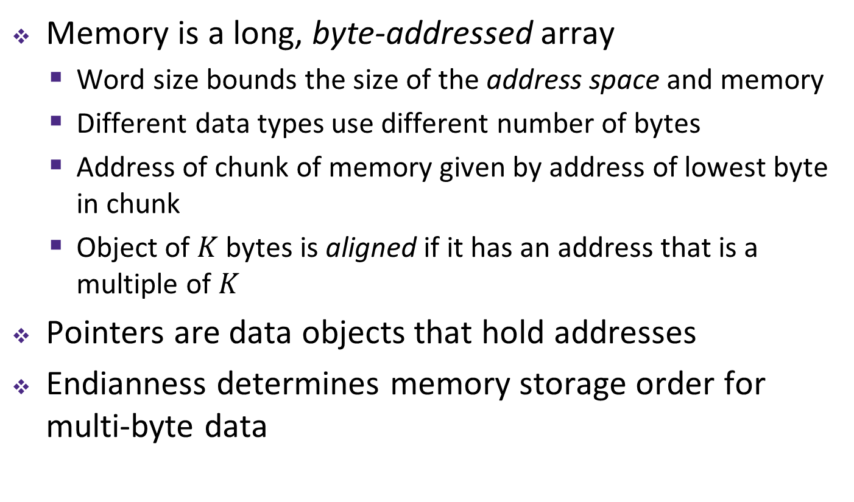
Summary
Memory is a long, byte-addressed array
  Word size bounds the size of the address space and memory
  Different data types use different number of bytes
  Address of chunk of memory given by address of lowest byte in chunk
  Object of $K$ bytes is aligned if it has an address that is a multiple of $K$
Pointers are data objects that hold addresses
Endianness determines memory storage order for multi-byte data

