Slide 1

CMPT 120
CMPT 130
http://www.sfu.ca/outlines.html?2021/fall/cmpt/130/d100
https://www.sfu.ca/outlines.html?2018/summer/cmpt/120/d100
Basics of binary encoding including 2s complement
memory management, dynamic memory: pointers and addresses, and allocation of dynamic memory

Slide 2


Programming. ~8hrs/week

Slide 3


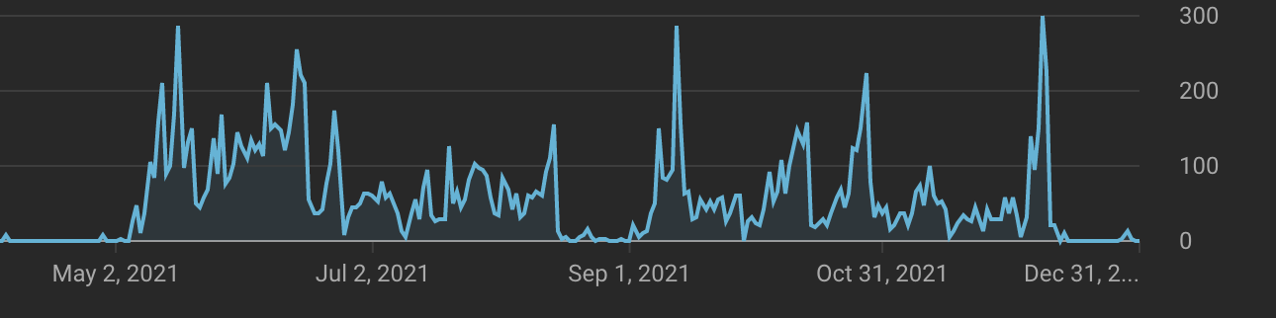
DO NOT BINGE!
Midterm
Final
Midterm
Final

Slide 4

Ask Questions.
I cannot answer questions I do not receive

Slide 5
Questions format
Example 1: In the dictionary.c file, your code adds the vector_string.h and vector_char.h files by doing this: #include <vector_char.h> and #include <vector_string.h>. I thought this was incorrect and surely enough when I ran the code myself, I got an error because of the way these files were added. Shouldn't it be: #include "vector_char.h" and #include "vector_string.h" instead?
What command to run: FILL HERE
Have you created your own test input ? (YES/NO)
Expected behavior: FILL HERE
Observed behavior: FILL HERE
Did you refer to assignment page hints ? (YES/NO) FILL HERE

Slide 6
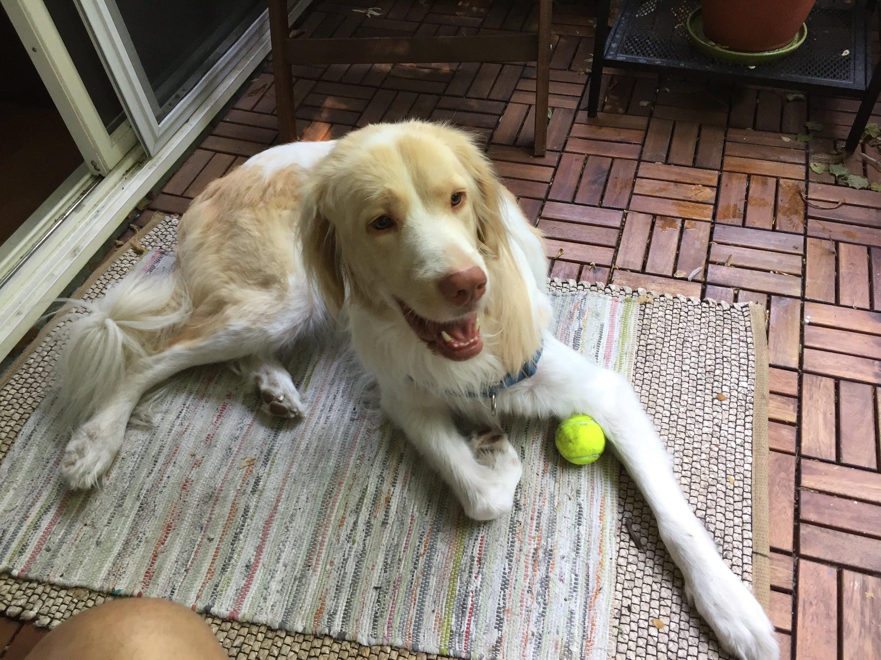
Please don’t cheat!
https://www.cs.sfu.ca/~ashriram/Courses/CS295//assignments.html

Slide 7
https://www.cs.sfu.ca/~ashriram/Courses/CS295/policy.html

