Slide 1
Black Box Architecture
A black box is employed to abstract the function of a device.
Notation:
values of 0 / 1 travel along wires (lines)
arrows indicate direction of travel
there are inputs and outputs
input x
output z
input y
z = x | y
OR gate
Also:
AND
XOR
After a change in inputs, there is a time delay for outputs
≕ propagation delay (t_{pd})
on a picosecond to nanosecond scale
find longest distance from inputs to outputs

Slide 2
: Full Adder
Mystery Circuit
function table:
  basically a truth table
A
B
S
A B C
C S
0 0 0
0 0 1
0 1 0
0 1 1
1 0 0
1 0 1
1 1 0
1 1 1
0
0
0
1
0
1
1
1
0
1
1
0
1
0
0
1
Half Adder
Half Adder
C
3-bit
Addition!
C
Q. What’s the propagation delay?
Full Adder
A
B
3 gate delays (highlighted)
Q. What does the circuit accomplish?
algebra:
FA
C
C
S = A ^ B ^ C
; C = (A & B) | (C & (A ^ B))
S = A ⊕ B ⊕ C; C = AB + C(A ⊕ B)
S
S = A ⊕ B ⊕ C

Slide 3
Computing with Combinational Circuits
Definition: A combinational circuit computes a pure function, i.e., its outputs react only based on its inputs. There are no feedback loops and no state information (memory) is maintained.
Theorem: Every Boolean function can be implemented with NAND and NOT. Circuits are modular
… a 4-bit ripple carry adder!
  adds by columns
  propagation delay
A₃
B₃
A₂
B₂
A₁
B₁
A₀
B₀
A
B
4
4
C₃
C₂
C₁
= 9
C₄
FA
FA
FA
FA
C₀
(2n + 1)
Adder-4
C
C
4
S₃
S₂
S₁
S₀
S
Notes:
Orally: We used to spend ⅔ of CMPT 150 on the design techniques to minimize circuit size, gate delay, etc …
The point in CMPT 295 is only that it is possible to do so, and that gate delay is a thing
Orally: This is why additions is slow. And why mul is even slower.
Orally: How to make an Adder-8?

Slide 4
Function Unit
Hardware circuits are fixed
can’t adjust wires / gates while running
build control wires to parametrize its function
Function Unit:
Function Select:
FS func
0001 A + B
0010 A − B
1000 A * B
0100 A ^ B
0101 A + 1
1101 B
32
32
opA
opB
FS
4
res
32

Slide 5
Function Unit: Adder-Subtractor
A
B
32
FS
if FS == 0 then
S = A + B
if FS == 1 then
32
32
C
Adder-32
S = A + B + 1
32
= A − B
S

Slide 6
Digital State Machines
inputs
Memory holds state information
memory
current
state
combinational
circuit
outputs
next state
compute next state based on (current state, inputs)
compute outputs based on (current state, inputs)
Q. What does this imply about the clock period?
clock period must exceed (t_{pd} of combinational circuit + t_{pd} of registers)

Slide 7
CPU Hardware
Goal: Given an instruction set architecture, construct a machine that reliably executes instructions.
Design choices will influence speed of instructions:
some instructions will be faster than others
order of instructions may matter
order of memory accesses may matter
“conflicts” or “hazards”

Slide 8
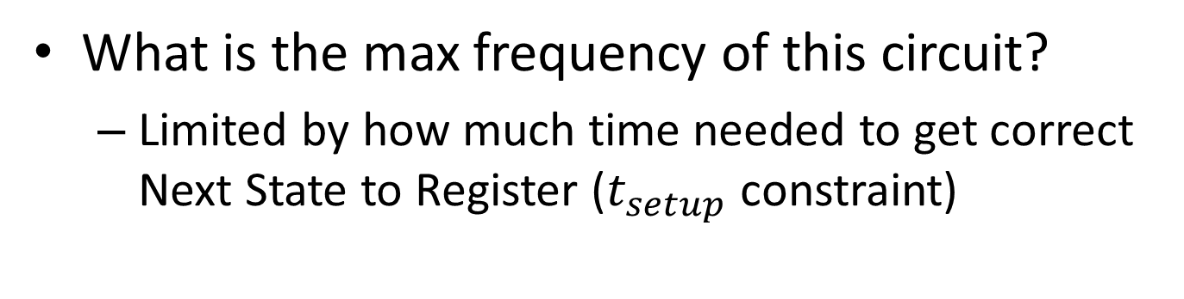
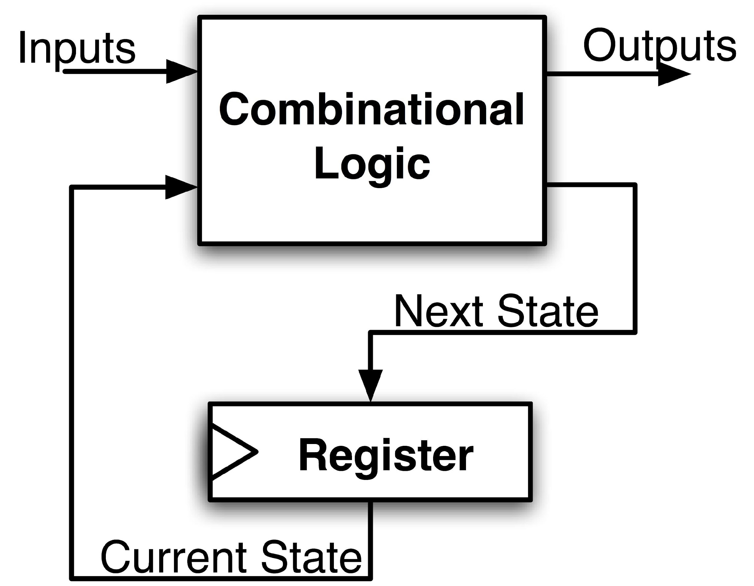
Maximum Clock Frequency
Assumes Max Delay > Hold Time
Max Delay =
Min Period = Max Delay
Max Freq = 1/Min Period
CLK-to-Q Delay
+ CL Delay
+ Setup Time
Notes:
Hold time is included in CLK-to-Q delay.
Make sure to shift thinking for setup time for next clock trigger (one clock cycle).

Slide 9
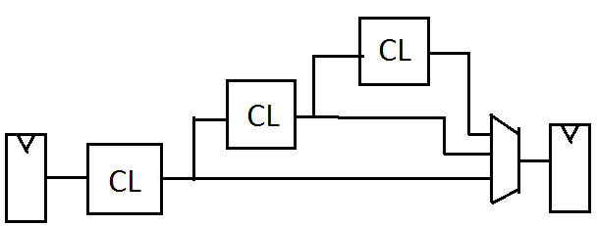
The Critical Path
The critical path is the longest delay between any two registers in a circuit
The clock period must be longer than this critical path, or the signal will not propagate properly to that next register
+
Reg
Reg

Slide 10
How do we go faster?
Pipelining!
Split operation into smaller parts and add a register between each one.

Slide 11
RISC-V CPU Datapath, Control Intro
Notes:
Podcast link: https://gimletmedia.com/tags/6dug/super-tech-support

Slide 12
Design Principles
Five steps to design a processor:
  Analyze instruction set →
  datapath requirements
  Select set of datapath
  components & establish
  clock methodology
  Assemble datapath meeting
  the requirements
  Analyze implementation of each instruction to determine setting of control points that effects the register transfer
  Assemble the control logic
    Formulate Logic Equations
    Design Circuits
Processor
Input
Control
Memory
Datapath
Output

Slide 13
Summary !
Universal datapath
  Capable of executing all RISC-V instructions in one cycle each
  Not all units (hardware) used by all instructions
5 Phases of execution
  IF (Instruction Fetch), ID (Instruction Decode), EX (Execute), MEM (Memory), WB (Write Back)
  Not all instructions are active in all phases (except for loads!)
Controller specifies how to execute instructions
  Worth thinking about: what new instructions can be added with just most control?

Slide 14
Your CPU in two parts
Central Processing Unit (CPU):
  Datapath: contains the hardware necessary to perform operations required by the processor
    Reacts to what the controller tells it! (ie. “I was told to do an add, so I”ll feed these arguments through an adder)
  Control: decides what each piece of the datapath should do
    What operation am I performing? Do I need to get info from memory? Should I write to a register? Which register?
    Has to make decisions based on the input instruction only!

Slide 15
Design Principles
Determining control signals
  Any time a datapath element has an input that changes behavior, it requires a control signal
  (e.g. ALU operation, read/write)
  Any time you need to pass a different input based on the instruction, add a MUX with a control signal as the selector
  (e.g. next PC, ALU input, register to write to)
Your control signals will change based on your exact datapath
Your datapath will change based on your ISA

Slide 16
Storage Element: Register File
RW
RA
RB
Write Enable
5
5
5
Register File consists of 31 registers:
  Output ports portA and portB
  Input port portW
Register selection
  Place data of register RA (number) onto portA
  Place data of register RB (number) onto portB
  Store data on portW into register RW (number) when Write Enable is 1
Clock input (CLK)
  CLK is passed to all internal registers so they can be written to if they match RW and Write Enable is 1
portA
portW
32 x 32-bit
Registers
32
32
portB
Clk
32

Slide 17
Implementing R-Types
(4) Perform operation
New hardware: ALU (Arithmetic Logic Unit)
Abstraction for adders, multipliers, dividers, etc.
How do we know what operation to execute?
  Our first control bit! ALUSel(ect)
+4
Reg[]
pc
IMEM
inst[11:7]
AddrD
ALU
R[rs1]
inst[19:15]
AddrA
DataA
inst[24:20]
R[rs2]
AddrB
DataB
inst[31:0]
Control
ALUSel

Slide 18
Adding addi to datapath
+4
Reg[]
pc
DataD
ALU
IMEM
inst[11:7]
AddrD
Reg[rs1]
alu
pc+4
0
inst[19:15]
AddrA
DataA
Reg[rs2]
inst[24:20]
AddrB
DataB
1
Also works for all other I-format arithmetic instruction (slti,sltiu,andi,ori,xori,slli,srli,srai) just by changing ALUSel
inst[31:20]
Imm.
Gen
imm[31:0]
Control Logic
inst[31:0]
ImmSel=I
RegWEn=1
BSel=1
ALUSel=Add

Slide 19
Adding lw to datapath
+4
Reg[]
alu
pc
wb
DataD
Reg[rs1]
ALU
DMEM
1
IMEM
inst[11:7]
AddrD
Reg[rs2]
Addr
wb
pc+4
inst[19:15]
AddrA
DataA
0
DataR
0
1
mem
inst[24:20]
AddrB
DataB
inst[31:20]
Imm.
Gen
imm[31:0]
inst[31:0]
ImmSel=I
RegWEn=1
Bsel=1
ALUSel=Add
MemRW=Read
WBSel=0

Slide 20
Storage Element: Idealized Memory
Memory (idealized)
  One input port: Data In
  One output port: Data Out
Memory access:
  Read: Write Enable = 0, data at Address is placed on Data Out
  Write: Write Enable = 1, Data In written to Address
Clock input (CLK)
  CLK input is a factor ONLY during write operation
  During read, behaves as a combinational logic block: Address valid → Data Out valid after “access time”
Write Enable
Address
Data In
DataOut
32
32
CLK

Slide 21
Current Datapath
+4
Reg[]
ALU
pc
wb
DataD
Reg[rs1]
ALU
1
DMEM
IMEM
inst[11:7]
AddrD
Addr
pc+4
Reg[rs2]
DataR
wb
inst[19:15]
AddrA
DataA
0
0
mem
inst[24:20]
AddrB
DataB
1
inst[31:20]
Imm.
Gen
imm[31:0]
inst[31:0]
ImmSel
BSel
ALUSel
MemRW
WBSel

Slide 22
Adding sw to datapath
+4
Reg[]
alu
pc
wb
DataD
Reg[rs1]
ALU
DMEM
pc+4
IMEM
inst[11:7]
AddrD
Reg[rs2]
Addr
1
wb
inst[19:15]
AddrA
DataA
0
DataR
0
1
DataW
mem
inst[24:20]
AddrB
DataB
inst[31:7]
Imm.
Gen
imm[31:0]
inst[31:0]
ImmSel=S
RegWEn=0
Bsel=1
ALUSel=Add
MemRW=Write
WBSel=*
*= “Don’t Care”

Slide 23
Adding branches to datapath
alu
+4
Reg[]
pc
alu
pc
wb
DataD
1
1
Reg[rs1]
ALU
DMEM
IMEM
inst[11:7]
AddrD
0
1
0
Branch Comp.
Reg[rs2]
Addr
DataR
0
wb
pc+4
inst[19:15]
AddrA
DataA
0
DataW
mem
inst[24:20]
AddrB
DataB
1
inst[31:7]
Imm.
Gen
imm[31:0]
PCSel=taken/not-taken
inst[31:0]
ImmSel=B
RegWEn=0
BrUn
BrEq
BrLT
Bsel=1
ASel=1
MemRW=Read
WBSel=*
ALUSel=Add

Slide 24
Adding jalr to datapath
+4
Reg[]
pc
alu
pc+4
alu
pc
wb
1
1
DataD
Reg[rs1]
ALU
DMEM
2
IMEM
inst[11:7]
AddrD
0
1
pc+4
0
Branch Comp.
Reg[rs2]
Addr
DataR
0
wb
inst[19:15]
AddrA
DataA
0
DataW
mem
inst[24:20]
AddrB
DataB
1
inst[31:7]
Imm.
Gen
imm[31:0]
PCSel
inst[31:0]
ImmSel=B
RegWEn=1
Bsel=1
Asel=0
MemRW=Read
WBSel=2
BrEq=*
ALUSel=Add
BrUn=*
BrLT=*

Slide 25
Adding jal to datapath
+4
Reg[]
pc
alu
pc+4
alu
pc
wb
1
1
DataD
Reg[rs1]
ALU
DMEM
2
IMEM
inst[11:7]
AddrD
0
1
pc+4
0
Branch Comp.
Reg[rs2]
Addr
DataR
0
wb
inst[19:15]
AddrA
DataA
0
DataW
mem
inst[24:20]
AddrB
DataB
1
inst[31:7]
Imm.
Gen
imm[31:0]
PCSel
inst[31:0]
ImmSel=J
RegWEn=1
Bsel=1
Asel=1
MemRW=Read
WBSel=2
BrEq=*
ALUSel=Add
BrUn=*
BrLT=*

Slide 26
Implementing lui
+4
Reg[]
pc
pc+4
pc
wb
1
alu
alu
1
DataD
Reg[rs1]
ALU
DMEM
2
IMEM
inst[11:7]
AddrD
0
1
pc+4
0
Branch Comp.
Reg[rs2]
Addr
DataR
0
wb
inst[19:15]
AddrA
DataA
0
DataW
mem
inst[24:20]
AddrB
DataB
1
inst[31:7]
Imm.
Gen
imm[31:0]
PCSel=pc+4
inst[31:0]
ImmSel=U
RegWEn=1
Bsel=1
Asel=*
ALUSel=B
MemRW=Read
WBSel=1
BrUn=*
BrE=*
BrLT=*

Slide 27
Implementing auipc
+4
Reg[]
pc
pc+4
pc
wb
1
alu
alu
1
DataD
Reg[rs1]
ALU
DMEM
2
IMEM
inst[11:7]
AddrD
0
1
pc+4
0
Branch Comp.
Reg[rs2]
Addr
DataR
0
wb
inst[19:15]
AddrA
DataA
0
DataW
mem
inst[24:20]
AddrB
DataB
1
inst[31:7]
Imm.
Gen
imm[31:0]
PCSel=pc+4
inst[31:0]
ImmSel=U
RegWEn=1
Bsel=1
Asel=1
ALUSel=Add
MemRW=0
WBSel=1
BrUn=*
BrE=*
BrLT=*

