Slide 1

Digital Logic - Combinational

Slide 2
Agenda
Combinational Logic
  Combinational Logic Gates
  Truth Tables
  Boolean Algebra
  Circuit Simplification

Slide 3




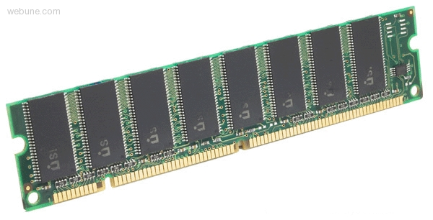

Roadmap
C:
Java:
Memory & data
Arrays & structs
Integers & floats
RISC V assembly
Procedures & stacks
Executables
Memory & caches
Processor Pipeline
Performance
Parallelism
car *c = malloc(sizeof(car));
c->miles = 100;
c->gals = 17;
float mpg = get_mpg(c);
free(c);
Car c = new Car();
c.setMiles(100);
c.setGals(17);
float mpg =
c.getMPG();
Assembly language:
OS:
Machine code:
0111010000011000
100011010000010000000010
1000100111000010
110000011111101000011111
Computer system:

Slide 4
Why is this important?
Why study hardware design?
  Background for other more in-depth classes
  Only course in CMPT that deals with hardware
  We need some digital systems knowledge to build our own processor

Slide 5
Why is this important?
We need some digital systems knowledge to build our own processor
Why build our own processor?
  Because we believe computer scientists should have an answer to the question “How does a computer work?”
  So you can understand how code is actually executed on a computer

Slide 6
Why is this important?
So you can understand how code is actually executed on a computer
Why do we care about how code executes?
  Reliability
  Performance
  Security

Slide 7
Hardware Design
Why study hardware design and processors and computers
if you only care about high-level software?
Example of the power of layered abstractions
  Transistors -> Combinational Logic
  Combinational Logic -> Sequential Logic
  Sequential Logic -> Processors
  Processors -> Machine Language
  Machine Language -> Assembly
  Assembly -> High-level Programming Languages
  High-level Programming Languages -> Word,Minecraft,Twitter
At each step we can “abstract away” the lower steps and (mostly) forget they exist

Slide 8
Synchronous Digital Systems (SDS)
Hardware of a processor, such as a RISC-V processor, is an example of a Synchronous Digital System
Synchronous:
  All operations coordinated by a central clock
    “Heartbeat” of the system! (processor frequency)
Digital:
  Represent all values with two discrete values
  Electrical signals are treated as 1’s and 0’s
    1 and 0 are complements of each other
  High/Low voltage for True/False, 1/0

Slide 9
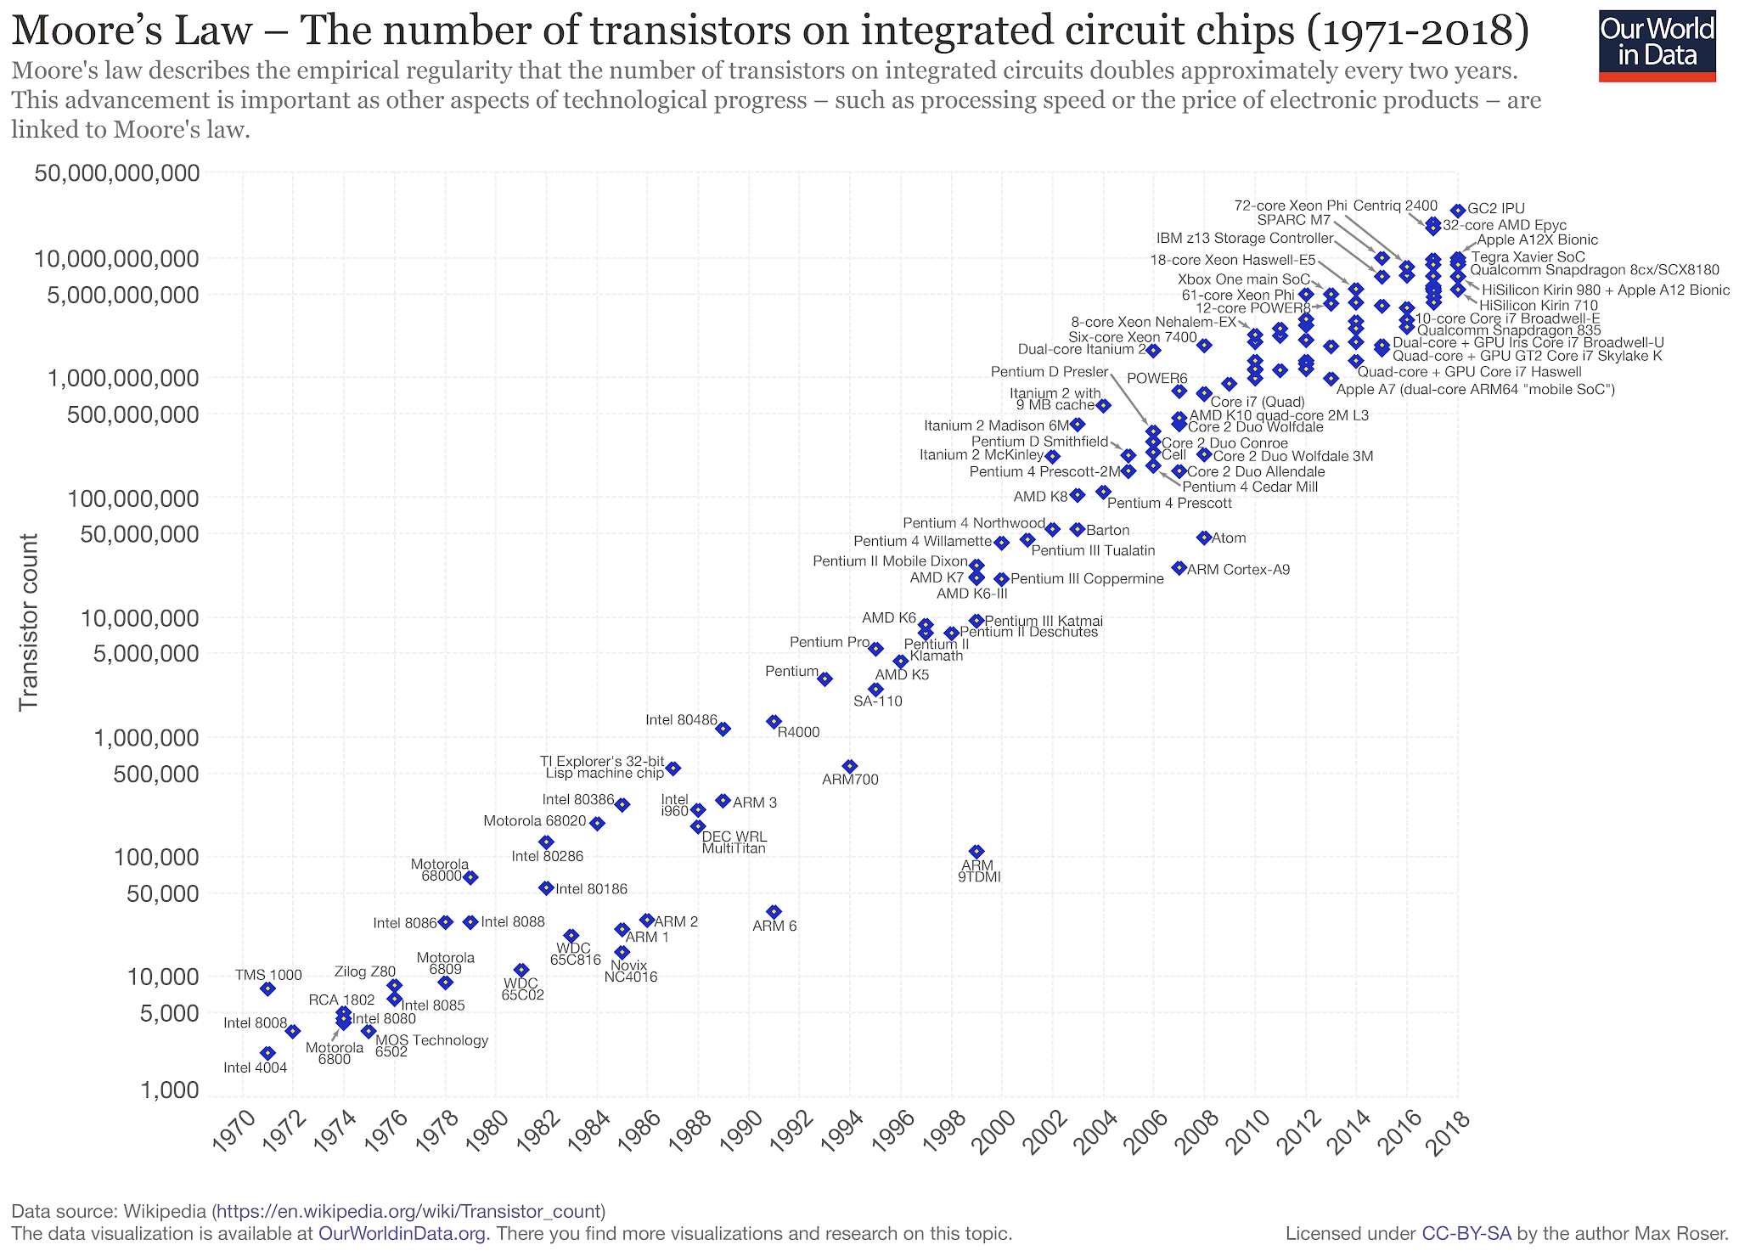

Slide 10
Historical Trend
Trend:
Hardware gets more powerful every year.
  (Really due to hard work of thousands of engineers)
Therefore:
Software gets more resources and faster compute!
  (And has to keep up with ever-changing hardware)

Slide 11
Agenda
Combinational Logic
  Combinational Logic Gates
  Truth Tables
  Boolean Algebra
  Circuit Simplification

Slide 12
Type of Circuits
Digital Systems consist of two basic types of circuits:
  Combinational Logic (CL)
    Output is a function of the inputs only, not the history of its execution
    e.g. circuits to add A, B (ALUs)
  Sequential Logic (SL)
    Circuits that “remember” or store information
    a.k.a. “State Elements”
    e.g. memory and registers (Registers)

Slide 13



Logic Gates (1/2)
Special names and symbols:
Circle means NOT!
a | c
0 | 1
1 | 0
NOT
a | b | c
0 | 0 | 0
0 | 1 | 0
1 | 0 | 0
1 | 1 | 1
AND
a | b | c
0 | 0 | 0
0 | 1 | 1
1 | 0 | 1
1 | 1 | 1
OR

Slide 14



Logic Gates (2/2)
Inverted versions are easier to implement in CMOS
a | b | c
0 | 0 | 1
0 | 1 | 1
1 | 0 | 1
1 | 1 | 0
NAND
a | b | c
0 | 0 | 1
0 | 1 | 0
1 | 0 | 0
1 | 1 | 0
NOR
a | b | c
0 | 0 | 0
0 | 1 | 1
1 | 0 | 1
1 | 1 | 0
XOR

Slide 15
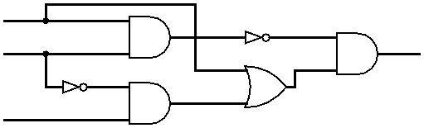
Combining Multiple Logic Gates
(NOT(A AND B)) AND (A OR (NOT B AND C))
A
B
D
C

Slide 16
Agenda
Combinational Logic
  Combinational Logic Gates
  Truth Tables
  Boolean Algebra
  Circuit Simplification

Slide 17
Representations of
Combinational Logic
Text Description
Circuit Diagram
  Transistors and wires
  Logic Gates
Truth Table
Boolean Expression
All are equivalent

Slide 18
Truth Tables
Table that relates the inputs to a combinational logic circuit to its output
  Output only depends on current inputs
  Use abstraction of 0/1 instead of high/low V
  Shows output for every possible combination of inputs
How big?
  0 or 1 for each of N inputs, so 2^{N} rows

Slide 19
General Form
A B C
Y
0 0 0
0 0 1
0 1 0
0 1 1
1 0 0
1 0 1
1 1 0
1 1 1
0
1
0
0
0
1
1
0
F(0,0,0)
F(0,0,1)
F(0,1,0)
F(0,1,1)
F(1,0,0)
F(1,0,1)
F(1,1,0)
F(1,1,1)
A
F
B
Y
C
If N inputs, how many distinct functions F do we have?
Function maps each row to 0 or 1, so possible functions
2^{N}
Notes:
Circle the output, use variables/animations, talk about the output as a bit combination (integer?)
Maybe 3 inputs?

Slide 20
Multiple Outputs
A
F
X
B
Y
C
D
Z
For 3 outputs, just three indep. functions:
X(A,B,C,D), Y(A,B,C,D), and Z(A,B,C,D)
  Can show functions in separate columns without
  adding any rows!

Slide 21
Question: Convert the following statements into
a Truth Table for: (x XOR y) OR (NOT z)
X | Y | Z | (A) | (B) | (C) | (D)
0 | 0 | 0 | 1 | 1 | 1 | 1
0 | 0 | 1 | 0 | 0 | 0 | 0
0 | 1 | 0 | 1 | 1 | 1 | 1
0 | 1 | 1 | 1 | 1 | 1 | 1
1 | 0 | 0 | 0 | 1 | 1 | 1
1 | 0 | 1 | 1 | 1 | 0 | 1
1 | 1 | 0 | 1 | 1 | 1 | 0
1 | 1 | 1 | 1 | 0 | 1 | 1

Slide 22
Question: Convert the following statements into
a Truth Table for: (x XOR y) OR (NOT z)
X | Y | Z | (A) | (B) | (C) | (D)
0 | 0 | 0 | 1 | 1 | 1 | 1
0 | 0 | 1 | 0 | 0 | 0 | 0
0 | 1 | 0 | 1 | 1 | 1 | 1
0 | 1 | 1 | 1 | 1 | 1 | 1
1 | 0 | 0 | 0 | 1 | 1 | 1
1 | 0 | 1 | 1 | 1 | 0 | 1
1 | 1 | 0 | 1 | 1 | 1 | 0
1 | 1 | 1 | 1 | 0 | 1 | 1

Slide 23
More Complicated Truth Tables
3-Input Majority
2-bit Adder
a | b | c | y
0 | 0 | 0 | 0
0 | 0 | 1 | 0
0 | 1 | 0 | 0
0 | 1 | 1 | 1
1 | 0 | 0 | 0
1 | 0 | 1 | 1
1 | 1 | 0 | 1
1 | 1 | 1 | 1
a₁
+
c₂
a₀
c₁
b₁
b₀
c₀
How many
rows?
A |  | B |  | C
a₁ | a₀ | b₁ | b₀ | c₂ | c₁ | c₀
 |  |  | .
 |  |  | .
 |  |  | .

Slide 24
Agenda
Combinational Logic
  Combinational Logic Gates
  Truth Tables
  Boolean Algebra
  Circuit Simplification

Slide 25
My Hand Hurts…
Truth tables are huge
  Write out EVERY combination of inputs and outputs (thorough, but inefficient)
  Finding a particular combination of inputs involves scanning a large portion of the table
There must be a shorter way to represent combinational logic
  Boolean Algebra to the rescue!

Slide 26
Boolean Algebra
Represent inputs and outputs as variables
  Each variable can only take on the value 0 or 1
Overbar or ¬ is NOT: “logical complement”
  e.g. if A is 0, A is 1. If A is 1, then ¬A is 0
Plus (+) is 2-input OR: “logical sum”
Product (·) is 2-input AND: “logical product”
  All other gates and logical expressions can be built from combinations of these
  ¬AB + A¬B == (NOT(A AND B)) OR (A AND NOT B)
For slides, will use ¬A

Slide 27
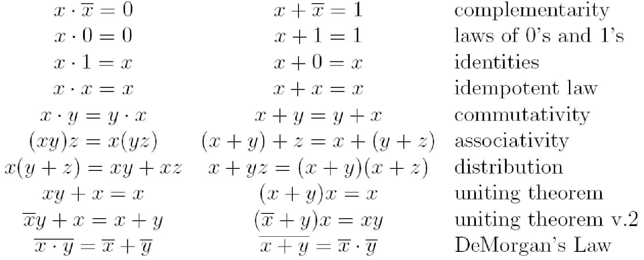
Laws of Boolean Algebra
These laws allow us to perform simplification:
Notes:
Demorgan’s law example

Slide 28
Truth Table to Boolean Expression
Read off of table
  For 1, write variable name
  For 0, write complement of variable
Sum of Products (SoP)
  Take rows with 1’s in output column,
  sum products of inputs
  c=
Product of Sums (PoS)
  Take rows with 0’s in output column, product the sum of the complements of the inputs
  c =
a | b | c
0 | 0 | 0
0 | 1 | 1
1 | 0 | 1
1 | 1 | 0
¬a
b
+
a
¬b
We can show that these
are equivalent!
(a + b) · (¬a + ¬b)
Notes:
Choice between the two generally comes down to whether the output function has more 0’s or 1’s. Choosing the conversion (SoP/PoS) with less items will result in a shorter expression!
(This example happens to be balanced: 2 0’s and 2 1’s)

Slide 29
Faster Hardware?
Recall: Everything we are dealing with is just an abstraction of transistors and wires
  Inputs propagating to the outputs are voltage signals passing through transistor networks
  There is always some delay before a CL’s output updates to reflect the inputs
Simpler Boolean expressions ↔ smaller transistor networks ↔ smaller circuit delays ↔ faster hardware

Slide 30
Agenda
Muxes
Sequential Logic Timing
Maximum Clock Frequency
Finite State Machines
Functional Units
Summary
Bonus Slides
Logisim Intro
Notes:
Should be at no later than 10

Slide 31
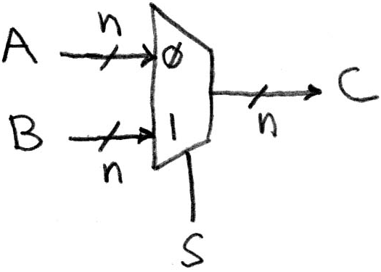
Data Multiplexor
Multiplexor (“MUX”) is a selector
  Place one of multiple inputs onto output (N-to-1)
Shown below is an n-bit 2-to-1 MUX
  Input S selects between two inputs of n bits each
This input is passed to output if selector bits match shown value
Represents that this wire has n bits

Slide 32
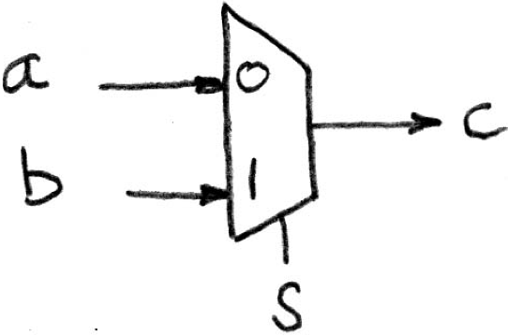
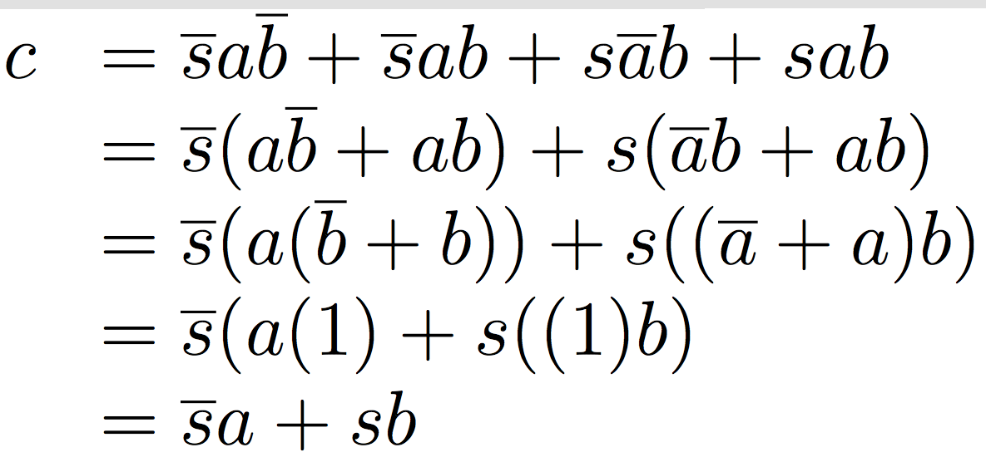
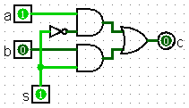
Implementing a 1-bit 2-to-1 MUX
Schematic:
Truth Table:
Boolean Algebra:
Circuit Diagram:
s | a | b | c
0 | 0 | 0 | 0
0 | 0 | 1 | 0
0 | 1 | 0 | 1
0 | 1 | 1 | 1
1 | 0 | 0 | 0
1 | 0 | 1 | 1
1 | 1 | 0 | 0
1 | 1 | 1 | 1

Slide 33
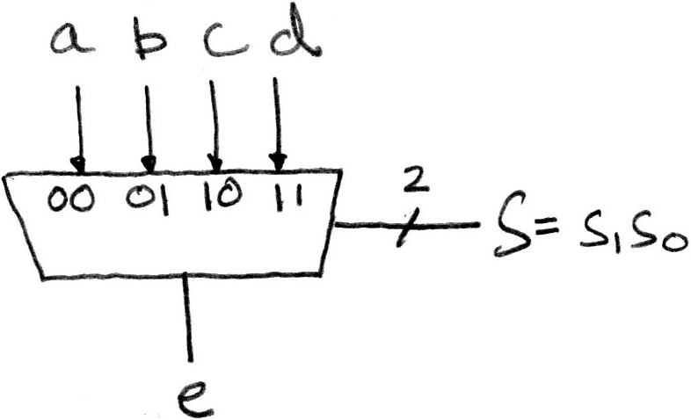
1-bit 4-to-1 MUX (1/2)
Schematic:
Truth Table: How many rows?
Boolean Expression:
e = ¬s₁¬s₀a + ¬s₁s₀b + s₁¬s₀c + s₁s₀d
2⁶

Slide 34
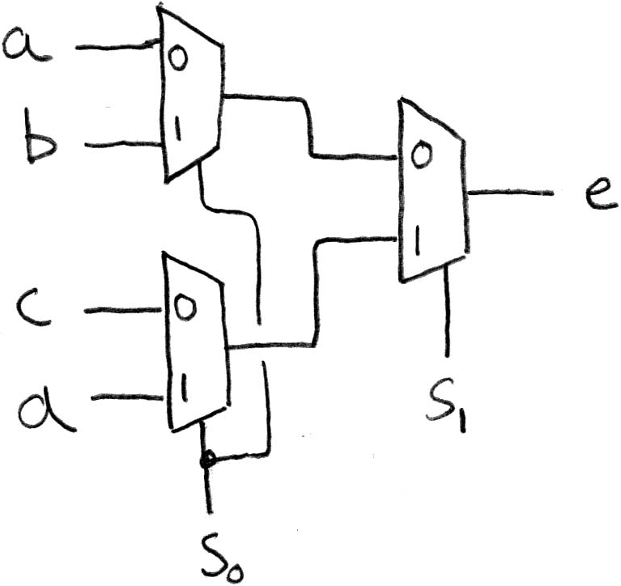
1-bit 4-to-1 MUX (2/2)
Can we leverage what we’ve previously built?
  Alternative hierarchical approach:

Slide 35
Bonus slides (not testable)

Slide 36
Agenda
Combinational Logic
  Combinational Logic Gates
  Truth Tables
  Boolean Algebra
  Circuit Simplification

Slide 37
Manipulating Boolean Algebra
SoP and PoS expressions can still be long
  We wanted to have shorter representation than a truth table!
Boolean algebra follows a set of rules that allow for simplification
  Goal will be to arrive at the simplest equivalent expression
  Allows us to build simpler (and faster) hardware

Slide 38
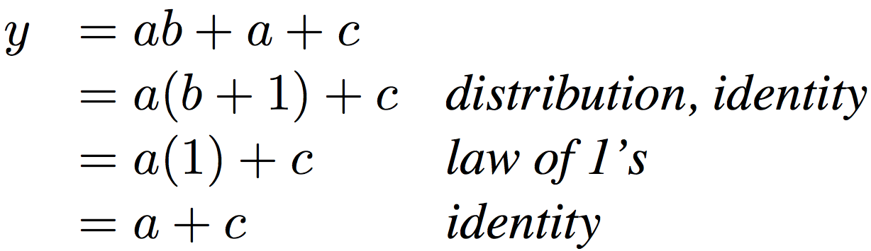
Boolean Algebraic
Simplification Example
Notes:
Do on black board
From distribution: a(b +1) + c
Froms laws of 0s and 1s: b+1 = b
= ab + c
Truth Table
a b c y
0 0 0 0
0 0 1 1
0 0 1 1

Slide 39
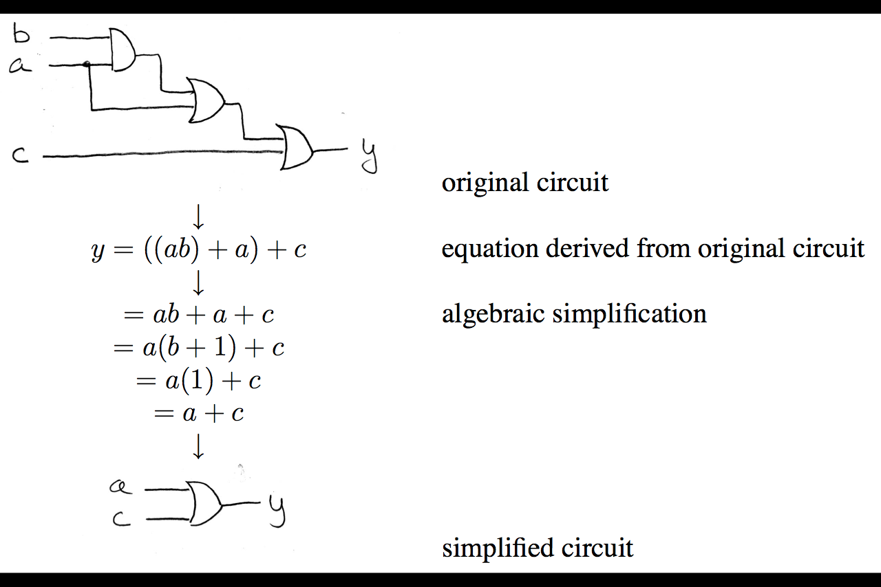
Circuit Simplification
1)
(Transistors and/or Gates)
2)
3)
4)

Slide 40
Representations of
Combinational Logic
Text Description
Circuit Diagram
  Transistors and wires
  Logic Gates
Truth Table
Boolean Expression
All are equivalent

Slide 41
Converting Combinational Logic
Try all input combinations
Circuit
Diagram
This is difficult to do efficiently!
Truth
Table
Try all input
combinations
Propagate signals
through gates
Wire inputs to proper gates
(easiest to use AND, OR, and NOT)
SoP or PoS
Boolean
Expression

Slide 42
Circuit Simplification Example (1/4)
Simplify the following circuit:
Options:
  Test all combinations of the inputs and build the Truth Table, then use SoP or PoS
  Write out expressions for signals based on gates
    Will show this method here
A
B
D
C

Slide 43
Circuit Simplification Example (2/4)
Simplify the following circuit:
Start from left, propagate signals to the right
A
A
AB
¬(AB)
B
B
D
A
A+¬BC
¬B
¬BC
C
C
Arrive at D = ¬(AB)(A + ¬BC)

Slide 44
Circuit Simplification Example (3/4)
Simplify Expression:
D = ¬(AB)(A + ¬BC)
= (¬A + ¬B)(A + ¬BC) DeMorgan’s
= ¬AA + ¬A¬BC + ¬BA + ¬B¬BC Distribution
= 0 + ¬A¬BC + ¬BA + ¬B¬BC Complementarity
= ¬A¬BC + ¬BA + ¬BC Idempotent Law
= (¬A + 1)¬BC + ¬BA Distribution
= ¬BC + ¬BA Law of 1’s
= ¬B(A + C) Distribution
Which of these
is “simpler”?

Slide 45
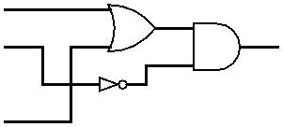
Circuit Simplification Example (4/4)
Draw out final circuit:
  D = ¬BC + ¬BA = ¬B(A + C)
Simplified Circuit:
  Reduction from 6 gates to 3!
How many gates
do we need for each?
5
3
A
B
D
C
Notes:
Also only has to go through 2 “stages” worth of gates as opposed to 4 previously.
Longest path here is B → NOT → AND → D. Before one of the longest paths was B → NOT → AND → OR → AND → D.

