Slide 1
Control Signals: Big picture!
Control signals are how we get the same hardware to behave differently and produce different instructions
For every instruction, all control signals are set to one of their possible values (Not always 0 or 1!) or an indeterminate (*) value indicating the control signal doesn’t affect the instruction’s execution
Each control signal has a sub-circuit based on ~nine bits from the instruction format:
  Upper 5 func7 bits (lower 2 are the same for all 295 instructions)
  All func3 bits
  “2nd” upper opcode bit (others are the same for all 295 instructions)

Slide 2
Control Signals: ADD
+4
Reg[]
pc
pc+4
pc
wb
1
alu
1
DataD
Reg[rs1]
ALU
2
alu
0
DMEM
0
IMEM
inst[11:7]
AddrD
Addr
1
pc+4
Branch Comp.
Reg[rs2]
DataR
wb
inst[19:15]
AddrA
DataA
0
0
DataW
mem
inst[24:20]
AddrB
DataB
1
inst[31:7]
Imm.
Gen
imm[31:0]
PCSel
inst[31:0]
ImmSel
RegWEn
BrUn
BrEq
BrLT
BSel
ASel
ALUSel
MemRW
WBSel

Slide 3
Inst[31:0] | PCSel | ImmSel | RegWEn | BrUn | BrEq | BrLT | BSel | ASel | ALUSel | MemRW | WBSel
add | +4 | * | 1 (Y) | * | * | * | Reg | Reg | Add | Read | ALU
sub | +4 | * | 1 | * | * | * | Reg | Reg | Sub | Read | ALU
(R-R Op) | +4 | * | 1 | * | * | * | Reg | Reg | (Op) | Read | ALU
addi | +4 | I | 1 | * | * | * | Imm | Reg | Add | Read | ALU
lw | +4 | I | 1 | * | * | * | Imm | Reg | Add | Read | Mem
sw | +4 | S | 0 (N) | * | * | * | Imm | Reg | Add | Write | *
beq | +4 | B | 0 | * | 0 | * | Imm | PC | Add | Read | *
beq | ALU | B | 0 | * | 1 | * | Imm | PC | Add | Read | *
bne | ALU | B | 0 | * | 0 | * | Imm | PC | Add | Read | *
bne | +4 | B | 0 | * | 1 | * | Imm | PC | Add | Read | *
blt | ALU | B | 0 | 0 | * | 1 | Imm | PC | Add | Read | *
bltu | ALU | B | 0 | 1 | * | 1 | Imm | PC | Add | Read | *
jalr | ALU | I | 1 | * | * | * | Imm | Reg | Add | Read | PC+4
jal | ALU | J | 1 | * | * | * | Imm | PC | Add | Read | PC+4
auipc | +4 | U | 1 | * | * | * | Imm | PC | Add | Read | ALU

Slide 4
“Iron Law” of Processor Performance
Time = Instructions Cycles Time
Program Program * Instruction * Cycle

Slide 5
Agenda
Quick Datapath Review
Control Implementation
Performance Analysis
Pipelined Execution
Pipelined Datapath

Slide 6
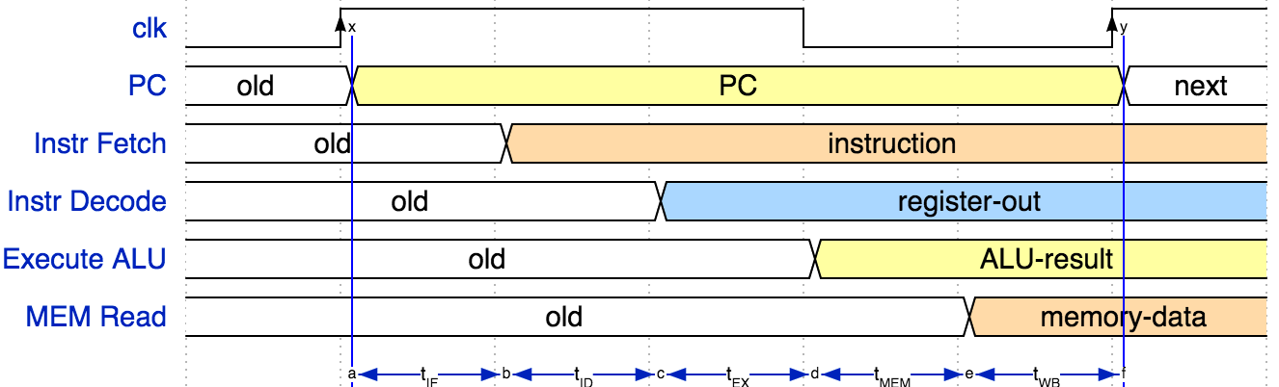
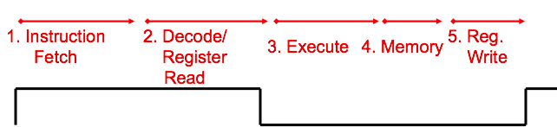
Instruction Timing
IF | ID | EX | MEM | WB | Total
IMEM | Reg Read | ALU | DMEM | Reg W
200 ps | 100 ps | 200 ps | 200 ps | 100 ps | 800 ps

Slide 7
Control Signals: ADD
+4
Reg[]
pc
pc+4
pc
wb
1
alu
1
DataD
Reg[rs1]
ALU
2
alu
0
DMEM
0
IMEM
inst[11:7]
AddrD
Addr
1
pc+4
Branch Comp.
Reg[rs2]
DataR
wb
inst[19:15]
AddrA
DataA
0
0
DataW
mem
inst[24:20]
AddrB
DataB
1
inst[31:7]
Imm.
Gen
imm[31:0]
PCSel
inst[31:0]
ImmSel
RegWEn
BrUn
BrEq
BrLT
BSel
ASel
ALUSel
MemRW
WBSel

Slide 8
Instruction Timing
Instr | IF = 200ps | ID = 100ps | ALU = 200ps | MEM=200ps | WB = 100ps | Total
add | X | X | X |  | X | 600ps
beq | X | X | X |  |  | 500ps
jal | X | X | X |  | X | 600ps
lw | X | X | X | X | X | 800ps
sw | X | X | X | X |  | 700ps
Maximum clock frequency
  f_{max} = 1/800ps = 1.25 GHz
Most blocks idle most of the time! ex. “IF” active every 600ps
Instruction 1
Instruction 2
IF
ID
ALU
MEM
WB
IF
ID
ALU
MEM
WB
Clk

Slide 9
Performance Measures
In our example, CPU executes instructions at 1.25 GHz
  1 instruction every 800 ps
Can we improve its performance?
  What do we mean with this statement?
  Not so obvious:
    Quicker response time, so one job finishes faster?
    More jobs per unit time (e.g. web server returning pages)?
    Longer battery life?

Slide 10
Speed Trade-off Example
For some task (e.g. image compression) …
 | Processor A | Processor B
# Instructions | 1 Million | 1.5 Million
Average CPI | 2.5 | 1
Clock rate f | 2.5 GHz | 2 GHz
Execution time | 1 ms | 0.75 ms
Processor B is faster for this task, despite executing more instructions and having a lower clock rate! Why? Each instruction is less complex! (~2.5 B instructions = 1 A instruction)

Slide 11
Agenda
Quick Datapath Review
Control Implementation
Administrivia
Performance Analysis
Pipelined Execution
Pipelined Datapath

Slide 12
Each stage operates on different instruction
lw t0, 8(t3)
sw t0, 4(t3)
slt t6, t0, t3
or t3, t4, t5
add t0, t1, t2
pc_{X}
pc_{M}
pc_{F}
pc_{D}
+4
+4
Reg[]
rs1_{X}
1
DataD
ALU
alu_{X}
DMEM
0
AddrD
alu_{M}
Addr
pc_{F}+4
IMEM
Branch Comp.
DataR
AddrA
DataA
DataW
DataB
AddrB
inst_{D}
rs2_{X}
rs2_{M}
imm_{X}
Imm.
inst_{X}
inst_{M}
inst_{W}
Pipeline registers separate stages, hold data for each instruction in flight

Slide 13

Pipelining with RISC-V
t_{instruction}
add t0, t1, t2
or t3, t4, t5
instruction sequence
sll t6, t0, t3
t_{cycle}
 | Single Cycle | Pipelining
Timing | t_{step} = 100 … 200 ps | t_{cycle} = 200 ps
 | Register access only 100 ps | All cycles same length
Instruction time, t_{instruction} | = t_{cycle} = 800 ps | 1000 ps
Clock rate, f_{s} | 1/800 ps = 1.25 GHz | 1/200 ps = 5 GHz
Notes:
Tc = “Time between completion of instructions”

Slide 14
RISC-V Pipeline
t_{instruction} = 1000 ps
Resource use in a particular time slot
add t0, t1, t2
Resource use by instruction over time
or t3, t4, t5
slt t6, t0, t3
instruction sequence
sw t0, 4(t3)
lw t0, 8(t3)
t_{cycle}
= 200 ps
addi t2, t2, 1

Slide 15
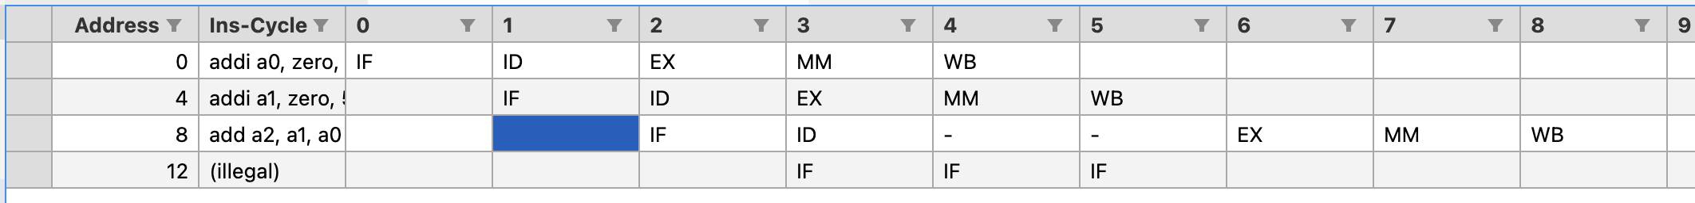

Slide 16
Instruction Level Parallelism (ILP)
Pipelining allows us to execute parts of multiple instructions at the same time using the same hardware!
  This is known as instruction level parallelism
Later: Other types of parallelism
  DLP: same operation on lots of data (SIMD)
  TLP: executing multiple threads “simultaneously” (OpenMP)

Slide 17

Agenda
Hazards Ahead!
RISC-V Pipeline
Hazards
  Structural
  Data
    R-type instructions
    Load
  Control
Superscalar processors

Slide 18
Pipelining Hazards
A hazard is a situation that prevents starting the next instruction in the next clock cycle
Structural hazard
  A required resource is busy
  (e.g. needed in multiple stages)
Data hazard
  Data dependency between instructions
  Need to wait for previous instruction to complete its data write
Control hazard
  Flow of execution depends on previous instruction

Slide 19
Structural Hazard: Regfile!
RegFile: Used in ID and WB!
Time (clock cycles)
I
n
s
t
r
O
r
d
e
r
Load
Add
Store
Sub
Or

Slide 20
Regfile Structural Hazards
Each instruction:
  can read up to two operands in decode stage
  can write one value in writeback stage
Avoid structural hazard by having separate “ports”
  two independent read ports and one independent write port
Three accesses per cycle can happen simultaneously
RW
RA
RB
Write Enable
5
5
5
portA
portW
32 x 32-bit
Registers
32
32
portB
Clk
32

Slide 21
Regfile Structural Hazards
Two alternate solutions:
  Build RegFile with independent read and write ports (assignment); good for single-stage)
  Double Pumping: split RegFile access in two! Prepare to write during 1st half, write on falling edge, read during 2nd half of each clock cycle
    Will save us a cycle later...
    Possible because RegFile access is VERY fast
    (takes less than half the time of ALU stage)
Conclusion: Read and Write to registers during same clock cycle is okay

Slide 22
Structural Hazard: Memory Access
Instruction and data memory used simultaneously
  Use two separate memories
add t0, t1, t2
or t3, t4, t5
slt t6, t0, t3
instruction sequence
sw t0, 4(t3)
lw t0, 8(t3)

Slide 23
Structural Hazards – Summary
Conflict for use of a resource
In RISC-V pipeline with a single memory unit
  Load/store requires data access
  Without separate memory units, instruction fetch would have to stall for that cycle
    All other operations in pipeline would have to wait
Pipelined datapaths require separate instruction/data memory units
  Or separate instruction/data caches
RISC ISAs (including RISC-V) designed to avoid structural hazards
  e.g. at most one memory access/instruction

Slide 24
2. Data Hazards (1/2)
Consider the following sequence of instructions:
add s0, s1, s2
sub s4, s0, s3
and s5, s0, s6
or s7, s0, s8
xor s9, s0, s10
Stored
during WB
Read during ID

Slide 25
2. Data Hazards (2/2)
Identifying data hazards:
Where is data WRITTEN?
Where is data READ?
Does the WRITE happen AFTER the READ?
Time (clock cycles)
add s0, s1, s2
sub s4, s0, s3
and s5, s0, s6
or s7, s0, s8
xor s9, s0, s10

Slide 26
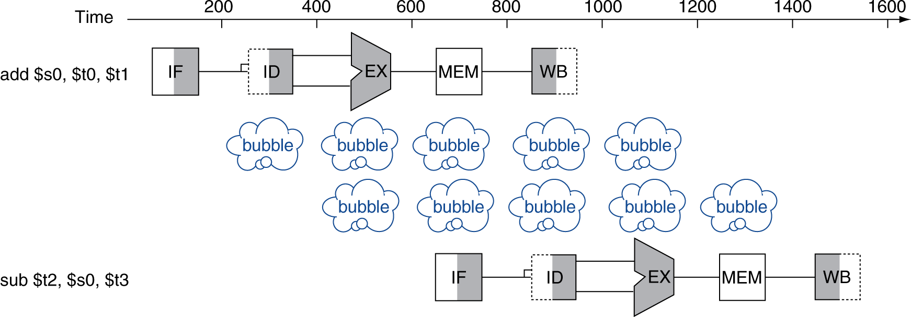


Solution 1: Stalling
Problem: Instruction depends on result from previous instruction
  add s0, s1, s2
  sub s4, s0, s3
Bubble:
  effecsively NOP: affecsed pipeline ssages do “nothing” (add x0 x0 x0)

Slide 27
Data Hazard Solution: Forwarding
Forward result as soon as it is available, even though it’s not stored in RegFile yet
add s0, s1, s2
sub s4, s0, s3
and s5, s0, s6
or s7, s0, s8
xor s9, s0, s10
Forwarding: grab operand from pipeline stage, rather than register file

Slide 28
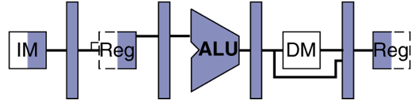
Data Hazard: Loads (1/4)
Recall: Dataflow backwards in time are hazards
Can’t solve all cases with forwarding
  Must stall instruction dependent on load (sub), then forward after the load is done (more hardware)
lw t0, 0(t1)
sub t3, t0, t2

Slide 29
Data Hazard: Loads (4/4)
Slot after a load is called a load delay slot
  If that instruction uses the result of the load, then the hardware will stall for one cycle
  Equivalent to inserting an explicit nop in the slot
    except the latter uses more code space
  Performance loss
Idea: Let the compiler/assembler put an unrelated instruction in that slot → no stall!

Slide 30
3. Control Hazards
Branch (beq, bne,...) determines flow of control
  Fetching next instruction depends on branch outcome
  Pipeline can’t always fetch correct instruction
    Result isn’t known until end of execute
Simple Solution: Stall or flush on every branch until we have the new PC value
  How long must we stall?

Slide 31
How many instructions after beq are affected by the control hazard?
1
2
3
4
5
beq
Instr 1
Instr 2
Instr 3
Instr 4

Slide 32
Branch Stall
How many bubbles required for branch?
Time (clock cycles)
beq
Instr 1
Instr 2
Instr 3
Instr 4

Slide 33
3. Control Hazard: Branching
RISC-V Solution: Branch Prediction – guess outcome of a branch, fix afterwards if necessary
  Must cancel (flush) all instructions in pipeline that depended on guess that was wrong
  How many instructions do we end up flushing?

Slide 34
Kill Instructions after Branch if Taken
Taken branch
beq t0, t1, label
Convert to NOP
sub t2, s0, t5
Convert to NOP
or t6, s0, t3
PC updated reflecting branch outcome
label: xxxxxx
Two instructions are affected by an incorrect branch, just like we’d have to insert two NOP’s/stalls in the pipeline to wait on the correct value!

Slide 35
Branch Prediction
Taken branch
beq t0, t1, label
Guess next PC!
label: …..
…..
Check guess correct
In the correct case, we don’t have any stalls/NOP’s at all!
Prediction, if done correctly, is better on average than stalling

