Slide 1
Review of Last Lecture
Implementing controller for your datapath
  Take decoded signals from instruction and generate control signals
Pipelining improves performance by exploiting Instruction Level Parallelism
  5-stage pipeline for RISC-V: IF, ID, EX, MEM, WB
  Executes multiple instructions in parallel
  Each instruction has the same latency
  What can go wrong???

Slide 2

Agenda
Hazards Ahead!
RISC-V Pipeline
Hazards
  Structural
  Data
    R-type instructions
    Load
  Control
Superscalar processors

Slide 3
Pipelining Hazards
A hazard is a situation that prevents starting the next instruction in the next clock cycle
Structural hazard
  A required resource is busy
  (e.g. needed in multiple stages)
Data hazard
  Data dependency between instructions
  Need to wait for previous instruction to complete its data write
Control hazard
  Flow of execution depends on previous instruction

Slide 4
Agenda
RISC-V Pipeline
Hazards
  Structural
  Data
    R-type instructions
    Load
  Control
Superscalar processors

Slide 5
Structural Hazard
Problem: Two or more instructions in the pipeline compete for access to a single physical resource
Solution 1: Instructions take turns using resource, some instructions have to stall (wait)
Solution 2: Add more hardware to machine
Can always solve a structural hazard by adding more hardware

Slide 6

Structural Hazard: Regfile!
RegFile: Used in ID and WB!
Time (clock cycles)
I
n
s
t
r
O
r
d
e
r
Load
Add
Store
Sub
Or

Slide 7
Regfile Structural Hazards
Each instruction:
  can read up to two operands in decode stage
  can write one value in writeback stage
Avoid structural hazard by having separate “ports”
  two independent read ports and one independent write port
Three accesses per cycle can happen simultaneously
RW
RA
RB
Write Enable
5
5
5
portA
portW
32 x 32-bit
Registers
32
32
portB
Clk
32

Slide 8
Regfile Structural Hazards
Two alternate solutions:
  Build RegFile with independent read and write ports (what you will do in the project; good for single-stage)
  Double Pumping: split RegFile access in two! Prepare to write during 1st half, write on falling edge, read during 2nd half of each clock cycle
    Will save us a cycle later...
    Possible because RegFile access is VERY fast
    (takes less than half the time of ALU stage)
Conclusion: Read and Write to registers during same clock cycle is okay

Slide 9
Structural Hazard: Memory Access
Instruction and data memory used simultaneously
  Use two separate memories
add t0, t1, t2
or t3, t4, t5
slt t6, t0, t3
instruction sequence
sw t0, 4(t3)
lw t0, 8(t3)

Slide 10
Instruction and Data Caches
Processor
Memory (DRAM)
Control
Instruction Cache
Program
Datapath
PC
Bytes
Data
Cache
Registers
Arithmetic & Logic Unit
(ALU)
Data
Caches: small and fast “buffer” memories

Slide 11
Structural Hazards – Summary
Conflict for use of a resource
In RISC-V pipeline with a single memory unit
  Load/store requires data access
  Without separate memory units, instruction fetch would have to stall for that cycle
    All other operations in pipeline would have to wait
Pipelined datapaths require separate instruction/data memory units
  Or separate instruction/data caches
RISC ISAs (including RISC-V) designed to avoid structural hazards
  e.g. at most one memory access/instruction

Slide 12
Agenda
RISC-V Pipeline
Hazards
  Structural
  Data
    R-type instructions
    Load
  Control
Superscalar processors

Slide 13
2. Data Hazards (1/2)
Consider the following sequence of instructions:
add s0, s1, s2
sub s4, s0, s3
and s5, s0, s6
or s7, s0, s8
xor s9, s0, s10
Stored
during WB
Read during ID

Slide 14
2. Data Hazards (2/2)
Identifying data hazards:
Where is data WRITTEN?
Where is data READ?
Does the WRITE happen AFTER the READ?
Time (clock cycles)
add s0, s1, s2
sub s4, s0, s3
and s5, s0, s6
or s7, s0, s8
xor s9, s0, s10

Slide 15
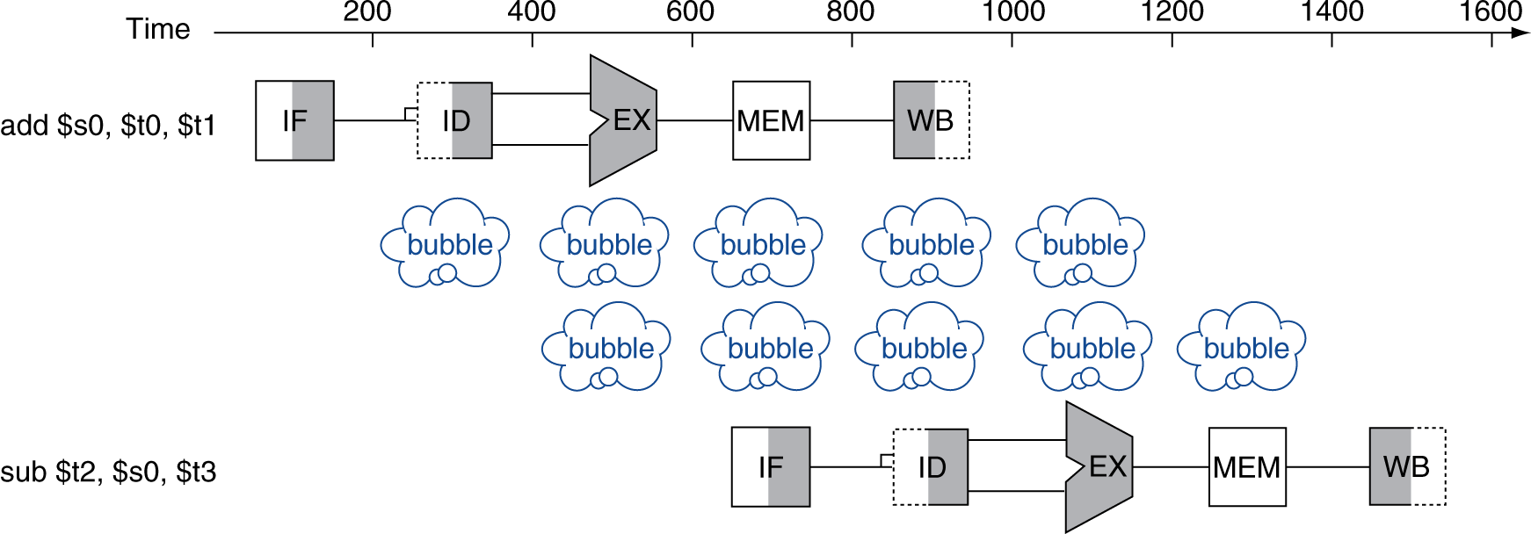


Solution 1: Stalling
Problem: Instruction depends on result from previous instruction
  add s0, s1, s2
  sub s4, s0, s3
Bubble:
  effecsively NOP: affecsed pipeline ssages do “nothing” (add x0 x0 x0)

Slide 16
Stalls and Performance
Stalls reduce performance
  Decrease throughput of “valid” or useful instructions
  Can also be seen as increasing the latency of our stalled instruction
But stalls are required to get correct results
Compiler can arrange code to avoid hazards and stalls!
  Requires knowledge of the pipeline structure, and knowledge of instruction interactions

Slide 17
Data Hazard Solution: Forwarding
Forward result as soon as it is available, even though it’s not stored in RegFile yet
add s0, s1, s2
sub s4, s0, s3
and s5, s0, s6
or s7, s0, s8
xor s9, s0, s10
Forwarding: grab operand from pipeline stage, rather than register file

Slide 18
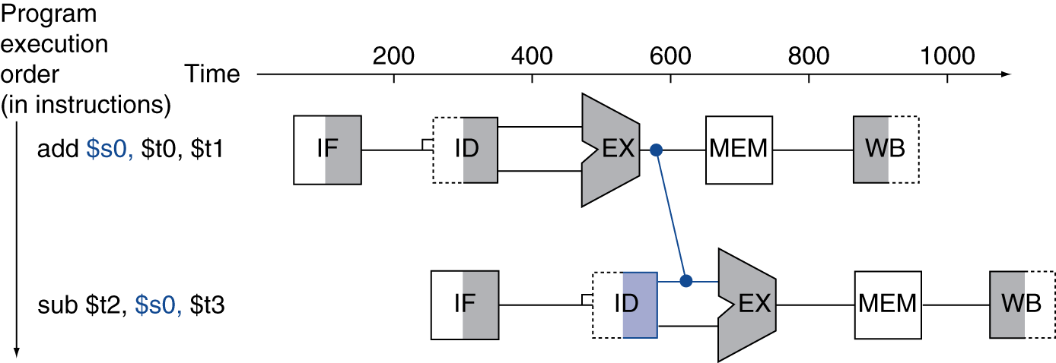
Forwarding (aka Bypassing)
Use result when it is computed
  Don’t wait for it to be stored in a register
  Requires extra hardware in the datapath (and extra control!)

Slide 19
Forwarding Path
pc_{X}
pc_{M}
pc_{F}
pc_{D}
+4
+4
Reg[]
rs1_{X}
1
DataD
ALU
alu_{X}
DMEM
0
AddrD
alu_{M}
Addr
pc_{F}+4
IMEM
Branch Comp.
DataR
AddrA
DataA
DataW
DataB
AddrB
inst_{D}
rs2_{X}
rs2_{M}
imm_{X}
Imm.
inst_{X}
inst_{M}
inst_{W}
Forwarding Control Logic

Slide 20
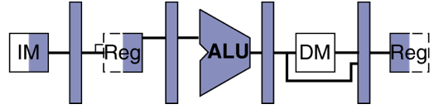
Detect Need for Forwarding
(example)
Compare destination of older instructions in pipeline with sources of new instruction in decode stage.
Must ignore writes to x0!
D
X
M
W
inst_{X}.rd
add s0, s1, s2
inst_{D}.rs1
or s3, s0, s5
sub s6, s0, s3

Slide 21
In our 5-stage pipeline, how many subsequent instructions do we need to look at to detect data hazards for this add? Assume we have double-pumping.
1 instruction
2 instructions
3 instructions
4 instructions
5 instructions
add s0, s1, s2
sub s4, s0, s3
and s5, s0, s6
or s7, s0, s8
xor s9, s0, s10

Slide 22
In our 5-stage pipeline, how many subsequent instructions do we need to look at to detect data hazards for this add? Assume we have double-pumping.
1 instruction
2 instructions
3 instructions
4 instructions
5 instructions
add s0, s1, s2
sub s4, s0, s3
and s5, s0, s6
or s7, s0, s8
xor s9, s0, s10

Slide 23
Agenda
RISC-V Pipeline
Hazards
  Ssructural
  Data
    R-type instructions
    Load
  Control
Superscalar processors

Slide 24
Data Hazard: Loads (1/4)
Recall: Dataflow backwards in time are hazards
Can’t solve all cases with forwarding
  Must stall instruction dependent on load (sub), then forward after the load is done (more hardware)
lw t0, 0(t1)
sub t3, t0, t2

Slide 25
Data Hazard: Loads (2/4)
This is what happens in hardware in a “hardware interlock”
Hardware stalls pipeline
  Called “hardware interlock”
lw t0, 0(t1)
sub t3, t0, t2
bubble
and t5, t0, t4
bubble
bubble
or t7, t0, t6

Slide 26
Data Hazard: Loads (3/4)
Stall is equivalent to nop
lw t0, 0(t1)
nop
bubble
bubble
bubble
bubble
bubble
sub t3, t0, t2
and t5, t0, t4
or t7, t0, t6

Slide 27
Data Hazard: Loads (4/4)
Slot after a load is called a load delay slot
  If that instruction uses the result of the load, then the hardware will stall for one cycle
  Equivalent to inserting an explicit nop in the slot
    except the latter uses more code space
  Performance loss
Idea: Let the compiler/assembler put an unrelated instruction in that slot → no stall!

Slide 28
Code Scheduling to Avoid Stalls
Reorder code to avoid use of load result in the next instruction!
RISC-V code for D=A+B; E=A+C;
11 cycles
13 cycles
Original Order:
lw t1, 0(t0)
lw t2, 4(t0)
add t3, t1, t2
sw t3, 12(t0)
lw t4, 8(t0)
add t5, t1, t4
sw t5, 16(t0)
Alternative:
lw t1, 0(t0)
lw t2, 4(t0)
lw t4, 8(t0)
add t3, t1, t2
sw t3, 12(t0)
add t5, t1, t4
sw t5, 16(t0)
Stall!
Stall!

Slide 29

Break!

Slide 30
Agenda
RISC-V Pipeline
Hazards
  Structural
  Data
    R-type instructions
    Load
  Control
Superscalar processors

Slide 31
3. Control Hazards
Branch (beq, bne,...) determines flow of control
  Fetching next instruction depends on branch outcome
  Pipeline can’t always fetch correct instruction
    Result isn’t known until end of execute
Simple Solution: Stall or flush on every branch until we have the new PC value
  How long must we stall?

Slide 32
How many instructions after beq are affected by the control hazard?
1
2
3
4
5
beq
Instr 1
Instr 2
Instr 3
Instr 4

Slide 33
Branch Stall
How many bubbles required for branch?
Time (clock cycles)
beq
Instr 1
Instr 2
Instr 3
Instr 4

Slide 34
3. Control Hazard: Branching
Option #1: Move branch comparator to ID stage
As soon as instruction is decoded, immediately make a decision and set the new value of PC
  Benefit: Branch decision made in 2nd stage, so only one nop is needed instead of two
  Side Note: Have to compute new PC value (PC + imm) in ID instead of EX
    Adds extra copy of new-PC logic in ID stage
    Branches are idle in EX, MEM, and WB

Slide 35
Improved Branch Stall
When is comparison result available?
beq
Only one stall needed!
Instr 1
Instr 2
Instr 3
Instr 4

Slide 36
Data Hazard: Branches!
Recall: Dataflow backwards in time are hazards
Now that t0 is needed earlier (ID instead of EX), we can’t forward it to the beq’s ID stage
  Must stall after add, then forward (more hardware)
add t0, t0, t1
beq x0, t0, foo

Slide 37
Observations
Takeaway: Moving branch comparator to ID stage would add redundant hardware and introduce new problems
Can we work with the nature of branches?
  If branch not taken, then instructions fetched sequentially after branch are correct
  If branch or jump taken, then need to flush incorrect instructions from pipeline by converting to NOPs

Slide 38
Agenda
Structural Hazards
Data Hazards
  Forwarding
Administrivia
Data Hazards (Continued)
  Load Delay Slot
Control Hazards
  Branch and Jump Delay Slots
  Branch Prediction

Slide 39
3. Control Hazard: Branching
RISC-V Solution: Branch Prediction – guess outcome of a branch, fix afterwards if necessary
  Must cancel (flush) all instructions in pipeline that depended on guess that was wrong
  How many instructions do we end up flushing?

Slide 40
Kill Instructions after Branch if Taken
Taken branch
beq t0, t1, label
Convert to NOP
sub t2, s0, t5
Convert to NOP
or t6, s0, t3
PC updated reflecting branch outcome
label: xxxxxx
Two instructions are affected by an incorrect branch, just like we’d have to insert two NOP’s/stalls in the pipeline to wait on the correct value!

Slide 41
Branch Prediction
Taken branch
beq t0, t1, label
Guess next PC!
label: …..
…..
Check guess correct
In the correct case, we don’t have any stalls/NOP’s at all!
Prediction, if done correctly, is better on average than stalling

Slide 42
Dynamic Branch Prediction
Branch penalty is more significant in deeper pipelines
Use dynamic branch prediction
  Have branch prediction mechanism (a.k.a. branch history table) that stores outcomes (taken/not taken) of previous branches
  To execute a branch
    Check table and predict the same outcome for next fetch
    If wrong, flush pipeline and flip prediction

Slide 43
1-Bit Predictor: Shortcoming
Examine the code below, assuming both loops will be executed multiple times:
outer: …
…
inner: …
…
beq …, …, inner
…
beq …, …, outer
for (int i = 0; i < 10; i++) {
for (int j = 0; j < 10; j++) {
….
}
}
Inner loop branches are predicted wrong twice!
  Predict as taken on last iteration of inner loop
  Then predict as not taken on first iteration of inner loop next time around

Slide 44
Question: For the code sequence below, choose the statement that best describes requirements for correctness
lw t0,0(t0) add t1,t0,t0
A
No stalls as is
B
No stalls with forwarding
C
Must stall

Slide 45
Code Sequence 1
Time (clock cycles)
I
n
s
t
r
O
r
d
e
r
lw
Must stall at least once! Forwarding doesn’t help us here!
add
instr
instr
instr

Slide 46
Question: For the code sequence below, choose the statement that best describes requirements for correctness
 | add t1, t0, t0 addi t2,t0,5 addi t4,t1,5
A
No stalls as is
B
No stalls with forwarding
C
Must stall

Slide 47
Code Sequence 2
Time (clock cycles)
I
n
s
t
r
O
r
d
e
r
add
No stalls are necessary if we forward!
addi
addi
instr
instr

Slide 48
Question: For the code sequence below, choose the statement that best describes requirements for correctness
3: addi t1,t0,1 addi t2,t0,2 addi t3,t0,2 addi t3,t0,4 addi t5,t1,5
A
No stalls as is
B
No stalls with forwarding
C
Must stall

Slide 49
Code Sequence 3
Time (clock cycles)
I
n
s
t
r
O
r
d
e
r
addi
No stalls as is! Our reading takes place after our write has finished!
addi
addi
addi
addi

Slide 50
Agenda
RISC-V Pipeline
Hazards
  Structural
  Data
    R-type instructions
    Load
  Control
Superscalar processors

Slide 51
Increasing Processor Performance
Clock rate
  Limited by technology and power dissipation
Pipelining
  “Overlap” instruction execution
  Deeper pipeline: 5 => 10 => 15 stages
    Less work per stage → shorter clock cycle
    But more potential for hazards (CPI > 1)
Multi-issue ”super-scalar” processor
  Multiple execution units (ALUs)
    Several instructions executed simultaneously
    CPI < 1 (ideally)

Slide 52
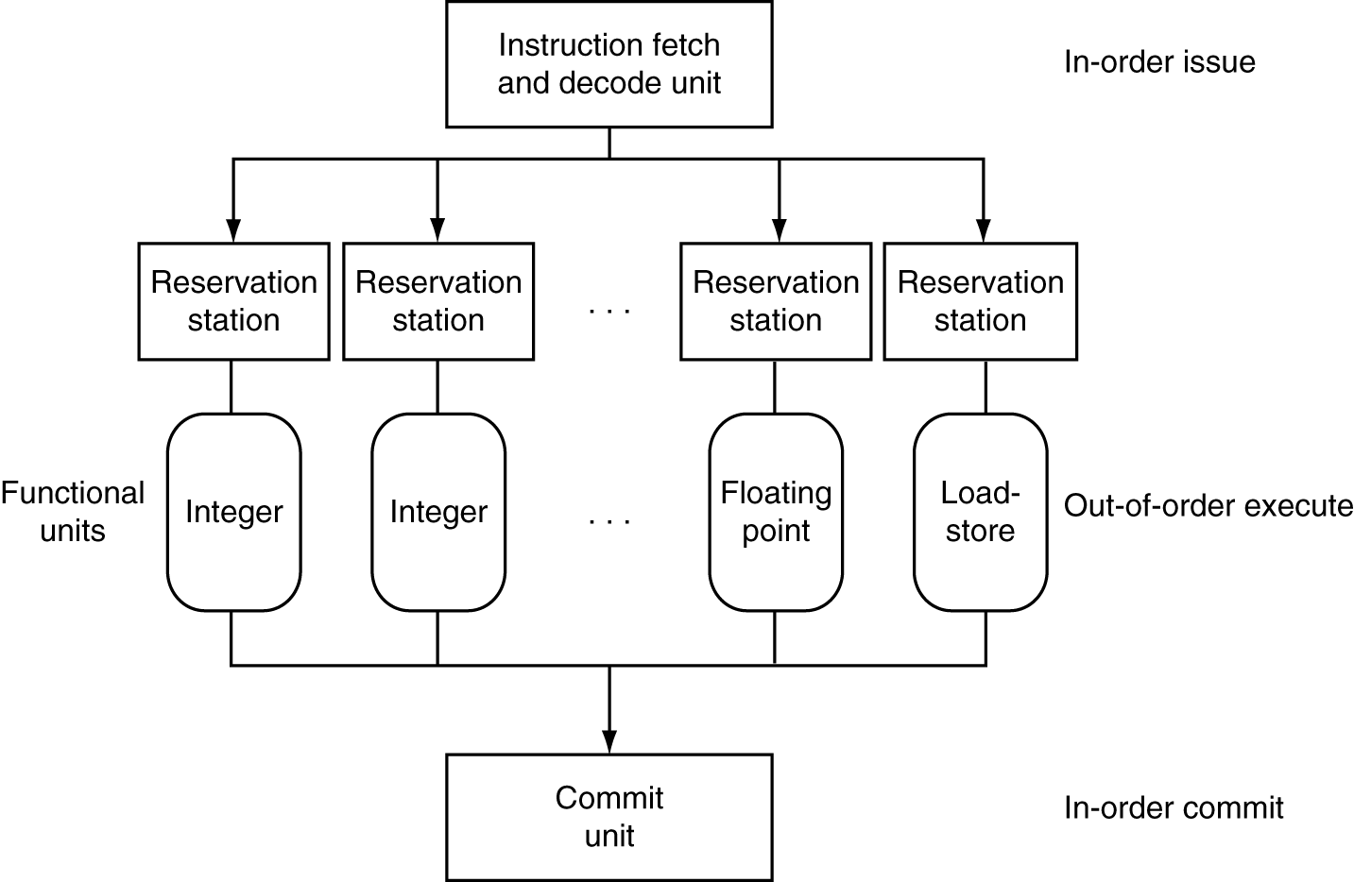
Superscalar Processor
P&H p. 340
DECODE ORDER
addi t0 t0 t1
lw t2 0(a0)
sub t4 a1 a0
addi t0 t0 t1
EXECUTION ORDER
sub AND addi (1) AND load
addi (2)
COMMIT ORDER
addi t0 t0 t1
lw t2 0(a0)
sub t4 a1 a0
addi t0 t0 t1

Slide 53
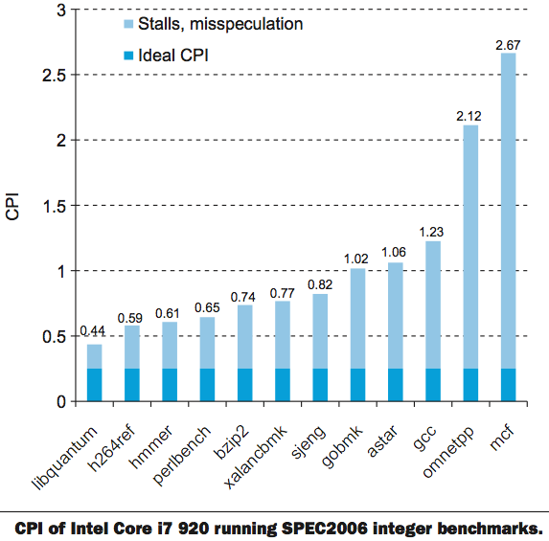
Benchmark: CPI of Intel Core i7
CPI = 1
P&H p. 350

Slide 54
Summary
Hazards reduce effectiveness of pipelining
  Cause stalls/bubbles
Structural Hazards
  Conflict in use of a datapath component
Data Hazards
  Need to wait for result of a previous instruction
Control Hazards
  Address of next instruction uncertain/unknown
Superscalar processors use multiple execution units for additional instruction level parallelism
  Performance benefit highly code dependent

Slide 55
Extra Slides

Slide 56
Pipelining and ISA Design
RISC-V ISA designed for pipelining
  All instructions are 32-bits
    Easy to fetch and decode in one cycle
    Versus x86: 1- to 15-byte instructions
  Few and regular instruction formats
    Decode and read registers in one step
  Load/store addressing
    Calculate address in 3rd stage, access memory in 4th stage
  Alignment of memory operands
    Memory access takes only one cycle

Slide 57
Superscalar Processor
Multiple issue “superscalar”
  Replicate pipeline stages ⇒ multiple pipelines
  Start multiple instructions per clock cycle
  CPI < 1, so use Instructions Per Cycle (IPC)
  E.g., 4GHz 4-way multiple-issue
    16 BIPS, peak CPI = 0.25, peak IPC = 4
  Dependencies reduce this in practice
“Out-of-Order” execution
  Reorder instructions dynamically in hardware to reduce impact of hazards
CS152 discusses these techniques!

