Slide 1
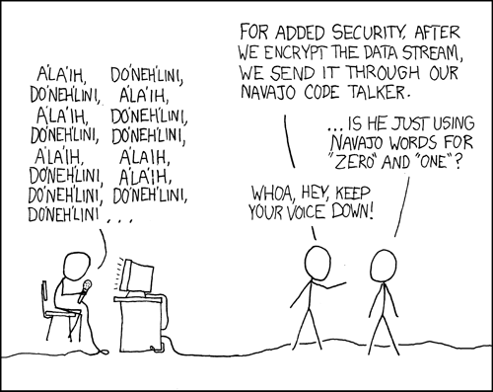
Integers I
http://xkcd.com/257/
Acknowledgments: These slides have been modified by Arrvindh Shriraman, Justin Tsia

Slide 2

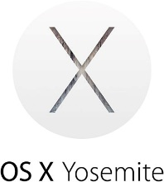

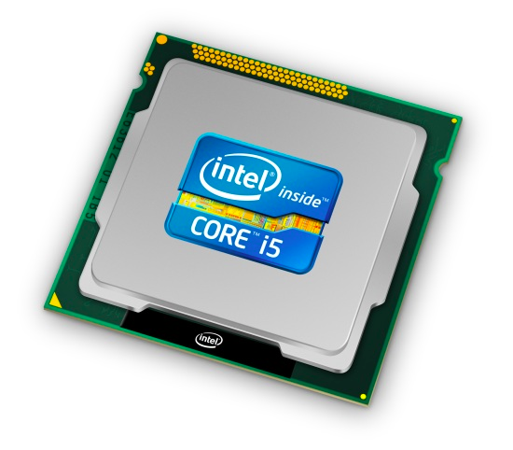
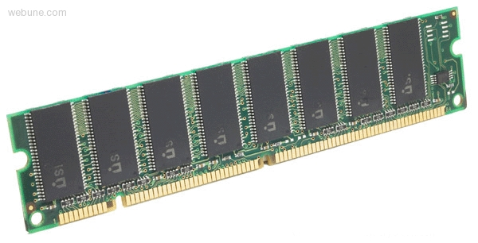
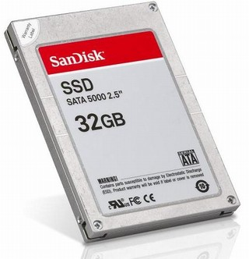
Roadmap
C:
Java:
Memory & data
Arrays & structs
Integers & floats
RISC V assembly
Procedures & stacks
Executables
Memory & caches
Processor Pipeline
Performance
Parallelism
car *c = malloc(sizeof(car));
c->miles = 100;
c->gals = 17;
float mpg = get_mpg(c);
free(c);
Car c = new Car();
c.setMiles(100);
c.setGals(17);
float mpg =
c.getMPG();
Assembly language:
OS:
Machine code:
0111010000011000
100011010000010000000010
1000100111000010
110000011111101000011111
Computer system:

Slide 3
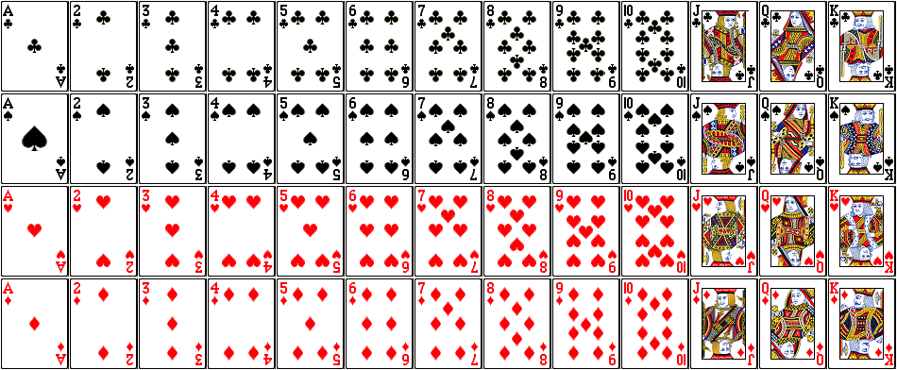
But before we get to integers….
Encode a standard deck of playing cards
52 cards in 4 suits
  How do we encode suits, face cards?
What operations do we want to make easy to implement?
  Which is the higher value card?
  Are they the same suit?
Notes:
Value comparison: War
Same suit: Crazy Eights

Slide 4
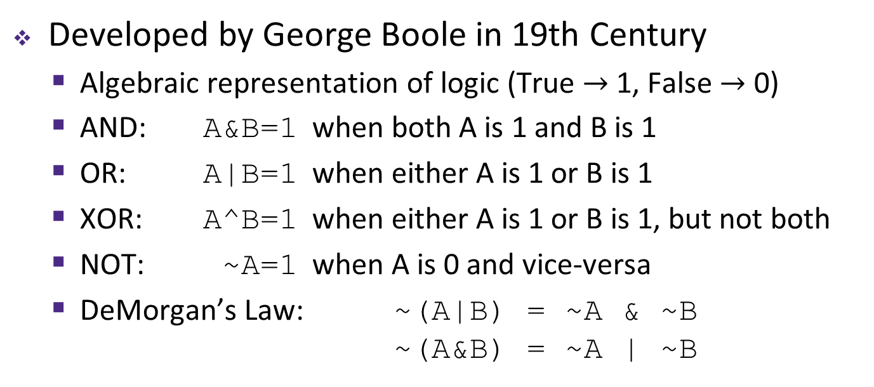
Boolean Algebra
Developed by George Boole in 19th Century
  Algebraic representation of logic (True $→$ 1, False $→$ 0)
  AND: A&B=1 when both A is 1 and B is 1
  OR: A|B=1 when either A is 1 or B is 1
  XOR: A^B=1 when either A is 1 or B is 1, but not both
  NOT: ~A=1 when A is 0 and vice-versa
  DeMorgan’s Law: ~(A|B) = ~A & ~B
  ~(A&B) = ~A | ~B
AND
OR
XOR
NOT
& | 0 | 1
0 | 0 | 0
1 | 0 | 1
| | 0 | 1
0 | 0 | 1
1 | 1 | 1
^ | 0 | 1
0 | 0 | 1
1 | 1 | 0
~
0 | 1
1 | 0

Slide 5
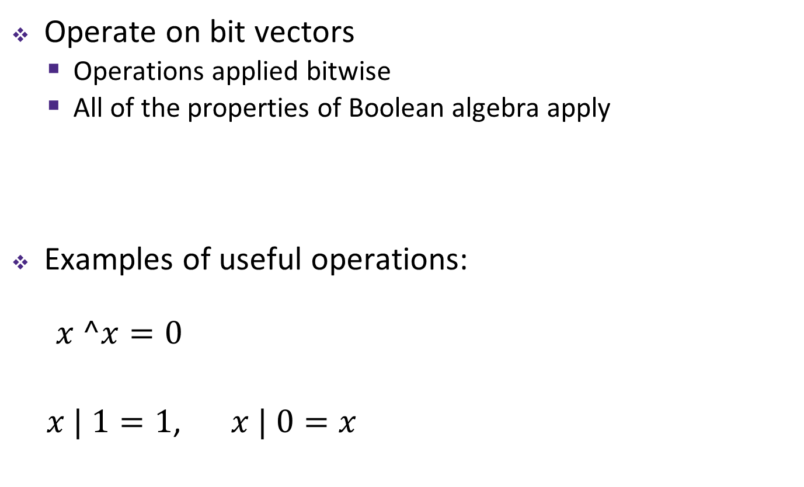
General Boolean Algebras
Operate on bit vectors
  Operations applied bitwise
  All of the properties of Boolean algebra apply
Examples of useful operations:
$x ^x=0$
  $x | 1=1$, $x | 0=x$
01101001
& 01010101
01101001
| 01010101
01101001
^ 01010101
~ 01010101
01010101
^ 01010101
00000000
01010101
| 11110000
11110101
Notes:
Now, how do we use the boolean operators?
Typically on ”bit vectors” (treat a byte, or multiple bytes) as a bit vector

Slide 6
Bit-Level Operations in C
& (AND), | (OR), ^ (XOR), ~ (NOT)
  View arguments as bit vectors, apply operations bitwise
  Apply to any “integral” data type
    long, int, short, char, unsigned
Examples with char a, b, c;
  a = (char) 0x41; // 0x41->0b 0100 0001
  b = ~a; // 0b ->0x
  a = (char) 0x69; // 0x69->0b 0110 1001
  b = (char) 0x55; // 0x55->0b 0101 0101
  c = a & b; // 0b ->0x
  a = (char) 0x41; // 0x41->0b 0100 0001
  b = a; // 0b 0100 0001
  c = a ^ b; // 0b ->0x
Notes:
Some bit-twiddling puzzles in Lab 2 and 3

Slide 7
Contrast: Logic Operations
Logical operators in C: && (AND), || (OR), ! (NOT)
  0 is False, anything nonzero is True
  Always return 0 or 1
  Early termination (a.k.a. short-circuit evaluation) of &&, ||
    int x = (42 == 6) || boom();
    int y = (42 == 6) && boom();
Examples (char data type)
  !0x41 -> 0x00
  !0x00 -> 0x01
  !!0x41 -> 0x01
  0xCC && 0x33 -> 0x01
  0x00 || 0x33 -> 0x01

Slide 8
Two possible representations
1 bit per card (52): bit corresponding to card set to 1
  “One-hot” encoding (similar to set notation)
  Drawbacks:
    Hard to compare values and suits
    Large number of bits required
1 bit per suit (4), 1 bit per number (13): 2 bits set
  Pair of one-hot encoded values
  Easier to compare suits and values, but still lots of bits used
low-order 52 bits of 64-bit word
4 suits
13 numbers
Notes:
52 bits takes 7 bytes
17 bites takes 3 bytes

Slide 9
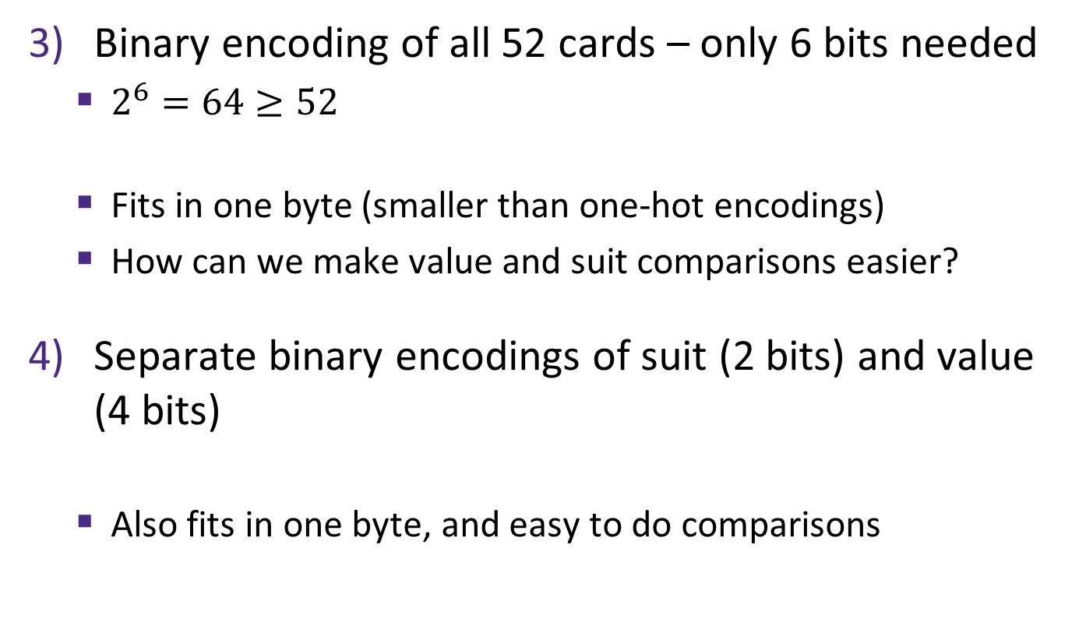
Two better representations
Binary encoding of all 52 cards – only 6 bits needed
  $2^{6}=64≥52$
  Fits in one byte (smaller than one-hot encodings)
  How can we make value and suit comparisons easier?
Separate binary encodings of suit (2 bits) and value (4 bits)
  Also fits in one byte, and easy to do comparisons
low-order 6 bits of a byte
suit
value
♣ | 00
♦ | 01
♥ | 10
♠ | 11
K | Q | J | . . . | 3 | 2 | A
1101 | 1100 | 1011 | ... | 0011 | 0010 | 0001
Notes:
Notice the arbitrariness of binary encoding choices: A is 1 instead of 0, ordering of suits

Slide 10
Compare Card Suits
mask: a bit vector designed to achieve a desired behavior when used with a bitwise operator on another bit vector v.
Here we turns all but the bits of interest in v to 0.
  char hand[5]; // represents a 5-card hand
  char card1, card2; // two cards to compare
  card1 = hand[0];
  card2 = hand[1];
  ...
  if ( isSameSuit(card1, card2) ) { ... }
  #define SUIT_MASK 0x30
  int isSameSuit(char card1, char card2) {
  return (card1 & SUIT_MASK) == (card2 & SUIT_MASK);
  }
returns int
SUIT_MASK = 0x30 =
0
0
1
1
0
0
0
0
suit
value
Notes:
#define does text substitution
x & 0 = 0
x & 1 = x

Slide 11
Compare Card Suits
mask: a bit vector designed to achieve a desired behavior when used with a bitwise operator on another bit vector v.
Here we turns all but the bits of interest in v to 0.
  #define SUIT_MASK 0x30
  int isSameSuit(char card1, char card2) {
  return (!((card1 & SUIT_MASK) ^ (card2 & SUIT_MASK)));
  // return (card1 & SUIT_MASK) == (card2 & SUIT_MASK);
  }
🃂
🃎
0 | 0 | 0 | 1 | 0 | 0 | 1 | 0
0 | 0 | 0 | 1 | 1 | 1 | 0 | 1
&
&
0 | 0 | 1 | 1 | 0 | 0 | 0 | 0
SUIT_MASK
0 | 0 | 1 | 1 | 0 | 0 | 0 | 0
=
=
0 | 0 | 0 | 1 | 0 | 0 | 0 | 0
0 | 0 | 0 | 1 | 0 | 0 | 0 | 0
^
0 | 0 | 0 | 0 | 0 | 0 | 0 | 0
!(x^y) equivalent to x==y
!
0 | 0 | 0 | 0 | 0 | 0 | 0 | 1
Notes:
What if you don’t wanna use “==”

Slide 12
Compare Card Values
mask: a bit vector designed to achieve a desired behavior when used with a bitwise operator on another bit vector v.
  char hand[5]; // represents a 5-card hand
  char card1, card2; // two cards to compare
  card1 = hand[0];
  card2 = hand[1];
  ...
  if ( greaterValue(card1, card2) ) { ... }
  #define VALUE_MASK 0x0F
  int greaterValue(char card1, char card2) {
  return ((unsigned char)(card1 & VALUE_MASK) >
  (unsigned char)(card2 & VALUE_MASK));
  }
VALUE_MASK = 0x0F =
0
0
0
0
1
1
1
1
suit
value
Notes:
0x0F = 0000_1111
Cast to unsigned because of two’s complement, later

Slide 13
Compare Card Values
mask: a bit vector designed to achieve a desired behavior when used with a bitwise operator on another bit vector v.
  #define VALUE_MASK 0x0F
  int greaterValue(char card1, char card2) {
  return ((unsigned int)(card1 & VALUE_MASK) >
  (unsigned int)(card2 & VALUE_MASK));
  }
🃂
🃎
0 | 0 | 1 | 0 | 0 | 0 | 1 | 0
0 | 0 | 1 | 0 | 1 | 1 | 0 | 1
&
&
0 | 0 | 0 | 0 | 1 | 1 | 1 | 1
VALUE_MASK
0 | 0 | 0 | 0 | 1 | 1 | 1 | 1
=
=
0 | 0 | 0 | 0 | 0 | 0 | 1 | 0
0 | 0 | 0 | 0 | 1 | 1 | 0 | 1
2₁₀ > 13₁₀
0 (false)

Slide 14
Integers
Binary representation of integers
  Unsigned and signed
  Casting in C
Consequences of finite width representation
  Overflow, sign extension
Shifting and arithmetic operations
Notes:
14

Slide 15


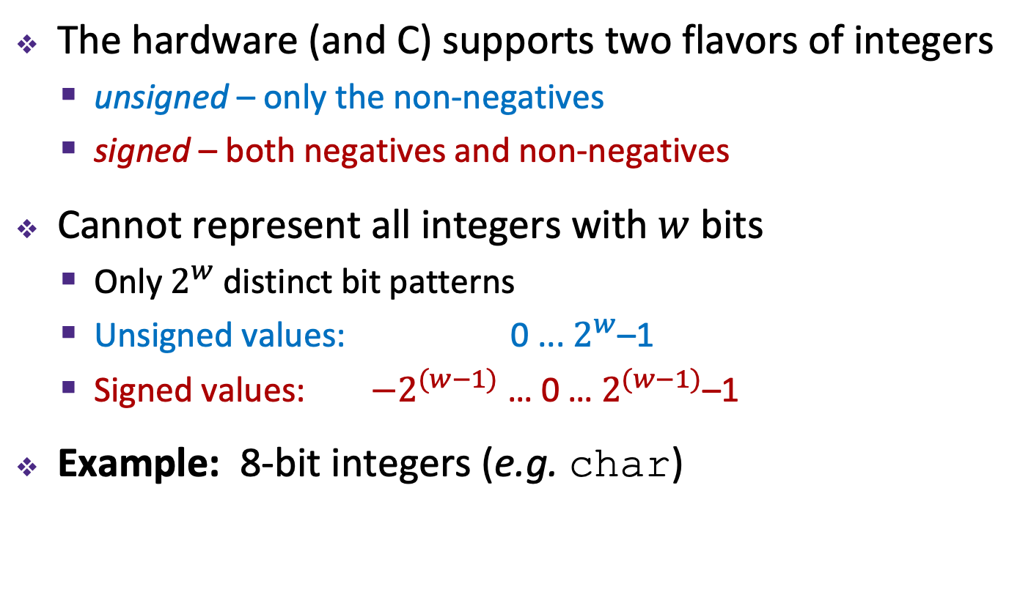








Encoding Integers
The hardware (and C) supports two flavors of integers
  unsigned – only the non-negatives
  signed – both negatives and non-negatives
Cannot represent all integers with $w$ bits
  Only $2^{w}$ distinct bit patterns
  Unsigned values: 0 ... $2^{w}$–1
  Signed values: $−2^{(w−1)}$ … 0 … $2^{(w−1)}$–1
Example: 8-bit integers (e.g. char)
-$∞$
+$∞$
$$−128$$
$$0$$
$$+128$$
$$+256$$
$${−2}^{8−1}$$
$$0$$
$${+2}^{8−1}$$
$$+2^{8}$$
Notes:
Okay, so now let’s talk some more about how we represent numbers, or integers to be specific
Multiple sizes of integers, using different numbers of bytes
But for each size, there are two ways of interpreting the bits…
Same width, just shifted

Slide 16
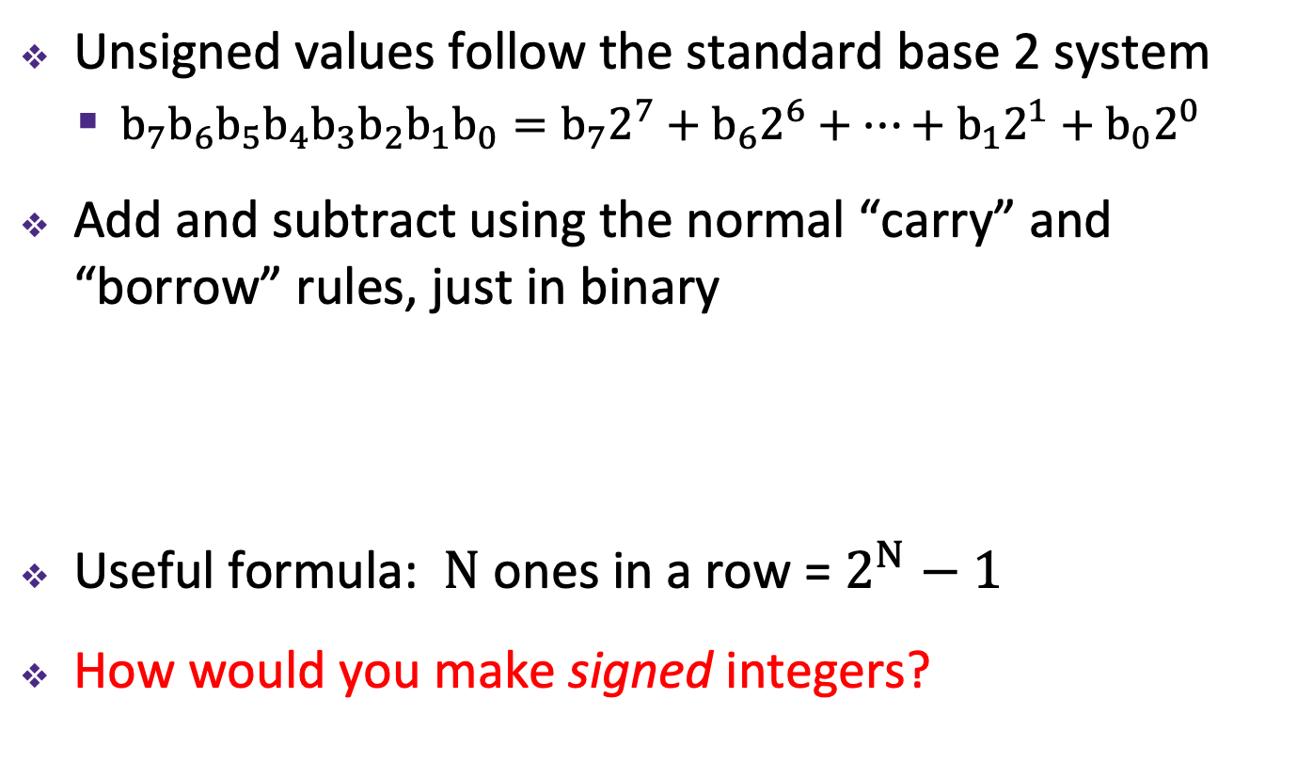
Unsigned Integers
Unsigned values follow the standard base 2 system
  $b_{7}b_{6}b_{5}b_{4}b_{3}b_{2}b_{1}b_{0}=b_{7}2^{7}+b_{6}2^{6}+…+b_{1}2^{1}+b_{0}2^{0}$
Add and subtract using the normal “carry” and “borrow” rules, just in binary
Useful formula: $N$ ones in a row = $2^{N}−1$
How would you make signed integers?
63
+ 8
71
00111111
+00001000
01000111
Notes:
“1’s place”, the “2’s place”, “4’s place”…
An important use of unsigned values in C is pointers - there are no negative memory addresses
What if we want to represent negative numbers?

Slide 17
Sign and Magnitude
Most Significant Bit
Designate the high-order bit (MSB) as the “sign bit”
  sign=0: positive numbers; sign=1: negative numbers
Benefits:
  Using MSB as sign bit matches positive numbers with unsigned
  All zeros encoding is still = 0
Examples (8 bits):
  0x00 = 00000000₂ is non-negative, because the sign bit is 0
  0x7F = 01111111₂ is non-negative (+127₁₀)
  0x85 = 10000101₂ is negative (-5₁₀)
  0x80 = 10000000₂ is negative...
... zero???
Notes:
One possibility; some good things
0b0010 = 2 in signed or unsigned

Slide 18
Sign and Magnitude
MSB is the sign bit, rest of the bits are magnitude
Drawbacks?
15
0
– 7
+ 0
14
1111
0000
1
– 6
1111
0000
+ 1
13
1110
0001
2
– 5
1110
0001
+ 2
1101
0010
1101
0010
12
3
– 4
1100
0011
+ 3
1100
0011
Sign and Magnitude
Unsigned
11
1011
0100
4
– 3
1011
0100
+ 4
1010
0101
1010
0101
10
1001
0110
5
– 2
1001
0110
+ 5
9
1000
0111
6
– 1
1000
0111
+ 6
8
7
– 0
+ 7
Notes:
To help visualize these numbers, we’ll use this number wheel
Binary goes up clockwise
See how we start with +0 – +7 on right side
Then the left side, which starts with 1, are all negative, starting with -0 .. -7

Slide 19
Sign and Magnitude
MSB is the sign bit, rest of the bits are magnitude
Drawbacks:
  Two representations of 0 (bad for checking equality)
– 7
+ 0
– 6
1111
0000
+ 1
– 5
1110
0001
+ 2
1101
0010
– 4
1100
0011
+ 3
Sign and Magnitude
– 3
1011
0100
+ 4
1010
0101
– 2
1001
0110
+ 5
– 1
1000
0111
+ 6
– 0
+ 7

Slide 20
Sign and Magnitude
MSB is the sign bit, rest of the bits are magnitude
Drawbacks:
  Two representations of 0 (bad for checking equality)
  Arithmetic is cumbersome
    Example: 4-3 != 4+(-3)
    Negatives “increment” in wrong
    direction!
– 7
+ 0
– 6
1111
0000
+ 1
– 5
1110
0001
+ 2
4
- 3
1
0100
- 0011
0001
4
+ -3
-7
0100
+ 1011
1111
1101
0010
– 4
1100
0011
+ 3
Sign and Magnitude
– 3
1011
0100
+ 4
✓
✗
1010
0101
– 2
1001
0110
+ 5
– 1
1000
0111
+ 6
– 0
+ 7
Notes:
Arithmetic is cumbersome
4 – 3 should be 1, as we see on the left
But 4 + -3 should be equivalent, but if we naively add the two together, it doesn’t work
We have to make sure we change all plus-negatives to subtractions
So, how do we solve these problems?
It turns out there’s a really clever other way of interpreting the MSB

Slide 21
Two’s Complement
Let’s fix these problems:
  “Flip” negative encodings so incrementing works
– 0
+ 0
– 1
1111
0000
+ 1
– 2
1110
0001
+ 2
1101
0010
– 3
1100
0011
+ 3
– 4
1011
0100
+ 4
1010
0101
– 5
1001
0110
+ 5
– 6
1000
0111
+ 6
– 7
+ 7
Notes:
Negative addition should work now

Slide 22
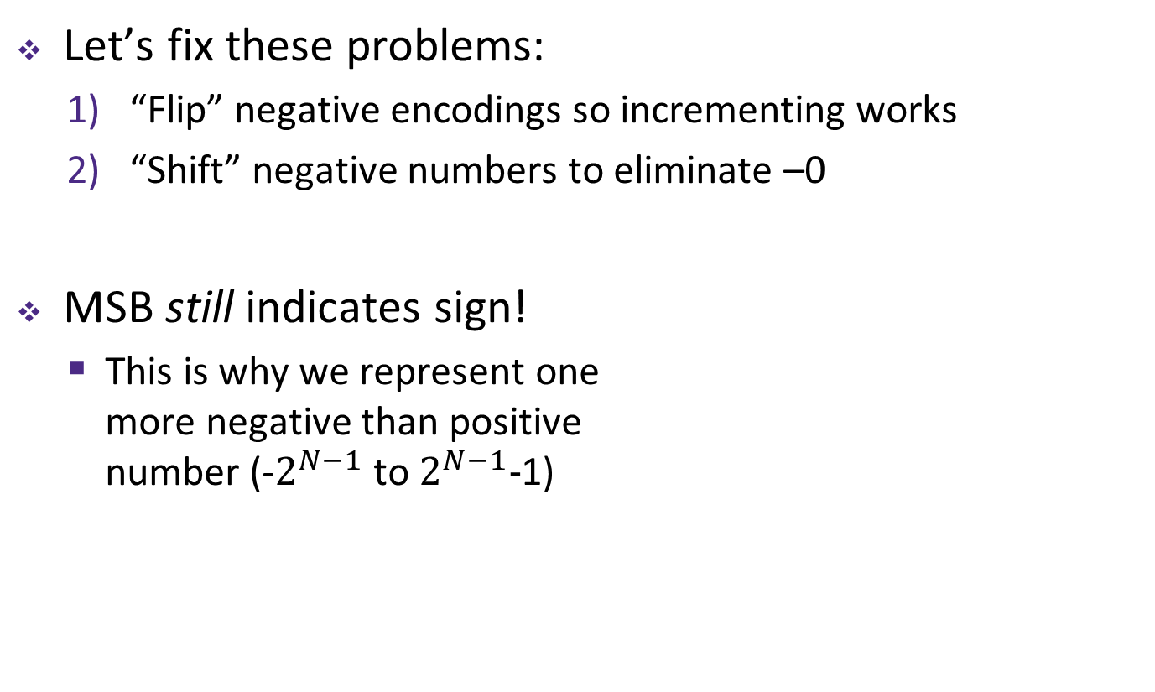
Two’s Complement
Let’s fix these problems:
  “Flip” negative encodings so incrementing works
  “Shift” negative numbers to eliminate –0
MSB still indicates sign!
  This is why we represent one
  more negative than positive
  number (-$2^{N−1}$ to $2^{N−1}−$1)
– 1
+ 0
– 2
1111
0000
+ 1
– 3
1110
0001
+ 2
1101
0010
– 4
1100
0011
+ 3
– 5
1011
0100
+ 4
1010
0101
– 6
1001
0110
+ 5
– 7
1000
0111
+ 6
– 8
+ 7
Notes:
We shift negatives so 0 == 0

Slide 23
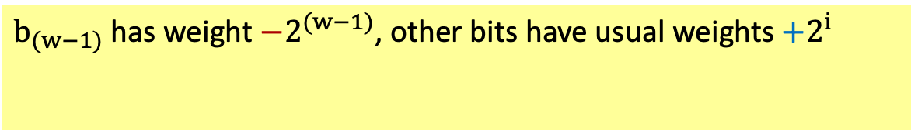
Two’s Complement Negatives
Accomplished with one neat mathematical trick!
  4-bit Examples:
    1010₂ unsigned:
    1*2³+0*2²+1*2¹+0*2⁰ = 10
    1010₂ two’s complement:
    -1*2³+0*2²+1*2¹+0*2⁰ = –6
  -1 represented as:
  1111₂ = -2³+(2³ – 1)
    MSB makes it super negative, add up
    all the other bits to get back up to -1
$b_{(w−1)}$ has weight $−2^{(w−1)}$, other bits have usual weights $+2^{i}$
b_{w-1}
b_{w-2}
. . .
b₀
– 1
+ 0
– 2
1111
0000
+ 1
– 3
1110
0001
+ 2
1101
0010
– 4
1100
0011
+ 3
Two’s
Complement
– 5
1011
0100
+ 4
1010
0101
– 6
1001
0110
+ 5
– 7
1000
0111
+ 6
– 8
+ 7
Notes:
Big negative shift!
8 + 2 = 10
-8 + 2 = -6

Slide 24
Why Two’s Complement is So Great
Roughly same number of (+) and (–) numbers
Positive number encodings match unsigned
Simple arithmetic (x + -y = x – y)
Single zero
All zeros encoding = 0
Simple negation procedure:
  Get negative representation
  of any integer by taking
  bitwise complement and
  then adding one!
  ( ~x + 1 == -x )
– 1
+ 0
– 2
1111
0000
+ 1
– 3
1110
0001
+ 2
1101
0010
– 4
1100
0011
+ 3
Two’s
Complement
– 5
1011
0100
+ 4
1010
0101
– 6
1001
0110
+ 5
– 7
1000
0111
+ 6
– 8
+ 7
Notes:
Memorize this trick. It’s very handy

Slide 25
Summary
Bit-level operators allow for fine-grained manipulations of data
  Bitwise AND (&), OR (|), and NOT (~) different than logical AND (&&), OR (||), and NOT (!)
  Especially useful with bit masks
Choice of encoding scheme is important
  Tradeoffs based on size requirements and desired operations
Integers represented using unsigned and two’s complement representations
  Limited by fixed bit width
  We’ll examine arithmetic operations next lecture
Notes:
Watch out for & vs &&

