Slide 1
Structs & Alignment
Acknowledgments: These slides have been modified by Arrvindh Shriraman, Justin Tsia

Slide 2
Data Structures in Assembly
Arrays
  One-dimensional
  Multi-dimensional (nested)
  Multi-level
Structs
  Alignment
Notes:
Compare all the arrays

Slide 3

Array Allocation
Basic Principle
  T A[N]; $→$ array of data type T and length N
  Contiguously allocated region of N*sizeof(T) bytes
  Identifier A returns address of array (type T*)
char msg[12];
x
x + 12
int val[5];
x
x + 4
x + 8
x + 12
x + 16
x + 20
double a[3];
x
x + 8
x + 16
x + 24
char* p[3];
(or char *p[3];)
x
x + 8
x + 16
x + 24
Notes:
Basically all you need to know about arrays!

Slide 4

Array Access
Basic Principle
  T A[N]; $→$ array of data type T and length N
  Identifier A returns address of array (type T*)
Reference Type Value
int x[5];
3
7
1
9
5
a
a+4
a+8
a+12
a+16
a+20
x[4] | int | 5
x | int* | a
x+1 | int* | a + 4
&x[2] | int* | a + 8
x[5] | int | ?? (whatever’s in memory at addr x+20)
*(x+1) | int | 7
x+i | int* | a + 4*i
Notes:
Arrays explain the funky part of pointer arithmetic

Slide 5
Array Example
typedef int zip_dig[5];
zip_dig cmu = { 1, 5, 2, 1, 3 };
zip_dig sfu = { 9, 8, 1, 9, 5 };
zip_dig ucb = { 9, 4, 7, 2, 0 };
initialization
typedef: Declaration “zip_dig sfu” equivalent to “int sfu[5]”

Slide 6
Referencing Examples
zip_dig cmu;
1
5
2
1
3
16
20
24
28
32
36
zip_dig sfu;
9
8
1
9
5
36
40
44
48
52
56
zip_dig ucb;
9
4
7
2
0
56
60
64
68
72
76
Reference Address Value Guaranteed?
  sfu[3]
  sfu[6]
  sfu[-1]
  cmu[15]
No bounds checking
Example arrays happened to be allocated in successive 20 byte blocks
  Not guaranteed to happen in general
Notes:
Don’t do this!

Slide 7
C Details: Arrays and Pointers
Arrays are (almost) identical to pointers
  char *string and char string[] are nearly identical declarations
  Differ in subtle ways: initialization, sizeof(), etc.
An array name looks like a pointer to the first (0th) element
  ar[0] same as *ar; ar[2] same as *(ar+2)
An array name is read-only (no assignment)
  Cannot use "ar = <anything>"
Notes:
Sizeof

Slide 8
C Details: Arrays and Functions
Declared arrays only allocated while the scope is valid:
  char* foo() {
  char string[32]; ...;
  return string;
  }
An array is passed to a function as a pointer:
  Array size gets lost!
int foo(int ar[], unsigned int size) {
... ar[size-1] ...
}
BAD!
Really int *ar
Must explicitly
pass the size!
Notes:
Arrays can be local variables

Slide 9
Referencing Examples
typedef int zip_dig[5];
zip_dig cmu;
1
5
2
1
3
16
20
24
28
32
36
zip_dig sfu;
9
8
1
9
5
36
40
44
48
52
56
zip_dig ucb;
9
4
7
2
0
56
60
64
68
72
76
Reference Address Value Guaranteed?
  sfu[3]
  sfu[6]
  sfu[-1]
  cmu[15]
36 + 4* 3 = 48 9 Yes
36 + 4* 6 = 60 4 No
36 + 4*-1 = 32 3 No
16 + 4*15 = 76 ?? No
No bounds checking
Example arrays happened to be allocated in successive 20 byte blocks
  Not guaranteed to happen in general

Slide 10
Nested Array Example
typedef int zip_dig[5];
zip_dig sea[4] =
{{ 9, 8, 1, 9, 5 },
{ 9, 8, 1, 0, 5 },
{ 9, 8, 1, 0, 3 },
{ 9, 8, 1, 1, 5 }};
Remember, T A[N] is an array with elements of type T, with length N
What is the layout in memory?
same as:
int sea[4][5];

Slide 11
Nested Array Example
typedef int zip_dig[5];
zip_dig sea[4] =
{{ 9, 8, 1, 9, 5 },
{ 9, 8, 1, 0, 5 },
{ 9, 8, 1, 0, 3 },
{ 9, 8, 1, 1, 5 }};
Remember, T A[N] is an array with elements of type T, with length N
sea[3][2];
Row 0
Row 1
Row 2
Row 3
9
8
1
9
5
9
8
1
0
5
9
8
1
0
3
9
8
1
1
5
76
96
116
136
156
“Row-major” ordering of all elements
Elements in the same row are contiguous
Guaranteed (in C)

Slide 12
Two-Dimensional (Nested) Arrays
Declaration: T A[R][C];
  2D array of data type T
  R rows, C columns
  Each element requires
  sizeof(T) bytes
Array size?
A[0][0]
• • •
A[0][C-1]
•
•
•
•
•
•
A[R-1][0]
• • •
A[R-1][C-1]
Notes:
Down, then across

Slide 13
Two-Dimensional (Nested) Arrays
Declaration: T A[R][C];
  2D array of data type T
  R rows, C columns
  Each element requires
  sizeof(T) bytes
Array size:
  R*C*sizeof(T) bytes
Arrangement: row-major ordering
A[0][0]
• • •
A[0][C-1]
•
•
•
•
•
•
A[R-1][0]
• • •
A[R-1][C-1]
int A[R][C];
• • •
A
[0]
[0]
A
[0]
[C-1]
• • •
A
[1]
[0]
A
[1]
[C-1]
• • •
• • •
A
[R-1]
[0]
A
[R-1]
[C-1]
4*R*C bytes
Notes:
Memory is linear

Slide 14
Multi-Level Array Example
Multi-Level Array Declaration(s):
int cmu[5] = { 1, 5, 2, 1, 3 };
int sfu[5] = { 9, 8, 1, 9, 5 };
int ucb[5] = { 9, 4, 7, 2, 0 };
int* univ[3] = {sfu, cmu, ucb};
Is a multi-level array the
same thing as a 2D array?
NO
2D Array Declaration:
zip_dig univ2D[3] = {
{ 9, 8, 1, 9, 5 },
{ 1, 5, 2, 1, 3 },
{ 9, 4, 7, 2, 0 }
};
One array declaration = one contiguous block of memory

Slide 15
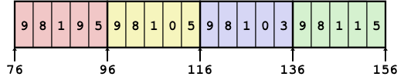
Array Element Accesses
Nested array
Multi-level array
int get_sea_digit
(int index, int digit)
{
return sea[index][digit];
}
int get_univ_digit
(int index, int digit)
{
return univ[index][digit];
}
cmu
univ
1
5
2
1
3
160
36
sfu
16
20
24
28
32
36
168
16
9
8
1
9
5
176
60
ucb
36
40
44
48
52
56
9
4
7
2
0
60
64
68
72
76
80
Access looks the same, but it isn’t:
Mem[sea+20*index+4*digit]
Mem[Mem[univ+8*index]+4*digit]
Notes:
Depends on how array is declared, look at type
Multi-dimensional arrays are a special construct!

Slide 16
Multi-Level Referencing Examples
cmu
1
5
2
1
3
univ
16
20
24
28
32
36
160
36
sfu
9
8
1
9
5
168
16
ucb
36
40
44
48
52
56
176
60
9
4
7
2
0
60
64
68
72
76
80
Reference Address Value Guaranteed?
  univ[2][3]
  univ[1][5]
  univ[2][-2]
  univ[3][-1]
  univ[1][12]
  C code does not do any bounds checking
  Location of each lower-level array in memory is not guaranteed
Notes:
72 2 yes
36 9 no
52 5 no
?? ?? No
64 4 no

Slide 17
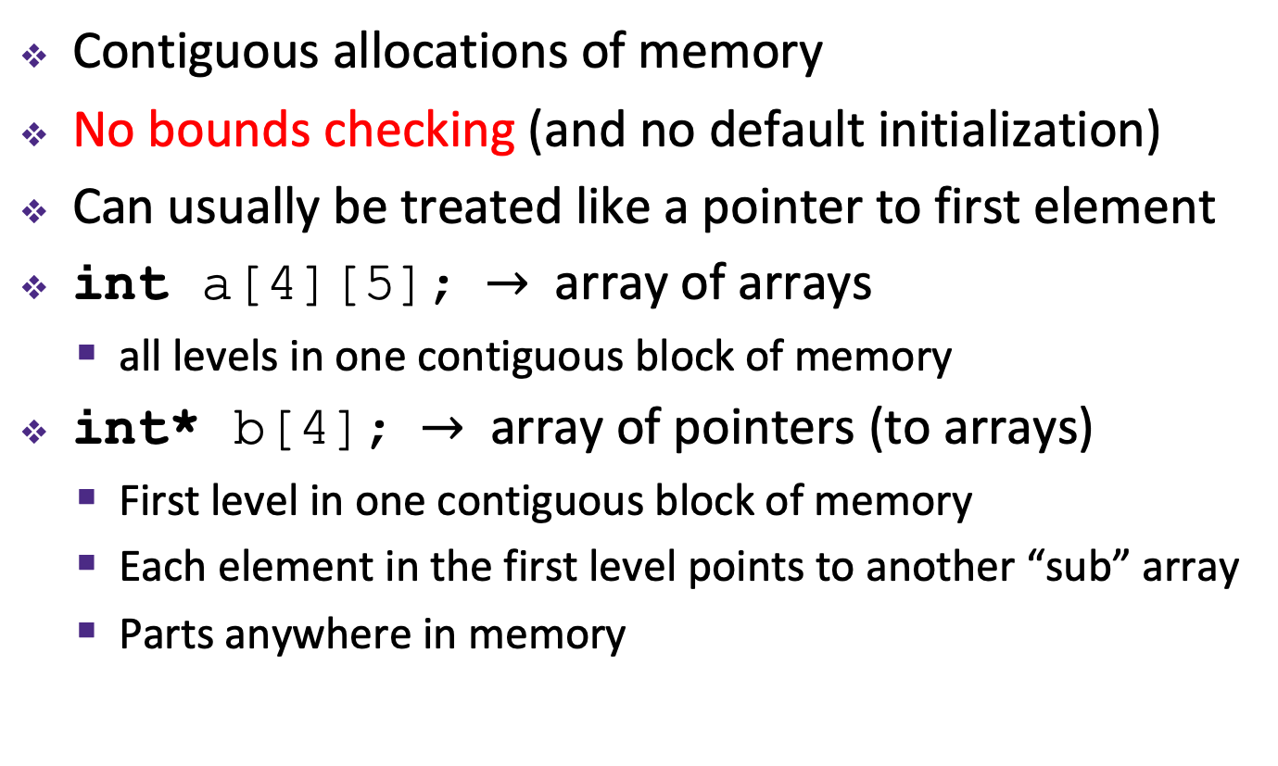
Summary
Contiguous allocations of memory
No bounds checking (and no default initialization)
Can usually be treated like a pointer to first element
int a[4][5]; $→$ array of arrays
  all levels in one contiguous block of memory
int* b[4]; $→$ array of pointers (to arrays)
  First level in one contiguous block of memory
  Each element in the first level points to another “sub” array
  Parts anywhere in memory

Slide 18
Data Structures in Assembly
Arrays
  One-dimensional
  Multi-dimensional (nested)
  Multi-level
Structs
  Alignment
Unions

Slide 19
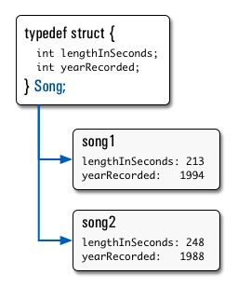
Structs in C
Way of defining compound data types
A structured group of variables, possibly including other structs
typedef struct {
int lengthInSeconds;
int yearRecorded;
} Song;
Song song1;
song1.lengthInSeconds = 213;
song1.yearRecorded = 1994;
Song song2;
song2.lengthInSeconds = 248;
song2.yearRecorded = 1988;
Notes:
typedef

Slide 20
Accessing Structure Members
Given a struct instance, access
member using the . operator:
    struct rec r1;
    r1.i = val;
Given a pointer to a struct:
    struct rec *r;
    r = &r1; // or malloc space for r to point to
We have two options:
    Use * and . operators: (*r).i = val;
    Use -> operator for short: r->i = val;
In assembly: register holds address of the first byte
  Access members with offsets
struct rec {
int a[4];
long i;
struct rec *next;
};
Notes:
How does a “.” access get translated into assembly? It looks exactly like a pointer access: an offset is added to the beginning of the struct to reach the appropriate member, then the access is performed. When a “.” access is performed, no “pointer” (i.e. no address kept in some register) is needed: the struct’s location on the current function’s stack frame (or in the args section of the caller’s stack frame) is always known, so the offsets can always be calculated relative to %rsp.

Slide 21
Structure Representation
struct rec {
int a[4];
long i;
struct rec *next;
};
struct rec *r;
r
a
i
next
0
16
24
32
Characteristics
  Contiguously-allocated region of memory
  Refer to members within structure by names
  Members may be of different types

Slide 22
Structure Representation
struct rec {
int a[4];
long i;
struct rec *next;
};
struct rec *r;
r
a
i
next
0
16
24
32
Structure represented as block of memory
  Big enough to hold all of the fields
Fields ordered according to declaration order
  Even if another ordering would be more compact
Compiler determines overall size + positions of fields
  Machine-level program has no understanding of the structures in the source code
Notes:
No structs or field names in assembly! Just offsets

Slide 23
Accessing a Structure Member
struct rec {
int a[4];
long i;
struct rec *next;
};
struct rec *r;
r
r->i
a
i
next
0
16
24
32
long get_i(struct rec *r)
{
return r->i;
}
Compiler knows the offset of each member within a struct
  Compute as *(r+offset)
    Referring to absolute offset, so no pointer arithmetic
add a0, a1, 16 # Coming up in Week 3
ret

Slide 24
Generating Pointer to Array Element
struct rec {
int a[4];
long i;
struct rec *next;
};
struct rec *r;
r
r+4*index
a
i
next
0
16
24
32
int* find_addr_of_array_elem
(struct rec *r, long index)
{
return &r->a[index];
}
Generating Pointer to
Array Element
  Offset of each structure member determined at compile time
  Compute as:
  r+4*index
&(r->a[index])
Notes:
Note the order of operation: & applies to the entire expression
Also: 2 instances of “syntactic sugar”
Could use additional offset if not first elem of struct

Slide 25
Struct Definitions
Structure definition:
  Does NOT declare a variable
  Variable type is “struct name”
Joint struct definition and typedef
  Don’t need to give struct a name in this case
struct name {
/* fields */
};
pointer
Easy to forget semicolon!
struct name name1, *pn, name_ar[3];
array
struct nm {
/* fields */
};
typedef struct nm name;
name n1;
typedef struct {
/* fields */
} name;
name n1;

Slide 26
Scope of Struct Definition
Why is placement of struct definition important?
  What actually happens when you declare a variable?
    Creating space for it somewhere!
  Without definition, program doesn’t know how much space
Almost always define structs in global scope near the top of your C file
  Struct definitions follow normal rules of scope
struct data {
int ar[4];
long d;
};
Size = _____ bytes
struct rec {
int a[4];
long i;
struct rec* next;
};
Size = _____ bytes
Notes:
Fill in sizes

Slide 27
Nested Struct
struct foo {
long a;
long b;
struct bar my_bar;
};
struct bar {
long x;
long y;
};
struct foo *f;
&f->my_bar
&f->my_bar.y
a
b
x
y
0
8
16
24
32
Notes:
Note the difference of -> and .

Slide 28
Nested Struct
struct foo {
long a;
long b;
struct foo my_foo;
};
a
b
?????????
0
8
16
Notes:
Infinite struct!!!
This is why you need a pointer

Slide 29

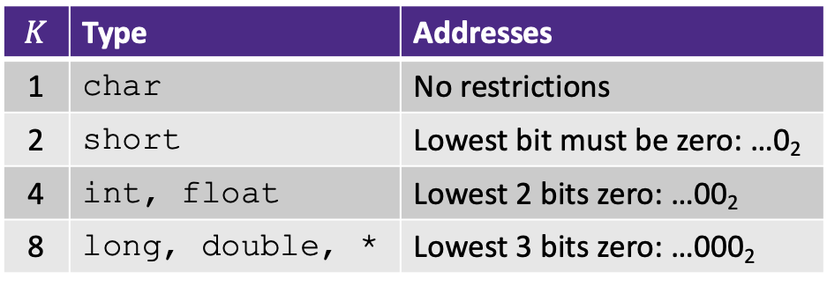
Review: Memory Alignment
Aligned means that any primitive object of $K$ bytes must have an address that is a multiple of $K$
Aligned addresses for data types:
$$K$$ | Type | Addresses
1 | char | No restrictions
2 | short | Lowest bit must be zero: …0₂
4 | int, float | Lowest 2 bits zero: …00₂
8 | long, double, * | Lowest 3 bits zero: …000₂
Notes:
Lowest log(k) bits should be 0

Slide 30
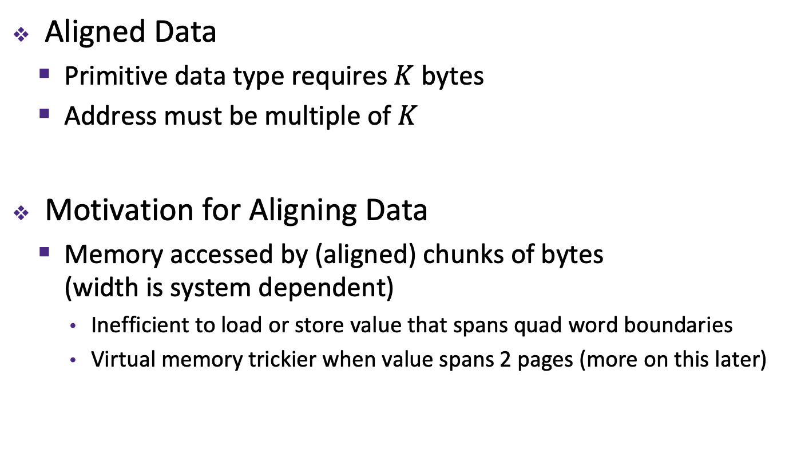
Alignment Principles
Aligned Data
  Primitive data type requires $K$ bytes
  Address must be multiple of $K$
Motivation for Aligning Data
  Memory accessed by (aligned) chunks of bytes
  (width is system dependent)
    Inefficient to load or store value that spans quad word boundaries
    Virtual memory trickier when value spans 2 pages (more on this later)
Notes:
Analogy?

Slide 31
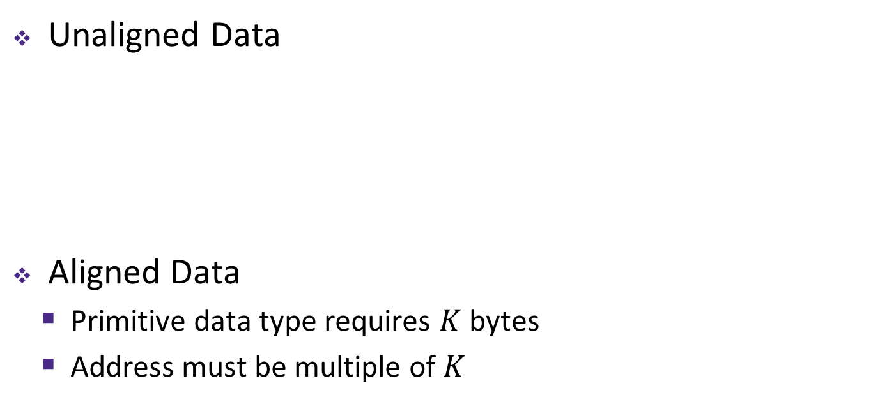
Structures & Alignment
Unaligned Data
Aligned Data
  Primitive data type requires $K$ bytes
  Address must be multiple of $K$
struct S1 {
char c;
int i[2];
double v;
} *p;
c
i[0]
i[1]
v
p
p+1
p+5
p+9
p+17
c
3 bytes
i[0]
i[1]
4 bytes
v
p+0
p+4
p+8
p+16
p+24
Multiple of 4
Multiple of 8
Multiple of 8
internal fragmentation
Multiple of 8
Notes:
struct S1 { … } *p; - this defines a new type “struct S1”, and creates a variable p with type “struct S1 *”
#include <stddef.h>// for offsetof
printf("sizeof p = %d\n", (int) sizeof(p));
printf("offset of v in p = %d\n", (int) offsetof(struct S1, v));

Slide 32
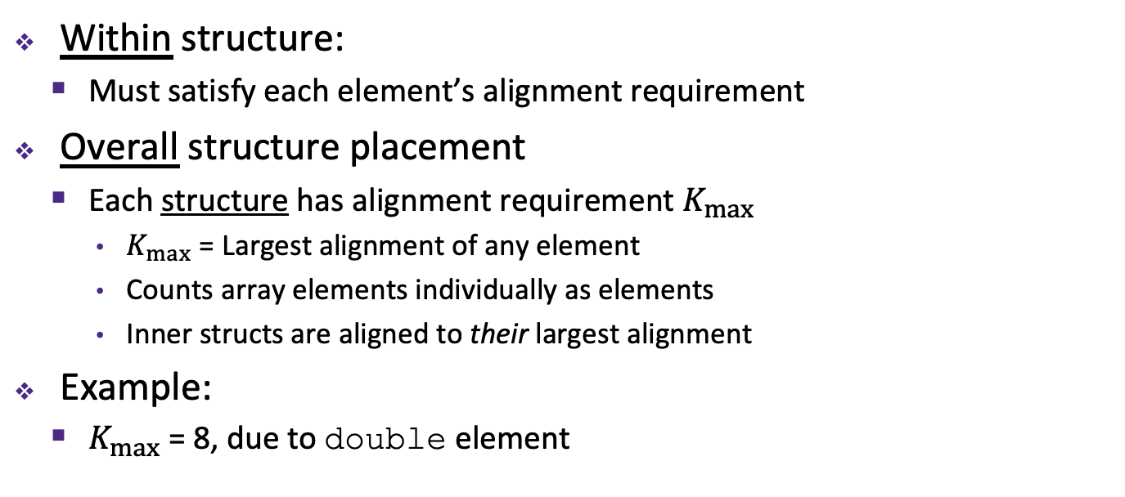
Satisfying Alignment with Structures (1)
Within structure:
  Must satisfy each element’s alignment requirement
Overall structure placement
  Each structure has alignment requirement $K_{max}$
    $K_{max}$ = Largest alignment of any element
    Counts array elements individually as elements
    Inner structs are aligned to their largest alignment
Example:
  $K_{max}$ = 8, due to double element
struct S1 {
char c;
int i[2];
double v;
} *p;
c
3 bytes
i[0]
i[1]
4 bytes
v
p+0
p+4
p+8
p+16
p+24
Multiple of 4
Multiple of 8
Multiple of 8
internal fragmentation
Notes:
Whole struct padded to 8, otherwise inner padding isn’t really possible

Slide 33
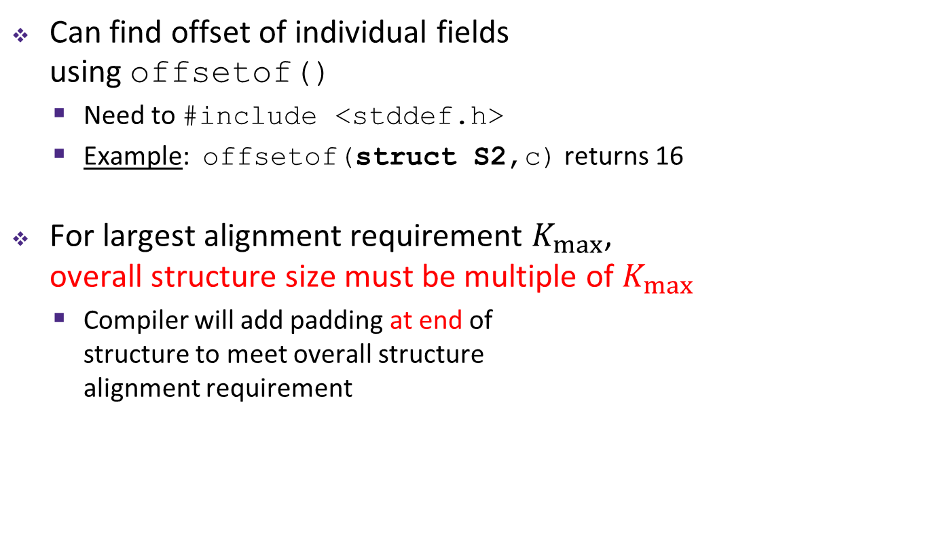
Satisfying Alignment with Structures (2)
Can find offset of individual fields
using offsetof()
  Need to #include <stddef.h>
  Example: offsetof(struct S2,c) returns 16
For largest alignment requirement $K_{max}$,
overall structure size must be multiple of $K_{max}$
  Compiler will add padding at end of
  structure to meet overall structure
  alignment requirement
struct S2 {
double v;
int i[2];
char c;
} *p;
 | v |  |  |  |  |  |  | i[0] |  |  |  | i[1] |  |  |  | c | 7 bytes
p+0 |  |  |  |  |  |  | p+8 |  |  |  |  |  |  |  | p+16 |  |  |  |  |  |  |  | p+24
Multiple of 8
external fragmentation
Multiple of 8
Notes:
Swapped double and char
Why end padding? Arrays

Slide 34

Arrays of Structures
Overall structure length multiple of $K_{max}$
Satisfy alignment requirement
for every element in array
struct S2 {
double v;
int i[2];
char c;
} a[10];
 | a[0] |  |  |  |  | a[1] |  |  |  |  | a[2] |  |  |  |  | • • •
a+0 |  |  |  |  | a+24 |  |  |  |  | a+48 |  |  |  |  | a+72
 | v |  |  |  |  |  |  | i[0] |  |  |  | i[1] |  |  |  | c | 7 bytes
a+24 |  |  |  |  |  |  | a+32 |  |  |  |  |  |  |  | a+40 |  |  |  |  |  |  |  | a+48
external fragmentation
Notes:
struct S2 { … } a[10]; - declares a new type “struct S2”, then declares an array a that contains 10 “struct S2” elements

Slide 35
Accessing Array Elements
Compute start of array element as: 12*index
  sizeof(S3) = 12, including alignment padding
Element j is at offset 8 within structure
Assembler gives offset a+8
struct S3 {
short i;
float v;
short j;
} a[10];
 | a[0] |  |  |  |  | • • • |  |  |  | a[index] |  |  |  | • • |  |  | •
a+0 |  |  |  |  | a+12 |  |  |  | a+12*index
 |  |  |  |  | i | 2 bytes |  | v |  |  | j | 2 bytes
 |  |  |  | a+12*index
a+12*index+8
short get_j(int index)
{
return a[index].j;
}

Slide 36
Alignment of Structs
Compiler will do the following:
  Maintains declared ordering of fields in struct
  Each field must be aligned within the struct
  (may insert padding)
    offsetof can be used to get actual field offset
  Overall struct must be aligned according to largest field
  Total struct size must be multiple of its alignment
  (may insert padding)
    sizeof should be used to get true size of structs

Slide 37
How the Programmer Can Save Space
Compiler must respect order elements are declared in
  Sometimes the programmer can save space by declaring large data types first
struct S4 {
char c;
int i;
char d;
} *p;
struct S5 {
int i;
char c;
char d;
} *p;
c
3 bytes
i
d
3 bytes
i
c
d
2 bytes
12 bytes
8 bytes

Slide 38
Peer Instruction Question
Minimize the size of the struct by re-ordering the vars
What are the old and new sizes of the struct?
sizeof(struct old) = _____ sizeof(struct new) = _____
struct old {
int i;
short s[3];
char *c;
float f;
};
struct new {
int i;
______ ______;
______ ______;
______ ______;
};
Notes:
Biggest is 8 bytes
So 4 + 6 + (6) + 8 + 4 + (4) = 32
Char* first
8 + 4 + 4 + 6 + (2) = 24

Slide 39
Summary
Arrays in C
  Aligned to satisfy every element’s alignment requirement
Structures
  Allocate bytes in order declared
  Pad in middle and at end to satisfy alignment

