Slide 1






ACKNOWLEDGEMENT: These slides have been modified by your your CMPT 295 instructor and RISC-V ISA creators. However, please report all mistakes to your instructor.
C:
Java:
Memory & data
Arrays & structs
Integers & floats
RISC V assembly
Procedures & stacks
Executables
Memory & caches
Processor Pipeline
Performance
Parallelism
car *c = malloc(sizeof(car));
c->miles = 100;
c->gals = 17;
float mpg = get_mpg(c);
free(c);
Car c = new Car();
c.setMiles(100);
c.setGals(17);
float mpg =
c.getMPG();
Assembly language:
OS:
Machine code:
0111010000011000
100011010000010000000010
1000100111000010
110000011111101000011111
Computer system:

Slide 2

Agenda
Stored-Program Concept
R-Format
I-Format
S-Format
SB-Format
U-Format
UJ-Format

Slide 3
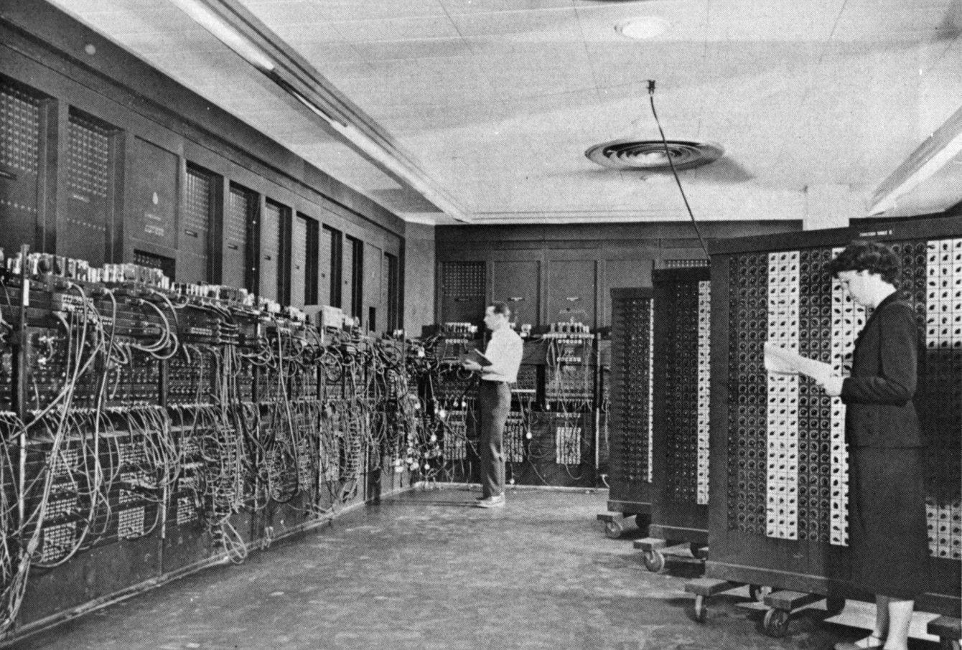
ENIAC (U.Penn., 1946)
First Electronic General-Purpose Computer
Blazingly fast (multiply in 2.8ms!)
10 decimal digits x 10 decimal digits
But needed 2-3 days to setup new program,
as programmed with patch cords and switches
3
Notes:
-Electronic Numerical Integrator and Computer
-Digital (electronic), capable of being reprogrammed to solve a variety of mathematical problems
-Dev began at the end of WWII, was designed and primarily used to calculate artillery firing tables for the US Army’s
-Very slow to program
-Story about 2 architects who designed it and Von Neumann, how it led to EDSAC
-Slow program entry, I/O

Slide 4
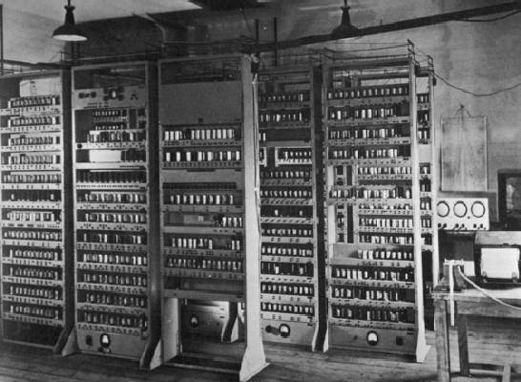
EDSAC (Cambridge, 1949)
First General Stored-Program Electronic Computer
Programs held as numbers in memory
35-bit binary 2’s complement words
Notes:
Programming EDSAC

Slide 5
So how do we represent instructions?
  Remember: Computer only understands 1s and 0s, so assembler string “add x10,x11,x0” is meaningless to hardware

Slide 6
Big Idea: Stored-Program Concept
INSTRUCTIONS ARE DATA
programs can be stored in memory as numbers
Before: a number can mean anything
Now: make convention for interpreting numbers as instructions

Slide 7
Instructions as Numbers
By convention, RISCV instructions are each
1 word = 4 bytes = 32 bits
31
0
Divide the 32 bits of an instruction into “fields”
  regular field sizes → simpler hardware
  will need some variation….
Notes:
6 formats to memorize, but 4 formats to internalize (R with three registers, I with two registers and an immediate, S with two registers and an address, U with a big immediate/address)

Slide 8
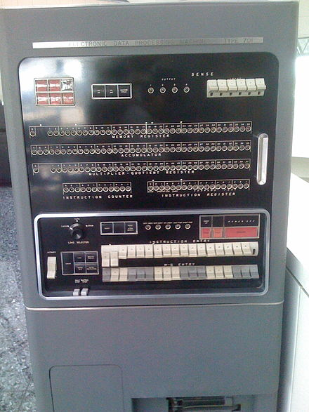
Consequence #1: Everything Has a Memory Address
Since all instructions and data are stored in memory, everything has a memory address: instructions, data words
  Both branches and jumps use these
C pointers are just memory addresses: they can point to anything in memory
  Unconstrained use of addresses can lead to nasty bugs; avoiding errors up to you in C; limited in Java by language design
One register keeps address of instruction being executed: “Program Counter” (PC)
  Basically a pointer to memory
  Intel calls it Instruction Pointer (IP)
IBM 701, 1953 (Image source: Wikipedia)

Slide 9
Consequence #2: Binary Compatibility
Programs are distributed in binary form
  Programs bound to specific instruction set
  Different version for phones and PCs
New machines want to run old programs (“binaries”) as well as programs compiled to new instructions
Leads to “backward-compatible” instruction set evolving over time
Selection of Intel 8088 in 1981 for 1st IBM PC is major reason latest PCs still use 80x86 instruction set; could still run program from 1981 PC today

Slide 10
The 6 Instruction Formats
R-Format: instructions using 3 register inputs
  add, xor, mul —arithmetic/logical ops
I-Format: instructions with immediates, loads
  addi, lw, jalr, slli
S-Format: store instructions: sw,sb
SB-Format: branch instructions: beq, bge
U-Format: instructions with upper immediates
  lui, auipc —upper immediate is 20-bits
UJ-Format: the jump instruction: jal
Notes:
lui: load upper immediate
auipc: adding an upper immediate to PC and putting the result in a register

Slide 11
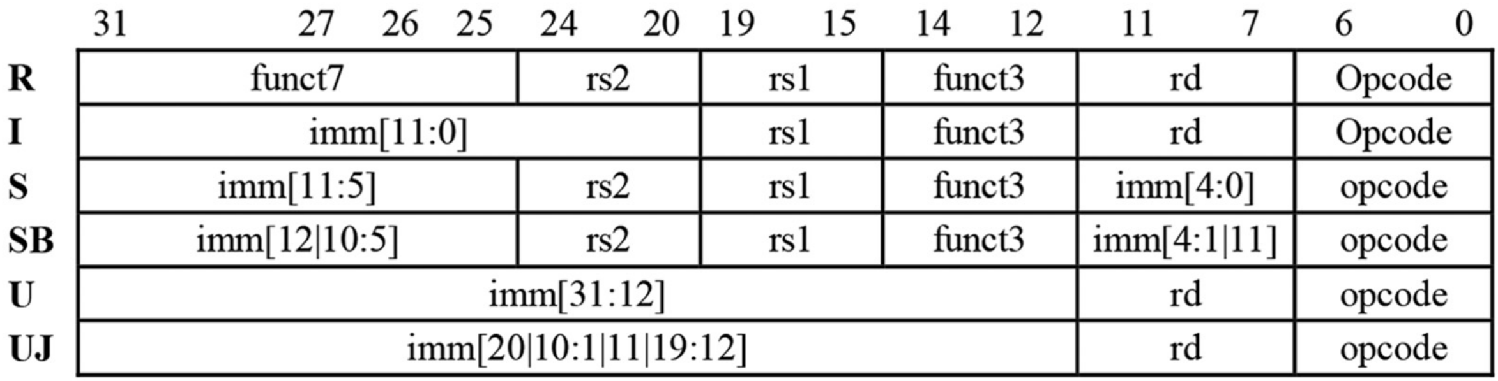
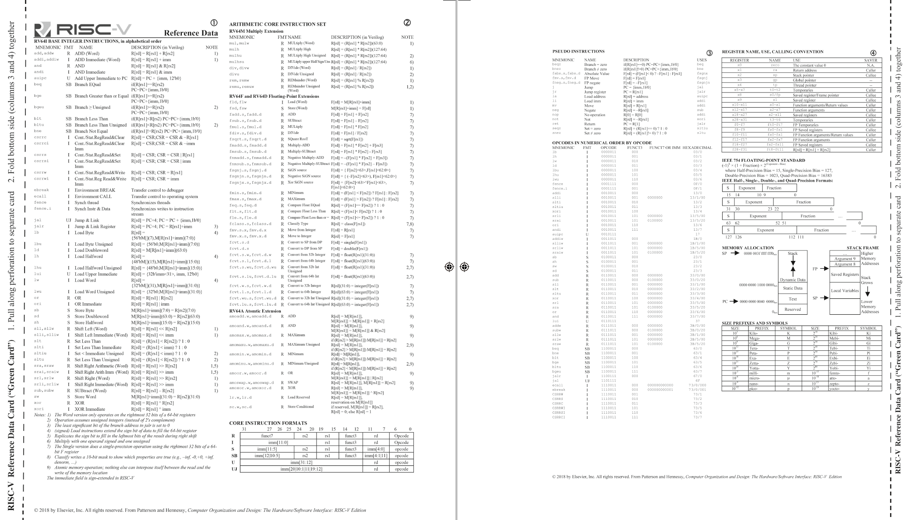
The 6 Instruction Formats
Notes:
lui: load upper immediate
auipc: adding an upper immediate to PC and putting the result in a register

Slide 12
Agenda
Stored-Program Concept
R-Format
I-Format
Administrivia
S-Format
SB-Format
U-Format
UJ-Format

Slide 13
R-Format Instructions (1/3)
Define “fields” of the following number of bits each: 7 + 5 + 5 + 3 + 5 + 7 = 32
Each field has a name:
Each field is viewed as its own unsigned int
  5-bit fields can represent any number 0-31,
  while 7-bit fields can represent any number 0-127, etc.
31
0
7
5
5
3
5
7
31
0
funct7
rs2
rs1
funct3
rd
opcode

Slide 14
R-Format Instructions (2/3)
31
0
funct7
rs2
rs1
funct3
rd
opcode
opcode (7): partially specifies operation
  e.g. R-types have opcode = 0b0110011, SB (branch) types have opcode = 0b1100011
funct7+funct3 (10): combined with opcode, these two fields describe what operation to perform
How many R-format instructions can we encode?
  with opcode fixed at 0b0110011, just funct varies:
  (2⁷) x (2³)= (2¹⁰) = 1024

Slide 15
R-Format Instructions (3/3)
31
0
funct7
rs2
rs1
funct3
rd
opcode
rs1 (5): 1st operand (“source register 1”)
rs2 (5): 2nd operand (second source register)
rd (5): “destination register” — receives the result of computation
Recall: RISCV has 32 registers
  A 5 bit field can represent exactly 2⁵ = 32 things (interpret as the register numbers x0-x31)

Slide 16

Reading from the Green Sheet
add t0 t1 t2
rd = t0 = x5
rs1 = t1 = x6
rt2 = t2 = x7
31
0
???
0
???
7
???
6
???
0
???
5
???
0x33
funct7
rs2
rs1
funct3
rd
opcode

Slide 17
R-Format Example
RISCV Instruction: add x5,x6,x7
  Field representation (decimal):
  Field representation (binary):
31
0
0
7
6
0
5
0x33
31
0
0000000
00111
00110
000
00101
0110011
_{two}
  hex representation: 0x 0073 02B3
  decimal representation: 7,537,331
  Called a Machine Language Instruction
Notes:
x5 = t0, x6 = t1, x7 = t2

Slide 18
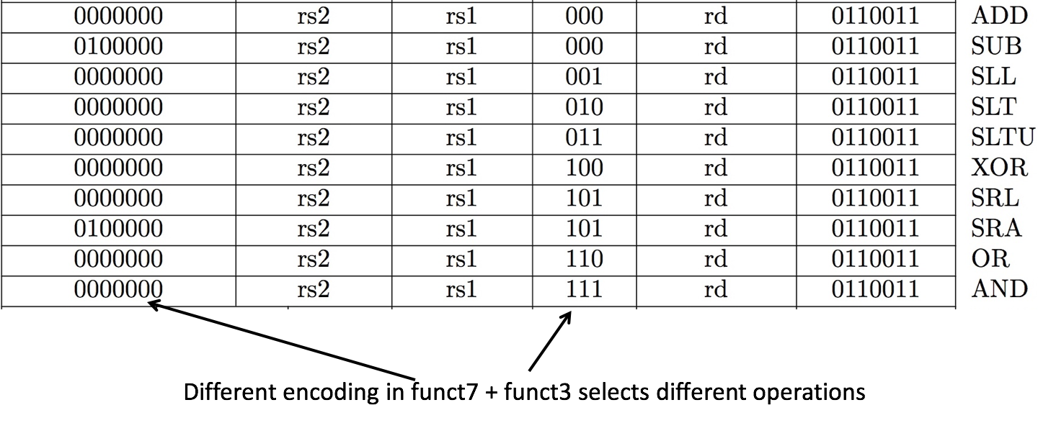
All RV32 R-format instructions

Slide 19
Agenda
Stored-Program Concept
R-Format
I-Format
S-Format
SB-Format
U-Format
UJ-Format

Slide 20
I-Format Instructions (1/4)
What about instructions with immediates?
  5-bit field too small for most immediates
Ideally, RISCV would have only one instruction format (for simplicity)
  Unfortunately here we need to compromise
Define new instruction format that is mostly consistent with R-Format
  First notice that, if instruction has immediate, then it uses at most 2 registers (1 src, 1 dst)

Slide 21
I-Format Instructions (2/4)
Define “fields” of the following number of bits each: 12 + 5 + 3 + 5 + 7 = 32 bits
Field names:
Key Concept: Only imm field is different from R-format: rs2 and funct7 replaced by 12-bit signed immediate, imm[11:0]
31
0
12
5
3
5
7
31
0
imm[11:0]
rs1
func3
rd
opcode

Slide 22
I-Format Instructions (3/4)
31
0
imm[11:0]
rs1
func3
rd
opcode
opcode (7): uniquely specifies the instruction
rs1 (5): specifies a register operand
rd (5): specifies destination register that receives result of computation

Slide 23
I-Format Instructions (4/4)
31
0
imm[11:0]
rs1
func3
rd
opcode
immediate (12): 12 bit number
  All computations done in words, so 12-bit immediate must be extended to 32 bits
  always sign-extended to 32-bits before use in an arithmetic operation
Can represent 2¹² different immediates
  imm[11:0] can hold values in range [-2¹¹ , +2¹¹)

Slide 24
I-Format Example (1/2)
  addi x15,x1,-50
rd = x15
rs1 = x1
31
0
00001
???
???
01111
111111001110
?
0
???
???
0x13
imm[11:0]
rs1
func3
rd
opcode

Slide 25
I-Format Example (2/2)
RISCV Instruction: addi x15,x1,-50
  Field representation (binary):
  hex representation: 0x FCE0 8793
  decimal representation: 4,242,573,203
  Called a Machine Language Instruction
31
0
00001
???
???
01111
111111001110
000
?
0010011
_{two}
Notes:
$21 = $s5, $22 = $s6

Slide 26
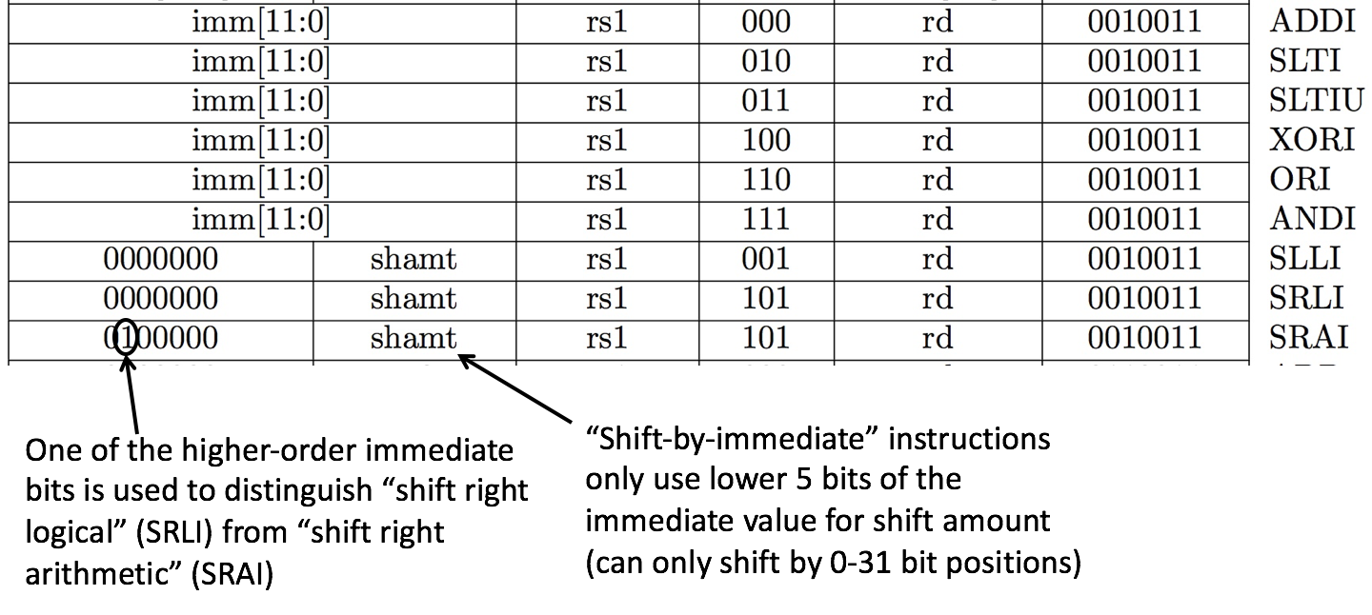
All RISCV I-Type Arithmatic Instructions

Slide 27
Question: If the number of registers were halved,
which statement is true?
(A)
There must be more R-type instructions
(B)
There must be less I-type instructions
(C)
Shift amounts would change to 0-63
(D)
I-type instructions could have 2 more immediate bits
5
4
5
12
4
14
3
3
7
31
7
31
31
31
0
0
0
0
rs1
rs1
rd
imm[11:0]
rd
imm[13:0]
func3
func3
opcode
opcode

Slide 28
Agenda
Stored-Program Concept
R-Format
I-Format
S-Format
SB-Format
U-Format
UJ-Format

Slide 29
Load Instructions are also I-Type
31
0
imm[11:0]
rs1
func3
rd
opcode
offset[11:0]
base
width
dst
LOAD
The 12-bit signed immediate is added to the base address in register rs1 to form the memory address
  This is very similar to the add-immediate operation but used to create address, not to create final result
Value loaded from memory is stored in rd

Slide 30
I-Format Load Example
lw x14, 8(x2)
31
0
imm[11:0]
rs1
func3
rd
opcode
offset[11:0]
base
width
dst
LOAD
000000001000
00010
010
01110
0000011
imm=+8
rs1=2
LW
rd=14
LOAD

Slide 31
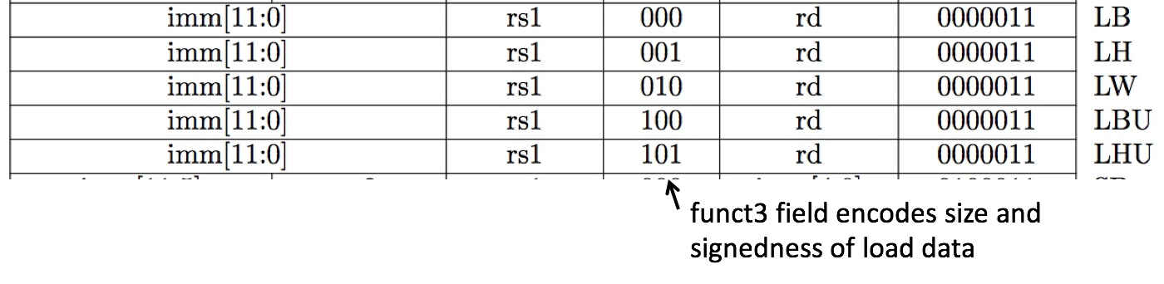
All RV32 Load Instructions
LBU is “load unsigned byte”
LH is “load halfword”, which loads 16 bits (2 bytes) and sign-extends to fill destination 32-bit register
LHU is “load unsigned halfword”, which zero-extends 16 bits to fill destination 32-bit register
There is no LWU in RV32, because there is no sign/zero extension needed when copying 32 bits from a memory location into a 32-bit register

Slide 32
Agenda
Stored-Program Concept
R-Format
I-Format
S-Format
SB-Format
U-Format
UJ-Format

Slide 33
S-Format Used for Stores
Store needs to read two registers, rs1 for base memory address, and rs2 for data to be stored, as well as need immediate offset!
Can’t have both rs2 and immediate in same place as other instructions!
Note: stores don’t write a value to the register file, no rd!
RISC-V design decision is move low 5 bits of immediate to where rd field was in other instructions – keep rs1/rs2 fields in same place
register names more critical than immediate bits in hardware design
31
0
imm[11:5]
rs2
rs1
func3
imm[4:0]
opcode

Slide 34
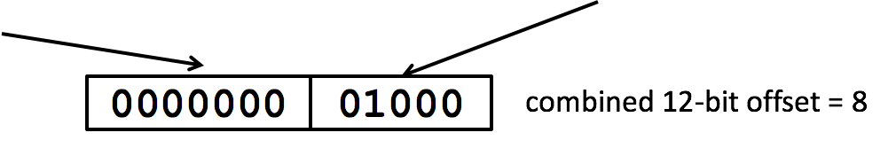
S-Format Example
sw x14, 8(x2)
31
0
imm[11:5]
rs2
rs1
func3
imm[4:0]
opcode
00000000
01110
00010
010
01000
0100011
off[11:5] = 0
rs2=14
rs1=2
SW
off[4:0] = 8
STORE

Slide 35
All RV32 Store Instructions

Slide 36
Agenda
Stored-Program Concept
R-Format
I-Format
S-Format
SB-Format
U-Format
UJ-Format

Slide 37
Branching Instructions
beq, bne,bge,blt
  Need to specify an address to go to
  Also take two registers to compare
  Doesn’t write into a register (similar to stores)
How to encode label, i.e., where to branch to?

Slide 38
Branching Instruction Usage
Branches typically used for loops (if-else, while, for)
  Loops are generally small (< 50 instructions)
Recall: Instructions stored in a localized area of memory (Code/Text)
  Largest branch distance limited by size of code
  Address of current instruction stored in the program counter (PC)

Slide 39
PC-Relative Addressing
PC-Relative Addressing: Use the immediate field as a two’s complement offset to PC
  Branches generally change the PC by a small amount
  Can specify ± 2¹¹ addresses from the PC
Why not use byte address offset from PC as the immediate?

Slide 40
Branching Reach
Recall: RISCV uses 32-bit addresses, and memory is byte-addressed
Instructions are “word-aligned”: Address is always a multiple of 4 (in bytes)
PC ALWAYS points to an instruction
  PC is typed as a pointer to a word
  can do C-like pointer arithmetic
Let immediate specify #words instead of #bytes
  Instead of specifying ± 2¹¹ bytes from the PC,
  we will now specify ± 2¹¹ words = ± 2¹³ byte addresses around PC
Notes:
Locker room analogy

Slide 41
Branch Calculation
If we don’t take the branch:
PC = PC+4 = next instruction
If we do take the branch:
PC = PC + (immediate*4)
Observations:
  immediate is number of instructions to move (remember, specifies words) either forward (+) or backwards (–)

Slide 42
RISC-V Feature, n×16-bit instructions
Extensions to RISC-V base ISA support 16-bit compressed instructions and also variable-length instructions that are multiples of 16-bits in length
16-bit = half-word
To enable this, RISC-V scales the branch offset to be half-words even when there are no 16-bit instructions
Reduces branch reach by half and means that ½ of possible targets will be errors on RISC-V processors that only support 32-bit instructions (as used in this class)
RISC-V conditional branches can only reach ± 2¹⁰ × 32-bit instructions either side of PC

Slide 43
RISC-V B-Format for Branches
B-format is mostly same as S-Format, with two register sources (rs1/rs2) and a 12-bit immediate
But now immediate represents values -2¹² to +2¹²-2 in 2-byte increments
The 12 immediate bits encode even 13-bit signed byte offsets (lowest bit of offset is always zero, so no need to store it)
31
0
imm[12|10:5]
rs2
rs1
func3
imm[4:1|11]
opcode
7
5
5
3
5
7

Slide 44
Branch Example (1/2)
RISCV Code:
  Loop: beq x19,x10,End
  add x18,x18,x10
  addi x19,x19,-1
  j Loop
  End: <target instr>
Branch offset =
(Branch with offset of 0, branches to itself)
Start counting from instruction AFTER the branch
1
2
3
4
4×32-bit instructions = 16 bytes

Slide 45
Branch Example (1/2)
RISCV Code:
  Loop: beq x19,x10,End
  add x18,x18,x10
  addi x19,x19,-1
  j Loop
  End: <target instr>
Start counting from instruction AFTER the branch
1
2
3
4
7
5
5
3
5
7
31
0
???????
01010
10011
000
?????
1100011
rs2=10
rs1=19
BEQ
BRANCH

Slide 46
Branch Example (1/2)
  beq x19,x10,offset = 16 bytes
  13-bit immediate, imm[12:0], with value 16
  0000000010000
imm[0] discarded, always zero
31
0
0 000000
01010
10011
000
1000 0
1100011
imm[12|10:5]
imm[4:1|11]

Slide 47
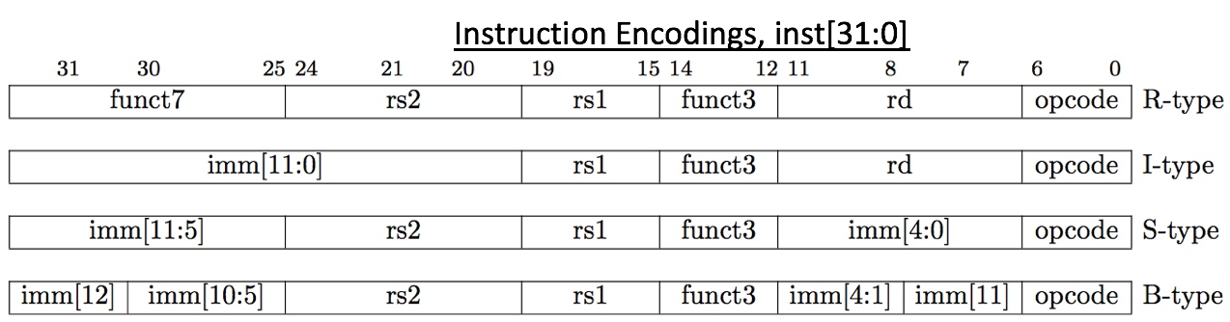
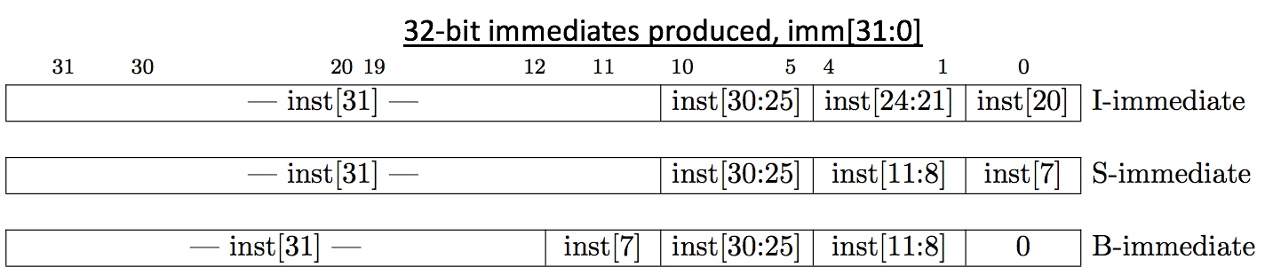
RISC-V Immediate Encoding
Why is it so confusing?!?!
Only bit 7 of instruction changes role in immediate between S and B
Upper bits sign-extended from inst[31] always

Slide 48
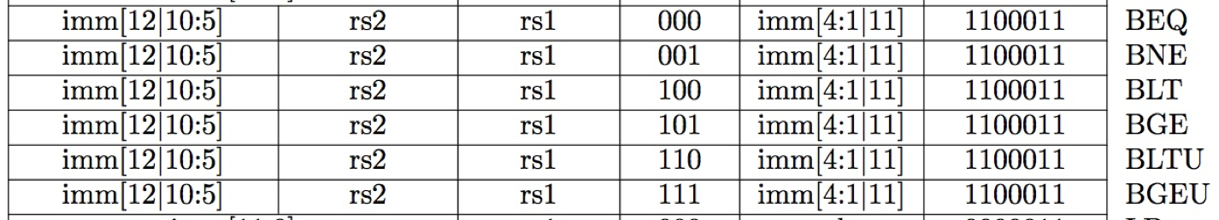
All RISC-V Branch Instructions

Slide 49
Questions on PC-addressing
Does the value in branch immediate field change if we move the code?
  If moving individual lines of code, then yes
  If moving all of code, then no (why?)
What do we do if destination is > 2¹⁰ instructions away from branch?
  Other instructions save us:
beq x10,x0,far bne x10,x0,next
# next instr → j far
next: # next instr
Notes:
As we will see, jumping instructions can reach farther than branching

Slide 50
Agenda
Stored-Program Concept
R-Format
I-Format
S-Format
SB-Format
U-Format
UJ-Format

Slide 51
Dealing With Large Immediates
How do we deal with 32-bit immediates?
  Our I-type instructions only give us 12 bits
Solution: Need a new instruction format for dealing with the rest of the 20 bits.
This instruction should deal with:
  a destination register to put the 20 bits into
  the immediate of 20 bits
  the instruction opcode

Slide 52
U-Format for “Upper Immediate” instructions
31
0
imm[31:12]
rd
opcode
20
U-immediate[31:12]
5
dest
7
LUI/AUIPC
Has 20-bit immediate in upper 20 bits of 32-bit instruction word
One destination register, rd
Used for two instructions
  LUI – Load Upper Immediate
  AUIPC – Add Upper Immediate to PC

Slide 53
LUI to create long immediates
lui writes the upper 20 bits of the destination with the immediate value, and clears the lower 12 bits
Together with an addi to set low 12 bits, can create any 32-bit value in a register using two instructions (lui/addi).
lui x10, 0x87654 # x10 = 0x87654000
addi x10, x10, 0x321 # x10 = 0x87654321

Slide 54
Corner Case
How to set 0xDEADBEEF?
lui x10, 0xDEADB # x10 = 0xDEADB000
addi x10, x10,0xEEF # x10 = 0xDEADAEEF
addi 12-bit immediate is always sign-extended!
if top bit of the 12-bit immediate is a 1, it will subtract -1 from upper 20 bits

Slide 55
Solution
How to set 0xDEADBEEF?
lui x10, 0xDEADC # x10 = 0xDEADC000
addi x10, x10,0xEEF # x10 = 0xDEADBEEF
Pre-increment value placed in upper 20 bits, if sign bit will be set on immediate in lower 12 bits.
Assembler pseudo-op handles all of this:
li x10, 0xDEADBEEF # Creates two instructions

Slide 56
AUIPC
Adds upper immediate value to PC and places result in destination register
Used for PC-relative addressing
Label: auipc x10, 0
  Puts address of label into x10

Slide 57
Agenda
Stored-Program Concept
R-Format
I-Format
S-Format
SB-Format
U-Format
UJ-Format

Slide 58
UJ-Format Instructions (1/3)
For branches, we assumed that we won’t want to branch too far, so we can specify a change in the PC
For general jumps (jal), we may jump to anywhere in code memory
  Ideally, we would specify a 32-bit memory address to jump to
  Unfortunately, we can’t fit both a 7-bit opcode and a 32-bit address into a single 32-bit word
  Also, when linking we must write to an rd register
Notes:
We have lots of needs—we’ll do the best we can just like with U-instructions!

Slide 59
UJ-Format Instructions (2/3)
31
0
imm[20|10:1|11|19:12]
rd
opcode
20
offset[31:12]
5
dest
7
JAL
jal saves PC+4 in register rd (the return address)
Set PC = PC + offset (PC-relative jump)
Target somewhere within ±2¹⁹ locations, 2 bytes apart
±2¹⁸ 32-bit instructions
Reminder: “j” jump is a pseudo-instruction—the assembler will instead use jal but sets rd=x0 to discard return address
Immediate encoding optimized similarly to branch instruction to reduce hardware cost

Slide 60
UJ-Format Instructions (2/3)
31
0
imm[20|10:1|11|19:12]
rd
opcode
20
offset[31:12]
5
dest
7
JAL
# j pseudo-instruction
j Label = jal x0, Label # Discard return address
# Call function within 2¹⁸ instructions of PC
jal ra, FuncName
Why is the immediate so funky?
  Similar reasoning as for branch immediates

Slide 61
jalr Instruction (I-Format)
31
0
imm[11:0]
rs1
func3
rd
opcode
offset
base
0
dest
JALR
jalr rd, rs1, offset
Writes PC+4 to rd (return address)
Sets PC = rs1 + offset
Uses same immediates as arithmetic & loads
  no multiplication by 2 bytes

Slide 62
Uses of jalr
31
0
imm[11:0]
rs1
func3
rd
opcode
offset
base
0
dest
JALR
# ret and jr psuedo-instructions
ret = jr ra = jalr x0, ra, 0
# Call function at any 32-bit absolute address
lui x1, <hi 20 bits>
jalr ra, x1, <lo 12 bits>
# Jump PC-relative with 32-bit offset
auipc x1, <hi 20 bits>
jalr x0, x1, <lo 12 bits>

Slide 63
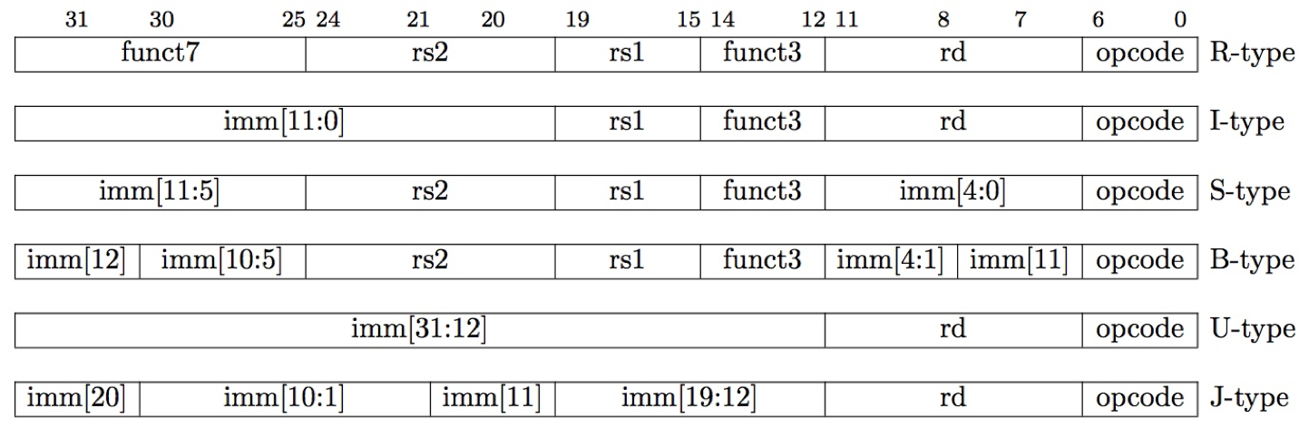
Summary of RISC-V Instruction Formats

