Slide 1
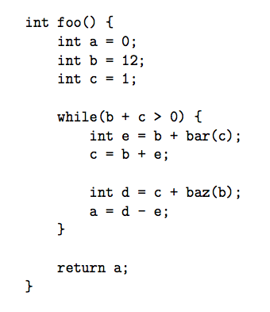
Question
You are a compiler. Do you choose to put a in a:
Caller-saved register (t)
Callee-saved register (s)
Depends on where we put the other variables in this fn
Both are equally valid

Slide 2
Question
You are a compiler. Do you choose to put a in a:
Caller-saved register (t)
Callee-saved register (s)
Depends on where we put the other variables in this fn
Both are equally valid
Repeat but assume that foo is recursive (bar/baz → foo)

Slide 3
Question
You are a compiler. Do you choose to put b in a:
Caller-saved register (t)
Callee-saved register (s)
Depends on where we put the other variables in this fn
Both are equally valid

Slide 4
Question
  Which is a true statement about the arguments to the function
  void sub(int a, int b, int c, int d, int e, int f, int g, int h, int i);
Arguments a-i are all passed in registers.
Arguments a-i are all stored on the stack.
Only i is stored on the stack, but space is allocated for all 9 arguments.
Only a-h are stored on the stack, but space is allocated for all 9 arguments.

Slide 5
Quiz
Which statement is FALSE?
1: RISC-V uses jal to invoke a function and
jr to return from a function
2: jal saves PC+1 in ra
3: The callee can use temporary registers (ti) without saving and restoring them
4: The caller can rely on save registers (si) without fear of callee changing them
Notes:
B: Print It saves PC+4
…because instructions in this system are 4-bytes long and
the actual address increments by 4 bytes even though it appears to only increment by one instruction.

