Slide 1

Agenda
Function calls and Jumps
Call Stack
Register Convention
Program memory layout

Slide 2
Calling Convention for Procedure Calls
Transfer Control
  Caller → Routine
  Routine → Caller
Pass Arguments to and from the routine
  fixed length, variable length, recursively
  Get return value back to the caller
Manage Registers
  Allow each routine to use registers
  Prevent routines from clobbering each others’ data

Slide 3
Six Steps of Calling a Function
Put arguments in a place where the function can access them
Transfer control to the function
The function will acquire any (local) storage resources it needs
The function performs its desired task
The function puts return value in an accessible place and “cleans up”
Control is returned to you

Slide 4
Jumps are not enough
1
main:
j myfn
after1:
add x1,x2,x3
myfn:
…
…
j after1
2
Jumps to the callee
Jumps back
Notes:
Jumps and branches can transfer control to the callee (called procedure)
Jumps and branches can transfer control back

Slide 5
Jumps are not enough
1
main:
j myfn
after1:
add x1,x2,x3
j myfn
after2:
sub x3,x4,x5
myfn:
…
…
3
2
j after2
j after1
4
??? Change target
on the fly ???
Jumps to the callee
Jumps back
What about multiple sites?
Notes:
Jumps and branches can transfer control to the callee (called procedure)
Jumps and branches can transfer control back

Slide 6
Takeaway 1: Need Jump And Link
JAL (Jump And Link) instruction moves a new value into the PC, and simultaneously saves the old value in register x1 (aka $ra or return address)
Thus, can get back from the subroutine to the instruction immediately following the jump by transferring control back to PC in register x1

Slide 7
Jump-and-Link / Jump Register
First call
x1
after1
1
main:
jal myfn
after1:
add x1,x2,x3
jal myfn
after2:
sub x3,x4,x5
myfn:
…
…
jr x1
2
JAL saves the PC in register $31
Subroutine returns by jumping to $31

Slide 8
Jump-and-Link / Jump Register
Second call
x1
after2
after1
1
main:
jal myfn
after1:
add x1,x2,x3
jal myfn
after2:
sub x3,x4,x5
myfn:
…
…
jr x1
3
2
4
JAL saves the PC in register x1
Subroutine returns by jumping to x1
What happens for recursive invocations?

Slide 9
JAL / JR for Recursion?
int main (int argc, char* argv[ ]) {
int n = 9;
int result = myfn(n);
}
int myfn(int n) {
if(n > 0) {
return n * myfn(n - 1);
} else {
return 1;
}
}

Slide 10
JAL / JR for Recursion?
First call
x1
after1
1
main:
jal myfn
after1:
add x1,x2,x3
myfn:
if (test)
jal myfn
after2:
jr x1
Problems with recursion:
overwrites contents of x1

Slide 11
JAL / JR for Recursion?
Recursive Call
x1
after2
after1
1
2
main:
jal myfn
after1:
add x1,x2,x3
myfn:
if (test)
jal myfn
after2:
jr x1
Problems with recursion:
overwrites contents of x1

Slide 12
JAL / JR for Recursion?
Return from Recursive Call
x1
after2
1
2
main:
jal myfn
after1:
add x1,x2,x3
myfn:
if (test)
jal myfn
after2:
jr x1
3
Problems with recursion:
overwrites contents of x1

Slide 13
JAL / JR for Recursion?
Return from Original Call???
x1
after2
1
2
main:
jal myfn
after1:
add x1,x2,x3
myfn:
if (test)
jal myfn
after2:
jr x1
3
4
Stuck!
Problems with recursion:
overwrites contents of x1

Slide 14
JAL / JR for Recursion?
Return from Original Call???
x1
after2
1
2
main:
jal myfn
after1:
add x1,x2,x3
myfn:
if (test)
jal myfn
after2:
jr x1
3
4
Stuck!
Problems with recursion:
overwrites contents of x1
Need a way to save and restore register contents

Slide 15
Agenda
Function calls and Jumps
Call Stack
Register Convention
Program memory layout

Slide 16
Takeaway2: Need a Call Stack
JAL (Jump And Link) instruction moves a new value into the PC, and simultaneously saves the old value in register x1 (aka ra or return address) Thus, can get back from the subroutine to the instruction immediately following the jump by transferring control back to PC in register x1
Need a Call Stack to return to correct calling procedure. To maintain a stack, need to store an activation record (aka a “stack frame”) in memory. Stacks keep track of the correct return address by storing the contents of x1 in memory (the stack).

Slide 17
Need a “Call Stack”
Call stack
  contains activation records (aka stack frames)
Each activation record contains
  the return address for that invocation
  the local variables for that procedure
A stack pointer (sp) keeps track of the top of the stack
  dedicated register (x2) on the RISC-V
Manipulated by push/pop operations
  push: move sp down, store
  pop: load, move sp up

Slide 18
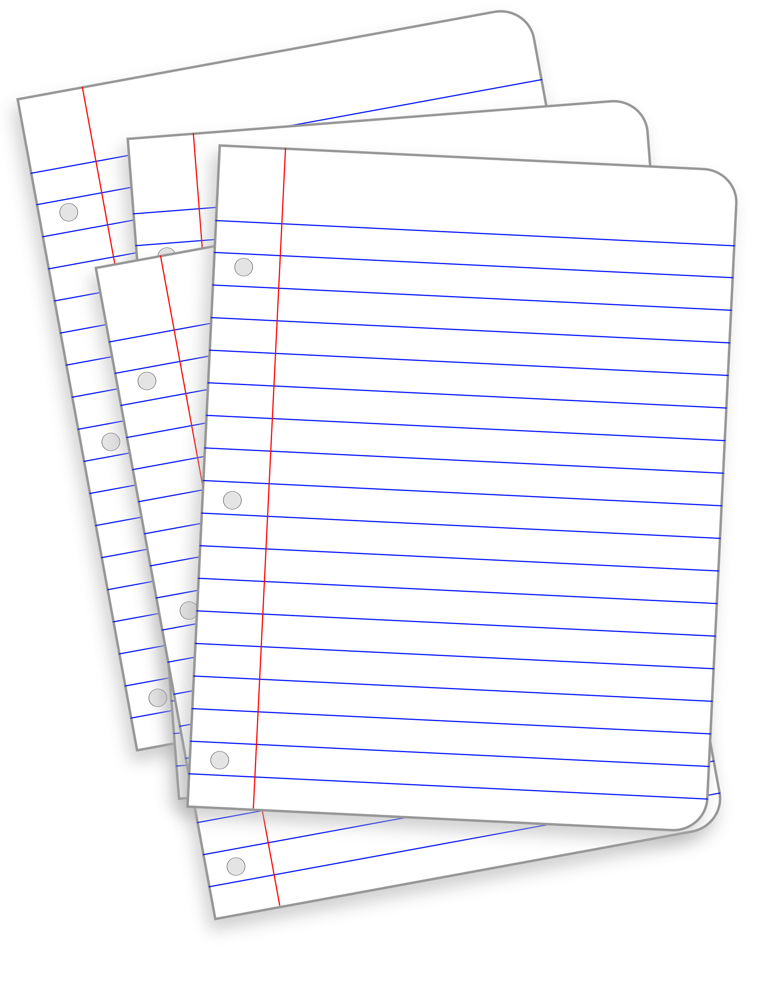
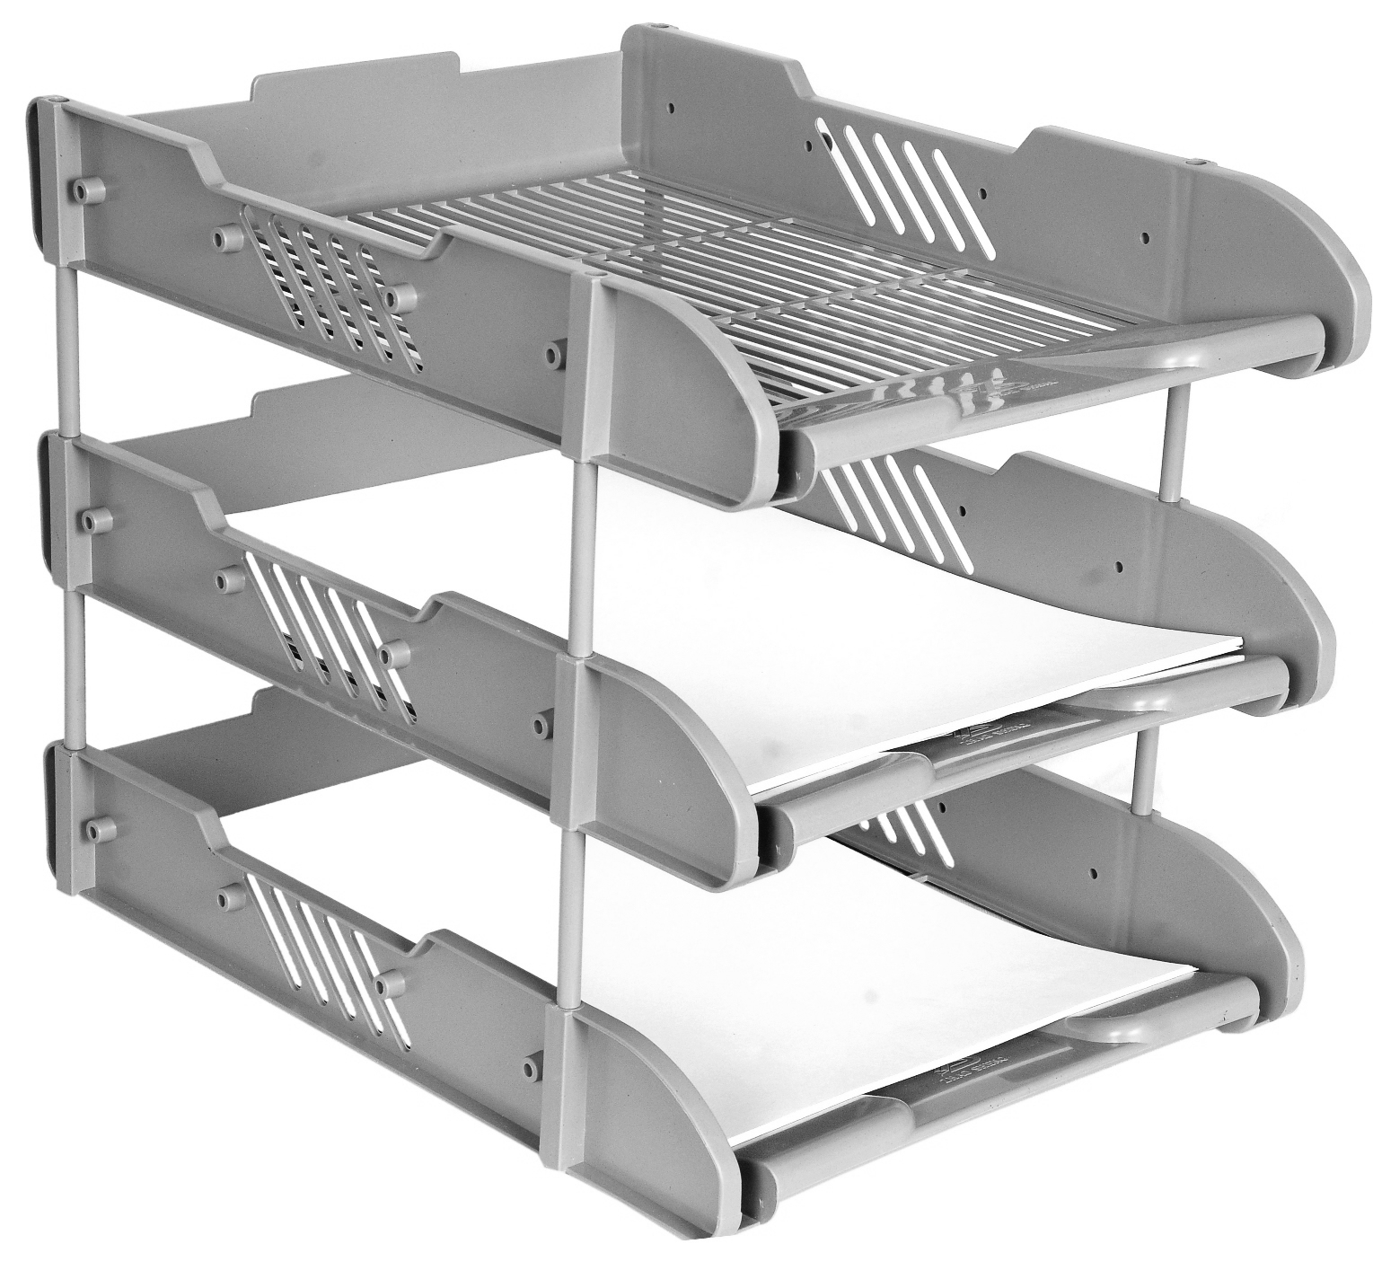

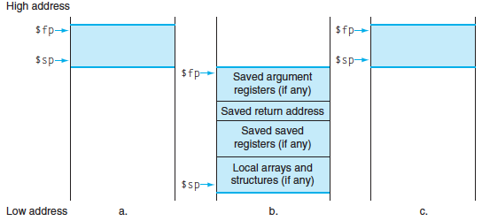

Stack Before, During, After Call
ra
Notes:
Exact ordering of saved registers is up to you (make sure you keep track, though!).
(actually don’t need to save argument registers)

Slide 19
Local Variables and Arrays
Any local variables the compiler cannot assign to registers will be allocated as part of the stack frame (Recall: spilling to memory)
Locally declared arrays and structs are also allocated as part of the stack frame
Stack manipulation is same as before
  Move sp down an extra amount and use the space it created as storage

Slide 20
Function Call Example
int Leaf(int g, int h, int i, int j) {
int f;
f = (g + h) – (i + j);
return f;
}
Parameter variables g, h, i, and j in argument registers a0, a1, a2, and a3, and f in s0
Assume need one temporary register s1

Slide 21
RISC-V Code for Leaf()
Leaf: addi sp,sp,-8 # adjust stack for 2 items
sw s1, 4(sp) # save s1 for use afterwards
sw s0, 0(sp) # save s0 for use afterwards
add s0,a0,a1 # f = g + h
add s1,a2,a3 # s1 = i + j
sub a0,s0,s1 # return value (g + h) – (i + j)
lw s0, 0(sp) # restore register s0 for caller
lw s1, 4(sp) # restore register s1 for caller
addi sp,sp,8 # adjust stack to delete 2 items
jr ra # jump back to calling routine

Slide 22
Stack Before, During, After Function
Need to save old values of s0 and s1
sp
sp
Saved s1
Saved s1
sp
Saved s0
Saved s0
Before call
During call
After call

Slide 23
Agenda
Function calls and Jumps
Call Stack
Register Convention
Program memory layout

Slide 24
Register Conventions
CalleR: the calling function
CalleE: the function being called
When callee returns from executing, the caller needs to know which registers may have changed and which are guaranteed to be unchanged.
Register Conventions: A set of generally accepted rules as to which registers will be unchanged after a procedure call (jal) and which may be changed.

Slide 25
Basic Structure of a Function
func_label:
addi sp,sp, -framesize
sw ra, <framesize-4>(sp)
save other regs if need be
restore other regs if need be
lw ra, <framesize-4>(sp)
addi sp,sp, framesize
jr ra
Prologue
$ra
Body (call other functions…)
...
...
Epilogue
ra
$ra
stack
Notes:
Substitute the proper immediate for <framesize-4>.
Can order registers on stack however you want to, but must make sure to restore them properly.

Slide 26
Using Stack to Backup Registers
Limited number of registers for everyone to use (limited desk space)
All functions use the same conventions -- look for arguments/return addresses in the same places
  What happens if a function calls another function?
  (ra would get overwritten!)
To reduce expensive loads and stores from spilling and restoring registers, RISC-V function-calling convention divides registers into two categories:

Slide 28
Convention Summary
first eight arg words passed in $a0-$a7
Space for args in child’s stack frame
return value (if any) in $a0, $a1
stack frame ($fp to $sp) contains:
  $ra (clobbered on JALs)
  local variables
  space for 8 arguments to Callees
  arguments 9+ to Callees
callee save regs: preserved
caller save regs: not preserved
global data accessed via $gp
$fp →
incoming
args
saved ra
saved fp
saved regs
($s0 ... $s7)
locals
$sp →

Slide 29


Saved Registers
These registers are expected to be the same before and after a function call
  If calleE uses them, it must restore values before returning
  This means save the old values, use the registers, then reload the old values back into the registers
s0-s11 (saved registers)
sp (stack pointer)
  If not in same place, the caller won’t be able to properly restore values from the stack
ra (return address)
ra

Slide 30

Volatile Registers
These registers can be freely changed by the calleE
  If calleR needs them, it must save those values before making a procedure call
t0-t6 (temporary registers)
a0-a7 (return address and arguments)
  These will change if calleE invokes another function (nested function means calleE is also a calleR)
$t
a

Slide 31
Activity #1: Calling Convention Example
int test(int a, int b) {
int tmp = (a&b)+(a|b);
int s = sum(tmp,1,2,3,4,5,6,7,8);
int u = sum(s,tmp,b,a,b,a);
return u + a + b;
}
Correct Order:
Body First
Determine stack frame size
Complete Prologue/Epilogue

Slide 32
int test(int a, int b) {
int tmp = (a&b)+(a|b);
int s =sum(tmp,1,2,3,4,5,6,7,8);
int u = sum(s,tmp,b,a,b,a);
return u + a + b;
}
test:
MOVE s1, a0
MOVE s2, a1
AND t0, a0, a1
OR t1, a0, a1
ADD t0, t0, t1
MOVE a0, t0
LI a1, 1
LI a2, 2
…
LI a7, 7
LI t1, 8
SW t1, -4(sp)
SW t0, 0(sp)
JAL sum
LW t0, 0(sp)
MOVE a0, a0 # s
MOVE a1, t0 # tmp
MOVE a2, s2 # b
MOVE a3, s1 # a
MOVE a4, s2 # b
MOVE a5, s1 # a
JAL sum
# add u (a0) and a (s1)
ADD a0, a0, s1
ADD a0, a0, s2
# a0 = u + a + b
Prologue
Epilogue

Slide 33
int test(int a, int b) {
int tmp = (a&b)+(a|b);
int s =sum(tmp,1,2,3,4,5,6,7,8);
int u = sum(s,tmp,b,a,b,a);
return u + a + b;
}
test:
MOVE s1, a0
MOVE s2, a1
AND t0, a0, a1
OR t1, a0, a1
ADD t0, t0, t1
MOVE a0, t0
LI a1, 1
LI a2, 2
…
LI a7, 7
LI t1, 8
SW t1, -4(sp)
SW t0, 0(sp)
JAL sum
LW t0, 0(sp)
MOVE a0, a0 # s
MOVE a1, t0 # tmp
MOVE a2, s2 # b
MOVE a3, s1 # a
MOVE a4, s2 # b
MOVE a5, s1 # a
JAL sum
# add u (a0) and a (s1)
ADD a0, a0, s1
ADD a0, a0, s2
# a0 = u + a + b
Prologue
How many bytes do we
need to allocate for the
stack frame?
24
28
36
40
48
Epilogue

Slide 34
int test(int a, int b) {
int tmp = (a&b)+(a|b);
int s =sum(tmp,1,2,3,4,5,6,7,8);
int u = sum(s,tmp,b,a,b,a);
return u + a + b;
}
test:
MOVE s1, a0
MOVE s2, a1
AND t0, a0, a1
OR t1, a0, a1
ADD t0, t0, t1
MOVE a0, t0
LI a1, 1
LI a2, 2
…
LI a7, 7
LI t1, 8
SW t1, -4(sp)
SW t0, 0(sp)
JAL sum
LW t0, 0(sp)
MOVE a0, v0 # s
MOVE a1, t0 # tmp
MOVE a2, s2 # b
MOVE a3, s1 # a
MOVE a4, s2 # b
MOVE a5, s1 # a
JAL sum
# add u (a0) and a (s1)
ADD a0, a0, s1
ADD a0, a0, s2
# a0 = u + a + b
Prologue
$fp →
space for a1
space for a0
saved ra
saved fp
saved regs
(s1 ... s11)
locals
(t0)
$sp →
outgoing args
space for a0 – a7
and 9th arg
Epilogue

Slide 35
int test(int a, int b) {
int tmp = (a&b)+(a|b);
int s =sum(tmp,1,2,3,4,5,6,7,8);
int u = sum(s,tmp,b,a,b,a);
return u + a + b;
}
test:
MOVE s1, a0
MOVE s2, a1
AND t0, a0, a1
OR t1, a0, a1
ADD t0, t0, t1
MOVE a0, t0
LI a1, 1
LI a2, 2
…
LI a7, 7
LI t1, 8
SW t1, -4(sp)
SW t0, 0(sp)
JAL sum
LW t0, 0(sp)
MOVE a0, a0 # s
MOVE a1, t0 # tmp
MOVE a2, s2 # b
MOVE a3, s1 # a
MOVE a4, s2 # b
MOVE a5, s1 # a
JAL sum
# add u (a0) and a (s1)
ADD a0, a0, s1
ADD a0, a0, s2
# a0 = u + a + b
Prologue
$fp →
space incoming for a1
24
20
space incoming for a0
16
saved ra
12
saved fp
8
saved reg s2
4
saved reg s1
0
local t0
$sp →
-4
outgoing 9th arg
-8
space for a7
-12
space for a6
Epilogue
…
…
-28
space for a1
-36
space for a0
Notes:
-4 9th outgoing arg
-8 a7
-12 a6
-16 a5
-20 a4
-24 a3
-28 a2
-32 a1
-36 a0

Slide 36
Activity #2: Calling Convention Example:
test:
# allocate frame
# save $ra
# save old $fp
# callee save ...
# callee save ...
# set new frame ptr
...
...
# restore …
# restore …
# restore old $fp
# restore $ra
# dealloc frame
$fp →
space incoming for a1
24
20
Space incoming for a0
16
saved ra
12
saved fp
8
saved reg s2
4
saved reg s1
0
local t0
$sp →
-4
outgoing 9th arg
-8
space for a7
-12
space for a6
…
…
-28
space for a1
-36
space for a0

Slide 37
Space for t0
test:
ADDI sp, sp, -28
SW ra, sp, 16
SW fp, sp, 12
SW s2, sp, 8
SW s1, sp, 4
ADDI fp, sp, 24
LW s1, sp, 4
LW s2, sp, 8
LW fp, sp, 12
LW ra, sp, 16
ADDI sp, sp, 28
JR ra
Space for a0 and a1
# allocate frame
# save $ra
# save old $fp
# callee save ...
# callee save ...
# set new frame ptr
...
...
# restore …
# restore …
# restore old $fp
# restore $ra
# dealloc frame
$fp →
space incoming for a1
24
20
Space incoming for a0
16
saved ra
12
saved fp
8
saved reg s2
Body
(previous slide, Activity #1)
4
saved reg s1
0
local t0
$sp →
-4
outgoing 9th arg
-8
space for a7
-12
space for a6
…
…
-28
space for a1
-36
space for a0

Slide 38
Function Call Example
... sum(a,b); ... /* a→s0,b→s1 */
int sum(int x, int y) {
return x+y;
}
1000 addi a0,s0,0 # x = a
1004 addi a1,s1,0 # y = b
1008 addi ra,x0,1016 # ra=1016
1012 j sum # jump to sum
1016
...
2000 sum: add a0,a0,a1
2004 jr ra # return
C
RISC-V
address (decimal)
Would we know this before compiling?
Otherwise we don’t know where we came from
jr ra

Slide 39
Function Call Example
... sum(a,b); ... /* a→s0,b→s1 */
int sum(int x, int y) {
return x+y;
}
1000 addi a0,s0,0 # x = a
1004 addi a1,s1,0 # y = b
1008 jal sum # ra=1012, goto sum
1012
...
2000 sum: add v0,a0,a1
2004 jr ra # return
C
RISCV
address (decimal)

Slide 40
Example: sumSquare
int sumSquare(int x, int y) {
return mult(x,x)+ y; }
What do we need to save?
  Call to mult will overwrite ra, so save it
  Reusing a1 to pass 2nd argument to mult, but need current value (y) later, so save a1
To save something to the Stack, move sp down the required amount and fill the “created” space
Notes:
In general, you would also want to save $a0 to the Stack, in case the function you call calls another function can overwrites $a0.

Slide 41
Example: sumSquare
  int sumSquare(int x, int y) {
  return mult(x,x)+ y; }
sumSquare:
addi sp,sp,-8 # make space on stack
sw ra, 4(sp) # save ret addr
sw a1, 0(sp) # save y
add a1,a0,x0 # set 2nd mult arg
jal mult # call mult
lw a1, 0(sp) # restore y
add a0,a0,a1 # ret val = mult(x,x)+y
lw ra, 4(sp) # get ret addr
addi sp,sp,8 # restore stack
jr ra
mult: ...
“push”
“pop”

Slide 42
Example: Using Volatile Registers
myFunc: # Uses t0
addiu sp,sp,-4
sw ra,0(sp) # Save saved registers
... # Do stuff with t0
addiu sp,sp,-4 # Save volatile registers
sw t0,0(sp) # before calling a function
jal func1 # Function may change t0
lw t0,0(sp) # Restore volatile registers
addiu sp,sp,4 # before you use them again
... # Do stuff with t0
lw ra,0(sp)
addiu sp,sp,4 # Restore saved registers
jr ra # return
# This is the Prologue
# This is the Epilogue

Slide 43
Example: Using Saved Registers
myFunc: # Uses s0 and s1
addiu sp,sp,-12 # This is the Prologue
sw ra,8(sp) # Save saved registers
sw s0,4(sp)
sw s1,0(sp)
... # Do stuff with s0 and s1
jal func1 # s0 and s1 unchanged by
... # function calls, so can keep
jal func2 # using them normally
... # Do stuff with s0 and s1
lw s1,0(sp) # This is the Epilogue
lw s0,4(sp) # Restore saved registers
lw ra,8(sp)
addiu sp,sp,12
jr ra # return
# This is the Prologue
# This is the Epilogue

Slide 44
Choosing Your Registers
Minimize register footprint
  Optimize to reduce number of registers you need to save by choosing which registers to use in a function
  Only save when you absolutely have to
Function does NOT call another function
  Use only t0-t6 and there is nothing to save!
Function calls other function(s)
  Values you need throughout go in s0-s11, others go in t0-t6
  At each function call, check number arguments and return values for whether you or not you need to save
Notes:
Recall: memory is MUCH slower than registers.
The more you know about the internals of the other functions you call, the more you can get away with (e.g. using temporary registers that you know the other functions don’t use, so you don’t bother saving them across function calls).

Slide 45
Arguments & Return Values
Need consistent way of passing args and result
Given a procedure signature, need to know where arguments should be placed
  int min(int a, int b);
  int subf(int a, int b, int c, int d, int e, int f, int g, int h, int i);
  int isalpha(char c);
  int treesort(struct Tree *root);
  struct Node *createNode();
  struct Node mynode();
Too many combinations of char, short, int, void *, struct, etc.
  RISC-V treats char, short, int and void * identically
$a0, $a1
stack?
$a0
$a0, $a1
$a0

Slide 46
Simple Argument Passing (1-8 args)
main() {
int x = myfn(6, 7);
x = x + 2;
}
First eight arguments:
passed in registers x10-x17
  aka $a0, $a1, …, $a7
Returned result:
passed back in a register
  Specifically, x10, aka a0
  And x11, aka a1
main:
li x10, 6
li x11, 7
jal myfn
addi x5, x10, 2
Note: This is not the entire story for 1-8 arguments.
Please see the Full Story slides.

Slide 47
Conventions so far:
  args passed in $a0, $a1, …, $a7
  return value (if any) in $a0, $a1
  stack frame at $sp
    contains $ra (clobbered on JAL to sub-functions)
Q: What about argument lists?

Slide 48
Many Arguments (8+ args)
main() {
myfn(0,1,2,..,7,8,9);
…
}
sp→
First eight arguments:
passed in registers x10-x17
  aka a0, a1, …, a7
Subsequent arguments:
”spill” onto the stack
Args passed in child’s stack frame
9
8
space for x17
main:
li x10, 0
li x11, 1
…
li x17, 7
li x5, 8
sw x5, -8(x2)
li x5, 9
sw x5, -4(x2)
jal myfn
space for x16
space for x15
space for x14
space for x13
space for x12
space for x11
space for x10
Note: This is not the entire story for 9+ args.
Please see the Full Story slides.

Slide 49
Many Arguments (8+ args)
main() {
myfn(0,1,2,..,7,8,9);
…
}
sp→
First eight arguments:
passed in registers x10-x17
  aka a0, a1, …, a7
Subsequent arguments:
”spill” onto the stack
Args passed in child’s stack frame
9
8
space for x17
main:
li a0, 0
li a1, 1
…
li a7, 7
li t0, 8
sw t0, -8(sp)
li t0, 9
sw t0, -4(sp)
jal myfn
space for x16
space for x15
space for x14
space for x13
space for x12
space for x11
space for x10
Note: This is not the entire story for 9+ args.
Please see the Full Story slides.

Slide 50
Argument Passing: the Full Story
main() {
myfn(0,1,2,..,7,8,9);
…
}
sp→
Arguments 1-8:
passed in x10-x17 room on stack
Arguments 9+:
placed on stack
Args passed in child’s stack frame
9
-4($sp)
8
-8($sp)
space for x17
-12($sp)
main:
li a0, 0
li a1, 1
…
li a7, 7
li t0, 8
sw t0, -8(x2)
li t0, 9
sw t0, -4(x2)
jal myfn
space for x16
-16($sp)
space for x15
-20($sp)
space for x14
-24($sp)
space for x13
-28($sp)
space for x12
-32($sp)
space for x11
-36($sp)
space for x10
-40($sp)

Slide 51
Pros of Argument Passing Convention
Consistent way of passing arguments to and from subroutines
Creates single location for all arguments
  Caller makes room for a0-a7 on stack
  Callee must copy values from a0-a7 to stack
  → callee may treat all args as an array in memory
  Particularly helpful for functions w/ variable length inputs: printf(“Scores: %d %d %d\n”, 1, 2, 3);
Aside: not a bad place to store inputs if callee needs to call a function (your input cannot stay in $a0 if you need to call another function!)

Slide 52
Frame Layout & the Frame Pointer
sp→
blue’s stack frame
blue’s Ret Addr
sp→
blue() {
pink(0,1,2,3,4,5);
}

Slide 53
Frame Layout & the Frame Pointer
blue’s stack frame
Notice
Pink’s arguments are on pink’s stack
sp changes as functions call other functions, complicates accesses
→ Convenient to keep pointer to bottom of stack == frame pointer
x8, aka fp (also known as s0)
can be used to restore sp on exit
blue’s Ret Addr
sp→
fp→
space for a5
space for a4
pink’s stack frame
space for a3
space for a2
space for a1
space for a0
pink’s Ret Addr
blue() {
pink(0,1,2,3,4,5);
}
pink(int a, int b, int c, int d, int e, int f) {
…
}
sp→

Slide 54
Agenda
Function calls and Jumps
Call Stack
Register Convention
Program memory layout

Slide 55
Where is the Stack in Memory?
RV32 convention (RV64 and RV128 have different memory layouts)
Stack starts in high memory and grows down
  Hexadecimal: bfff_fff0_{hex}
  Stack must be aligned on 16-byte boundary (not true in examples above)
RV32 programs (text segment) in low end
  0001_0000_{hex}
static data segment (constants and other static variables) above text for static variables
  RISC-V convention global pointer (gp) points to static
  RV32 gp = 1000_0000_{hex}
Heap above static for data structures that grow and shrink ; grows up to high addresses

Slide 56
0xfffffffc
system reserved
top
0x80000000
0x7ffffffc
stack
dynamic data (heap)
0x10000000
static data
.data
code (text)
.text
0x00400000
0x00000000
bottom
system reserved

Slide 57
Return Address lives in Stack Frame
Stack Manipulated by push/pop operations
Context: after 2nd JAL to myfn (from myfn)
PUSH: ADDI sp, sp, -20 // move sp down
SW x1, 16(sp) // store retn PC 1st
Context: 2nd myfn is done (x1 == ???)
POP: LW x1, 16(sp) // restore retn PC →r31
ADDI sp, sp, 20 // move sp up
JR x1 // return
main stack frame
myfn stack frame
x2000
myfn stack frame
after2
x1FD0
r29
x2000
x1FD0
r31
after2
For now: Assume each frame = x20 bytes
(just to make this example concrete)
XXXX

Slide 58
Stack contains stack frames (aka “activation records”)
  1 stack frame per dynamic function
  Exists only for the duration of function
Grows down, “top” of stack is sp, x2
Example: lw x5, 0(sp) puts word at top of stack into x5
Each stack frame contains:
  Local variables, return address (later), register
  backups (later)
main stack frame
myfn stack frame
int main(…) {
...
myfn(x);
}
int myfn(int n) {
...
myfn();
}
system reserved
stack
myfn stack frame
$sp→
heap
static data
code
system reserved

Slide 59
Frame Pointer
It is often cumbersome to keep track of location of data on the stack
  The offsets change as new values are pushed onto and popped off of the stack
Keep a pointer to the bottom of the top stack frame
  Simplifies the task of referring to items on the stack
A frame pointer, x8, aka fp/s0
  Value of sp upon procedure entry
  Can be used to restore sp on exit

Slide 60
The Heap
Heap holds dynamically allocated memory
Program must maintain pointers to anything allocated
  Example: if x5 holds x
  lw x6, 0(x5) gets first word x points to
Data exists from malloc() to free()
system reserved
stack
X
Y
z
void some_function() {
int *x = malloc(1000);
int *y = malloc(2000);
free(y);
int *z = malloc(3000);
}
3000 bytes
2000 bytes
heap
static data
1000 bytes
code
system reserved

Slide 61
Data Segment
Data segment contains global variables
  Exist for all time, accessible to all routines
Accessed w/global pointer
  gp, x3, points to middle of segment
  Example: lw x5, 0(gp) gets middle-most word
  (here, max_players)
system reserved
int max_players = 4;
int main(...) {
...
}
stack
gp→
4
heap
static data
code
system reserved

Slide 62
Variables Visibility Lifetime Location
Function-Local
Global
Dynamic
int n = 100;
int main (int argc, char* argv[ ]) {
int i, m = n, sum = 0;
int* A = malloc(4*m + 4);
for (i = 1; i <= m; i++) {
sum += i; A[i] = sum; }
printf ("Sum 1 to %d is %d\n", n, sum);
}
Where is n ?
Stack
Heap
Global Data
Text
Where is i ?
Stack
Heap
Global Data
Text
Where is main ?
Stack
Heap
Global Data
Text
Notes:
function / func invocation / stack
file or prog / prog execution / data segment
undef / malloc to free / heap
bug in this code

Slide 63
0xfffffffc
system reserved
top
0x80000000
0x7ffffffc
stack
“Data Memory”
dynamic data (heap)
0x10000000
static data
code (text)
“Program Memory”
0x00400000
0x00000000
bottom
system reserved

Slide 64
Variables Visibility Lifetime Location
Function-Local
Global
Dynamic
function
invocation
w/in function
stack
i, m, sum, A
program
execution
n, str
whole program
.data
Anywhere that
has a pointer
b/w malloc
and free
*A
heap
int n = 100;
int main (int argc, char* argv[ ]) {
int i, m = n, sum = 0;
int* A = malloc(4*m + 4);
for (i = 1; i <= m; i++) {
sum += i; A[i] = sum; }
printf ("Sum 1 to %d is %d\n", n, sum);
}
Notes:
function / func invocation / stack
file or prog / prog execution / data segment
undef / malloc to free / heap
bug in this code

Slide 65
Global and Locals
How does a function load global data?
  global variables are just above 0x10000000
Convention: global pointer
  x3 is gp (pointer into middle of global data section)
  gp = 0x10000800
  Access most global data using LW at gp +/- offset
  LW t0, 0x800(gp)
  LW t1, 0x7FF(gp)
Notes:
# data at 0x10000000
# data at 0x10000FFF
(4KB range)

Slide 66
Anatomy of an executing program
0xfffffffc
system reserved
top
0x80000000
0x7ffffffc
stack
dynamic data (heap)
$gp
0x10000000
static data
code (text)
0x00400000
0x00000000
bottom
system reserved

Slide 67
Calling Convention for Procedure Calls
Transfer Control
  Caller → Routine
  Routine → Caller
Pass Arguments to and from the routine
  fixed length, variable length, recursively
  Get return value back to the caller

