Slide 1
Floating Point I
ACKNOWLEDGEMENT: These slides have been modified by your your CMPT 295 instructor and CS:APP Textbook authors. However, please report all mistakes to your instructor.

Slide 2
Number Representation Revisited
What can we represent in one word?
  Signed and Unsigned Integers
  Characters (ASCII)
  Addresses
How do we encode the following:
  Real numbers (e.g. 3.14159)
  Very large numbers (e.g. 6.02×10²³)
  Very small numbers (e.g. 6.626×10⁻³⁴)
  Special numbers (e.g. ∞, NaN)
Floating
Point

Slide 3
Representation of Fractions
“Binary Point,” like decimal point, signifies boundary between integer and fractional parts:
Example 6-bit
representation:
Example: 10.1010₂ = 1×2¹ + 1×2⁻¹ + 1×2⁻³ = 2.625₁₀
xx.yyyy
2¹
2⁻⁴
2⁰
2⁻¹
2⁻²
2⁻³

Slide 4
Representation of Fractions
“Binary Point,” like decimal point, signifies boundary between integer and fractional parts:
Example 6-bit
representation:
In this 6-bit representation:
  What is the encoding and value of
  the smallest (most negative) number?
  What is the encoding and value of
  the largest (most positive) number?
  What is the smallest number greater
  than 2 that we can represent?
xx.yyyy
2¹
2⁻⁴
2⁰
2⁻¹
2⁻²
2⁻³

Slide 5
Scientific Notation (Binary)
Computer arithmetic that supports this called floating point due to the “floating” of the binary point
  Declare such variable in C as float (or double)
mantissa
exponent
1.01₂ × 2⁻¹
binary point
radix (base)

Slide 6
Floating Point Encoding
Use normalized, base 2 scientific notation:
  Value: ±1 × Mantissa × 2^{Exponent}
  Bit Fields: (-1)^{S} × 1.M × 2^{(E–bias)}
Representation Scheme:
  Sign bit (0 is positive, 1 is negative)
  Mantissa (a.k.a. significand) is the fractional part of the number in normalized form and encoded in bit vector M
  Exponent weights the value by a (possibly negative) power of 2 and encoded in the bit vector E
31 30
23 22
0
S
E
M
1 bit
8 bits
23 bits

Slide 7
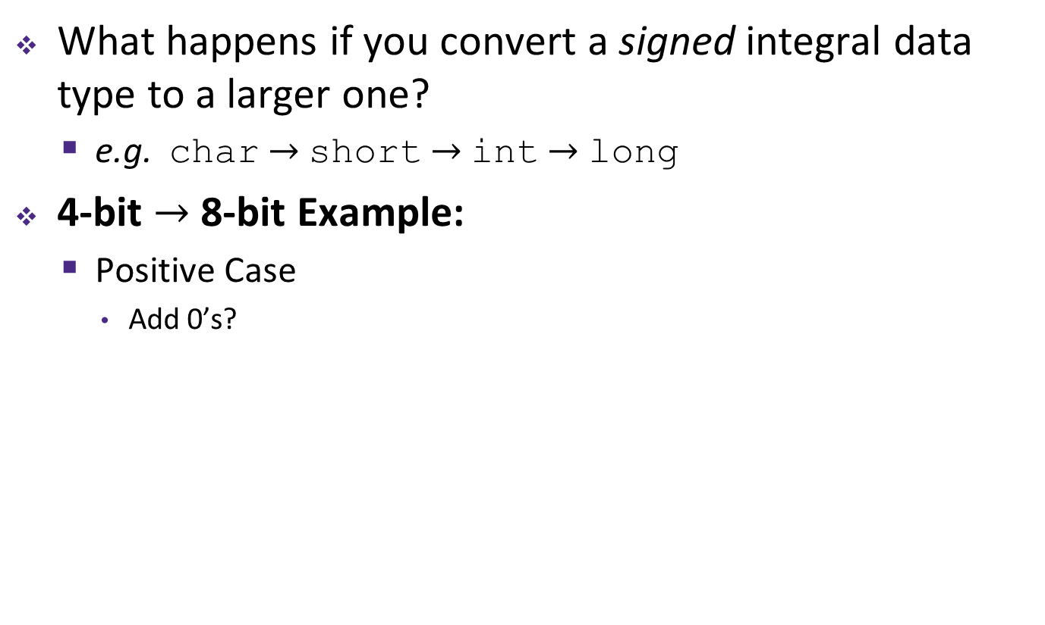
The Exponent Field
Use biased notation
  Read exponent as unsigned, but with bias of 2^{w-1}-1 = 127
  Representable exponents roughly ½ positive and ½ negative
  Exponent 0 (Exp = 0) is represented as E = 0b 0111 1111
Why biased?
  Makes floating point arithmetic easier
  Makes somewhat compatible with two’s complement
Practice: To encode in biased notation, add the bias then encode in unsigned:
  Exp = 1 $→$ $→$ E = 0b
  Exp = 127 $→$ $→$ E = 0b
  Exp = -63 $→$ $→$ E = 0b
Notes:
E = 1 $→$ 128 $→$ 0b 1000 0000
E = 127 $→$ 254 $→$ 0b 1111 1110
E = -63 $→$ 64 $→$ 0b 0100 0000

Slide 8
The Mantissa (Fraction) Field
Note the implicit 1 in front of the M bit vector
  Example: 0b 0011 1111 1100 0000 0000 0000 0000 0000
  is read as 1.1₂ = 1.5₁₀, not 0.1₂ = 0.5₁₀
  Gives us an extra bit of precision
Mantissa “limits”
  Low values near M = 0b0…0 are close to 2^{Exp}
  High values near M = 0b1…1 are close to 2^{Exp+1}
31 30
23 22
0
S
E
M
1 bit
8 bits
23 bits
(-1)^{S} x (1 . M) x 2^{(E–bias)}

Slide 9
Peer Instruction Question
What is the correct value encoded by the following floating point number?
  0b 0 10000000 11000000000000000000000
+ 0.75
+ 1.5
+ 2.75
+ 3.5
We’re lost…

Slide 10
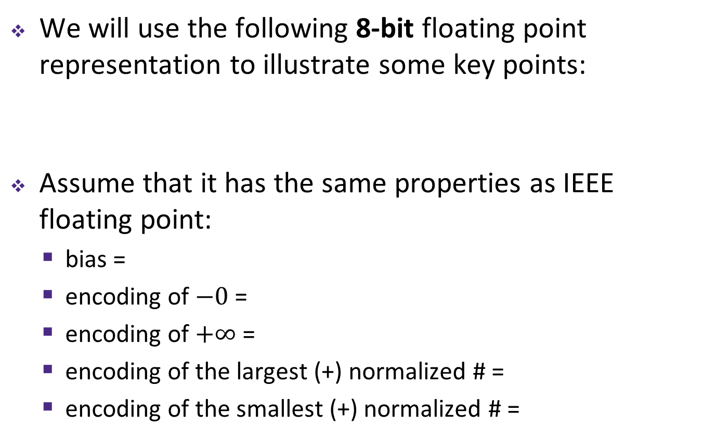
Tiny Floating Point Representation
We will use the following 8-bit floating point representation to illustrate some key points:
Assume that it has the same properties as IEEE floating point:
  bias =
  encoding of $−0$ =
  encoding of $+∞$ =
  encoding of the largest (+) normalized # =
  encoding of the smallest (+) normalized # =
S
E
M
1
4
3

Slide 11
Peer Instruction Question
Using our 8-bit representation, what value gets stored when we try to encode 2.625 = 2¹ + 2⁻¹ + 2⁻³?
+ 2.5
+ 2.625
+ 2.75
+ 3.25
We’re lost…
S
E
M
1
4
3

Slide 12
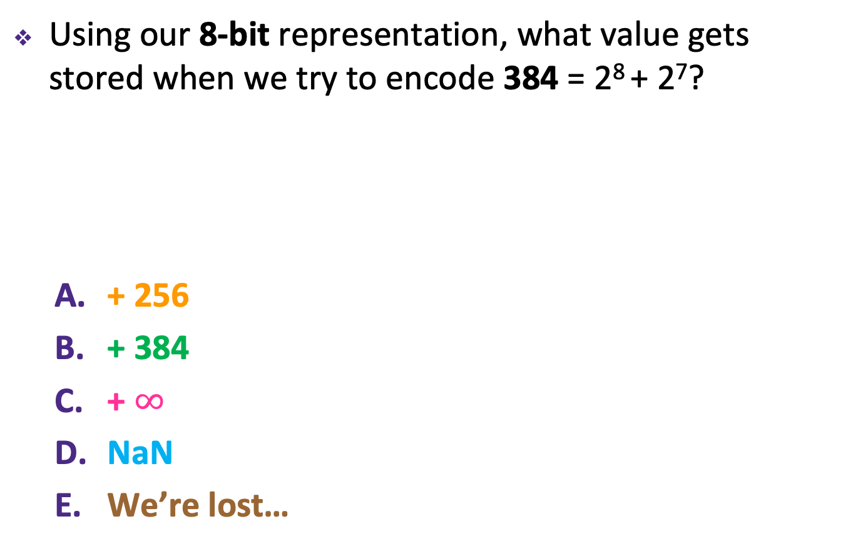
Peer Instruction Question
Using our 8-bit representation, what value gets stored when we try to encode 384 = 2⁸ + 2⁷?
+ 256
+ 384
+ $∞$
NaN
We’re lost…
S
E
M
1
4
3

Slide 13
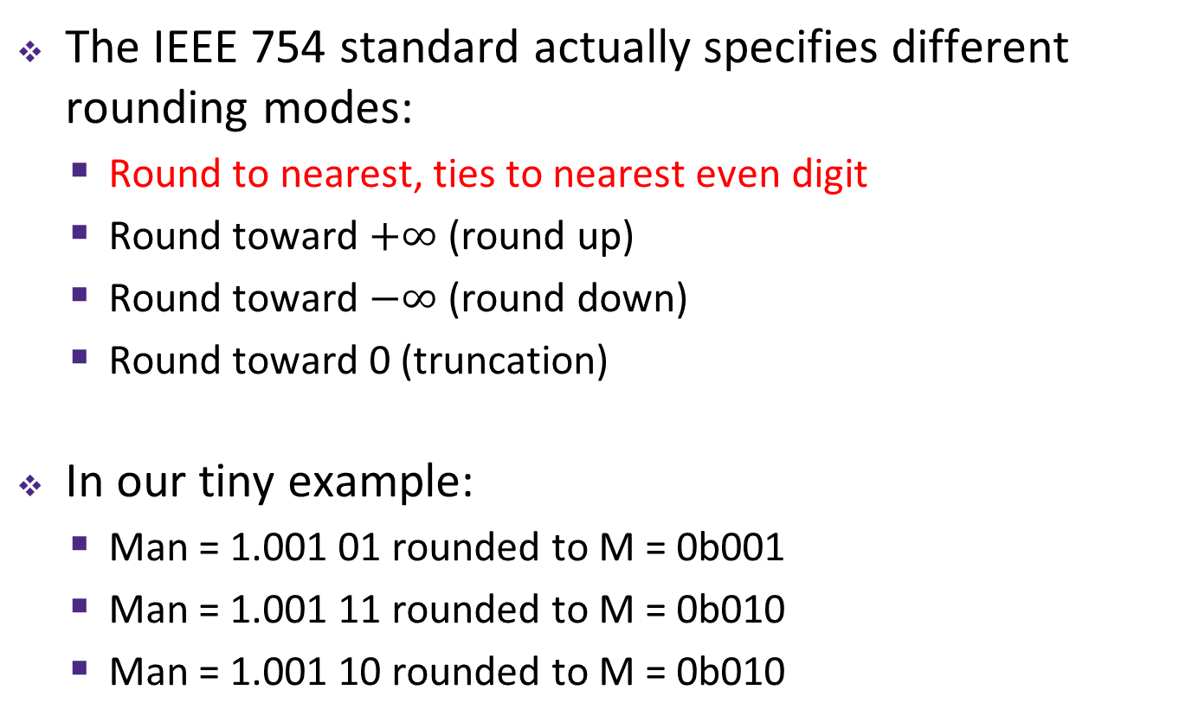
Floating Point Rounding
This is extra (non-testable) material
The IEEE 754 standard actually specifies different rounding modes:
  Round to nearest, ties to nearest even digit
  Round toward $+∞$ (round up)
  Round toward $−∞$ (round down)
  Round toward 0 (truncation)
In our tiny example:
  Man = 1.001 01 rounded to M = 0b001
  Man = 1.001 11 rounded to M = 0b010
  Man = 1.001 10 rounded to M = 0b010
S
E
M
1
4
3

Slide 14
Precision and Accuracy
Precision is a count of the number of bits in a computer word used to represent a value
  Capacity for accuracy
Accuracy is a measure of the difference between the actual value of a number and its computer representation
  High precision permits high accuracy but doesn’t guarantee it. It is possible to have high precision but low accuracy.
  Example: float pi = 3.14;
    pi will be represented using all 24 bits of the mantissa (highly precise), but is only an approximation (not accurate)

Slide 15
Need Greater Precision?
Double Precision (vs. Single Precision) in 64 bits
  C variable declared as double
  Exponent bias is now 2¹⁰–1 = 1023
  Advantages: greater precision (larger mantissa),
  greater range (larger exponent)
  Disadvantages: more bits used,
  slower to manipulate
63 62
52 51
32
S
E (11)
M (20 of 52)
31
0
M (32 of 52)

Slide 16
Floating Point Numbers Summary
Exponent | Significand | Meaning
0 | ? | ?
0 | ? | ?
1-254 | anything | ± fl. pt
255 | ? | ?
255 | ? | ?

Slide 17
Representing Zero
But wait… what happened to zero?
–Using standard encoding 0x00000000 is 1.0×2⁻¹²⁷≠0
  All because of that dang implicit 1
–Special case: Exp and Significand all zeros = 0
–Two zeros! But at least 0x00000000 = 0 like integers
31 30 23 22 0
+0
0 | 00000000 | 00000000000000000000000
sign exponent significand
31 30 23 22
sign exponent significand
0
-0
1 | 00000000 | 00000000000000000000000

Slide 18
Floating Point Numbers Summary
Exponent | Significand | Meaning
0 | 0 | ± 0
0 | ? | ?
1-254 | anything | ± fl. pt
255 | ? | ?
255 | ? | ?

Slide 19
Representing ± ∞
Division by zero
  infinity is a number!
  okay to do further comparison eg. x/0 > y
Representation
  Max exponent = 255
  all zero significand
31 30 23 22
0
+ ∞
0 | 11111111 | 00000000000000000000000
sign exponent
31 30
significand
- ∞
23 22
0
1 | 11111111 | 00000000000000000000000
sign exponent
significand

Slide 20
Floating Point Numbers Summary
Exponent | Significand | Meaning
0 | 0 | ± 0
0 | non-zero | ?
1-254 | anything | ± fl. pt
255 | 0 | ± ∞
255 | non-zero | ?

Slide 21
Representing NaN
0/0, sqrt(-4), ∞–∞ ?
  Useful for debugging
  Op(NaN, some number) = NaN
Representation
  Max exponent = 255
  non-zero significand
31 30 23 22
0
+ NaN
0 | 11111111 | Non-zero
sign exponent
31 30
significand
23 22
0
- NaN
1 | 11111111 | Non-zero
sign exponent
significand

Slide 22
Floating Point Numbers Summary
Exponent | Significand | Meaning
0 | 0 | ± 0
0 | non-zero | ?
1-254 | anything | ± Norm fl. pt
255 | 0 | ± ∞
255 | non-zero | NaN

Slide 23
Representing Very Small Numbers
But wait… what happened to zero?
  Using standard encoding 0x00000000 =
  Special case: E and M all zeros = 0
    Two zeros! But at least 0x00000000 = 0 like integers
New numbers closest to 0:
  a = 1.0…0₂×2⁻¹²⁶ = 2⁻¹²⁶
  b = 1.0…01₂×2⁻¹²⁶ = 2⁻¹²⁶ + 2⁻¹⁴⁹
  Normalization and implicit 1 are to blame
  Special case: E = 0, M ≠ 0 are denormalized numbers
Gaps!
b
-∞
+∞
0
a

Slide 24
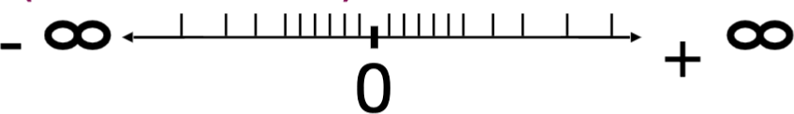
Denorm Numbers
Short for “denormalized numbers”
–No leading 1
–Careful! Implicit exponent = -126 when Exp = 0x00 (intuitive reason: the “binary point” moves one
more bit to the left of the leading bit)
Now what do the gaps look like?
So much closer to 0
–Smallest denorm: ± 0.0…01_{two}×2⁻¹²⁶ = ± 2⁻¹⁴⁹
–Largest denorm: ± 0.1…1_{two}×2⁻¹²⁶ = ± (2⁻¹²⁶ – 2⁻¹⁴⁹)
–Smallest norm: ± 1.0…0_{two}×2⁻¹²⁶ = ± 2⁻¹²⁶
No uneven gap! Increments by 2⁻¹⁴⁹

Slide 25
Floating Point Numbers Summary
Exponent | Significand | Meaning
0 | 0 | ± 0
0 | non-zero | ± Denorm fl pt.
1-254 | anything | ± Norm fl. pt
255 | 0 | ± ∞
255 | non-zero | NaN

